Slide 1
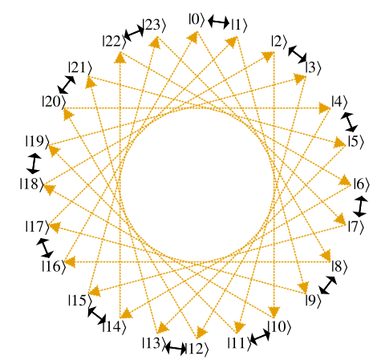
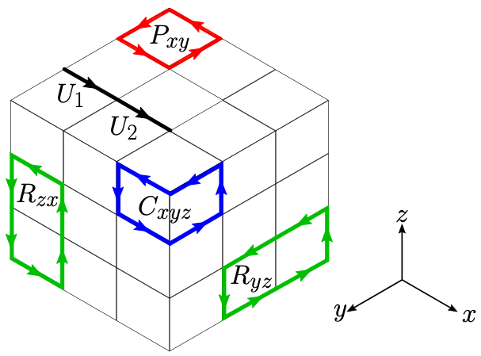
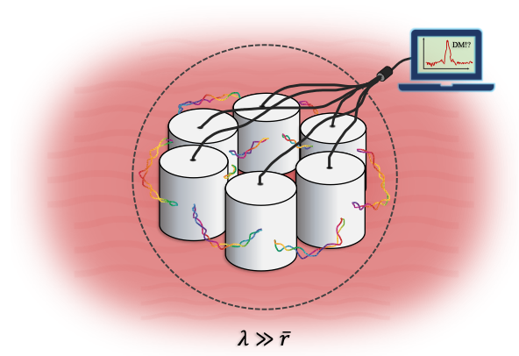
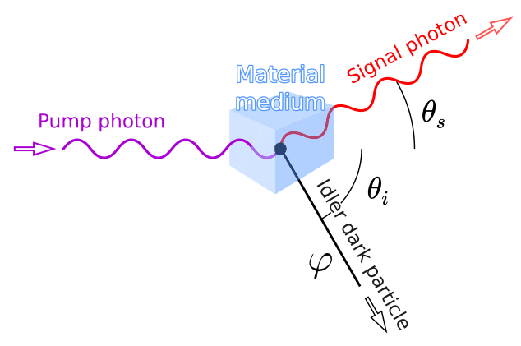
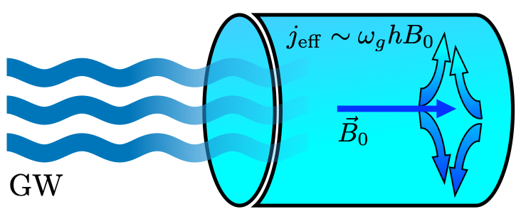
Fermilab Quantum Theory Department
Roni Harnik
Quantum Theory Department Head
SQMS Science Thust Lead
Once again, featuring Hank Lamm

Slide 2
Overview
Quantum Theory Department Overview
    Research
    People
    Timeline
  Quantum Sensing Theory
  Quantum Simulation Theory [featuring Hank Lamm]
  Quantum Internship and School [ditto]

Slide 3
Quantum Theory Department
Quantum Theory Department works at the interface of quantum information science (QIS) and HEP theory.
Focus on experiment-adjacent areas. We work closely with experimentalists.
As with the rest of the theory division our goal is to support lab experimental efforts.
Helped launch some of the biggest quantum efforts in the lab (in Theory Division, SQMS, and ETD).
Broadly, we work on:
  Quantum simulation of Quantum Field Theory
  Quantum sensing to probe fundamental physics
Leveraging our expertise in Lattice Field theory and in BSM physics.

Slide 4
Quantum Theory Department - Staff
Primarily QTH
Hank Lamm
Asher Berlin
Roni Harnik (Dep. head)
Shared effort with Particle Theory
Marcela Carena
Ruth Van der Water
Mike Wagman
Simulation
Sensing

Slide 5
Quantum Theory Department - Postdocs & Students
Postdocs: 5.5 FTE + 1 Joint RA
Visitor:
Alex Millar
Hersh Singh
Ryan Janish
Erik Gustafson - NASA (Fermilab-based)
Sohitri Ghosh
(Joint with QSC)
Students:
Judah Unmuth-Yockey
Tanner Trickle (Joint with particle TH)
Christina Gao (Joint with UIUC)
Wanqian Liu
Tong Ou
+ Undergrad interns (more later on our internship)
Simulation
Sensing

Slide 6
Quantum Consortium
Fermilab (Carena, Harnik) , Caltech (Preskil) , U. Washington (Savage), UIUC (El Khadra, Draper), MIT (Thaler), Purdue (Kruczenski)
Fermilab started the in-house QTH effort in 2019.
It was accompanied by a successful partnership with University groups, some with years of experience in QIS (e.g. Caltech, UW) and some new to the area (e.g. UIUC).
Main goal: grow the field at Fermilab and in the US. After five years of sustained effort this goal was achieved! Fermilab Theory is attracting some of the best RA’s in quantum theory for HEP.
Initial focus on the new field of quantum simulation for HEP. Broadening in later stages.
Upcoming changes: Ending partnership with MIT (PI moving towards AI) and Purdue (formal) and adding Johns Hopkins (Sensing and quantum foundations).

Slide 7




Quantum Theory Department
QTH has significant synergy with other quantum efforts:
  SQMS: see previous talk. Strong synergy across sensing and simulation.
  ETD: Theory involvement in bringing the MAGIS-100 experiment and making physics case. Collaborations with ETD quantum computing researchers, as well as on dSPDC (see later slides).
  QSC: Joint postdoc Ghosh, working in quantum metrology and sensing area.
A crucial and substantial component is a broad approach to quantum theory, simulation, and sensing.
ETD-Quantum
Quantum Theory
QSC
SQMS

Slide 8
Quantum Theory Department - Timeline
Mid 2018: Awarded a 2-year QuantISED grant (PI Carena) in collaboration with Caltech and U. Washington, forming consortium.
Mid 2020: Awarded a continuation of QuantISED grant for 3+2 years, adding UIUC, MIT, and Purdue to the consortium. Launched department.
Mid 2020: SQMS awarded with strong theory involvement.
2021: Associate scientists Lamm and Berlin hired.
2023: P5 “adopts” quantum as part of the HEP portfolio.

Slide 9

“The quantum nature of particle physics phenomena provides a rich set of problems where quantum computing is expected to have an inherent advantage over classical computing. For example, quantum computing approaches can resolve fundamental challenges to studying the structure of nuclear matter that are encountered with the classical computing approaches.”
“Since the 2014 P5 report, progress in theory has expanded our understanding of other plausible dark matter candidates that have both compelling implications for particle physics and viable cosmological histories. These advances have been accompanied by significant advances in direct-detection technologies, particularly in quantum sensing, enabling discernment of the most minute signals. This convergence of theoretical developments and cutting-edge detection capabilities holds tremendous potential for discovery. "
We hope this strong embrace from P5 will help welcoming Quantum research as a HEP base program

Slide 10
Quantum Sensing Theory
Working on theoretical aspects of sensing:
Novel probes of fundamental physics with new technology.
Optimal Quantum metrology.
Theoretical targets for sensing experiments.
Theoretical support

Slide 11
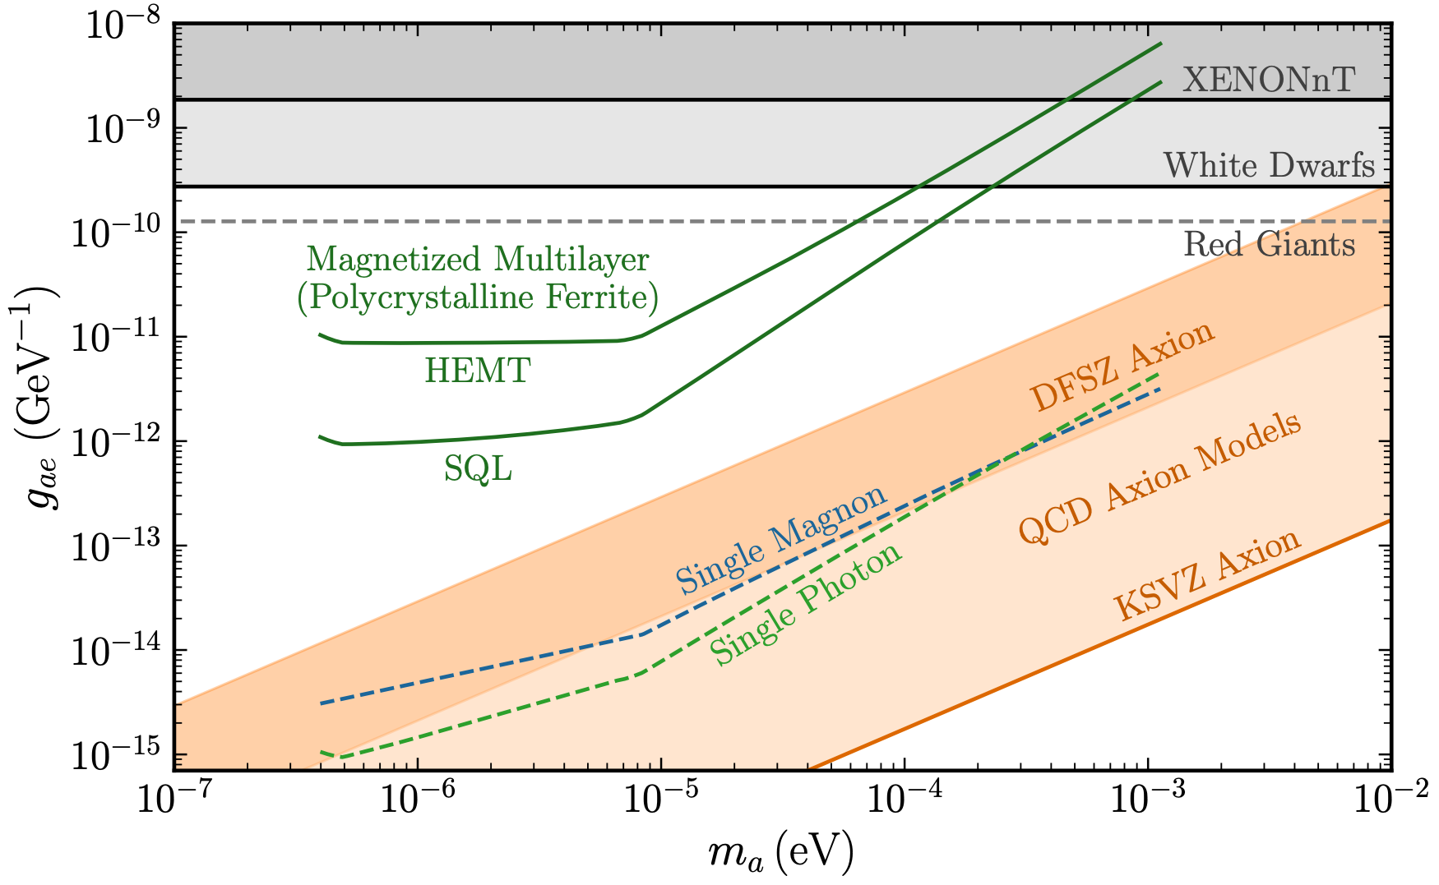


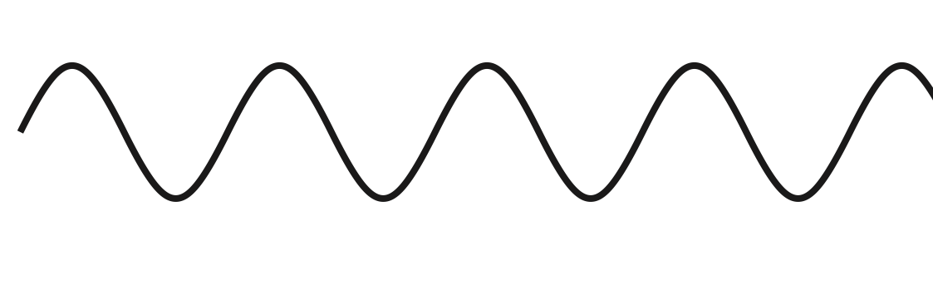
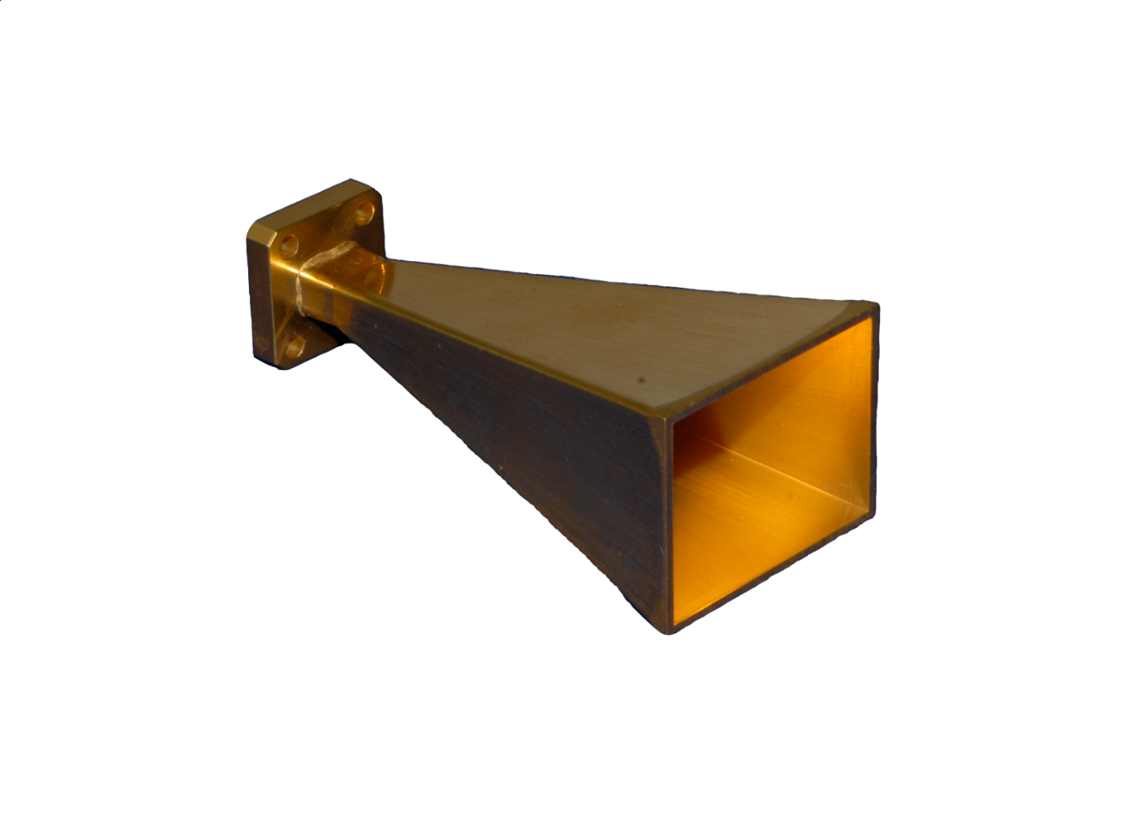

Physical Signatures of Fermion-Coupled Axion Dark Matter
arXiv:2312.11601, A. Berlin, A. Millar, T. Trickle, K. Zhou
Axion Wind
Other Nuggets
New axioelectric signals (mechanical and electromagnetic)
Reformulation of axion wind absorption ~ Im[-1/μ] (magnetic energy loss function)
No EDMs proportional to the field value
No leading order electronic energy shifts in normal materials

Slide 12
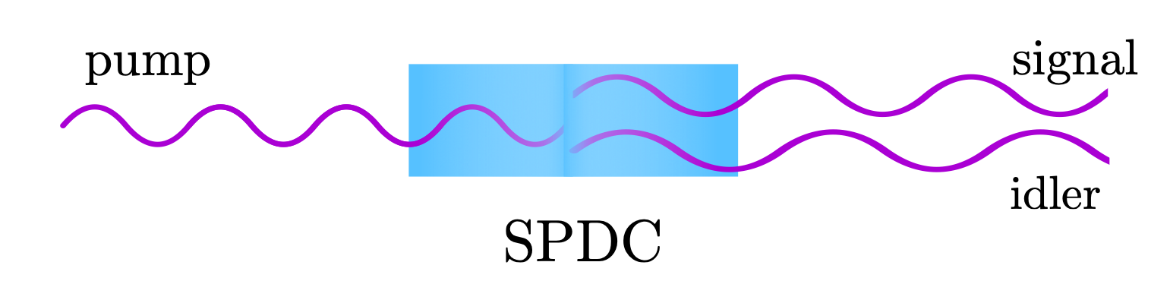
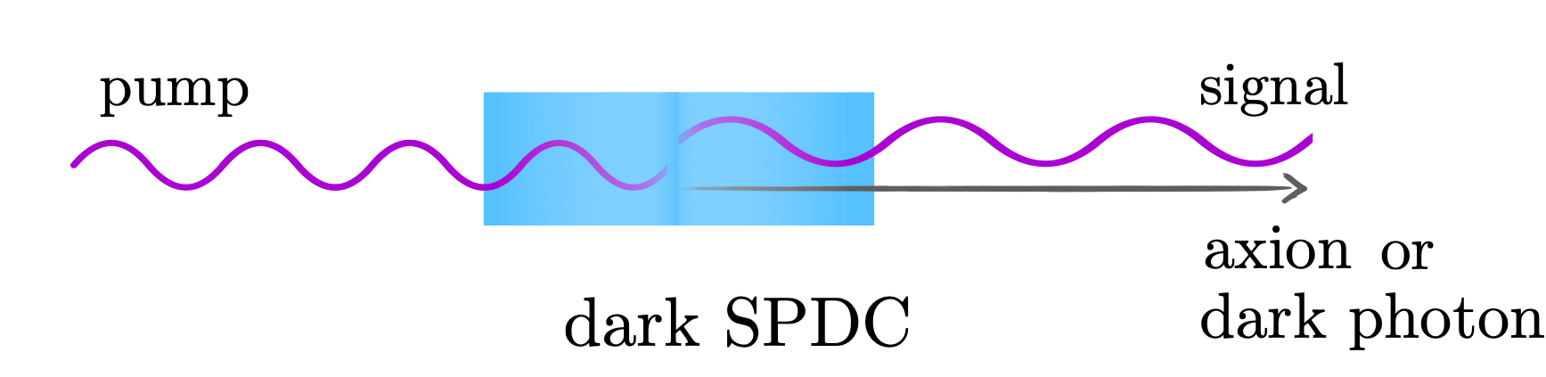

Dark SPDC
Estrada, RH Senger, Rodriguez
PRX Quantum 2 (2021) 3, 030340
+ RH, in preparation.
Nonlinear optics is a working horse in quantum optics labs around the world.
SPDC - A down-conversion (decay?) process in which
pump photon $→$ signal + idler photons
The presence of the idler can be inferred. “Heralded”.
dSPDC:
pump photon $→$ signal photon + axion or dark photon
“Associated production of an axion”. “Missing energy at the optics table”.

Slide 13
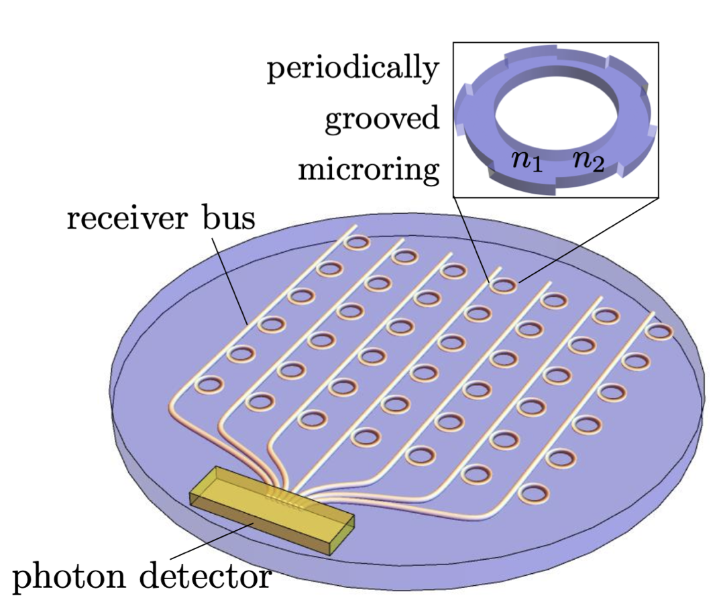
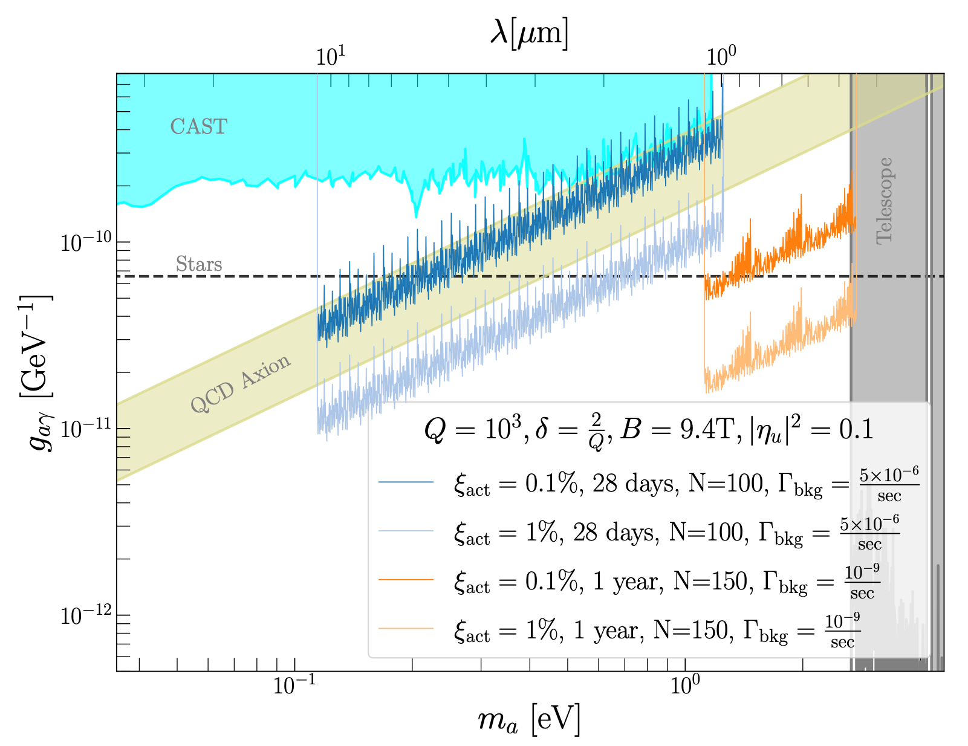
DM searches on a chip
An increasing number of optical applications are being produced “on-chip”. “Integrated photonics”.
A versatile arena for precision quantum optics. Now a mature industry.
We are designing dedicated on-chip axion “micro-haloscope” arrays with promising reach.
Blinov, Gao, Janish, RH, Sinclair - in preparation.
Sinclair et al

Slide 14
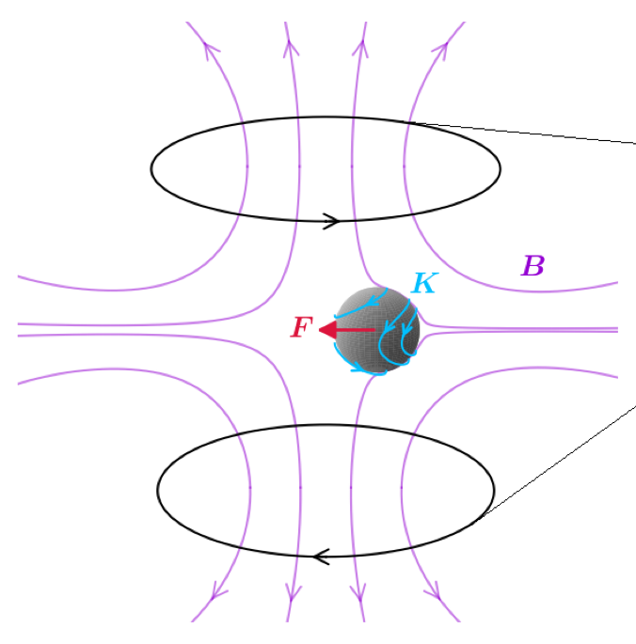
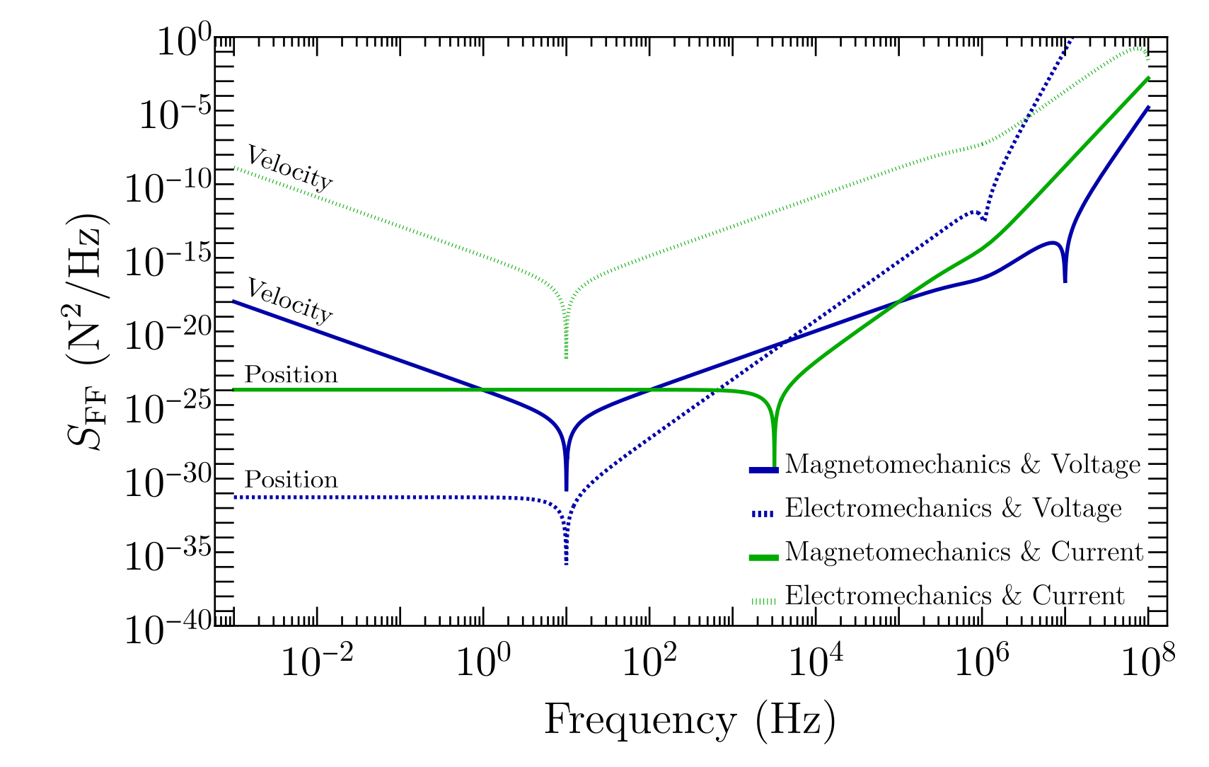
Quantum Measurment in Mechanical Systems
Optomechanical and magnetomecanical sensors are a novel method to probe dark matter:
  via gravitation (for heavy DM). “Windchime” (a QSC project)
  For wavelike DM (axion, B-L) [1908.04797, 2310.18398]
In 2311.09587, Ghosh and collaborators devised “back-action-evading” measurement protocols (using QND measurement).

Slide 15
Quantum Simulation Theory
Working on theoretical aspects of simulation for HEP:
Mapping HEP systems to qubits and audits
Formulation of Lattice Hamiltionians for Quantum
State preparation.
Error mitigation and Error correction in HEP simulations
Lattice formulations of gravity
Tensor networks

Slide 16
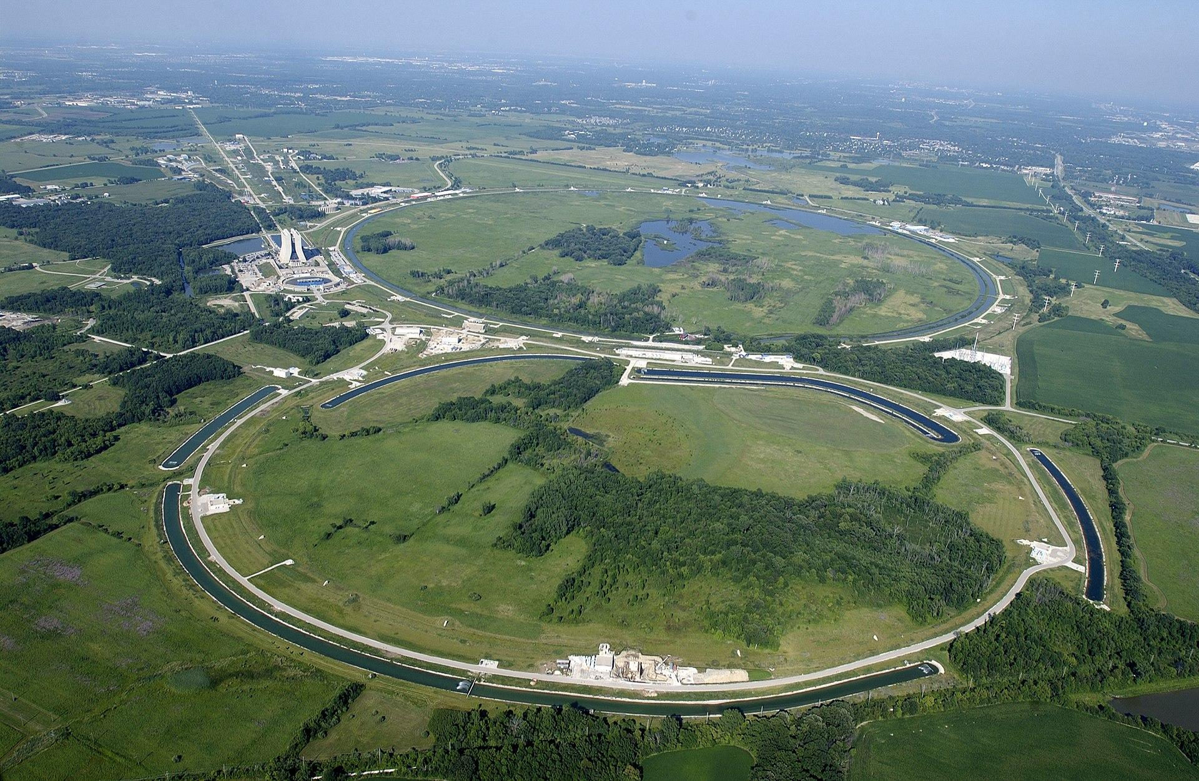
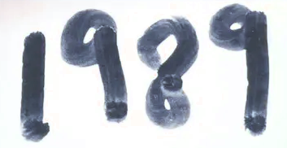
Long history here of lattice field theory
In , ACPMAPS came online, but the eventual success of lattice field theory came from orders of magnitude changes in computational power and algorithms via theoretical insight

Slide 17

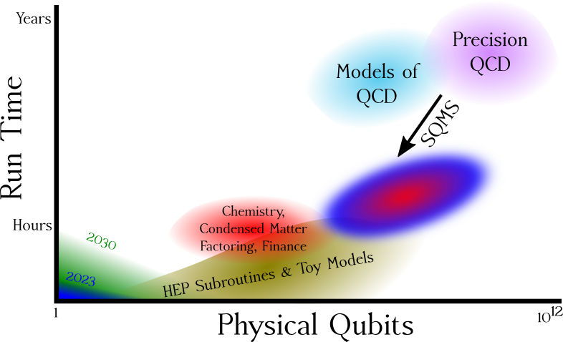
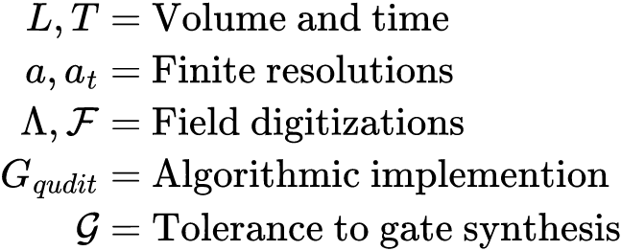
What will quantum practicality take?
Theoretical physics affects:
But what is the theoretical uncertainty on those results?
Are these the optimal algorithms?

Slide 18
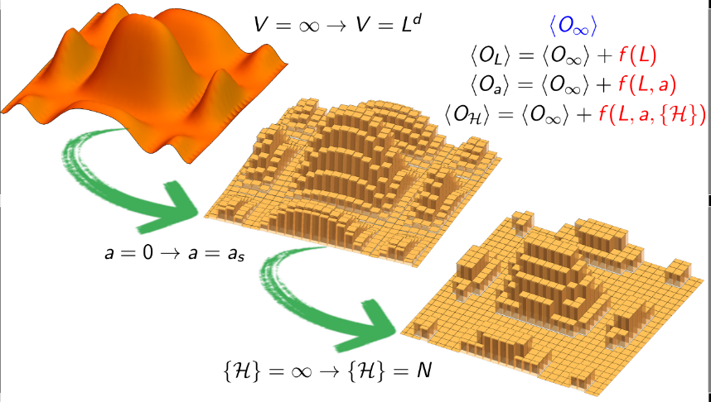
Take it to the limit
O(L,a,𝓗) is an approximation for HEP
Truncations leads to systematic errors
Extrapolating is done on results, reducing computational resources…
…but obscures precise resource estimates

Slide 19
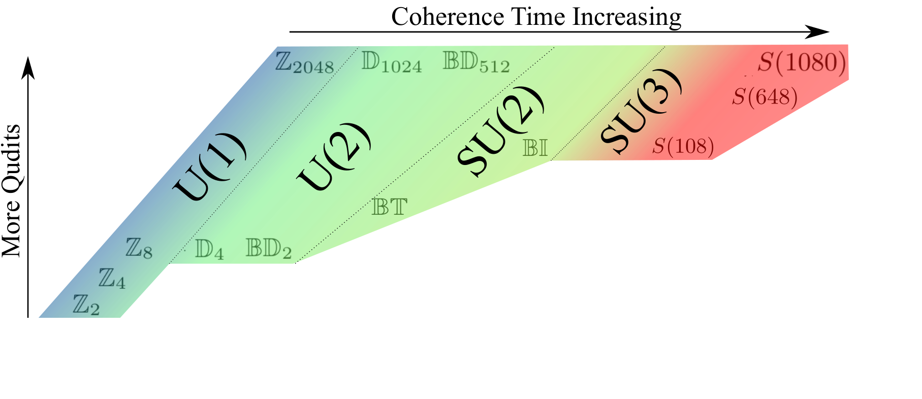
The ladder of discrete gauge theories in HEP calculations
Exploring renormalization and truncation error, but reduces by ~10-10³

Slide 20
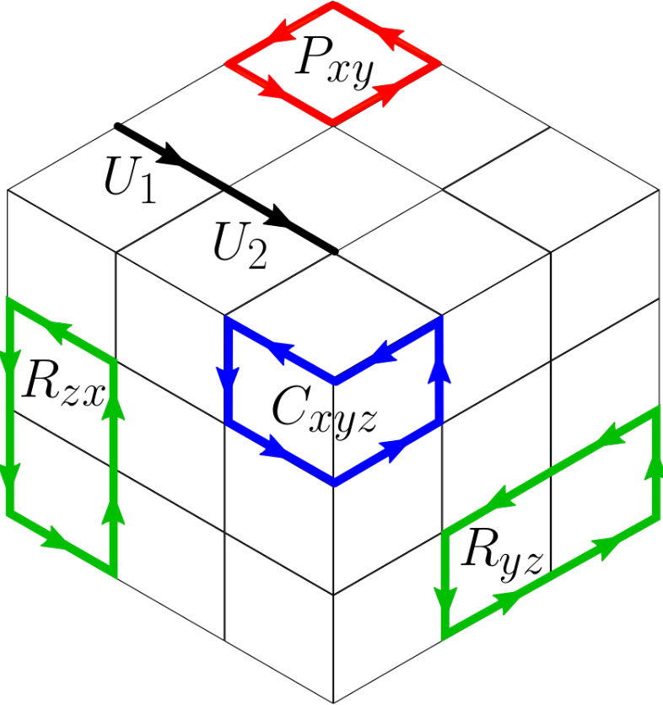
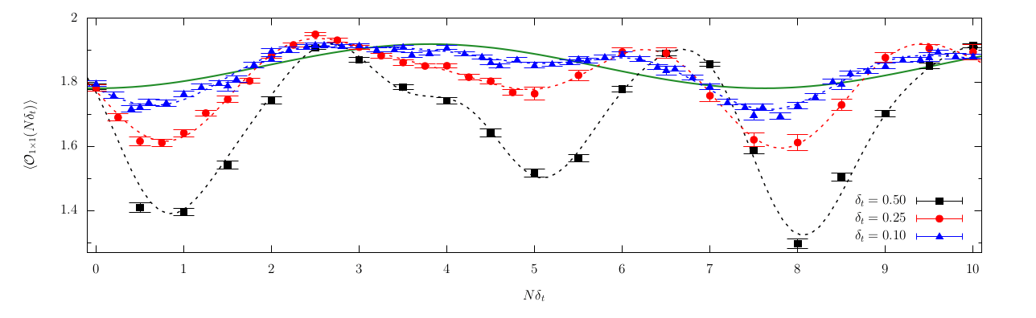
Theory improvements yield reduction in resources and errors
Ultimate timeline for quantum practicality in lattice QCD has been reduced by years by increasing
while reducing
Carena, Lamm, Li, Liu - PRL 129 (2022)
Carena, Lamm, Li, Liu - PRD 104 (2021)
Carena, Gustafson, Lamm, Li, Liu - Phys.Rev.D 106 (2022)
Gustafson, Lamm, Unmuth-Yockey - Phys.Rev.D 106 (2022)
Alexandru, Bedaque, Brett, Lamm - Phys.Rev.D 105 (2022)
Saroni, Lamm, Orth, Iadecola Phys.Rev.B 108 (2023)
Gustafson, Lamm - arxiv:2301.10207

Slide 21
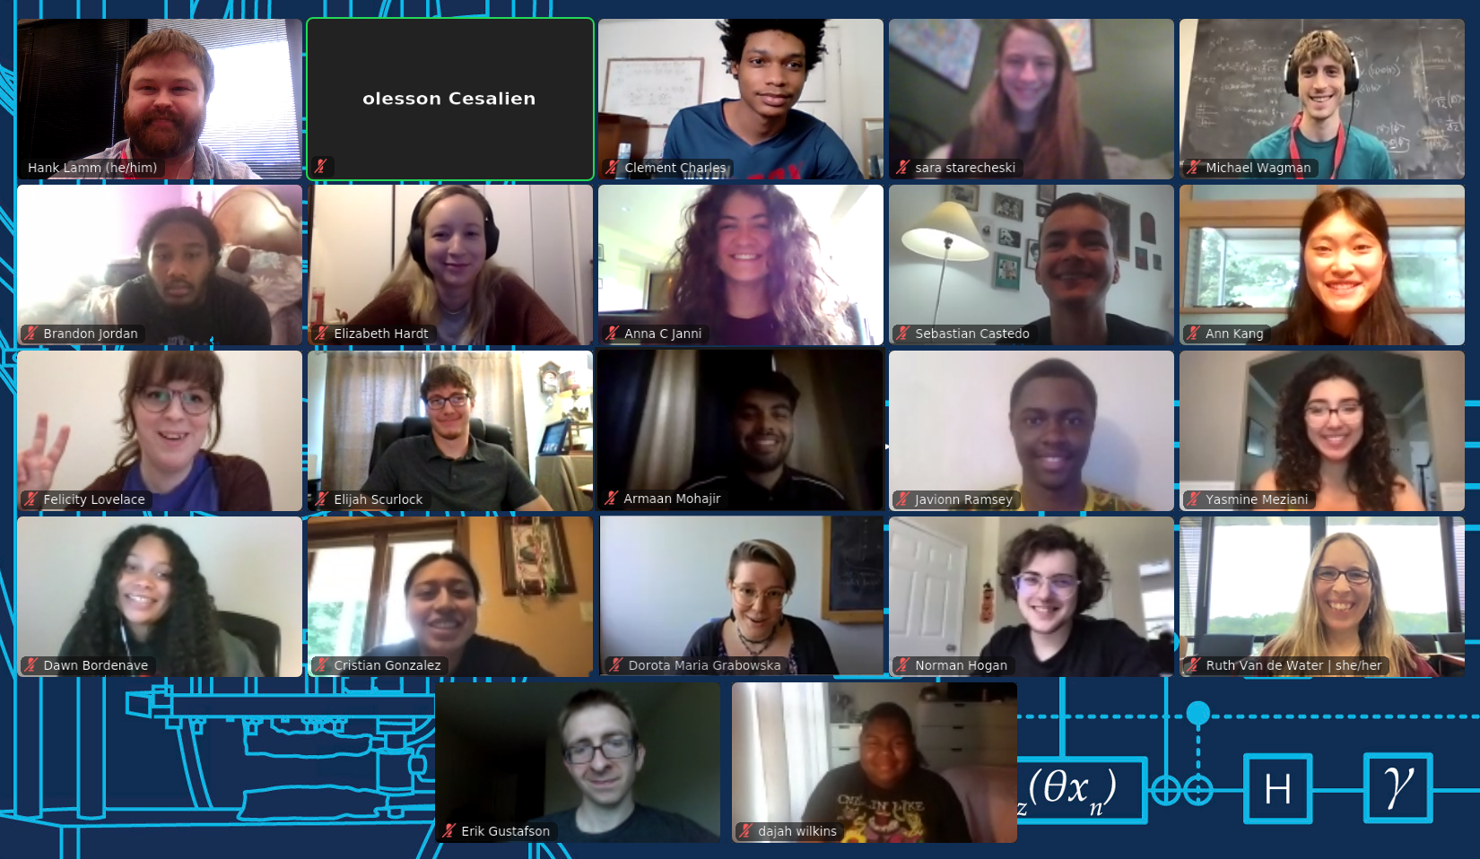
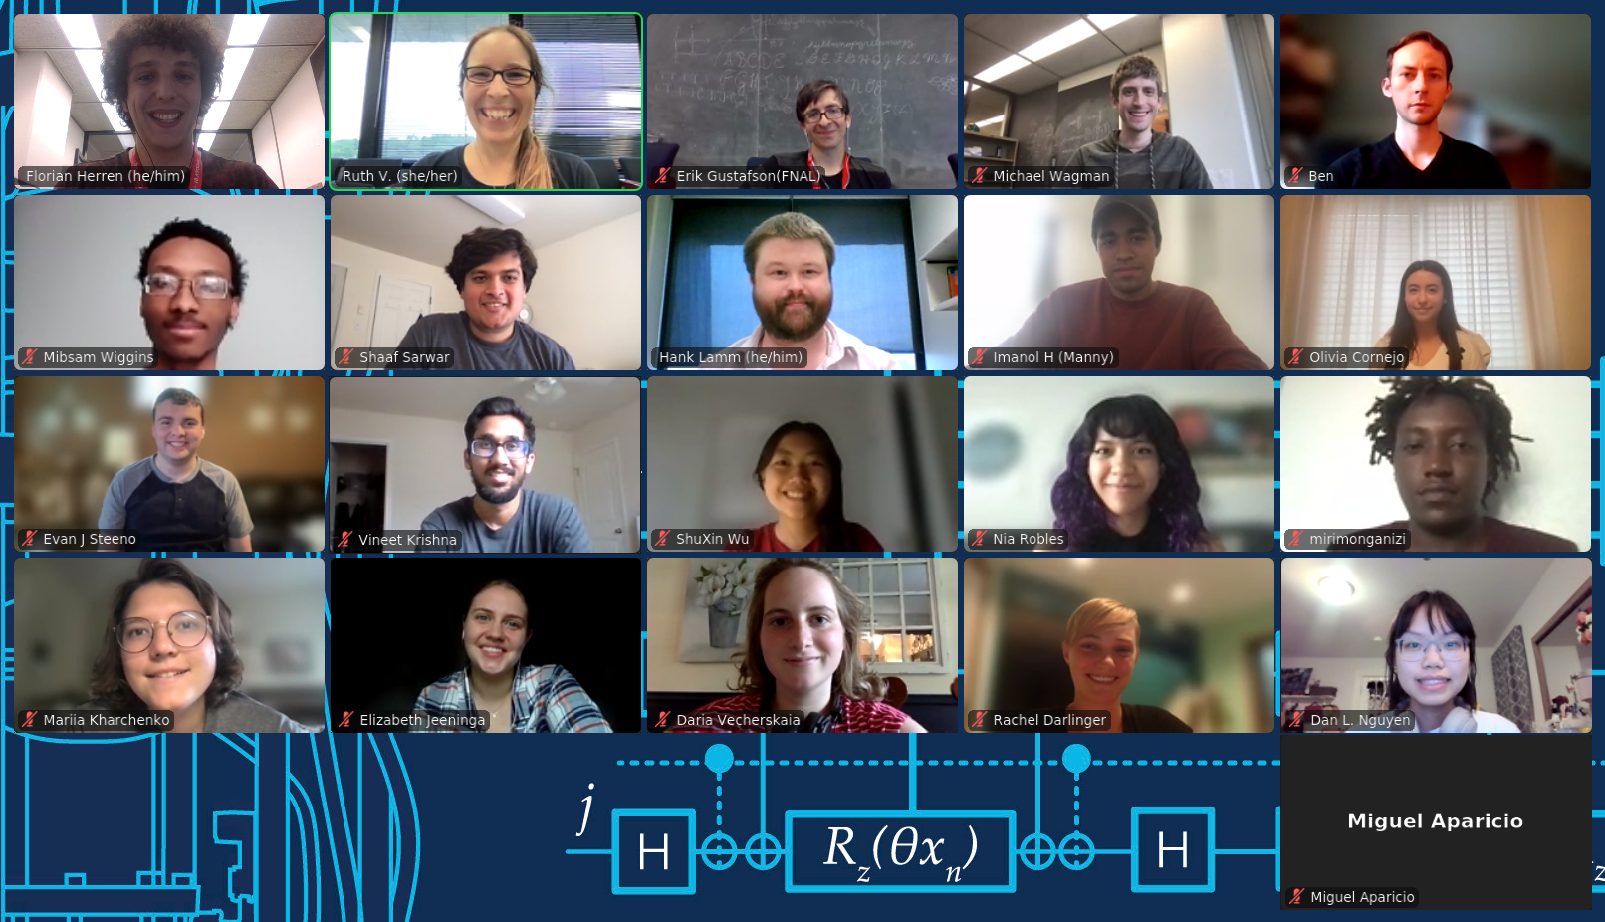
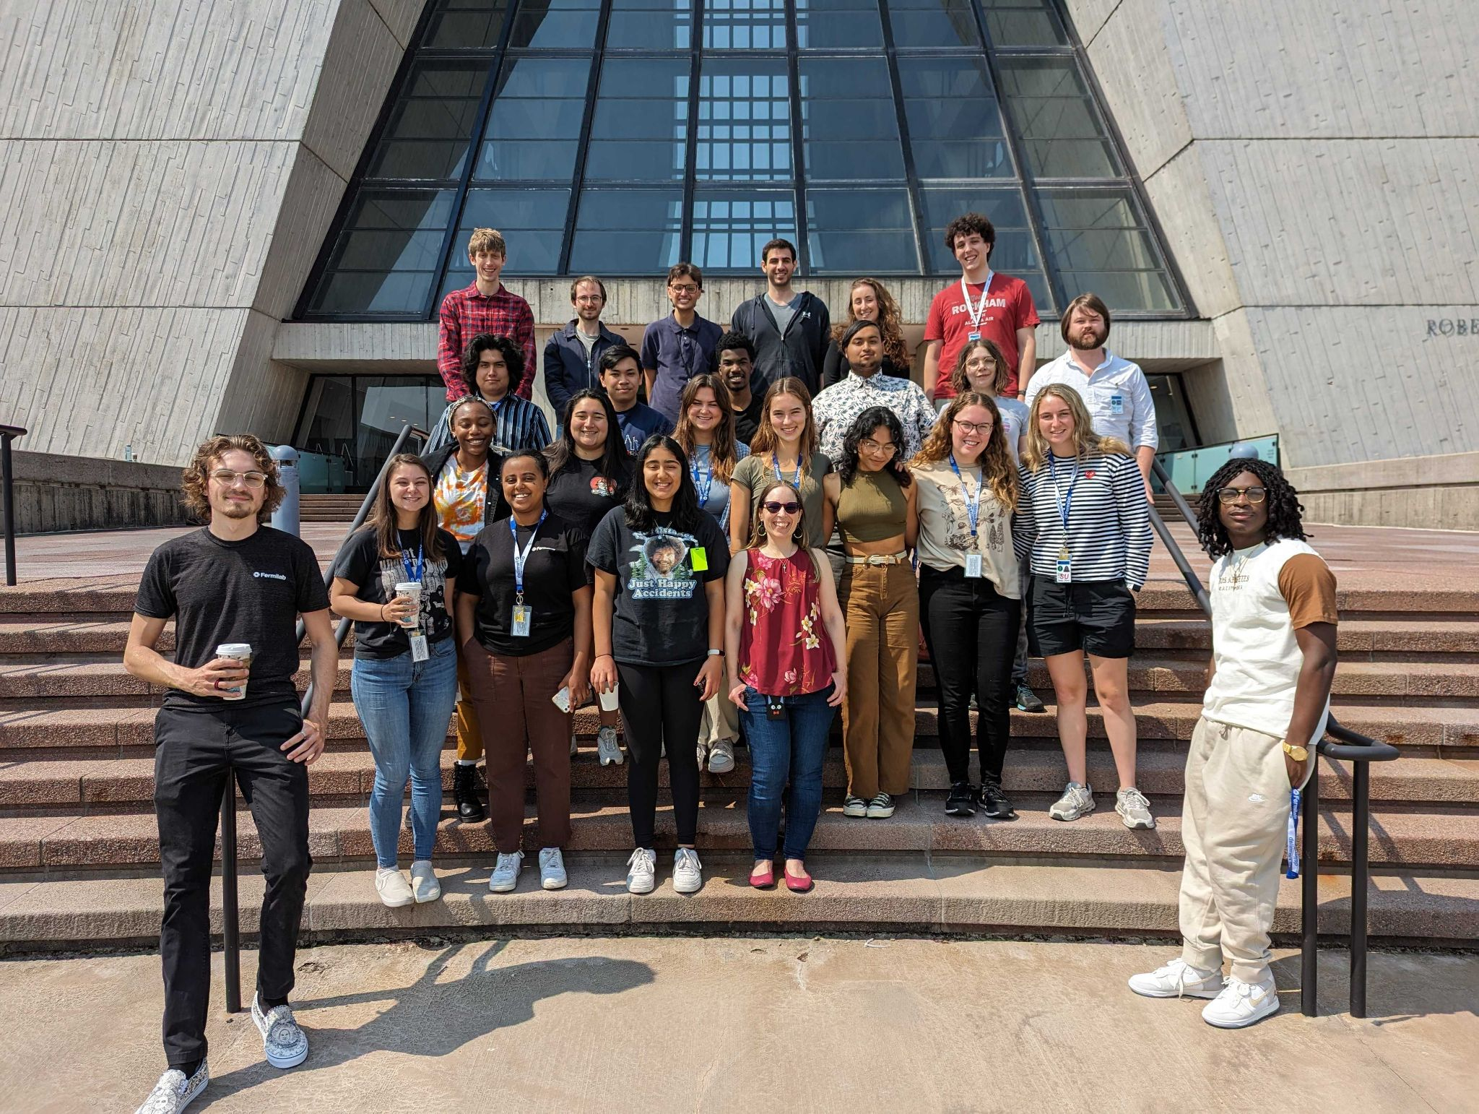
Fermilab Quantum Computing Internship For Physics Undergraduates
3-week summer school for around 20 students organized and hosted by Fermilab’s Theory Division
Expanding opportunities to study quantum science
Students paid competitive hourly wage
  Essential to enable participation by students from all socioeconomic backgrounds.
Topical lectures by experts in the field
  Quantum physics & math, quantum algorithms, error mitigation & correction,
  quantum hardware. Self-contained and accessible to all preparation levels.
Hands-on computational laboratories
  Python programming exercises on classical and quantum computers reinforce
  concepts and build to final project at the cutting edge of quantum research
Accessible to wide range of undergraduate students
  Self-contained program designed for students with only introductory physics,
  mathematics, and/or computer science coursework
Panels and informal discussions on career opportunities
  Discussions on post-graduate education and career opportunities in science and technology
2021
2022
2023

Slide 22
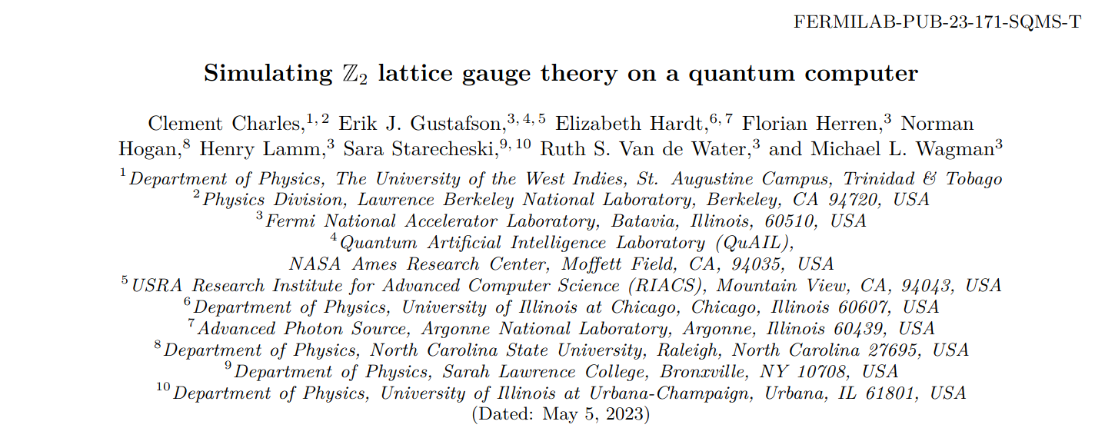
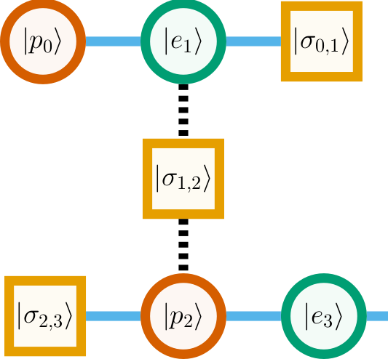
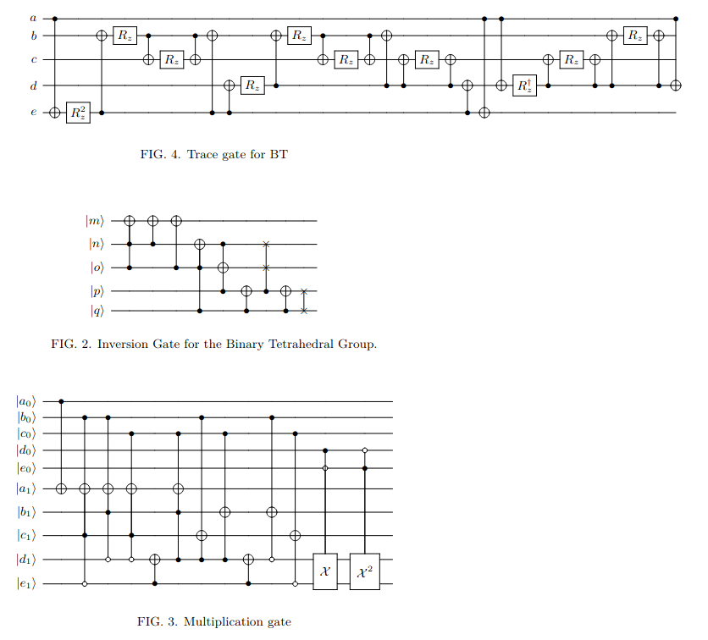
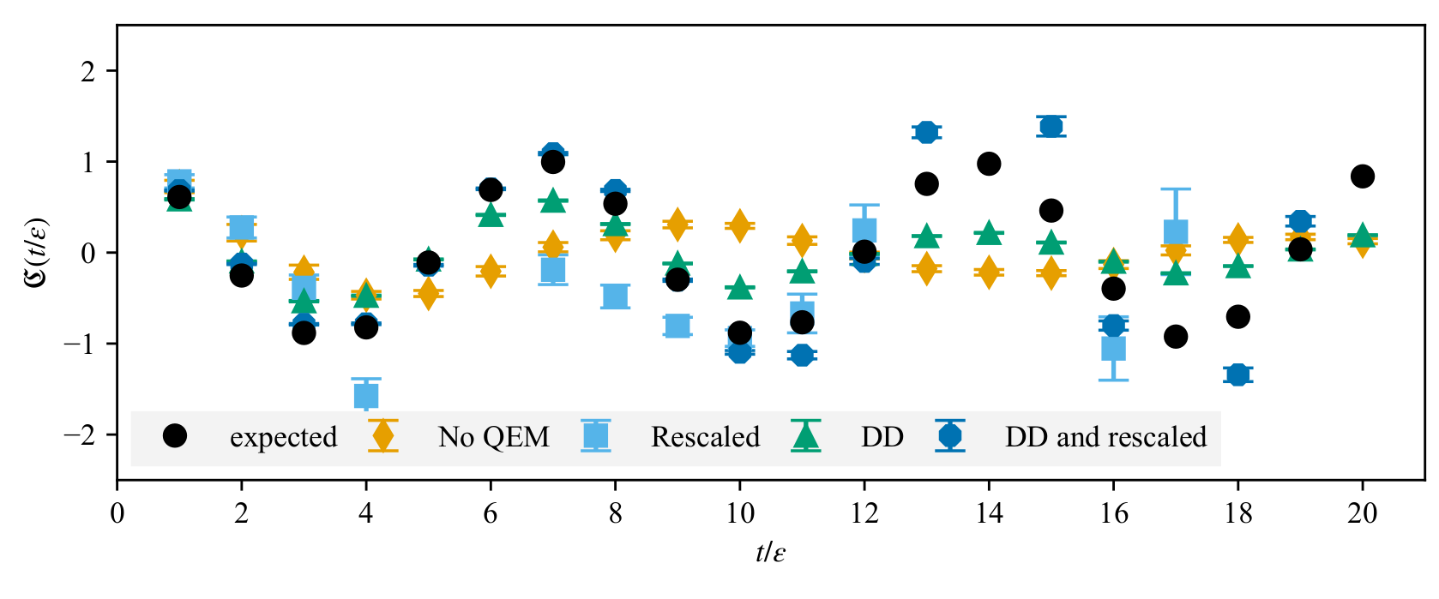
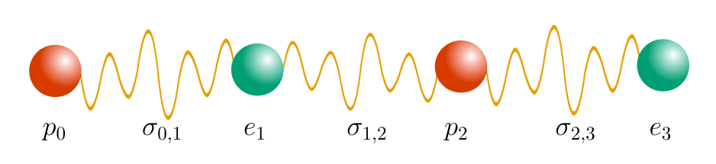
Fermilab Quantum Computing Internship For Physics Undergraduates
Supporting the next generation of scientists
Students build long-term connections with instructors and peers
  Instructors regularly act as professional references, mentors, and collaborators
Opportunities for year-long research internship with Fermilab scientists
  Two papers with 5 student authors completed with 3 more in progress
3 students pursuing PhD in QIS
  Others accepted into further REUs, national lab jobs

Slide 23
Summary
The new Quantum Theory Department provides -
  A vibrant hub for research at the QIS-HEP interface
  Close collaboration with expermentalists in quantum sensing and computing
We are grateful to the Fermilab directorate for the supporting a strong QTH program.
Also grateful for generous support of the QuantISED program and from SQMS.

