Slide 1

Quantum Experiments + Spin-Off Applications in ETD
Aaron S. Chou
January 10, 2024

Slide 2
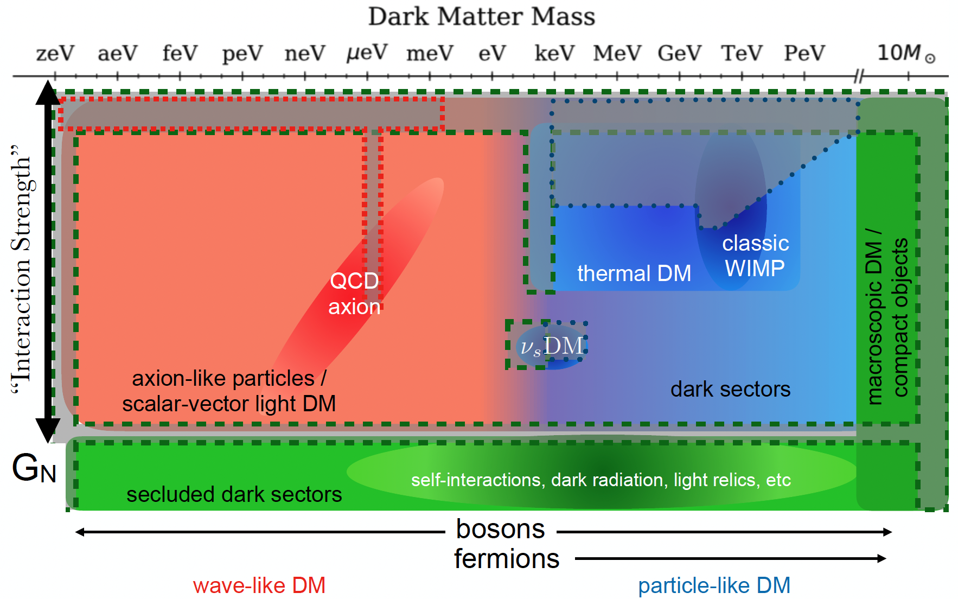
Fermilab quantum sensors target sub-MeV mass dark matter
E&M
Atom IFO as dark wave detector
Qubit as single photon detector
Qubits as single phonon detectors
Si
Cartoon from Snowmass

Slide 3
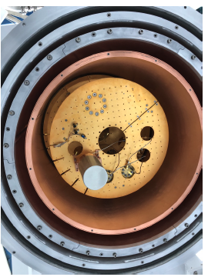
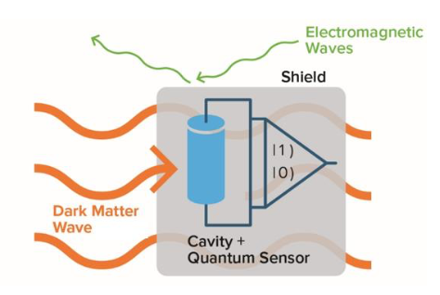
Hmmm… quantum computing platforms look just like dark matter searches:
DOE-OHEP Basic Research Needs white paper, 2018
Sensitive single-quantum devices are operated in a cryostat and/or vacuum system and well-shielded from external disturbances (heat, light, sound) in order to maximize their coherence time.
Impossible to shield from the dark matter – the DM interacts so weakly that it flies right through the walls.
If your quantum computer crashes, it could be due to dark matter!
… but as consolation, you’ll get a Nobel prize anyway for the discovery.

Slide 4

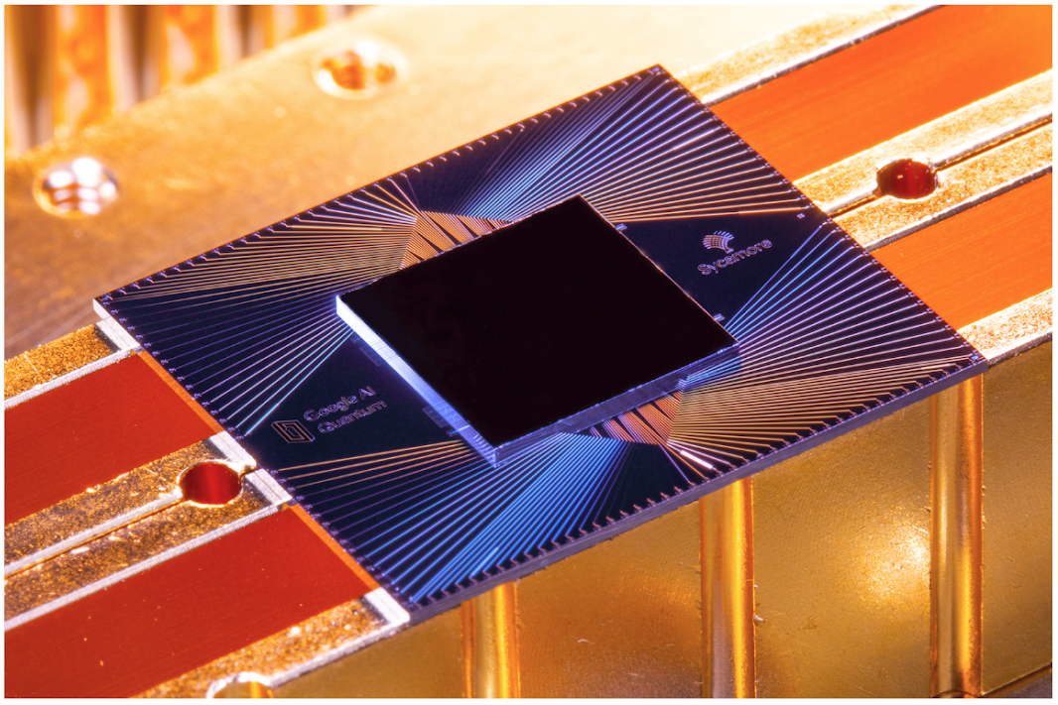
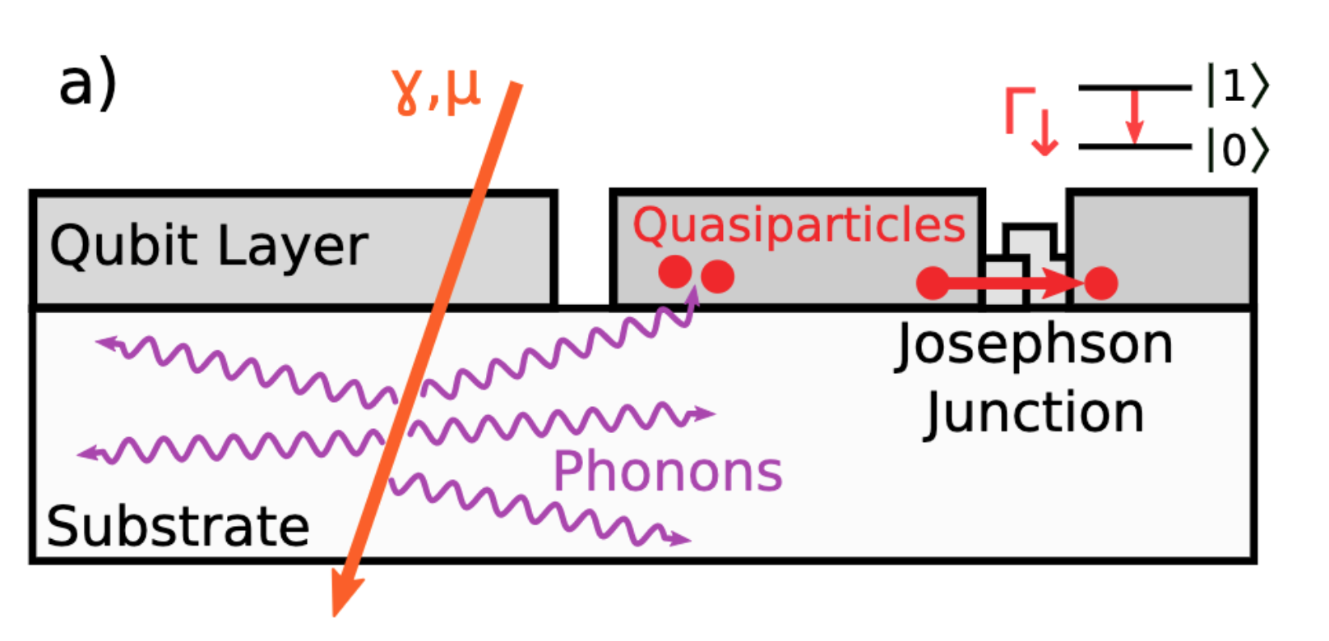
Quantum Computing and Background Radiation
Several studies have shown that background radiation is very disruptive to superconducting qubits (quasiparticle poisoning causing correlated errors)
Not coincidentally, Matt McEwen’s PhD advisor John Martinis was an OG member of CDMS.
Okay, let’s use SC qubits as low energy threshold DM detectors!
Detected event = error in quantum computation.
Google Sycamore team: M. McEwen et al., Nature Physics 18 (2022)

Slide 5
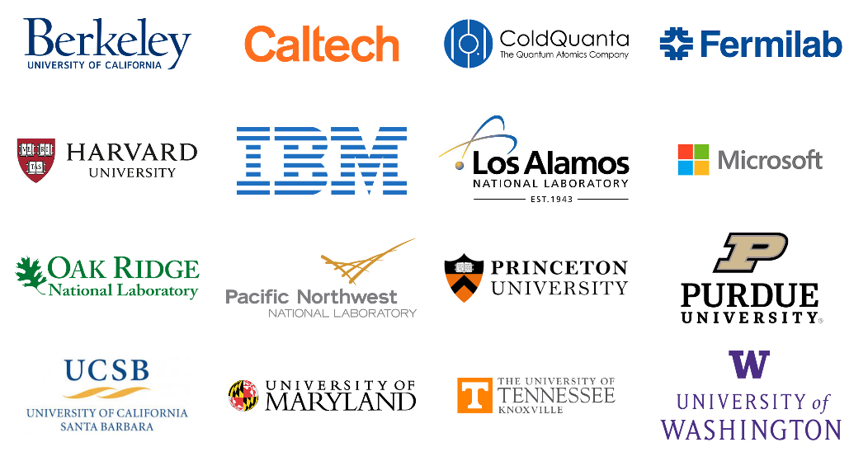

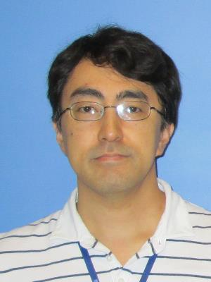
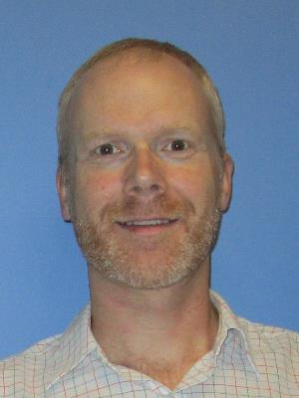
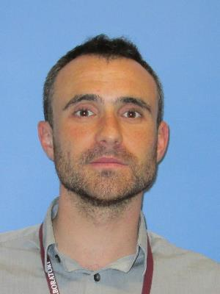
Quantum Science Center
QSC overarching goal:
Overcoming key roadblocks in quantum state resilience, controllability, and ultimately scalability of quantum technologies
Address the fragility of quantum states through the design of new topological materials for QIS
Develop algorithms and software for computation and sensing with current/future QIS hardware
Design new quantum devices and sensors to detect dark matter and topological quasiparticles
QSC comprises ~100 researchers across 16 institutions.
Fermilab headcount:
9 scientists (~2.5 FTE), 3 PD,
5 engineers

Slide 6
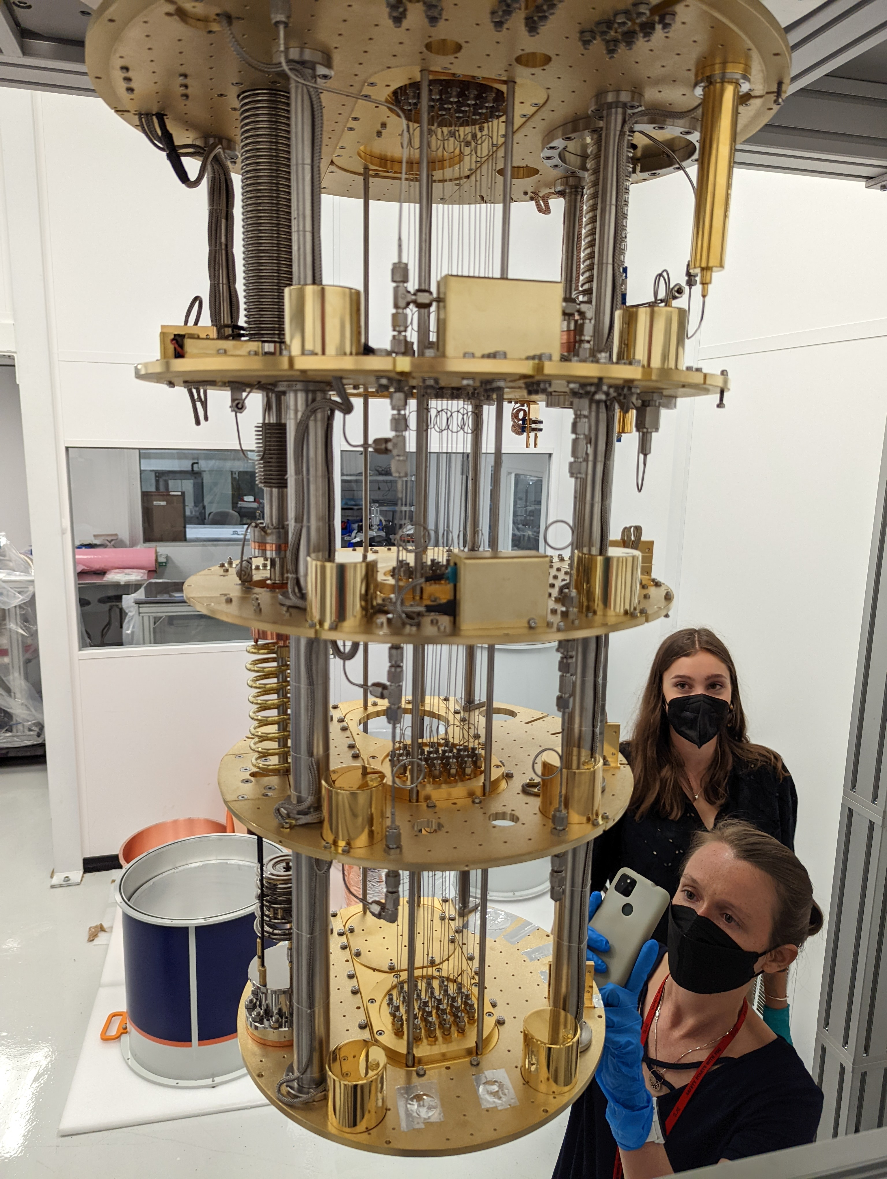
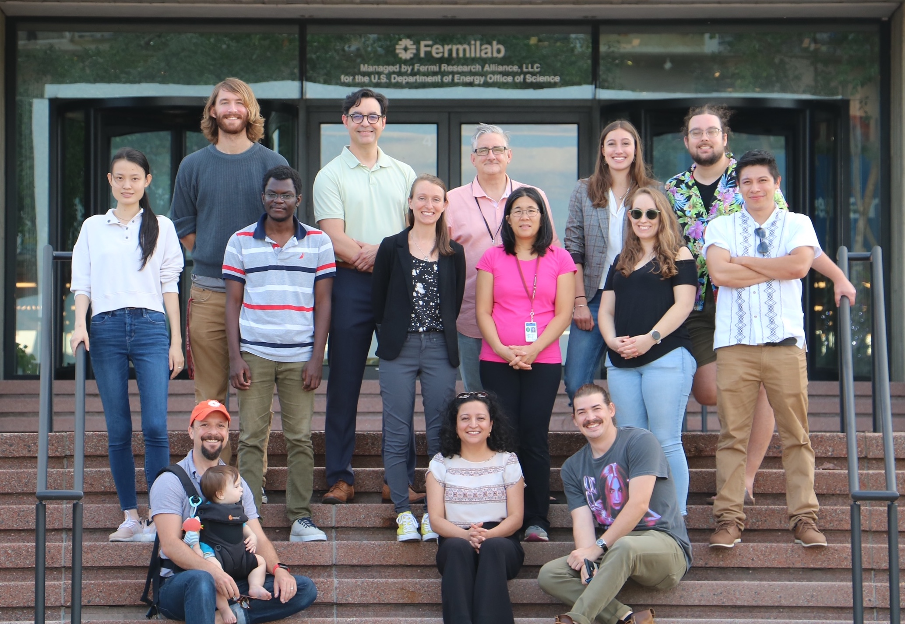
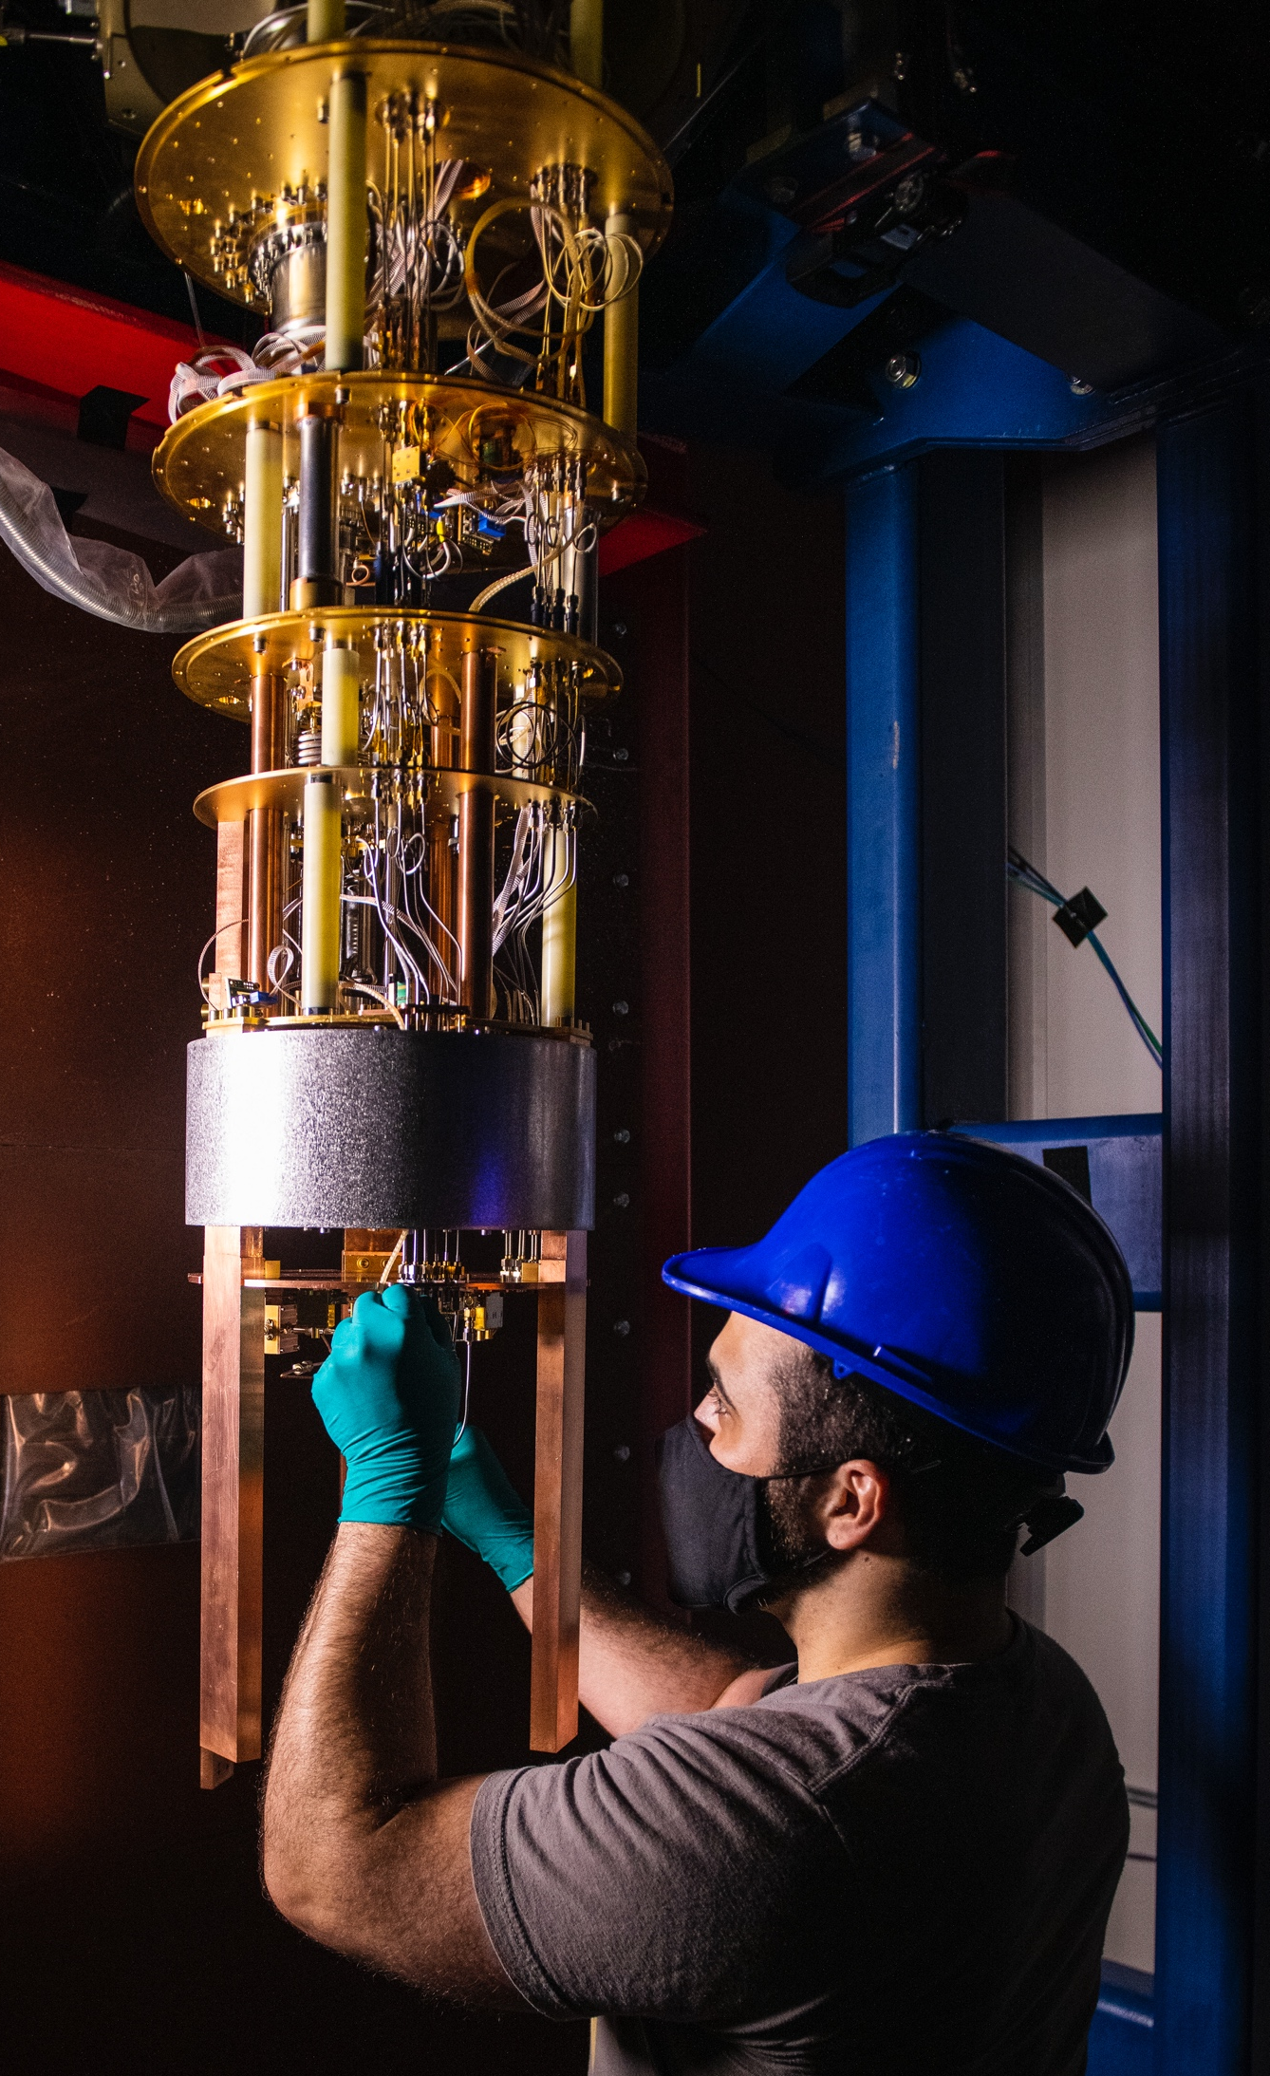
Use QSC cryogenic test stands to develop quantum sensor arrays:
Study qubit and materials response to ionizing radiation and dark matter
SiDet Lab G
NuMI underground
Fermilab QSC dark matter group
Notes:
This example is from a single-investigator award. Please use the NQISRC template.

Slide 7
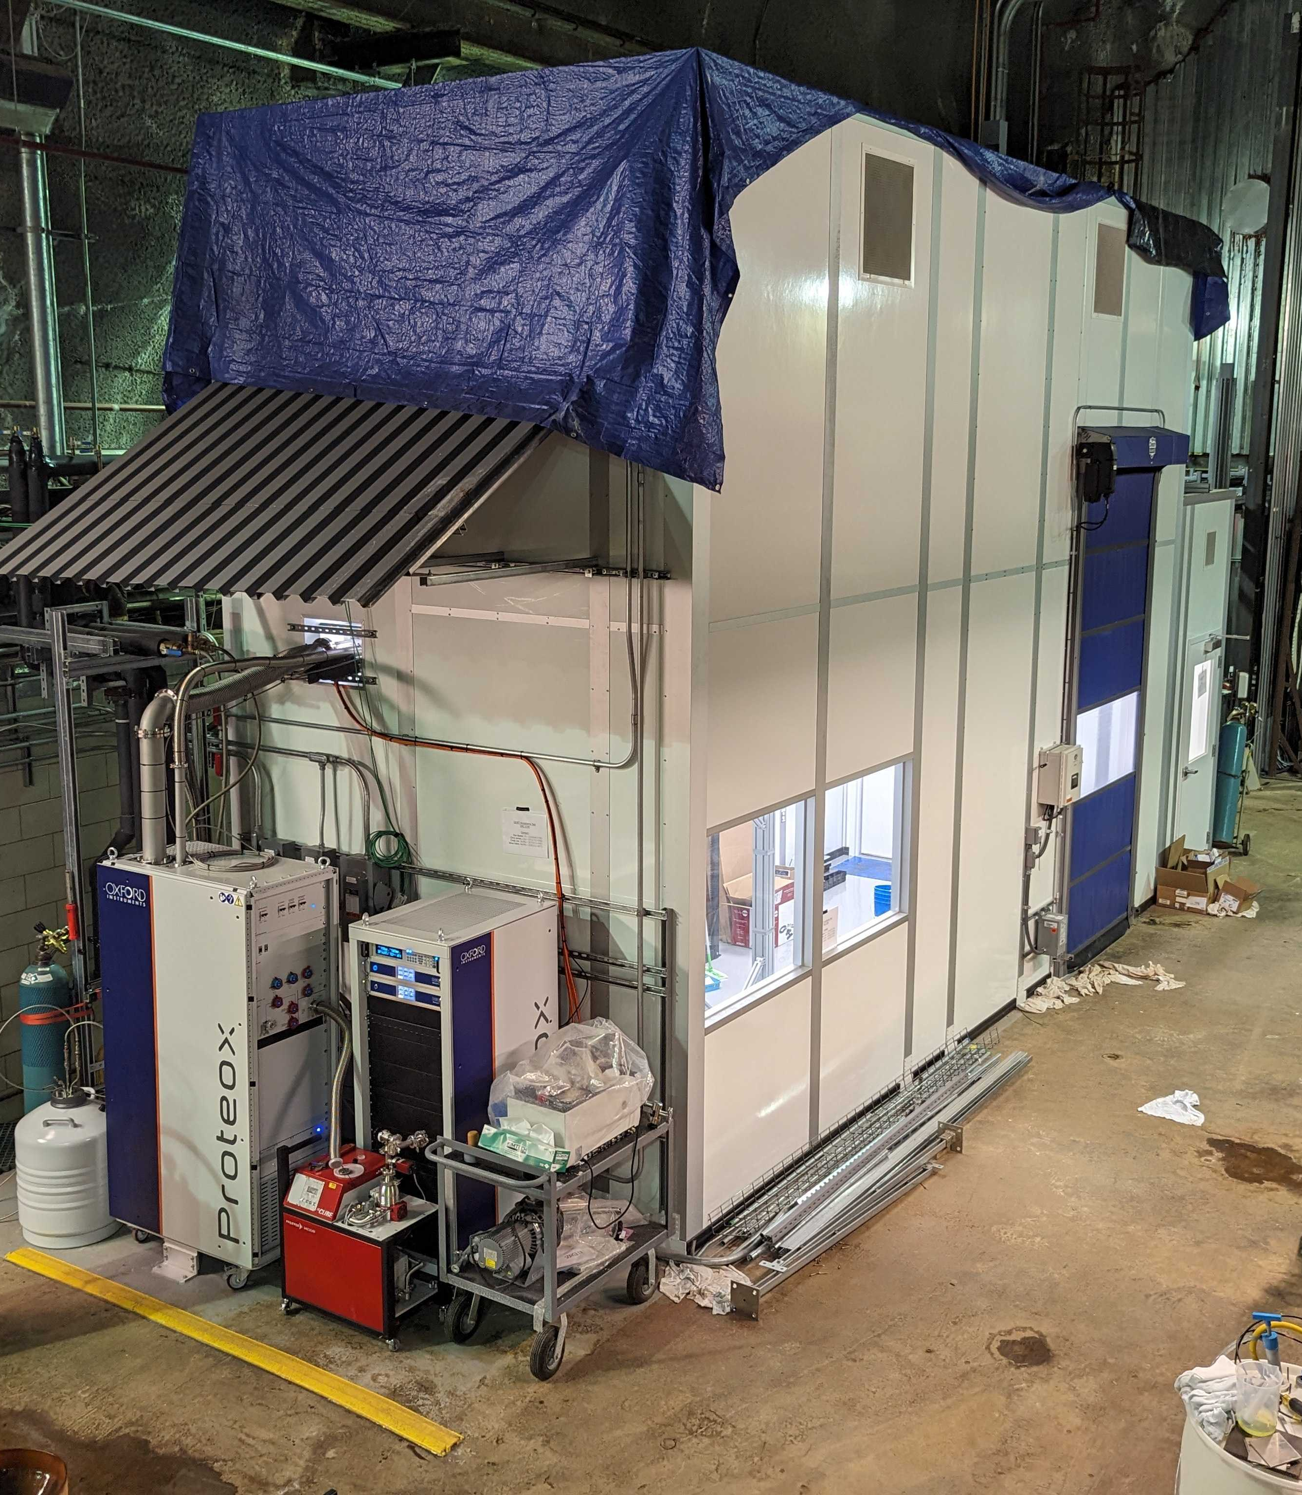
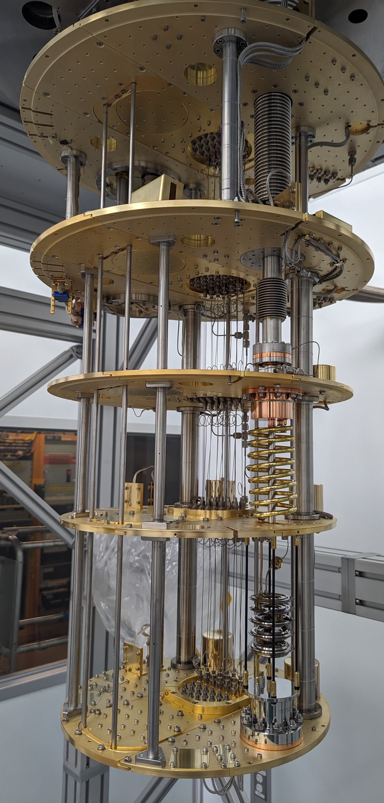
Newly commissioned
Quantum Underground Instrumentation Experimental Testbed
  This QSC facility is the first underground QIS-dedicated facility in the United States
  250 ft² Clean room designed to Class 10,000 specification
  50 ft² antechamber for gowning and material cleaning
  Oxford Proteox dil. fridge reached 8.9 mK base temperature in acceptance cooldown
  225 m.w.e. overburden shields from muons and cosmic radiation
NEXUS

Slide 8
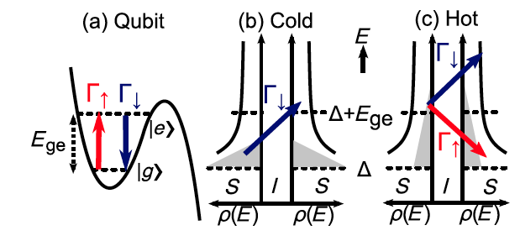
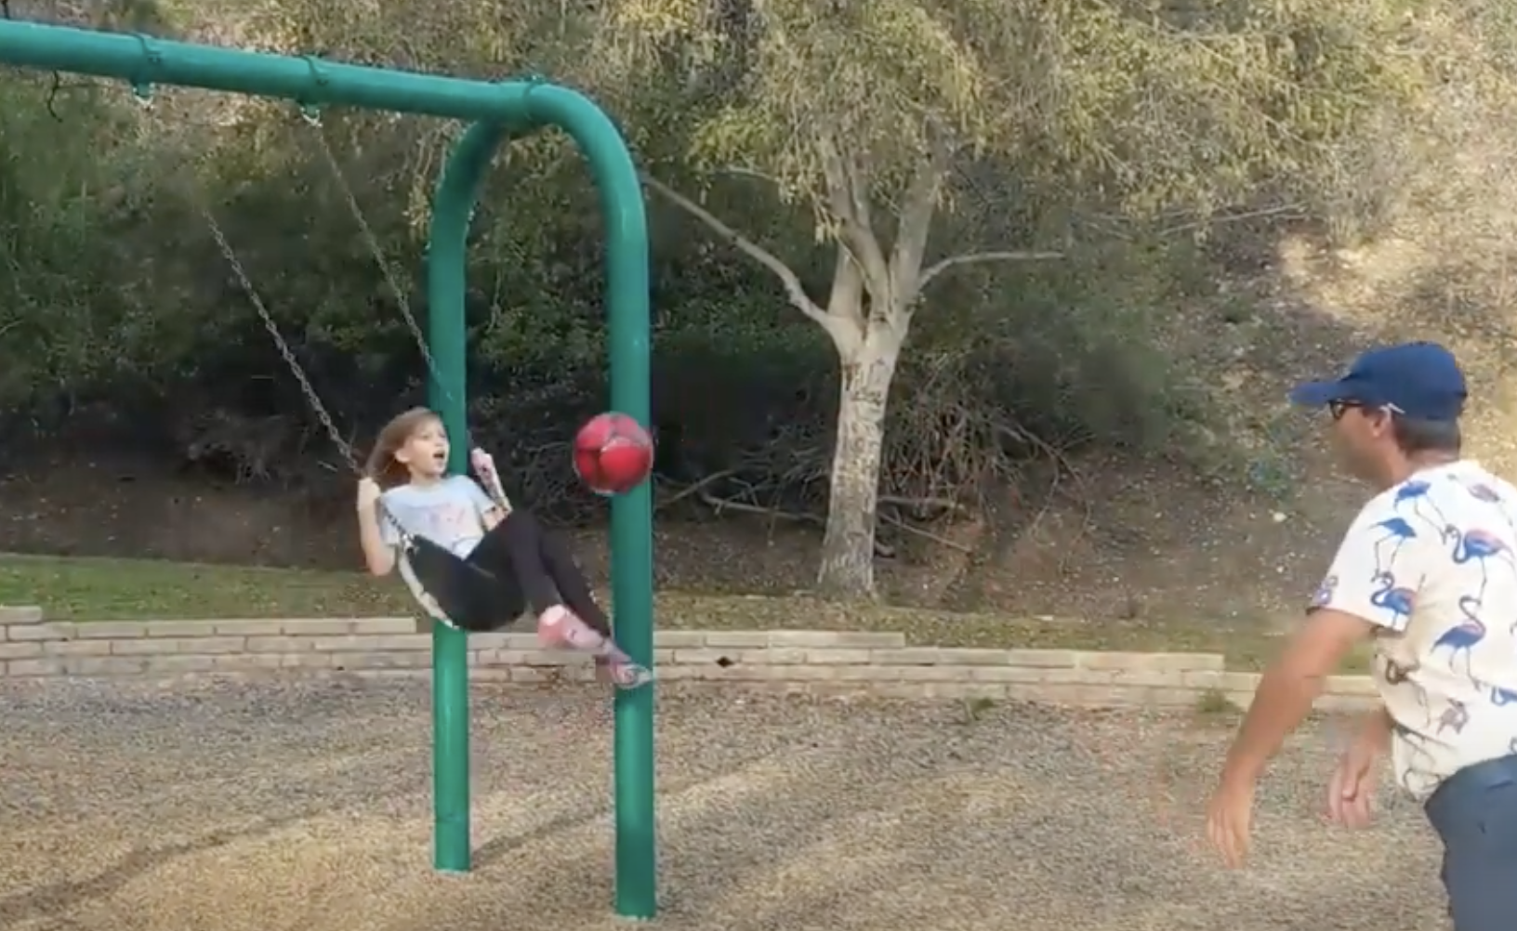
Backgrounds for single photon / phonon detectors
Unwanted electron-like quasiparticles from broken Cooper pairs are a direct background for qubit-based photon/phonon detectors. They scramble the information stored these single quantum Cooper pair oscillators.
Potential energy
diagram for qubit
No fair playing Dodgeball when kid is stuck in the swing!
Qubit
J. Wenner, et al., PRL 110, 150502 (2013)
A quasiparticle tunneling through the Josephson junction transfers energy/momentum from/to the qubit oscillator. This changes the qubit’s state and scrambles the quantum information!

Slide 9
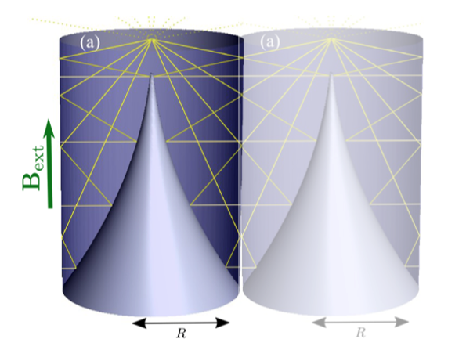
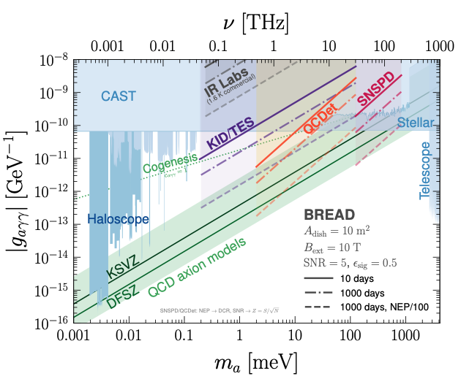
Charge qubit = single photon detector, counts single electrons from pair-breaking
BREAD experiment: Need to reduce best qubit SPD dark count rates by factor 10⁴ !!!
Dark Count Rates:
DCR=1 Hz
10⁸ counts in t=10⁸ s
DCR=10⁻⁴ Hz (!)
10⁴ counts in t=10⁸ s
photon-axion coupling
Signal rate
R_{s} ~ 10⁻⁶ Hz
100 counts in t=10⁸ s
R_{s} limit ~ sqrt(R_{b} / t)

Slide 10

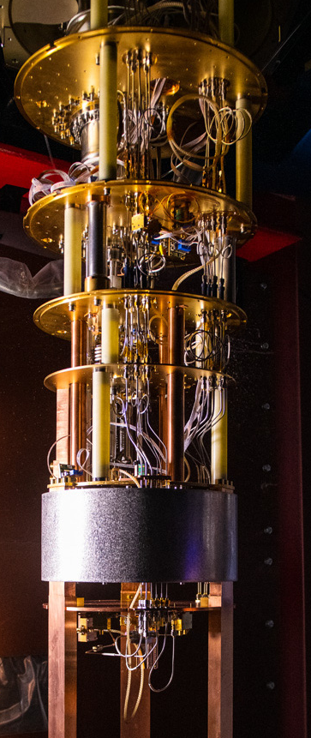
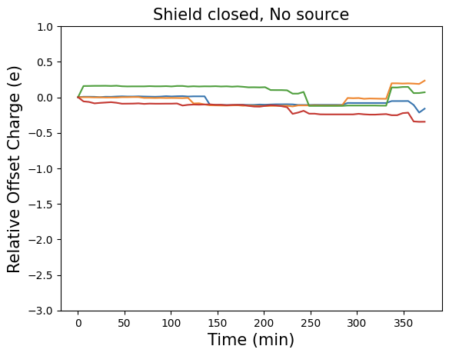
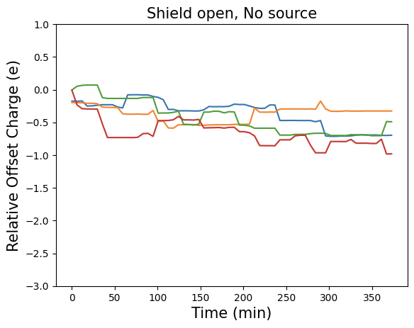
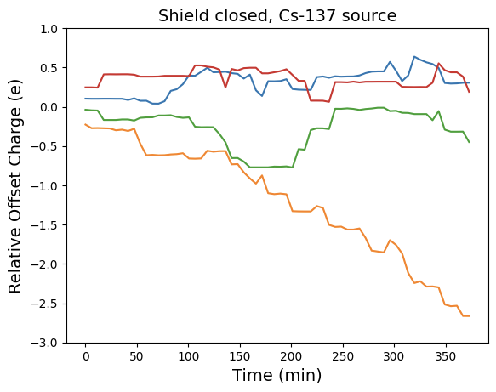
Qubit Errors due to Background Radiation
= Quantum sensor noise, dark counts
Increasing radiation
creates trapped charge, spurious gate voltage, qubit frequency shift
Preliminary
Preliminary
Preliminary
Clear change in qubit response as radiation levels are increased underground in NEXUS (first underground qubit result!)
Team: Kester Anyang, Dan Baxter,, Daniel Bowring, Grace Bratrud, Enectali Figueroa-Feliciano, Sami Lewis, Ryan Linehan, Hannah Magoon, Dylan Temples, Grace Wagner, Jialin Yu

Slide 11
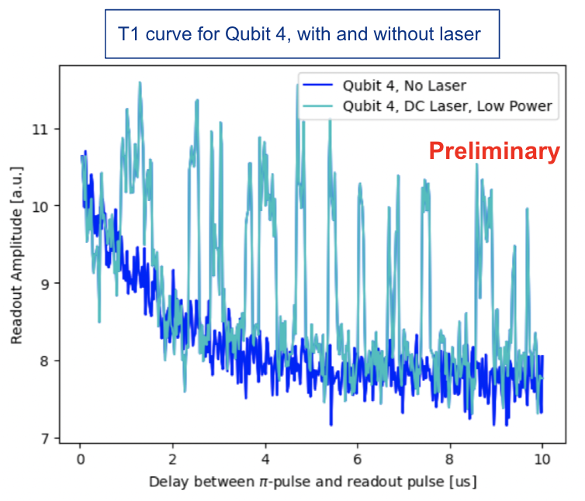
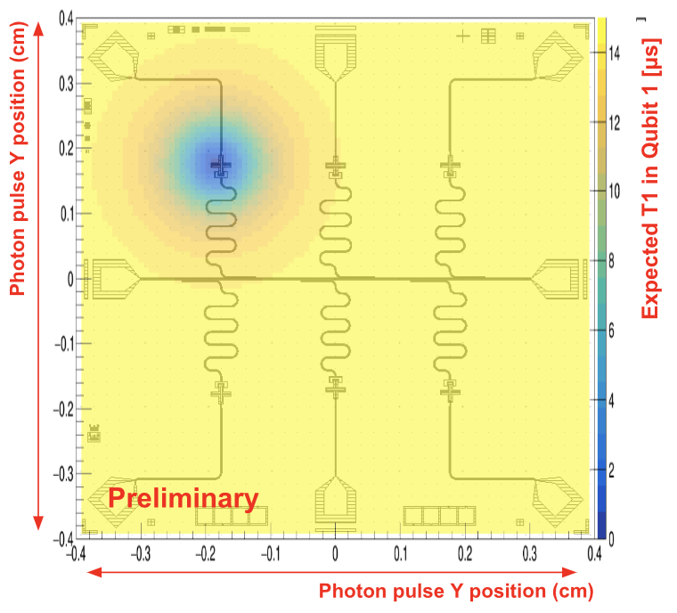
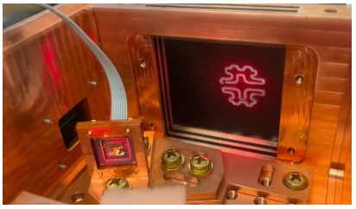
Simulating and measuring energy deposit in substrate
Qubit Detector’s Sensitivity depends on:
Type of qubit
Geometry/Size
Location of DM interaction
Substrate material and Superconductor
Qubit decoherence readout method
Ryan Linehan, FNAL Postdoc
Israel Hernandez, GS, IIT
Qubit decay vs time shows many quasiparticle scattering events
Simulation
Experiment: Zap the chip with laser using cryo-MEMS mirror

Slide 12
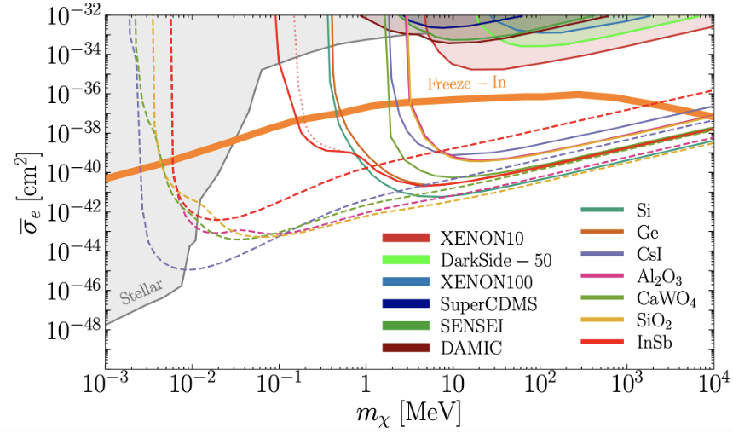
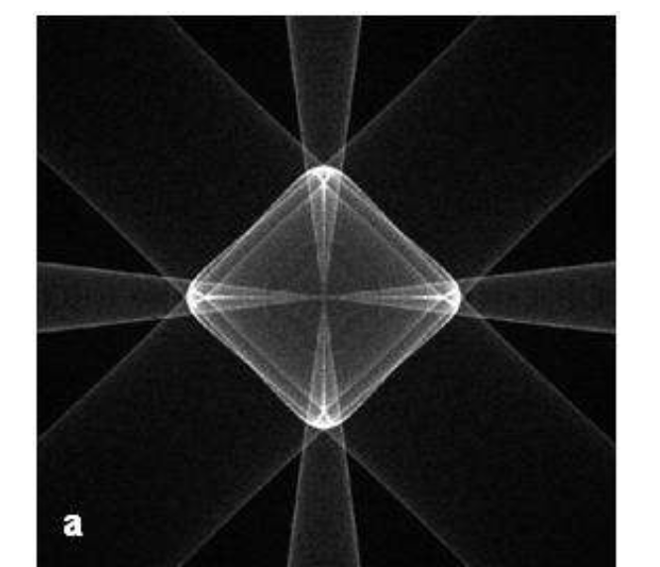
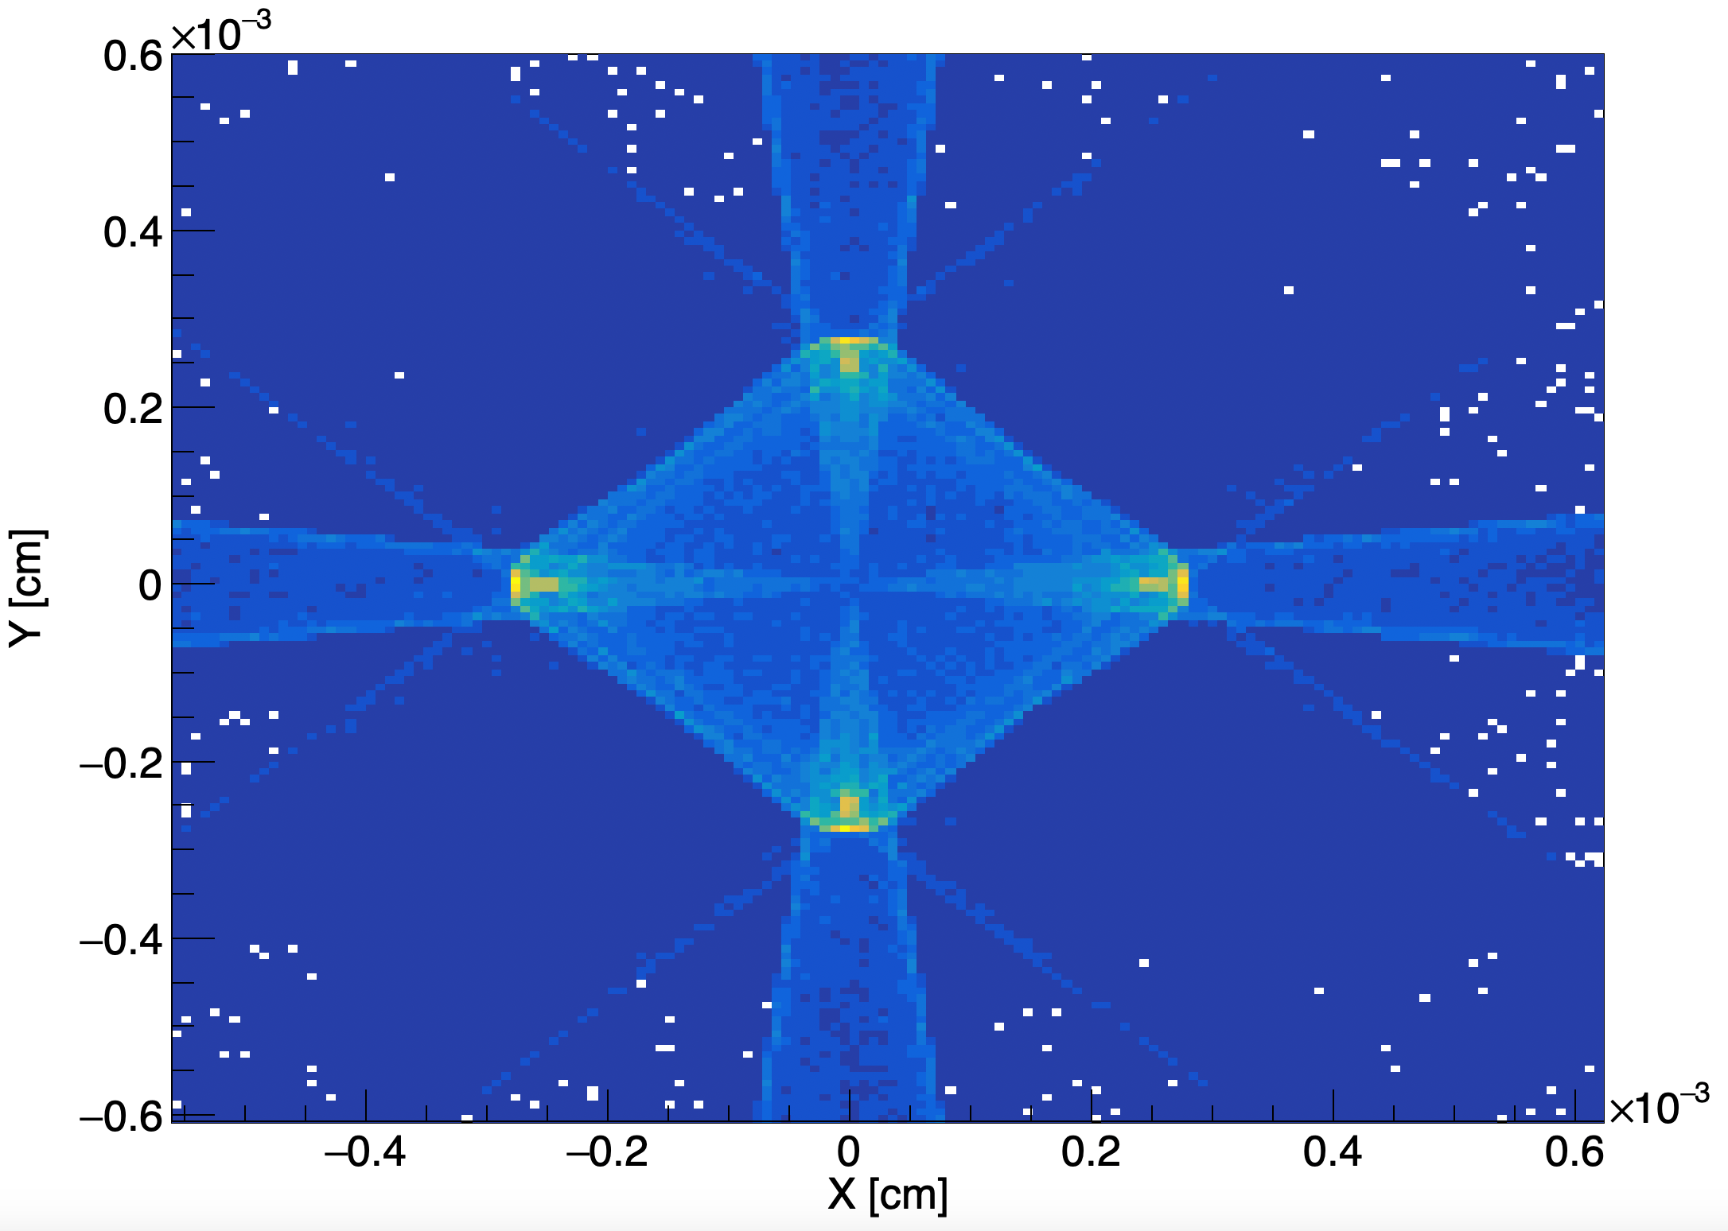
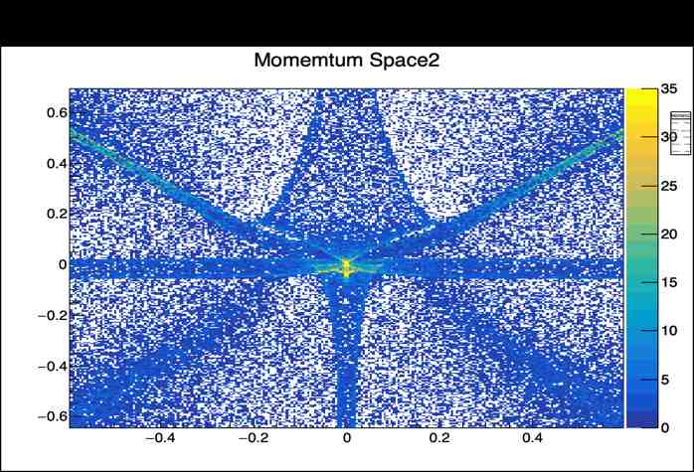
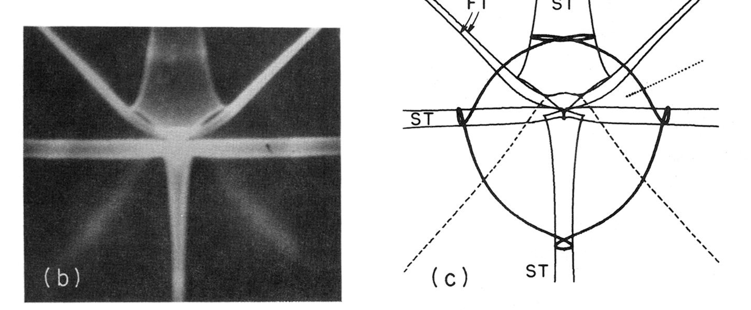
For lower energy threshold, substrate should have low phonon bandgap < 1 eV
Need simulation of low optical phonon bandgap materials
Charge tracking and phonon kinematics in G4CMP only supported for Si and Ge
This work expands G4CMP capabilities to include most of these materials
Israel Hernandez, GS, IIT
GaAs literature
+GaAs
S. M. Griffin, K. Inzani, T. Trickle, Z. Zhang, and K. M. Zurek, Phys. Rev. D, 101, 055004 (2020).
GaAs G4CMP
Sapphire (Al₂O₃) G4CMP
Measurement, literature
Working with G4CMP developers to incorporate this work. Should be available soon for the community!
Y (cm )
X (cm )

Slide 13

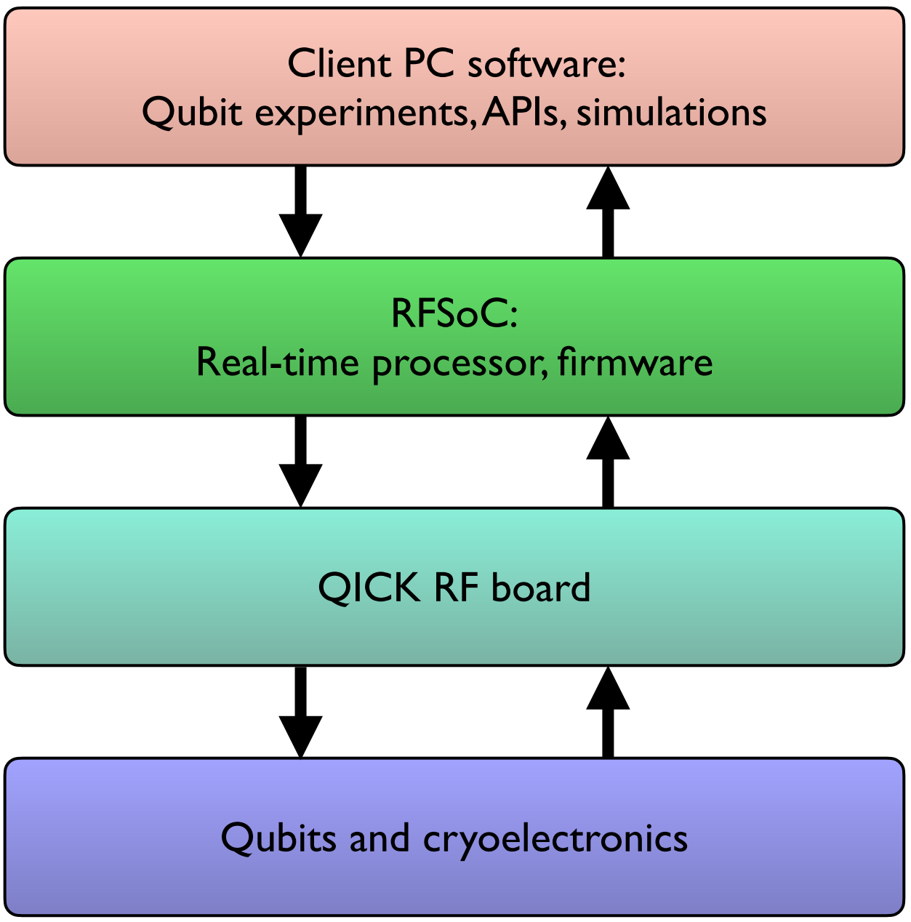
Quantum Instrumentation Control Kit:
Scalable control of quantum hardware including quantum sensor arrays
Xilinx
RFSoC
Quantum computing
Quantum networks
QICK control
Quantum sensing
Your QIS experiment (QC, QN, QS, cryo electronics)
QICK interfaces to it.
QICK open source is helping graduate students, postdocs and engineers to learn Quantum control and to do experiments.

Slide 14
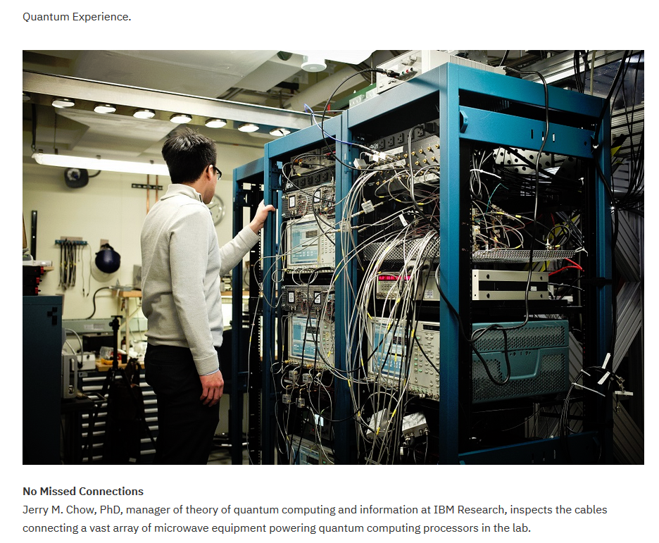
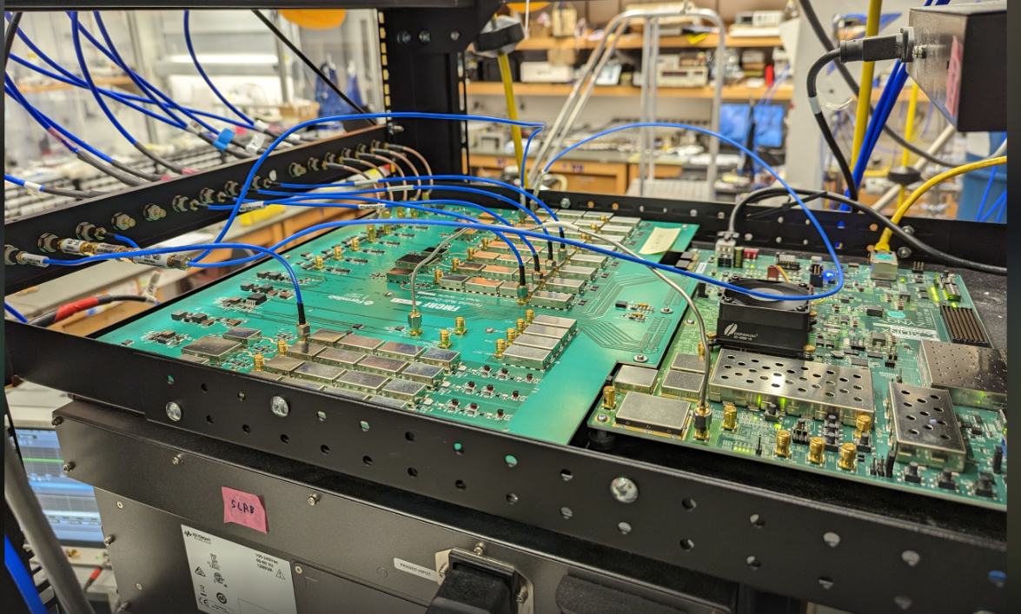
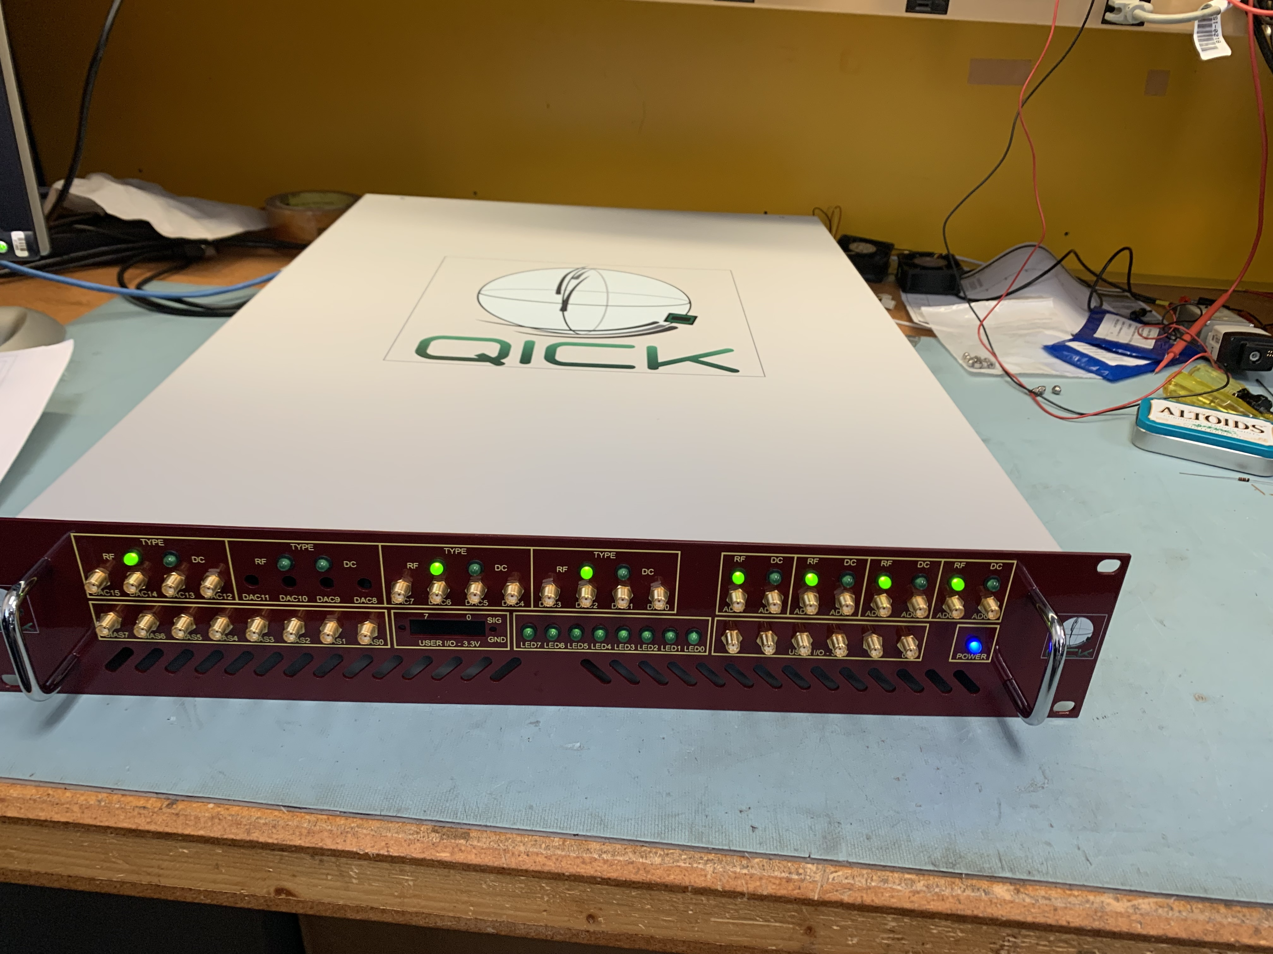
Quantum Control before QICK: $1M
Quantum Control with QICK and RF board: $25K
Eliminates discrete RF and DC electronics and cabling.
32 10GHz RF, 8 bias, 16 I/O
I can certainly say that using the QICK has not just let us do experiments more cheaply but has changed the way we think about control and that we do things differently now (David Schuster, Stanford, and QICK team member)
In 2023 QICK was used to achieve world class science as reported by 12 papers from academia.
See: https://github.com/openquantumhardware/qick
~$1K/channel

Slide 15
Quantum Instrumentation Control Kit (QICK) for scalable readout of multi-qubit and sensor arrays
A comprehensive, control and readout system for QIS based on Xilinx RFSOC, targeting quantum computing (QC), quantum networks (QN) and quantum sensors (QS).
  Open source: including hardware schematics/layouts, firmware, software. See https://github.com/openquantumhardware https://qick-docs.readthedocs.io/en/latest/
  Cost effective: <$1000/qubit, ~$1/detector pixel (e.g. MKID).
  Collaborative efforts with academia, DOE labs and industry.
Supported by a growing international community > 500 people, 60 institutions, 20 companies.
QICK started as a C&R tool for superconducting qubits.
Based on Fermilab’s previous designs for MKID detectors.
Now has spread to other qubit technologies: spin, AMO, NV-centers, QN.
In detectors supports: MKID, SNSPD, Quantum capacitors, broadband RF antenna, etc.
QICK is a FERMILAB and QSC success story (a big one).
QICK has become a standard for QIS. Still need to find a way to increase funding until QICK is transferred or in partnership with industry. This is the next big challenge since we want to keep it open source.

Slide 16
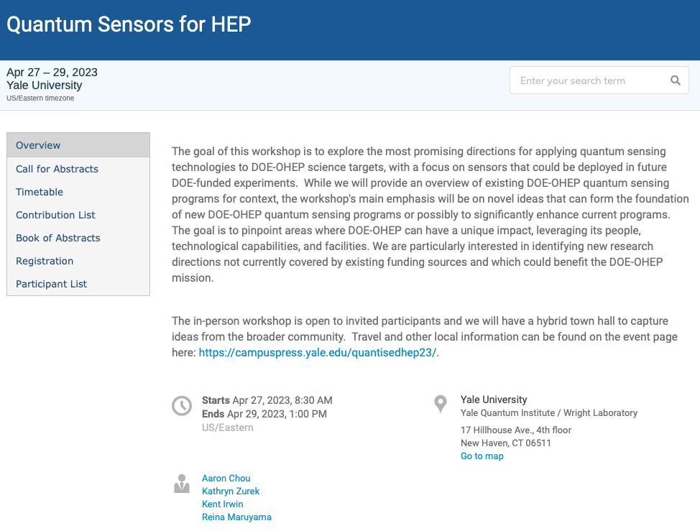
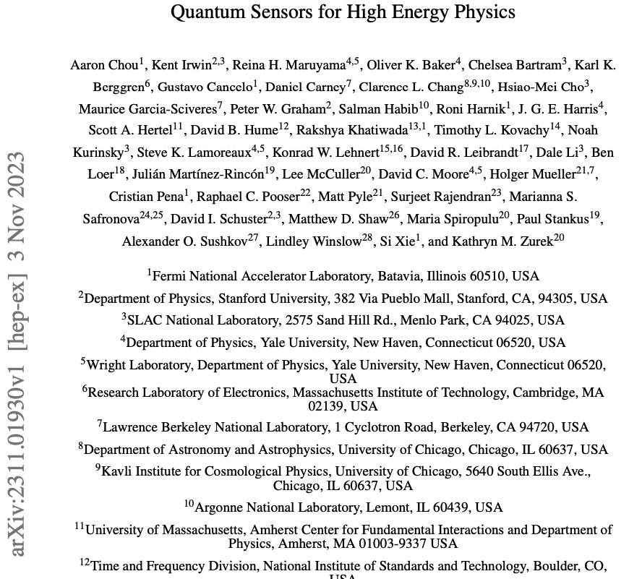
Workshop to reboot QuantISED program

Slide 17
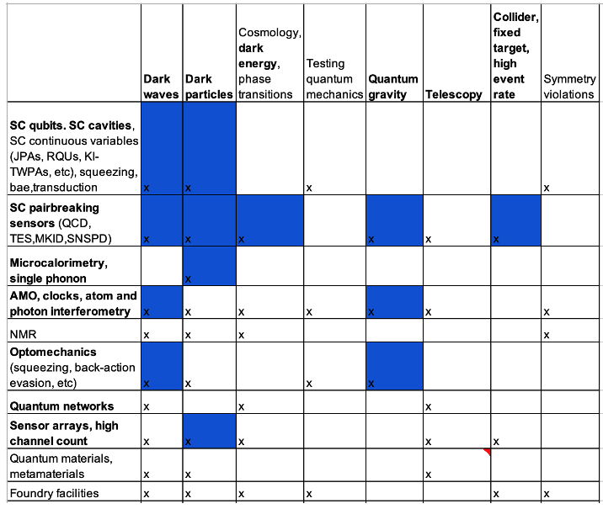
Workshop report: QIS technology vs HEP science application
Blue = Fermilab activities

Slide 18
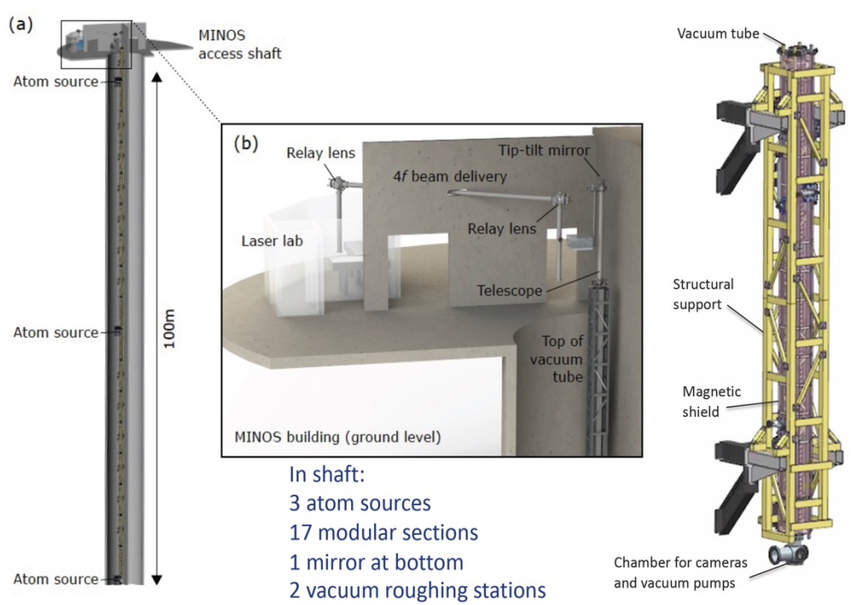
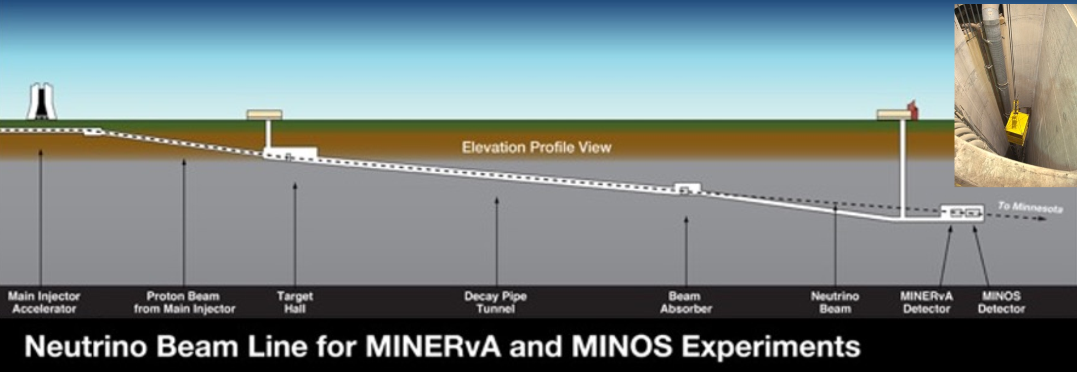
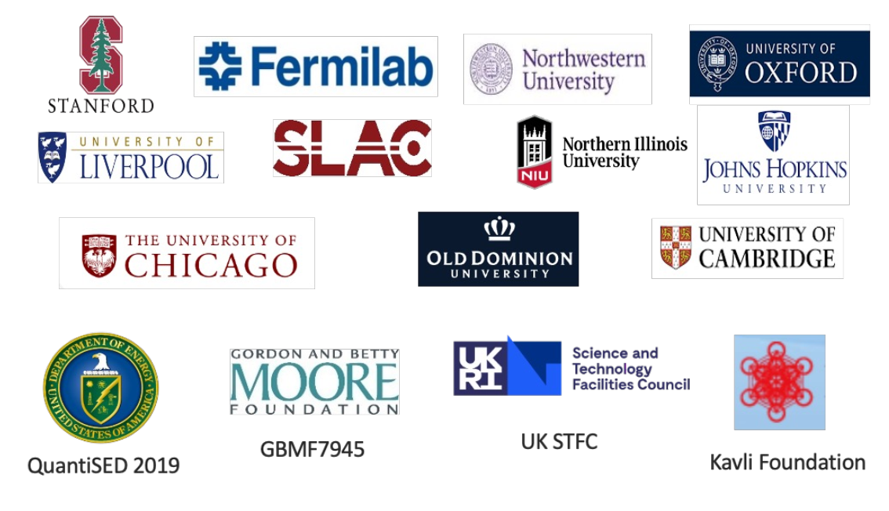
MAGIS-100 at Fermilab
MAGIS-100: cold atom gradiometer, using atom interferometry to compare free falling accelerometers
Exemplifies Fermilab’s QIS&T strategy:
  Leverages lab competencies and infrastructure
  Incorporates cutting-edge QIS&T expertise
→ to advance HEP science

Slide 19
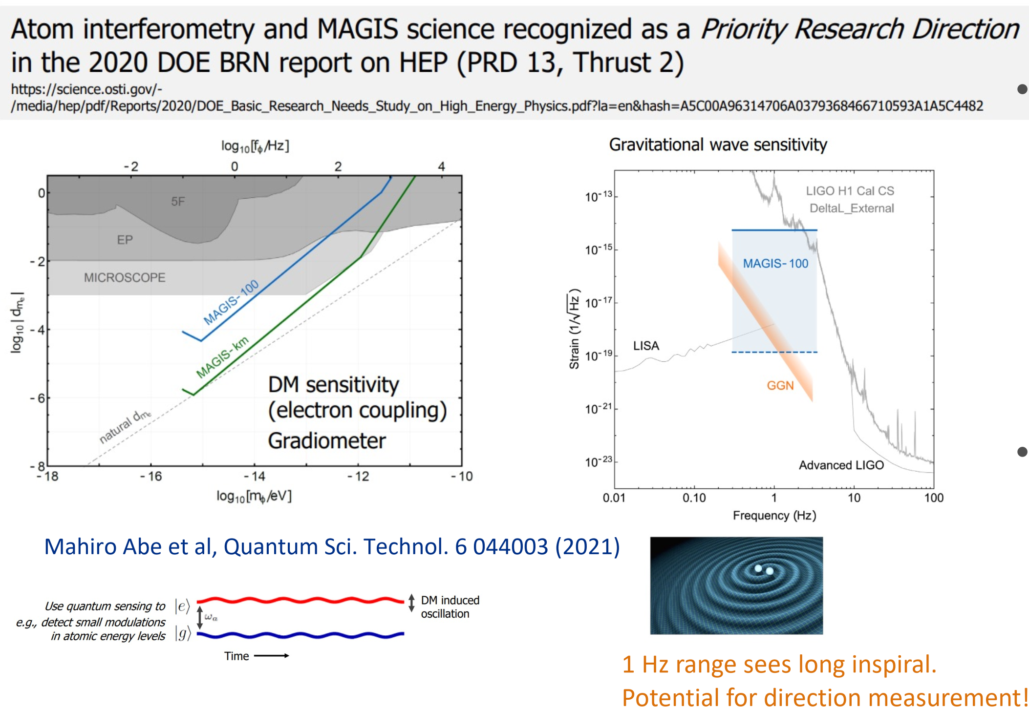
First step to an exciting science program
Major technological advance for studying very low mass dark matter.
– 100 m baseline – order of magnitude better than current state-of-the-art, ultra-precise Strontium clock transition.
Pathfinder for longer baselines, sensitive to ~1 Hz gravitational waves.

Slide 20
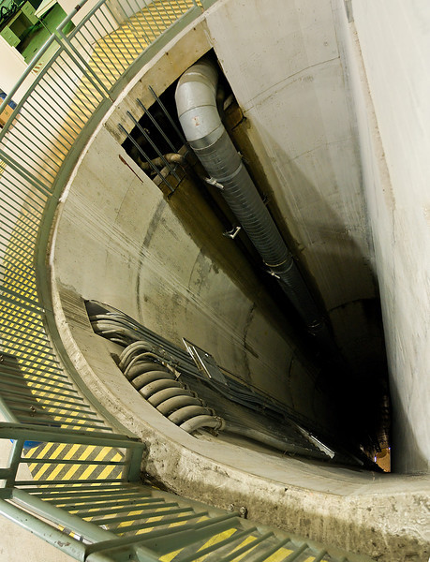
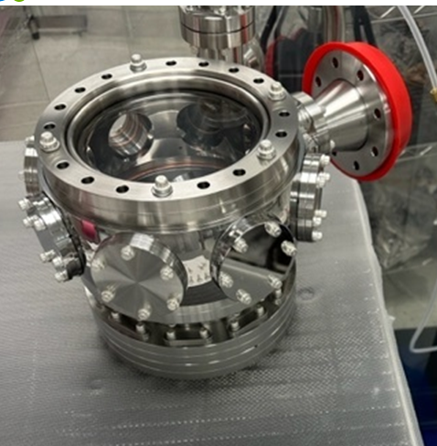
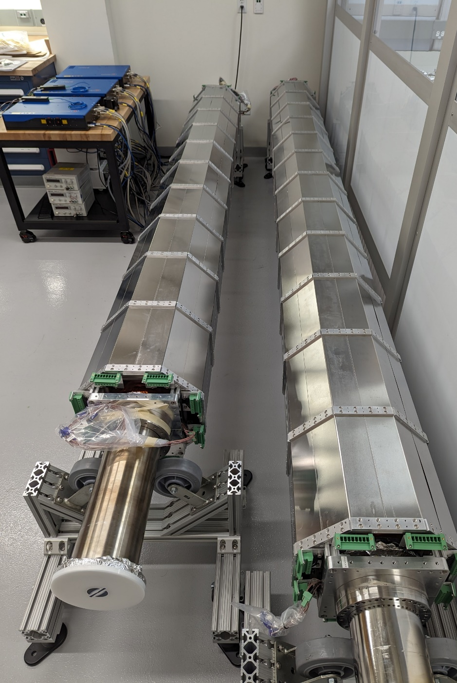
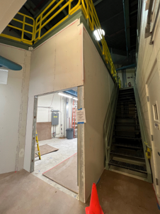
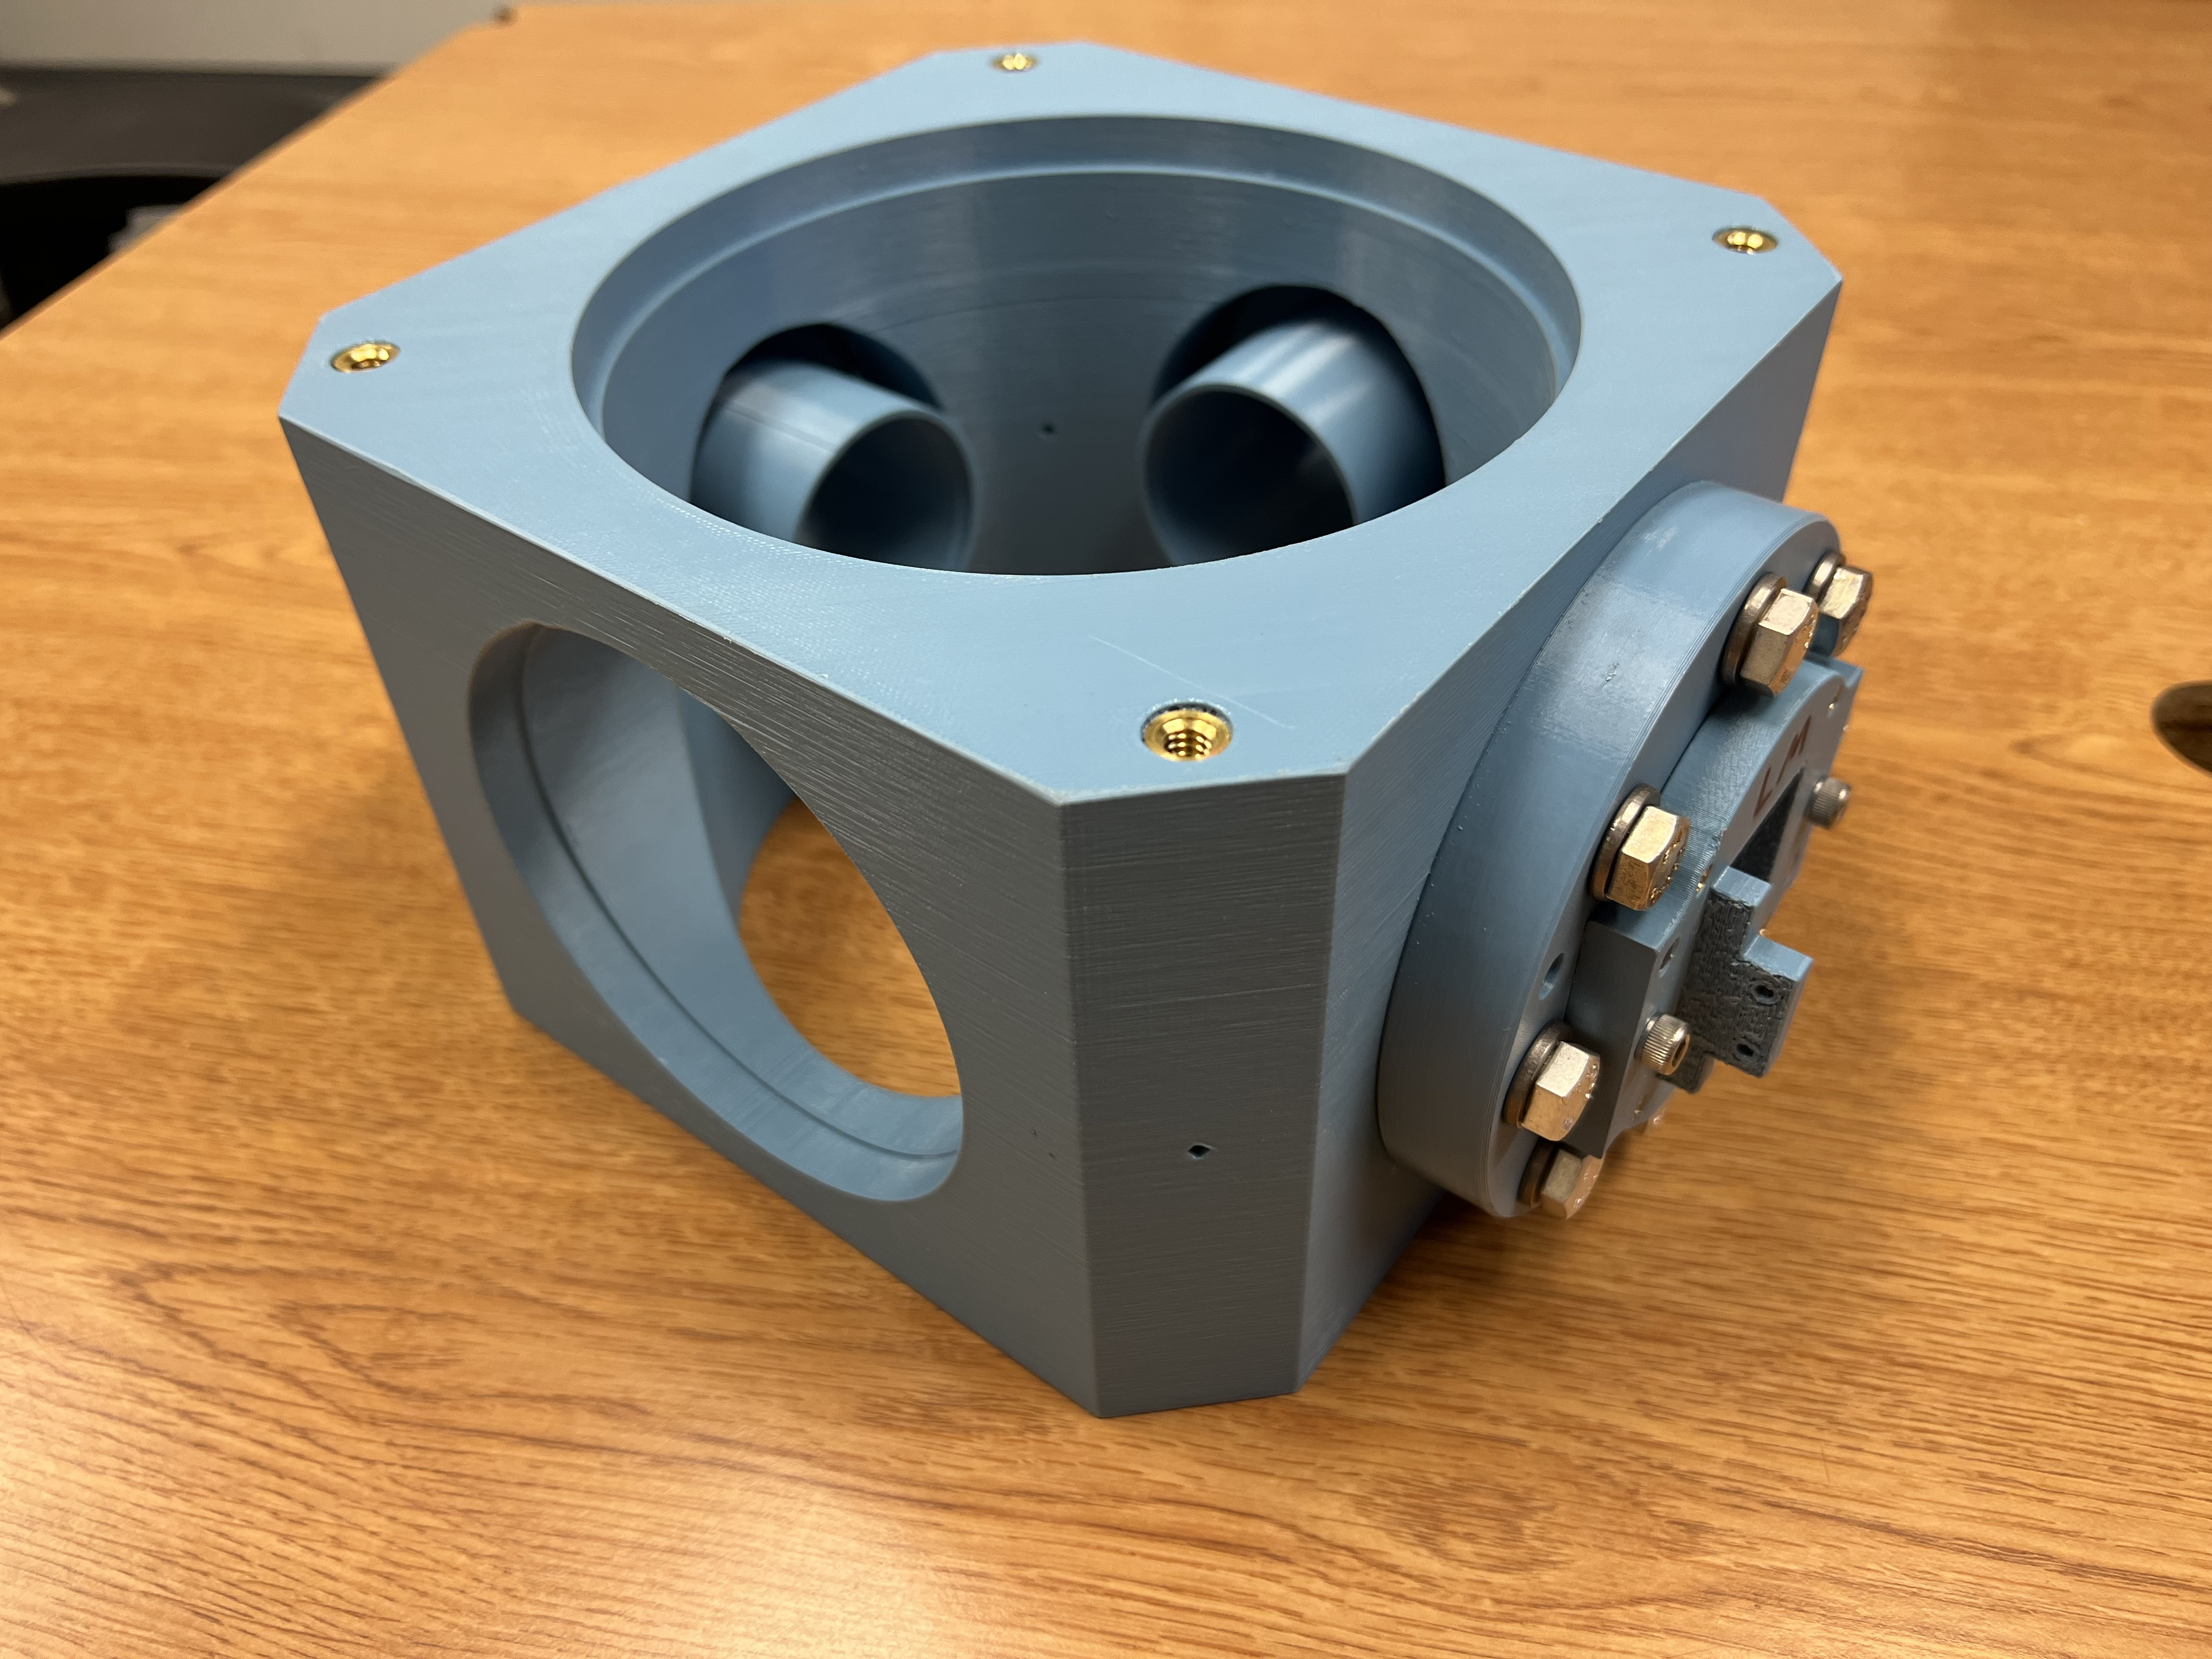
MAGIS-100 – Accomplishments, Goals, Challenges
UK ICRADA
Signing event happened November 16th at Fermilab. Includes Cambridge, Oxford, Liverpool, and Imperial College London.
Images left to right: (1) MINOS 100m shaft, (2) tip-tilt optical chamber and connection node prototype, (3) prototype modular sections, (4) laser lab at MINOS
FY23 Accomplishments
Completed rigorous bottom-up plan incorporating best project management practices. Received funding guidance and profile from DOE for MAGIS-100 in June 2023 with estimated project completion date of April 2027 totaling $19.7M.
Successfully completed small Project Decision (PD) 2/3 check-up review in June 2023. MAGIS-100 formally achieved PD-2/3 in October 2023.
Construction is underway for the new laser lab at the MINOS building. Expected completion February 2024.
Completed fabrication and testing of prototype vacuum components (FNAL) and modular sections (Stanford).
Prototype testing is underway at collaborating institutions and at Fermilab with collaborator input.
  10m prototype tower under assembly at Stanford has already proven magnetic shield design per requirements.
  Laser optics testing conducted by Northwestern has characterized beam stability and drifts.
  Outgassing tests of in-vacuum components conducted at Fermilab with samples from Liverpool and Northwestern.

Slide 21
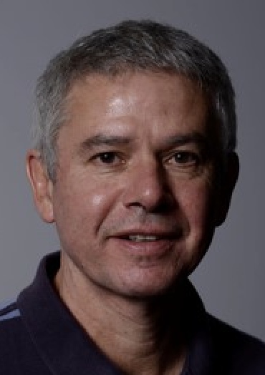
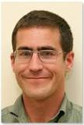
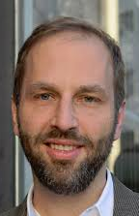
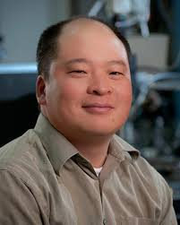












Fermilab-led QuantISED consortium:
Quantum Sensors for Dark Matter
Aaron Chou (Lead PI, FNAL)
Dave Schuster (Stanford)
Konrad Lehnert (Colorado)
Reina Maruyama (Yale)
Pierre Echternach (JPL)
Robert McDermott (Wisconsin)
Rakshya Khatiwada
(IIT/FNAL)
Karl Berggren (MIT)
Sae Woo Nam
(NIST)
Juan Estrada (FNAL)
Bold = PD alumni, now faculty
Dave Harrison
(Wisconsin)
Jialin Yu
(IIT)
Tony
Zhou
(MIT)
Danielle Speller
(JHU)
Akash
Dixit
(GS → NIST)
Ankur
Agrawal
(GS → AWS)
Fang
Zhao
(FNAL)
Morgan
Lynn
(Chicago)
Yue Jiang
(Colorado)
Liz Ruddy
(Colorado)
Sumita
Ghosh
(Yale)
Stewart
Koppell
(MIT)

Slide 22
Recent results from Fermilab QuantISED DM consortium

Slide 23


SC qubits as single photon detectors. No quantum noise!
Quantum readout electronics in remote, magnetically-shielded region
Fermilab/Chicago/Stanford
Nested sapphire cavity compatible with high B field needed for axion search: Q>10⁶,
¼-wave layers reflect photon waves back to center
SQuAD (Superconducting Qubits for Axion Darkmatter)
Transmon qubit performs quantum non-demolition single photon counting with noise 36x lower than zero-point noise, 1300x speed-up.
Installed in 10 mK dilution refrigerator and 14T solenoid magnet at SiDet Lab B.
(based on design from INFN/SQMS)
A.V. Dixit et al., Phys.Rev.Lett. 126 (2021)
Notes:
This example is from a single-investigator award. Please use the NQISRC template.

Slide 24


More stupid qubit tricks:
Increase signal rate by stimulated emission of photons from DM waves
Start the photon wave swinging so it can more easily accept energy from the DM.
Power = $\vec{Force}∙\vec{velocity}$
Good!
Waiting…
Oops, wrong phase
Quantum mechanically, this is encoded in the operator normalization:
So let’s initialize the cavity with a large N Fock state to improve the signal rate.

Slide 25



For signal amplitudes 𝜶, the transfer of quanta from DM to photons is enhanced by a factor (N+1)
N=0
N=10
Displacement
Displacement
Stimulated emission / absorption signals
Spontaneous emission signal
QuTiP simulation

Slide 26



Creating Fock states in a (non)linear system
“Optimal control” sequence of drives at both the qubit and cavity frequencies,
determined by “gradient ascent pulse engineering”
$\left. |g, 0\right\rangle →$ $\left. |g, 3\right\rangle$
$\hat{ℋ}$ = ${\left({ωc}^{ }+ χ\frac{σ_{z}}{2}\right)a}^{†}a + ωq\frac{σ_{z}}{2}$
Slide/data from Ankur Agrawal
Notes:
Fock states are quantum state of light which cannot be created in a linear system such as a cavity. However, if we rewrite the Hamiltonian again, we see that the cavity frequency is dependent on the state of the qubit. This non-linearity allows us to prepare the cavity in any quantum state.
I used an optimal control package which was developed in our lab to solve an inversion problem. Given a Hamiltonian, it uses machine learning algorithm to generate a set of qubit and cavity control drives to perform a non-trivial state transfer. I used a 3D multimode cavity coupled to a transmon as shown in the image here for the experiment.
Here is an example of such a state transfer from the ground state to n=1 Fock state. We can see the cavity’s wave function evolve from n=0 to n=1 in this movie.
Wigner function is a quasi-distribution function which represents the wavefunction of the oscillator. Parity operator is an effective experimental tool to compute the density matrix.

Slide 27

Verifying the state preparation
Sweep pi pulse frequency
Method 1: Qubit spectroscopy with a number resolved $π$pulse
Method 2: Wigner tomography to reconstruct the density matrix
Slide/data from Ankur Agrawal
Notes:
We can use this method to verify the preparation of cavity in a Fock state.
Method 1 is a qubit spectroscopy with a number resolved pi pulse which I had described earlier. On the left, we see the qubit spectrum and a single peak in each spectrum confirms the cavity state in a definite photon number.
The other method is Wigner tomography which is slightly more involved and requires multiple measurements to reconstruct the state of the cavity.
Hence, for the rest of this talk, I am going to use a number resolved qubit pi pulse to probe the cavity state.
I would like to point out that the information that we obtain from a resolved pi pulse and the Wigner tomography is the same, as there is no phase information associated with the cavity state. Henceforth, we will just use resolved pi pulse to probe the cavity state.

Slide 28










Signature of enhancement
Prepare$\left. |N\right\rangle$and see how often we measure $\left.|N+1\right\rangle$
$$\left. |N\right\rangle$$
$$n_{inj}$$
$$\left.|N+1\right\rangle$$
This is the first demonstration so far showing signal enhancement with $\left.|N\right\rangle$ = $\left.|4\right\rangle$Fock state
Less than a factor of (N+1) due to measurement inefficiencies.
Dark matter scan rate df/dt ∝ (N+1)
→ Factor of 3 improvement
Ankur Agrawal et al., 2305.03700
Notes:
Given this experimental protocol, let me describe how we characterize the detector.
After initializing the cavity in a particular Fock state, we inject a mean photon number shown on the x-axis. Y-axis is the probability of finding the cavity in (n+1) given that the cavity started in the correct Fock state.
So, let’s start with the cavity in its ground state. As we inject more photons, we measure more as expected. Now, if we initialize the cavity in n=1 Fock state then we should see higher occupation probability.
And, we do! Let’s go even higher.
As we can see, the stimulated emission does enhance the signal.
In a previous work such enhancement with n=1 was reported in an ion-trap system.
However, this is the first demonstration of enhancing weak signals using n=4 Fock state.
You may be asking why n=3 is missing. Unfortunately, we see some anomalous behaviour with n=3 and we suspect it is due to leakage to other modes in the cavity. We have identified a couple of potential transition with other modes which could explain this.

Slide 29


Quantum Capacitance Detector based on charge-parity switching in charge qubit.
Single THz photon detector, DCR = 1 Hz
Fermilab/Caltech/JPL
A QCD pixel
P. Echternach, A. Beyer, and C. Bradford (2021)
https://doi.org/10.1117/1.JATIS.7.1.011003
Echternach, P. M., et al. Nature Astronomy 2.1 (2018): 90-97.

Slide 30

Late Dark Energy Radiation
(LADERA)
Experiment prototype at JPL
Measure cosmological dark blackbody appearing inside dark box.
Like CMB Expts, needs large array of single mode detectors to get large area detector.

Slide 31
Where is this all going?
Lots of quantum device/sensor technologies are being developed using quantum funds from HEP, ASCR. Pathfinder experiments in progress.
P5 recommends investment in “small-scale dark matter experiments using innovative technologies” and targeted increases in areas including “general accelerator R&D, instrumentation” which are areas which “align with national initiatives in ... quantum information science.”
P5 recommends small projects portfolio (ASTAE) at $35M/yr
Fermilab facilities/infrastructure (accelerator, cryogenics, magnets, underground) can be used to host several ADMX-scale (or MAGIS-scale) ASTAE experiments utilizing new quantum technologies
Quantum Sensors for HEP workshop included technologies funded through QuantISED, NQISRCs (QSC, SQMS, Q-NEXT), from the broader AMO/CM/quantum community, also from KA25 Generic Detector R&D and KA23 cosmic frontier.

Slide 32

Fermilab quantum infrastructure
+ above-ground fridges
+ SQMS facilities
+ ...
14 T cryogen-free solenoid

Slide 33


Envisioned Dark Wave Lab
First 9 T, warm bore MRI magnet ~$7M to be moved to Fermilab this year for ADMX-EFR.
Can host other experiments.
PW8 building can house 2 magnets

Slide 34

What we really need for all axion experiments are bigger magnets
Barely reach axion with a lot of hand-waving
Decisively reach axion
(g=0.3)
Push to g=0.1 !
Dish antenna: g ~ 5 (R_{b}/t)^{1/4} B⁻¹ L⁻¹
Even better scaling with magnet size L for multi-cavity or LC experiments.

Slide 35




Make TurDucken!
Multi-experiment magnet user facility
Dish antenna expt.
Cavity expt.
LC expt.

Slide 36


A future large solenoid facility would provide a broad science program beyond just dark matter
Accelerator Frontier:
Magnet R&D,
Muon Collider, Accelerator Complex Evolution
Energy Frontier:
Muon Collider,
Tracking detector
magnets
Cosmic Frontier:
Axion Dark Matter
Non-HEP:
Plasma fusion,
High field MRI,
Crystal growth,
Quantum magnetic materials
Rare/Precision Frontier:
Charged Lepton Flavor Violation
Motivates development of HTS cable

Slide 37



Highlights from QuantISED DM sensors consortium
Oops, contemporary SC qubit designs are accidentally impedance-matched to free space radiation and easily absorb pair-breaking photons.
→Further optimize to get high-QE SPDs.
Qubits transmit and receive rf photon beam
Antenna coupling
Calibrate SPD response using photons generated via the AC Josephson effect
Measured QP rate

Slide 38


Wisconsin’s Josephson photon emitter installed at Fermilab to calibrate single photon detectors
mk plate
JJ emitter
Filters
Bias T
QCD chip
Assembly inside Fermilab Lab B fridge
Design with filters and emitter
Single frequency cryogenic photon source, no heating required.

Slide 39



Remote SC qubit readout for axion experiments with high B field
Blue = signal
Red = noise
Simultaneously pump Josephson parametric converter at sum and difference frequencies between axion cavity and remote, field-free readout cavity to provide:
State swapping between cavities
Single quadrature amplification with backaction noise bounced to the original cavity
Pumps OFF
Pumps ON
Now adapting scheme to Fermilab setup

Slide 40



Using real atoms instead of artificial atoms as SPDs
Can reach higher frequencies than those of artificial atoms

Slide 41



GQuEST: Single photon counting readout for gravitational wave interferometers
Fermilab, Caltech, JPL
Pathway towards 50 dB below SQL?
Enables search for stochastic GW backgrounds.
Exotic sources include early universe phase transitions, cosmic string decays,
space-time noise from quantum gravity.
Fermilab provides cryogenic engineering for fiber-coupled SNSPD, QICK IFO controls.
Low dark rate single photon detector
Narrowband filter cavity defines the mode linewidth
Lee McCuller, arXiv:2211.04016

Slide 42
Charge questions:
Coordinates with DOE to have FQI projects reviewed and possibly extended to match timing of upcoming funding opportunities.
  MAGIS-100 has been baselined, achieved PD 2/3.
  ASTAE will likely start with the existing DMNI portfolio on the time scale of FY27. Quantum sensor R&D will target new opportunities for quantum sensing-based experiments for the second round.
Develops a long-term strategy towards quantum science and how it integrates with HEP goals.
  Continue to engage the non-HEP QIS community to access new technologies. “Quantum Sensors for HEP” workshop identified most promising directions.
  Leverage non-HEP quantum funding through NQISRCs, direct cross-disciplinary collaboration with DOE-BES and DOE-ASCR.
  Host future ASTAE experiments at Fermilab, using unique laboratory infrastructure and capabilities.

