Slide 1
Unreviewed Safety Issue (USI) Screener Training
Jessica Malo, Accelerator Safety Specialist
Rev. 0
January 2024

Slide 2
The Accelerator Safety Order (ASO)
Per our contract, Fermi is required to follow DOE Order 420.2D, “SAFETY OF ACCELERATORS”.
The purpose of the order is:
“To establish accelerator-specific safety requirements for Department of Energy (DOE), including National Nuclear Security Administration (NNSA), accelerators and their operations that, when supplemented by other applicable safety and health requirements, promote safe operations to ensure adequate protection of workers, the public, and the environment.”
Accelerator definition:
“A device and its components employing electrostatic or electromagnetic fields to impart kinetic energy to molecular, atomic, or sub-atomic particles and capable of creating a radiological area as defined by 10 CFR Part 835, Occupational Radiation Protection. Accelerator components include injectors, targets, beam dumps, detectors, experimental enclosures, accelerator enclosures, experimental areas, and experimental apparatus utilizing the accelerator. The accelerator also includes associated support and test facilities, equipment, systems, and utilities necessary to operate the accelerator or utilize the accelerated beam.”
Fermilab has five (5) accelerators that meet the definition of accelerator per the Order: The Fermilab Main Accelerator, FAST, PIP2IT, CMTS1 and VTS.
01/2024
Malo | Unreviewed Safety Issue (USI) Screener Training

Slide 3
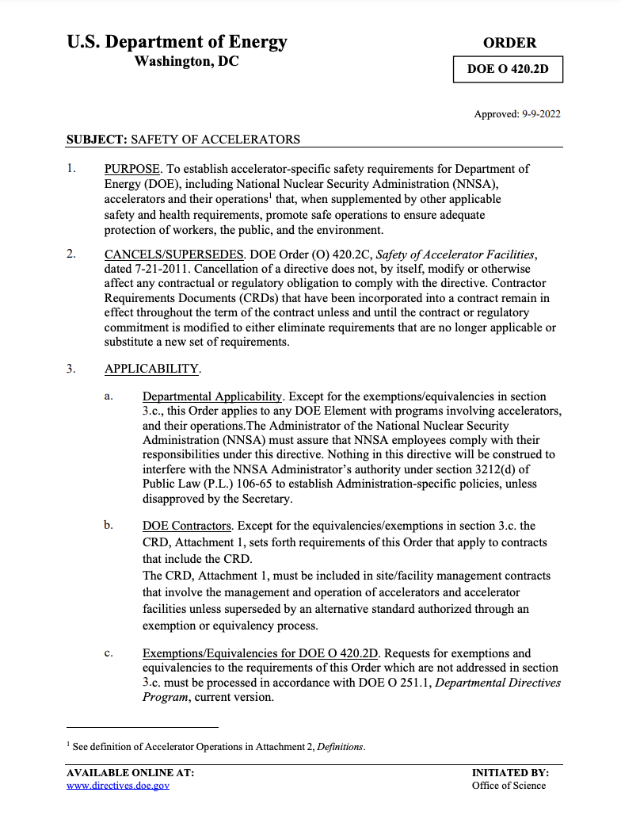
Required Elements of DOE O 420.2D
An approved Safety Assessment Document (SAD), which represents the technical basis for the ASE.
An approved Accelerator Safety Envelope (ASE), defining the physical and administrative bounding conditions and controls for safe operations, based on the safety analysis documented in the Safety Assessment Document.
Clearly defined roles and responsibilities for accelerator activities including those for training and procedures.
An unreviewed safety issue (USI) process. A USI process supports configuration management efforts that help ensure the facility and safety documentation are maintained current and periodically updated.
An accelerator readiness review program that ensures facilities are adequately prepared for safe commissioning and/or operations.
A current listing/inventory of accelerators under the Order and exemptions or equivalencies granted in accordance with the Order. (ESH-ASD maintains the inventory)
01/2024
Malo | Unreviewed Safety Issue (USI) Screener Training

Slide 4
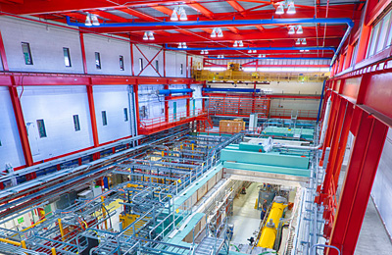
Outline
USI Program Overview
Configuration Management
Installed examples
USI Program Steps
Roles and Responsibilities
Notifications Required
Screening
Purpose of USI Screening
Screener training requirements
Screener actions
Required notifications
Evaluation & Determination
ASE violation and required actions
Records
USI Program Flowchart
FAST electron injector
01/2024
Malo | Unreviewed Safety Issue (USI) Screener Training

Slide 5
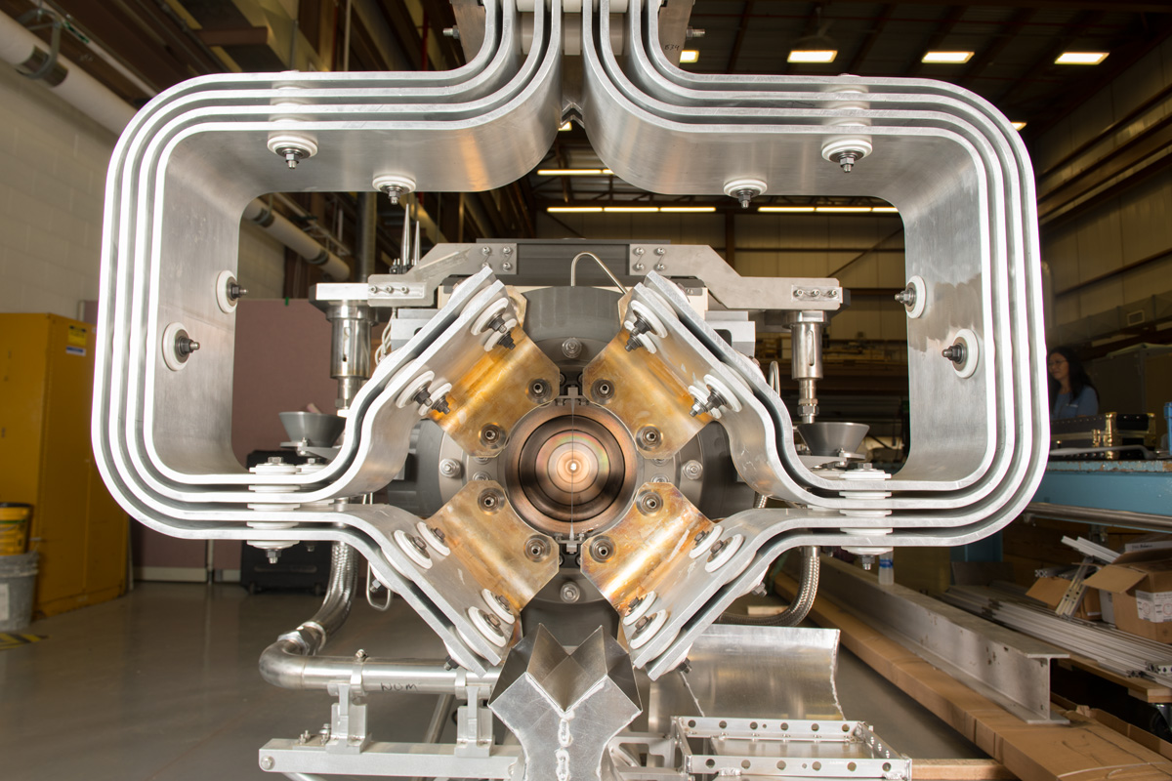
USI Process Is Key to Configuration Management under the ASO
Fundamental Purpose:
Evaluate proposed changes and as-found conditions to determine if they will impact or require a change to the safety analysis or credited controls or a change to the current configuration of an existing accelerator.
This ensures continuous compliance with existing approved safety basis for operations.
NuMI megawatt-capable target
01/2024
Malo | Unreviewed Safety Issue (USI) Screener Training

Slide 6
USI Process Is Key to Configuration Management under the ASO
Screening: Rapid evaluation of the proposed change or as-found condition to determine if it might impact the safety analysis or credited controls or a change to the current configuration of an existing accelerator.
If “yes”, then…
Unreviewed Safety Issue Evaluation and Determination: Formal, reviewed, and documented evaluation of whether the change or as-found condition modifies a credited control or documented hazard analysis. If “yes”, then…
Unreviewed Safety Issue (USI): Actions taken to address the issue including halting operations, corrective actions, updates to the safety analysis. Requires DOE approval to implement the proposed activity (i.e., approval required before work begins) or resume operations.
Reviewed Safety Issue (RSI): Once an USI has been appropriately reviewed, the issue becomes a Reviewed Safety Issue (RSI) and may be considered as an addendum to the SAD.
DOE approval is required if the USI Process determines that an RSI introduces accelerator specific hazards that are not adequately addressed by the current SAD and approved ASE prior to implementation of the proposed activity.
Once approval is obtained, proposed activity may begin or operations may resume.
01/2024
Malo | Unreviewed Safety Issue (USI) Screener Training

Slide 7
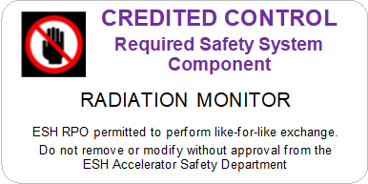
Configuration Management
The ASE describes methods for assuring configuration management for credited controls.
Several methods of Configuration Management are in place:
ESH Radiation Safety personnel review of JULIEs within “Excavation Waiver Prohibited Zone” around accelerators
Movable and penetration shielding Credited Controls posted with updated Credited Control label
Radiation monitors that are Credited Controls are posted with updated Credited Control labels, shown here..
Credited Control Label
01/2024
Malo | Unreviewed Safety Issue (USI) Screener Training

Slide 8
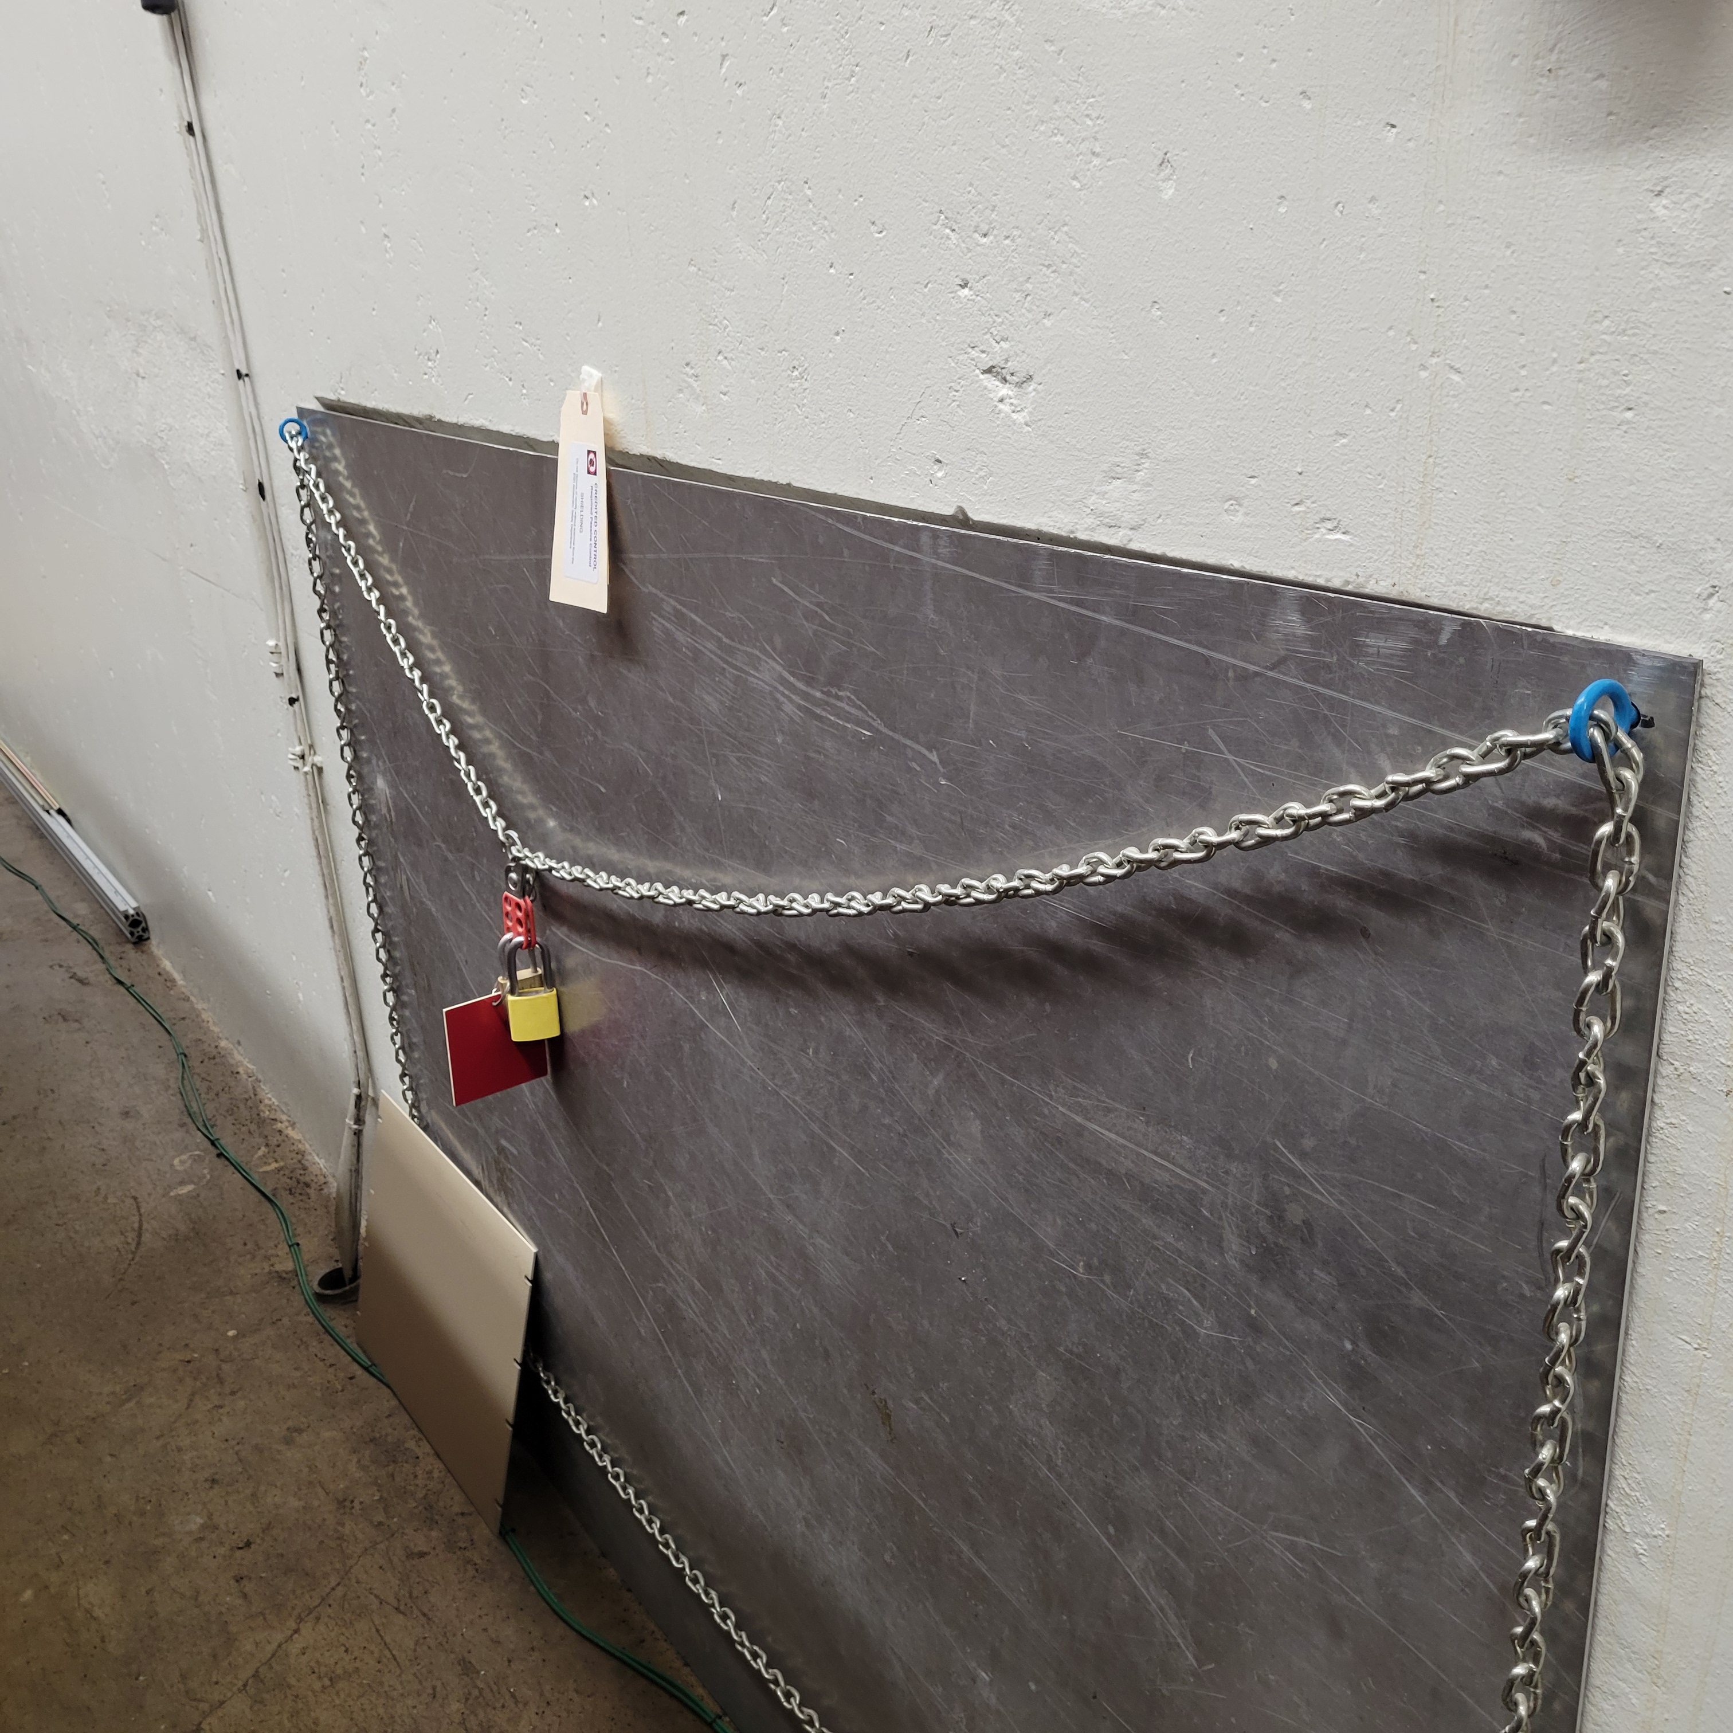
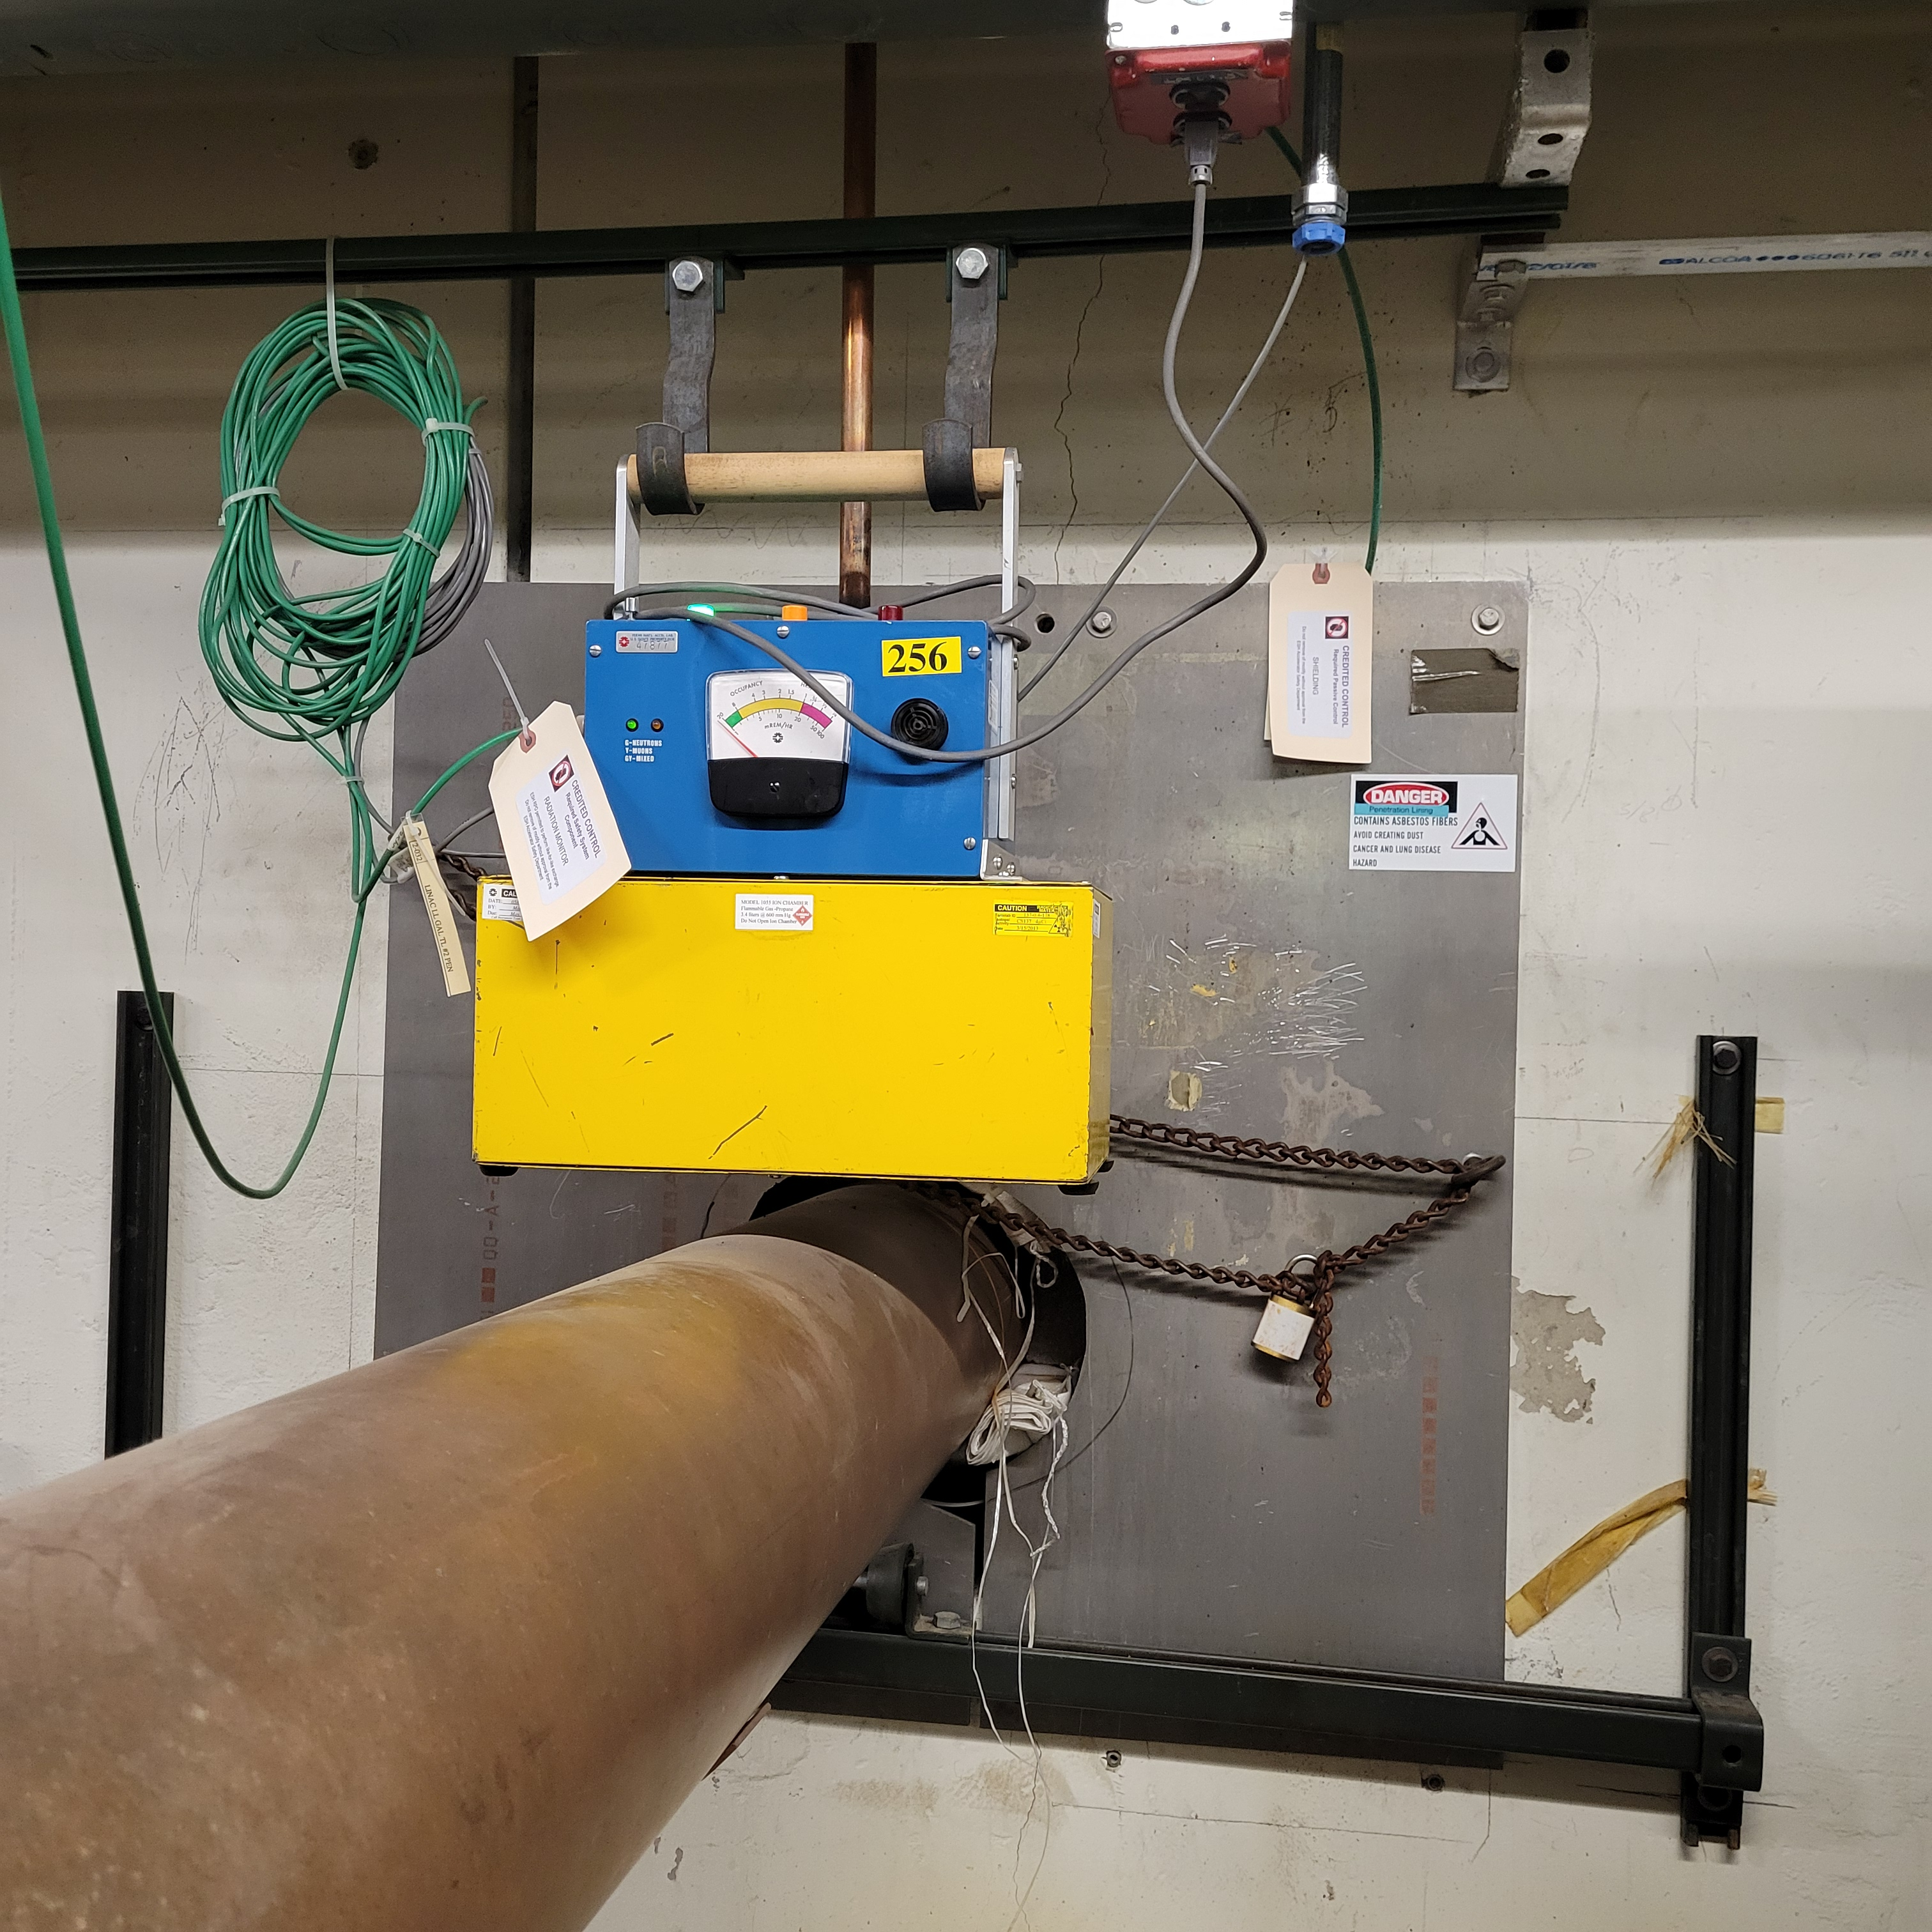
Credited Control Label Examples
Figure 1. Example of labels installed on Credited Control shielding and Credited Control radiation monitor for a penetration in the Linac segment of the Fermilab Main Accelerator.
Figure 2. Example of labels and configuration method (cover plate, lock and chain) installed on Credited Control shielding for a penetration in the Linac segment of the Fermilab Main Accelerator.
01/2024
Malo | Unreviewed Safety Issue (USI) Screener Training

Slide 9
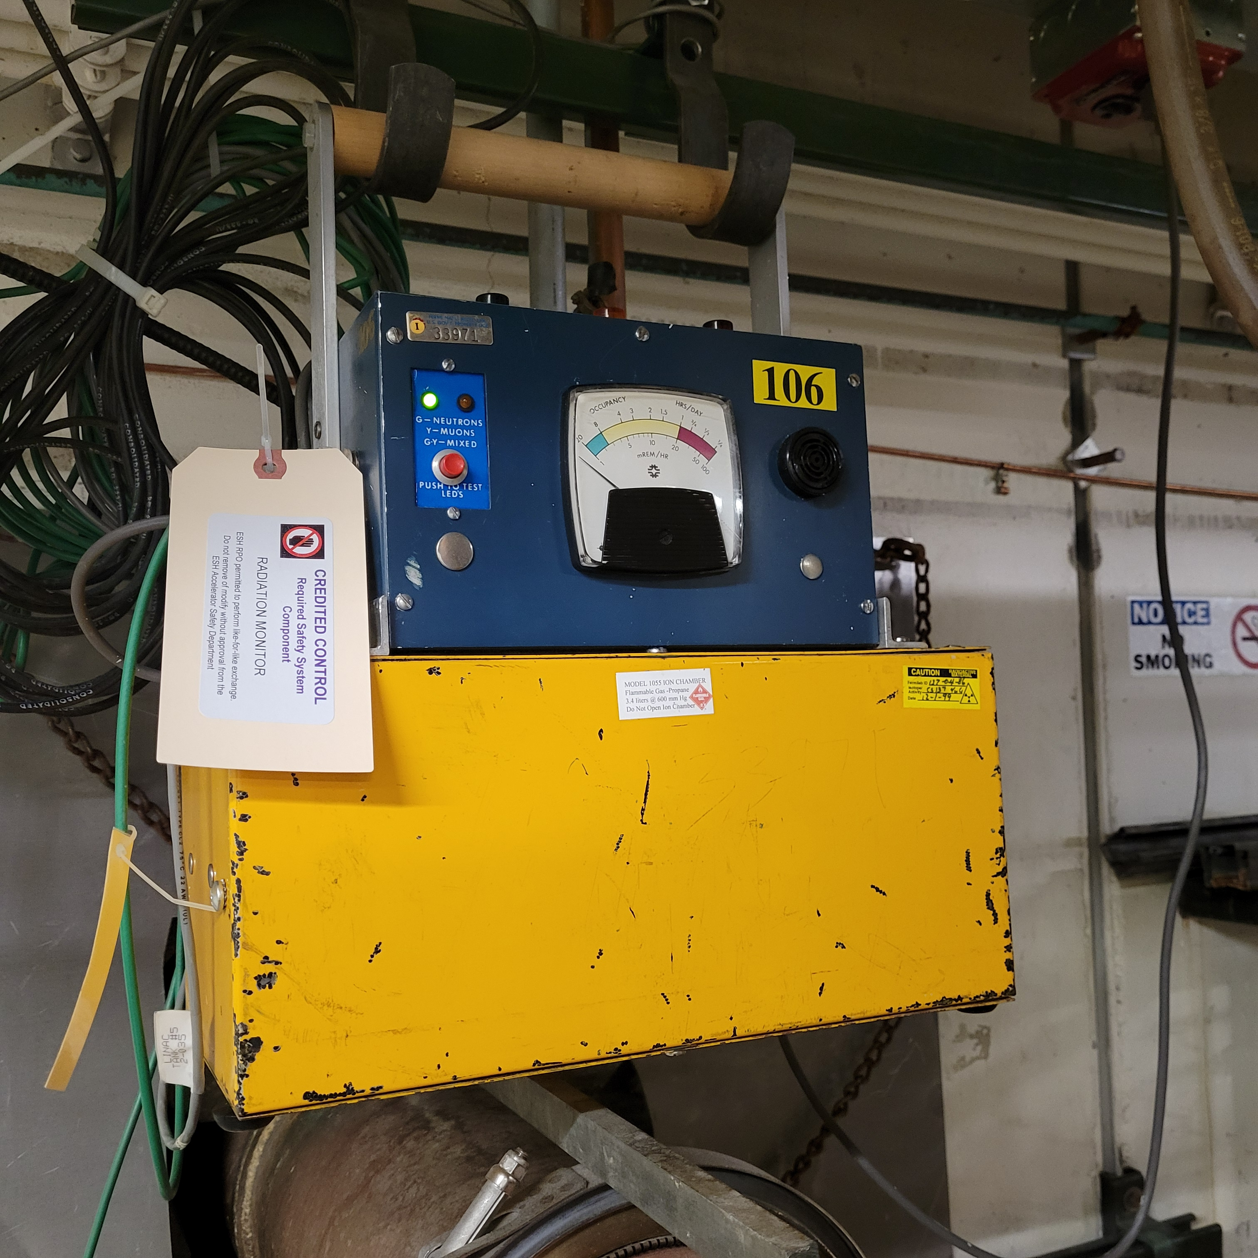
Credited Control Label Examples
Figure 3. Example of label installed on a Credited Control radiation monitor for the Linac segment of the Fermilab Main Accelerator.
01/2024
Malo | Unreviewed Safety Issue (USI) Screener Training

Slide 10
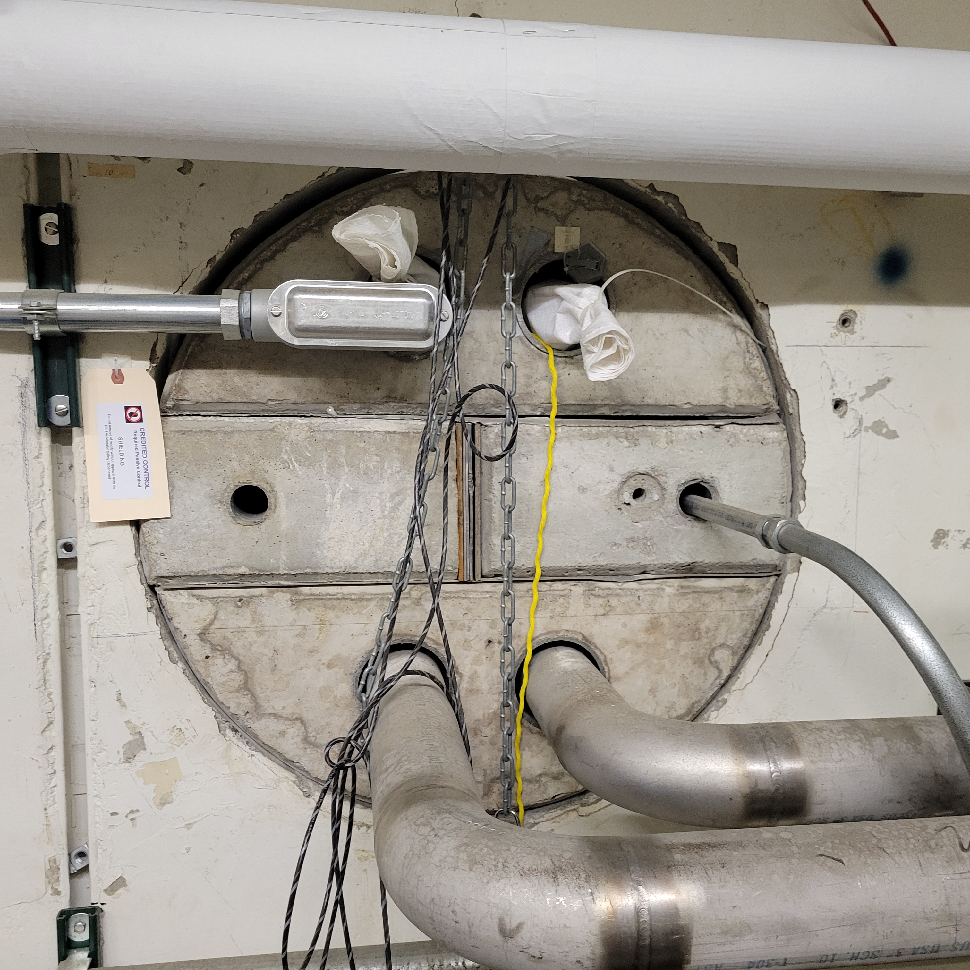
Credited Control Label Examples
Figure 4. Example of labels and configuration method (lock and chain) installed on Credited Control shielding for a penetration in the Linac segment of the Fermilab Main Accelerator.
01/2024
Malo | Unreviewed Safety Issue (USI) Screener Training

Slide 11
Configuration Management
Following a USI:
The assigned RSO responsible for ensuring affected accelerator, or segment, locked off in a safe state using RSO Configuration Control locks
Accelerator, or segment, ensured locked-off prior to removal of Credited Control.
RSO confirms Credited Control is back in place prior to removing RSO Configuration Control lock.
ESH Radiation Physics Operations Department and Accelerator Safety Department utilize Configuration Control Log to track placing affected accelerator, or segment, in a Configuration Controlled off state
Dictates what must be done prior to removing RSO locks
01/2024
Malo | Unreviewed Safety Issue (USI) Screener Training
Notes:
This is what the RSO does following a USI to ensure accelerator/segment remains off if Credited Control is moved/modified during work

Slide 12
USI Screener Training Requirements
USI Screener Requirements
Pre-requisite: Radiological Worker Training
FESHM 2010
Accelerator Safety Envelope (ASE) for applicable accelerator(s)
Unreviewed Safety Issue Program
USI Screening and Evaluation Forms
USI Screener Approval Process
USI Screener Candidate | completes required training
USI Screener Instructor | recommends candidate be approved
Accelerator Safety Department Head | approves USI Screener candidate
01/2024
Malo | Unreviewed Safety Issue (USI) Screener Training

Slide 13
USI Program Overview
USI Program implemented for all Fermilab accelerators
Provides standard approach for reviewing USIs
USI Program required to “evaluate if accelerator specific hazards associated with a proposed activity or discovered condition are adequately addressed by the current SAD and approved ASE.”
Fermilab SAD evaluates accelerator specific hazards to ensure they are maintained at an acceptable level of risk (category III or IV).
If a proposed activity or discovered condition changes level of risk to an unacceptable level of risk (category I or II), that would constitute a condition not previously evaluated and/or addressed in the SAD.
Therefore, USI Process utilized when there is a reasonable chance that an issue could affect the risk of an accident from that evaluated in the SAD
01/2024
Malo | Unreviewed Safety Issue (USI) Screener Training

Slide 14
USI Program Overview
Two types of categories, with examples:
Proposed Activities
New accelerators, segments, experimental areas
Modifications to existing accelerators, segments, experimental areas
Modifications to existing modes or parameters
Planned excavation near accelerator enclosure
Non-editorial modifications to a procedure whose implementation is associated with a Credited Control
Decommissioning activities
Discovered Conditions
Discovery of modification to accelerator, segment, experimental area with hazards beyond those evaluated in SAD or ASE
Discovery of modification to mode and/or parameter that have potential to introduce new accelerator specific hazard or increase consequence of previously evaluated hazard
Discovery of failed or missing Credited Control
Discovery of non-editorial modification to procedure whose implementation is associated with a Credited Control
01/2024
Malo | Unreviewed Safety Issue (USI) Screener Training

Slide 15
Roles and Responsibilities
The following individuals have roles and responsibilities pertinent to the USI process.
Screener
Machine Owner
ESH Division Accelerator Safety Department
ESH Division Accelerator Safety Department Head
Senior Radiation Safety Officer
Chief Safety Officer (CSO)
Directorate/Division Leadership
Fermilab Director
Fermilab DOE Site Office Manager
These roles and responsibilities will be defined in the following slides, and are described in detail in ESH-ASD-0001.
01/2024
Malo | Unreviewed Safety Issue (USI) Screener Training

Slide 16
Roles and Responsibilities
Screener
The screener is an identified Fermilab employee who has received USI Screening training. These individuals are typically members of the ESH Division, accelerator operators, accelerator Machine Owners and their line management. The ESH Accelerator Safety Department Head is responsible for identifying and providing training to USI Screeners, and maintaining a list of qualified Screeners. The Screener is responsible for:
completing the USI Screening Form;
reviewing/signing the USI Screening Form with the Machine Owner.
01/2024
Malo | Unreviewed Safety Issue (USI) Screener Training

Slide 17
Roles and Responsibilities
Machine Owner
The Machine Owner is the Fermilab employee identified as the primary point of contact for an accelerator or segment of an accelerator. This individual has knowledge of the accelerator (or segment of the accelerator) and its associated SAD Chapter(s) and ASE. These individuals are identified either by being appointed by their respective Associate Lab Director (ALD) as a Machine Department Head or the author of the SAD Chapter.
The Machine Owner is responsible for:
reviewing and concurring with the determination of the USI Screening Form;
signing the USI Screening Form with the Screener;
notifying accelerator operators of proposed activities or discovered conditions that warrant USI Evaluation, requesting that accelerator operations to the affected accelerator, or accelerator segment, be suspended immediately and put in a safe and stable condition;
submitting completed USI Screening Forms to the ESH Division Accelerator Safety Department;
completing the USI Evaluation Form, when determined by the USI Screening Form, with the ESH Division Accelerator Safety Department;
notifying accelerator operations of an ASE violation, requesting that accelerator operations to the affected accelerator, or accelerator segment, be suspended immediately and put in a safe and stable condition; and
signing the USI Evaluation Form with the ESH Division Accelerator Safety Department Head.
01/2024
Malo | Unreviewed Safety Issue (USI) Screener Training

Slide 18
Roles and Responsibilities
ESH Division Accelerator Safety Department
The Environment, Safety and Health (ESH) Division Accelerator Safety Department is made up of accelerator safety specialists who have demonstrated familiarity with and ability to interpret DOE O 420.2D, Safety of Accelerators, including the USI Process. The ESH Division Accelerator Safety Department is responsible for:
collecting completed USI Screening Forms;
completing the USI Evaluation Form with the Machine Owner;
processing the USI Evaluation Forms, ensuring all required signatures/approvals are received • providing notification when a USI is identified;
providing notifications when an ASE violation is identified
maintains records of USI Screenings and USI Evaluations, including assigning USI Report Numbers; and
ensuring identified personnel are adequately trained in the USI Program.
01/2024
Malo | Unreviewed Safety Issue (USI) Screener Training

Slide 19
Roles and Responsibilities
ESH Division Accelerator Safety Department Head
The ESH Division Accelerator Safety Department Head is responsible for:
maintaining the USI Program
identifying and providing training to USI Screeners
maintaining a list of qualified Screeners
reviewing the USI Program and recommending approval of the USI Program to the Fermilab Director;
promptly (within one business day) notifying DOE upon discovery of conditions with the credible potential to introduce accelerator specific hazards that are not adequately addressed by the current SAD and approved ASE; and
reviewing and signing the USI Evaluation Form with the Machine Owner.
01/2024
Malo | Unreviewed Safety Issue (USI) Screener Training

Slide 20
Roles and Responsibilities
Senior Radiation Safety Officer (SRSO)
The Fermilab Senior Radiation Safety Officer (SRSO) is responsible for:
reviewing the USI Program and recommending approval of the USI Program to the Fermilab Director;
approving USI Evaluation Forms with radiological accelerator-specific findings when a USI is identified; and
determining whether a USI with radiological accelerator-specific findings warrants further reporting, including possible Occurrence Reporting and Processing System (ORPS) and Noncompliance Tracking System (NTS) reporting.
01/2024
Malo | Unreviewed Safety Issue (USI) Screener Training

Slide 21
Roles and Responsibilities
Chief Safety Officer (CSO)
The Fermilab Chief Safety Officer (CSO) is responsible for:
reviewing the USI Program and recommending approval of the USI Program to the Fermilab Director;
approving USI Evaluation Forms with oxygen deficiency hazard (ODH) accelerator-specific findings and/or non-accelerator specific (NASH) findings when a USI is identified; and
determining whether a USI with ODH findings and/or NASH findings warrants further reporting, including possible Occurrence Reporting and Processing System (ORPS) and Noncompliance Tracking System (NTS) reporting.
01/2024
Malo | Unreviewed Safety Issue (USI) Screener Training

Slide 22
Roles and Responsibilities
Directorate/Division Leadership
The Directorate Associate Lab Directors and Division Senior Directors who operate accelerators are responsible for:
reviewing the USI Program and recommending approval of the USI Program to the Fermilab Director.
Fermilab Director
The Fermilab Director is responsible for:
Approving the USI Program;
Approving commencing/resuming operations following a USI that affects the SAD;
Approving commencing/resuming operations following a USI that affects an ASE; and approving resuming operations following an ASE violation.
01/2024
Malo | Unreviewed Safety Issue (USI) Screener Training

Slide 23
Roles and Responsibilities
Fermilab DOE Site Office Manager
The Fermilab DOE Site Office Manager (i.e., the DOE Field Element Manager) is responsible for:
Approving the USI Program;
Approving commencing/resuming operations following a USI that affects an ASE; and
Approving resuming operations following an ASE violation
01/2024
Malo | Unreviewed Safety Issue (USI) Screener Training

Slide 24
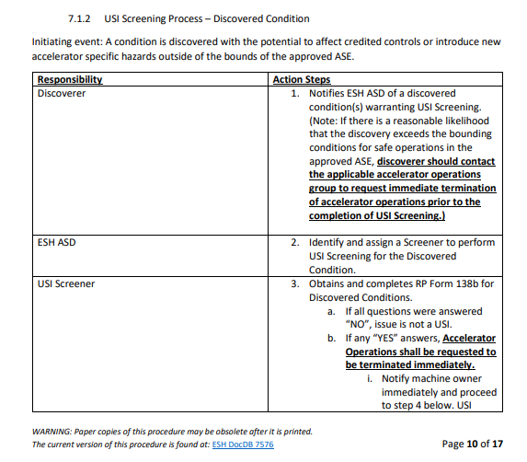
Notifications
Various notifications are required throughout the Screening, Evaluation & Determination Steps.
These are to be performed as dictated by ESH-ASD-0001, USI Process Implementation Procedure.
Example of notifications and required actions from ESH-ASD-0001.
01/2024
Malo | Unreviewed Safety Issue (USI) Screener Training

Slide 25
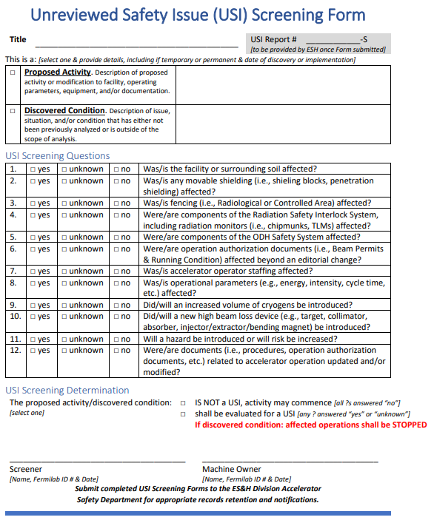
USI Program Steps
1. Screening
Performed by a Screener
Screeners – members of ESH Division, accelerator operations, accelerator Machine Owners and line management who has received USI Screening training
Uses USI Screening Form
Answer series of questions to determine if proposed activity or discovered condition should be formally evaluated using USI Evaluation Process
Possible Outcomes: is not a USI, or shall be evaluated for a USI
If discovered condition determined to need USI Evaluation, affected accelerator operations is terminated
USI Screening Form signed by Screener and Machine Owner, submitted to ESH Accelerator Safety Dept for records retention.
01/2024
Malo | Unreviewed Safety Issue (USI) Screener Training

Slide 26
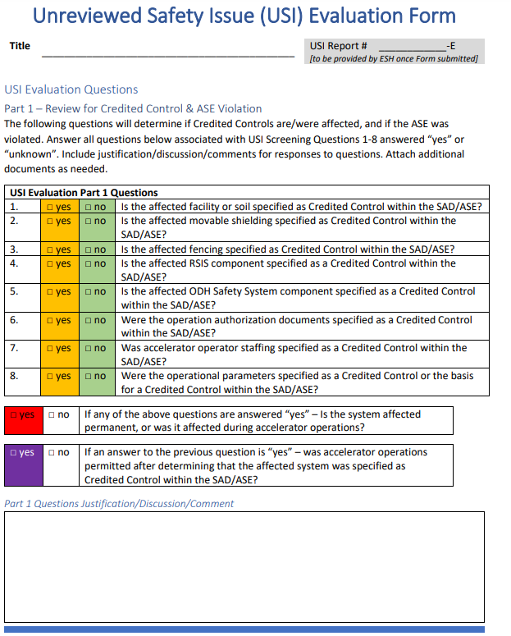
USI Program Steps
2. Evaluation & Determination
Completed by the Machine Owner and the ESH Accelerator Safety Department
USI Evaluation Form used as deemed necessary by USI Screening Form
Asks a series of more detailed questions related to question in the USI Screening Form
Determines if proposed activity is or is not a USI, and what levels of approvals are necessary for USIs
Color coded for ease of determination
01/2024
Malo | Unreviewed Safety Issue (USI) Screener Training

Slide 27
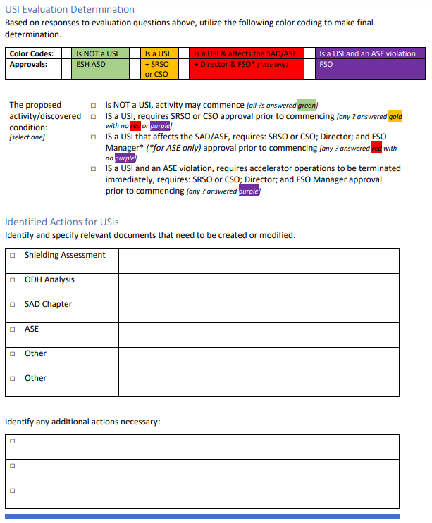
USI Program Steps
3. Evaluation & Determination
Possible outcomes:
Not a USI
Is a USI
Is a USI that affects the SAD or ASE
Is a USI and ASE violation
Form includes space to identify actions for USIs
Actions are determined by Machine Owner in consultation with ESH ASD in the Evaluation phase here.
01/2024
Malo | Unreviewed Safety Issue (USI) Screener Training

Slide 28
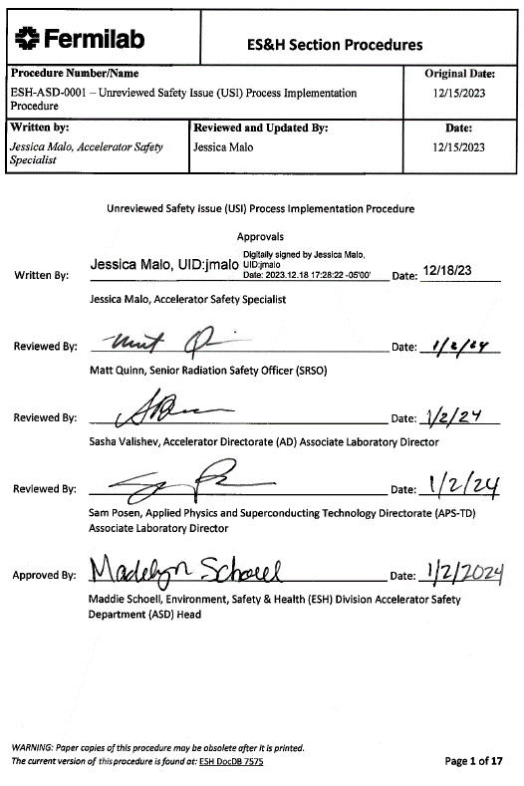
USI Program Steps per ESH-ASD-0001, USI Process Implementation Procedure
4. Evaluation & Determination
Approvals to implement proposed activity or resume operations following a discovered condition:
All issues: Machine Owner and ESH Accelerator Safety Dept Head
All Issues Determined to be USIs: SRSO or CSO
All Issues that affect SAD: Director
All Issues that affect the ASE: Director and FSO Manager
All Issues found to have violated the ASE: requires FSO Manager
Submitted to ESH Accelerator Safety Department for records retention
01/2024
Malo | Unreviewed Safety Issue (USI) Screener Training

Slide 29
ASE violation and required actions
All USIs found to have violated the ASE must follow the ASE Violation response action items specified in the ASE.
Fermilab DOE Site Office Manager approval is required prior to resuming operations following an ASE violation.
Note: Accidental violations may occur due to acts of nature (e.g. sinkholes). This is a risk deemed acceptable by the laboratory. ASE violations due to acts of nature do not reflect non-compliant operatoional practices, but the Discoverer must follow required notification actions per ESH-ASD-0001 upon discovery.
01/2024
Malo | Unreviewed Safety Issue (USI) Screener Training

Slide 30
USI Program Steps
5. Records
All completed USI Screening and USI Evaluation Forms are submitted to the ESH Division Accelerator Safety Department for records retention
Assigns USI report numbers
ESH Accelerator Safety Department submits electronic copies of all USI Evaluation Forms to the FSO Facility Representative
01/2024
Malo | Unreviewed Safety Issue (USI) Screener Training

Slide 31
USI Program Flowchart
01/2024
Malo | Unreviewed Safety Issue (USI) Screener Training

Slide 32
References
DOE O 420.2D, Safety Of Accelerators
Fermilab Safety Assessment Document
Fermilab Unreviewed Safety Issue (USI) Program
ESH-ASD-0001, USI Process Implementation Procedure
FESHM
01/2024
Malo | Unreviewed Safety Issue (USI) Screener Training

