Slide 1
Safety Assessment Document Updates for DOE O 420.2D
SAD Section III Chapter 04 - Booster
Salah Chaurize
Booster Internal Readiness Review
9 January 2024

Slide 2
Outline
Booster Overview
Hazard Inventory
Non-Accelerator Specific Hazards
Accelerator Specific Hazards
Maximum Credible Incident (MCI) Discussion
Summary of Credited Controls
Summary of Defense in Depth Controls

Slide 3
Outline
Booster Overview
Hazard Inventory
Non-Accelerator Specific Hazards
Accelerator Specific Hazards
Maximum Credible Incident (MCI) Discussion
Summary of Credited Controls
Summary of Defense in Depth Controls

Slide 4
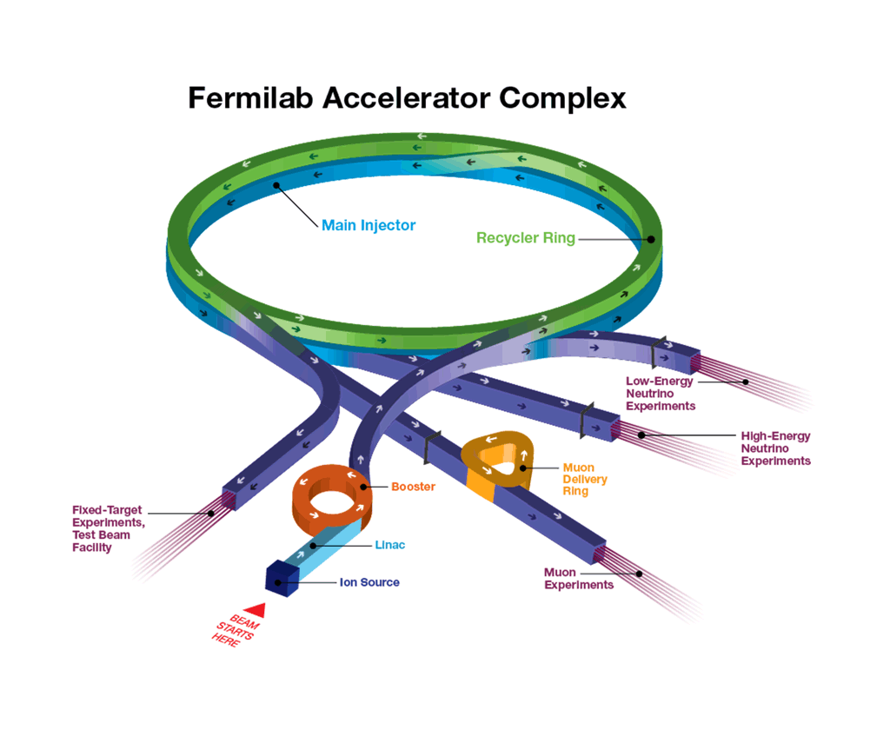
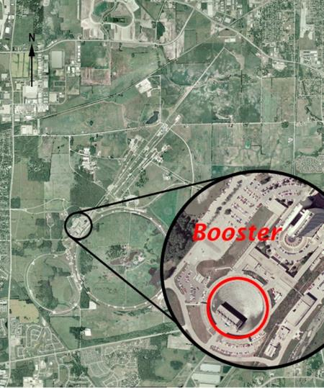
Booster Overview
Booster is a 15Hz alternating gradient Proton Synchrotron that accelerates beam received from the Linac at 400 MeV to 8 GeV.
Booster has an average radius of 75.5 meters.
The FOFDOOD lattice consists of 96 combined function magnets that bend and focus the beam through the 33ms beam cycle.

Slide 5
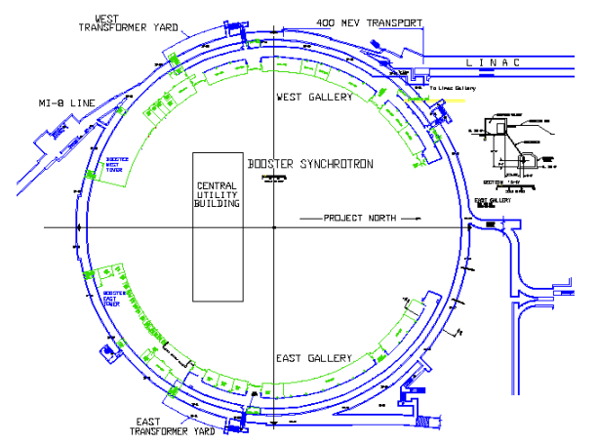
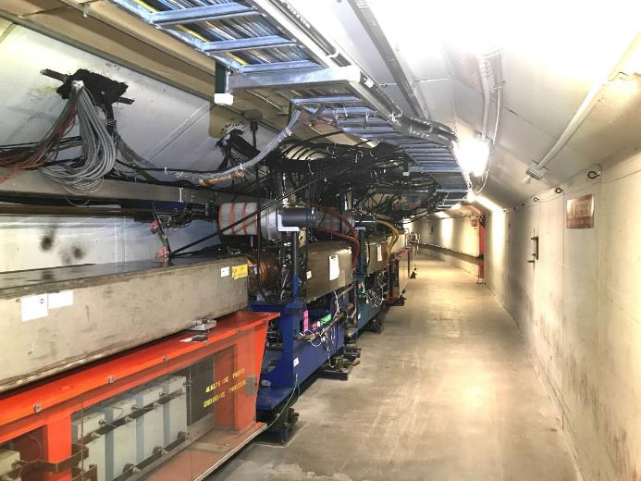
Booster Overview
Transfer Hall
Booster Gradient Magnet and RF cavities
The resonant magnet system ramps down for the remaining 33ms to accept beam once again as needed completing a 66ms machine cycle.
This constitutes the 15Hz mode of operation.
22 RF cavities are available to capture and accelerate beam from injection to extraction sweeping from 37 to 52Mhz.

Slide 6
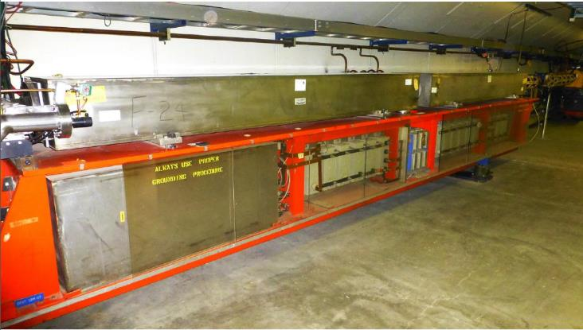
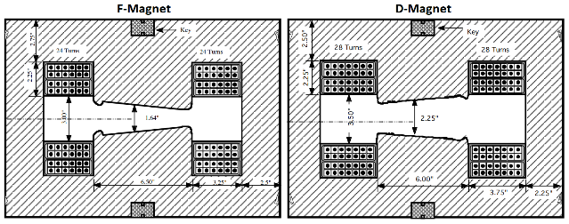
Booster Overview
The Booster enclosure consists of a 10ft wide by 8ft high tunnel enclosure below grade.
48 magnet girders, 25 ft long, support two combined function magnets, 10ft. long each.
D Magnet
F Magnet
Choke

Slide 7
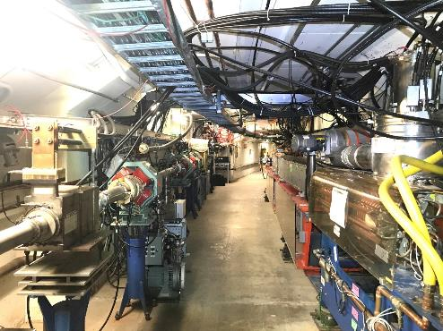
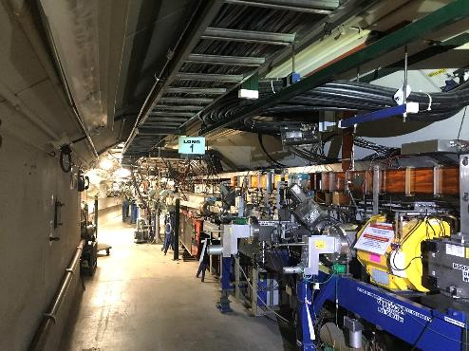
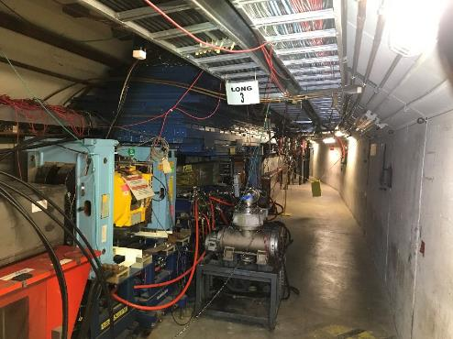
Booster Overview
Booster 400 MeV Booster Ring
Booster Injection Girder
H- Beam is injected from Linac in a multi-turn fashion via the 400 MeV line into Booster.
Beam is captured, accelerated and extracted to the Booster beam absorber or downstream MI8 beam line and other complex segments.
Booster Extraction

Slide 8
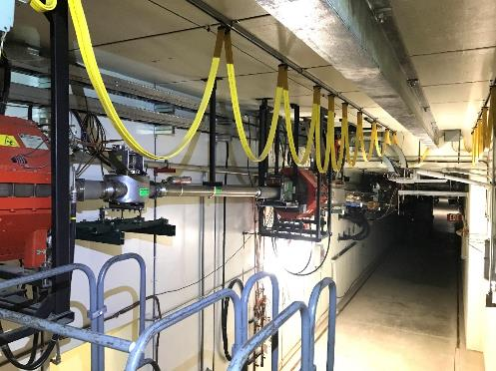
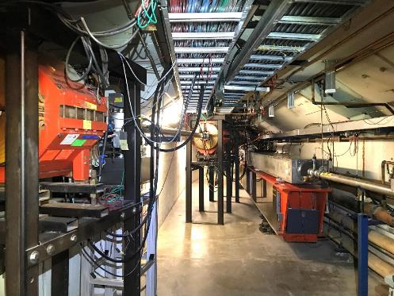
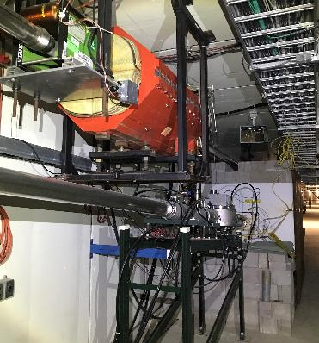
Booster Overview
These images show the two possible extraction areas for Booster beam at 8 GeV:
Booster Beam Absorber
MI8 Line segment.
Downstream segments are discussed further in SAD Section 1
Booster MI8 Line to Booster Absorber or MI8 Transfer Line to Downstream Accelerator Segments
Booster MI8 Line to Accelerator Segments
Booster Beam Absorber
Booster MI8 Line Booster Ring

Slide 9
Outline
Booster Overview
Hazard Inventory
Non-Accelerator Specific Hazards
Accelerator Specific Hazards
Maximum Credible Incident (MCI) Discussion
Summary of Credited Controls
Summary of Defense in Depth Controls

Slide 10
Hazard Inventory for Booster
Accelerator specific hazards are purple
Hazards not discussed today are evaluated via the common Risk Matrix tables
Covered in SAD Section I, Chapter 4
Hazards evaluated via risk assessment methodology per DOE-HDBK-1163-2020
Likelihood (L):
Anticipated (A), Unlikely (U), Extremely Unlikely (EU), Beyond Extremely Unlikely (BEU)
Consequence (C):
High (H), Moderate (M), Low (L), Negligible (N)
Risk (R):
I , II, III, IV (descending order of concern)

Slide 11
Outline
Booster Overview
Hazard Inventory
Non-Accelerator Specific Hazards
Accelerator Specific Hazards
Maximum Credible Incident (MCI) Discussion
Summary of Credited Controls
Summary of Defense in Depth Controls

Slide 12
Non-Accelerator Specific Hazards - Radiological
Residual Activation
High intensity beam delivery will produce activated materials inside the Booster enclosure.
The residual dose rate found in the Booster from initial entry surveys is historically less than 50 mrem/hr, exceptions include:
< 100 mrem at Injection, Collimation and Extraction HRA areas
Hazard applies to onsite facility workers and onsite co-located workers
Baseline Qualitative Risk (without controls) | Controls Preventive (P)/Mitigative (M) | Residual Qualitative Risk (with controls)
L: A C: H R: I | P – Employee Rad Worker training P – ALARA plan M – Shielding to reduce activation M – Proper dosimetry | L: EU C: L R: IV

Slide 13
Non-Accelerator Specific Hazards - Radiological
Radioactive Waste
Radioactive waste produced during Booster operations will be managed within the established Radiological Protection Program (RPP) as prescribed in the Fermilab Radiological Control Manual (FRCM)
Hazard applies to onsite facility workers and onsite co-located workers
Baseline Qualitative Risk (without controls) | Controls Preventive (P)/Mitigative (M) | Residual Qualitative Risk (with controls)
L: A C: H R: I | P – Postings P – Beam tuned to reduce beam loss M – Shielding to reduce generation of waste M – Material survey and release process | L: EU C: L R: IV

Slide 14
Non-Accelerator Specific Hazards - Radiological
Contamination
Areas of contamination likelihood are marked and typically limited to HRA areas of the enclosure.
Low levels of Beryllium 7 have been detected.
Hazard applies to onsite facility workers and onsite co-located workers
Baseline Qualitative Risk (without controls) | Controls Preventive (P)/Mitigative (M) | Residual Qualitative Risk (with controls)
L: A C: H R: I | P – Radiological controls personnel survey and decontamination P – Postings placed in the event contamination is identified M – Shielding to reduce generation of waste M – Material survey and release process | L: EU C: L R: IV

Slide 15
Non-Accelerator Specific Hazards – Radiological
Ground/Surface Water Activation
Booster tunnel sump system discharges water into the CUB pond to contain possible traces of tritium or other accelerator generated isotopes. ESH performs period sampling.
MARS calculations show that the water activation caused by Booster are low and can be managed by monitoring and sump discharge to the CUB retention pond.
Hazard applies to onsite facility workers and onsite co-located workers
Baseline Qualitative Risk (without controls) | Controls Preventive (P)/Mitigative (M) | Residual Qualitative Risk (with controls)
L: A C: H R: I | P – Beam loss monitoring. P – ESH periodic sump well water sampling M – Sumps discharge into CUB pond M – Shielding in High Loss areas M – Machine Design | L: BEU C: H R: IV

Slide 16
Non-Accelerator Specific Hazards – Radiological
Soil Interaction
Booster soil study samples contain traces of ³H and ²²Na
MARS Simulations and sump water monitoring indicate levels are negligible.
Hazard applies to onsite facility workers and onsite co-located workers
Baseline Qualitative Risk (without controls) | Controls Preventive (P)/Mitigative (M) | Residual Qualitative Risk (with controls)
L: A C: H R: I | P – Beam loss monitoring. P – ESH periodic sump well water sampling M – Sumps discharge into CUB pond M – Shielding in High Loss areas | L: BEU C: H R: IV

Slide 17
Non-Accelerator Specific Hazards - Radiological
Non-Ionizing Radiation – Radio-Frequency (RF)
Potential Hazardous levels of RF electromagnetic energy are generated by the RF power source in the Booster 400 MeV Line 805 MHz RF Cavity.
Hazard applies to onsite facility workers, onsite co-located workers.
Baseline Qualitative Risk (without controls) | Controls Preventive (P)/Mitigative (M) | Residual Qualitative Risk (with controls)
L: A C: M R: II | P – RF Shielding P – ES&H periodic monitoring P – LOTO procedure P – Affected area postings | L: BEU C: M R: IV

Slide 18
Non-Accelerator Specific Hazards - Radiological
Non-Ionizing Radiation - Laser
There is a Class IV Nd:YAG (neodymium-doped yttrium aluminum garnet) laser in the downstream end of the 400 MeV line. The laser is part of the Laser Profile Monitor (LPM).
This system is currently not in use.
Hazard applies to onsite facility workers and onsite co-located workers
Baseline Qualitative Risk (without controls) | Controls Preventive (P)/Mitigative (M) | Residual Qualitative Risk (with controls)
L: A C: H R: I | P – Class 1 (light tight) enclosures P – ORC and work planning processes P – Locked/Interlocked system P – LOTO procedure or other procedure approved by the laser safety officer (LSO) P – Affected areas are posted M – Use of PPE | L: BEU C: M R: IV

Slide 19
Non-Accelerator Specific Hazards - Electrical
Stored Energy Exposure
Pulsed Magnet systems could have stored energy in the capacitors and PFN.
Hazard applies to onsite facility workers and onsite co-located workers
Baseline Qualitative Risk (without controls) | Controls Preventive (P)/Mitigative (M) | Residual Qualitative Risk (with controls)
L: A C: M R: II | P – Stored capacitors with terminals grounded P – Procedures to for LOTO of equipment. P – Electrical worker training | L: BEU C: M R: IV

Slide 20
Non-Accelerator Specific Hazards - Electrical
Low Voltage, High Current Exposure
Booster Pulsed systems and RF Bias Supplies operate with high current.
Hazard applies to onsite facility workers and onsite co-located workers
Baseline Qualitative Risk (without controls) | Controls Preventive (P)/Mitigative (M) | Residual Qualitative Risk (with controls)
L: U C: H R: I | P – Insulating guards/closed cabinets prevent incidental contact P – Electrical worker training M – Overcurrent protection | L: BEU C: M R: IV

Slide 21
Non-Accelerator Specific Hazards – Magnetic Fields
Fringe Fields
Powered and permanent magnets produce fringe fields that can be hazardous to people who have medical implants.
Hazard applies to onsite facility workers and onsite co-located workers
Baseline Qualitative Risk (without controls) | Controls Preventive (P)/Mitigative (M) | Residual Qualitative Risk (with controls)
L: A C: H R: I | P – Work planning that warns about magnetic hazard P – Magnetic hazard warning part of hazard specification sheet P – Postings of magnetic field hazard at entry points | L: BEU C: H R: III

Slide 22
Non-Accelerator Specific Hazards – Confined Space
Confined Space
The 400 MeV Chute between Linac and Booster is designated as a confined space. This requires specific training, procedures and work support planning if access is required.
Hazard applies to onsite facility workers and onsite co-located workers
Baseline Qualitative Risk (without controls) | Controls Preventive (P)/Mitigative (M) | Residual Qualitative Risk (with controls)
L: A C: H R: I | P – Work planning that for Confined space access and work activity. P – Postings of Confined space. P - ESH coordination for Access to Chute M – Coordination/notification for Fire Dept M – Training and Air monitoring equipment and documentation. | L: BEU C: H R: III

Slide 23
Outline
Booster Overview
Hazard Inventory
Non-Accelerator Specific Hazards
Accelerator Specific Hazards
Maximum Credible Incident (MCI) Discussion
Summary of Credited Controls
Summary of Defense in Depth Controls

Slide 24
Accelerator Specific Hazards - Radiological
Prompt Ionizing Radiation – RF
805 MHz RF power sources for the accelerating cavity can be an X-ray producing source.
Hazard applies to onsite facility workers, onsite co-located workers
Baseline Qualitative Risk (without controls) | Controls Preventive (P)/Mitigative (M) | Residual Qualitative Risk (with controls)
L: A C: M R: II | P – Proper operation of equipment P – System is disabled during Booster access M – Shielding M – ESH gallery radiation surveys | L: A C: N R: IV

Slide 25
Outline
Booster Overview
Hazard Inventory
Non-Accelerator Specific Hazards
Accelerator Specific Hazards
Maximum Credible Incident (MCI) Discussion
Summary of Credited Controls
Summary of Defense in Depth Controls

Slide 26
Maximum Credible Incident (MCI) – Radiological
The MCI focuses on exposure to an onsite worker, an onsite coworker. and the maximally exposed off-site individual (MOI)
The MCI reflects theoretical accident scenarios for the Fermilab Booster requiring many unlikely conditions to be met to establish a higher than normal beam intensity and subsequent beam loss.
• Fermilab uses Credited Controls that flow down to the Accelerator Safety Envelope (ASE) to mitigate the consequences of an MCI to the following conditions:
Less than 5 rem in one hour in any area accessible by facility workers or co-located workers
Less than 500 mrem in one hour in all Laboratory areas to which the public is assumed to be excluded
Less than 100 mrem in one hour at Fermilab’s site boundary and/or in any areas onsite in which the public is authorized (which includes Batavia Road, Prairie Path, parking lots open to the public, and general access areas including Wilson Hall, Ramsey Auditorium)

Slide 27
Maximum Credible Incident (MCI) – Radiological
The MCI focuses on exposure to an onsite worker, an onsite coworker. and the maximally exposed off-site individual (MOI)
The MCI reflects theoretical accident scenarios for the Fermilab Booster requiring many unlikely conditions to be met to establish a higher than normal beam intensity and subsequent beam loss.
• Fermilab uses Credited Controls that flow down to the Accelerator Safety Envelope (ASE) to mitigate the consequences of an MCI to the following conditions:
Less than 5 rem in one hour in any area accessible by facility workers or co-located workers
Less than 500 mrem in one hour in all Laboratory areas to which the public is assumed to be excluded
Less than 100 mrem in one hour at Fermilab’s site boundary and/or in any areas onsite in which the public is authorized (which includes Batavia Road, Prairie Path, parking lots open to the public, and general access areas including Wilson Hall, Ramsey Auditorium)

Slide 28
Maximum Credible Incident (MCI) – Radiological
The MCI for the Fermilab Booster looks at beam injected and not captured at 400 MeV as well as the theoretical maximum that can be captured. We also look at the maximum that could be accelerated and extracted at 8 GeV.
MCI intensities is the theoretical maximum the machine could produce and is a product of the following parameters:
35 mA beam from Linac
15 Hz repetition rate
Design Limit of Booster
60 µs beam pulse length
Multiturn maximum based on Injection bump magnet PFN
Based on MCI parameters above, below are the beam intensities expected at 15Hz for 1 hour:
Beam intensity at 400 MeV injected but not circulating:
7E17 protons/hr
Beam intensity at 400 MeV injected and circulating:
5.4E17 protons per hour (Intensity reduced due to RF bucket size limitation)
Beam intensity extracted or lost at 8 GeV:
3.8E17 protons per hour (Intensity reduced due to efficiency (5.4E17 * 0.7) limitation and RF Beam Loading caused by Robinson Instabilities)
Assuming no shielding or other controls are present, this incident would result in a dose to any individual higher than 8M rem.

Slide 29
Outline
Booster Overview
Hazard Inventory
Non-Accelerator Specific Hazards
Accelerator Specific Hazards
Maximum Credible Incident (MCI) Discussion
Summary of Credited Controls
Shielding Assessment Discussion
Summary of Defense in Depth Controls

Slide 30
Credited Controls – Passive
Permanent Shielding
12.5 efd minimum shielding is present.
Movable Shielding
Concrete block wall between Linac and the 400 MeV chute.
Concrete block wall separating the Booster enclosure from the Transfer Hall enclosure.
Labyrinth passage concrete blocks
Penetration Shielding
The Booster enclosure has 192 penetrations of which 172 are filled with a combination of accelerator components and poly-beads to complete the necessary shielding.
Not all penetrations require shielding due to their specific geometry.

Slide 31
Credited Controls – Active Engineering
Credited Control: Radiation Safety Interlock System (RSIS)
Inhibits beam by controlled redundant critical devices
Enforces the search and secure process
Interlocked doors are present at all access points into the Booster enclosure
Includes interlocked radiation detectors which protect individuals by disabling beam should prompt radiation from operations exceed specific dose rates
The ES&H Radiation Physics Engineering Dept. (RPE) ensures that all requirements for hardware and system testing are completed semi-annually with a four-month grace period
RPE also verifies the inventory of interlock keys and updates procedures for maintenance and testing of interlock systems
All RSIS are designed, installed and configuration managed in conformance with the requirements of the Fermilab Radiological Control Manual (FRCM)

Slide 32
Credited Controls – Active Engineering
Interlocked Radiation Detectors
All interlocked detectors are calibrated on an annual basis
For areas that do not have adequate permanent shielding these detectors are used to protect an individual outside of the shielding
ES&H RPE Interlock group also installs, tests & maintains all interlocked detectors

Slide 33
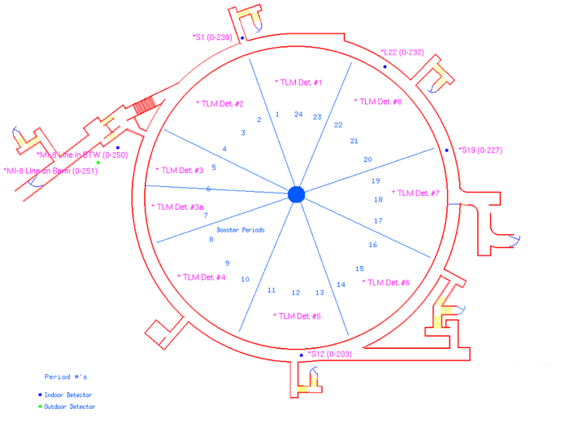
Credited Controls – Active Engineering
Type | Location | CC Limit mrem/hr)
Chipmunk | Booster East Fan Room (Short 12) | 490
Chipmunk | Booster Crossover at CUB (Short 19) | 490
Chipmunk | Booster/Line W Gal Intersect (Long 22) | 235
Chipmunk | Booster Per 1 Exit Stairwell (Short 1) | 490
Chipmunk | MI-8 Line in WBT (12’ US of Buttress) | 39
Chipmunk | MI-8 Line on Berm (WBT) | 490
TLM | BSTR TLM1 Per 23, 24, 1 | 10000 nC/min
TLM | BSTR TLM2 Per 2, 3, 4 | 10000 nC/min
TLM | BSTR TLM3 Per 5, 6 | 10000 nC/min
TLM | BSTR TLM4 Per 8, 9, 10 | 10000 nC/min
TLM | BSTR TLM5 Per 11, 12, 13 | 10000 nC/min
TLM | BSTR TLM6 Per 14, 15, 16 | 10000 nC/min
TLM | BSTR TLM7 Per 17, 18, 19 | 10000 nC/min
TLM | BSTR TLM8 Per 20, 21, 22 | 10000 nC/min
TLM | BSTR TLM3a Per 6, 7 | 10000 nC/min
Interlocked Radiation Detectors
Booster does not have sufficient shielding for normal or MCI intensities
Interlocked radiation detectors are required.
The credited control trip limits for these interlocked radiation detectors are sufficient to protect against the MCI.
These are maximum values, not the levels at which we operate
Operational trip levels are set by the Radiation Physics Operations Department (RPO).

Slide 34
Credited Controls - Administrative
Credited Control: Operation Authorization Document
Machine Beam Permit
Machine Run Condition
Beam will not be transported through Booster without approval of these documents
Credited Control: Staffing
Ensures operations within bounding conditions specified in Operation Authorization Document
The following staffing shall be in place during applicable beam operation:
At least one member of the AD Operations Department who has achieved the rank of Operator II or higher shall be on duty and on site.
At least one member of the AD Operations Department shall be present in the Main Control Room (MCR).
Note: these requirements could be satisfied by a single person
Credited Control: Accelerator Operating Parameters
The MCI intensity of 3.8E17 protons/hr shall not be exceeded at 8GeV

Slide 35
Outline
Booster Overview
Hazard Inventory
Non-Accelerator Specific Hazards
Accelerator Specific Hazards
Maximum Credible Incident (MCI) Discussion
Summary of Credited Controls
Summary of Defense in Depth Controls

Slide 36
Defense in Depth Controls
Machine Protection Controls
The Booster Accelerator is protected by
beam position and loss monitors
Vacuum, magnet, power supply and RF systems monitoring
These systems would disable beam for typical failures or poor quality beam within a few beam cycles.
Fencing and Posting
Select Booster berm areas are posted for ALARA purposes.
Training
Personnel accessing the Booster berm and enclosure must have Radiological Worker Training.
Procedures
FESHM 2100 requires all departmental procedure to be reviewed, re-approved and re-taught every twelve months.

Slide 37
Questions?

Slide 38
Back

Slide 39
C.Y Tan

Slide 40
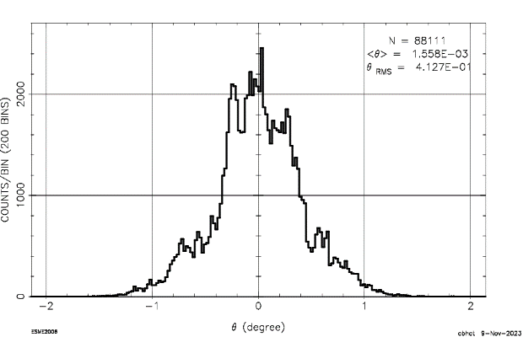
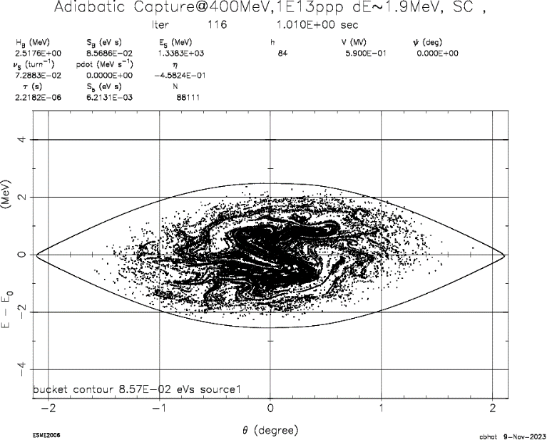
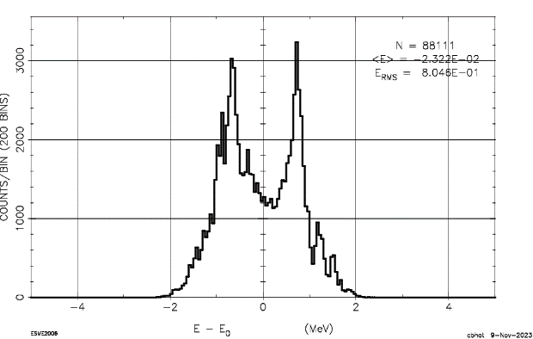
1E13 ppp in Booster
Line charge distribution of a single bunch
dE-dTheta-phase space
Energy Projection
This looks not that good: A few particles are on RF bucket separatrix
C. Bhat

