Slide 1
Safety Assessment Document Updates for DOE O 420.2D
SAD Section III Chapter 05 – 8-GeV Line
Martin Murphy
8-GeV Line SAD Internal Readiness Review
09 January 2024

Slide 2
Outline
8-GeV Line Overview
Hazard Inventory
Non-Accelerator Specific Hazards
Accelerator Specific Hazards
Maximum Credible Incident (MCI) Discussion
Summary of Credited Controls
Summary of Defense in Depth Controls

Slide 3
Outline
8-GeV Line Overview
Hazard Inventory
Non-Accelerator Specific Hazards
Accelerator Specific Hazards
Maximum Credible Incident (MCI) Discussion
Summary of Credited Controls
Summary of Defense in Depth Controls

Slide 4
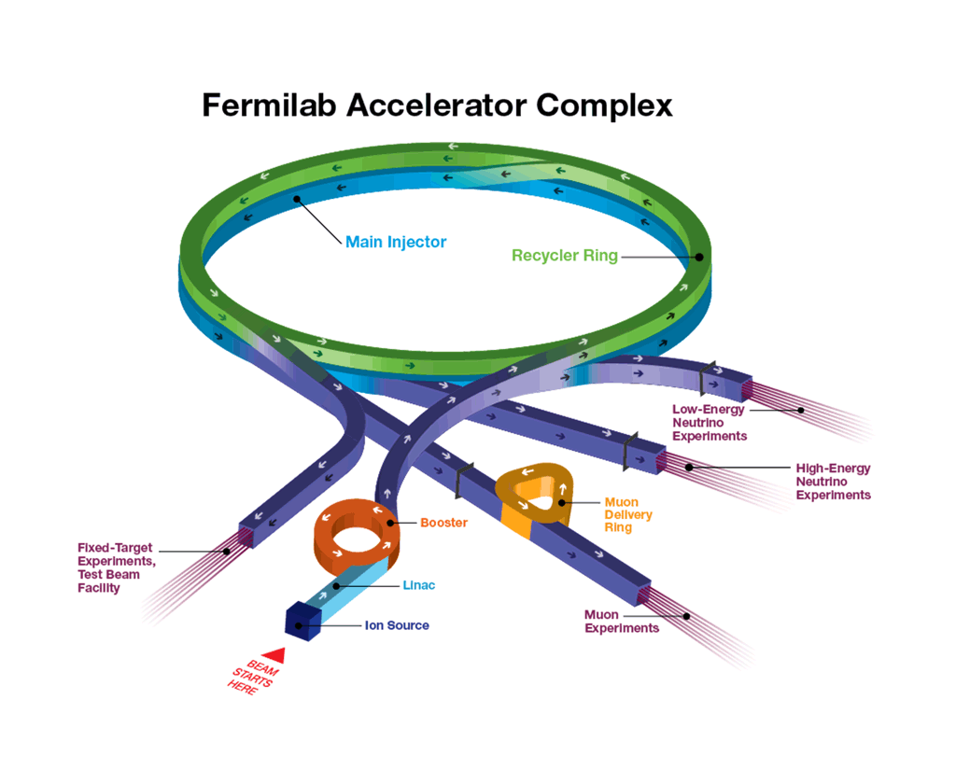
8-GeV Line Overview
Cartoon showing 8-GeV in the overall Fermilab accelerator complex.

Slide 5
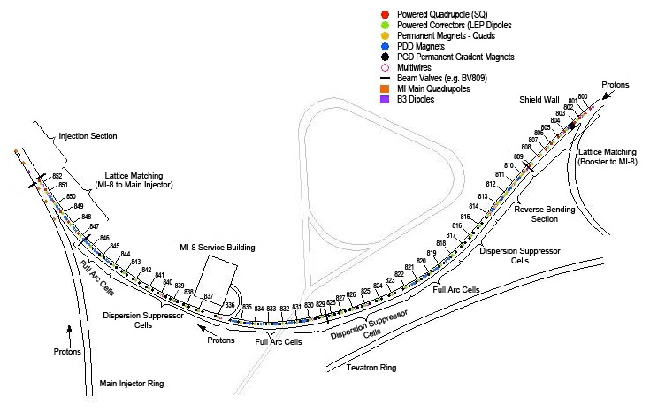
8-GeV Line Overview
The 8-GeV Line is designed to transmit protons from the Booster accelerator to the Main Injector, Recycler or Booster Neutrino Beamline (BNB).
The beam energy is fixed at 8-GeV.
Comprised of permanent (combined function) magnets.
The physical beam line extends 680 meters from the Booster tunnel to the MI-10 enclosure.
Interlocked Gate
at Cell 810
Interlocked Gate
at Cell 842

Slide 6
8-GeV Line Overview
The 8-GeV Line segment starts at the interlocked gate at Cell 810 and ends in the MI10 enclosure:
Cell 852 for Main Injector injection,
Cell 853 for Recycler injection,
Cell 860 for BNB operation.
There are two bifurcation points where beam is sent to one path or another (RR/BNB/MI).
Portions of the physical 8-GeV Line upstream of cell 810 are in the Booster radiation enclosure and as such are included in the Booster SAD chapter.

Slide 7
8-GeV Line Overview – Beam to Recycler

Slide 8
8-GeV Line Overview – Beam to BNB
BNB Switch magnet

Slide 9
8-GeV Line Overview – Beam to Main Injector

Slide 10
Outline
8-GeV Line Overview
Hazard Inventory
Non-Accelerator Specific Hazards
Accelerator Specific Hazards
Maximum Credible Incident (MCI) Discussion
Summary of Credited Controls
Summary of Defense in Depth Controls

Slide 11
Hazard Inventory for 8-GeV
Radiological |  | Toxic Materials
☒ | Prompt Ionizing Radiation | ☒ | Lead Shielding
☒ | Residual Activation | ☐ | Beryllium
☒ | Groundwater Activation | ☐ | Fluorinert & Its Byproducts
☒ | Surface Water Activation | ☐ | Liquid Scintillator Oil
☐ | Radioactive Water (RAW) Systems | ☐ | Pseudocumene
☒ | Air Activation | ☐ | Ammonia
☐ | Closed Loop Air Cooling | ☐ | Nanoparticle Exposures
☒ | Soil Interactions | Flammables and Combustibles
☒ | Radioactive Waste | ☒ | Combustible Materials (e.g., cables, wood cribbing, etc.)
☒ | Contamination | ☒ | Flammable Materials (e.g., flammable gas, cleaning materials, etc.)
☒ | Beryllium-7 | Electrical Energy
☐ | Radioactive Sources | ☒ | Stored Energy Exposure
☐ | Nuclear Material | ☒ | High Voltage Exposure
☐ | Radiation Generating Devices (RGDs) | ☒ | Low Voltage, High Current Exposure
☐ | Non-Ionizing Radiation Hazards | Kinetic Energy
Thermal Energy |  | ☒ | Power Tools
☐ | Magnet Bakeouts | ☒ | Pumps and Motors
☒ | Hot Work | ☒ | Motion Tables
☐ | Cryogenics | ☒ | Mobile Shielding
Potential Energy |  | Magnetic Fields
☒ | Crane Operations | ☒ | Fringe Fields
☒ | Compressed Gasses | Other Hazards
☒ | Vacuum/Pressure Vessels | ☒ | Confined Spaces
☒ | Vacuum Pumps | ☐ | Noise
☒ | Material Handling | ☒ | Silica
Access & Egress |  | ☒ | Ergonomics
☒ | Life Safety Egress | ☐ | Asbestos
Accelerator specific hazards are purple
Hazards not discussed today are evaluated via the common Risk Matrix tables
Covered in SAD Section I, Chapter 4
Hazards evaluated via risk assessment methodology per DOE-HDBK-1163-2020
Likelihood (L):
Anticipated (A), Unlikely (U), Extremely Unlikely (EU), Beyond Extremely Unlikely (BEU)
Consequence (C):
High (H), Moderate (M), Low (L), Negligible (N)
Risk (R):
I , II, III, IV (descending order of concern)

Slide 12
Outline
8-GeV Line Overview
Hazard Inventory
Non-Accelerator Specific Hazards
Accelerator Specific Hazards
Maximum Credible Incident (MCI) Discussion
Summary of Credited Controls
Summary of Defense in Depth Controls

Slide 13
Non-Accelerator Specific Hazards - Radiological
Residual Activation
High intensity beam delivery can produce activated materials inside the 8-GeV Line enclosure due to beam loss.
The residual dose rate found in the 8-GeV Line from initial entry surveys is historically less than 5 mrem/hr, exceptions include:
Beam collimators at cells 836 and 838, respectively. Dose rates at those locations are usually in excess of 200 mrem/hour.
Hazard applies to onsite facility workers and onsite co-located workers
Baseline Qualitative Risk (without controls) | Controls Preventive (P)/Mitigative (M) | Residual Qualitative Risk (with controls)
L: A C: H R: I | P – Locked Gates: P – Key Control Program: P – Radiological Work Permit P – Postings P – Training P – Beam Loss Monitoring M – Machine Protection System M – Local Component Shielding M – Run Conditions | L: BEU C: N R: IV

Slide 14
Non-Accelerator Specific Hazards - Radiological
Ground Water
Radionuclides are produced which may contaminate ground water, surface water. Can occur in areas of high chronic losses
Hazard applies to onsite facility workers and onsite co-located workers
Baseline Qualitative Risk (without controls) | Controls Preventive (P)/Mitigative (M) | Residual Qualitative Risk (with controls)
L: A C: H R: I | P – Beam loss monitoring P– ES&H periodic monitoring M – Machine Protection System M – Beamline Design M – Run Conditions M – Sump pumps to surface | L: U C: N R: IV

Slide 15
Non-Accelerator Specific Hazards - Radiological
Surface Water Contamination
Hazard applies to onsite facility workers, onsite co-located workers and a maximally exposed offsite individual (MOI)
Baseline Qualitative Risk (without controls) | Controls Preventive (P)/Mitigative (M) | Residual Qualitative Risk (with controls)
L: A C: M R: II | P – ES&H periodic monitoring P – Affected area postings | L: BEU C: M R: IV

Slide 16
Non-Accelerator Specific Hazards - Radiological
Soil Interactions
Radionuclides are produced which may contaminate soil. Can occur in areas of high chronic losses
Hazard applies to onsite facility workers and onsite co-located workers
Baseline Qualitative Risk (without controls) | Controls Preventive (P)/Mitigative (M) | Residual Qualitative Risk (with controls)
L: A C: H R: I | P – Beam loss monitoring P– ES&H testing of soil samples M – Machine Protection System M – Beamline Design M – Run Conditions | L: U C: N R: IV

Slide 17
Non-Accelerator Specific Hazards - Radiological
Air Activation
Air activation can occur at any area in the 8-GeV Line where high beam losses are present.
This is limited to the collimation area of Cells 836 & 838.
Hazard applies to onsite facility workers and onsite co-located workers
Baseline Qualitative Risk (without controls) | Controls Preventive (P)/Mitigative (M) | Residual Qualitative Risk (with controls)
L: A C: H R: I | P – Air Monitoring P– Beam loss Monitoring M – Run Conditions M – Machine Protection System M – Engineered Air Flow | L: EU C: N R: IV

Slide 18
Non-Accelerator Specific Hazards - Radiological
Radioactive Waste
Radioactive waste produced during 8-GeV Line operations will be managed within the established Radiological Protection Program (RPP) as prescribed in the Fermilab Radiological Control Manual (FRCM)
Hazard applies to onsite facility workers and onsite co-located workers
Baseline Qualitative Risk (without controls) | Controls Preventive (P)/Mitigative (M) | Residual Qualitative Risk (with controls)
L: A C: H R: I | P – Postings P – Beam tuned to minimize beam loss M – Shielding to reduce generation of waste M – Material survey and release process | L: EU C: L R: IV

Slide 19
Non-Accelerator Specific Hazards - Radiological
Contamination/⁷Be Contamination
The area in the immediate vicinity of the beam collimators at 836 and 838 are areas of residual contamination typically in the form of activated dust.
Hazard applies to onsite facility workers and onsite co-located workers
Baseline Qualitative Risk (without controls) | Controls Preventive (P)/Mitigative (M) | Residual Qualitative Risk (with controls)
L: A C: H R: I | P – Radiological controls personnel survey and decontamination P – Postings place in the event contamination is identified P – Beam tuned to minimize beam loss P – Locked Gates P – Key Control Program M – Shielding to reduce generation of waste M – Material survey and release process | L: EU C: L R: IV

Slide 20
Non-Accelerator Specific Hazards - Electrical
Stored Energy Exposure
Numerous electrical & some mechanical systems in the 8-GeV Line have the potential for stored energy.
Baseline Qualitative Risk (without controls) | Controls Preventive (P)/Mitigative (M) | Residual Qualitative Risk (with controls)
L: A C: M R: II | P – LOTO training program and written procedures. P – Electrical worker training | L: BEU C: M R: IV

Slide 21
Outline
8-GeV Line Overview
Hazard Inventory
Non-Accelerator Specific Hazards
Accelerator Specific Hazards
Maximum Credible Incident (MCI) Discussion
Summary of Credited Controls
Summary of Defense in Depth Controls

Slide 22
Accelerator Specific Hazards - Radiological
Prompt Ionizing Radiation – Beam Loss
Ionizing radiation due to beam loss in the 8-GeV Line enclosure
Analyzed maximum credible incident (MCI) to determine credited controls
Hazard applies to onsite facility workers, onsite co-located workers

Slide 23
Outline
8-GeV Line Overview
Hazard Inventory
Non-Accelerator Specific Hazards
Accelerator Specific Hazards
Maximum Credible Incident (MCI) Discussion
Summary of Credited Controls
Summary of Defense in Depth Controls

Slide 24
Maximum Credible Incident (MCI) – Radiological
The MCI is defined as an event that is expected to occur over the lifetime of the accelerator
The MCI focuses on exposure to an onsite worker, an onsite coworker and the maximally exposed off-site individual (MOI)
Incident bounds all postulated accident scenarios for the Fermilab Main Injector
The 8-GeV Line is located beyond the public access gate and contains no areas where the public is invited.
Fermilab uses Credited Controls that flow down to the Accelerator Safety Envelope (ASE) to mitigate the consequences of an MCI to the following conditions:
Less than 5 rem in one hour in any area accessible by facility workers or co-located workers
Less than 500 mrem in one hour in all Laboratory areas to which the public is assumed to be excluded
Less than 100 mrem in one hour at Fermilab’s site boundary and/or in any areas onsite in which the public is authorized (which includes Batavia Road, Prairie Path, parking lots open to the public, and general access areas including Wilson Hall, Ramsey Auditorium)

Slide 25
Maximum Credible Incident (MCI) – Radiological
The MCI for the Fermilab 8-GeV enclosure is a beam with an intensity of 3.78 x10¹⁷ protons per hour at an energy of 8 GeV persistently incident on a beamline component
Assuming no shielding or other controls are present this incident would result in a dose to any individual of approximately 8 x10⁶ rem
MCI intensity is the theoretical maximum the machine could produce and is a product of the following parameters:
7 x10¹² per Booster batch* 15 times per second (15 Hz)**.
*Booster intensity limitation
**15Hz is the maximum rate Booster can deliver beam.
Transmission efficiency of 100% to the location of MCI
All beam stability limitations, machine integrity limitations, and machine protection systems are ignored
Will be covered in Defense in Depth

Slide 26
Outline
8-GeV Line Overview
Hazard Inventory
Non-Accelerator Specific Hazards
Accelerator Specific Hazards
Maximum Credible Incident (MCI) Discussion
Summary of Credited Controls
Summary of Defense in Depth Controls

Slide 27
Credited Controls – Passive
Penetration Shielding
The 8-GeV Line enclosure has utility penetrations that lead to the MI-8 service building. These penetrations were engineered (with multiple turns) to eliminate the need for additional radiation shielding.
There are four “sight riser” 14-inch diameter penetrations along the length of the tunnel. They used for survey and alignment of the accelerator are filled with 2600 lbs steel plugs and additional poly beads. Sight risers are found near cells 812, 816, 831, 833.5. Local inspection in 2023 shows shielding remains undisturbed at all locations.

Slide 28
Credited Controls – Passive
Permanent Shielding
Topographical surveys of the 8-GeV Line enclosure and berm conclude that there is a minimum of 24.5 Equivalent Feet of Dirt (e.f.d.) shielding between the interior surface of the enclosure walls and the surface of the berm
Efficacy of passive shielding evaluated at MCI intensity at the location determined that a minimum of 17.9 e.f.d. is required to limit the dose received to an individual standing on top of the berm at the maximum dose point to 500 mrem in an hour.
Credited Control: 17.9 e.f.d. shielding between the interior surface of the enclosure walls and the surface of the berm.

Slide 29
Credited Controls – Active Engineering
Credited Control: Radiation Safety Interlock System (RSIS)
Inhibits beam by controlled redundant critical devices.
Enforces the search and secure process.
Interlocked doors are present at all access points into the 8-GeV Line enclosure.
The ES&H Radiation Physics Engineering Dept. (RPE) ensures that all requirements for hardware and system testing are completed semi-annually with a four-month grace period.
RPE also verifies the inventory of interlock keys and updates procedures for maintenance and testing of interlock systems.
All RSIS are designed, installed and configuration managed in conformance with the requirements of the Fermilab Radiological Control Manual (FRCM).

Slide 30
Credited Controls - Administrative
Credited Control: Operation Authorization Document
Machine Beam Permit
Machine Run Condition
Beam will not be transported through 8-GeV Line without approval of these documents
Credited Control: Staffing
Ensures operations within bounding conditions specified in Operation Authorization Document
The following staffing shall be in place during applicable beam operation:
At least one member of the AD Operations Department who has achieved the rank of Operator II or higher shall be on duty and on site.
At least one member of the AD Operations Department shall be present in the Main Control Room (MCR).
Note: these requirements could be satisfied by a single person
Credited Control: Accelerator Operating Parameters
The MCI intensity of 3.78 x10¹⁷ protons/hr shall not be exceeded

Slide 31
Outline
8-GeV Line Overview
Hazard Inventory
Non-Accelerator Specific Hazards
Accelerator Specific Hazards
Maximum Credible Incident (MCI) Discussion
Summary of Credited Controls
Summary of Defense in Depth Controls

Slide 32
Defense in Depth Controls
Permanent Shielding
6.5 e.f.d. excess shielding is present on the 8-GeV Line berm
Training
All personnel engaged in the commissioning, operation, and emergency management of the 8-GeV Line shall have at a minimum, Fermilab’s Radiological Worker. Furthermore, personnel approved for access into the 8-GeV Line interlocked enclosure shall have Fermilab’s Controlled Access training.
Procedures
FESHM 2100 requires all departmental procedure to be reviewed, re-approved and re-taught every twelve months
Radiation Detectors
Located where tunnel beam loss could expose a worker to a higher dose than an administrated limit.
8-GeV Line has three such detectors located underground at the MI-8 service building access labyrinth gate and two inside the Muon Transport-Mid at the Upstream & Downstream enclosure gates. Transport-Mid enclosure is located above the 8-GeV Tunnel, but still below grade. The Transport-Mid enclosure is an exclusion area with respect to 8-GeV Line beam.

Slide 33
Defense in Depth Controls
Machine Protection Controls
Active Engineered controls
Centered around the Beam Permit System
Fail safe designed active link around the accelerator containing dozens possible inputs
Inputs are required to be active high
When an input to this permit system transitions to a low state, the accelerator will abort the beam and inhibit further beam pulses until the fault is cleared and the system is reset
Alarms and Limits
Displayed in the MCR for operators. Some alarms require acknowledgement
Orbit control and monitoring
Semi-automated tuning to keep the beam at desired positions.
Reduces beam loss, tunnel activation, and aids ALARA
Accelerator Time-Line generator
Programmed timing for accelerator operations. Modules require approval prior to use

Slide 34
Defense in Depth Controls
Machine Protection Controls:
Active Engineered controls
Beam Switch Sum Box
Allows or prevents beam from the Linac based on requests from the TLG, Status of beam switches, and status of the beam permit system from all machines involved in the operation.
Vacuum Interlock System
Requires vacuum in the accelerator to be adequate to contain the beam. Will close vacuum valves and trip the permit system if the vacuum is poor.
Power Supply Permits and Regulation
Requires critical power supplies to be on with some monitored for regulation. Will trip the permit system if not at the desired configuration.

Slide 35
Defense in Depth Controls
Machine Protection Controls:
Active Engineered controls
Beam Loss Monitor System
Provides information to operator's tor control of beam losses, aids in ALARA
Allows for the prediction of tunnel activation for WPC
Collimator loss monitors are connected to the Beam Permit System
At least one beam loss monitor is present at every cell of the 8-GeV Line.
Loss monitors near the collimators monitor average beam loss over 20 consecutive beam pulses, i.e. 20 pulses at a 15 Hz rate, and are input to the beam permit system.
Limits the accident to a 20 beam pulses as opposed to the MCI of 54,000 pulses (15 Hz x 3600 sec/hour).

Slide 36
Questions?

