Slide 1
Booster Neutrino Beam (BNB) Safety Assessment Document Updates for DOE O 420.2D
Jason D. Crnkovic
BNB Internal Readiness Review
09-11 January 2024

Slide 2
Outline
BNB Overview
Hazards
Accelerator Specific Hazards
Maximum Credible Incident
Credited Controls
Defense in Depth Controls
Action Items
Non-accelerator specific hazards - radiological

Slide 3
Booster Neutrino Beam (BNB) Segment Overview
Begins with buried transport beam pipe at end of the 8 GeV Line
Receives beam from 8 GeV Line
Operates with 8 GeV protons
8 GeV Line receives beam from Booster
Booster receives beam from Linac
Beam is directed through dipole & quadrupole magnets to the target hall
On-target mode (use beryllium target, horn, & 25-meter or 50-meter absorber)
Off-target mode (use 25-meter or 50-meter absorber)
Utilizes components such as ion pumps & beam monitoring equipment
Currently used for the Short Baseline Neutrino (SBN) Program
ICARUS
ANNIE
SBND

Slide 4
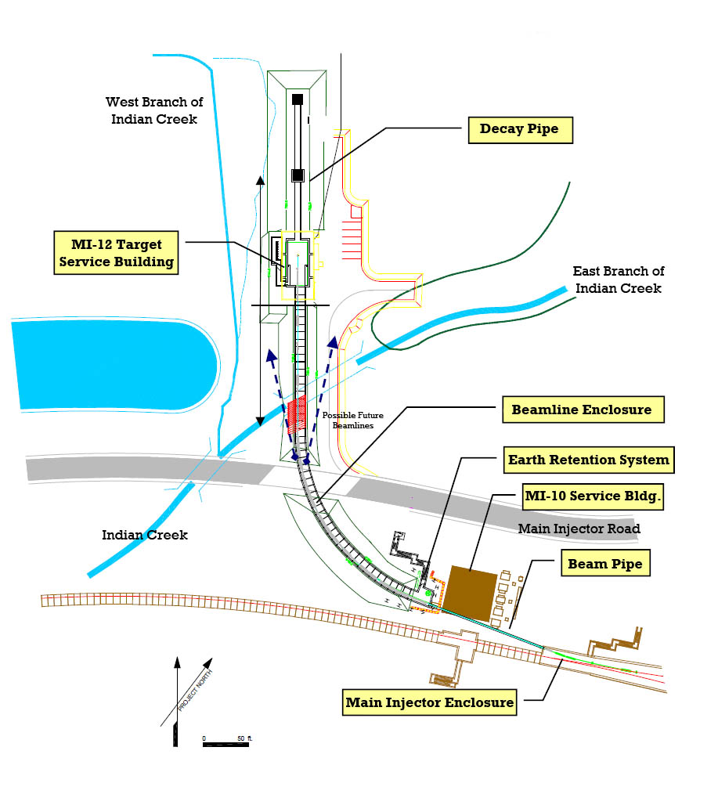
End
BNB Segment
BNB beam line
Start

Slide 5
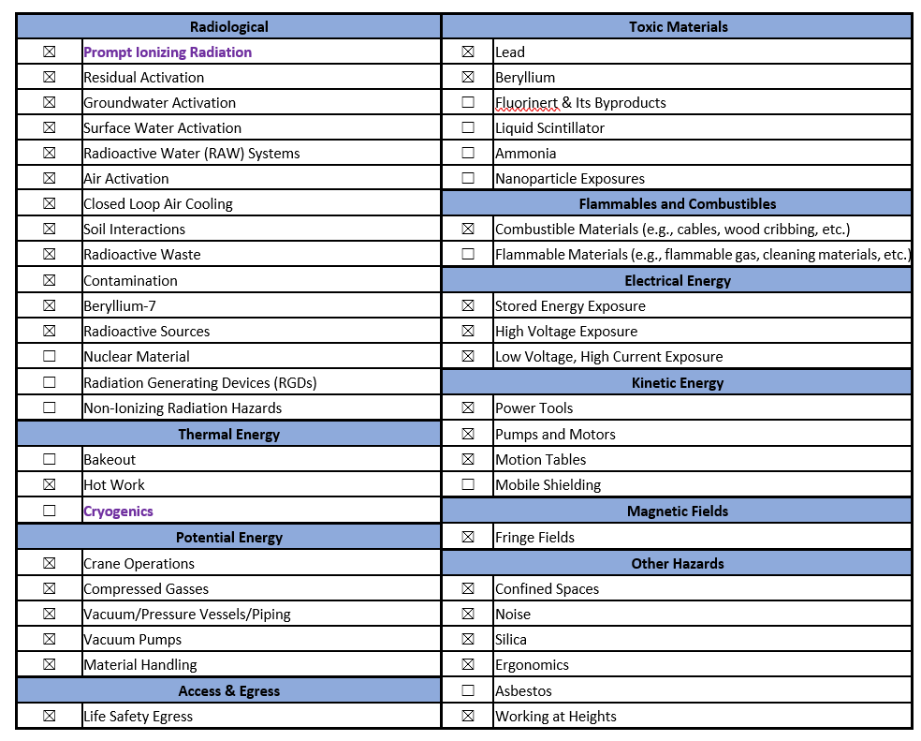
Hazard Inventory

Slide 6
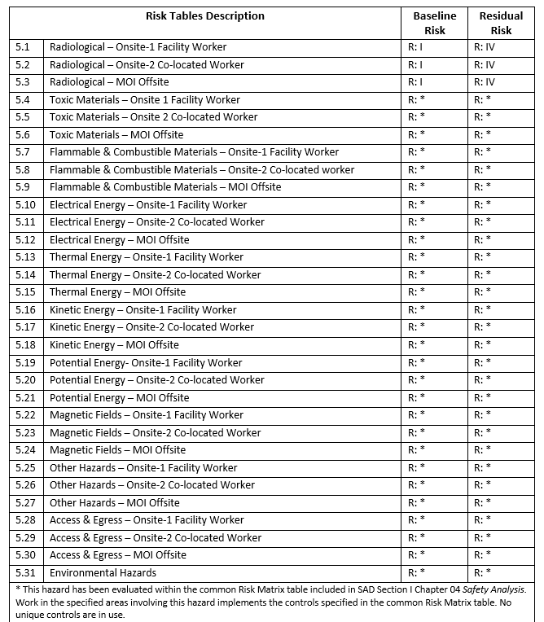
Hazard Inventory
Risk tables are used to evaluate hazards

Slide 7
Accelerator Specific Hazards
Prompt Ionizing Radiation
Significant radiation hazard during beam operations
Beam interacts with beam line & target materials
Includes protons, neutrons, pions, kaons, muons, photons, etc.
Credited Controls are needed!!!
Analyzed maximum credible incident to determine credited controls
Hazard applies to onsite facility workers, onsite co-located workers and a maximally exposed offsite individual

Slide 8
Accelerator Specific Hazards
Cryogenic Systems – Oxygen Deficiency Hazards (ODH)
Cryogens are not used in this beam line
No credited controls are needed!!!

Slide 9
Maximum Credible Incident
Assumes full potential BNB intensity
Same as 8 GeV Line & Booster
Beam completely & continually lost for one hour
On a magnet or buried beam pipe
Highest radiation dose rates outside beam line areas at locations with reduced passive shielding
3.78E+17 protons/hr or 7E+12 protons/pulse
8 GeV proton energy
15 Hz cycle time

Slide 10
Maximum Credible Incident
Maximum Credible Incident (MCI) considers an onsite worker, onsite coworker, & maximally exposed off-site individual (MOI)
Fermilab uses Credited Controls that flow down to the Accelerator Safety Envelope (ASE) to mitigate the consequences of an MCI to the following conditions:
Less than 5 rem in one hour in any area accessible by facility workers or co-located workers
Less than 500 mrem in one hour in all Laboratory areas to which the public is assumed to be excluded
Less than 100 mrem in one hour at Fermilab’s site boundary and/or in any areas onsite in which the public is authorized (which includes Batavia Road, Prairie Path, parking lots open to the public, and general access areas including Wilson Hall, Ramsey Auditorium)
BNB segment is located behind a security access gate
Members of the public are not invited to this area.

Slide 11
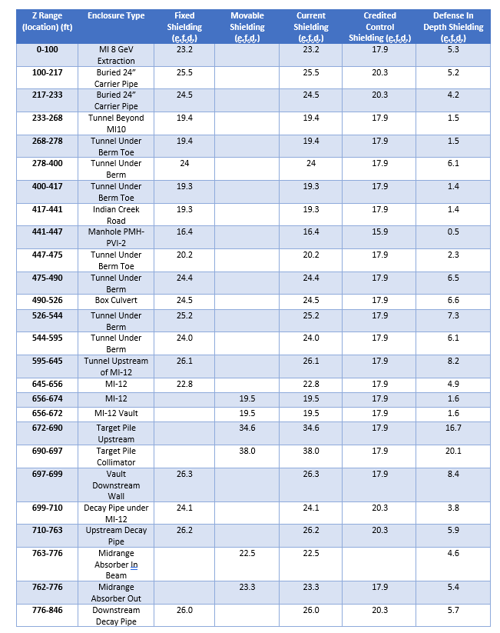
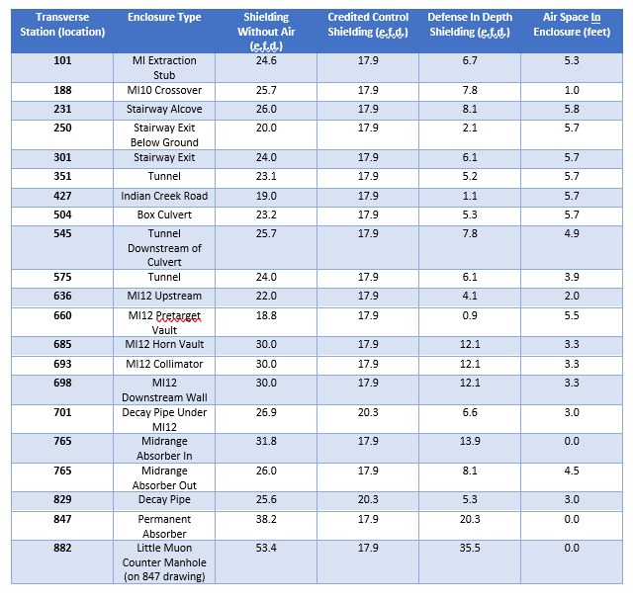
Passive Engineering Credited Controls
Permanent & Movable Shielding
Moveable shielding is managed by Radiation Physics Operations Dept. & utilizes a configuration management control system

Slide 12
Passive Engineering Credited Controls
Permanent & Movable Shielding
17.9 effective feet of dirt (e.f.d.) required for beam hitting a magnet in an enclosure
20.3 e.f.d. required for beam hitting a buried beam pipe
Requires a credited detector

Slide 13
Active Engineering Credited Controls
Radiation Safety Interlock System (RSIS)
Inhibits beam by controlled redundant critical devices
ES&H Radiation Physics Engineering Dept. (RPE) performs hardware & system testing on a semi-annual basis with a four-month grace period
RPE verifies inventory of interlock keys & updates procedures for maintenance, and testing interlock systems.
RSISs are designed, installed, & configuration managed in conformance with the requirements of the Fermilab Radiological Control Manual (FRCM)

Slide 14
Active Engineering Credited Controls
Interlocked Radiation Detectors
Credited detectors feed into RSISs used throughout Fermilab
Calibrated on an annual basis
Areas without sufficient shielding use detectors to protect people
BNB uses two credited detectors
One is on a berm by the Indian Creek Road manhole
One is by the stripline penetrations in the MI12 Service building
Detectors are colloquially called chipmunks:
Fixed area monitoring radiation detector
Sealed ion chamber
Photon & neutron detection capabilities
Maintained & calibrated by the Fermilab ES&H Instrumentation Dept.

Slide 15
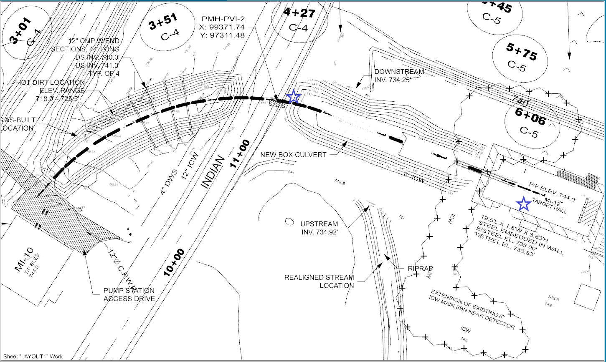
Active Engineering Credited Controls

Slide 16
Administrative Credited Controls
Operation Authorization Documents
Machine Beam Permit
Machine Run Condition
MCR Staffing
Perform Search & Secure Process for all areas
Monitor detector trip levels to ensure they are below the ASE limit
Monitor beam operations
Turn accelerator components on & off as desired/needed
The following staffing shall be in place during applicable beam operation:
At least one member of the AD Operations Department who has achieved the rank of Operator II or higher shall be on duty and on site
At least one member of the AD Operations Department shall be present in the Main Control Room (MCR)
Note: these requirements could be satisfied by a single person
Accelerator Operating parameters
Beam intensity limit derived from MCI analysis

Slide 17
Defense in Depth Controls
Employ additional Defense in Depth controls to further reduce risk associated with radiation exposure
Training
e.g. Radiological Worker & Fermilab Controlled Access Trainings
Procedures
e.g, FESHM 2100 requires all departmental procedures to be reviewed and re-approved every twelve months
Passive shielding
Not all passive shielding at a particular location is taken as the credited control shielding

Slide 18
Action Items
None

Slide 19
Non-Accelerator Specific Hazards - Radiological
Residual Activation
Proton beam produces activated materials inside enclosures
Hazard applies to onsite facility workers & onsite co-located workers
Baseline Qualitative Risk (without controls) | Controls Preventive (P)/Mitigative (M) | Residual Qualitative Risk (with controls)
L: A C: H R: I | P – General and/or Job Specific RWP P – LSM P – Radiological Training M – Radiological Signage and Decay Time Requirements M – Target Pile Shielding | L: BEU C: L R: IV

Slide 20
Non-Accelerator Specific Hazards - Radiological
Groundwater Activation
Protons can interact with soil and radioisotopes could leach into ground water
tritium & Na-22
Cooling water, e.g. low conductivity water (LCW), interacts with activated beam line components
Hazard applies to onsite facility workers & onsite co-located workers
Hazard | Baseline Qualitative Risk (without controls) | Controls Preventive (P)/Mitigative (M) | Residual Qualitative Risk (with controls)
Potential exposure due to construction activities, (e.g., earthmoving) Draining of groundwater captured in tanks | L: A C: N R: IV L: A C: N R: IV | P – Water Evaluation P – Water Capture M – Facility Designs P – Water Sampling M – RCTs Drain Tanks | L: EU C: N R: IV L: U C: N R: IV

Slide 21
Non-Accelerator Specific Hazards - Radiological
Surface Water Activation
Protons can interact with soil and radioisotopes could leach into ground water
tritium & Na-22
Cooling water, e.g. low conductivity water (LCW), interacts with activated beam line components
Hazard applies to onsite facility workers & onsite co-located workers
Hazard | Baseline Qualitative Risk (without controls) | Controls Preventive (P)/Mitigative (M) | Residual Qualitative Risk (with controls)
Potential exposure to activated surface water due to beam loss leakage from beam enclosures, located under the surface water impoundment. Potential exposure to activated surface water due to mixing surface water with a captured groundwater source. | L: A C: N R: IV L: A C: N R: IV | P – Beam Loss Monitoring M – Radiation Detectors M – Shielding P – Discharge Limit P – Monitoring Potential Sources M – Operations Pause M – Monitoring Surface Water | L: U C: N R: IV L: EU C: N R: IV

Slide 22
Non-Accelerator Specific Hazards - Radiological
Radioactive Water (RAW) Systems
Protons can interact with water
tritium
Cooling water, e.g. low conductivity water (LCW), interacts with activated beam line components
Humidity interacts with activated beam line components
Hazard applies to onsite facility workers & onsite co-located workers
Baseline Qualitative Risk (without controls) | Controls Preventive (P)/Mitigative (M) | Residual Qualitative Risk (with controls)
L: A C: H R: I | P – RAW Key Control System P – Secondary Containment P – General and/or Job Specific RWP P – LSM M – Run Condition M – RCT Or RSO Monitoring | L: BEU C: L R: IV

Slide 23
Non-Accelerator Specific Hazards - Radiological
Air Activation
Protons can interact with air in enclosures
C-11, O-15, N-13 and Ar-41
Hazard applies to onsite facility workers and onsite co-located workers
Baseline Qualitative Risk (without controls) | Controls Preventive (P)/Mitigative (M) | Residual Qualitative Risk (with controls)
L: A C: H R: I | P – Active Air Monitoring P – LSM M – Air Dilution and Decay Time M – Run Condition M – Target Pile Shielding | L: EU C: N R: IV

Slide 24
Non-Accelerator Specific Hazards - Radiological
Closed Loop Air Cooling
Protons can interact with air in enclosures
C-11, O-15, N-13 and Ar-41
Hazard applies to onsite facility workers and onsite co-located workers
Baseline Qualitative Risk (without controls) | Controls Preventive (P)/Mitigative (M) | Residual Qualitative Risk (with controls)
L: A C: H R: I | P – Active Air Monitoring P – LSM P – Air Containment M – Run Condition M – Target Pile Shielding | L: BEU C: L R: IV

Slide 25
Non-Accelerator Specific Hazards - Radiological
Soil Interactions
Protons can interact with soil and radioisotopes could leach into ground water
tritium & Na-22
Hazard applies to onsite facility workers and onsite co-located workers
Baseline Qualitative Risk (without controls) | Controls Preventive (P)/Mitigative (M) | Residual Qualitative Risk (with controls)
L: A C: N R: IV | P – General and/or Job Specific RWP M – Beamline and Beam Dump Designs M – PPE M – Run Condition | L: U C: N R: IV

Slide 26
Non-Accelerator Specific Hazards - Radiological
Radioactive Waste
Radioactive waste produced during beam operations
Managed within established Radiological Protection Program (RPP) as prescribed in Fermilab Radiological Control Manual (FRCM)
Hazard applies to onsite facility workers and onsite co-located workers
Baseline Qualitative Risk (without controls) | Controls Preventive (P)/Mitigative (M) | Residual Qualitative Risk (with controls)
L: A C: H R: I | P – Fencing/Postings P – Locked Gates M – Run Condition M – Material survey and release process | L: BEU C: L R: IV

Slide 27
Non-Accelerator Specific Hazards - Radiological
Contamination
Protons can interact with fine particulates (dust) and liquids (e.g. oil)
Not typically encountered during normal maintenance
Hazard applies to onsite facility workers and onsite co-located workers
Baseline Qualitative Risk (without controls) | Controls Preventive (P)/Mitigative (M) | Residual Qualitative Risk (with controls)
L: A C: H R: I | P – Shielding for Activated Contamination P – Radiological Surveying and Cleaning P – General and/or Job Specific RWP P – LSM M – Material Survey and Release Process M – PPE | L: BEU C: L R: IV

Slide 28
Non-Accelerator Specific Hazards - Radiological
⁷Be
⁷Be produced during beam operations
Target pile enclosed by shielding materials, e.g. concrete & steel
Hazard applies to onsite facility workers and onsite co-located workers
Baseline Qualitative Risk (without controls) | Controls Preventive (P)/Mitigative (M) | Residual Qualitative Risk (with controls)
L: A C: N R: IV | No prevention or mitigation is required. ⁷Be isn’t hazardous in this pattern of use by facility. | L: A C: N R: IV

Slide 29
Non-Accelerator Specific Hazards - Radiological
Radioactive Sources
Not typically used in the beam line
Hazard applies to onsite facility workers and onsite co-located workers
Baseline Qualitative Risk (without controls) | Controls Preventive (P)/Mitigative (M) | Residual Qualitative Risk (with controls)
L: A C: H R: I | P – Radiological Signage on or Near Source Cabinets P – Radiological Training P – Kept Under Lock-and-key M – Kept in Storage M – Shielded Containers | L: BEU C: L R: IV

Slide 30
Summary
Hazards are evaluated with risk tables
Analyzed MCI scenario
Acceptable risk during MCI scenario created via credited controls
Passive engineering credited controls
Active engineering credited controls
Administrative credited controls
Also use defense in depth controls to reduce risk
Non-accelerator-specific hazards also have an acceptable risk level

Slide 31
Backup

Slide 32
Hazard Inventory
Accelerator specific hazards are purple
Hazards not discussed today are evaluated via the common Risk Matrix tables
Covered in SAD Section I, Chapter 4
Hazards evaluated via risk assessment methodology per DOE-HDBK-1163-2020
Likelihood (L):
Anticipated (A), Unlikely (U), Extremely Unlikely (EU), Beyond Extremely Unlikely (BEU)
Consequence (C):
High (H), Moderate (M), Low (L), Negligible (N)
Risk (R):
I , II, III, IV (descending order of concern)

Slide 33
Shielding assessment discussion
Three categories of beam-induced radiation hazards:
Prompt radiation levels inside and surrounding the enclosure that are present during beam transport: protons, neutrons, pions, kaons, muons, photons, etc.
Residual radiation due to activation of beamline & target components; gives rise to radiation exposure during enclosure accesses for repair, maintenance, inspection, & operation activities
Environmental radioactivity due to the beam operation: activation of air, soil, & groundwater
All categories for the BNB have been previously evaluated for compliance with 10CFR835
All categories have been previously evaluated for compliance with DOE O420.2C
All categories have now been evaluated for compliance with DOE O420.2D

