Slide 1
Safety Assessment Document Updates for DOE O 420.2D
SAD Section III Chapter 07 – Main Injector
Dave Capista
Main Injector Internal Readiness Review
10 January2024

Slide 2
Outline
Main Injector Overview
Hazard Inventory
Non-Accelerator Specific Hazards
Accelerator Specific Hazards
Maximum Credible Incident (MCI) Discussion
Summary of Credited Controls
Summary of Defense in Depth Controls

Slide 3
Outline
Main Injector Overview
Hazard Inventory
Non-Accelerator Specific Hazards
Accelerator Specific Hazards
Maximum Credible Incident (MCI) Discussion
Summary of Credited Controls
Summary of Defense in Depth Controls

Slide 4
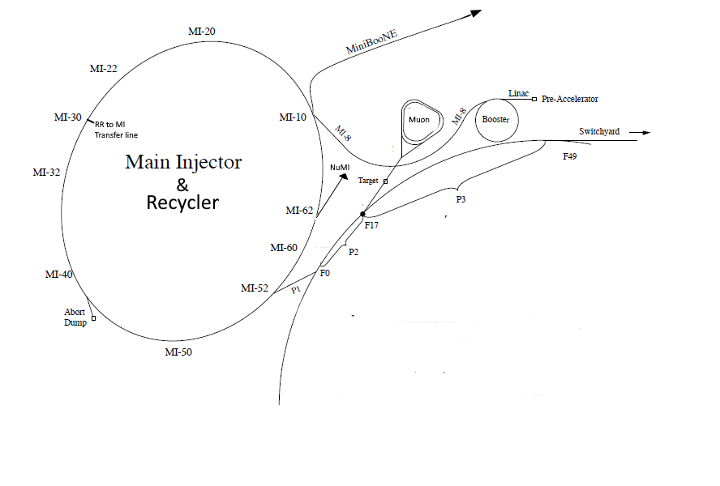
Main Injector Overview
3319 meters in circumference
Both recycler (RR) and Main Injector (MI) are in this enclosure
RR is an 8 Gev machine
MI is an 8-120 Gev machine
One injection line from MI8 to both MI and RR
Three transfer lines from RR
RR to MI line
P1 line to Muon
Abort line
Three extraction lines from MI
P1 line to Switchyard
NuMI extraction line
Abort line

Slide 5
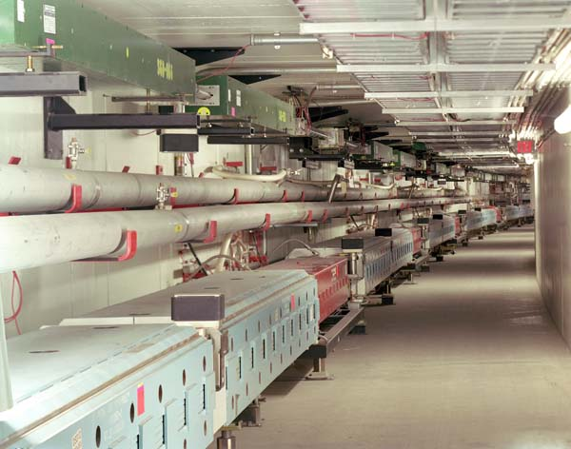
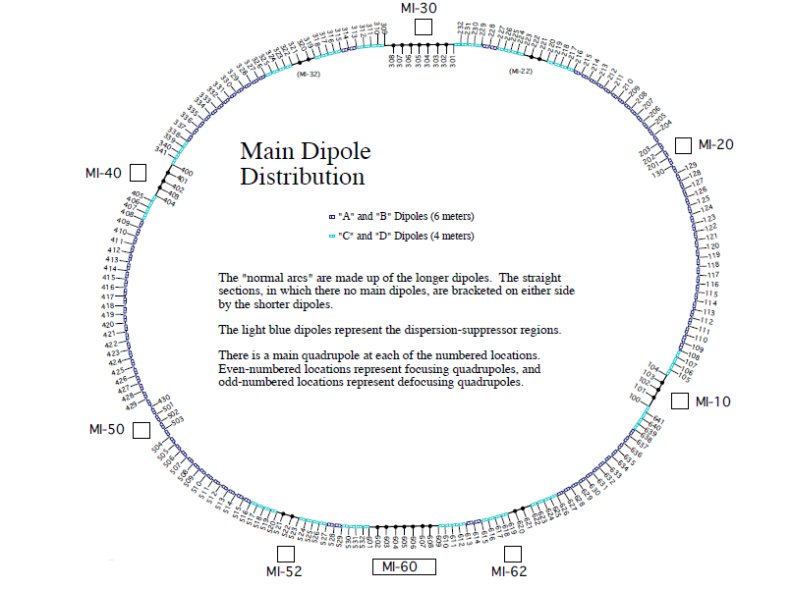
Main Injector Overview
MI is the bottom machine. Magnets are electrical
RR is the top machine. Magnets are permanent made from magnetized ferrite.
Vacuum beam pipe in both machines is stainless steel 316L, 65 mils (~1/16”) wall Vacuum is around 5E-8 torr to prevent scattering of the beam
Beam Loss Monitors are located at every quadrupole location (red magnet)

Slide 6
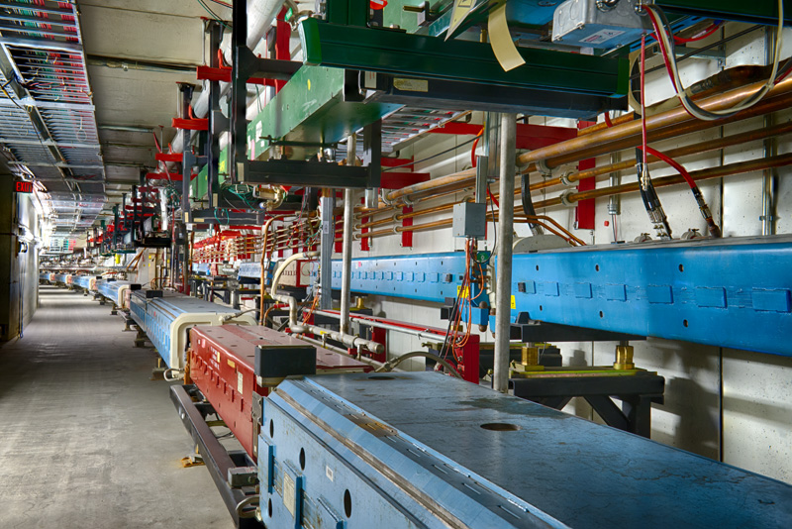
Main Injector Overview
Injection and extraction lines can create complicated work areas
Requires more engineering and technical time to plan and execute
Involves multiple groups to complete the task
LOTO
Safety

Slide 7
Outline
Main Injector Overview
Hazard Inventory
Non-Accelerator Specific Hazards
Accelerator Specific Hazards
Maximum Credible Incident (MCI) Discussion
Summary of Credited Controls
Summary of Defense in Depth Controls

Slide 8
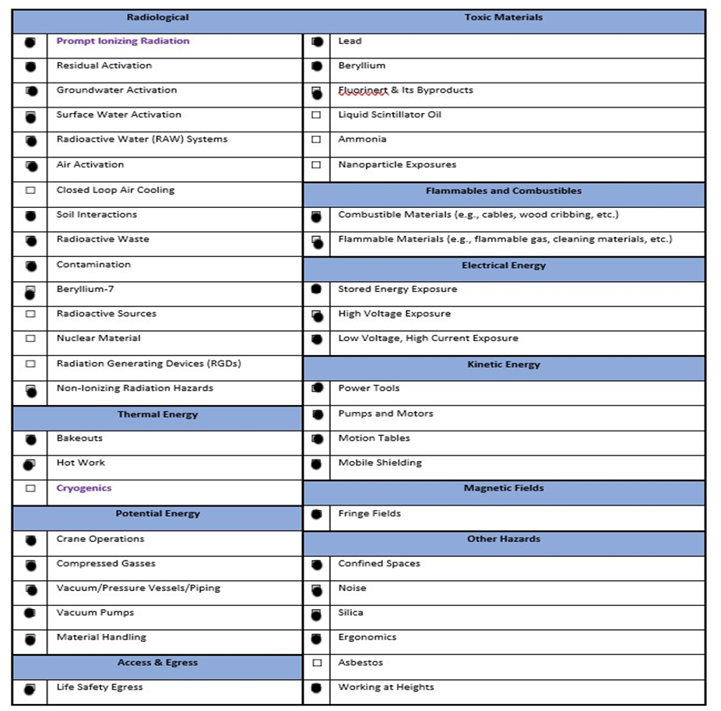
Hazard Inventory for Main Injector
Accelerator specific hazards are purple
Hazards not discussed today are evaluated via the common Risk Matrix tables
Covered in SAD Section I, Chapter 4
Hazards evaluated via risk assessment methodology per DOE-HDBK-1163-2020
Likelihood (L):
Anticipated (A), Unlikely (U), Extremely Unlikely (EU), Beyond Extremely Unlikely (BEU)
Consequence (C):
High (H), Moderate (M), Low (L), Negligible (N)
Risk (R):
I , II, III, IV (descending order of concern)

Slide 9
Outline
Main Injector
Hazard Inventory
Non-Accelerator Specific Hazards
Accelerator Specific Hazards
Maximum Credible Incident (MCI) Discussion
Summary of Credited Controls
Summary of Defense in Depth Controls

Slide 10
Non-Accelerator Specific Hazards - Radiological
Residual Activation
High intensity beam delivery can produce activated materials inside the Main Injector enclosure due to beam loss
The residual dose rate found in the Main Injector from initial entry surveys is historically less than 5 mrem/hr, exceptions include:
The injection and extraction areas
The collimation areas
Hazard applies to onsite facility workers and onsite co-located workers
Baseline Qualitative Risk (without controls) | Controls Preventive (P)/Mitigative (M) | Residual Qualitative Risk (with controls)
L: A C: H R: I | P – Locked Gates: P – Key Control Program P – Radiological Work Permit P – Postings P – Training P – Beam Loss Monitoring M – Machine Protection System M – Local Component Shielding M – Run Conditions | L: BEU C: N R: IV

Slide 11
Non-Accelerator Specific Hazards - Radiological
Radioactive Water (RAW) system
The Main Injector Abort is cooled with water which becomes activated.
The system is self contained and heat exchanged with the MI LCW system
Hazard applies to onsite facility workers and onsite co-located workers
Baseline Qualitative Risk (without controls) | Controls Preventive (P)/Mitigative (M) | Residual Qualitative Risk (with controls)
L: A C: H R: I | P – Locked Gates P – Key Control Program P – Radiological Work Permit P – Postings: P – Training: M – Volume Monitoring M – Engineered Containment | L: BEU C: N R: IV

Slide 12
Non-Accelerator Specific Hazards - Radiological
Air Activation
Air activation can occur at any area in the accelerator where high beam losses are present.
These areas are typically limited to the collimation and abort areas.
Hazard applies to onsite facility workers and onsite co-located workers
Baseline Qualitative Risk (without controls) | Controls Preventive (P)/Mitigative (M) | Residual Qualitative Risk (with controls)
L: A C: H R: I | P – Air Monitoring M – Run Conditions P– Beam loss Monitoring M – Machine Protection System M – Engineered Air Flow | L: EU C: N R: IV

Slide 13
Non-Accelerator Specific Hazards - Radiological
Soil Interactions
Radionuclides are produced which may contaminate ground water
Can occur in areas of high chronic losses
Hazard applies to onsite facility workers and onsite co-located workers
Baseline Qualitative Risk (without controls) | Controls Preventive (P)/Mitigative (M) | Residual Qualitative Risk (with controls)
L: A C: H R: I | P – Beam Loss Monitoring M – Machine Protection System M – Engineered Beam Dump M – Beamline Design M – Run Conditions | L: U C: N R: IV

Slide 14
Non-Accelerator Specific Hazards - Radiological
Radioactive Waste
Radioactive waste produced during Main Injector operations will be managed within the established Radiological Protection Program (RPP) as prescribed in the Fermilab Radiological Control Manual (FRCM)
Hazard applies to onsite facility workers and onsite co-located workers
Baseline Qualitative Risk (without controls) | Controls Preventive (P)/Mitigative (M) | Residual Qualitative Risk (with controls)
L: A C: H R: I | P – Locked Gates P – Key Control Program P – Postings M – Run Conditions M – Distance to Stored Material M – Material survey and release process | L:BEU C: N R: IV

Slide 15
Non-Accelerator Specific Hazards - Radiological
Contamination, ⁷Be
Contamination is found in the Main Injector enclosure in areas where beam loss has occurred, such as the collimation region.
Hazard applies to onsite facility workers and onsite co-located workers
Baseline Qualitative Risk (without controls) | Controls Preventive (P)/Mitigative (M) | Residual Qualitative Risk (with controls)
L: A C: H R: I | P – Locked Gates P – Key Control Program M – Radiological Work Permit M – Training | L: EU C: L R: IV

Slide 16
Outline
Main Injector Overview
Hazard Inventory
Non-Accelerator Specific Hazards
Accelerator Specific Hazards
Maximum Credible Incident (MCI) Discussion
Summary of Credited Controls
Summary of Defense in Depth Controls

Slide 17
Accelerator Specific Hazards - Radiological
Prompt Ionizing Radiation – Beam Loss
Ionizing radiation due to beam loss in the Main Injector enclosure
Analyzed maximum credible incident (MCI) to determine credited controls
Hazard applies to onsite facility workers, onsite co-located workers

Slide 18
Outline
Main Injector Overview
Hazard Inventory
Non-Accelerator Specific Hazards
Accelerator Specific Hazards
Maximum Credible Incident (MCI) Discussion
Summary of Credited Controls
Summary of Defense in Depth Controls

Slide 19
Maximum Credible Incident (MCI) – Radiological
The MCI is defined as an event that is expected to occur over the lifetime of the accelerator
The MCI focuses on exposure to an onsite worker, an onsite coworker and the maximally exposed off-site individual (MOI)
Incident bounds all postulated accident scenarios for the Fermilab Main Injector
The Main Injector is located beyond the public access gate and contains no areas where the public is invited
Fermilab uses Credited Controls that flow down to the Accelerator Safety Envelope (ASE) to mitigate the consequences of an MCI to the following conditions:
Less than 5 rem in one hour in any area accessible by facility workers or co-located workers
Less than 500 mrem in one hour in all Laboratory areas to which the public is assumed to be excluded
Less than 100 mrem in one hour at Fermilab’s site boundary and/or in any areas onsite in which the public is authorized (which includes Batavia Road, Prairie Path, parking lots open to the public, and general access areas including Wilson Hall, Ramsey Auditorium)

Slide 20
Maximum Credible Incident (MCI) – Radiological
The MCI for the Fermilab Main Injector enclosure is a beam with an intensity of 2.83E17 protons per hour at an energy of 120 GeV persistently incident on a beamline component
Assuming no shielding or other controls are present this incident would result in a dose to any individual of approximately 5.23E7 rem (52 Mrem)
MCI intensity is the theoretical maximum the machine could produce and is a product of the following parameters:
7E12 per Booster batch and 12 Booster batches to fill the Main Injector
Booster intensity limitation
1.067s repetition rate
Hardware limit of the Main Injector power supplies
Recycler and Main Injector transmission efficiency of 100%
All beam stability limitations, machine integrity limitations, and machine protection systems are ignored
Will be covered in Defense in Depth

Slide 21
Outline
Main Injector Overview
Hazard Inventory
Non-Accelerator Specific Hazards
Accelerator Specific Hazards
Maximum Credible Incident (MCI) Discussion
Summary of Credited Controls
Shielding Assessment Discussion
Summary of Defense in Depth Controls

Slide 22
Credited Controls – Passive
Movable Shielding
Concrete block wall separating the Main Injector enclosure are present in the P1 and decommissioned A1 line, between MI and F-sector. There are also shielding blocks at the MI30 area shielding the MI31 service building.
Penetration Shielding
The MI enclosure has utility and RF penetrations throughout the service buildings that are filled with either sand, poly beads, and/or covered with poly blocks
Sight risers used for survey and alignment of the accelerator are filled with steel plugs and poly beads

Slide 23
Credited Controls – Passive
Permanent Shielding
Topographical surveys of the Main Injector enclosure and berm conclude that there is a minimum of 21.6 Equivalent Feet of Dirt (e.f.d.) shielding between the interior surface of the enclosure walls and the surface of the berm
Efficacy of passive shielding evaluated at MCI intensity at the location determined that a minimum of 20.7 e.f.d. is required to limit the dose received to an individual standing on top of the berm at the maximum dose point to 500 mrem in an hour.
Credited Control: 20.7 e.f.d. shielding between the interior surface of the enclosure walls and the surface of the berm

Slide 24
Credited Controls – Active Engineering
Credited Control: Radiation Safety Interlock System (RSIS)
Inhibits beam by controlled redundant critical devices
Enforces the search and secure process
Interlocked doors are present at all access points into the Main Injector enclosure
The ES&H Radiation Physics Engineering Dept. (RPE) ensures that all requirements for hardware and system testing are completed semi-annually with a four-month grace period
RPE also verifies the inventory of interlock keys and updates procedures for maintenance and testing of interlock systems
All RSIS are designed, installed and configuration managed in conformance with the requirements of the Fermilab Radiological Control Manual (FRCM)

Slide 25
Credited Controls - Administrative
Credited Control: Operation Authorization Document
Machine Beam Permit
Machine Run Condition
Beam will not be transported through Recycler or Main Injector without approval of these documents
Credited Control: Staffing
Ensures operations within bounding conditions specified in Operation Authorization Document
The following staffing shall be in place during applicable beam operation:
At least one member of the AD Operations Department who has achieved the rank of Operator II or higher shall be on duty and on site.
At least one member of the AD Operations Department shall be present in the Main Control Room (MCR).
Note: these requirements could be satisfied by a single person
Credited Control: Accelerator Operating Parameters
The MCI intensity of 2.83E17 protons/hr shall not be exceeded

Slide 26
Outline
Main Injector Overview
Hazard Inventory
Non-Accelerator Specific Hazards
Accelerator Specific Hazards
Maximum Credible Incident (MCI) Discussion
Summary of Credited Controls
Summary of Defense in Depth Controls

Slide 27
Defense in Depth Controls
Permanent Shielding
0.9 e.f.d. excess shielding is present on the MI berm
Training
All personnel engaged in the commissioning, operation, and emergency management of the MI/RR shall have at a minimum, Fermilab’s Radiological Worker. Furthermore, personnel approved for access into the MI/RR interlocked enclosure shall have Fermilab’s Controlled Access training.
Procedures
FESHM 2100 requires all departmental procedure to be reviewed, re-approved and re-taught every twelve months
Radiation Detectors
Located in various service buildings where tunnel beam loss could expose a worker to a higher dose than an administrated limit

Slide 28
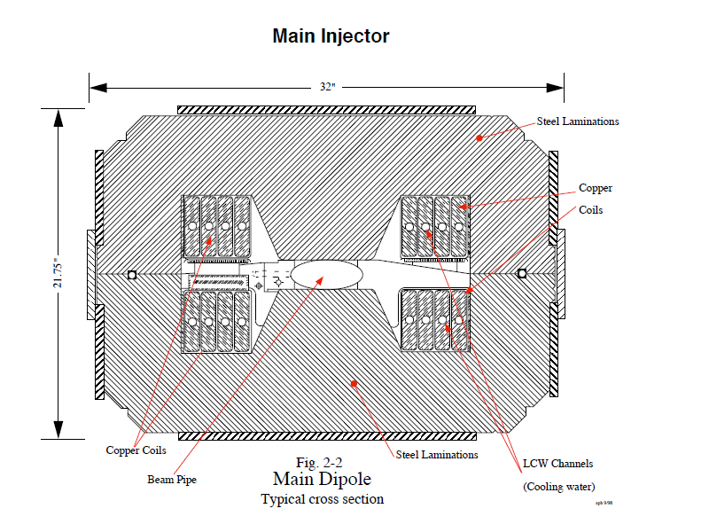
Defense in Depth Controls
Machine Protection Controls
Provides deep defense in depth
significantly reduces the probability of an MCI
Passive control
Destruction of the accelerator components from high intensity beam
Beam pipe is 0.065” stainless steel and will melt when exposed to 1MW particle beam. The vacuum will breach. The accelerator will be let up to atmosphere stopping the incident.
Has occurred twice with a single lost pulse
Has occurred twice in the abort area from repeated low intensity operation
Is difficult to predict.

Slide 29
Defense in Depth Controls
Machine Protection Controls
Active Engineered controls
Centered around the Beam Permit System
Fail safe designed active link around the accelerator containing some 200 possible inputs
Inputs are required to be active high
When an input to this permit system transitions to a low state, the accelerator will abort the beam and inhibit further beam pulses until the fault is cleared and the system is reset
Alarms and Limits
Displayed in the MCR for operators. Some alarms require acknowledgement
Orbit control and monitoring
Semi-automated tuning to keep the beam at desired positions. Some critical beam positions are connected to the permit system
Reduces beam loss, tunnel activation, and aids ALARA
Low Conductivity Water (LCW) activation monitoring
Protected by chipmunks at the enclosure stairwells
Accelerator Time-Line generator
Programmed timing for accelerator operations. Modules require approval prior to use

Slide 30
Defense in Depth Controls
Machine Protection Controls:
Active Engineered controls
Beam Switch Sum Box
Allows or prevents beam from the Linac based on requests from the TLG, Status of beam switches, and status of the beam permit system from all machines involved in the operation.
Beam transfer Permit system
Allows or inhibits beam transfers to accelerators. Beam present in an upstream machine will be sent to the Abort absorber
Vacuum Interlock System
Requires vacuum in the accelerator to be adequate to contain the beam. Will close vacuum valves and trip the permit system if the vacuum is poor.
Power Supply Permits and Regulation
Requires critical power supplies to be on with some monitored for regulation. Will trip the permit system if not at the desired configuration

Slide 31
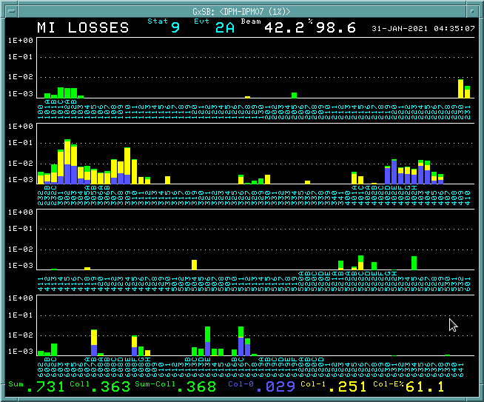
Defense in Depth Controls
Machine Protection Controls:
Active Engineered controls
Beam Loss Monitor System
Provides information to operator's tor control of beam losses, aids in ALARA
Used in conjunction with AI for pattern recognition to locate the source of a tuning problem or accelerator drift
Allows for the prediction of tunnel activation for WPC
Connected to the Beam Permit System
Monitors integrated beam loss through a cycle and if above limit, will drop the beam permit after extraction
Monitors instantaneous loss and if over the limit, will drop the beam permit immediately
Limits the accident to a single pulse as opposed to the MCI of 3374 pulses
MCR Display of BLM around the Main Injector.

Slide 32
Thank you for your attention

Slide 33
Outline
Linac Overview
Hazard Inventory
Non-Accelerator Specific Hazards
Accelerator Specific Hazards
Maximum Credible Incident (MCI) Discussion
Summary of Credited Controls
Summary of Defense in Depth Controls
Backup Slide(s)

