Slide 1
Safety Assessment Document Updates for DOE O 420.2D
SAD Section III Chapter 08 - NuMI
Phil Schlabach
Internal Readiness Review
09-11 January 2024

Slide 2
Outline
NuMI Overview
Hazard Inventory
Non-Accelerator Specific Hazards
Accelerator Specific Hazards
Maximum Credible Incident (MCI) Discussion
Summary of Credited Controls
Summary of Defense in Depth Controls

Slide 3
Outline
NuMI Overview
Hazard Inventory
Non-Accelerator Specific Hazards
Accelerator Specific Hazards
Maximum Credible Incident (MCI) Discussion
Summary of Credited Controls
Summary of Defense in Depth Controls

Slide 4
NuMI Overview
The Neutrinos at the Main Injector (NuMI) beam line begins with 120 GeV protons extracted from the Main Injector to a target station in the target hall where it collides, producing charged secondary particles (primarily pions and kaons) which are focused by a magnetic “horn” system and decay downstream producing the neutrino beam
The present primary consumer of NuMI beam is NuMI Off-axis ν_{e} Appearance (NOvA) experiment which has a near detector cavern in the MINOS tunnel and far detector in Ash River, MN
  for geographic reference I recall the nearest hardware store being in International Falls, MN which I’m sure you’ve visited many times
  There are and have been additional experiments in the MINOS cavern and other experiments in the short baseline program (SBN) which utilize it as well (off axis to SBN detectors as well)
    The original experiment was the Main Injector Neutrino Oscillation Search (MINOS) for which the cavern was named
    It was joined by MINERvA (Main Injector Neutrino ExpeRiment to study v-A interactions)

Slide 5
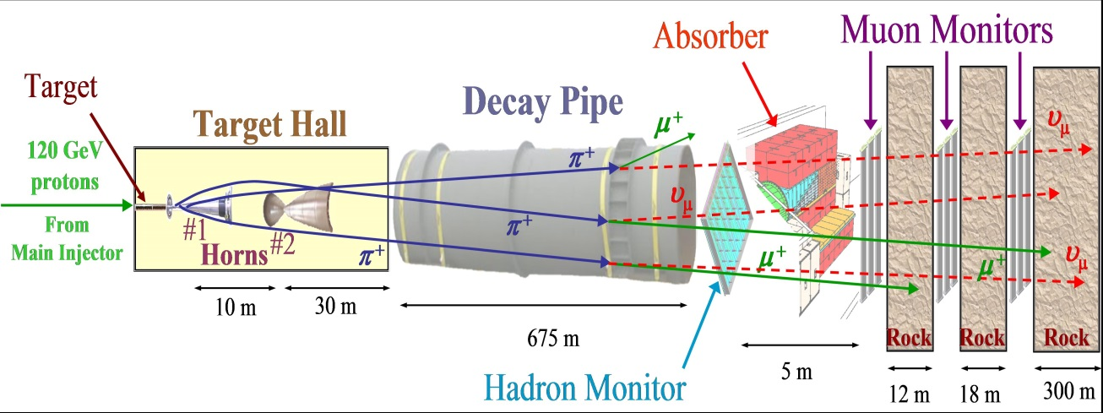
NuMI Overview (2)
Extraction kicks MI beam up and toward the outer MI enclosure wall, flattens it out to transport out of the enclosure between the RR and MI beamlines, when it exits, it is bent downwards to dive through the water table and then back up to point at the target to aim the neutrino beam to the detector(s)
Features (see next slide)
  An underground lined Carrier Tunnel starting at the NuMI stub in the MI;
  An underground unlined Carrier Tunnel;
  Underground Pre-Target/Target enclosure;
  An underground Decay Tunnel;
  An underground Hadron Absorber Enclosure and Access Tunnel with Muon Alcoves
  Surface MI-65 and MINOS Service Buildings

Slide 6
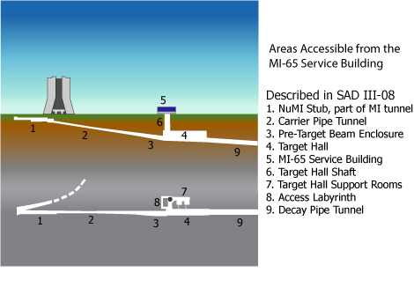
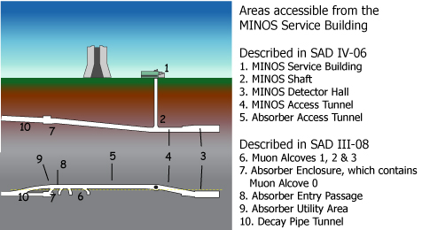
NuMI Overview (3)
This SAD covers from the upstream end of the carrier pipe tunnel to the downstream end of the absorber including radiation area outside and the muon alcoves
Stars locate the boundaries schematically (not to scale)

Slide 7
Outline
NuMI Overview
Hazard Inventory
Non-Accelerator Specific Hazards
Accelerator Specific Hazards
Maximum Credible Incident (MCI) Discussion
Summary of Credited Controls
Summary of Defense in Depth Controls

Slide 8
Hazard Inventory for NuMI
Accelerator specific hazards are purple
Hazards not discussed today are evaluated via the common Risk Matrix tables
  Covered in SAD Section I, Chapter 4
Hazards evaluated via risk assessment methodology per DOE-HDBK-1163-2020
  Likelihood (L):
    Anticipated (A), Unlikely (U), Extremely Unlikely (EU), Beyond Extremely Unlikely (BEU)
  Consequence (C):
    High (H), Moderate (M), Low (L), Negligible (N)
  Risk (R):
    I , II, III, IV (descending order of concern)

Slide 9
Outline
NuMI Overview
Hazard Inventory
Non-Accelerator Specific Hazards
Accelerator Specific Hazards
Maximum Credible Incident (MCI) Discussion
Summary of Credited Controls
Summary of Defense in Depth Controls
The public is not invited to any areas of the NuMI beamline; also, the slides cover only the main elements of the hazards (see SAD for detailed discussion)

Slide 10
Non-Accelerator Specific Hazards - Radiological
Residual Activation
  The NuMI shielding assessment assesses residual activiation
    The residual dose rate in the primary beamline and downstream absorber are assessed as <100 milli-rem (mrem)/hr and 30 mrem/hr respectively; measured rates following normal continuous operation have typically been <15 mrem/hr
    Exceptions include target hall consumable components
      Target, horn1 and 2 (6, 400, 33 rem/hr, estimated values for (30d, 1d) at operations of 700-kilowatt (kW) beam power)
      A typical changeout would involve remotely removing a component to the morgue for a years long cool off, followed by insertion in a cask for removal to on site radioactive storage for further years before transport
  Hazard applies to onsite facility workers and onsite co-located workers

Slide 11
Non-Accelerator Specific Hazards - Radiological
Radioactive Waste
  Radioactive waste produced during NuMI operations will be managed within the established Radiological Protection Program (RPP) as prescribed in the Fermilab Radiological Control Manual (FRCM)
  Normal operation generates tritiated condensate from the NuMI dehumitifiers which is continuously pumped upstream into the MI65 service building for disposal
  Target and horns are consumable components
  Hazard applies to onsite facility workers and onsite co-located workers

Slide 12
Non-Accelerator Specific Hazards - Radiological
Contamination
  Although not typically encountered, contamination is possible in the primary beamline and is a consideration in work planning
  Contamination is common in the target pile and associated systems
    Shielding surrounding the target pile limits the spread of contamination
    Work is performed as per a radiological work permit specifying preventative measures
    Surveying and cleaning; mitigative measures, such as the material survey and release process, and the use of personal protective equipment reduce the spread of contamination
  Hazard applies to onsite facility workers and onsite co-located workers

Slide 13
Non-Accelerator Specific Hazards –
Flammable & Combustible Materials
Flammable Materials
  ³H is produced in the target gas cooling system. It is diluted into a non-flammable ratio in air by venting into the large volume of the target hall
  Hazard applies to onsite facility workers, onsite co-located

Slide 14
Non-Accelerator Specific Hazards - Electrical
Stored Energy Exposure
  Electrical hazards are present in the stripline connections between the power supply capacitor bank and the horns
  Similarly for the 60 kJules of stored energy in the power supply capacitor bank
  Access to the stripline is controlled by the NuMI radiation safety interlock system, the stripline is contained behind a cage
  The power supply capacitor bank is designed, installed, operated, and maintained in accordance with FESHM requirements. Performing Lock out Tag out (LOTO) is required before performing maintenance on devices connected to hazardous energy sources. LOTO and grounding procedures are in place for work required
  These are a Non-Accelerator Specific Hazard (NASH) and described in Section I, Chapter 4
  Hazard applies to onsite facility workers and onsite co-located workers

Slide 15
Non-Accelerator Specific Hazards - Electrical
Low Voltage, High Current Exposure:
  This hazard has been evaluated within the common Risk Matrix table included in SAD Section I Chapter 04 Safety Analysis. Work in NuMI involving this hazard implements the controls specified in the common Risk Matrix table. No unique controls are in use.

Slide 16
Non-Accelerator Specific Hazards –
Magnetic Fields
Fringe Fields
  The only magnetic fields present when personnel are present are corrector magnets. The electrical safety system prevents energizing of the large dipole and quadrupoles when interlocks are dropped. Access also requires the LOTO of the power to these magnets. No permanent magnets are present.
  Hazard applies to onsite facility workers and onsite co-located workers

Slide 17
Non-Accelerator Specific Hazards – Potential Energy
Compressed gasses
  Compressed nitrogen and argon are used NuMI areas to facilitate operations
  Hazards evaluated within the common Risk Matrix table included in SAD Section I Chapter 04 Safety Analysis
Vacuum/Pressure Vessels/Piping
  Vacuum vessels are present in the NuMI areas in the form of beam pipes and other beamline components. Hazards evaluated within the common Risk Matrix table included in SAD Section I Chapter 04 Safety Analysis
  NuMI has air compressor tanks which are pressure vessels
    They follow the rules laid out in FESHM Chapter 5031 pointing to the ASME BPVC (Boiler and Pressure Vessel Code) Section VIII (Division 1 or Division 2) for compliance
    The tanks have a “U-Stamp” indicating compliance with code and a “Fermilab Silver Sticker” indicating an approved engineering note
No unique controls are in use, hazard applies to onsite facility workers and onsite co-located workers

Slide 18
Outline
NuMI Overview
Hazard Inventory
Non-Accelerator Specific Hazards
Accelerator Specific Hazards
Maximum Credible Incident (MCI) Discussion
Summary of Credited Controls
Summary of Defense in Depth Controls

Slide 19
Accelerator Specific Hazards - Radiological
Prompt Ionizing Radiation – Beam Loss
  Ionizing radiation due to beam loss in the NuMI enclosures
  Analyzed maximum credible incident (MCI) to determine credited controls
    Accidental beam loss was analyzed for shielding but is not the MCI
    By intent, NuMI loses ~98% of the primary protons by hitting the target, this is not accidental, that is the MCI
    The rest is lost in the absorber
  Hazard applies to onsite facility workers, onsite co-located workers

Slide 20
Outline
NuMI Overview
Hazard Inventory
Non-Accelerator Specific Hazards
Accelerator Specific Hazards
Maximum Credible Incident (MCI) Discussion
Summary of Credited Controls
Summary of Defense in Depth Controls

Slide 21
Maximum Credible Incident (MCI) – Radiological
The MCI focuses on exposure to an onsite worker and coworker
Incident bounds all postulated accident scenarios for NuMI
Fermilab uses Credited Controls that flow down to the Accelerator Safety Envelope (ASE) to mitigate the consequences of an MCI to the following conditions:
  Less than 500 mrem in one hour in all Laboratory areas to which the public is assumed to be excluded
  Less than 100 mrem in one hour at Fermilab’s site boundary and/or in any areas onsite in which the public is authorized
  Less than 5 rem in one hour in any area accessible by facility workers or co-located workers

Slide 22
Maximum Credible Incident (MCI) – Radiological
The MCI for the NuMI beamline is a beam with an intensity of 2.83e+17 protons/hour at an energy of 120 MeV incident on the target for one hour
Assuming no shielding or other controls are present this incident would result in a dose to any individual far exceeding the limits in the last slide
MCI intensity is the product of what the upstream machines can provide
  7e12 at 15 Hz out of booster
  12 batches slip stacked in Recycler and accelerated in Main Injector transmitted with 100% efficiency in both
  1.067 second minimum repetition rate
  NuMI transmission efficiency of 100%
  These factor into the analysis only marginally but are here for reference
    8.40E+13 ppp (protons/pulse)
    1512 kW (kiloWatts) power on target
    3374 pulses/hour

Slide 23
Outline
NuMI Overview
Hazard Inventory
Non-Accelerator Specific Hazards
Accelerator Specific Hazards
Maximum Credible Incident (MCI) Discussion
Summary of Credited Controls
Shielding Assessment Discussion
Summary of Defense in Depth Controls

Slide 24
Credited Controls – Passive Engineering
Permanent Shielding
  Topographical surveys of the NuMI enclosure(s) and berm, completed over the years, concluded that there is a minimum of 41.5 Equivalent Feet of Dirt (e.f.d.) shielding between the interior surface of the enclosure walls and the surface of the berm
  The wall thickness between the NuMI enclosure(s) and the surface of the beam varies longitudinally due to the downward slope of the beamline from 41.5 e.f.d. at the carrier pipe to >264 e.f.d. for the muon alcoves
Movable Shielding
  There are movable shielding components that must be removed for replacing components and must be in place for beam operation (e.g. target pile shield blocks, target hall shield door)
Penetration and Labyrinths
  The enclosure(s) have penetrations to the beam surface (site risers and exhaust vents) which have been evaluated. Some site risers have movable shielding as well

Slide 25
Credited Controls – Passive
Efficacy of passive shielding evaluated using standard shielding spreadsheets at MCI intensity for all the longitudinal segments
Credited Control: 24 e.f.d. shielding between the interior surface of the enclosure walls and the surface of the berm
  The remainder provides defense in depth against unforeseen shielding modifications

Slide 26
Credited Controls – Active Engineering
Credited Control: Radiation Safety Interlock System (RSIS)
  Inhibits beam by controlled redundant critical devices
  Enforces the search and secure process
  Interlocked doors are present at all access points into the NuMI enclosure
  Includes interlocked radiation detectors which protect individuals by disabling beam should prompt radiation from operations cause exposure to exceed specific dose rates
  The ES&H Radiation Physics Engineering Dept. (RPE) ensures that all requirements for hardware and system testing are completed semi-annually with a four-month grace period
  RPE also verifies the inventory of interlock keys and updates procedures for maintenance and testing of interlock systems
  The RSIS is designed, installed and configuration managed in conformance with the requirements of the Fermilab Radiological Control Manual (FRCM)

Slide 27
Credited Controls – Active Engineering
Interlocked Radiation Detectors
  Location indicated by the star
Type | Location | Credited Control Limit (mrem/hr)
Chipmunk | MI-65 Horn Power Supply Room | 5000
  Trip levels are set by the Radiation Physics Operations Department (RPO)
  All interlocked detectors are calibrated on an annual basis
  ES&H RPE Interlock group also installs, tests & maintains all interlocked detectors

Slide 28
Credited Controls - Administrative
Credited Control: Operation Authorization Document
  Beam will not be transported through NuMI without approval of these documents
  Specifies the Machine Run Condition
Credited Control: Staffing
  Ensures operations within bounding conditions specified in Operation Authorization Document
  The following staffing shall be in place during applicable beam operation
    At least one member of the AD Operations Department who has achieved the rank of Operator II or higher shall be on duty and on site.
    At least one member of the AD Operations Department shall be present in the Main Control Room (MCR).
    Note: these requirements could be satisfied by a single person
Credited Control: Accelerator Operating Parameters
  The MCI intensity of 2.83e+17 protons/hr shall not be exceeded

Slide 29
Outline
NuMI Overview
Hazard Inventory
Non-Accelerator Specific Hazards
Accelerator Specific Hazards
Maximum Credible Incident (MCI) Discussion
Summary of Credited Controls
Summary of Defense in Depth Controls

Slide 30
Defense in Depth Controls
Permanent Shielding
  All shielding exceeding the required 24 e.f.d. credited
Machine Protection Controls
  Major elements are beam losses, magnet currents, and beam positions
Training
  Personnel accessing enclosure(s) must have Radiological Worker Training, Fermilab Controlled Access Training and NuMI/MINOS Underground Training
Procedures
  FESHM 2100 requires all departmental procedures to be reviewed, re-approved and re-taught every twelve months

Slide 31
Questions?

Slide 32
Backup Slide(s)

