Slide 1
Safety Assessment Document Updates for DOE O 420.2D
SAD Section IV Chapter 06 – MINOS Experimental Areas
Žarko Pavlović
Internal Readiness Review
10 January 2023

Slide 2
Outline
MINOS Experimental Areas Overview
Hazard Inventory
Non-Accelerator Specific Hazards
Accelerator Specific Hazards
Maximum Credible Incident
Summary of Credited Controls
Summary of Defense in Depth Controls

Slide 3
Outline
MINOS Experimental Areas Overview
Hazard Inventory
Non-Accelerator Specific Hazards
Accelerator Specific Hazards - NA
Maximum Credible Incident - NA
Summary of Credited Controls - NA
Summary of Defense in Depth Controls - NA

Slide 4
Outline
MINOS Experimental Areas Overview
Hazard Inventory
Non-Accelerator Specific Hazards

Slide 5
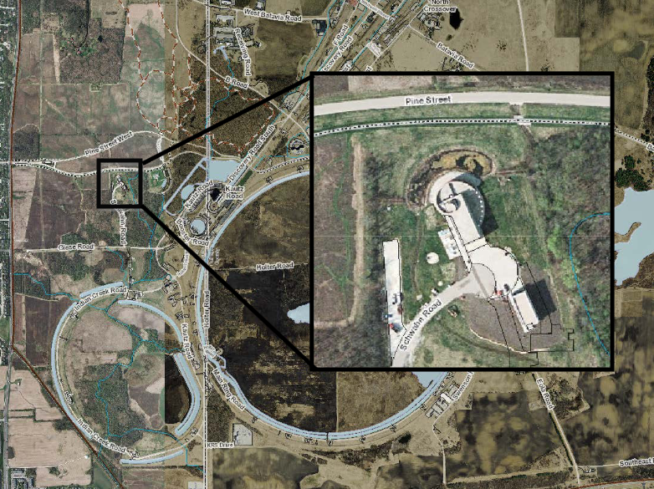
MINOS Experimental Areas Overview
Consists of MINOS Service Building on the surface and the underground areas accessible with the elevator
Positioned along the centerline of the NuMI Neutrino Beamline
The underground area is about 300ft under ground
Used by NuMI based neutrino experiments and low cosmic background Dark Matter experiments

Slide 6
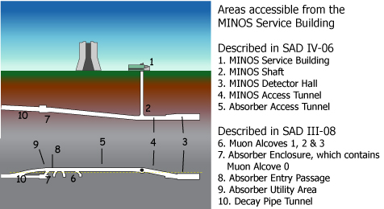
MINOS Experimental Areas Overview
The experiments are located in
Shaft – MAGIS-100
Detector Hall – ArgonCube
Access Tunnel – NEXUS, QUIET, SENSEI, MOSKITA, SBC
There are no experiment detectors located in the Absorber Access Tunnel.

Slide 7
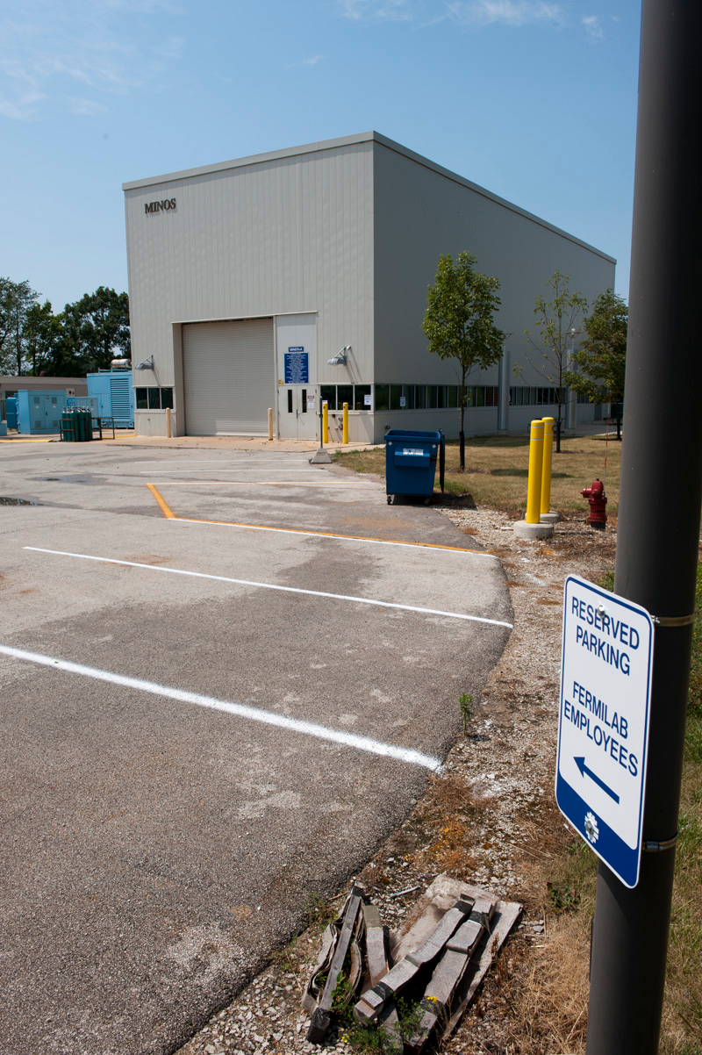
MINOS Experimental Areas Overview
Access to the MINOS Service Building requires a valid ID card
Access to the MINOS elevator and underground areas requires a key to the elevator enclosure. The keys are checked out from the Main Control Room
To obtain a key, personnel must have current General Employee Radiation Training (GERT) and NuMI/MINOS Underground Safety Training.
In case of emergency the secondary egress path goes from the Absorber Access Tunnel, to the Absorber enclosure, along the decay pipeline to MI-65, to the stairwell that leads to the surface; there is also an elevator at MI-65.
Use of the secondary egress path requires breaking the NuMI beam interlock at the entrance to the Absorber Enclosure.

Slide 8
Outline
MINOS Experimental Areas Overview
Hazard Inventory
Non-Accelerator Specific Hazards

Slide 9
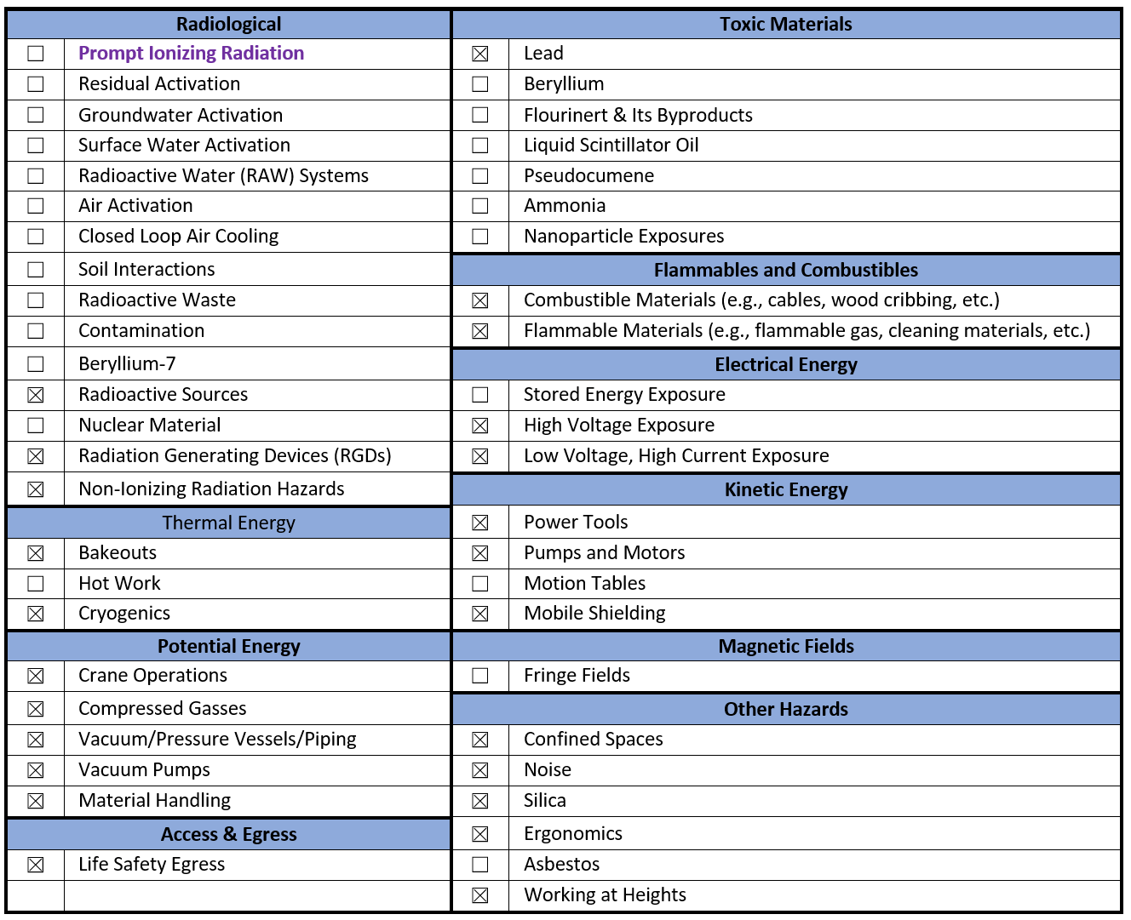
Hazard Inventory for MINOS Experimental Areas
Accelerator specific hazards are bold-purple – None for MINOS Experimental Areas
All MINOS Experimental Areas hazards are evaluated via the common Risk Matrix tables
Covered in SAD Section I, Chapter 4
Hazards evaluated via risk assessment methodology per DOE-HDBK-1163-2020
Likelihood (L):
Anticipated (A), Unlikely (U), Extremely Unlikely (EU), Beyond Extremely Unlikely (BEU)
Consequence (C):
High (H), Moderate (M), Low (L), Negligible (N)
Risk (R):
I , II, III, IV (descending order of concern)

Slide 10
Outline
MINOS Experimental Areas Overview
Hazard Inventory
Non-Accelerator Specific Hazards

Slide 11
Non-Accelerator Specific Hazards - Radiological
Radioactive sources
SENSEI, NEXUS, QUIET use radioactive sources to test/calibrate detectors
Baseline Qualitative Risk (without controls) | Controls Preventive (P)/Mitigative (M) | Residual Qualitative Risk (with controls)
L: A C: H R: I | P: MINOS Service Building and Underground are posted as “Controlled Area” and “Radioactive Materials.” P: Workers must be on access list or have an MCR key to enter the MINOS Surface Building P: Workers must have a permanent key or an MCR key to enter the elevator room to go down to the MINOS Underground P: Workers must have GERT or Rad Worker training AND have Radioactive Source training to be qualified as Source Monitors M: Sources are either used in place with one of more qualified workers or are placed and signed in or out of Source Monitor box located in MINOS electronics room | L: BEU C: M R: IV

Slide 12
Non-Accelerator Specific Hazards - Radiological
Radiation Generating Devices (RGDs)
NEXUS uses d-d neutron generator in their enclosure
Baseline Qualitative Risk (without controls) | Controls Preventive (P)/Mitigative (M) | Residual Qualitative Risk (with controls)
L: A C: H R: I | P: currently, Rad Safety has the key which allows operation of the neutron generator. P: the neutron generator is surrounded by layers of polypropylene, with the intention that nowhere outside the enclosure is considered a radioactive area. The collimated neutron beam hits a target surrounded by lead shielding with the same intention. P: when the neutron generator is first turned on, tests will be made by Rad Safety RCTs and RSOs to ensure that no radioactive area is present that presents a danger. M: Scheduled tests of the radiation field will be made after the neutron generator is brought into operation. | L: BEU C: M R: IV

Slide 13
Non-Accelerator Specific Hazards - Radiological
Non-Ionizing Radiation – Laser
MAGIS uses 3B and 4 lasers
Baseline Qualitative Risk (without controls) | Controls Preventive (P)/Mitigative (M) | Residual Qualitative Risk (with controls)
Class 3B and 4 Laser L: A C: H R: I Class 3R Laser L: A C: L R: III Class 1 and 2 Laser L: A C: L R: IV | P – Class 1 (light tight) enclosures P – ORC and work planning processes P – Locked/Interlocked system P – LOTO procedure or other procedure approved by the laser safety officer (LSO) P – Affected areas are posted M – Use of PPE No analysis required No analysis required | L: BEU C: M R: IV L: A C: L R: III L: A C: L R: IV

Slide 14
Non-Accelerator Specific Hazards – Toxic Materials
Lead
Lead bricks used by NEXUS, SENSEI and QUIET
Baseline Qualitative Risk (without controls) | Controls Preventive (P)/Mitigative (M) | Residual Qualitative Risk (with controls)
L: A C: H R: I | P: All bricks and shielding are encased in either duct tape and/or plastic bags. P: All workers handling lead have Lead Safety training. P: While encasing lead, appropriate PPE has been worn by workers P: Inventory has been maintained and monitored by personnel. Lead that required tooling has been monitored by the ES&H lead expert, and HEPA vacuums have been used to capture any lead dust. M: Checks were made of the area after all work was completed to look for residual lead traces; none were found | L: BEU C: M R: IV

Slide 15
Non-Accelerator Specific Hazards – Flammable and Combustible Materials
Combustible materials
While under construction there are cables, cardboard boxes, paper, wood cribbing, etc. present
Baseline Qualitative Risk (without controls) | Controls Preventive (P)/Mitigative (M) | Residual Qualitative Risk (with controls)
L: A C: H R: I | P: all waste materials are removed from MINOS Underground as soon as feasible by workers. P: housekeeping is routinely done to minimize the possibility of a fire. P: Fire safety and response are part of the MINOS Underground training is required of all workers. M: in the event of a fire, workers enter a Positive Pressure Emergency Tunnel to avoid smoke and toxic fumes. M: In the event the elevator is not working, there is a Secondary Escape Route via the NuMI beamline tunnels. If toxic fumes are present, there are EEBDs to wear for an emergency escape. This is all part of the MINOS Underground training. M: In the event of a fire in the MINOS Underground, standpipes are pre-charged and, if necessary, released under the Fire Department’s control. | L: BEU C: N R: IV

Slide 16
Non-Accelerator Specific Hazards – Flammable and Combustible Materials
Flammable liquids or gases may cause a rapid initiation or spread of fire
small amounts of such liquids, and they are all stored in the MINOS Surface Building
Baseline Qualitative Risk (without controls) | Controls Preventive (P)/Mitigative (M) | Residual Qualitative Risk (with controls)
L: A C: H R: I | P: We only have small amounts of such liquids, and they are all stored in the MINOS Surface Building in a Flammable cabinet. P: The one dangerous gas underground is carbon tetrafluoride, used by the upcoming SBC experiment. This gas is not flammable but can react violently with alkali metals. SBC is currently running in Lab D; the carbon tetrafluoride is completely contained within the bubble chamber. No alkali metals are permitted underground. P: Part of the MINOS Underground training is a discussion of fire prevention, especially as regards being aware of combustible and flammable materials. M: In the event of a fire in the MINOS Underground, standpipes are pre-charged and, if necessary, released under the Fire Department’s control | L: BEU C: M R: IV

Slide 17
Non-Accelerator Specific Hazards – Electrical Energy
High Voltage Exposure
High voltage is used for the PMT boxes in the MINERvA scintillator, ArgonCube, NEXUS d-d generator, and pumps and motors in every segment
Low Voltage, High Current Exposure
Low voltage high current sources are used by ArgonCube, NEXUS, SENSEI, and QUIET
Baseline Qualitative Risk (without controls) | Controls Preventive (P)/Mitigative (M) | Residual Qualitative Risk (with controls)
L: A C: H R: I | P: All commercial pumps and motors must have NRTL qualifications, which in turn requires no exposed electrical surfaces or wire. P: All custom electronics must pass an Electrical Committee review including documentation and walkthroughs of the equipment. Part of this review is ensuring adequate fusing is provided everywhere. M: Work on electrical devices will only be done in accordance with Level 2 Lockout/Tagout and NEPA and OSHA electrical standards. M: Work on electrical devices will only be done in accordance with any relevant IMPACT packages and/or ORCs, and under the control of the facility coordinator. | L: EU C: L R: IV

Slide 18
Non-Accelerator Specific Hazards – Thermal Energy
Bakeout
MAGIS-100 will do a bakeout of their tower vacuum pipe in the MINOS shaft
Baseline Qualitative Risk (without controls) | Controls Preventive (P)/Mitigative (M) | Residual Qualitative Risk (with controls)
L: A C: H R: I | P: MAGIS-100 will have multiple monitors on the tower vacuum pipe: cameras, temperature probes, smoke detectors, etc. These will be carefully monitored with a fire watch while the bakeout is in progress. P: The ORC for MAGIS-100 electrical systems will be reviews the Electrical Review Committee, and the ORC for MAGIS-100 fire safety systems will be reviewed by the ESH Fire Safety Committee and the Fire Department. M: In the case of a fire during bakeout, the Fire Department will respond immediately. They will have personnel monitoring the bakeout in the shaft, also as per the ORC and IMPACT documents. | L: EU C: M R: III

Slide 19
Non-Accelerator Specific Hazards – Thermal Energy
Cryogenics
Liquid nitrogen, liquid helium, in cryogenic vessels in the SENSEI, NEXUS, and QUIET enclosures
Liquid argon (Lar) used in large quantities by both ArgonCube and SBC.
SBC uses carbon tetrafluoride to allow rapid cooling of the bubble chamber.
Baseline Qualitative Risk (without controls) | Controls Preventive (P)/Mitigative (M) |  | Residual Qualitative Risk (with controls)
L: A C: H R: I | SENSEI, NEXUS, and QUIET Enclosures: P: TSW flags intended cryogenic liquids for SME review prior to arrival P: SMEs produce engineering notes on piping and vessel system and ODH calculations P: ORC process has SMEs review installed system and documentation prior to operation P: ODH system of oxygen sensors that trigger high evacuation alarms in the MINOS Underground that are tested and calibrated at prescribed intervals to maintain an engineered ODH 0 classification M: Special training and approved procedures for personnel handling cryogens. M: ODH system alarms both in building and through FIRUS for MINOS Underground. M: Experimenters trained on evacuation procedures in MINOS Underground training. | Liquid argon (LAr) cryostats for ArgonCube and SBC: P: TSW flags intended cryogenic liquids for SME review prior to arrival P: SMEs produce engineering notes on piping and vessel system and ODH calculations. At present all amounts of cryogenic liquids in these spaces are ODH 0 P: ORC process has SMEs review installed system and documentation prior to operation M: Special training and approved procedures for personnel handling cryogens. M: Experimenters trained on evacuation procedures in MINOS Underground Training. | L: BEU C: N R: IV

Slide 20
Non-Accelerator Specific Hazards – Kinetic Energy
Pumps and Motors
Located throughout the MINOS underground
Baseline Qualitative Risk (without controls) | Controls Preventive (P)/Mitigative (M) | Residual Qualitative Risk (with controls)
L: A C: H R: I | P: All machine guarding required to be in place prior to use to prevent injury. P: Lock out/Tagout procedure prevents personnel from accessing rotating shafts or motors. Zero energy is verified prior to equipment access. P: Engineering Notes and ORC specify construction and procedures associated with installation and use of the pumps and motors, and have been reviewed by ESH. | L: EU C: H R: III

Slide 21
Non-Accelerator Specific Hazards – Kinetic Energy
Mobile Shielding
Polypropylene shielded d-d neutron generator runs on rails
Baseline Qualitative Risk (without controls) | Controls Preventive (P)/Mitigative (M) | Residual Qualitative Risk (with controls)
L: A C: H R: I | P: Shielding is secured in an engineered enclosure which runs on rails with a crank system to move cart this all rests on. P: Only one person moves cart and all other personnel will stay out of path of cart. P: Engineering Notes and ORC specify construction and procedures associated with movement of the cart and have been reviewed by ESH. | L: BEU C: H R: III

Slide 22
Non-Accelerator Specific Hazards – Potential Energy
Crane Operations
All large items underground were craned down using the cranes in the MINOS Surface Building. In addition, there is another crane in the ArgonCube area, and a hoist crane in the NEXUS enclosure.
Baseline Qualitative Risk (without controls) | Controls Preventive (P)/Mitigative (M) | Residual Qualitative Risk (with controls)
L: A C: H R: I | P: All overhead crane operators must take crane operator training P: Mobile Crane operators are trained and certified/licensed and take. P: Qualified riggers are determined by their supervisor. P: All crane operators have to be familiar with FESHM 10000 series and apply requirements, (i.e. HAs, lift plans, etc.). P: All cranes are inspected monthly by an outside vendor. M: Personal Protective Equipment mitigates the severity of injury by protecting the individual. | L: BEU C: M R: IV

Slide 23
Non-Accelerator Specific Hazards – Potential Energy
Compressed Gasses
Compressed gas tanks are used throughout the MINOS Underground.
Baseline Qualitative Risk (without controls) | Controls Preventive (P)/Mitigative (M) | Residual Qualitative Risk (with controls)
L: A C: H R: I | P: All personnel must take Pressure Safety orientation training P: All personnel must take compressed gas cylinder safety training P: All personnel must be familiar with FESHM 5000 series and apply requirements. P: Gas cylinders are secured and capped when not in use. M: Personal Protective Equipment mitigates severity of injury. | L: BEU C: M R: IV

Slide 24
Non-Accelerator Specific Hazards – Potential Energy
Vacuum/Pressure Vessels
The two large pressure vessels in the MINOS Underground are the ArgonCube cryostat and the SBC bubble chamber/cryostat.
Baseline Qualitative Risk (without controls) | Controls Preventive (P)/Mitigative (M) | Residual Qualitative Risk (with controls)
L: A C: H R: I | P: All personnel must be familiar with FESHM 5000 series and apply requirements. P: All personnel must take Pressure Safety orientation training. P: All vacuum/ pressure vessels have pressure safety devices that are tested and inspected every 5 years, tracked in Fermilab pressure vessel and pressure relief device database. P: All vacuum/ pressure vessels go through the Operational Readiness Clearance and engineering note process with peer review and must meet ASME code. | L: BEU C: M R: IV

Slide 25
Non-Accelerator Specific Hazards – Potential Energy
Vacuum Pumps
Vacuum pumps are present throughout the MINOS Underground.
Baseline Qualitative Risk (without controls) | Controls Preventive (P)/Mitigative (M) | Residual Qualitative Risk (with controls)
L: A C: H R: I | P: All machine guarding required to be in place prior to use to prevent injury. P: Lock out/Tagout procedure prevents personnel from accessing rotating shafts or motors. Zero energy is verified prior to equipment access. P: All personnel must take Pressure Safety orientation training. M: Personal Protective Equipment mitigates severity of injury. | L: BEU C: M R: IV

Slide 26
Non-Accelerator Specific Hazards – Potential Energy
Material Handling
Risk of falling/crushing while using forklifts, hand trucks, carts, other rigging in experiment installation
Baseline Qualitative Risk (without controls) | Controls Preventive (P)/Mitigative (M) | Residual Qualitative Risk (with controls)
L: A C: H R: I | M: Training required for special equipment (ex: forklifts) M: Facility staff inspection and maintenance of hand trucks, carts, etc. M: HA and/or access restrictions as required by task | L: A C: N R: IV

Slide 27
Non-Accelerator Specific Hazards – Other Hazards
Confined Spaces
The ArgonCube cryostat is a confined space until filled with liquid argon
Baseline Qualitative Risk (without controls) | Controls Preventive (P)/Mitigative (M) | Residual Qualitative Risk (with controls)
L: A C: H R: I | P: Personnel follow procedures as per the HA. P: All personnel must have ODH training and Confined Space training. P: All personnel working in the confined space must have oxygen monitors and have an attendant outside the confined space. M: In the event of an ODH or confined space incident, the Fire Department responds with air tanks. | L: BEU C: M R: IV

Slide 28
Non-Accelerator Specific Hazards – Other Hazards
Working at Heights
Risk of falls, dropped tools/material
Baseline Qualitative Risk (without controls) | Controls Preventive (P)/Mitigative (M) | Residual Qualitative Risk (with controls)
L: A C: H R: I | P: Fall protection program P: Training for scaffolding, ladders, mobile elevating work platforms P: Guard rails M: PPE-PFAS including approved anchor points, hard hats | L: EU C: M R: IV

Slide 29
Non-Accelerator Specific Hazards – Access and Egress
Life Safety Egress
Baseline Qualitative Risk (without controls) | Controls Preventive (P)/Mitigative (M) | Residual Qualitative Risk (with controls)
L: A C: H R: I | P: All MINOS Underground workers must take MINOS Underground Training. The most important part of this training concerns Life Safety Egress. P: In the case of a power outage, all Life Safety systems are powered by a large diesel generator: emergency lights, elevators, cranes (so the personnel basket to underground can be used), and air handling units (AHUs). M: First action on hearing an ODH or fire alarm underground is to exit to the Positive Pressure Emergency Passageway which should prevent smoke or toxic fumes from entering the area. M: Normally, workers should exit the underground via the main elevator. In the event the elevator is not working, the group should first call the emergency number X3131. If instructed to do so, the group should use the Secondary Escape Route explained in the MINOS Underground training and indicated with signs. The group may also be instructed to carry or use EEBDs. M: In the MINOS Surface Building, workers should go to the Assembly Area in the parking lot in the case of a fire alarm and go to the Tornado Shelter in the mechanical room in the case of a tornado warning. | L: EU C: N R: IV

Slide 30
Questions?

