Slide 1


MQXFA13b Preload Targets
D. Cheng, P. Ferracin, L. Garcia-Fajardo, H. Pan
For the LBNL AUP Team
10-Jan-2024
LBNL

Slide 2
Outline
Preload targets
Overview of MQXFA03-17 pre-loads achieved
Proposed preload process

Slide 3
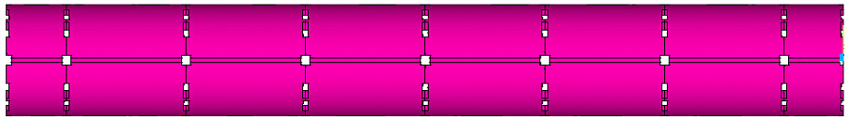
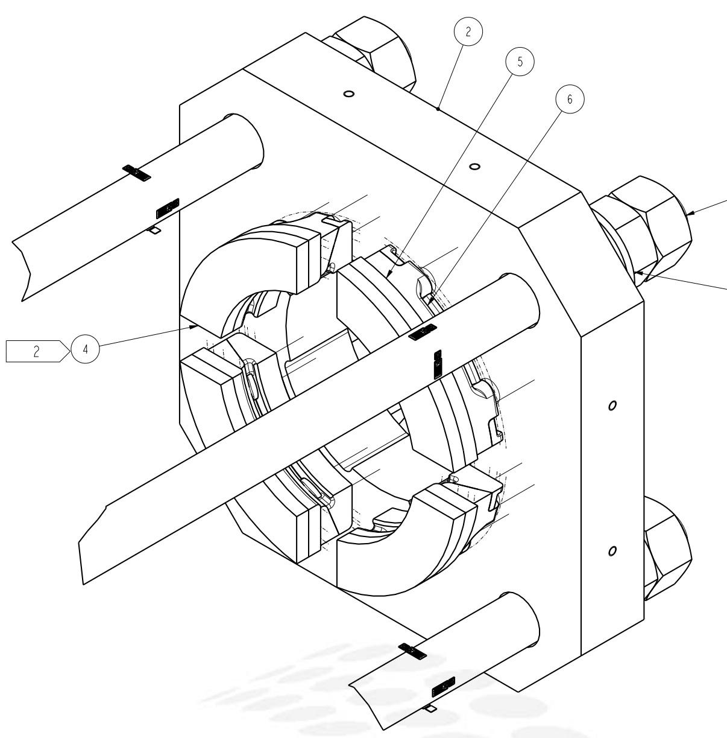
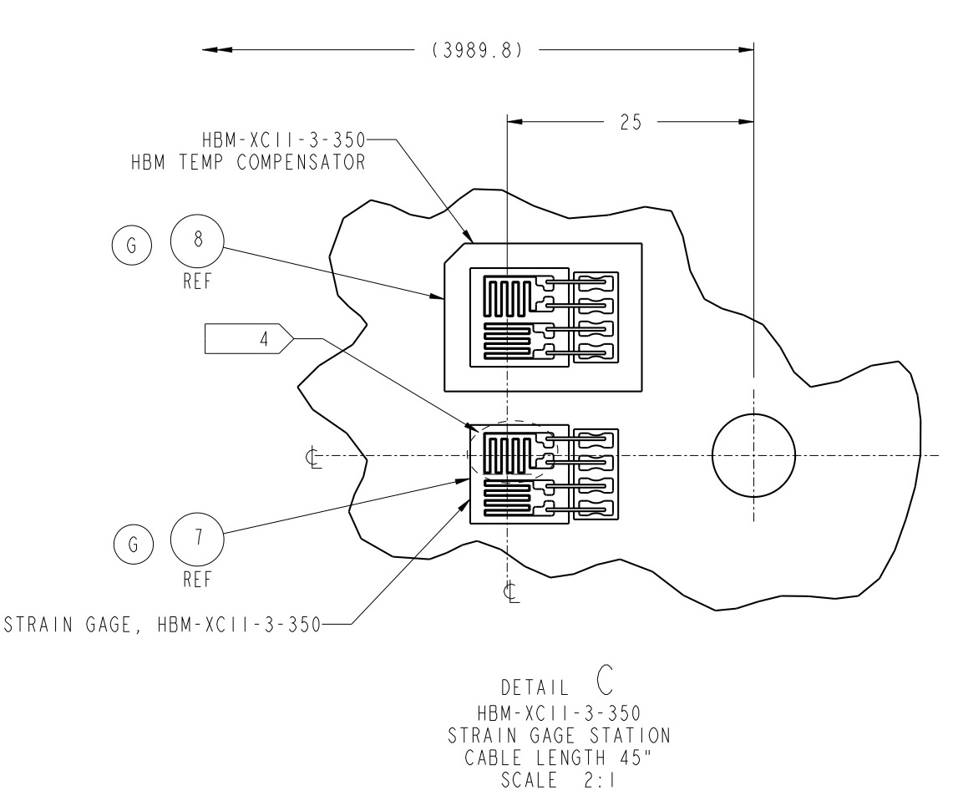
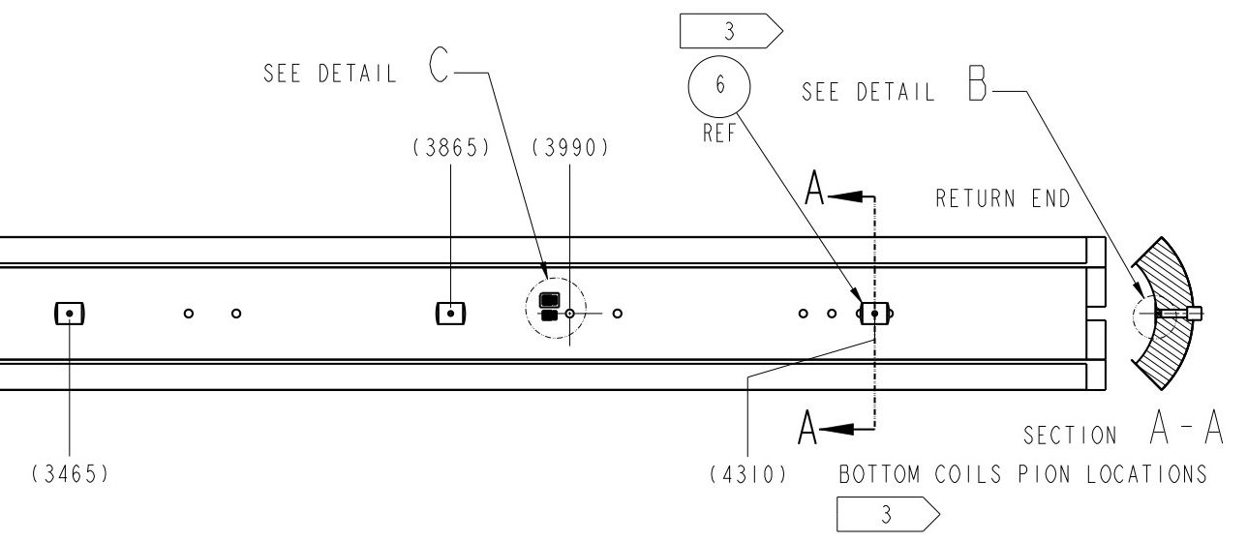
MQXFA SG Layout
LE
MID
RE
Shell 2
Shell 4
Shell 7
Coil Stations
Rod Stations
HBM gauges and FBG (next slide) are installed
Shell gauges --- three axial locations:
  Shell gauges (T & Z): on shell 2, 4, & 7
Coil gauges (T & Z): on the axial location of 3989 mm (RE) from LE.
Rod stations are located on the RE (see inset)
  Each station is full bridge with four individual gauges.
RE axial plate assembly

Slide 4
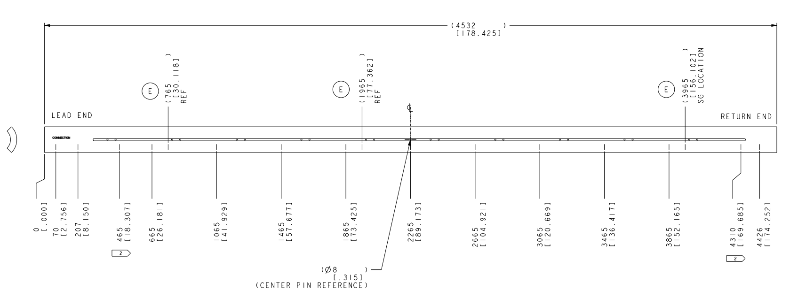
MQXFA SG Layout (FBG)
FBG Coil gauges (T & Z): on three axial locations:
  715 mm, 1915 mm, and 3725 mm from LE.
Based on experience with MQXFA09 thru MQXFA15
  Only on Upper coils

Slide 5
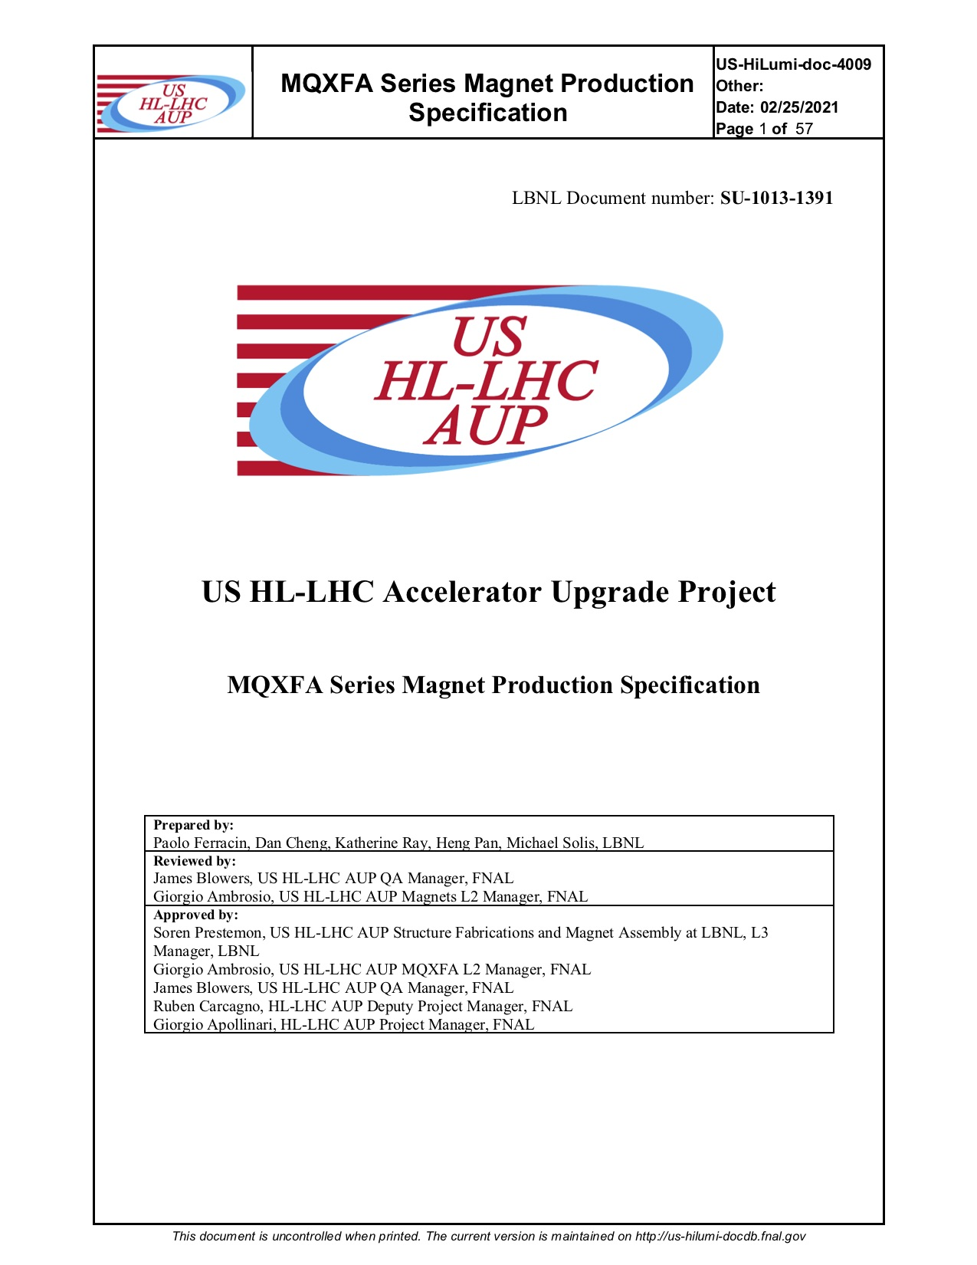
MQXFA Preload Specifications
Pole key gap: 0.016” (~400µm) average per side
  New specification wording has been in place since MQXFA11
Azimuthal pre-load
  Target coil pre-stress at cold of 100 MPa requires:
    ~80 ± 8 MPa at R.T. after 24 hours
      Assumes 5-10 MPa decrease in 24 hours
  We set as maximum coil stress to 120 MPa during loading
Axial pre-load
  The total force at cold is: 1.0 MN
    ~950 με at R.T
    Equates to total rod force ~0.58 MN at R.T.
Updated max excursion after MQXFA13 results
These stress targets have remained unchanged for both Pre-Series (MQXFA03-A07) and Series magnets, and are captured in the Series Magnet Specifications Document (US-Hilumi-Doc-4009).

Slide 6
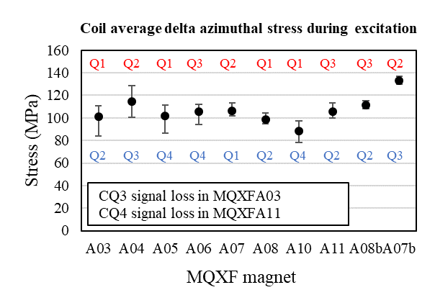
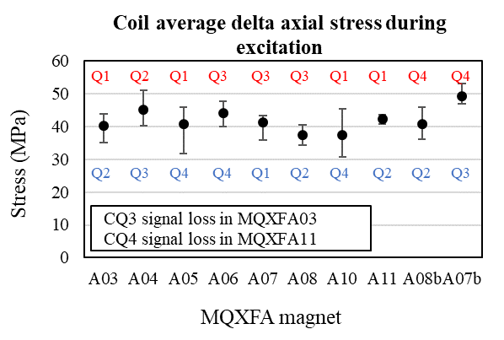
Preloads Measured for MQXFA Magnets
 |  | Target (MPa) | MQXFA03 | MQXFA04 | MQXFA05 | MQXFA06 | MQXFA08b | MQXFA10 | MQXFA11 | MQXFA13 | MQXFA14b | MQXFA07b | MQXFA15 | MQXFA16 | MQXFA17
R.T. | Coil | -80 ± 8 | -79 | -76 | -73 | -80 | -76 | -66 | -70 | -71/ -77 | -67 | -80 | -83 | -86 | -86
 | Shell 7 | 58 ± 6 | 54 | 64 | 62 | 60 | 50 | 56 | 66* | 61 | 58 | 56 | 62 | 65 | 66
Cold | Coil | -103 | Determined from unloading deltas during powering (see pictures on next slide
 | Shell 7 | 110 | 112 | 142 | 144 | 137 | 123 | 142 | 132 | 128 | 136 | 157
* Apparent high shell stress is due to residual offsets observed after the unloading of the MQXFA09 shell-yokes, which were reused in MQXFA11
Maximum stress values of each coil were selected for these plots
In red: Coil quadrants with the highest stress increase
In blue: Coil quadrants with the lowest stress increase

Slide 7
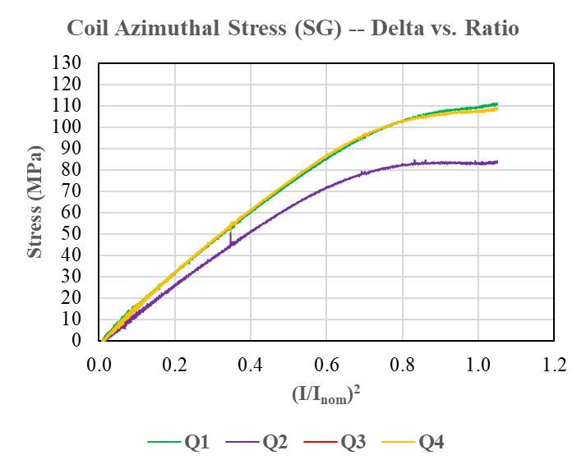
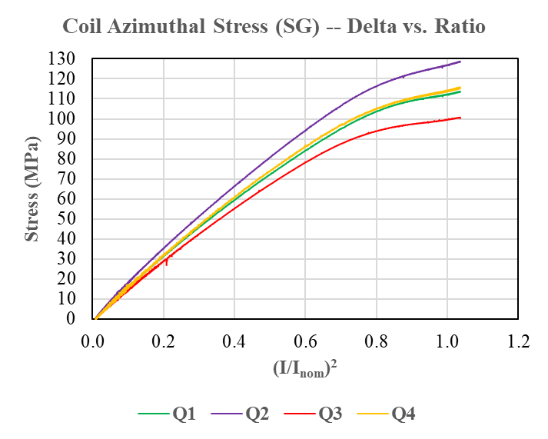
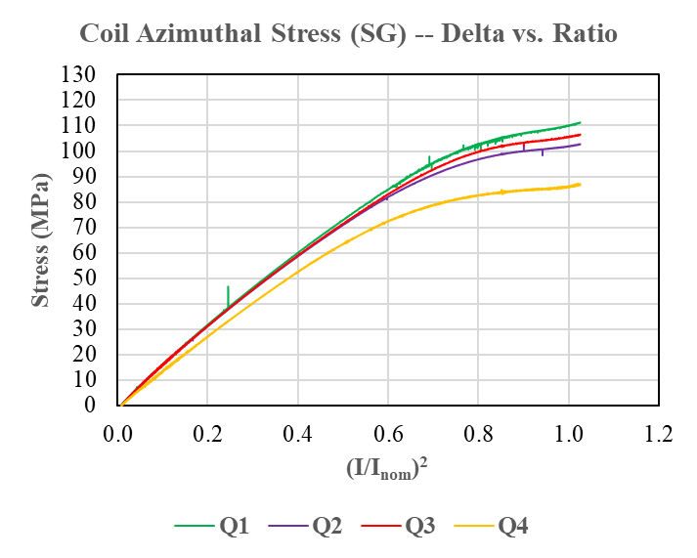
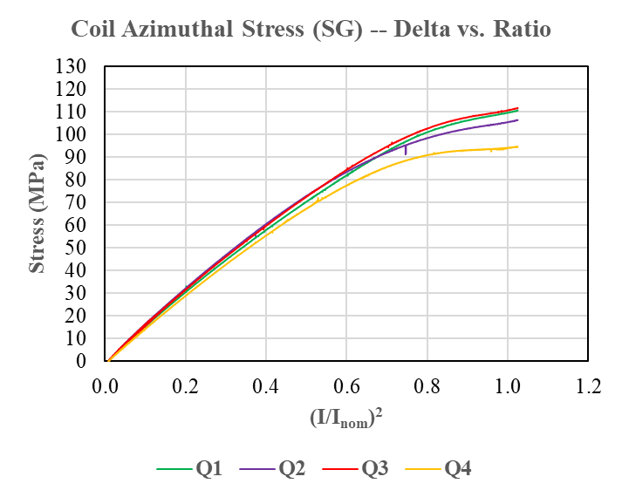
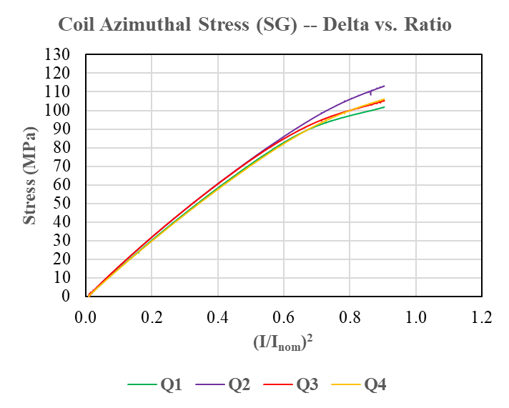
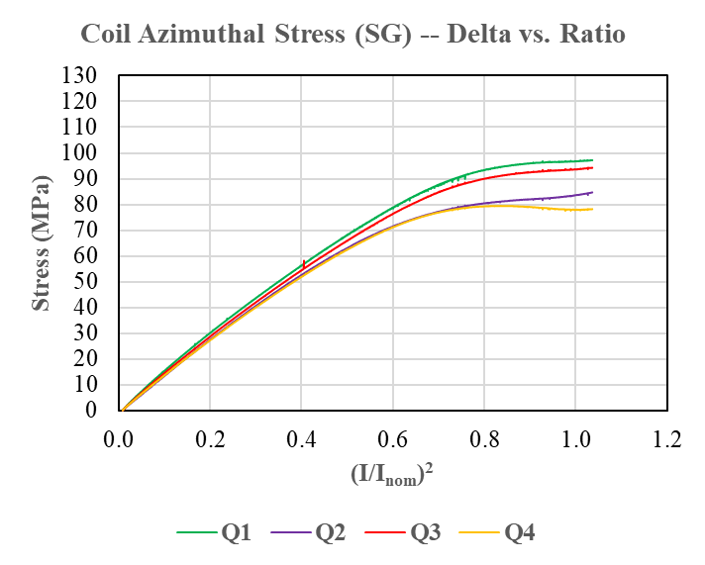
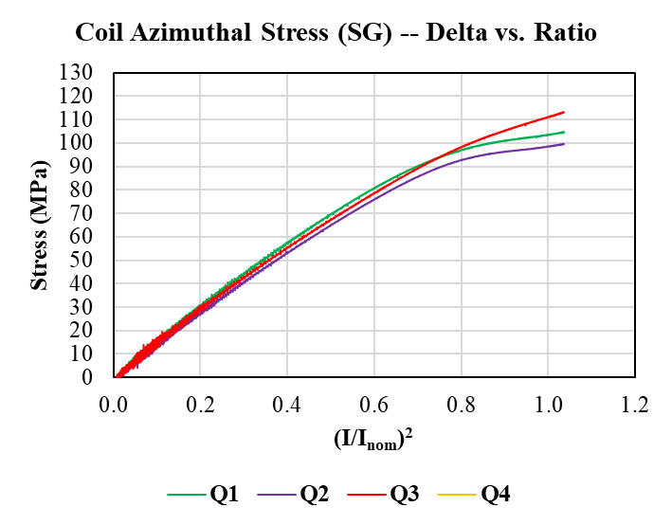
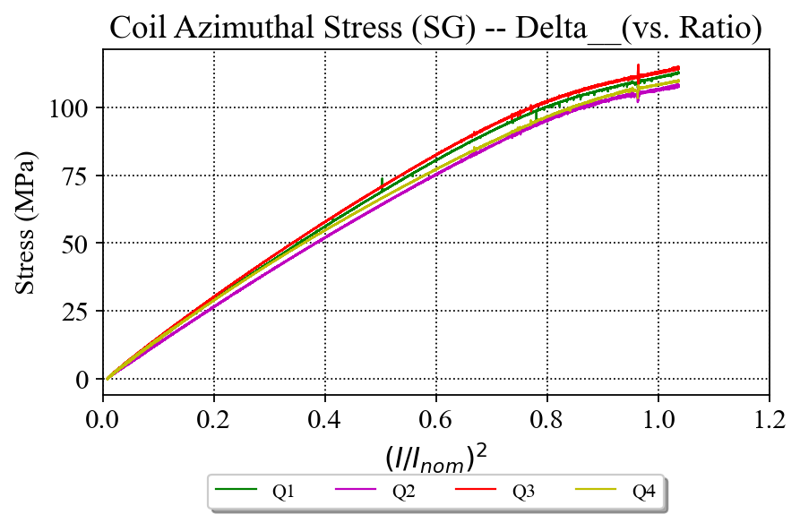
Preloads Measured for MQXFA Magnets
MQXFA03
Ramp to 16.65 kA
MQXFA04
Ramp to 16.55 kA
MQXFA05
Ramp to 16.46 kA
MQXFA06
Ramp to 16.45 kA
Av. delta stress: 101 MPa
Av. delta stress: 115 MPa
Av. delta stress: 102 MPa
Av. delta stress: 106 MPa
MQXFA07
Ramp to 15.45 kA
MQXFA08b
Ramp to 16.50 kA
MQXFA10
Ramp to 16.54 kA
MQXFA11
Ramp to 16.54 kA
Av. delta stress: 107 MPa
Av. delta stress: 111 MPa
Av. delta stress: 89 MPa
Av. delta stress: 106 MPa

Slide 8
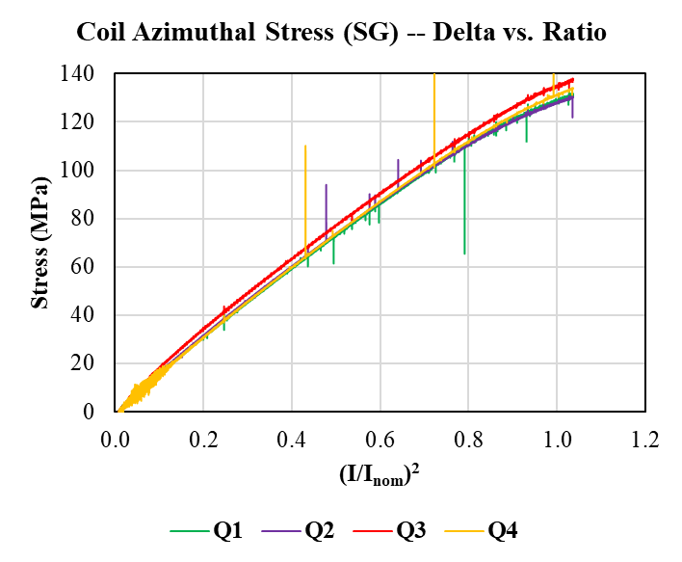
MQXFA07b
Ramp to 16.54 kA
Av. delta stress: 133 MPa

Slide 9
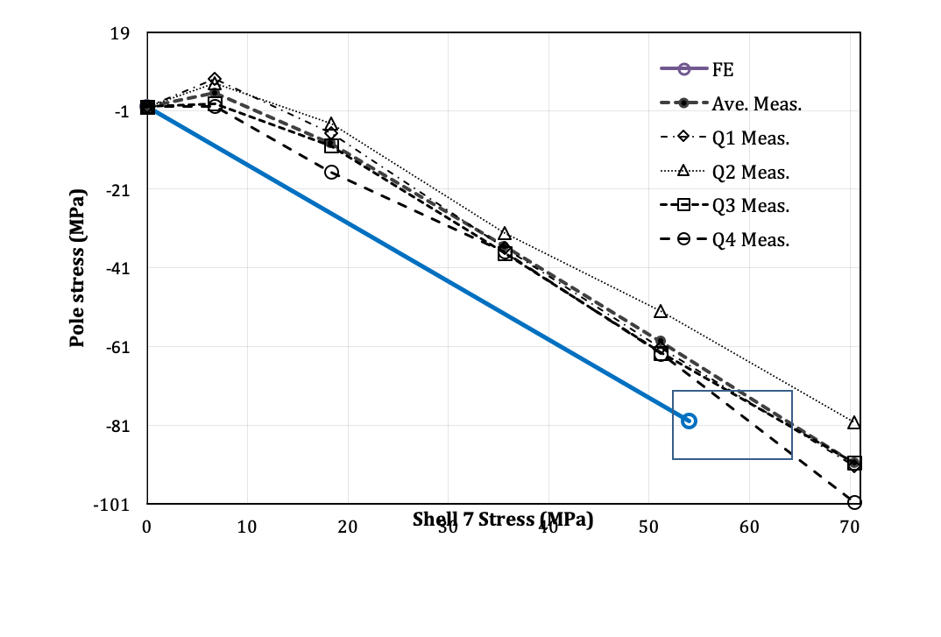

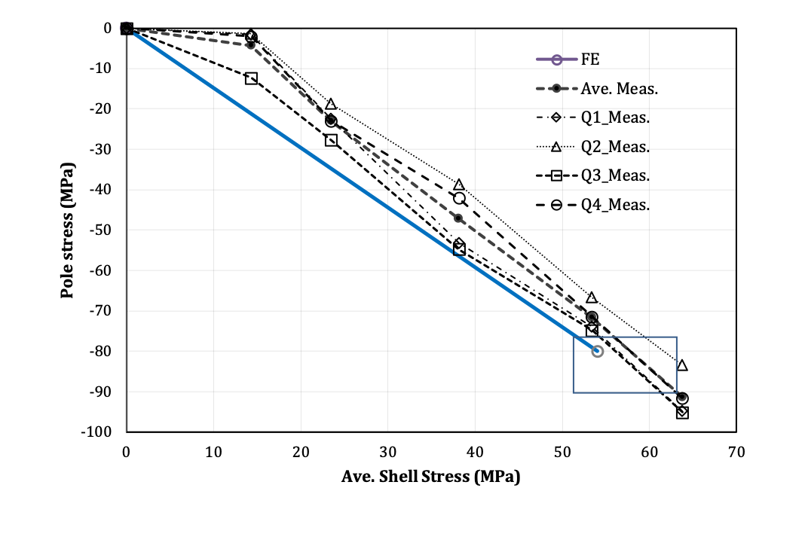

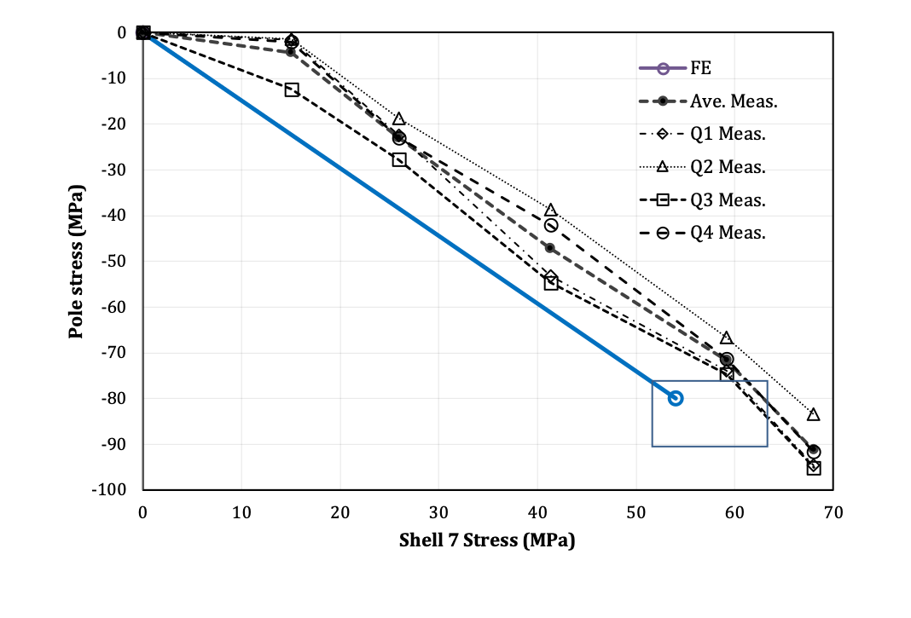
MQXFA15r and MQXFA16, MQXFA17
Transfer Function Plots
MQXFA15r reload had a smaller spread of coil stresses, with average at 91 MPa
MQXFA16 had a small spread; preloaded to avg 86 Mpa
MQXFA17r reload (due to axial bullet setup) had a small spread; preloaded to avg 86 Mpa
MQXFA15r
MQXFA16
MQXFA17r
MQXFA15r
MQXFA16
MQXFA17r

Slide 10
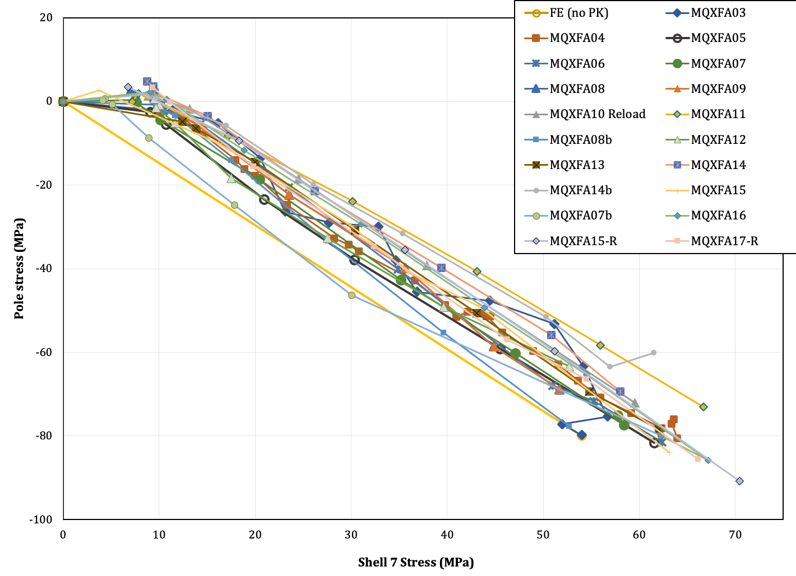
Transfer Function at RT for MQXFA Magnets
* NOTE: MQXFA09 shell-yoke assembly was unloaded and SG offsets were forced to original pre-A09 preload values before preloading MQXFA11. E.g. shell SG values are likely over-reporting calculated stresses by 2-5 MPa in Shell 7. See appendix.

Slide 11
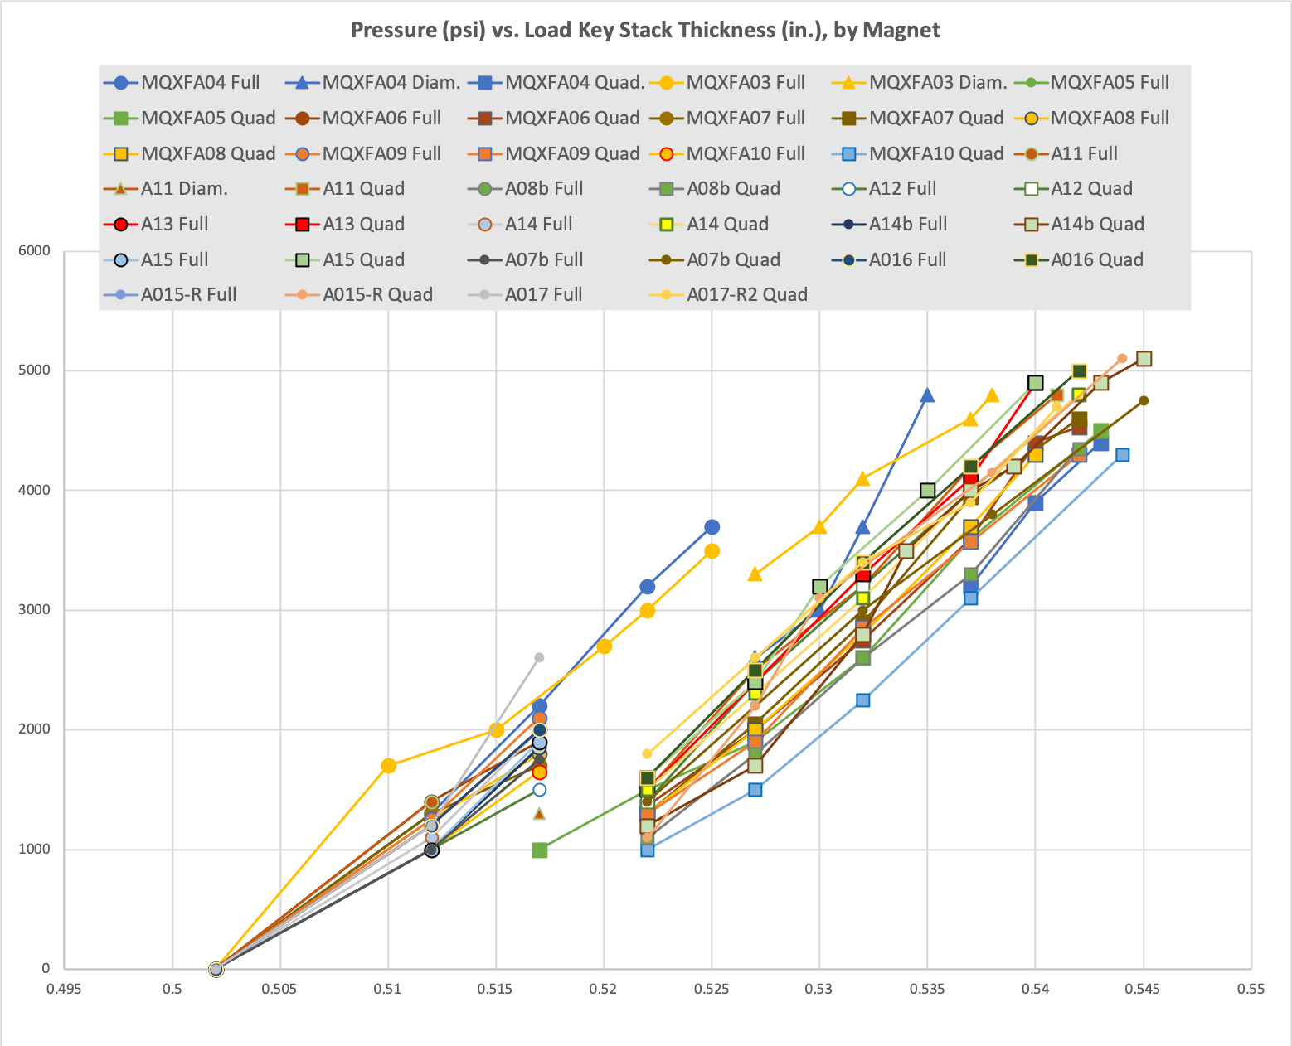
MQXFA Bladder Pressures
MQXFA10 shimmed coils were smaller, so overall coil pack size was smaller than in other magnets
  Required an additional .025 mm of load key shim to achieve target coil preload (13.82 mm total)
MQXFA11 utilized more midplane shim than A07-A10) due to adjusted measurement reporting
  Larger coil pack required higher pressures at same key shim size
  But required smaller total key size to reach target (13.74 mm total)
Plot of bladder pressures vs target shows correlation between required bladder pressure to achieve preload targets
50% Azimuthal load

Slide 12
Standard Preload Process
See Next Talk about shim package targets
The pre-load sequence:
  Pre-loaded axial rods with average ~50 µε;
  50% azimuthal pre-load (~0.030” shims, or total 13.52 mm)
  50% axial pre-load (~470 µε)
  100% azimuthal pre-load (~.040” shims, or total ~13.8 mm)
  100% axial pre-load (~950 µε)
The pre-load process:
  We preloaded MQXFA05 quadrant by quadrant from the initial 0.010” shims (total 13.01mm) in 0.005” steps, reaching a peak bladder pressure of 4500 psi.
  All subsequent magnets used quadrant by quadrant loading after the 0.015” shims step (total ~13.14 mm)
MQXFA05 Coil 115 slope may have been caused by “locking in” a position too early in the preload process

Slide 13
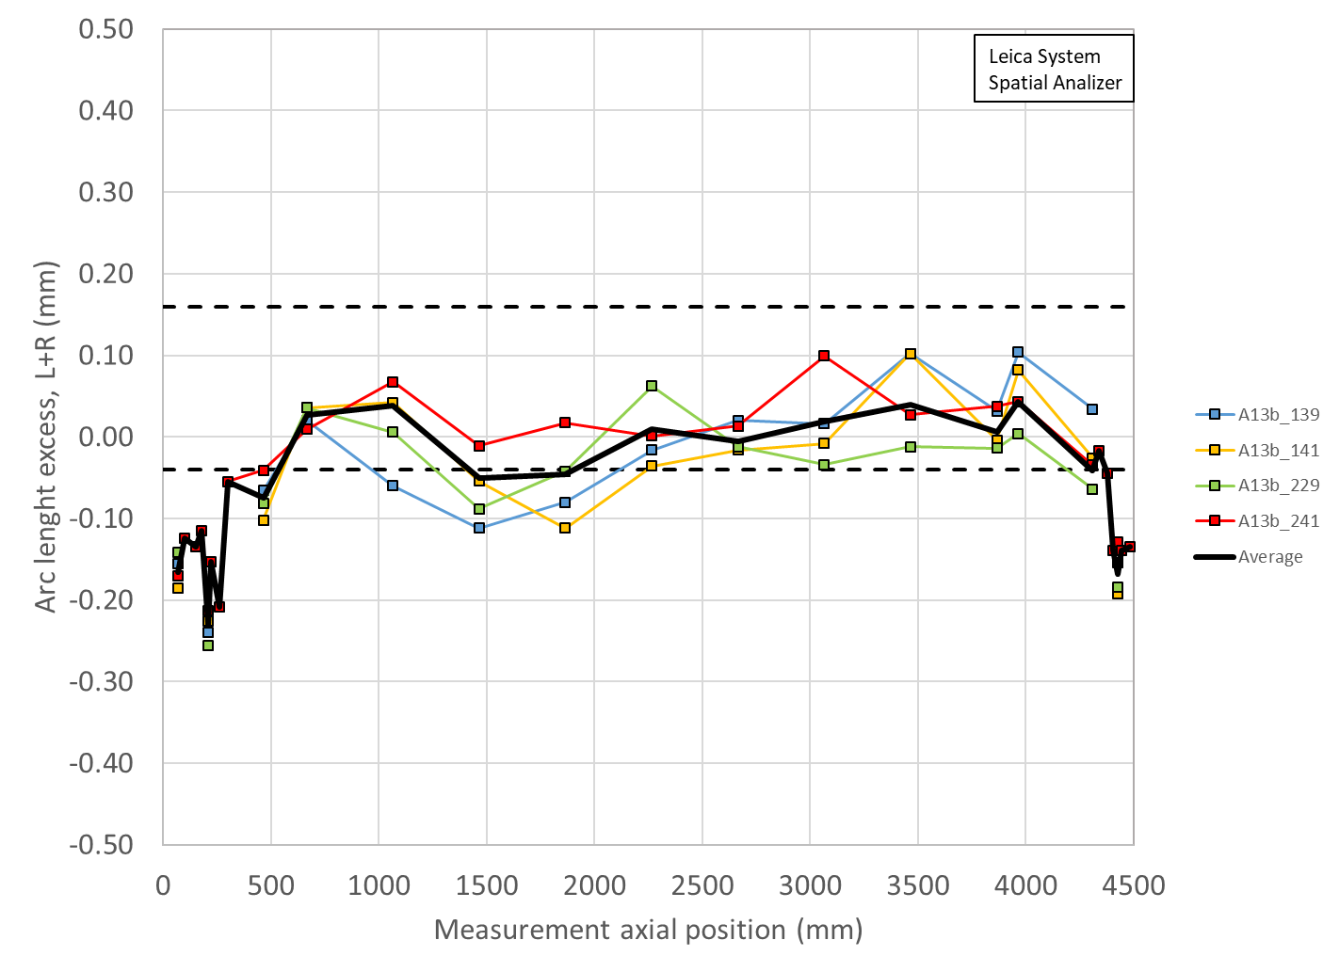
Variation of MQXFA13b Pre-Stress due to Coil Variations
Coil sizes based on CMM and shimmed sizes on midplane
The amount of increased average stress above what is measured at the SG is still below the +10 MPa “hard limit” when staying below the 120 MPa limit during all pressure operations
Shimmed
0.005” on Coil 139
0.005” on 141
0.002”+0.002” on 241
0.005” on 229
No points appear larger than at the SG location, per measurements
Starting with MQXFA08 coils there is now a CMM measurement at the SG location

Slide 14
Axial Preload for MQXFA
The axial preload targets the same level of MQXFA04 - 11:
MQXFA Target | R.T. | 1.9 K | Nom. Current
Preload | 950 µε ± 95 µε | 1700 µe | 1750 µe
Axial Force (MN) | 0.6 | 1.07 | 1.12
Ratio to the E.M. force at nom. current | 50% | 90% | 93%
Total axial e.m. force is 1.2 MN at nominal current

Slide 15
Summary
The R.T. preload targets for MQXFA13b remain unchanged and follow the Magnet Specifications:
  Shell Stress: 58 ± 6 MPa
  Coil Stress: -80 ± 8 MPa
  Rod strain: 950 ± 95 µε
Cold powering deltas are used to determine the preload on the coils (MQXFA7b Coil SG data is the last set available)
Updated max excursion from 110 MPa to 120 MPa
Average coil size (arc length) after shimming is within ~±100 µm with respect to average coil size measured at the strain gauge location within the straight section
The preload process will start quadrant by quadrant loading after the ~13.14 mm load key step
  Intended to prevent “locking in” a position too early
See Next talk for a discussion on the shim package targets

Slide 16
Additional Slides

Slide 17
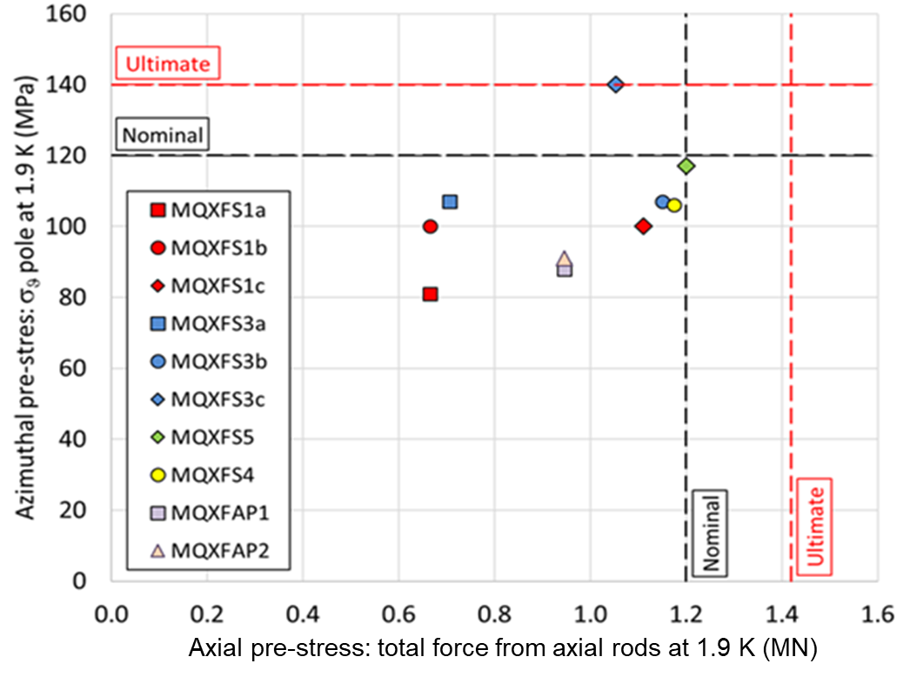
The Load Condition after CD
(based on powering)
MXQFA04
MXQFA03
MXQFA07
MXQFA05
MXQFA06
NOTE: axial load values due to cool down SG data is still being examined

Slide 18
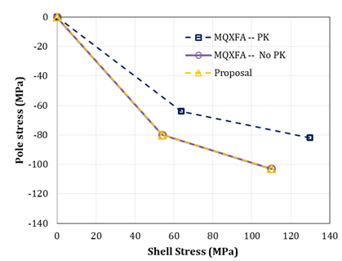
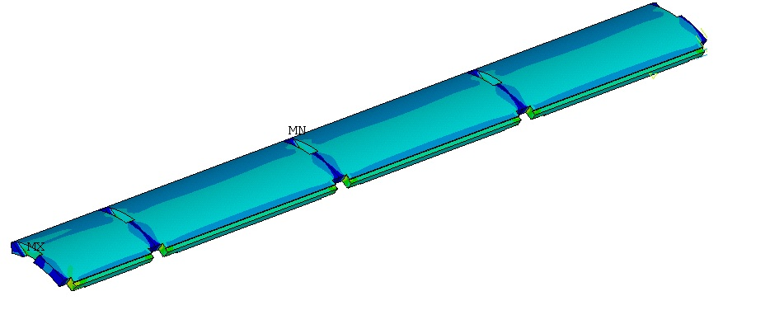
Preload Targets for MQXFA
We have kept the same pole-gap since MQXFA03:
  About ≥ 5.5 mil/side: will not fully close at cold
 | Value
Interference (µm) | 470
Polekey gap (µm/side) | 145
Polekey interception F_{pole}/F_{shell} (1.9K) | 0
 | 1.9 K | 16.47 kA | 17.89 kA | 19 kA
Shell Average Von Mises Stress (MPa) | 116 | 121 | 125 | 129
Shell Peak Stress (MPa) | 488 | 481 | 481 | 480

Slide 19
MQXFA05 &6 Load Key Shimming Summary
From MQXFA05, we reduced number of operations from ~10 steps to 7 steps using a constant 0.005” shim increment
Magnets MQXFA03 to -05 were plotted together
  Shows full-quadrant loading, diametrical loading, and quadrant loading
Load key shims stacks are shown vs. pump pressure required to achieve insertion
  Pressures shown are the highest pressure required (in the case of diametrical and/or quadrant) to complete a full round of shimming

Slide 20
Analysis of low stress in MQXFA05 coil 115

Slide 21
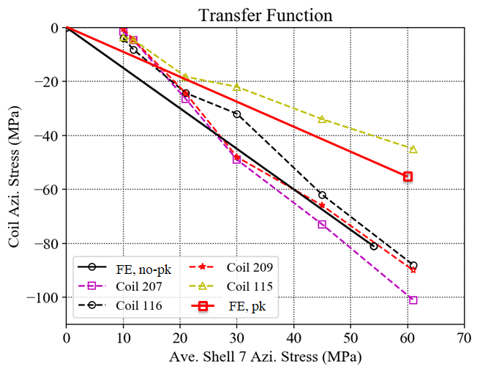
MQXFA05 Coils TF
Detailed data points in next slide

Slide 22
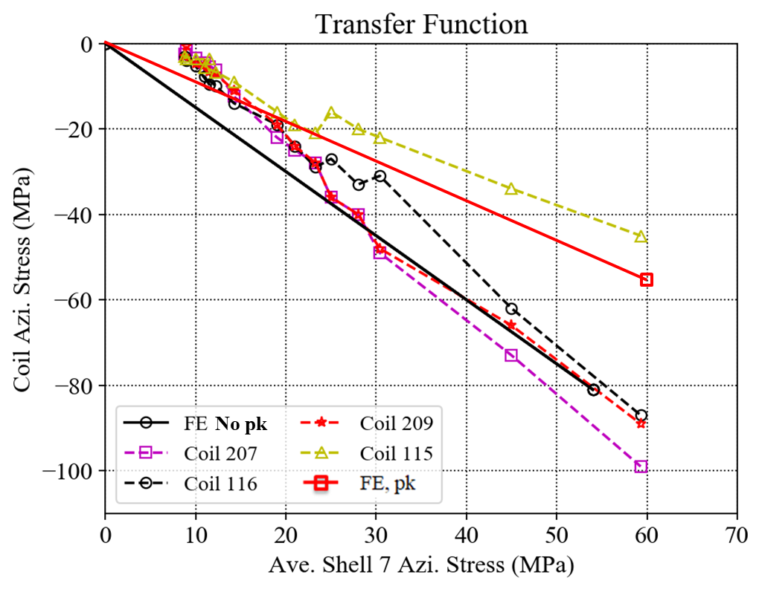
MQXFA05 Coils TF (detailed)
Detailed data points from 20 mil to 30 mil shims

Slide 23
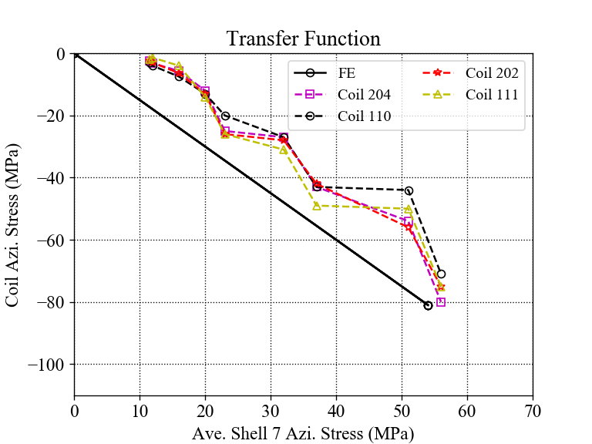
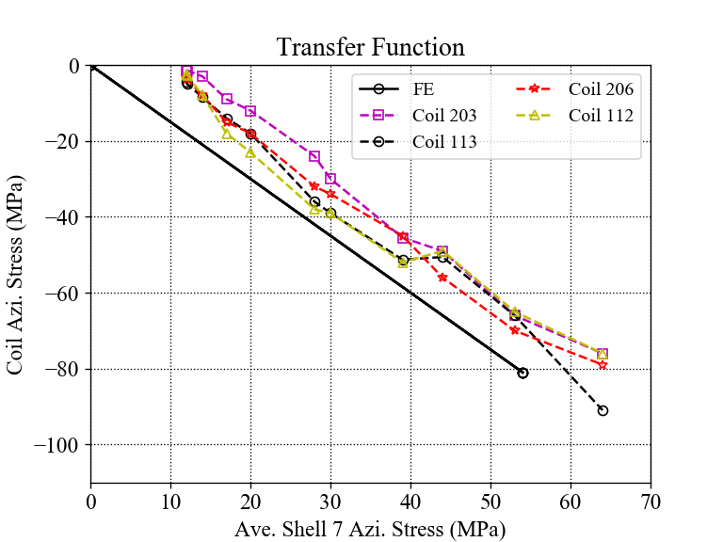
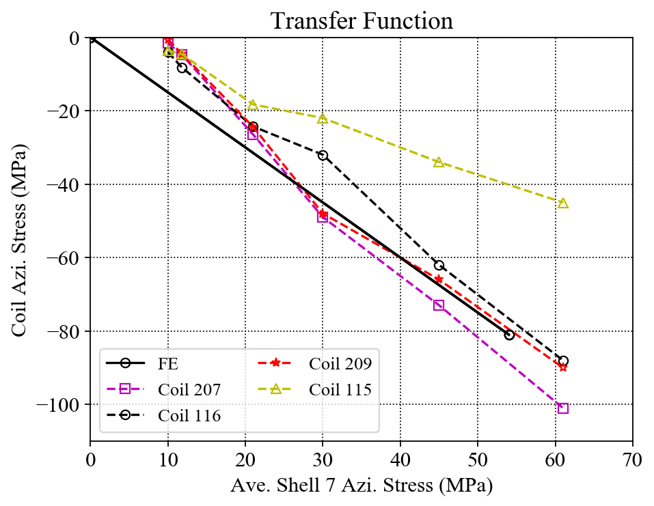
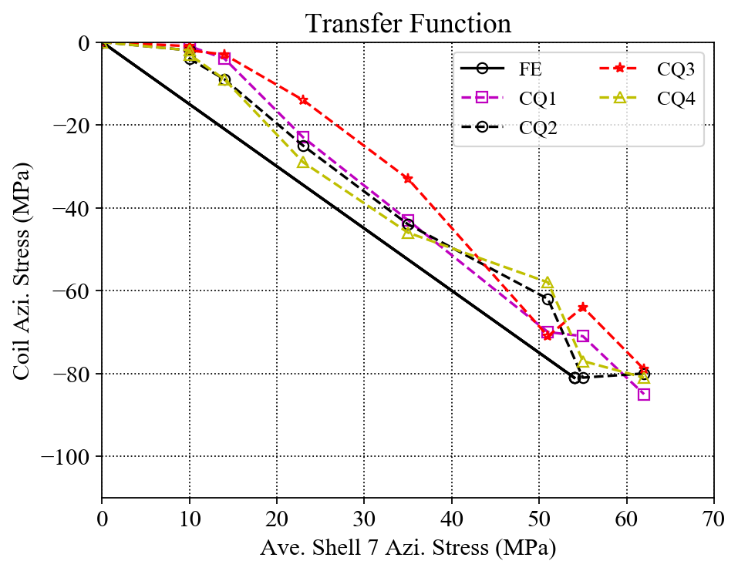
Individual Coil TF Comparisons
MQXFA03
MQXFA04
MQXFA05
MQXFA06
In general, coil stress spreads in MQXFA03 and A06 are much smaller.

Slide 24
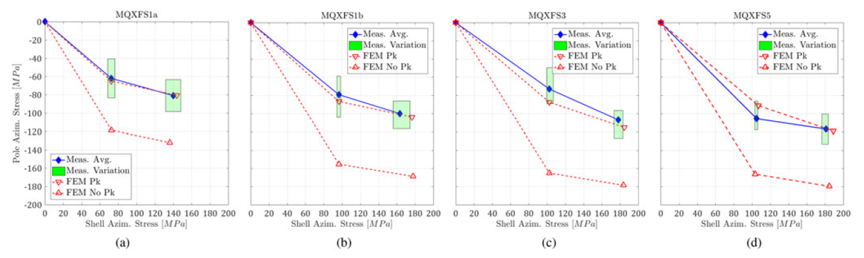
Previous cases

Slide 25
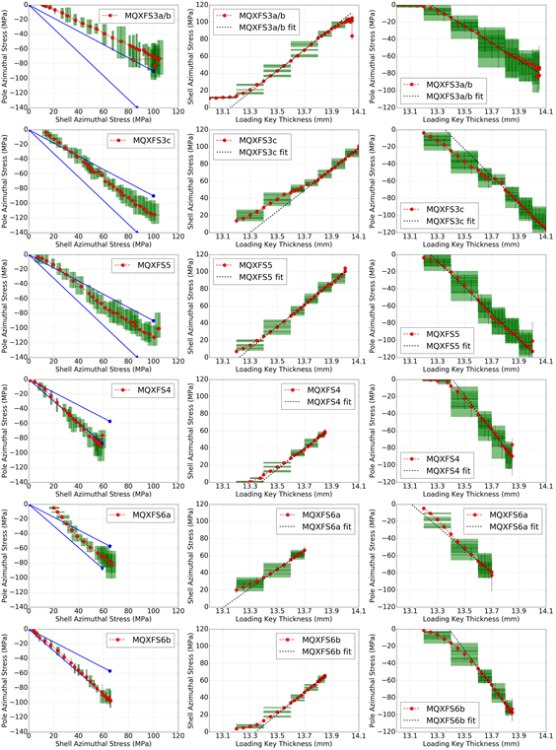

Slide 26
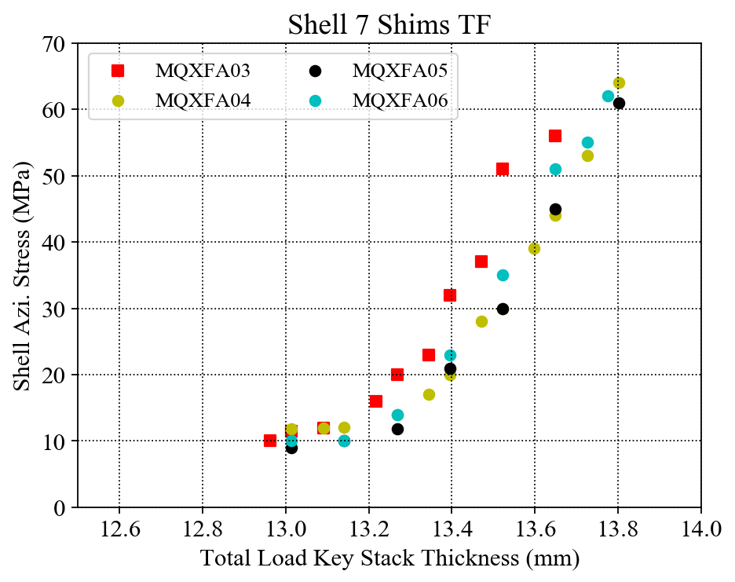
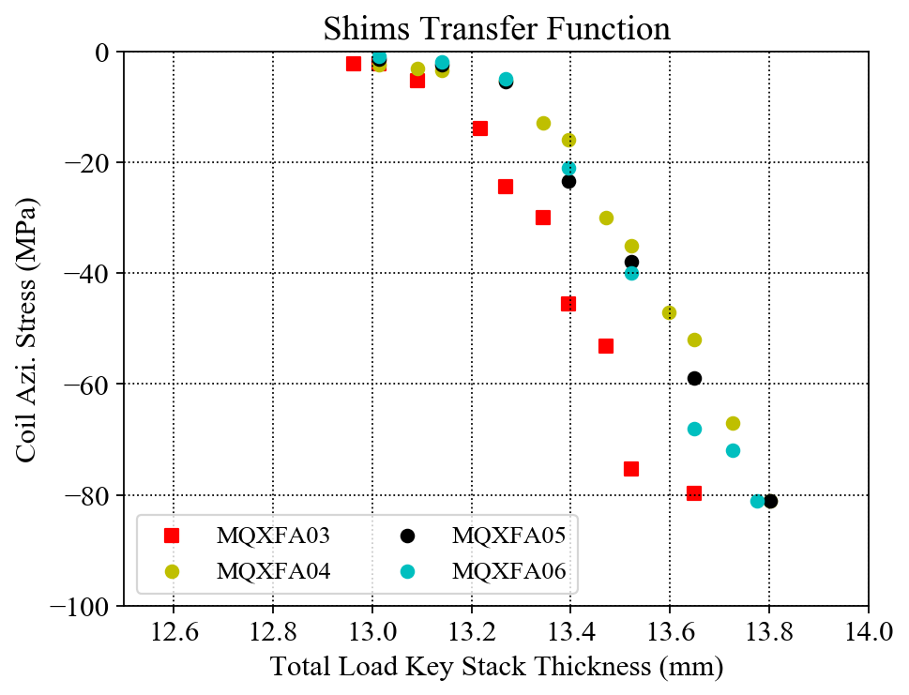
MQXFA03 - 06 Shims TF Plots
The correlations of the total load key thickness and the average coil / shell azimuthal stresses are investigated;
The slopes of the linear part of the three magnets are very close.

Slide 27
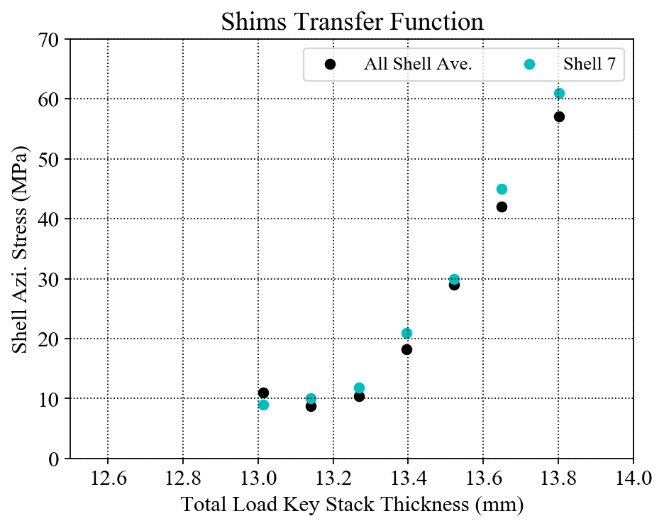
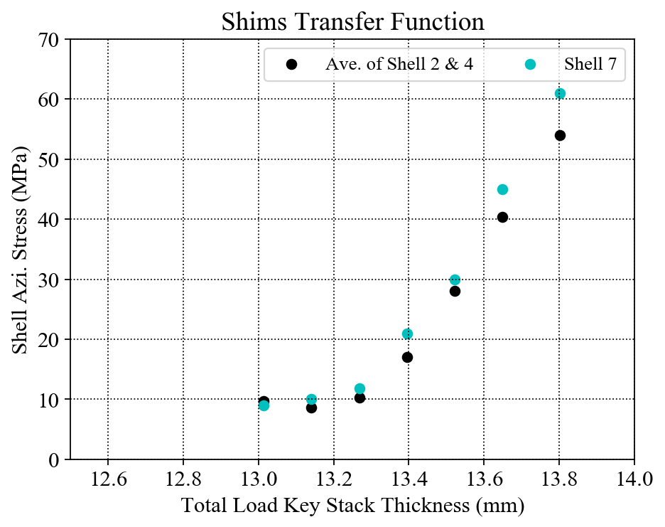
Shim TF only for MQXFA05
Only MQXFA05
The average stress of all the shells (shell 2, shell 4 and shell 7) seems linear (red line) ;
The average stress of the shells 2 & 4 seems linear (Dark blue line) ;
The average stress of shell 7 seems to have slope change (green line).

Slide 28
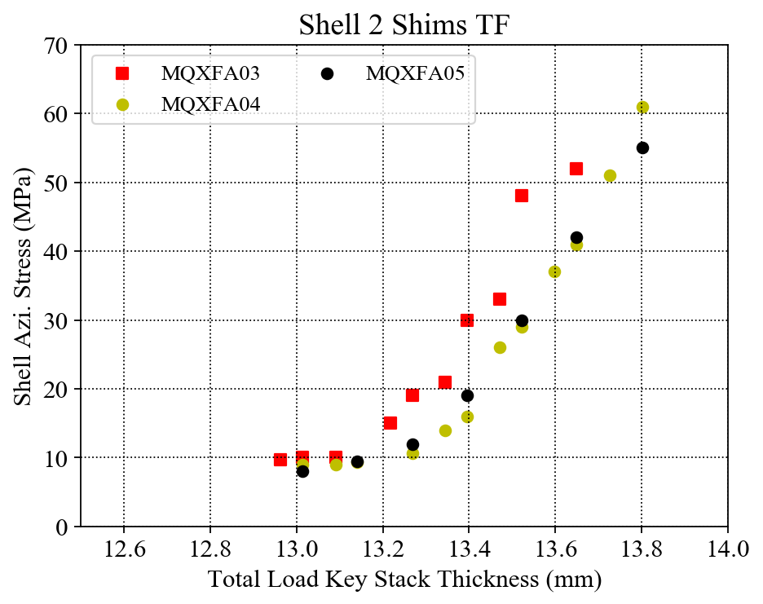
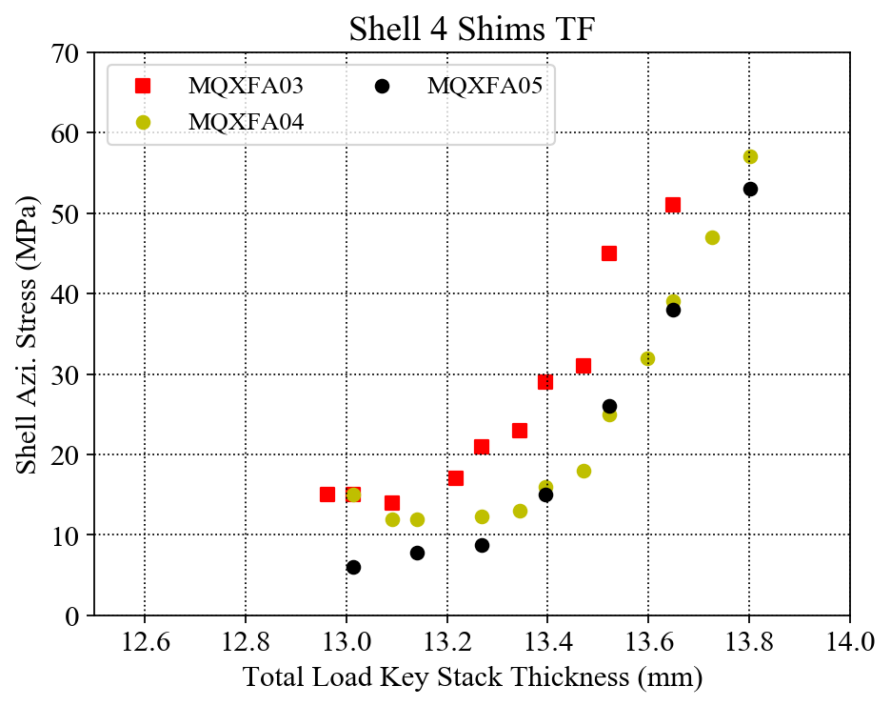
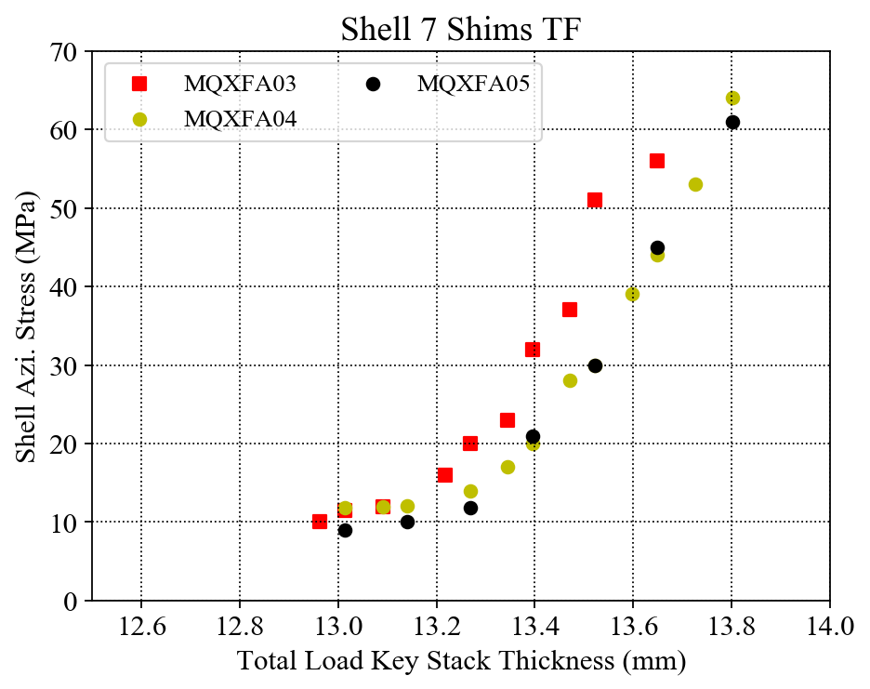
Individual Shell Shim TF Comparison
Individual shell stress with error bar at each final data point.

Slide 29
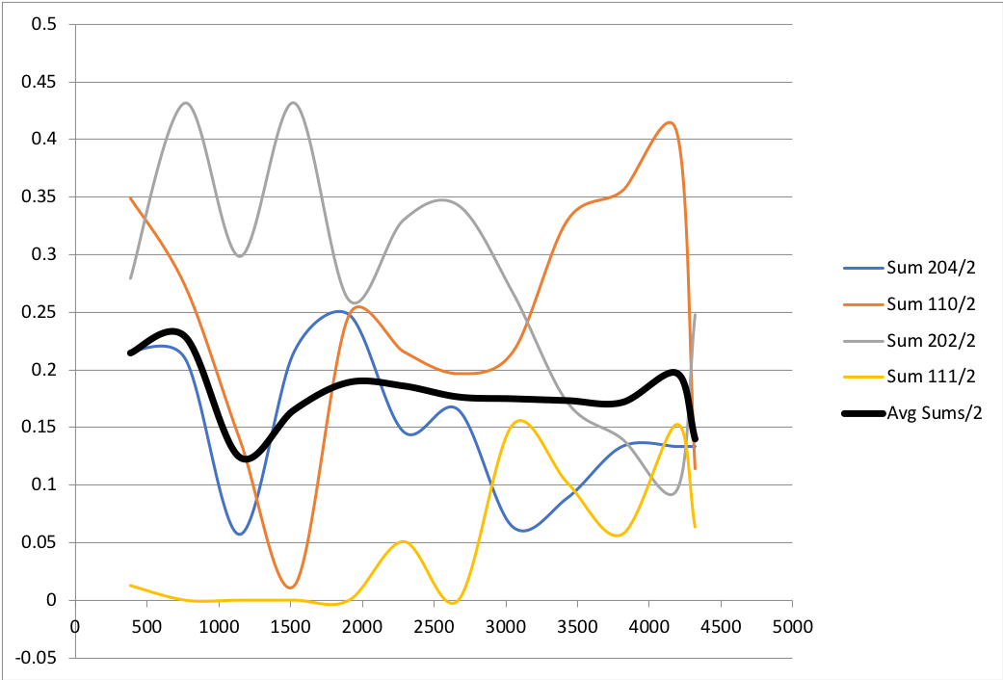
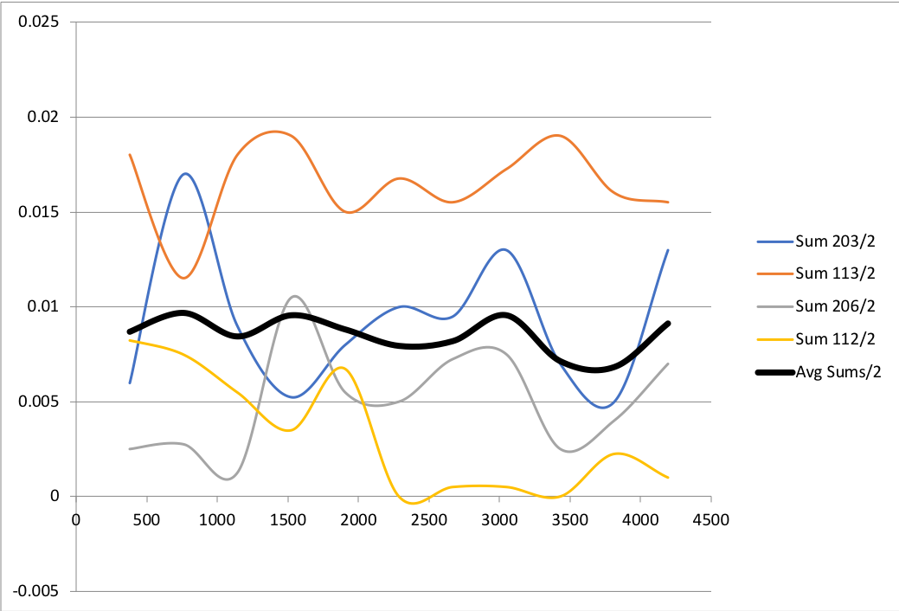
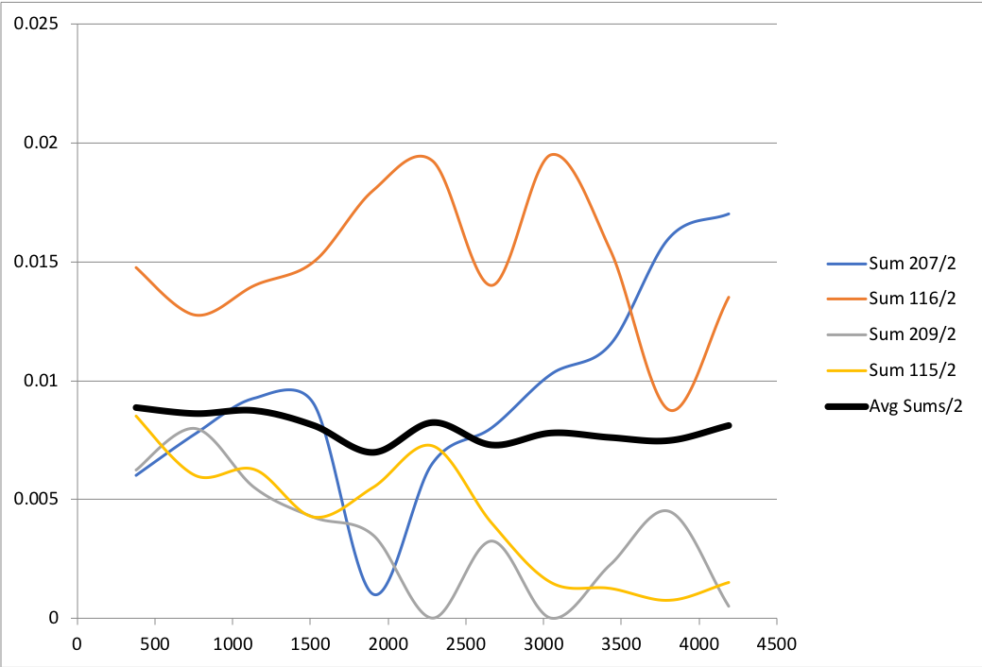
Coil Pack Pole-key Gaps
mm
inch
inch
MQXFA03
MQXFA04
MQXFA05

Slide 30
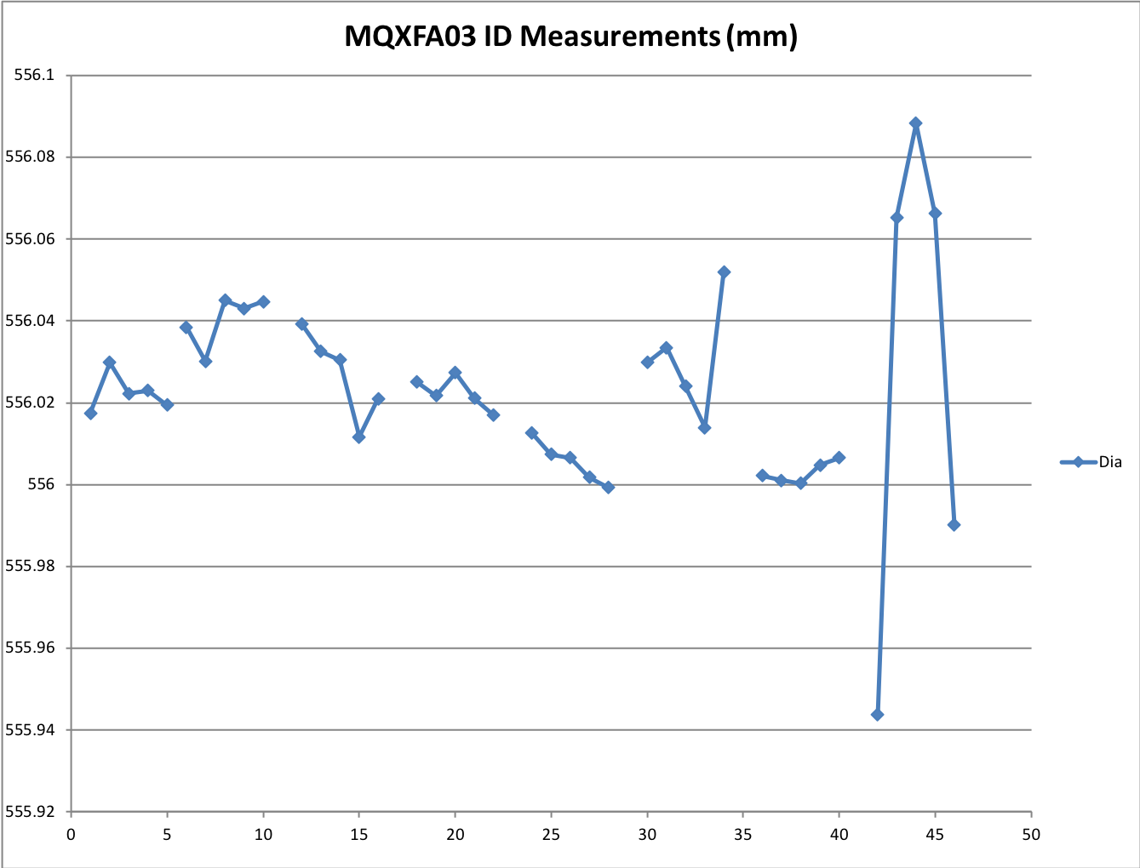
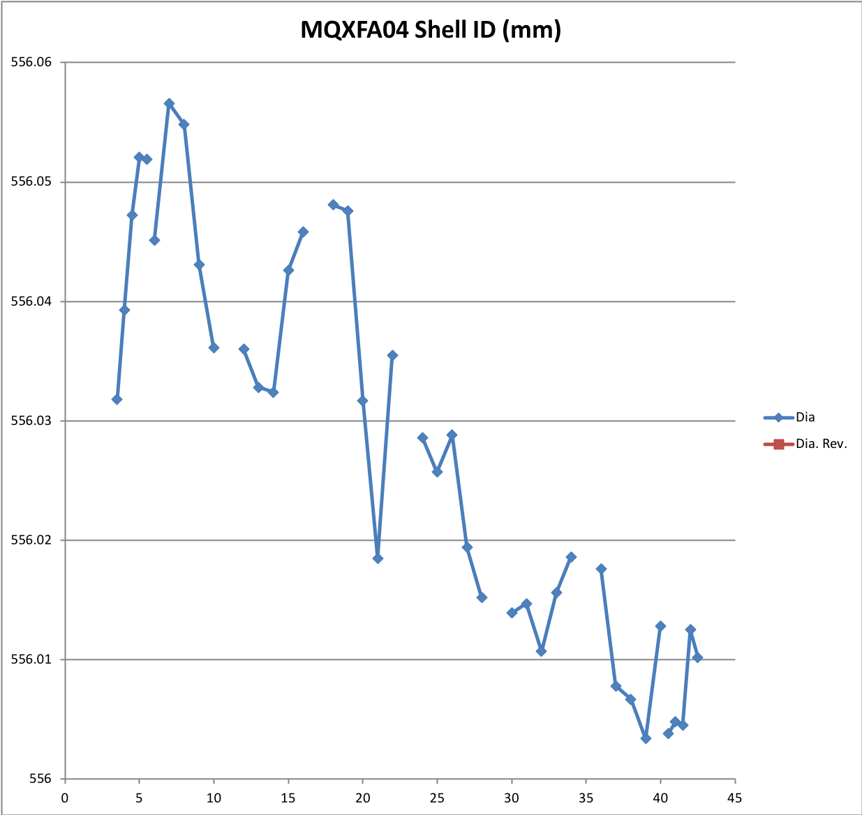
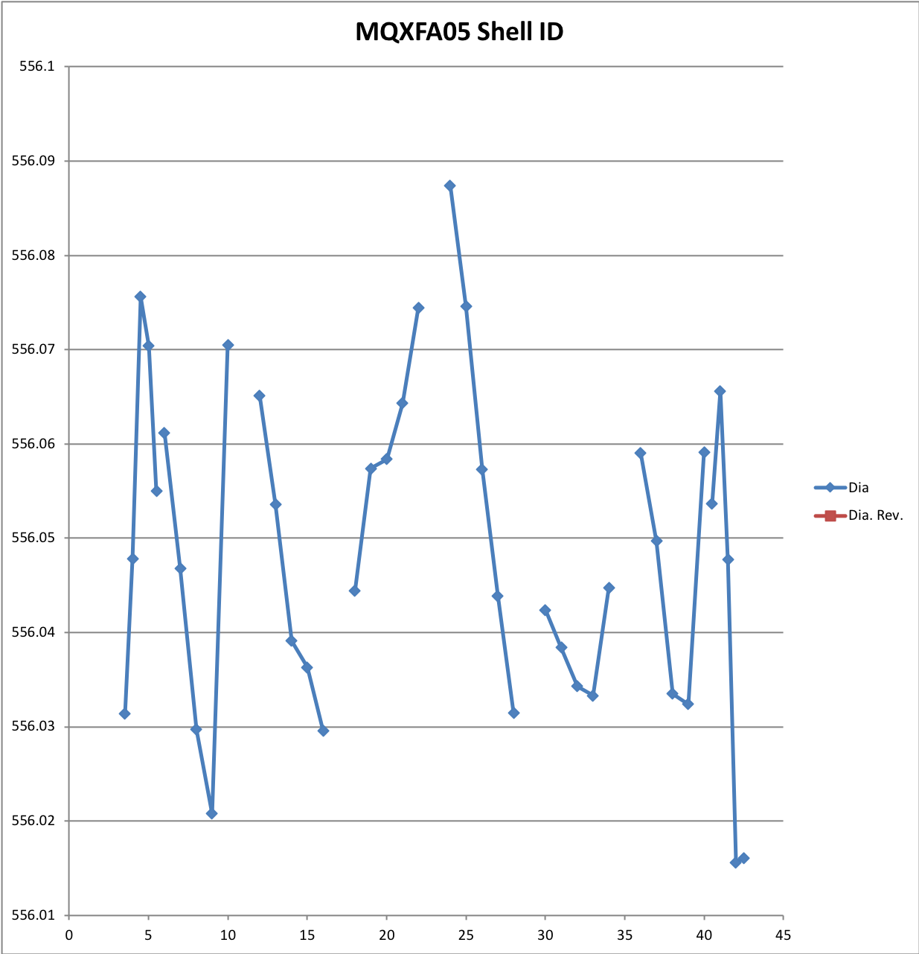
Shell ID Measurements
Unit: mm

Slide 31
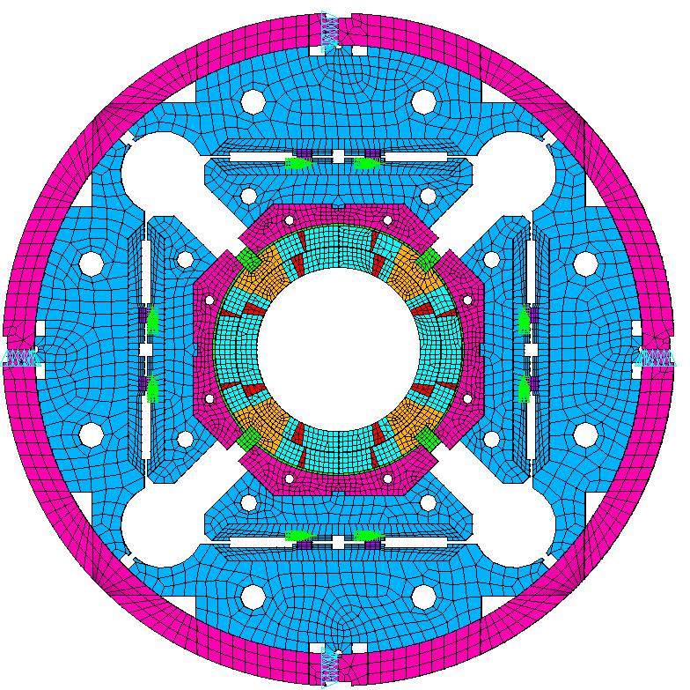
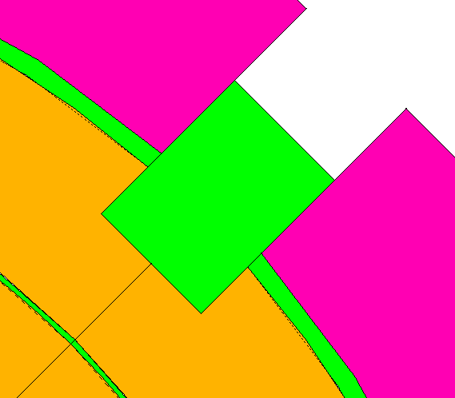
Appendix: Possible Polekey Interception in Q4
2D model Basic Settings:
X-lock
Full size 2D model.
The pad is assumed as only iron.
Initial pole key gap is 140 μm / side in quadrant 1 to 3.
No pole key gap in quadrant 4.
No axial loading in the 2D model.
All components are in contact using contact elements
  Contact172
  Target169
  Baseline Friction coefficient is 0.2
Y-lock
Q2
Q1
Q3
Q4
Boundary conditions:
Apply uy=0 and ux=0 on Y-lock and X-lock, respectively
Apply interference at the loadkey and p-master interface
No Gap
No Gap

Slide 32
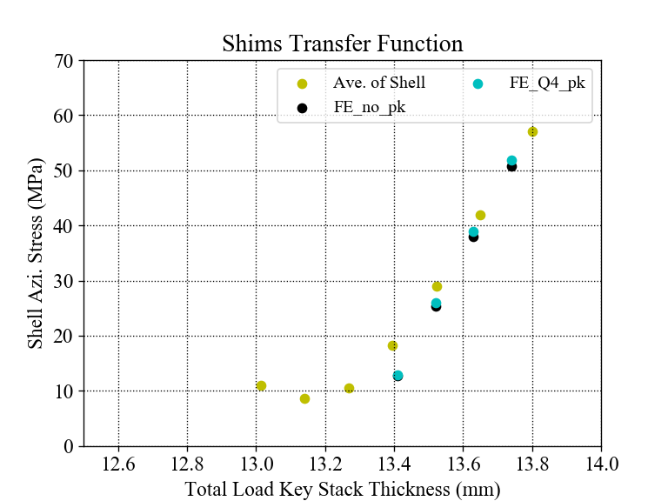

Shim TF (with FE simulations)
With simulations
The slope of average stress of FE is slightly higher than the measurements;
However, the slopes of the simulation results are not different obviously to make a clear comparison with the measurements.

Slide 33

Measurements vs. Simulation
Measurements
No polekey gap in Q4

Slide 34

TF of the Simulation
No polekey gap in Q4

Slide 35


Coil stress distribution
Coil Von Mises Stress after preloads:
All quadrants with polekey gap (8 mil /side)
No polekey gap in Q4, 8 mil /side gap in the rest quadrants
Pa
Pa

Slide 36



Coil stress distribution
90°
Coil Von Mises Stress on the path (red dash line):
0°
180°
All quadrants with polekey gap (8 mil /side)
No polekey gap in Q4, 8 mil /side gap in the rest quadrants
270°
Cooldown
Cooldown
Stress (MPa)
Stress (MPa)
R.T.
R.T.

