Slide 1
MQXFA13b Response to Recommendations Comment
Soren Prestemon, Katherine Ray, Jennifer Doyle, Dan Cheng, Laura Garcia Fajardo, Paolo Ferracin for the AUP Structures Team
Jan. 10, 2024
LBNL

Slide 2
MQXFA16 Review comments & recommendations
“Target key size: Based on the recent analysis, a new target for pre-load has been established, aiming at a given key size based on geometrical measurements. For the case of A17, the target key size is 13.77 – 13.84 mm.
Coils are typically undersized radially 25-50 um. This is neglected when defining the shimming plan, since it was considered to be in the noise of the measurements / assembly. If the target is now to be precise to a level better than 0.1 mm on the final key size, this should be re-visited, together with the overall precision of the geometrical measurements.”

Slide 3
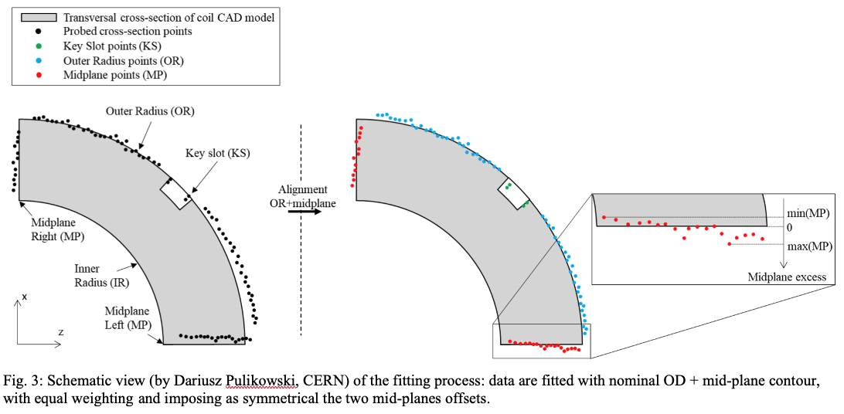
Target pre-stress of 80+/-8 MPa
Response to comment:
The shimming plan does take into consideration the coil radial size:
Coil “Excess arc-length” is determined from simultaneous best-fit of midplanes and outer radius
See US-HiLumi-doc-3043, p5
The arc length excess, which is difference between the measured coil arc length and the nominal one, is determined by fitting outer radius and mid-planes points with the nominal profile, with equal weighting and imposing as symmetrical the two mid-planes offsets (see Fig. 3). The sum of the two measured mid-plane offsets provides the arc length excess

Slide 4
Process for determining target key size
Based on best fit:
We determine the “delta-arc-length excess” Δs/side
∼Δs is applied to the midplanes (error here is Δε)
The coil outer radius is then assumed to be “nominal”
Residual error of 8 Δε/(2π) = ΔR_{ε} remains
This is typically <<100 microns
The estimated ΔR_{ε} is taken into consideration in the determination of the final key size
Note: the assumption that the coil outer radius is “nominal” may not be exactly correct – we are looking at evaluating/estimated the residual error

