Slide 1
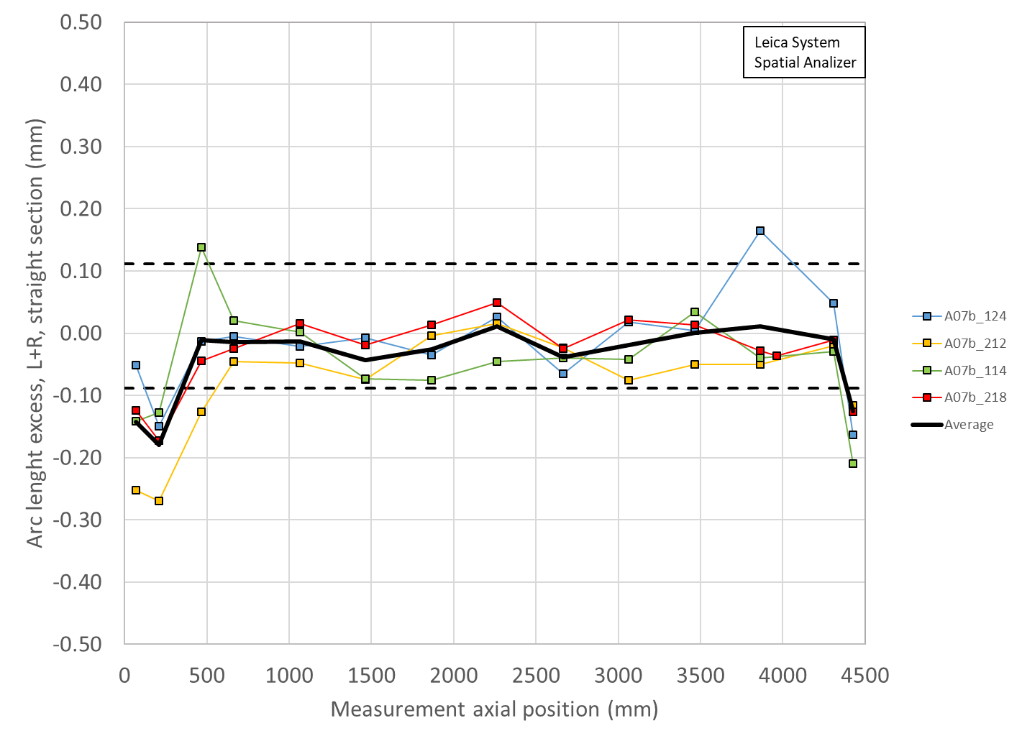
Summary Coil radial (shimmed) deviation and key/shim size
 | Ave ss | OR_Ave ss | LE min | OR_LE_min | RE min | OR_RE_min | Key | Shim | Shim | Ave ss + shim | LE + shim | RE + shim
 | mm | mm | mm | mm | mm | mm | mm | mils | mm | mm | mm | mm
A13b | -0.002 |  | -0.147 |  | -0.107 |  | ? | ? | ? | ? | ? | ?
A17 | -0.004 | -0.041 | -0.134 | -0.051 | -0.125 | -0.061 | 13.74 | 39 | 0.9906 | 0.987 | 0.857 | 0.865
A07b | -0.015 | -0.022 | -0.115 | -0.046 | -0.080 | -0.044 | 13.84 | 43 | 1.092 | 1.077 | 0.977 | 1.012
A16 | 0.023 | -0.044 | -0.089 | -0.065 | -0.080 | -0.072 | 13.77 | 40 | 1.016 | 1.039 | 0.927 | 0.936
A15 | 0.000 | -0.028 | -0.099 | -0.049 | -0.045 | -0.036 | 13.82 | 42 | 1.0668 | 1.067 | 0.968 | 1.022
A14b | -0.007 | -0.029 | -0.129 | -0.055 | -0.107 | -0.050 | 13.84 | 43 | 1.092 | 1.085 | 0.963 | 0.985
A13 | -0.004 | -0.054 | -0.146 | -0.079 | -0.094 | -0.070 | 13.72 | 38 | 0.965 | 0.961 | 0.819 | 0.871
A8b | 0.000 | -0.025 | -0.181 | -0.067 | -0.136 | -0.061 | 13.77 | 40 | 1.016 | 1.016 | 0.835 | 0.880
A11 | 0.004 | -0.043 | -0.124 | -0.070 | -0.047 | -0.051 | 13.74 | 39 | 0.991 | 0.995 | 0.867 | 0.944
A10 | -0.092 | -0.053 | -0.221 | -0.078 | -0.199 | -0.074 | 13.82 | 42 | 1.067 | 0.975 | 0.846 | 0.868
A8 | -0.029 |  | -0.216 |  | -0.172 |  | 13.72 | 38 | 0.965 | 0.936 | 0.749 | 0.793
A7 | -0.035 |  | -0.139 |  | -0.114 |  | 13.77 | 40 | 1.016 | 0.981 | 0.877 | 0.902
A6 | -0.034 | -0.020 | -0.138 | -0.024 | -0.178 | -0.051 | 13.72 | 38 | 0.965 | 0.931 | 0.827 | 0.787
A5 | -0.025 | NA | -0.154 | NA | -0.105 | NA | 13.79 | 41 | 1.041 | 1.016 | 0.887 | 0.936
OD | min | max | avg
Original | -0.062 | 0.053 | 0.002
5mil | -0.022 | 0.092 | 0.038
3mil | -0.038 | 0.076 | 0.024
2mil | -0.046 | 0.068 | 0.016

Slide 2
Summary Coil radial (shimmed) deviation and key/shim size
The fitting of the outer profile with nominal OR + mid-planes introduces an OR deviation of
Straight section
From -0.022 mm to -0.054 mm
RE
From -0.046 mm to -0.078 mm
LE
From -0.036 mm to -0.074 mm
Therefore
For azimuthally smaller coils, we have a systematic negative deviation in the OR
The variation magnet to magnet is of the order of 1 mil in the straight section

