Slide 1
MQXFA13b Structure & Shim Review Introduction & Charge
Giorgio Ambrosio
Magnets L2
U.S. HL-LHC Accelerator Upgrade Project
MQXFA13b Structure & Shim Review
January 10, 2024

Slide 2
Committee
Rodger Bossert, chairperson (FNAL)
Mike Anerella (BNL)
Susana Izquierdo Bermudez (CERN)
Date and Time
January 10, 2024. Start time is 7/9/10/16 (LBNL/FNAL/BNL/CERN)
Location/Connection
Video-link by Zoom, info by email.
Link to agenda with talks and other documents
https://indico.fnal.gov/event/62598/

Slide 3
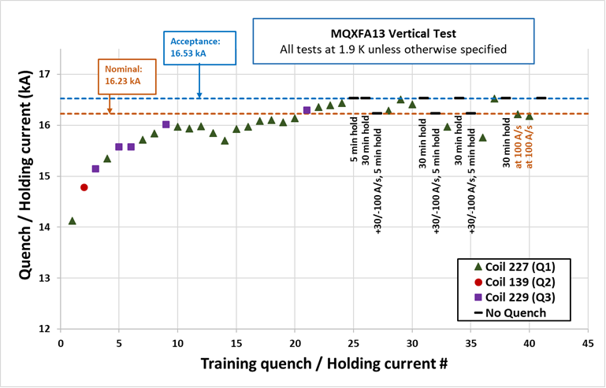
Review Goals
The HL-LHC AUP project is starting the assembly of MQXFA13b quadrupole magnet. This is the re-assembly of MQXFA13 that showed some issues during vertical testing (slow training and quenches after down-ramp at 100 A/s) even if it was able to reach and hold acceptance current. If MQXFA13b meets MQXFA requirements [1] it will be used in a Q1/Q3 cryo-assembly to be installed in the HL-LHC.

Slide 4
Review Goals
All issues during MQXFA13 test occurred in a single coil (227). This coil has been removed and is being replaced by coil 241 that was reviewed on November 8, 2023 [2]. To avoid reoccurrence of the MQXFA13 issue we introduced: 1) analysis of CMM data in coil ends [3], 2) assessment of minimum loading-key shim size, 3) increased to 120 MPa the max coil stress during pre-load [4].
MQXFA Series magnet specifications are presented in [4]. Discrepancy or Non-Conformity Reports are generated whenever a component does not meet specifications [5].
The main goal of this review is to evaluate MQXFA13b structure and shim plan. Reviewers should also assess that discrepancies and non-conformities of the magnet structure have been adequately processed, and that the shims will allow MQXFA13b to meet MQXFA requirements [1].

Slide 5
CHARGE Questions
The committee is requested to answer the following questions:
Have all recommendations from previous reviews [6] been adequately addressed?
Have discrepancies and non-conformities been adequately documented and processed?
If there are major/critical non-conformities [5], have they been adequately documented and processed?
Are the proposed shims adequate for allowing MQXFA13b to meet MQXFA requirements [1]?
Do you have any other comment or recommendation to assure MQXFA13b is going to meet requirements?

Slide 6
Major/Critical DR/NCR:
Critical nonconformance: a nonconformance which meets at least one of the following:
affects form, fit, or function in the as-found condition
involves damage, or suspected damage, to the coil conductor
is likely to trigger yellow or red schedule or cost variance reporting thresholds
meets the requirements of “Moderate” or higher per the CERN Impact Matrix (for collaborations) in EDMS 1863763
Handling of Discrepancies and Nonconformances
US-HiLumi-doc-2484

Slide 7
References
1) MQXFA Functional Requirements Specification, US-HiLumi-doc-36.
2) MQXFA13b Coils Acceptance Review, US-HiLumi-doc-4956.
3) QXFA Series Coil Production Specification, US-HiLumi-doc-2986.
4) MQXFA Series Magnet Production Specification, US-HiLumi-doc-4009.
5) Handling of Discrepancies and Nonconformances, US-HiLumi-doc-2484.
6) MQXFA17 Structure and Shims Review, US-HiLumi-doc-4939.

Slide 8
Traveler Upload Status
Update by Jamie:

Slide 9
MQXFA17 Review Recommendation
Measure the return end of the coils using the same strategy as used for the lead end.
Done in several sections on some coils, and updated the QXFA Series Coil Production Specification for future coils:
“This specification applies at four CMM locations: at 260 and 300 mm (for the lead end) and at 4340 and 4380 mm (for the return end). At these four locations the absolute value of the coil Delta arc-length must not exceed 210 μm. The coil Delta arc-length is the difference between the coil arc length at each location in the ends and the average coil arc-length in the straight section. CMM locations are presented in [6]. CMM measurements are taken according to [7]. If the absolute value of the Delta arc-length exceeds 210 μm at any location in the lead end or return end, a critical DR must be initiated and disposition must be approved by the MQXFA magnet L2.”

Slide 10
Schedule
Today:
Talks
Q&A
Following days:
Closed session(s)
Possibly Q&A by email
Report by email or Zoom mtg in ~2 weeks

