Slide 1
AD Controls Department Report
Adam Watts
5 January 2023

Slide 2
Operational Issues
CLX40 hanging for NuMI LCW parameters fixed with front end configuration change.
Muon crate $73 CAMAC timers becoming corrupted. Techs changed crate power supply, seems to have helped.
LOOKUP service issues appear resolved by restarting processes. Unclear what root cause was, but no return of issue yet.
I68 troubleshooting ongoing between Ops, PESD, and Controls, primarily affects a few large NuMI supplies and the ability to write new ramps. Some configuration issues found, working to resolve.
https://github.com/orgs/fermi-ad/projects/13/views/5
Notes:
We are working on another robot that used to be part of the MARV family. It is now called HERMES, short for Helpful Robotic Messenger). It is the smallest robot that we have that can be used for confined spaces and high radiation areas. A co-op engineering student designed a 3D printed chassis. Curently, under Susanna Stevenson's and Adam Watt's guidance, a senior engineering design group at Northern Illinois University is buidling a payload for autonomous photographic mapping of enclosures.

Slide 3
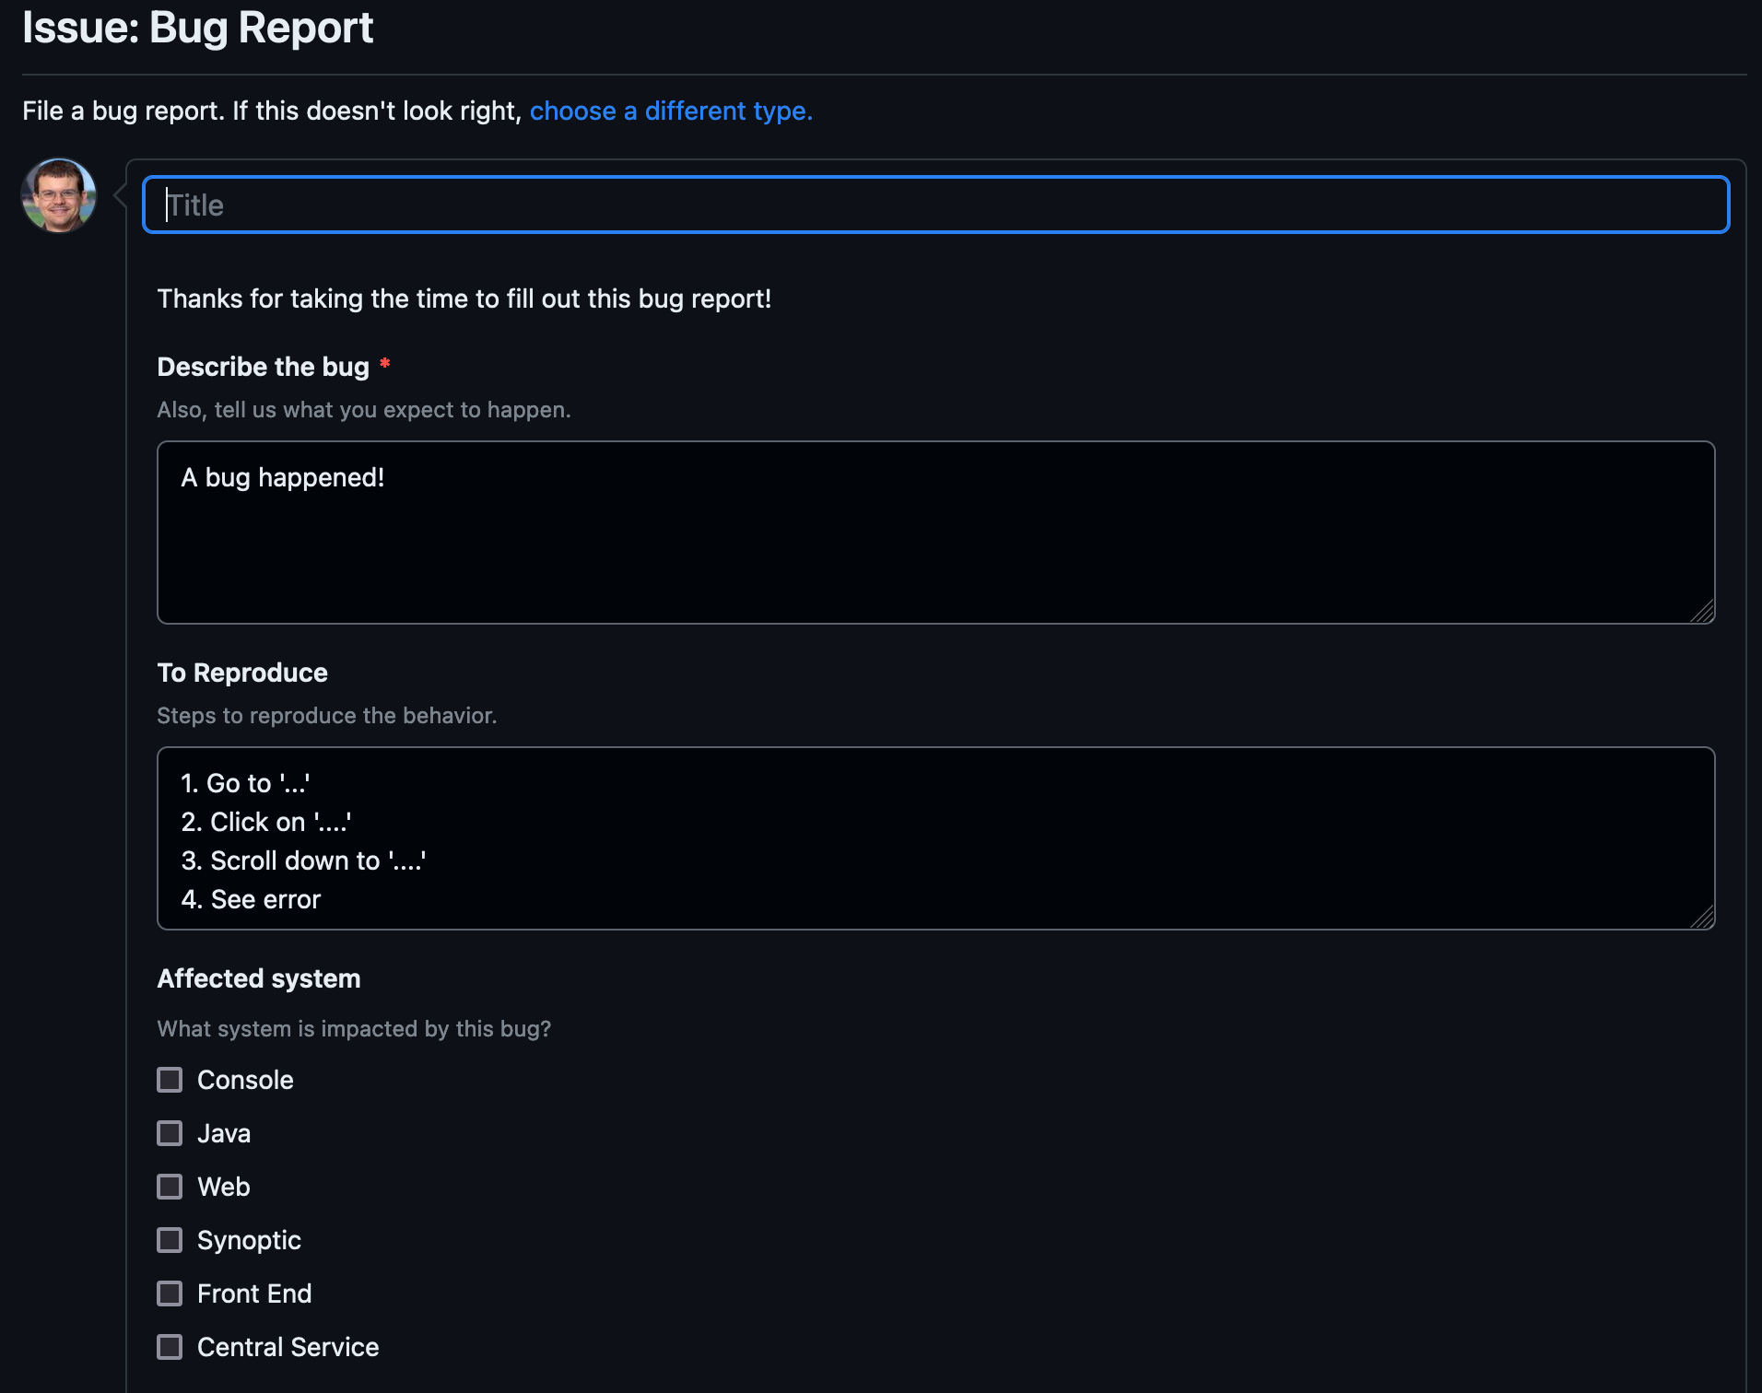
Issue reporting
On AD GitHub: https://github.com/fermi-ad/controls/issues/new?assignees=&labels=bug&projects=fermi-ad%2F13&template=bug_report.yaml
Or, https://github.com/fermi-ad/controls -> Issues -> Green “New Issue” button -> Bug report green “Get Started” button
Will add “Feature Request” option soon
Simple form for reporting operational issues with enough information for us to get started
Automatically tracks on the project board (previous slide)
Only requires (free) GitHub account to use
Not required, just convenient. You can always reach out to us to report issues directly.
Credit: Beau Harrison
Notes:
We are working on another robot that used to be part of the MARV family. It is now called HERMES, short for Helpful Robotic Messenger). It is the smallest robot that we have that can be used for confined spaces and high radiation areas. A co-op engineering student designed a 3D printed chassis. Curently, under Susanna Stevenson's and Adam Watt's guidance, a senior engineering design group at Northern Illinois University is buidling a payload for autonomous photographic mapping of enclosures.

