Slide 1
Muon Campus Operation Report
Jim Morgan
Friday 09:00 Operations Meeting
January 5, 2024

Slide 2
Muon Campus status
ESS1 Electrostatic Septum at NWA
Still on hold due to NWA roofing work and collateral damage
Damage to lighting circuit and building interior needs to be cleaned
Pros and Cons being considered for using A-0 Clean Room for ESS1 work
TD began installing rad hard water lines on D30 quads on Thursday
Technicians from TD will attempt to install rad hard lines with SQ’s in place
Vacuum system modifications for Electrostatic Septa installation
Extraction Kicker has been removed and stored in Stub Room
Will install new vacuum layout between Q202 and Q204 for electrostatic septa
Need to remove blocks from D40 Hatch for incoming and outgoing magnets
8Q24 with rad hardened water lines moved this week from TD to AP-50
Forklift and rad hard 8Q24 will be lowered into tunnel for installation
Existing 8Q24 and four NSA sextupoles that had water leaks go to TD
Investigating source of chronic D50 ceiling tunnel ceiling leak
ICW the remaining suspect, would like it valved out to AP-50 as test
ISD powered off circuit in AP-50 yesterday taking out racks and air compressor
AP-0 Lens and Pmag systems drained on December 20
Letting small amount of remaining water evaporate before capping systems
Plan to finish up and return shielding blocks later this month
Study – M1-M3 Optics
Study – Alternative M5 optics
KPS5A PFL Repair
MC-1 Controlled Access
G-2 Trolley Run
Intentional Accelerator
Standby Period
<------------Week Days -------------------→

Slide 3
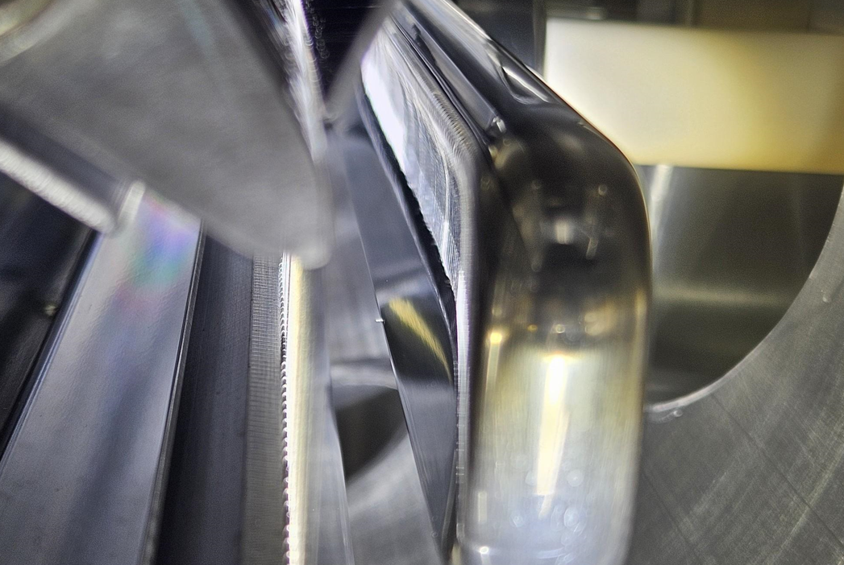
Mu2e Electrostatic Septa ESS1 and mystery object

Slide 4
Close-up of mystery object

Slide 5
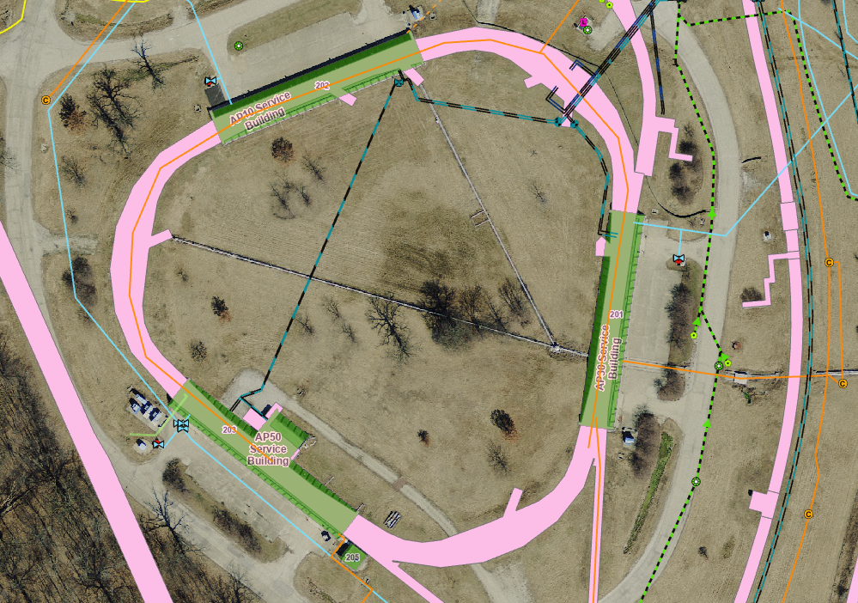
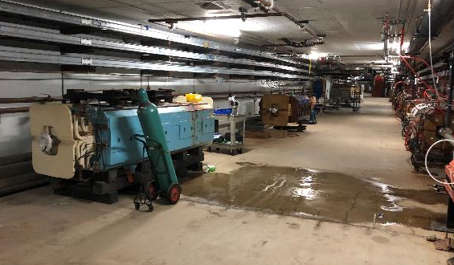
D50 tunnel ceiling water leak
MI-8
Chilled Water
Location of
tunnel ceiling leak
NuMI
ICW
(fire protection)

Slide 6
Upcoming work
ESS1 troubleshooting and repair plan
Need to decide whether to still use NWA Clean Room or move equipment to A-0
New ESS2 assembly was supposed to be in A0 Clean Room when it was ready
Both Clean Rooms and septa being worked on by the same personnel
Modify five SQ and one 8Q24 (Q205) quadrupoles so that they’re rad hardened
TD began work, will continue as they’re available
Quadrupole ends with water tubing have been cleared of obstructions
8Q24 has larger tubing and must be worked on at IB2, will be swapped with spare
Need D40 Hatch opened to receive new 8Q24 and Forklift for installation
New Q205 to ELAM vacuum pipe and flanges, will be easier to disconnect
Replace rotatable Conflat on downstream end of ELAM with QD flange
New compact ESS vacuum layout with modified Q203 pipe
Will accommodate eventual ESS1 installation
AP-0 Lens and Pmag systems drying out, will be capped later this month
Would like to valve out AP-50 ICW to see if D50 sump activity changes
May require Fire Watch of AP-50 during this time

