Slide 1
nuSTORM Expression of Interest to CERN
K. Long

Slide 2
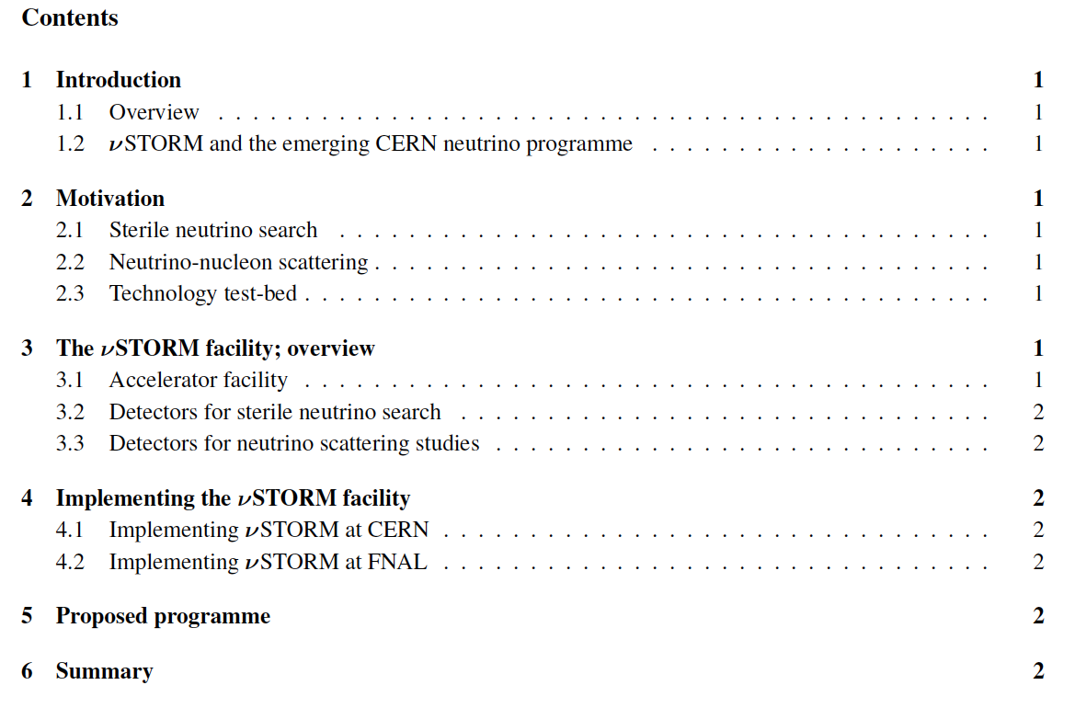
Drafted
Drafted
Drafted
Drafted
Drafted. Some detector sentences to be added?
Rough draft
Drafted
Drafted
Rough draft
Drafted
KL/EW to develop at CERN next week

Slide 3
nuSTORM EoI: revised timeline
Goal:
Draft EoI available by Erice w/s – week of 21Jan13
Skeleton for nuSTORM EoI: 09Nov12
Done!
Text deadline for lead authors:
31Dec12
I will chase them starting next week!
Circulate for comments:
Week of 14Jan13
nuSTORM w/s #2 at CERN:
In last week of Feb13 or first week of Mar13?
Review status of nuSTORM
Review status of EoI
Gather additional European authors
Implies ready for April SPSC
Goal:
Draft EoI ready to be circulated in the week of 28Jan13
nuSTORM w/s #2 at CERN:
26th and 27th March 2013
Review status of nuSTORM
Review status of EoI
Gather additional European authors
Implies ready for April SPSC

