Slide 1
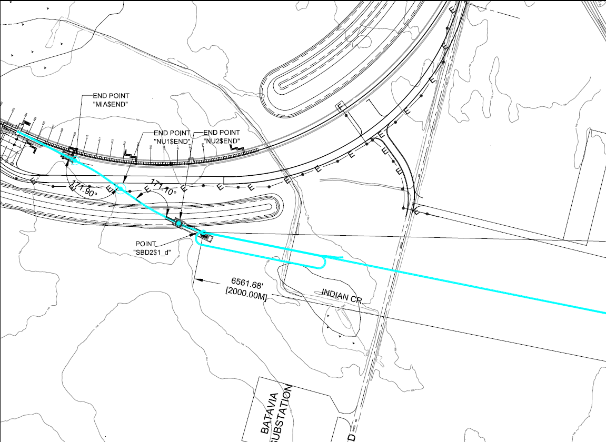
AD - NuStorm Update

Slide 2
FESS Beamline Map Version 8

Slide 3
FESS Beamline Map Version 8

Slide 4
FESS Beamline Map Version 9

Slide 5
FESS Beamline Map Version 8

Slide 6
Version 8 vs 9

Slide 7
Version 8 vs 9
Spot Size on Target | Version 8 (half width mm) | Version 9 (half width mm)
X (1 sigma) | 1.19393 | 0.90446
Y (1 sigma) | 1.20388 | 1.03086
X (95%) | 2.92411 | 2.21514
Y (95%) | 2.94847 | 2.52474
X (99%) | 3.63349 | 2.75252
y (99%) | 3.66375 | 3.13721
Cost | Version 8 | Cost ($M) | Version 9 | Cost ($M)
Dipoles | 20 | 5.3* | 12 | 2.9*
Quads | 11 | 1.7* | 7 | 1.1*
Enclosure length | 660 ft | 6.6** | 520 ft | 5.2**
Total |  | 13.6 |  | 9.2
* Estimates provided by TJ Gardner TD Project Coordinator
** Estimates provided by FESS Engineering

Slide 8
What’s next?
Cost estimates
Trim Magnets
4-4-30 style or others?
16 trim magnets needed/wanted
Instrumentation
BLMs
Multiwires
12 BPMs
Beam pipe
4” pipe $/foot
Flanges
Clamps
Vacuum
Roughing pumps
Turbo pumps
Ion Pumps

