Slide 1
A-QNET Update Meeting January 16, 2024

Slide 2
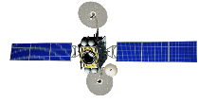
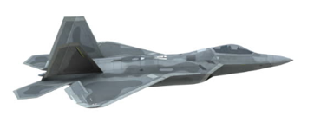
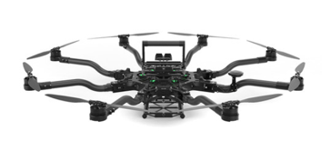
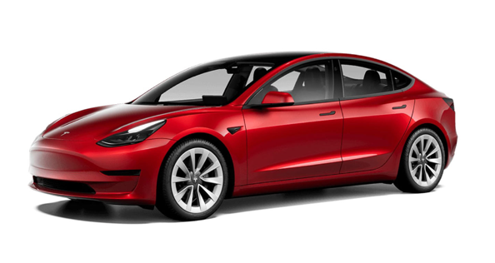
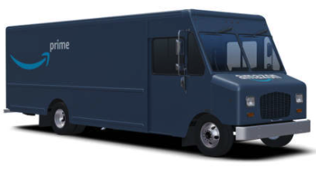
Hybrid Quantum Network
U.S. Quantum Satellite
U.S. Quantum Satellite
Free-Space Quantum Link
Fiber Optic Quantum Link
Quantum Relay Drone
Quantum Relay Drone
Our Work
Fiber Optic Cable
QLAN
QLAN
Fiber Optic Cable

Slide 3
Car-to-Car Setup at Rantoul (Closed Road)
Setup Location
Data collected Dec 21st, 2023
Coordinated with Illinois Center for Transportation and the Village of Rantoul Police Department to close public road
Police provided road barricades
622 meters closed course
3x longer than closed course
First demonstration of a vehicle-based quantum network on a closed-road
Closed Road (620m)
Illinois Center for Transportation
Finish
Start
Start Line

Slide 4
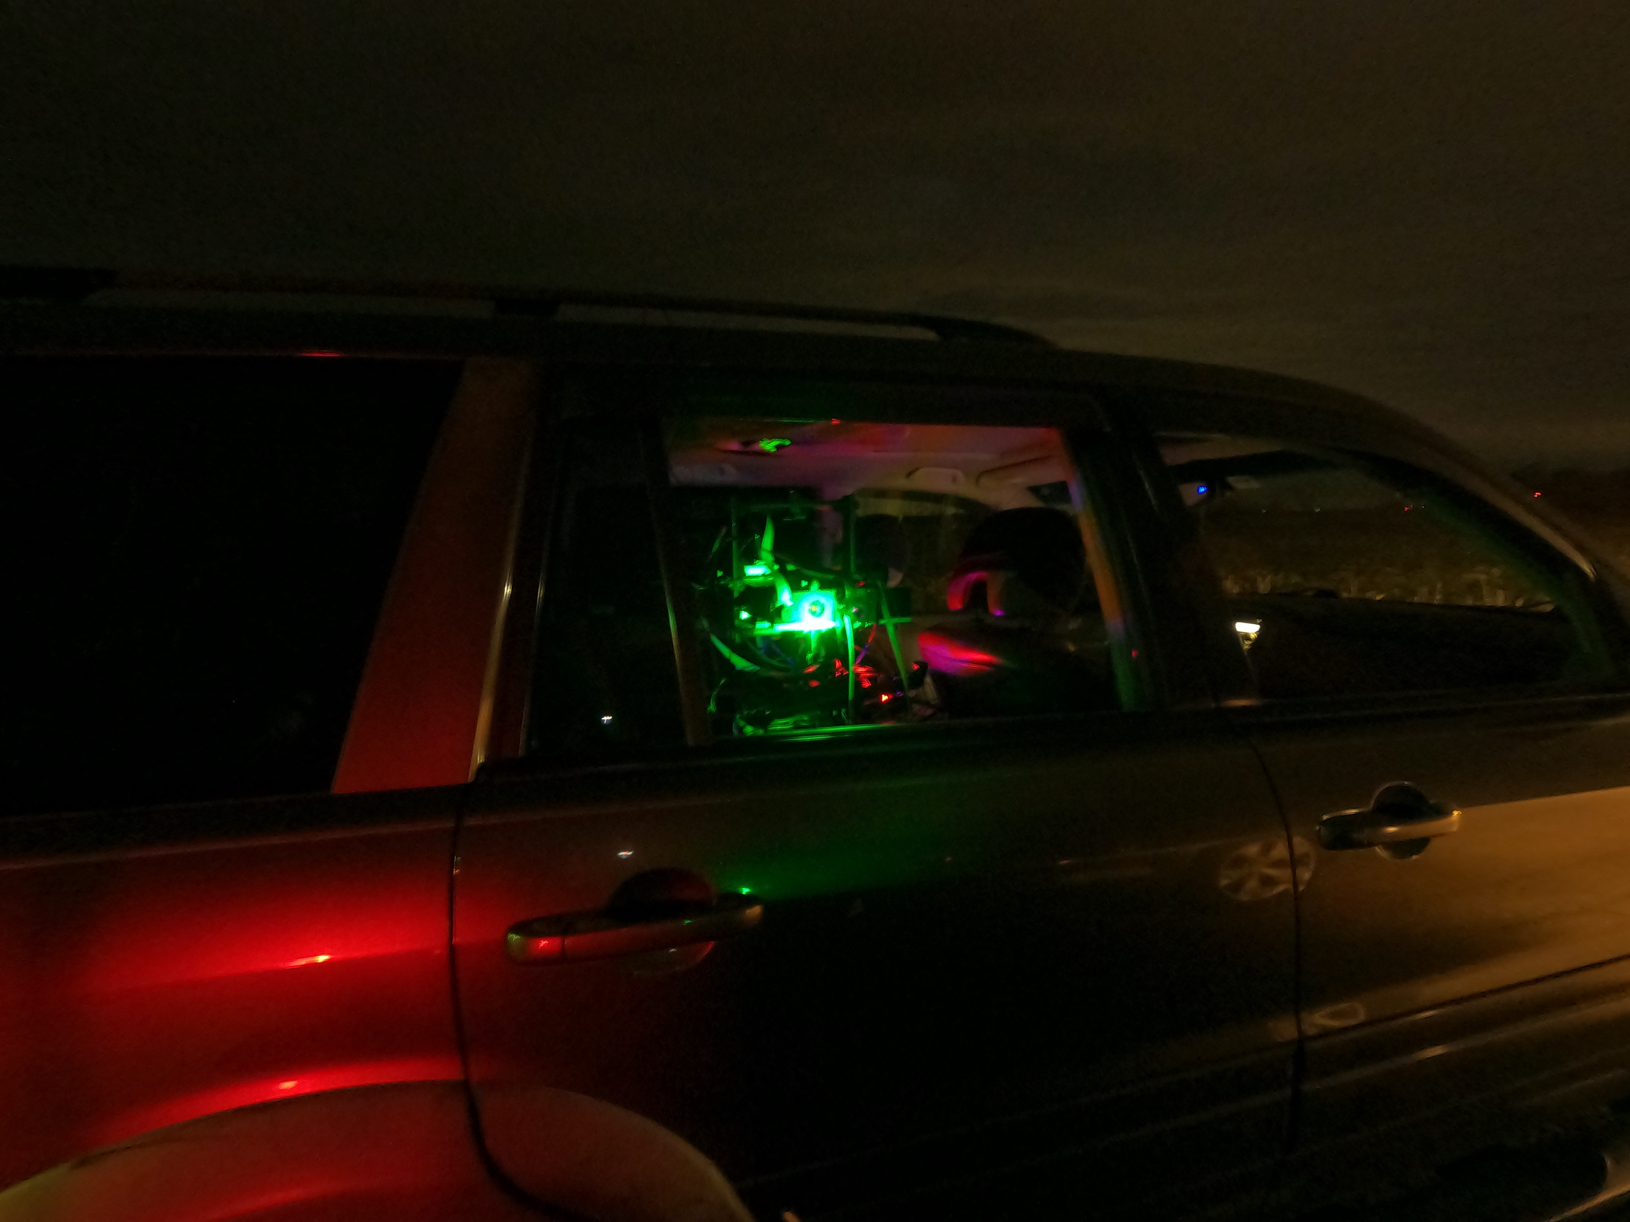
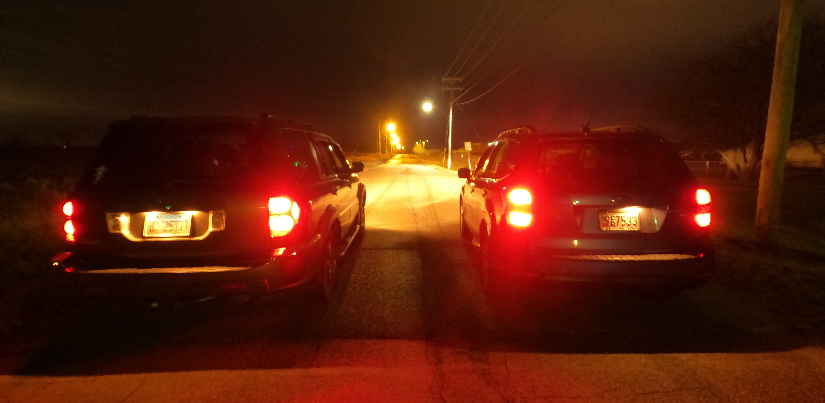
Car-to-Car Setup at Rantoul (Closed Road)
Quantum Payloads in Cars
Car-to-Car Quantum Link

Slide 5
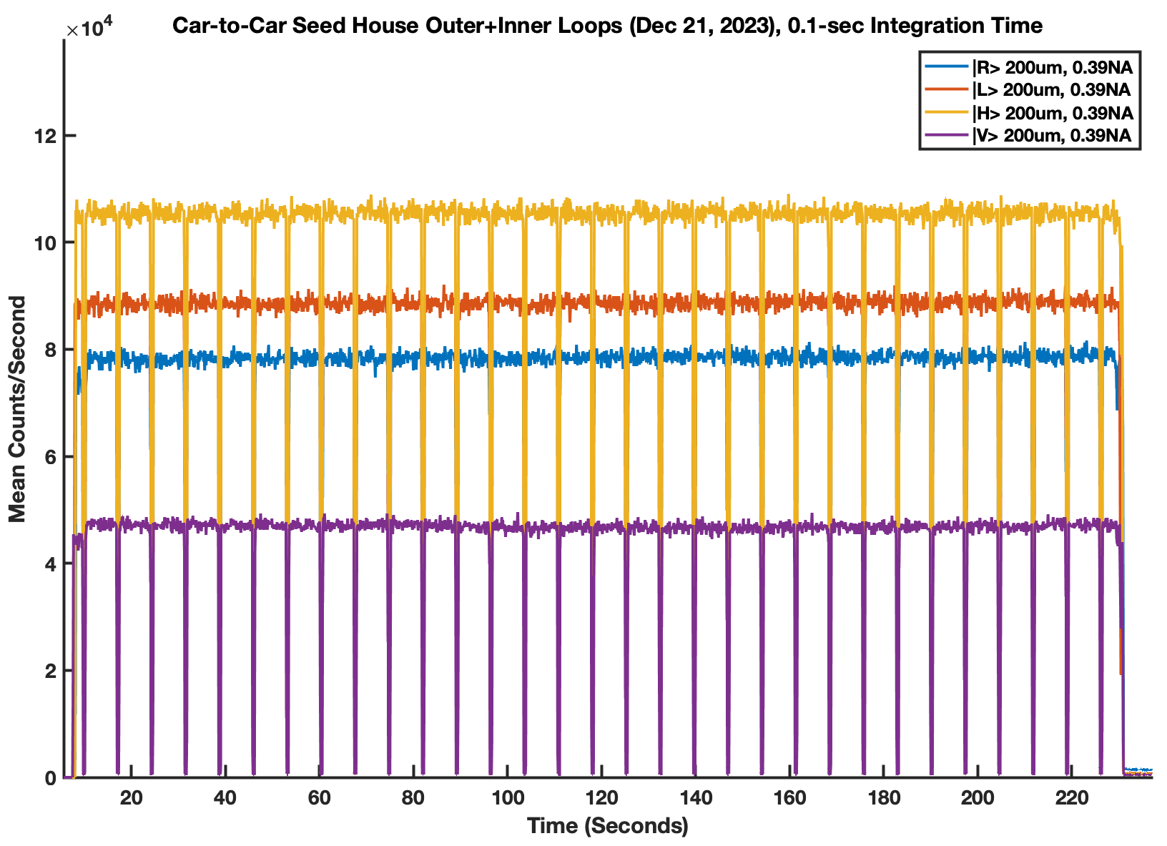
Stationary Car-to-Car QKD (Inner+Outer Loops)

Slide 6
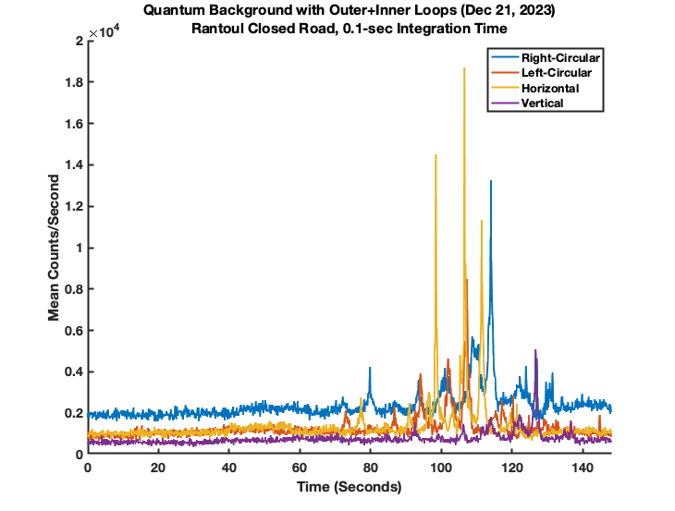
Car-to-Car Quantum Background (Inner+Outer Loops)
Quantum Background
Signal duty cycle = 12.5%
→ effective background reduced by 8x
Streetlights

Slide 7
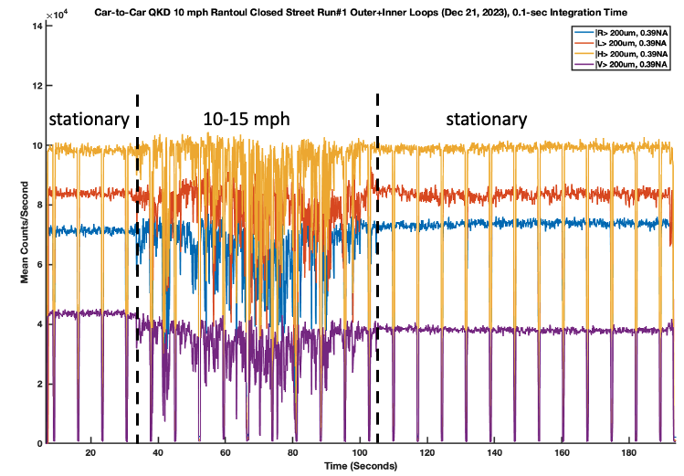
Run #1 Car-to-Car QKD (Inner+Outer Loops)

Slide 8
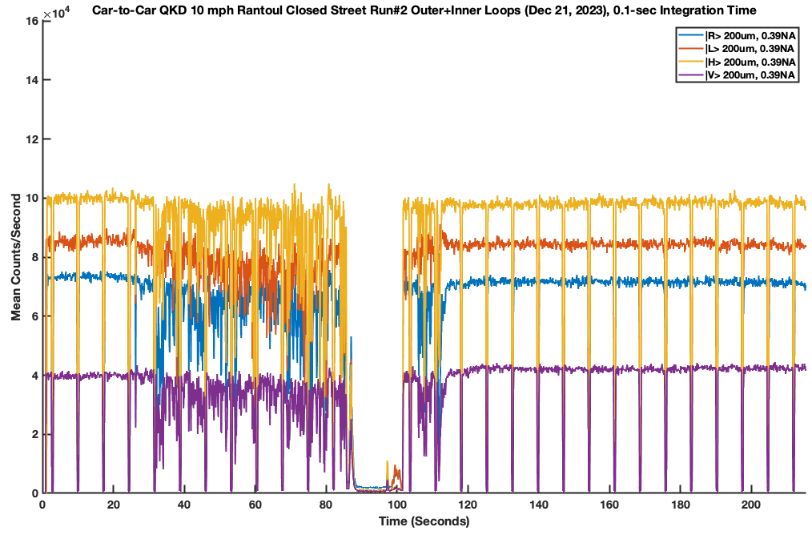
Run #2 Car-to-Car QKD (Inner+Outer Loops)
Stationary
10-15 mph
Stationary
Drop
Out

Slide 9
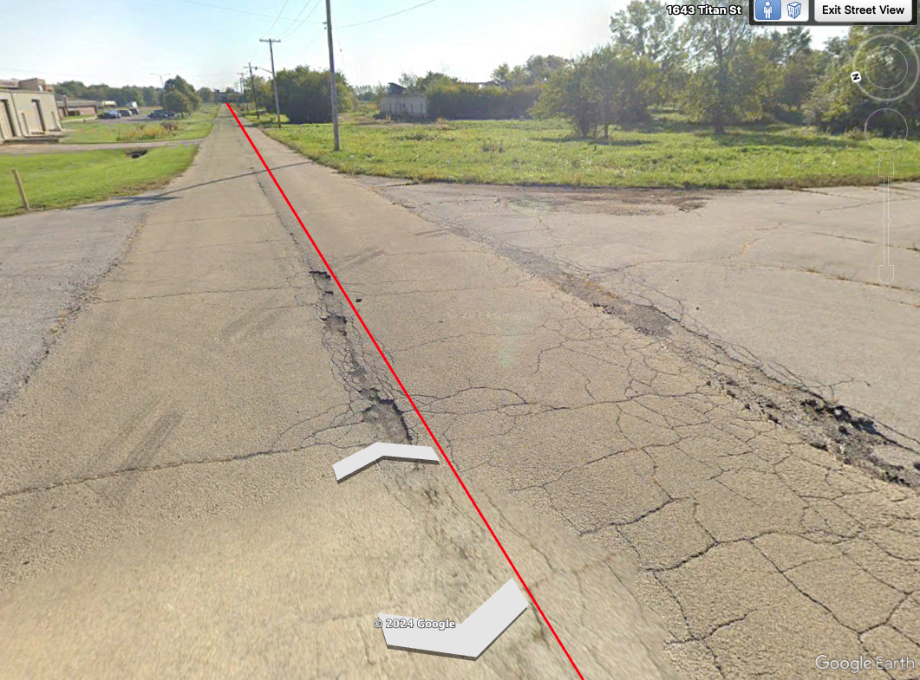
Run #2 Car-to-Car QKD (Inner+Outer Loops)
Stationary
10-15 mph
Stationary
Dropout caused by potholes, but the system automatically re-acquires
Drop
Out

Slide 10
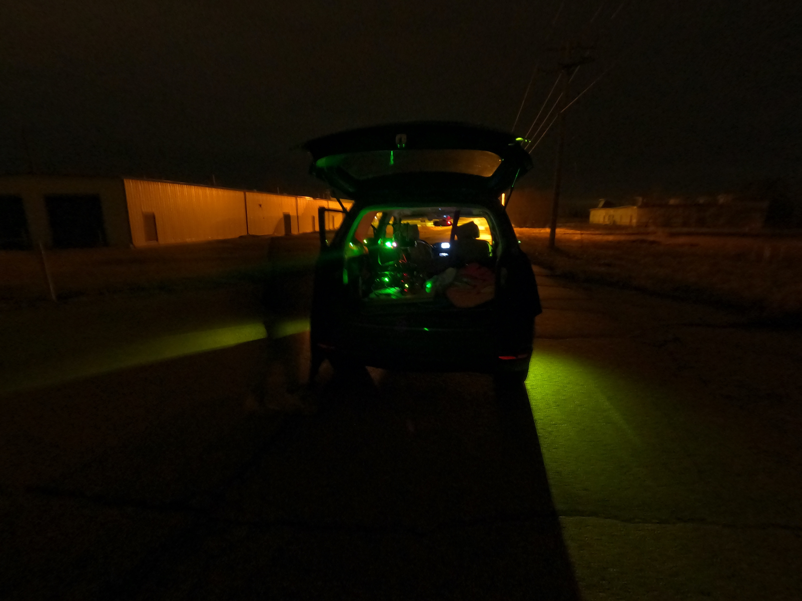
Car-to-Car QKD vs Distance Setup

Slide 11
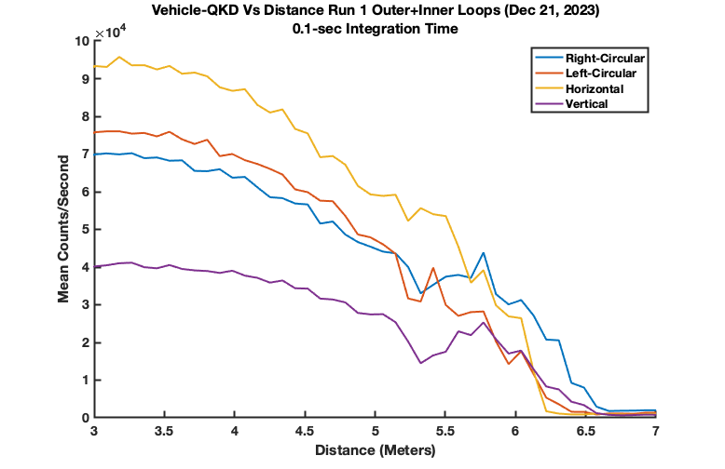
Car-to-Car QKD vs Distance

Slide 12
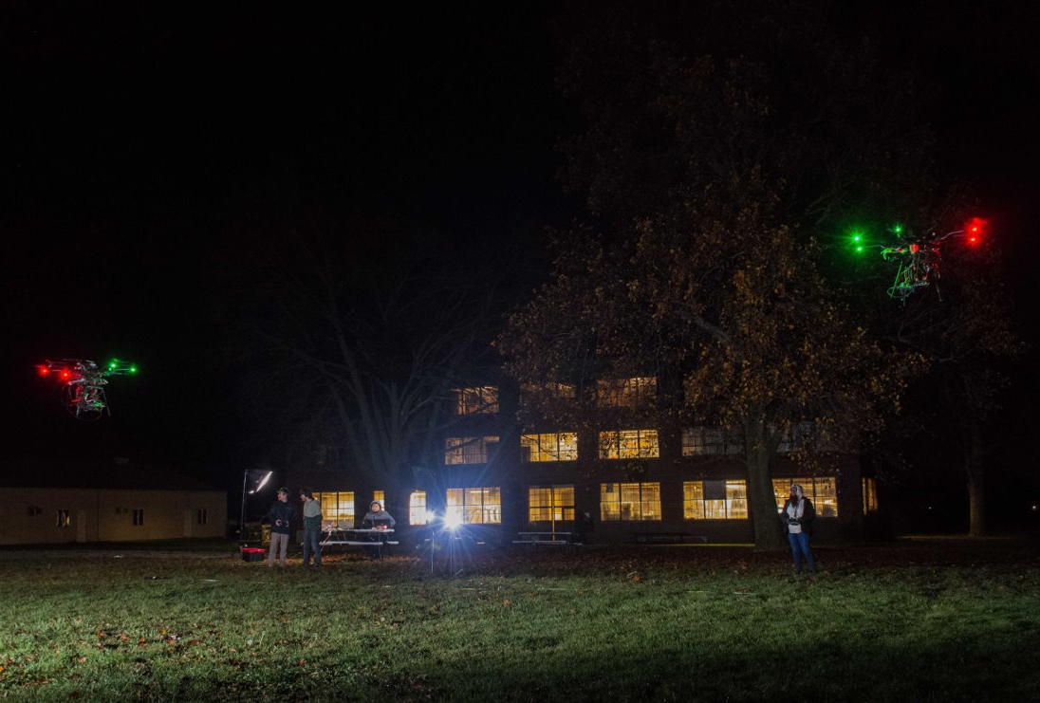
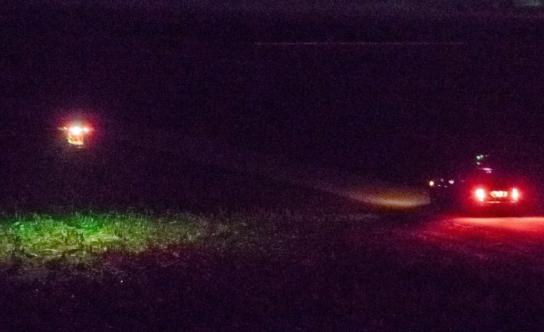
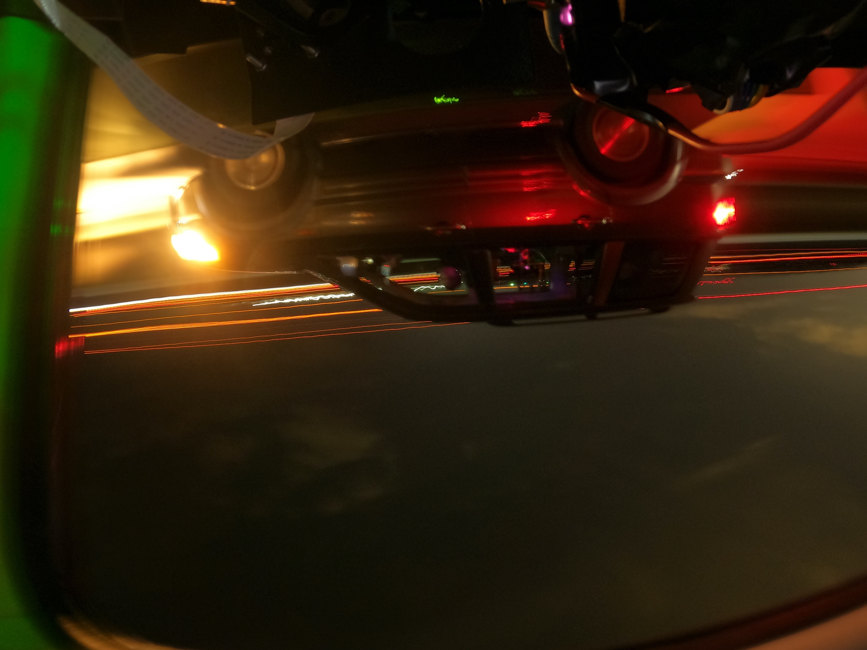
QKD Summary
Drone-to-Drone
Drone-to-Car
Car-to-Car
Image Courtesy Timur Javid
Image Courtesy Timur Javid
Image Courtesy Roderick Cochran
Link Configuration | QBER | Raw Key Rate | Secret Key [1] | Secret Key [2]
Tabletop (Aug 8, 2023) | 3.62% | 572.8 Kbits/sec | - | 7.5 Kbits/sec
Drone-to-Drone (Nov 2, 2022) Run2 | 2.45% | 361.8 Kbits/sec | 8.7 Kbits/sec | -
Drone-to-Car (Nov 15, 2023) Run 1 | <4%* | 156.9 Kbits/sec | - | -
Car-to-Car (Dec 21, 2023) Run 1 | <4%* | 265.7 Kbits/sec | - | -
[1] Lim, Charles Ci Wen, et al. "Concise security bounds for practical decoy-state quantum key distribution." Physical Review A 89.2 (2014): 022307.
[2] Custom Finite Key Model developed by Lütkenhaus group
*Preliminary Data

Slide 13
Drone Entanglement Architecture
Transmitter Drone
Receiver Drone
Post-Selected Entangled State:
Position Sensitive Detector
Position Sensitive Detector
$$|ψ⟩=\frac{1}{2}\left({\left|H\right\rangle }_{a}{\left|V\right\rangle }_{b}+{\left|V\right\rangle }_{a}{\left|H\right\rangle }_{b}\right)$$
705 nm Beacon
520 nm Beacon
Polarization Compensation
PM Fiber-Attenuator
50:50 Beam Splitter
Lens
Lens
Bandpass Filter @ 810nm +/- 1nm
Liquid
Crystal
Matchbox Laser 405nm
Waveguide
SPDC Source
Path a
Single-Photon Detector
$${\left|H\right\rangle }_{405nm}$$
$${\left|H\right\rangle }_{405nm}→{\left|H\right\rangle }_{810nm}⊗{\left|V\right\rangle }_{810nm}$$
Path b
Dichroic Mirrors
Dichroic Mirrors
Long-Pass Filter
45 deg
Or 27.35 deg
PBS
Long-Pass Filter
Liquid
Crystal
Bandpass Filter @ 810nm +/- 1nm
HWP
Single-Photon Detector
Single-Photon Detector
22.5 deg
90:10 Beam Splitter
27.35 deg
Single-Photon Detector
PBS
Liquid Crystals
0 deg
45 deg
Single-Photon Detector
Single-Photon Detector
Single-Photon Detector
PBS
Single-Photon Detector

Slide 14
Hybrid Quantum Network
U.S. Quantum Satellite
U.S. Quantum Satellite
Free-Space Quantum Link
Fiber Optic Quantum Link
Quantum Relay Drone
Quantum Relay Drone
Our Work
Fiber Optic Cable
QLAN
QLAN
Fiber Optic Cable

Slide 15
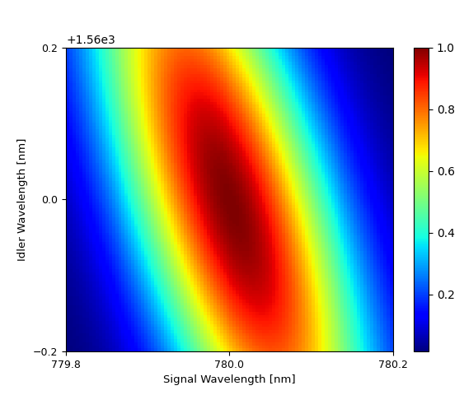
NonDegenerate Source: Predicted Joint Spectral Intensity
520 → 780 + 1560
crystal = KTP e->o+e
pump wavelength [m] = 5.2e-07
pulse width [s] = 5e-12
tbp = 0.44
signal wavelength [m] = 7.8e-07
idler wavelength [m] = 1.56e-06
periodic poling [m] = -2.96e-05
signal collection angle [deg] = 0
pump waist [m] = 7e-05
signal waist [m] = 6e-05
idler waist [m] = 5.5e-05
crytal length [m] = 0.02
Deff [m/V] = 1e-12
pump power [W] = 0.001
repetition rate [Hz] = 1.0e9
signal filter [m] = [7.798e-07, 7.802e-07]
idler filter [m] = [1.5598e-06, 1.5602e-06] Brightness [cc per pulse power] = 1.38e-05
Purity = 0.9548
Symmetric Heralding Efficiency = 0.8791

Slide 16
Beam-displacer Polarization-entanglement Source
DM
520 HWP
1560 HWP/780 FWP
BD
BD
1550 nm
V
H
HV
HH
520 nm
(H + V)
H
V
780 nm
VH
VV
SPDC
HH + VV

Slide 17
Broadband Beam Displacer
All wavelengths require different beam-displacer lengths to match the displacements
Two separate (non-overlapping) interferometers
Cannot easily align with single-color classical laser
Single beam-displacer length works for all 3 λ’s
Single 2-BD interferometer
Can easily align with single laser

