Slide 1
PQN

Slide 2
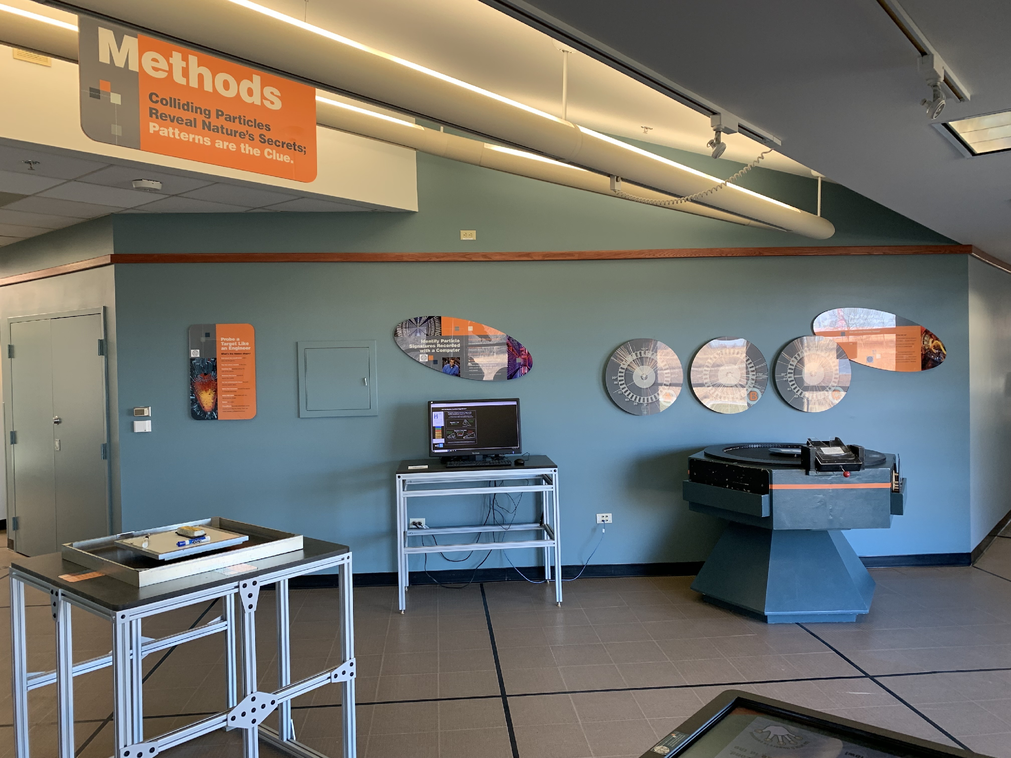
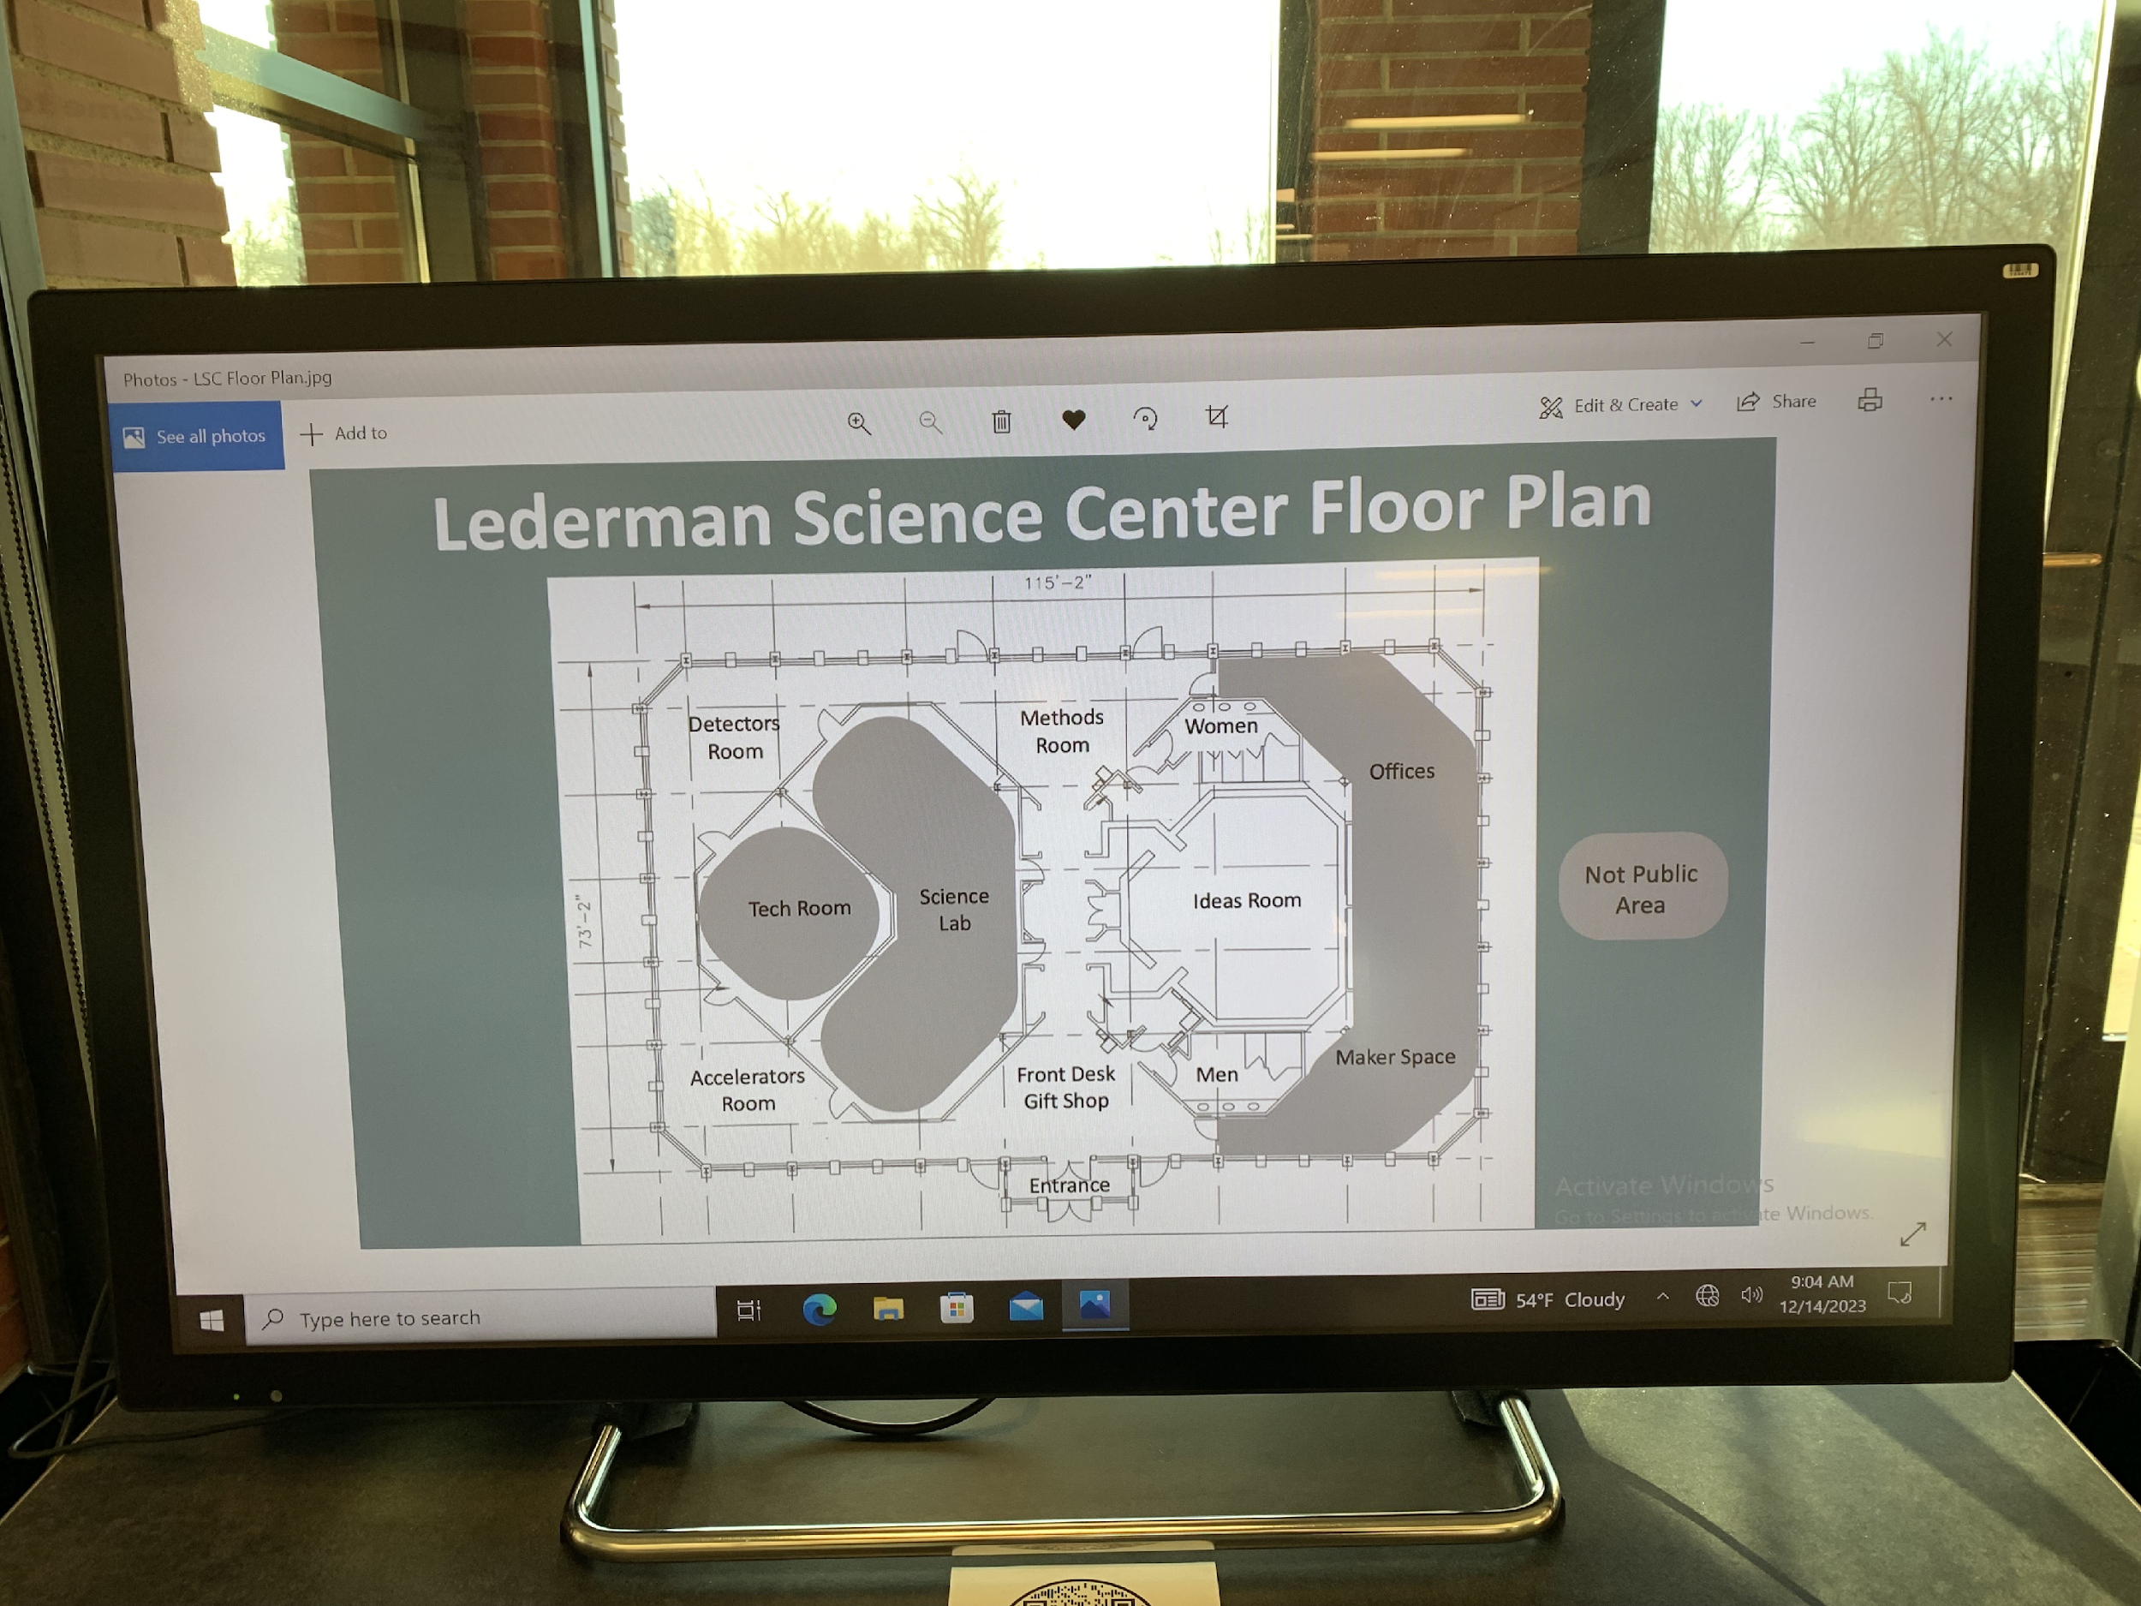
PQN @ Fermilab
Toured Lederman Science Center after all-hands meeting
Met with Ketevan Akhobadze and Luis Mendoza
Preliminary discussions on setups
Saw network closet, other interactive displays

Slide 3
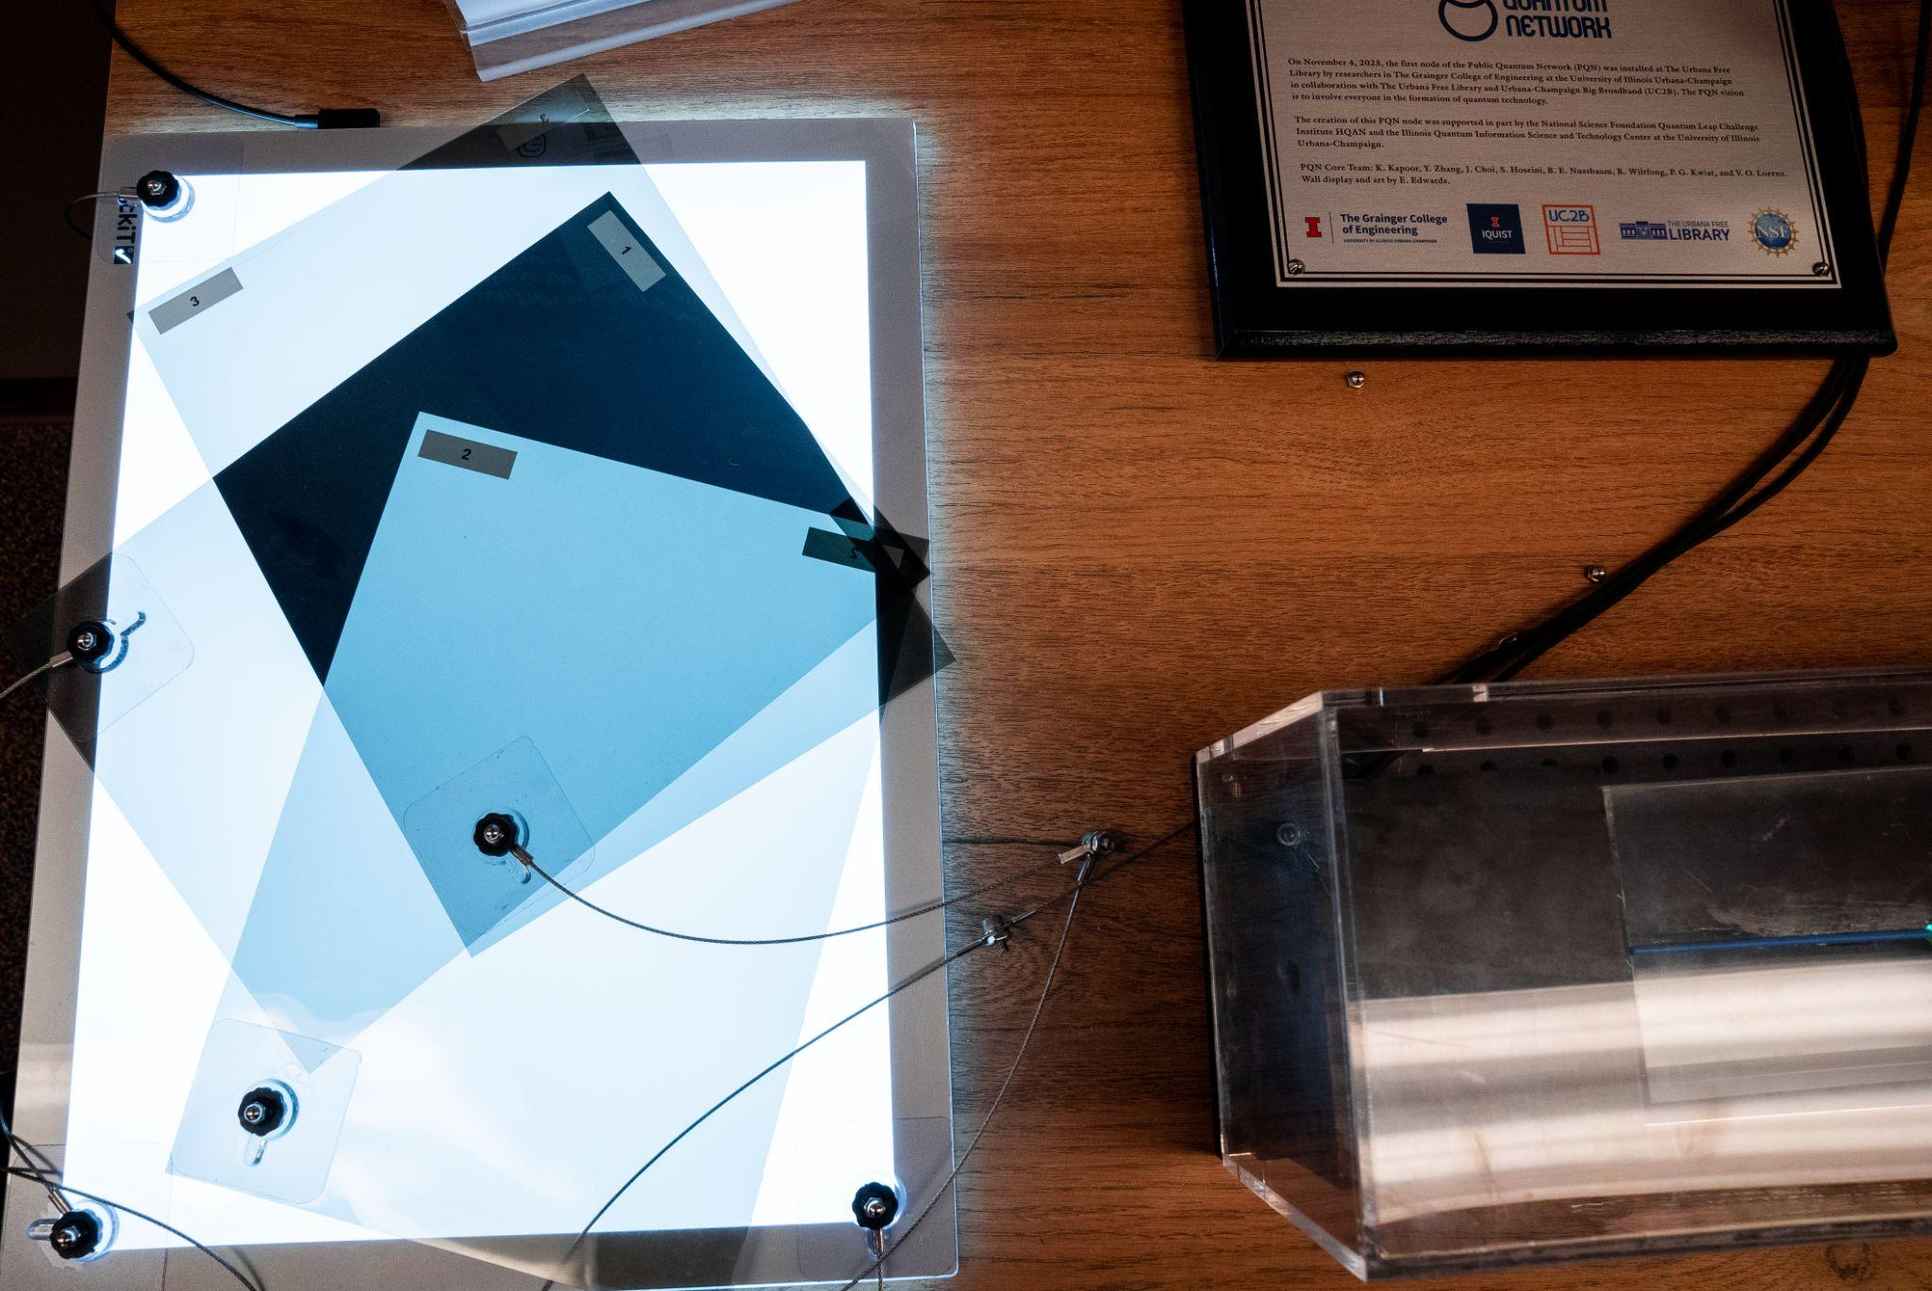
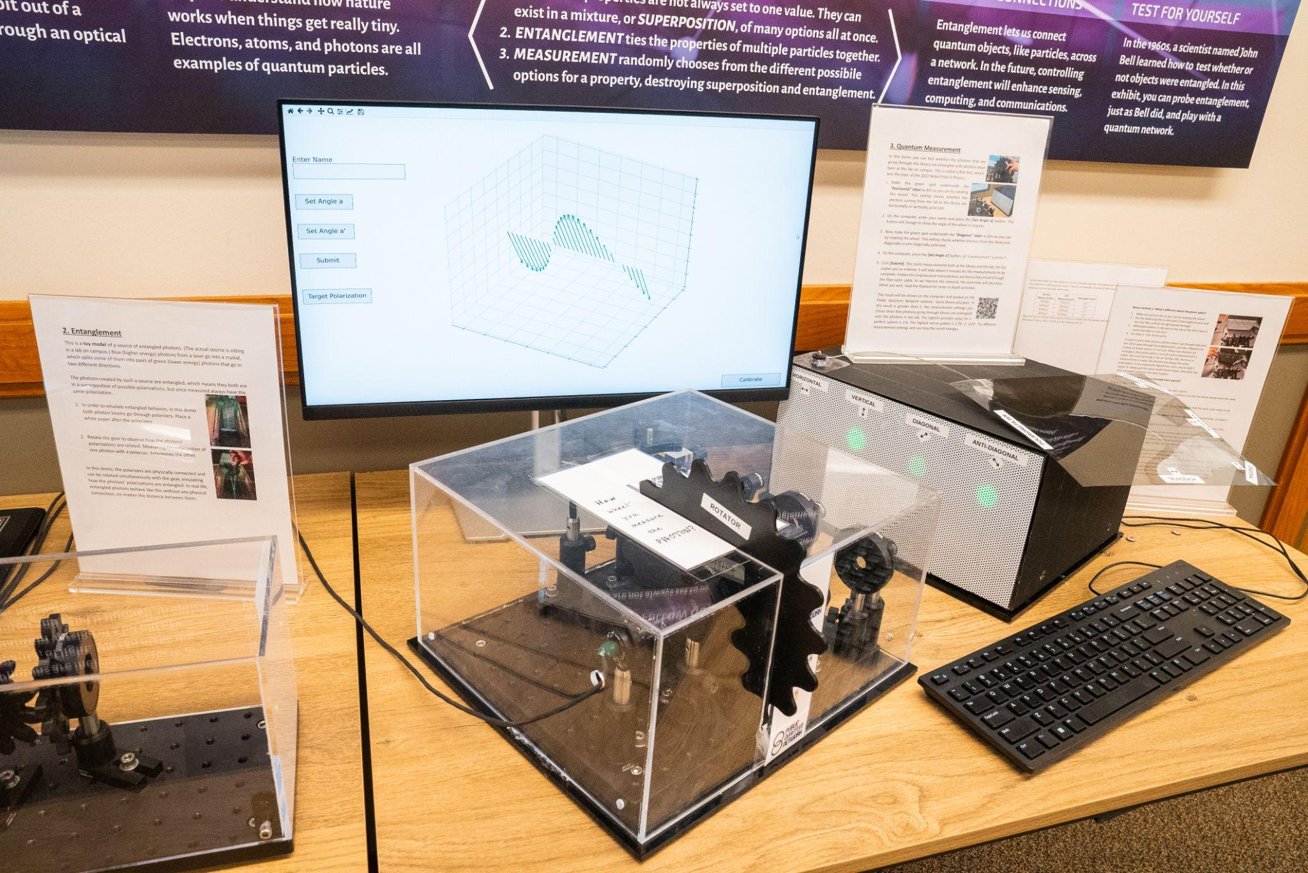
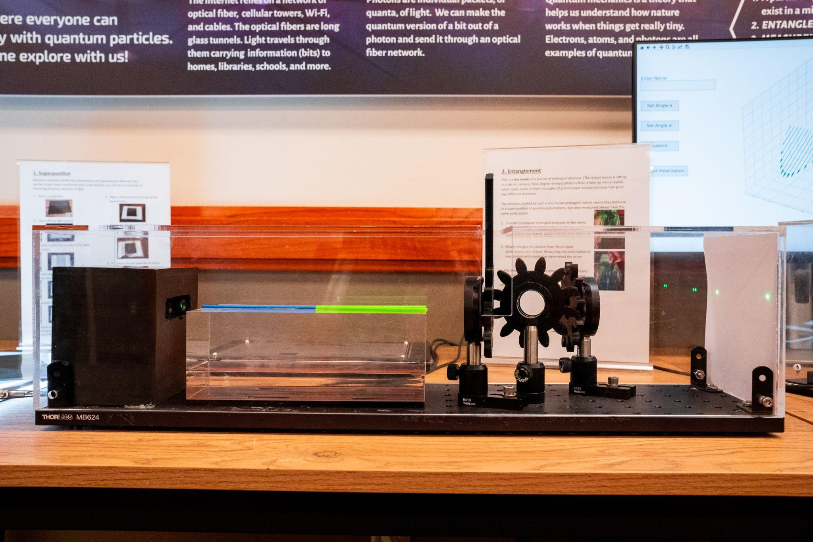
Public Interaction Setup at Urbana Free Library

Slide 4
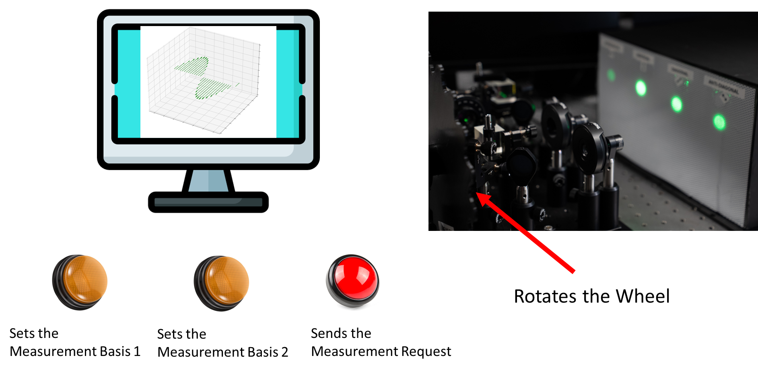
Public Interaction Setup at Urbana Free Library
Video
1
Video
2
Video
3

Slide 5
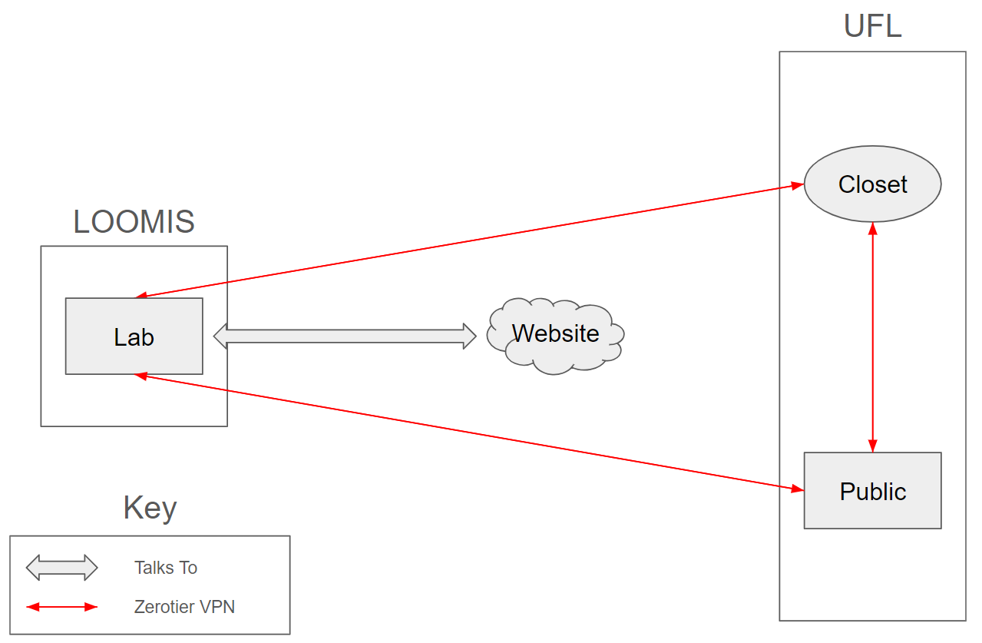
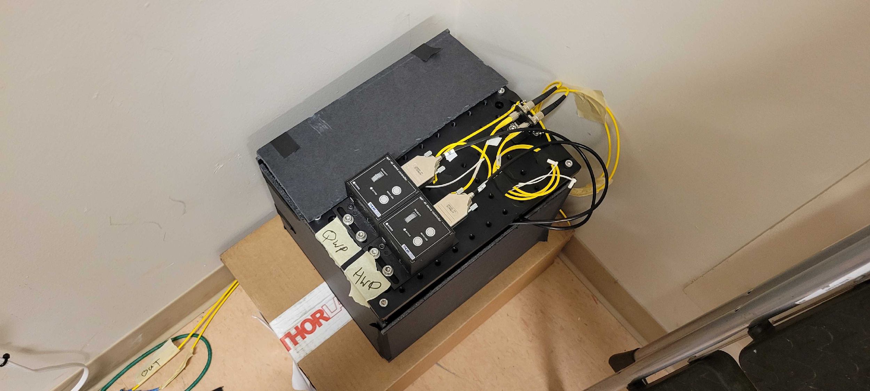
UFL Installation
We have installed a new projection measurement system in the library network closet
Additional QWP for new CHSH measurement scheme
New communication system in the works with Raspberry Pis

Slide 6
CHSH Measurement System
Both Loomis and UFL have QWP + HWP to do a full tomography
Every few hours (~3) we do a full state tomography
We have code which allows us to find the optimal basis angles at Loomis and UFL to give the maximum CHSH violation
We also map user selected basis angles using the state tomography data

Slide 7
Future Steps
Finish communication system for UFL
New CHSH measurement scheme
Performs state tomography
Maps basis selections to QWP and HWP based on tomography, bypassing need for active polarization corrections
These changes to the UFL system will guide us in creating Fermilab system

