Slide 1
AQNET Meeting Jan 30th, 2024
Andrew Cameron & Jordan Thomas

Slide 2
Current Status
We are three weeks in to working on replicating the swapping experiment conducted in summer 2023.
Two EPR sources are running, each with Z basis visibilities of ~98.5%.
Time bins are 346ps apart, with 5ns between qubits.
6 SNSPDs are running (Four-fold coincidence + 2 extras for both MZI outputs).
We’ve been preparing classical signals for coexistence
We have a pure photonics CW laser that can be tuned between 1529nm 1570nm with a maximum power of 17dBm.
Ordered SFP transceivers at 1270nm, 1310nm, and 1545nm. Our FPGA can modulate these sources to emulate 10Gbps internet communication.
We have the WDMs required to multiplex the classical signals in and out of the quantum channels before the BSM beamsplitter.

Slide 3
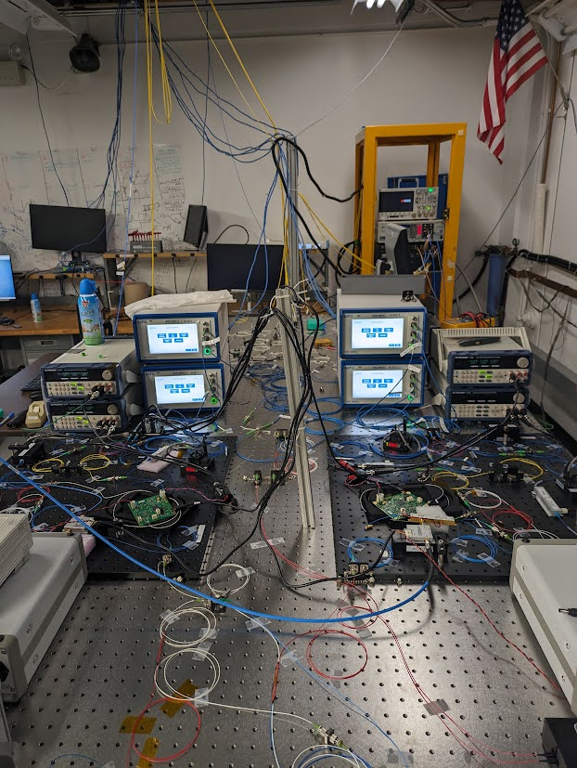
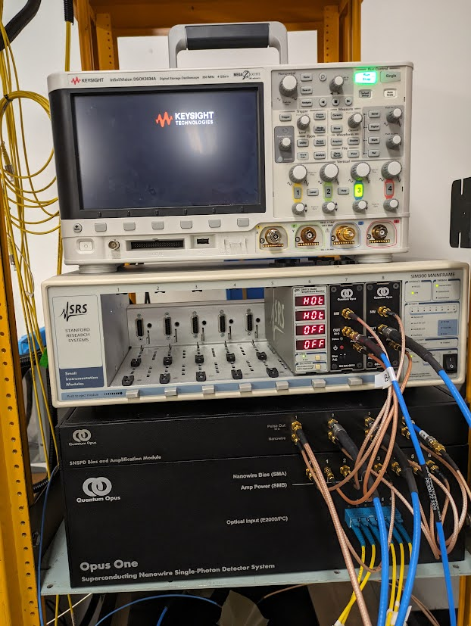

Slide 4
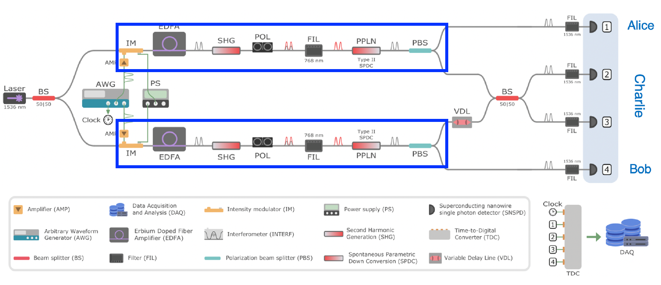
Experimental Setup – Z Basis
$${\left|Φ^{+}\right\rangle }_{12}$$
$${\left|Φ^{+}\right\rangle }_{34}$$

Slide 5
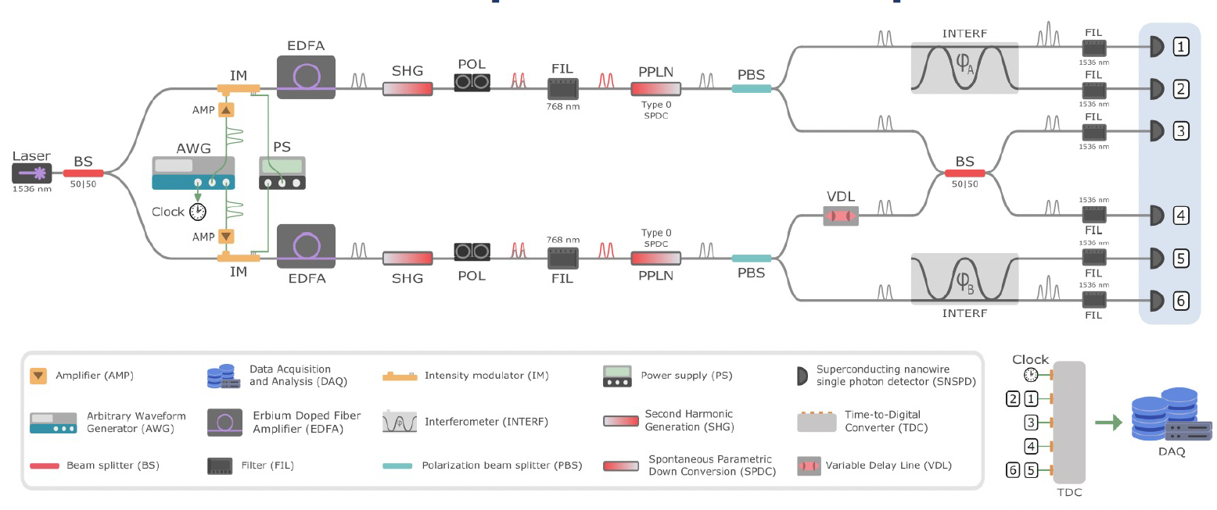
Experimental Setup – X Basis

Slide 6
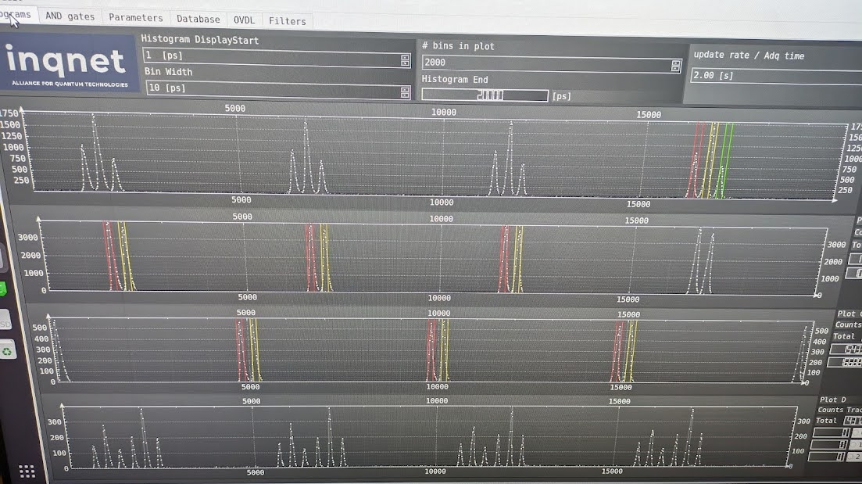

Slide 7
Plans for this week
Measure X-basis visibilities of both sources. As of Friday, we can remotely control the interferometer power supplies.
Combine one photon from each source on the BSM beam splitter and measure HOM visibility. A variable optical delay is on the table, and it’s the last component we have to learn how to remotely address.
If all goes to plan, we’ll begin entanglement swapping measurements by the end of the week/early next week.

Slide 8
Future steps
Raju is sending us two 10km spools of telecom fiber. First, we’ll see how the spools affect the experiment, then we’ll multiplex in our classical signals. We’ll check how the following are affected:
Entanglement distribution visibility
HOM interference visibility
Entanglement swapping fidelity
In addition to studying how much classical CW power we can put in the spools, the final demo will show coexistence with 10Gbps classical communications at three different wavelengths.

