Slide 1
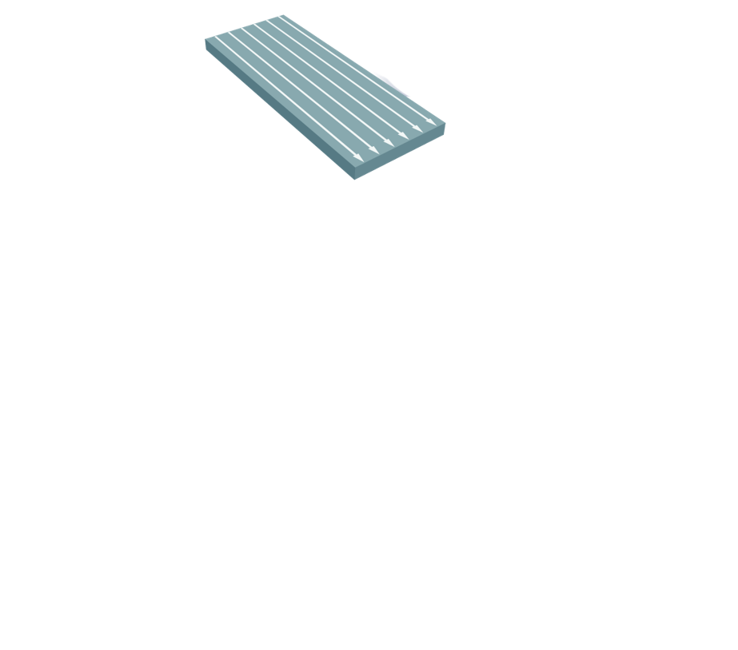
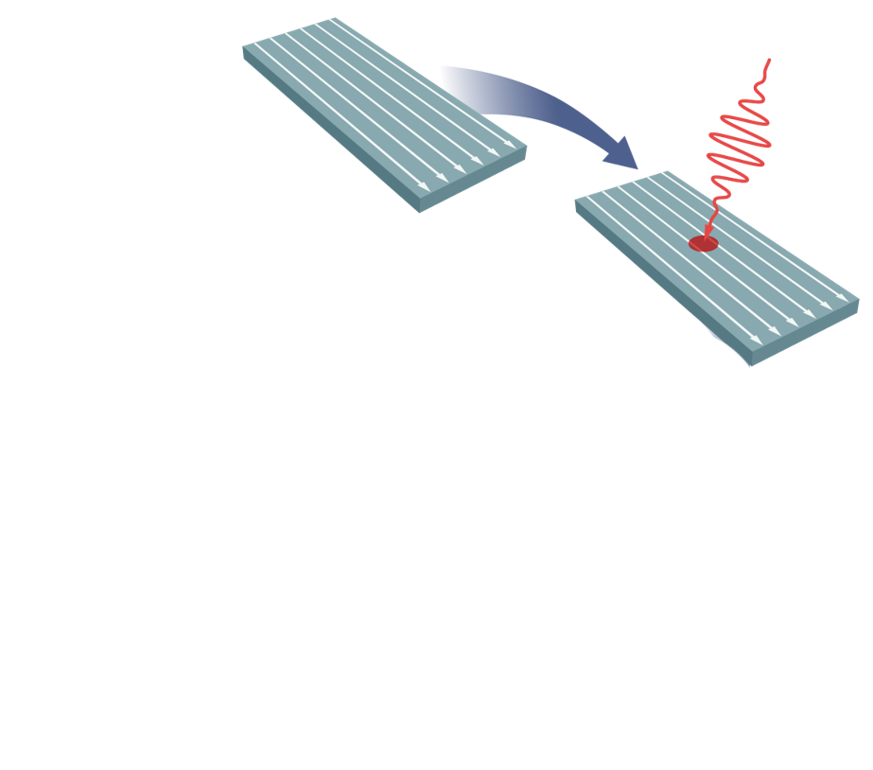
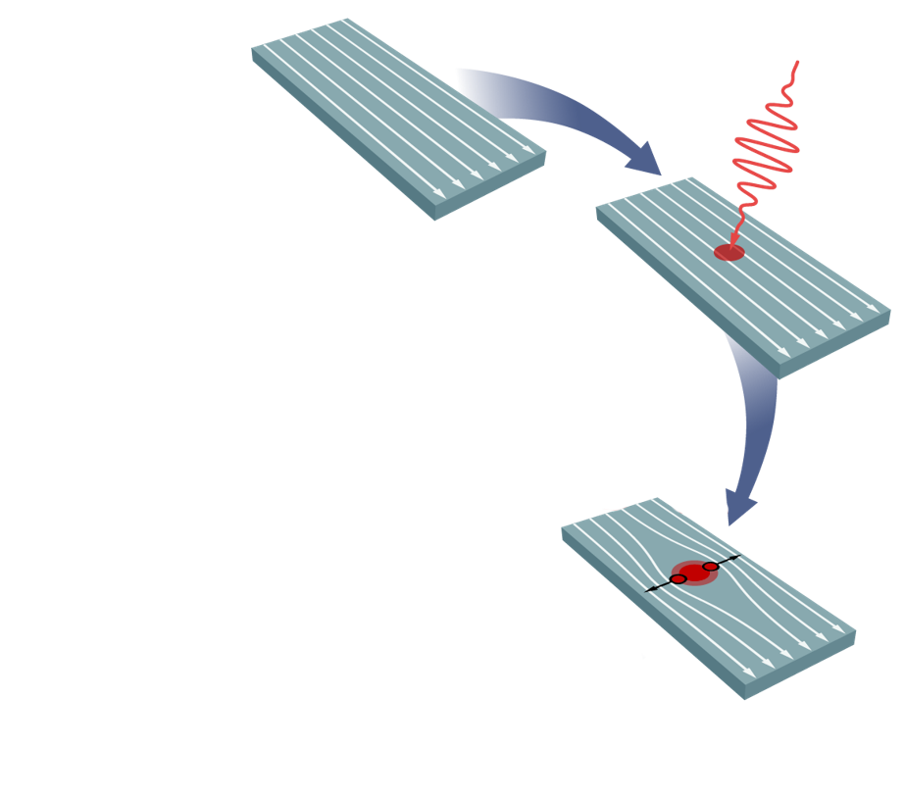
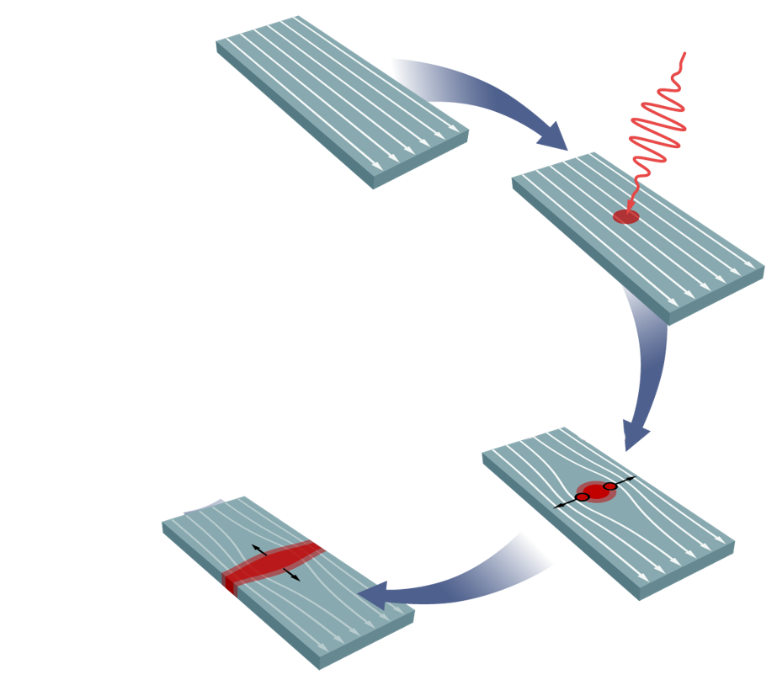
Differential Single Pixel

Slide 2
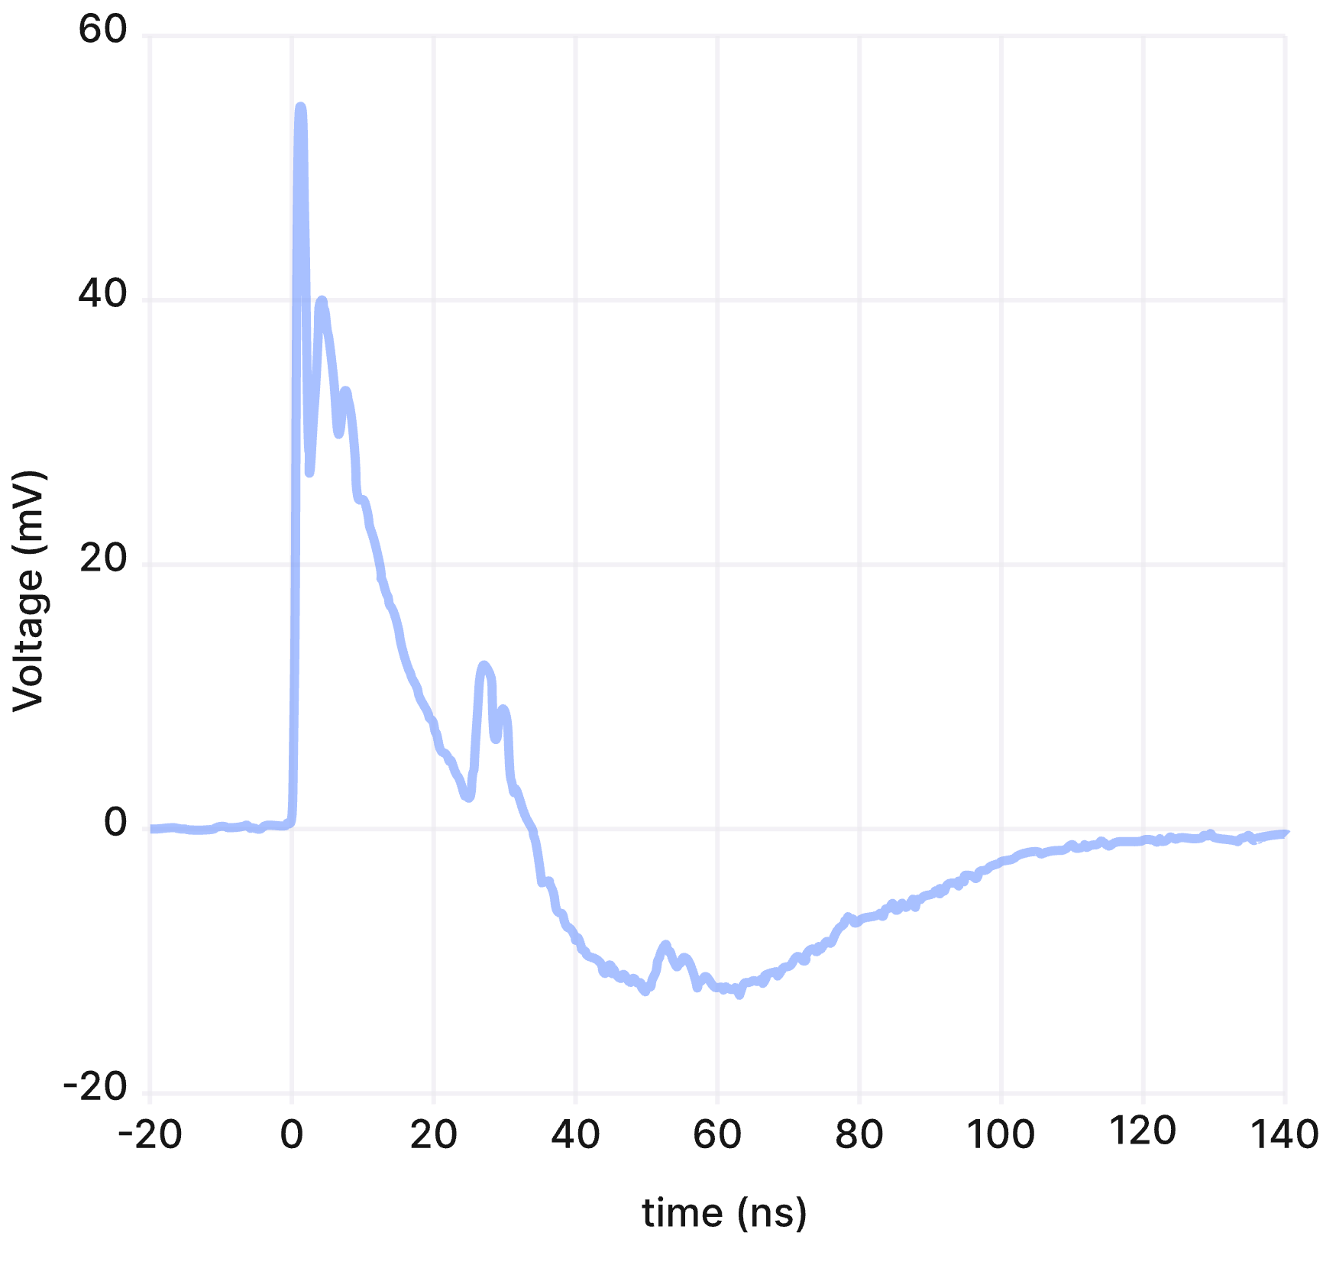
Differential Single Pixel
Impedance matching tapers increase pulse height and rise time

Slide 3
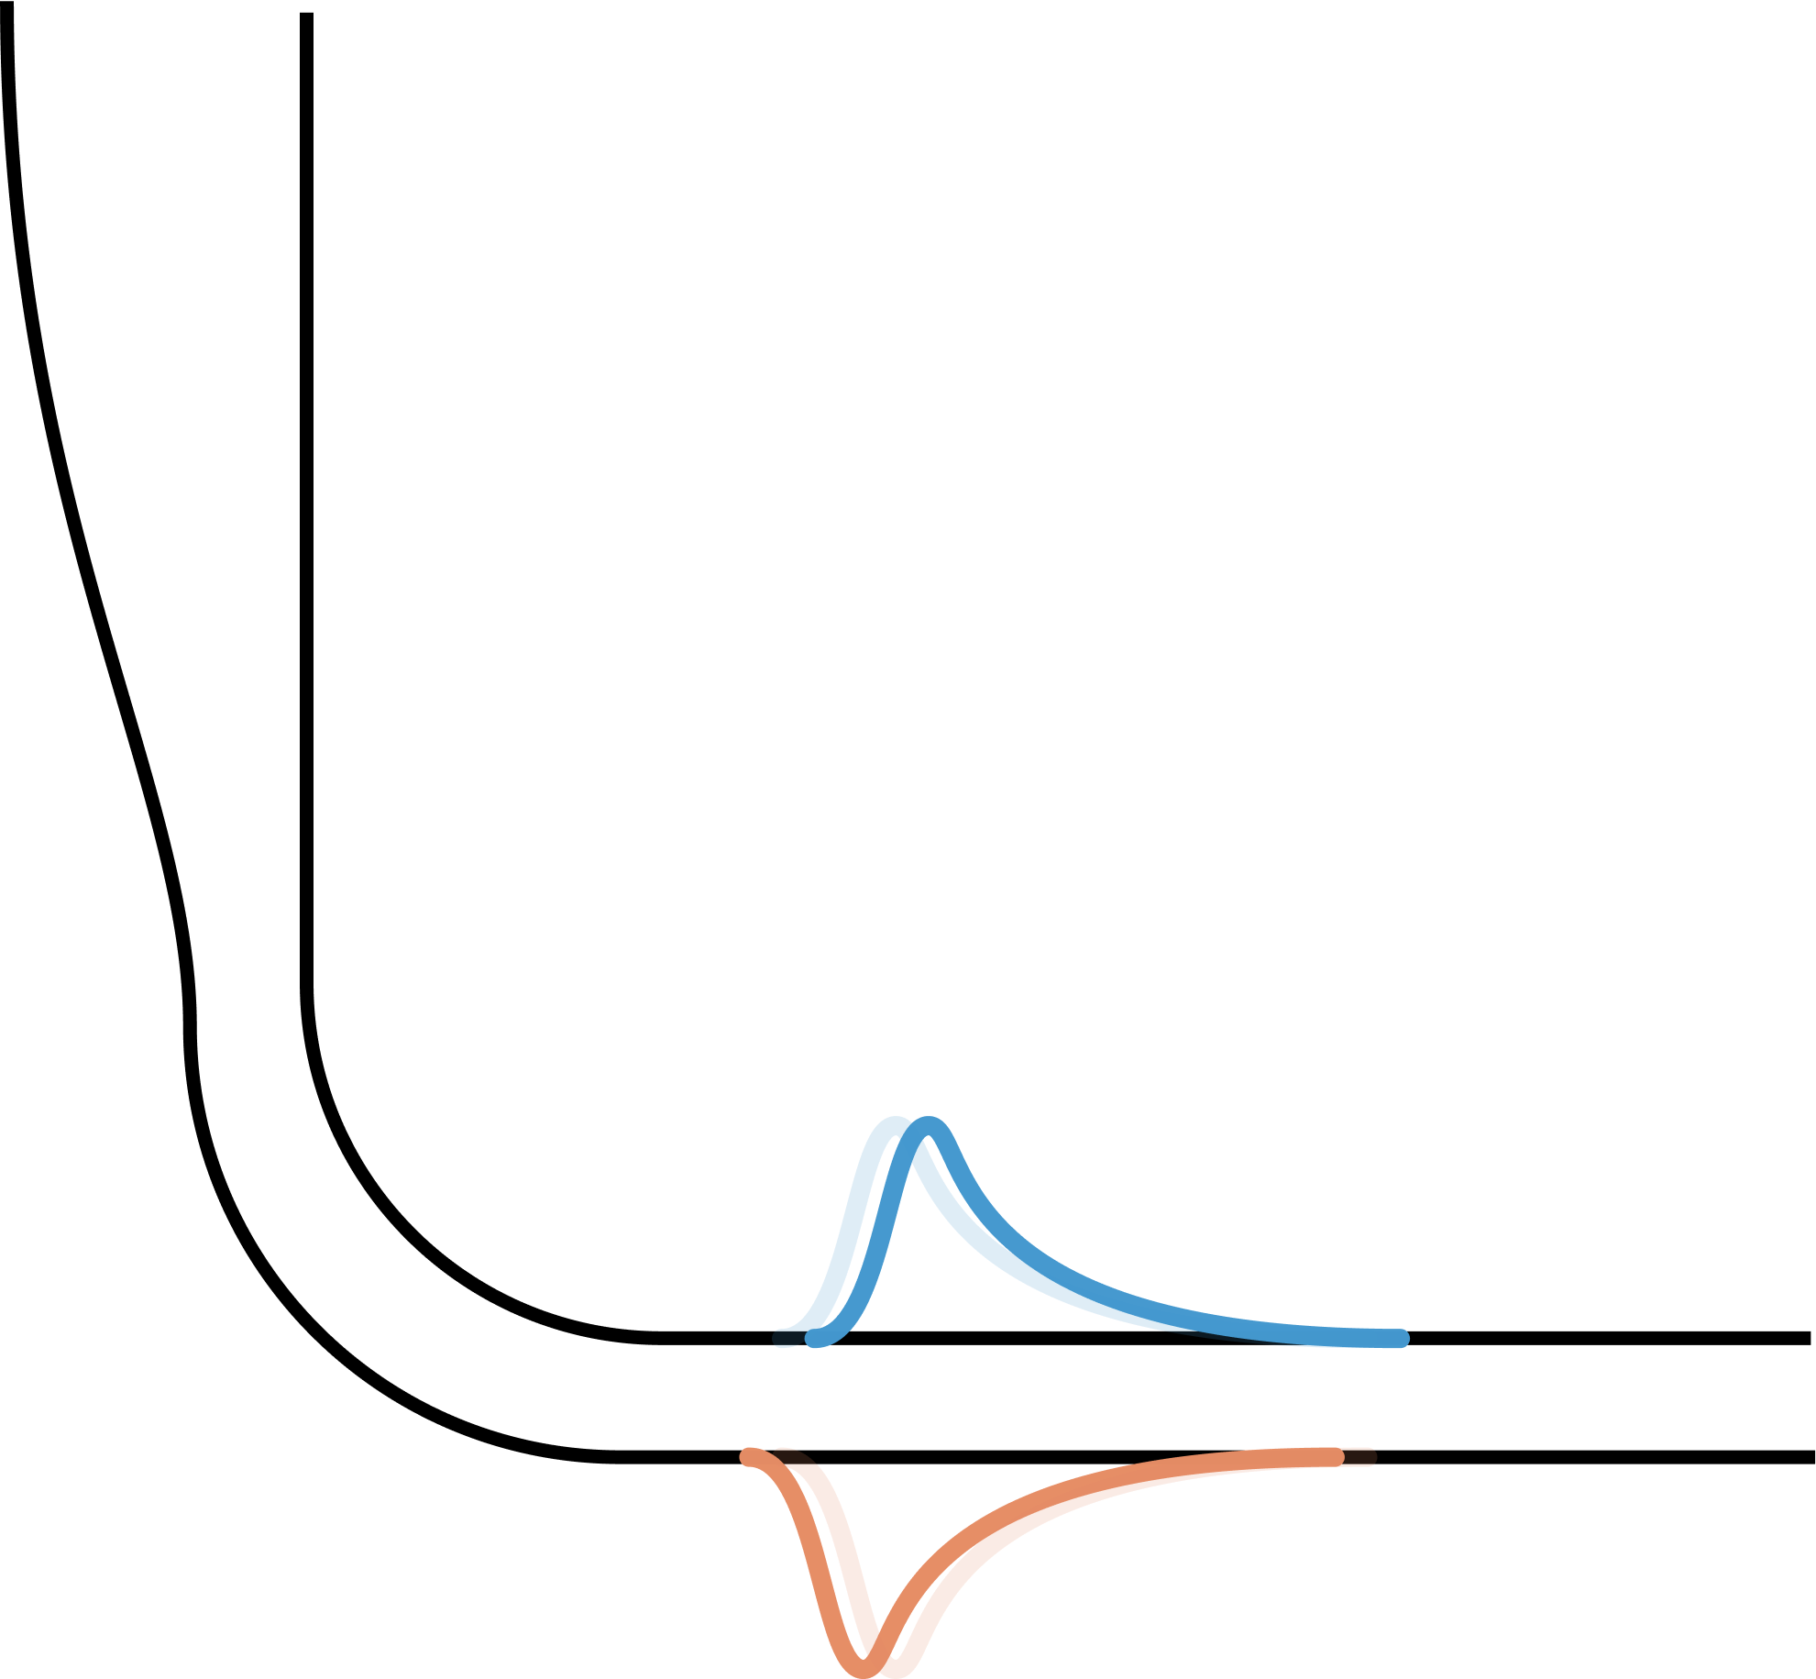
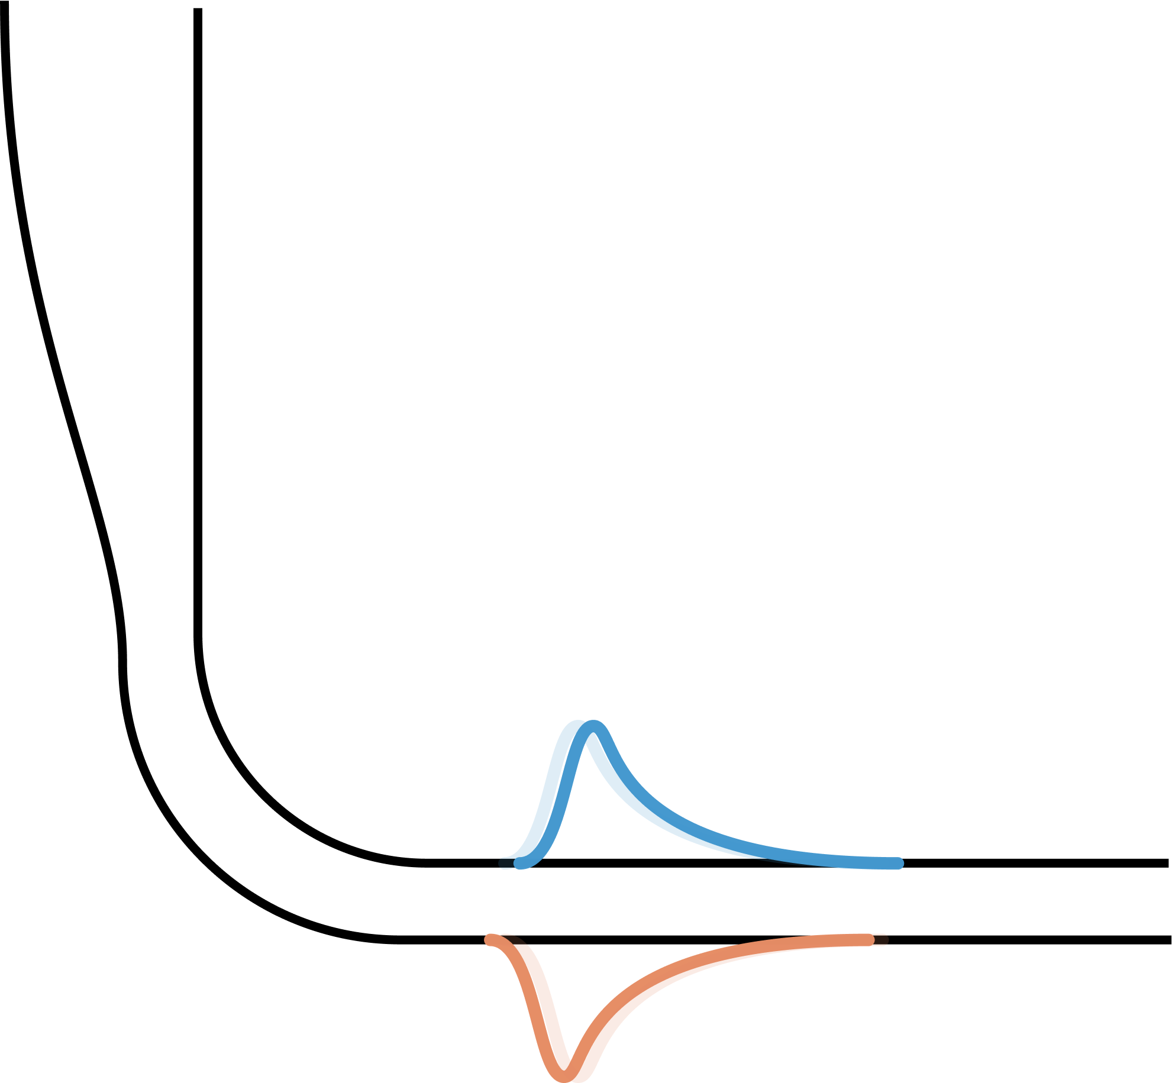
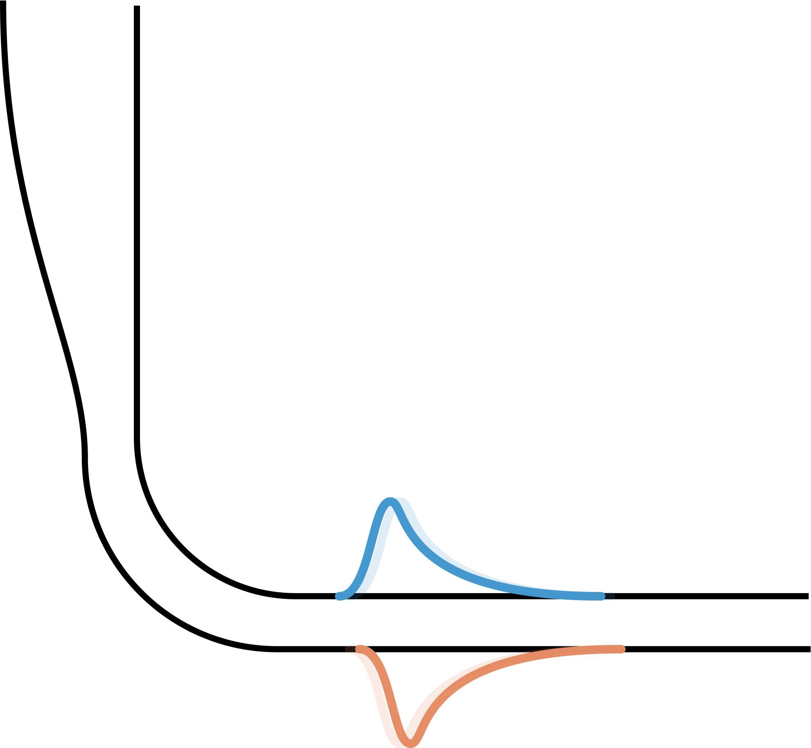
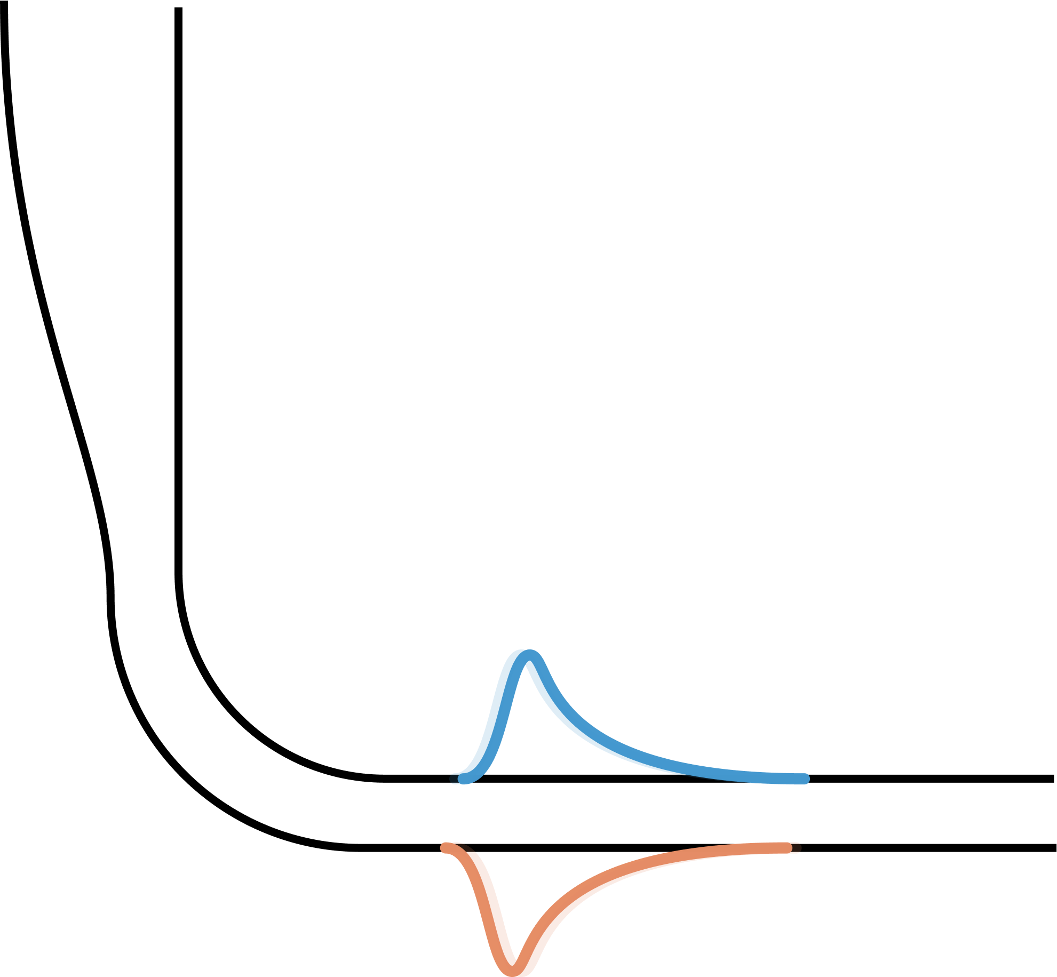
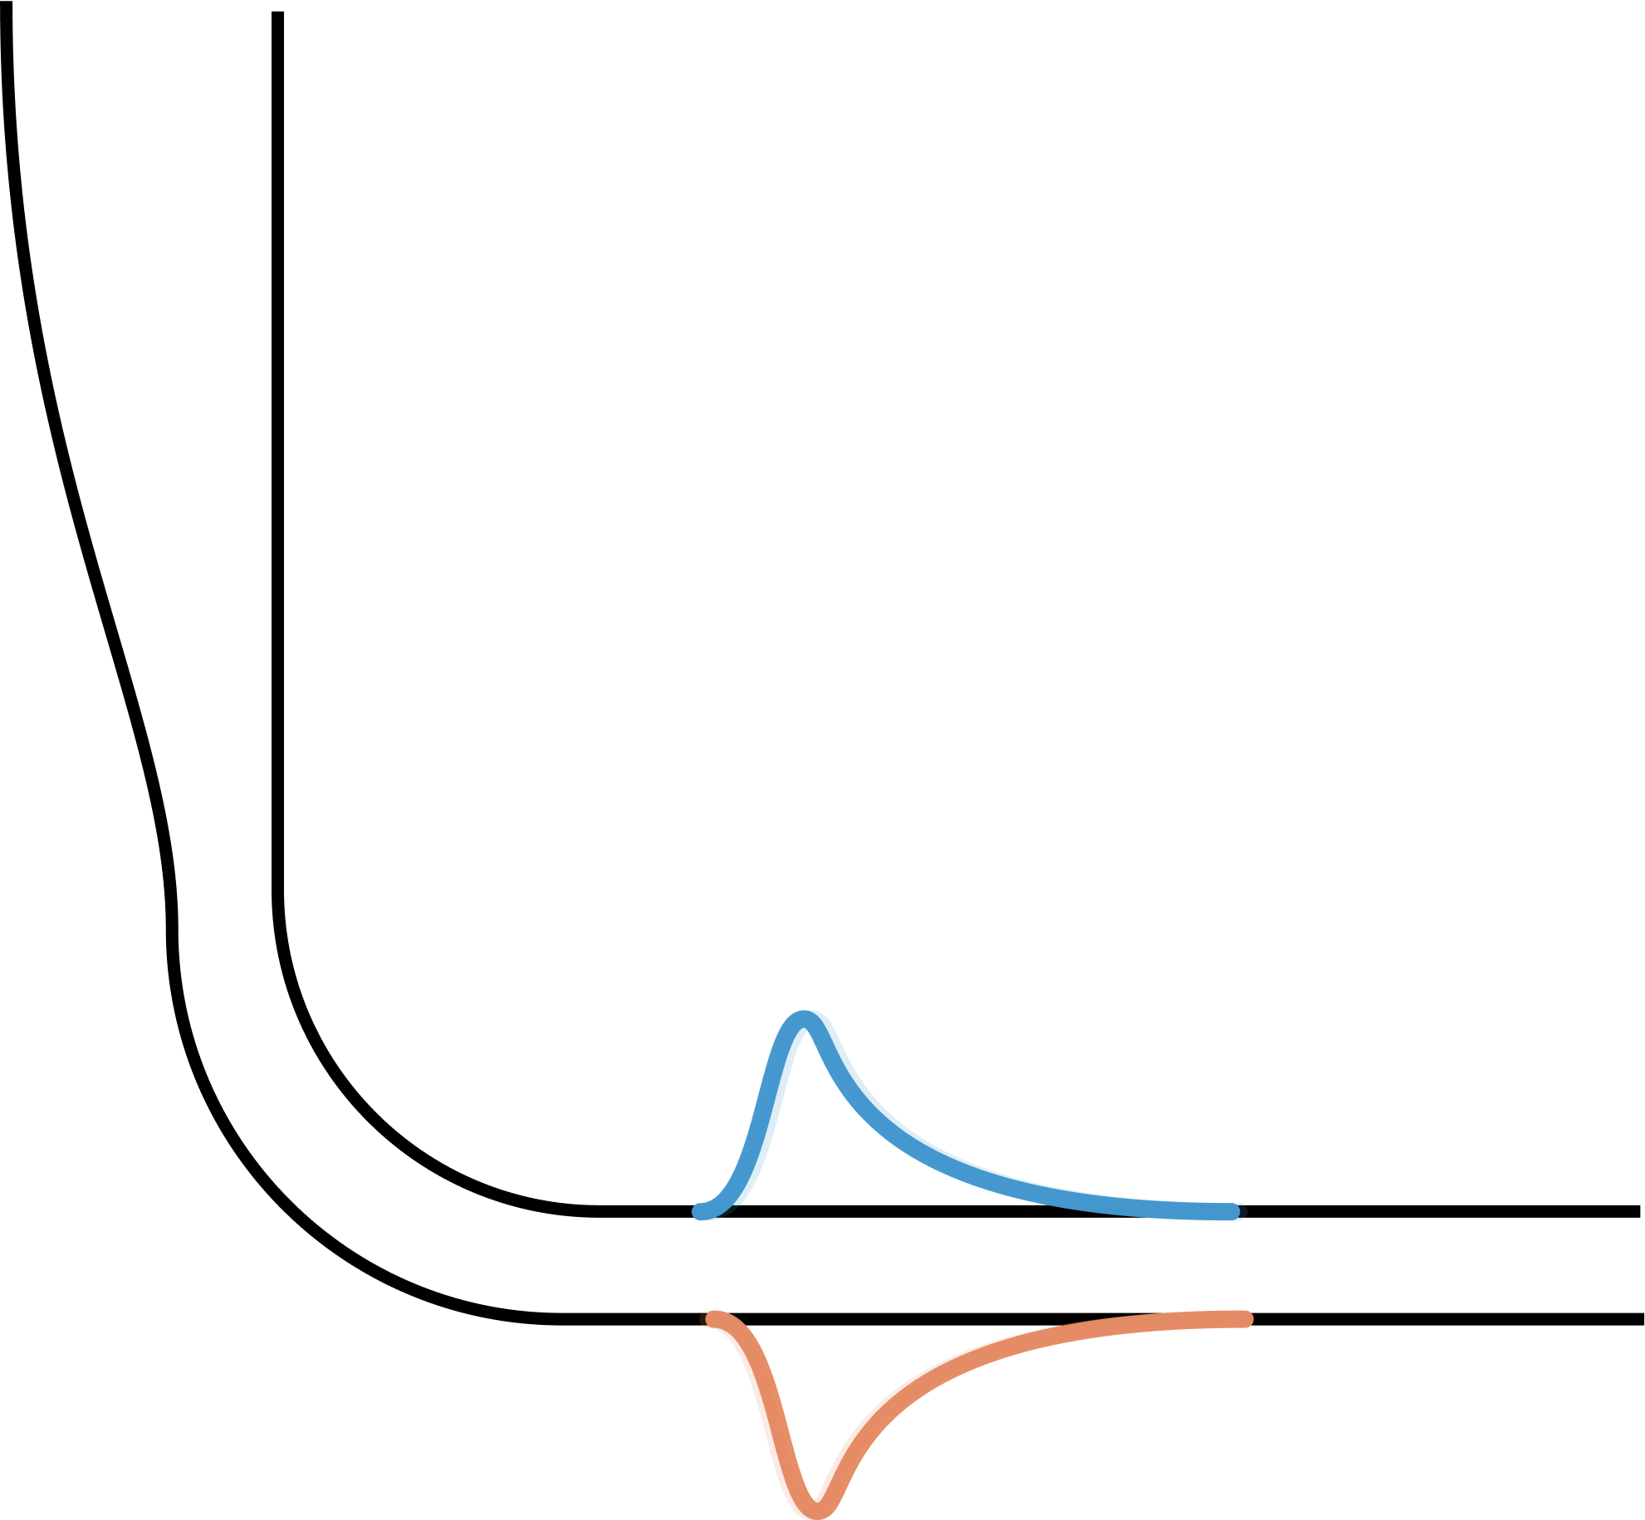
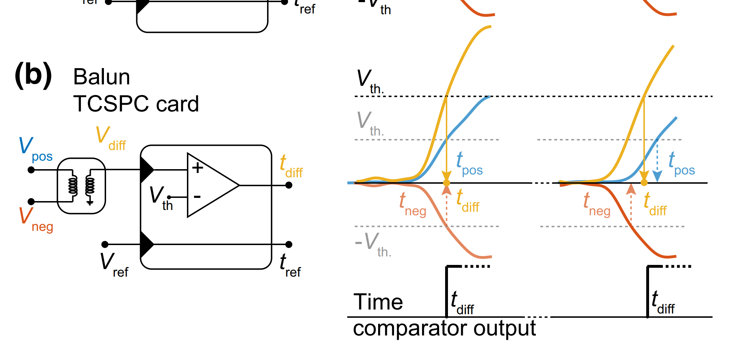
Differential Single Pixel
Impedance matching tapers increase pulse height and rise time
[1]

Slide 4
Differential Single Pixel
Impedance matching tapers increase pulse height and rise time
[1]

Slide 5
Differential Single Pixel
Impedance matching tapers increase pulse height and rise time
[1]

Slide 6
Differential Single Pixel
Impedance matching tapers increase pulse height and rise time
[1]

Slide 7
Differential Single Pixel
Impedance matching tapers increase pulse height and rise time
[1]

Slide 8
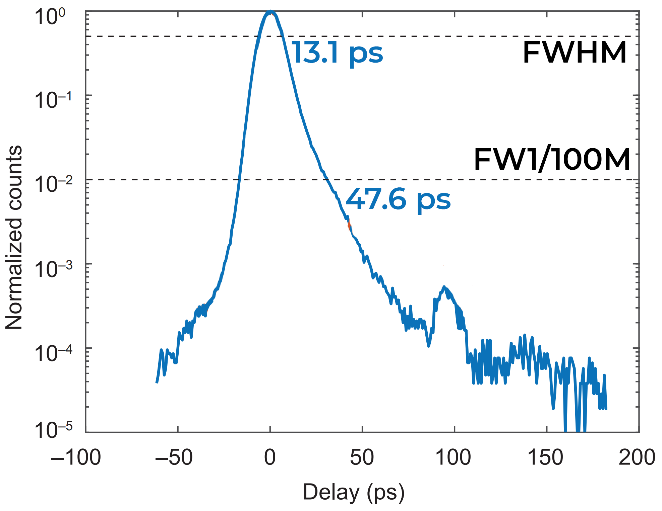
Differential Single Pixel
Impedance matching tapers increase pulse height and rise time
[1]
[1] Colangelo et al. 2023

