Slide 1
Muon Collider Experiments
Overview of detector requirements and limitations
R. Lipton, Fermilab
Why contemplate a Muon Collider?
Because of the reduced bremsstrahlung muon rings can be made compact
  Lower cost
  Lower power consumption- 230 (MuC) vs 570 (CLIC) MW for 3 TeV
    20% increase for 6 TeV
  Fits on existing sites
Different cost scaling and lower power consumption mean that one can contemplate collider rings to 6 TeV
A Muon Collider is uniquely capable of producing Higgs bosons in the s channel with beam energy resolution comparable to it’s width

Slide 2
A Vision
Possible staging:
Project X proton source
Stored Muon Neutrino factory
Higgs factory
High energy muon collider
Physics at each step
Requires a sustained effort

Slide 3
The Standard Model Higgs
The SM Higgs:
  All properties are determined for a given mass.
  Any deviations signal new physics.
Theoretical questions:
  Couplings and width SM?
  Scalar self-coupling SM?
  Any additional scalars? EW doublets, triplets or singlets? (e.g. SUSY requires two Higgs doublets)
  Any invisible decay modes?
Branching Fractions
bb = 0.584 W⁺W⁻ = 0.229
ττ = 6.02 x10⁻² Z⁰Z⁰ = 2.82 x 10⁻²
cc = 2.57 x10⁻² gg = 6.81 x 10⁻²
ss = 2.57 x10⁻² γγ = 2.26 x 10⁻³
μ⁺μ⁻ = 2.09 x 10⁻⁴ Z⁰γ = 1.58 x 10⁻³
M(H) = 126 GeV
Γ(H) = 4.21 MeV

Slide 4
Questions
Central Question:
Can we do precision physics in the high background environment of the Muon Collider?
Subsidiary questions
What detectors are needed?
What compromises must be made and what is the physics impact?
What new technologies must be developed?
Identify and study sensitivity to specific processes in the Muon Collider environment

Slide 5
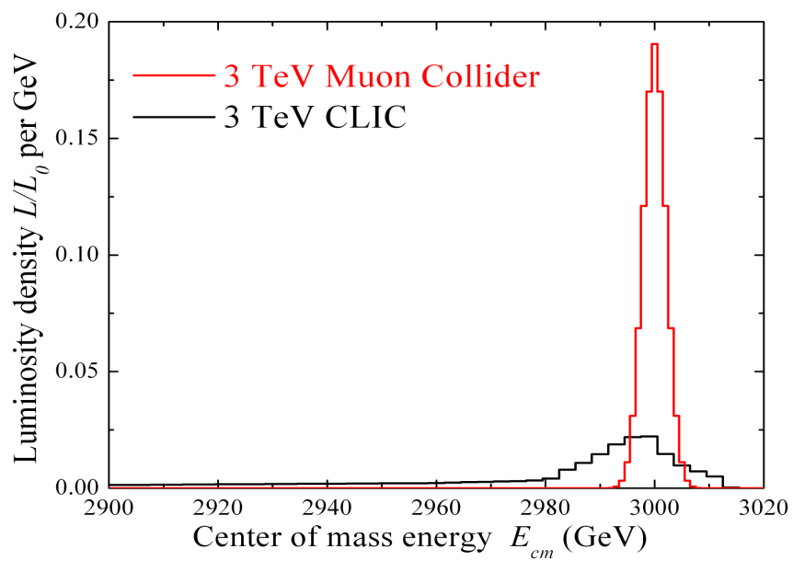
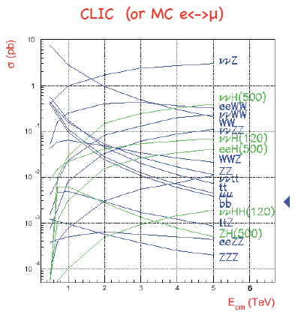
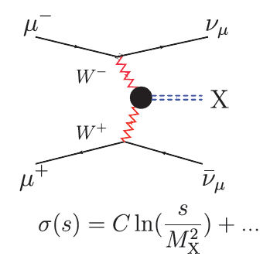
HE Collider Physics Environment
Narrow beam energy spread
  Precision scan
  Kinematic constraints
2 Detectors
ΔT_{bunch} ~ 10 μs
  Lots of time for readout
  Most backgrounds don’t pile up
Multi-TeV lepton collider cross sections dominated by boson fusion
Beamstrahlung in
any e+e- collider
δE/E ∝ γ²
(Han)
Ronald Lipton 8/11/2011
5

Slide 6
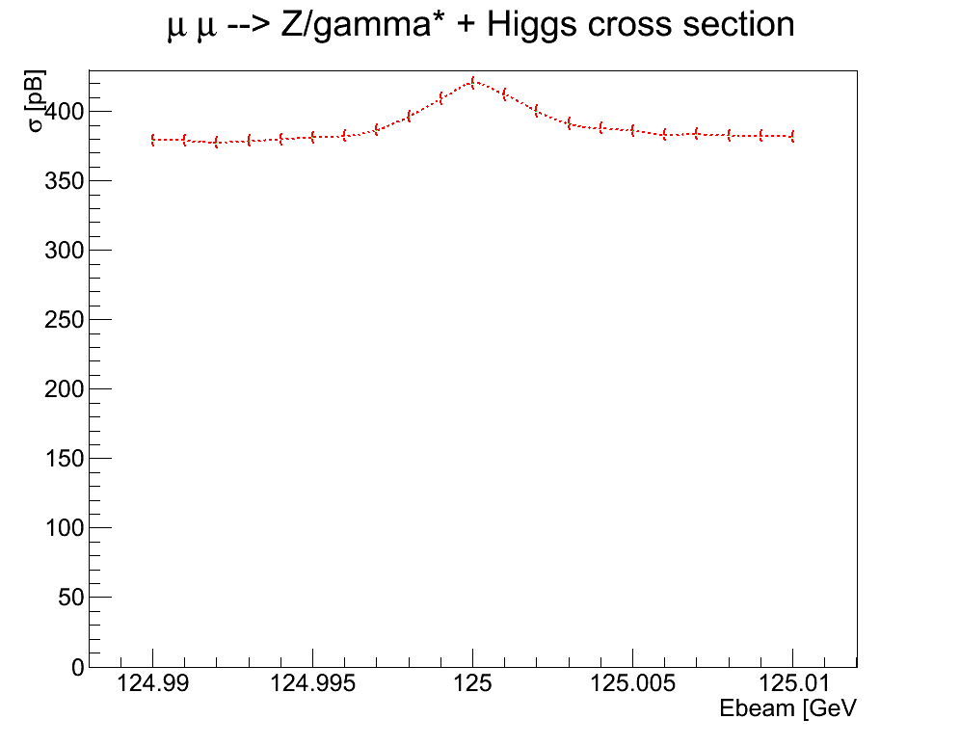
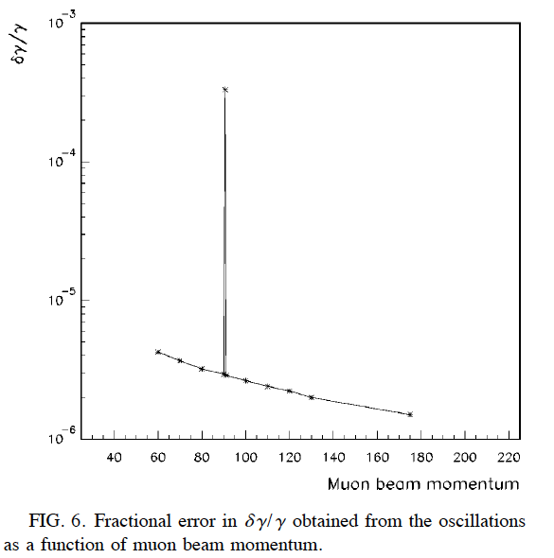
Higgs Factory Environment
An S-channel Higgs factory is possible:
Coupling: (m_{μ}/m_{e})² = ~40,000
Γ(H)~4.2 MeV
ΔE(beam) ~ 3 – 5 MeV possible
Beam energy resolution could be comparable to the Higgs width
  Direct measurement of width
  Precise mass measurement
∼300 meter circumference
  ΔT_{bunch} ~ 500 ns
1000 turns (~0.8 ms)/store
Polarization, (g-2)/2 provide precise beam energy measurement
124.99
125.01
10⁻⁵
Raja, Tollestrup
PHYSICAL REVIEW D 58 013005
10⁻⁶

Slide 7
Higgs Factory Rates
Cross section
At scan point
Overall rates
Luminosity estimates are in the
10³¹-10³² range
If we fold a 4.2 MeV Breit-
Wigner with a 2.5 MeV
Gaussian beam we get a on-peak
cross section of ~46 pb
This gives us between 3,000 (5 MeV, 10³¹) and 46,000 (2.5 MeV, 10³²) Higgs/year
The physics we can do depends strongly on machine parameters

Slide 8
Higgs Factory vs High Energy Collider Requirements
The unique contributions of a MuC Higgs Factory include precise, model-independent measurements of width and mass. This requires:
Excellent machine energy resolution and stability
g-2 based measurement of energy
Z/γ* background rejection (W/W* signal probably best)
A high energy machine would be used to measure new states (supersymmetric …). The requirements are similar to CLIC, MuC has lower beamstrahlung – more precise fits.
Precise, low mass tracking (μμ→Zh)
Vertex Flavor tagging
Calorimetry capable of separating W/Z signals

Slide 9
For Detectors - It’s All About the Background
Experiments at the Muon Collider will endure very harsh background environments. The first order of business in evaluating physics capabilities is to understand and simulate the machine backgrounds.
Muon beam decays:
  For 62.5-GeV muon beam of 2x10¹², 5x10⁶ dec/m per bunch crossing
  For 0.75-TeV muon beam of 2x10¹², 4.28x10⁵ dec/m per bunch crossing, or 1.28x10¹⁰ dec/m/s for 2 beams; 0.5 kW/m.
Full MARS simulation of 1.5 TeV machine backgrounds available
Higgs factory background work underway

Slide 10
Detector Simulation
Work based on ILCROOT/LCSIM simulations
Both full and fast simulation available
  Mars backgrounds incorporated into full simulation
  A variety of detector options can be explored
Background only studies
  Full event simulation
    Study how cuts affect backgrounds
    Study parameterization of backgrounds
    Build background library
  Background characteristics
    Time and energy distributions

Slide 11
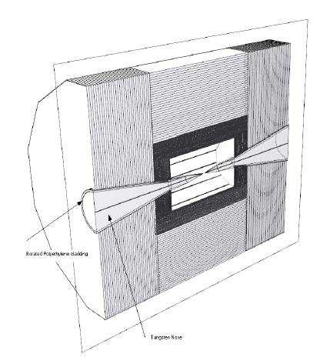
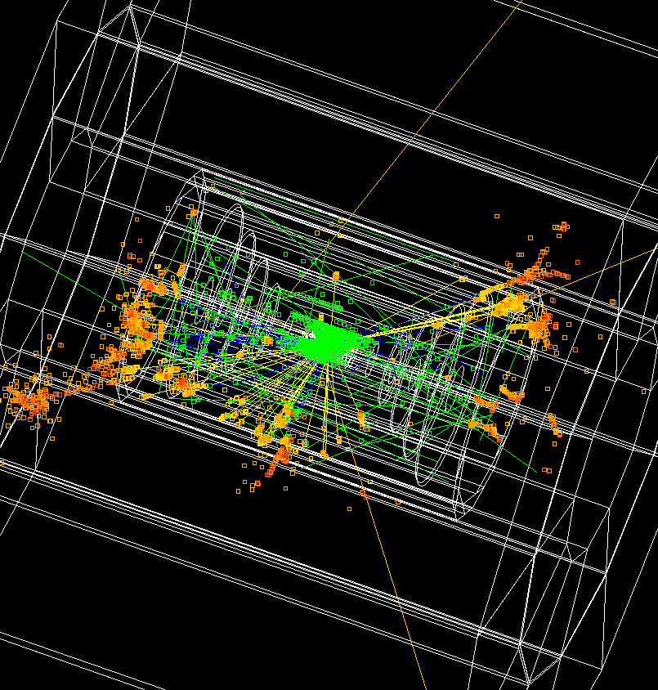
Detector Models based on ILC concepts (SiD, ILD, 4Th)
LCSIM Detector Model
Full Simulation

Slide 12
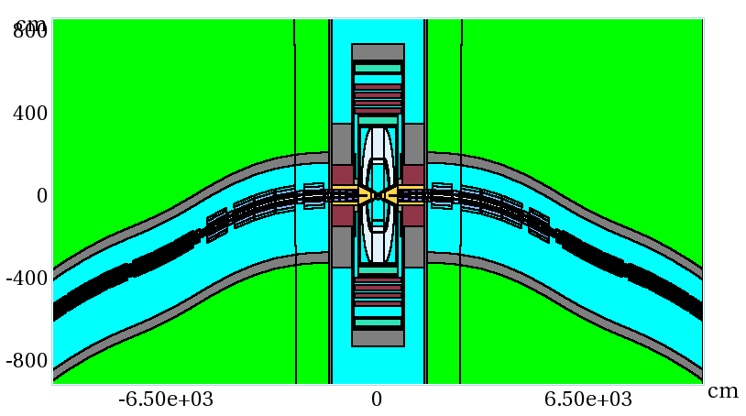
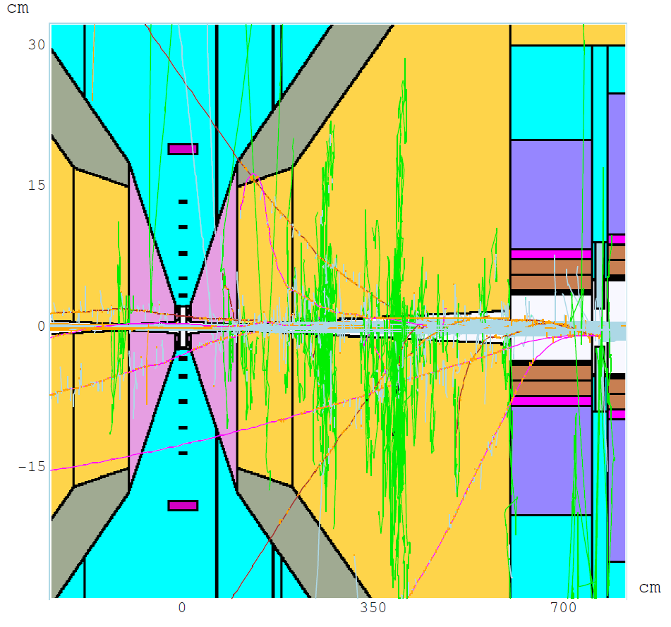
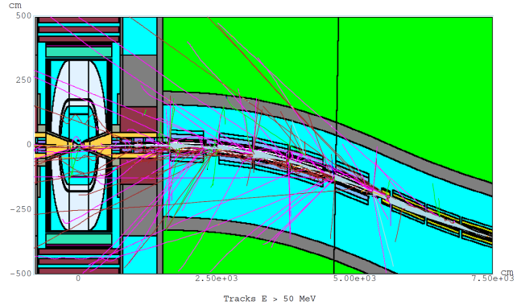
MARS 1.5 TeV
Machine Detector Interface Model
Θ = 10º 6 < z < 600 cm x:z = 1:17
Q1
W
BCH₂

Slide 13
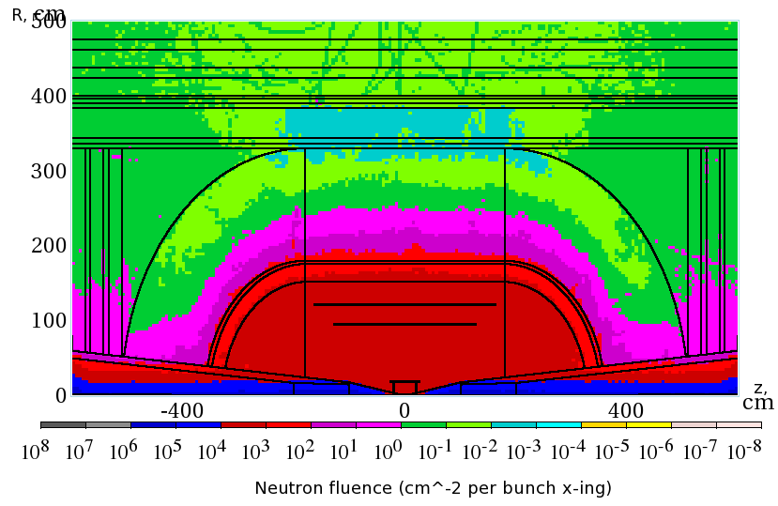
Overall Background – 1.5 TeV
Detectors must be rad hard
Dominated by neutrons –
smaller radial dependence
Non-ionizing background ~ 0.1 x LHC
But crossing interval 10μs/25 ns 400 x

Slide 14
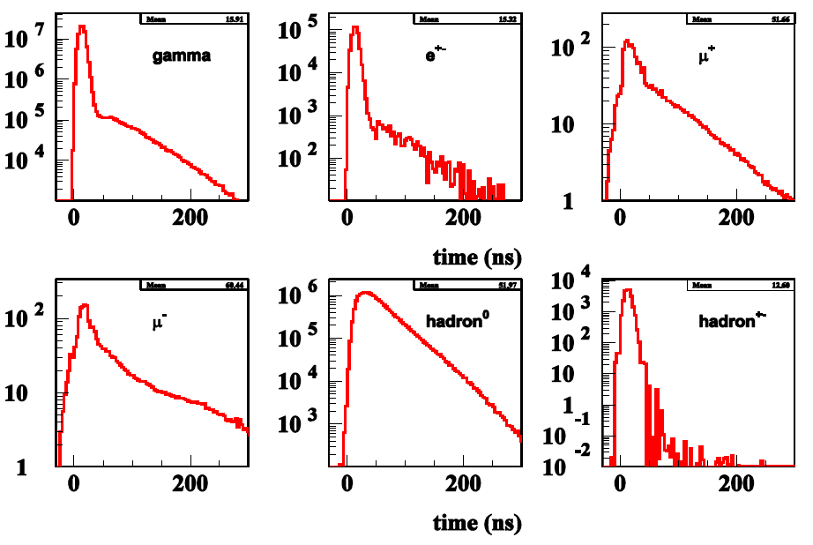
Much of the Background is Soft
γ
e^{+/−}
μ⁺
μ⁻
h⁰
h⁺⁻
γ
e^{+/−}
μ⁺
And Out of Time
μ⁻
h⁰
h⁺⁻
(Striganov)

Slide 15
Attacking the Background
It is clear that timing and energy discrimination will be crucial in limiting the background in a Muon Collider
We have concentrated on understanding the time resolution required and how it may affect the detector mass and resolution for physics objects
The R&D is synergistic with CLIC, which requires ns level resolutions, LHC which is looking at fast timing for background reduction, and intensity frontier experiments, which may require 100’s of ps resolutions

Slide 16
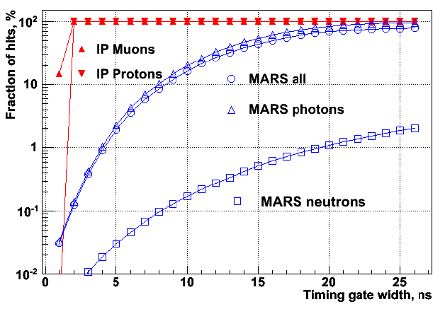
Track Timing Information
Tracking can benefit from precise timing, low occupancy in a pixelated silicon detector.
(Terentiev)

Slide 17
Background Inside a silicon detector:
Detector thickness
Angled tracks
dE/dX
MIP
Path in detector
Background Path length in silicon detector vs de/dx

Slide 18
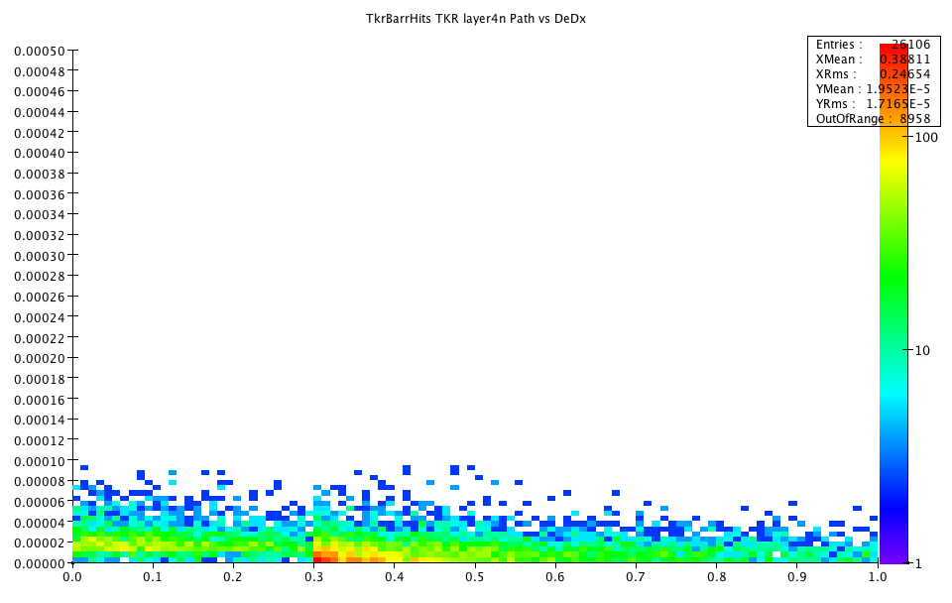
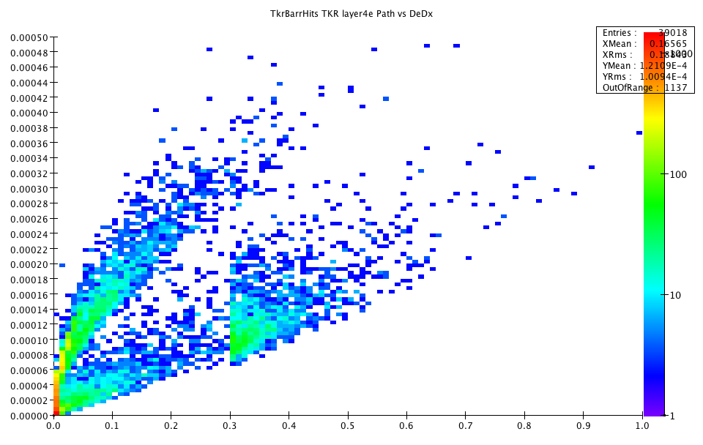
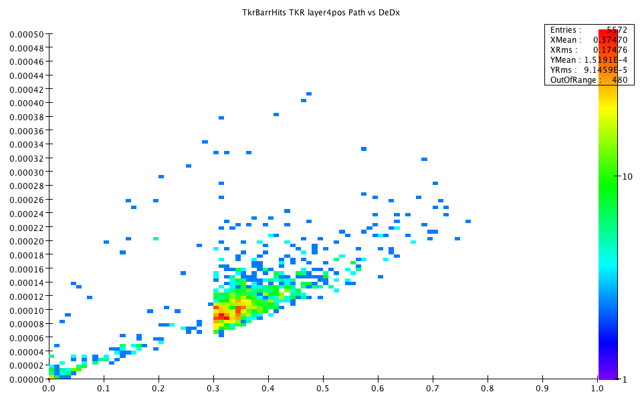
Time of energy deposit with respect to TOF from IP
Neutrons
electrons
positrons
Compton
High energy
conversions
soft
conversions

Slide 19
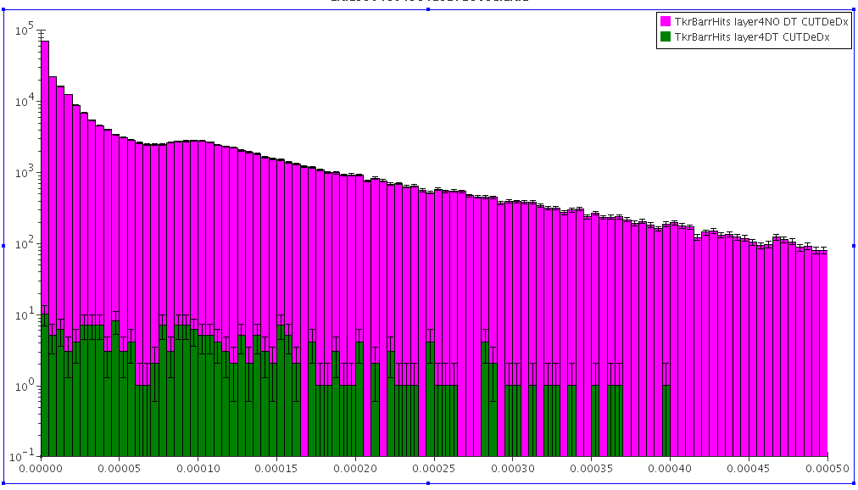
Effects of Cuts on Tracker Background
Tracker Layer 4
Background, no time cut
Timing is the most
important
  Reduces backgrounds by 3 orders of magnitude
De/dx also is also important
  We need pulse height information anyway since our timing accuracy will depend on signal/noise and time walk corrections
Background, 1ns time cut
de/dx
Radius | DT Cut | DT & rphi & dedx
20 | 0.0012 | 0.0009
46.2 | 0.0008 | 0.0006
71.7 | 0.0011 | 0.0007
97.3 | 0.0006 | 0.0004
122.9 | 0.0009 | 0.0006
Background Hit rejection

Slide 20
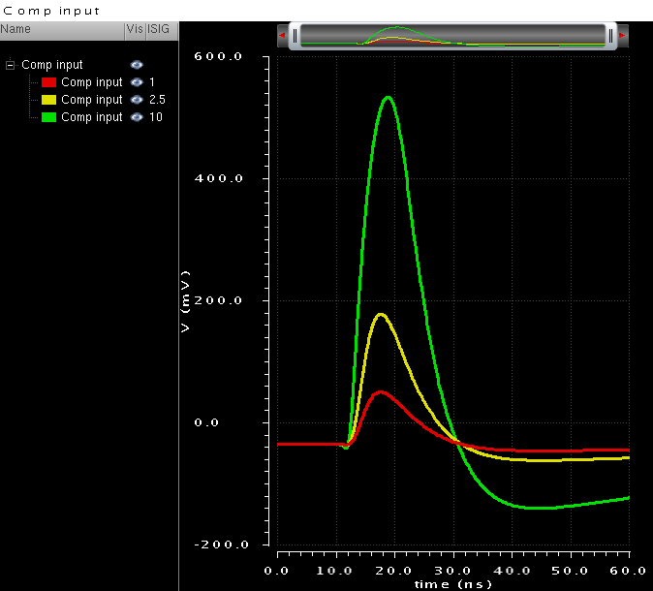
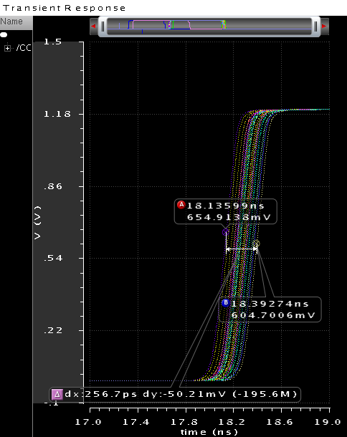
Timing In a Tracker
There is already an example of a fast timing IC design at CERN for CMS upgrades
Intent is to use fast timing to reject “loopers”
65 nm process
  Pixel ~ 1mm x 100 μ x 200 μ thick
  Peaking time: 6 ns
  220 e- ENC for 260 fF input capacitance
  Consumption for nominal bias: 65 uA
Jitter for 0.6fC V_{th} and 2.5fC signal; ~50 ps rms
Jitter for 1 fC signal; ~100 ps rms.
Time resolution defined by time walk (~3 ns) → without correction the resolution will be ~500 ps RMS
Time walk for signals 1 to 10 fC (0.6 fC threshold); <3 ns

Slide 21
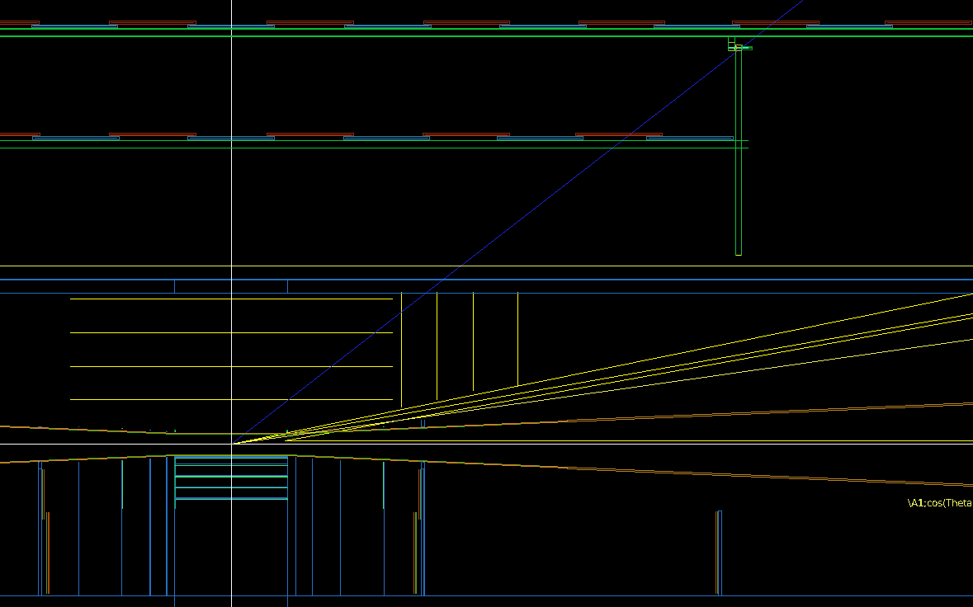
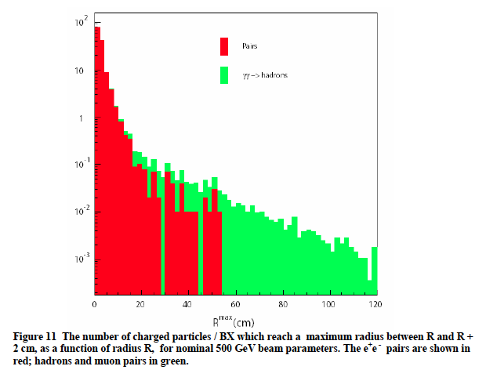
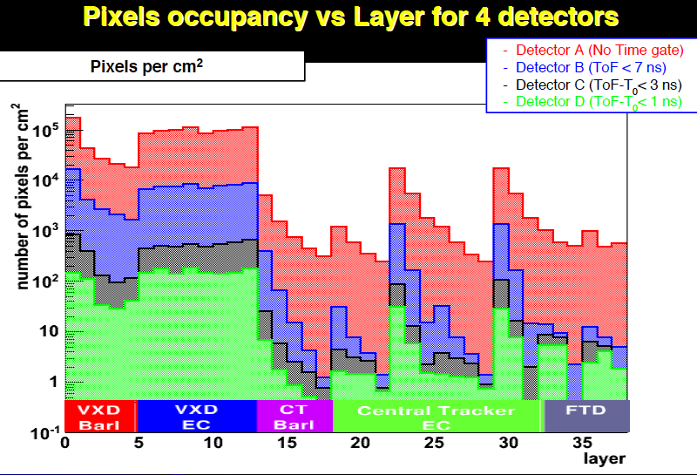
Vertex Detector
ILC inner radius ~1.5 cm set by beamstrahlung
MuC Inner radius ~5 cm set by EM background from cone
Preserve IP resolution
by scaling by r_{outer}/r_{inner}
MuC vertex
ILC vertex
ILC Charged particle
Density vs radius
(Mazzacane)

Slide 22
Tracking Strategy
Tracker segmentation very similar to CMS Phase 2 tracker (1mm x 100 μ x 200 μ)
Lots of space for time stamping circuitry
  Read out all hits within a ~10ns window
  Time stamp each hit to ~0.5 ns
  Pulse height to allow offline energy cuts and time walk corrections
Offline include time stamp in fit to allow for low momentum tracks, protons and kaons …
Need to demonstrate that this works in full simulation with MARS backgrounds.

Slide 23
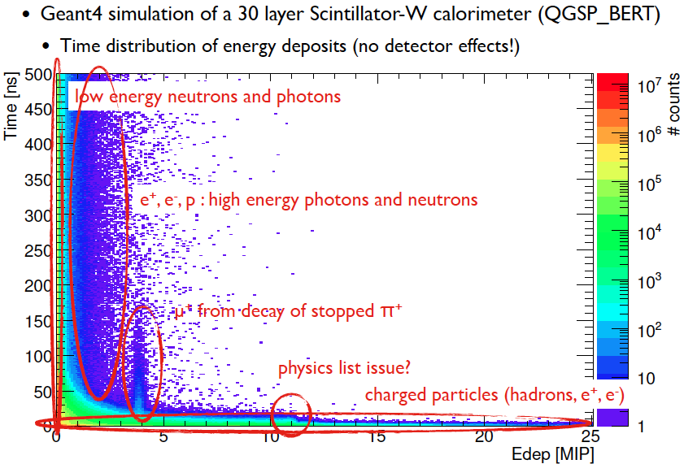
Time Development of Hadron Showers
The problem of hadron calorimetry at CLIC and a Muon Collider is interesting…
Hadron showers take time to develop – nuclear processes can take more than the ns time scale we would like for μC
How is resolution affected by integration time for various schemes?
  Dual readout
  PFA
  Pixelated
Depends on absorber
material
Depends on sensor
material
(F. Simon CALICE)

Slide 24
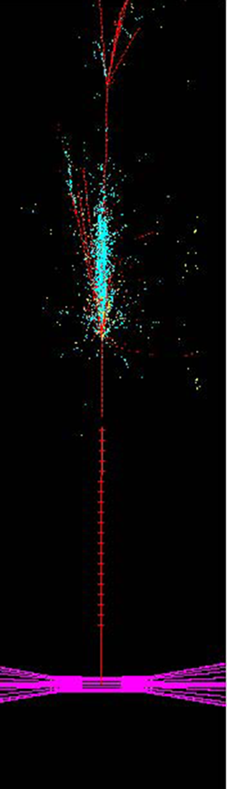
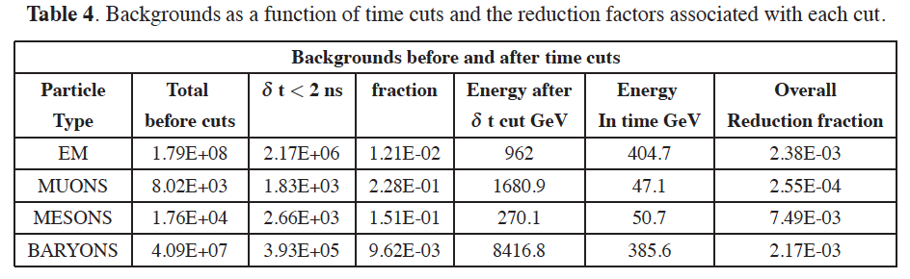
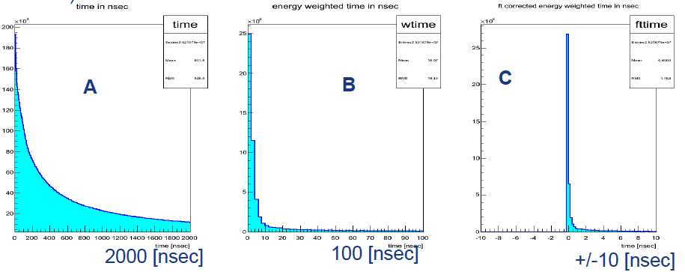
Two approaches
Software compensation
Based on nuclear int. vertices
Pixelated digital calorimeter with 2ns gate
[R Raja 2012 JINST 7 P04010]
Hadron shower time development
Dual readout calorimetry with fast timing

Slide 25
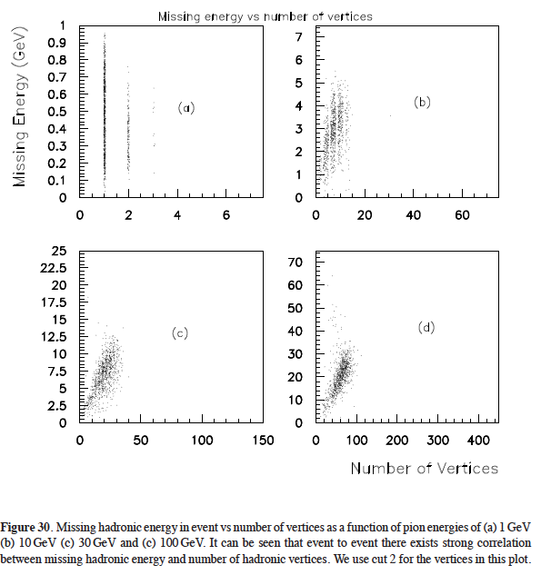
Compensation by vertex counting
(Raja)
Counting vertices in a highly pixelated calorimeter could compensate for missing energy due to nuclear breakup
Geant generator-based results

Slide 26
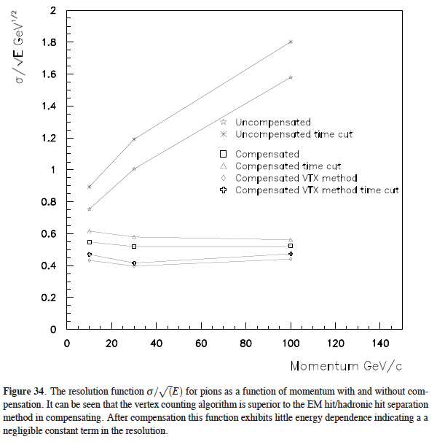
Resolution of a pixelated calorimeter with vertex counting compensation

Slide 27
Summary of Detector Requirements
Much of the HE collider physics is similar to e⁺e⁻ (ILC, CLIC), low mass tracking, good calorimetery w/z discrimination
But with the additional challenges of:
  Radiation hardness
  Nanosecond (or better) time resolution
Requirements are relaxed for Higgs Factory if we aim primarily at measuring the width
  Use bb pairs (higher background)
  W*W has almost no physics background

Slide 28
Conclusions
The Muon Collider is a “poster child” for a technically ambitious project with high risks and rewards.
The central themes are fast and radiation-hard
Low mass tracking and vertexing with ns resolution
  Cooling, power delivery, and support are central issues in making a low mass tracker
Fast, high resolution calorimetry
  Pixelated? Digital?
  PFA?
  Dual readout?
We need to understand the detector possibilities and tradeoffs to access the physics reach of a Muon Coliider.

