Slide 1
Safety Assessment Document Updates for DOE O 420.2D
SAD Section III Chapter 10 – Muon Campus
Jerry Annala
Muon Campus Internal Readiness Review
23 January 2024

Slide 2
Outline
Muon Campus Overview
Hazard Inventory
Non-Accelerator Specific Hazards
Accelerator Specific Hazards
Maximum Credible Incident (MCI) Discussion
Summary of Credited Controls
Summary of Defense in Depth Controls
Notes:
Outline of what I will cover starting with an overview of the Muon Campus.

Slide 3
Muon Campus Overview - History
Originally Antiproton Source for Tevatron Collider, completed in 1985
  Ceased operation in 2011 when Collider program ended
  Original shielding designed for secondary beam downstream of Target Station
Plans were already underway to repurpose facility for new experiments
  Mu2e Project received CD-0 in 2008, CD-1 in 2012
  g-2 Project received CD-0 in 2012, CD-1 in 2013
Beamlines were reconfigured for new uses
  Upstream beamlines simplified with dual-use M3 Line
  Accumulator Ring decommissioned and magnets used for new beamlines
  New external beamlines and tunnels built to transport beam to experiments
New experimental facilities were built
  MC-1 Building for g-2 and MC-2 Building for Mu2e
Commissioning of the Muon Campus began in early 2017
  Commissioning while the campus was still being constructed impacted the design of some enclosures
  g-2 Experiment ran 2017 – 2023 and has successfully concluded
  Upstream beam commissioning for Mu2e underway
Notes:
Originally constructed in the 80’s as the Antiproton Source for the Tevatron Collider.
Built to support 2 experiments – g-2 and Mu2e
Required new construction for experimental halls and beamlines from the existing accelerator
Use most of the Delivery Ring is used and decommissioned the Accumulator to use the magnets for the new beamlines.
We started commissioning parts of the Campus while building others – this influenced some of the enclosure boundaries.

Slide 4
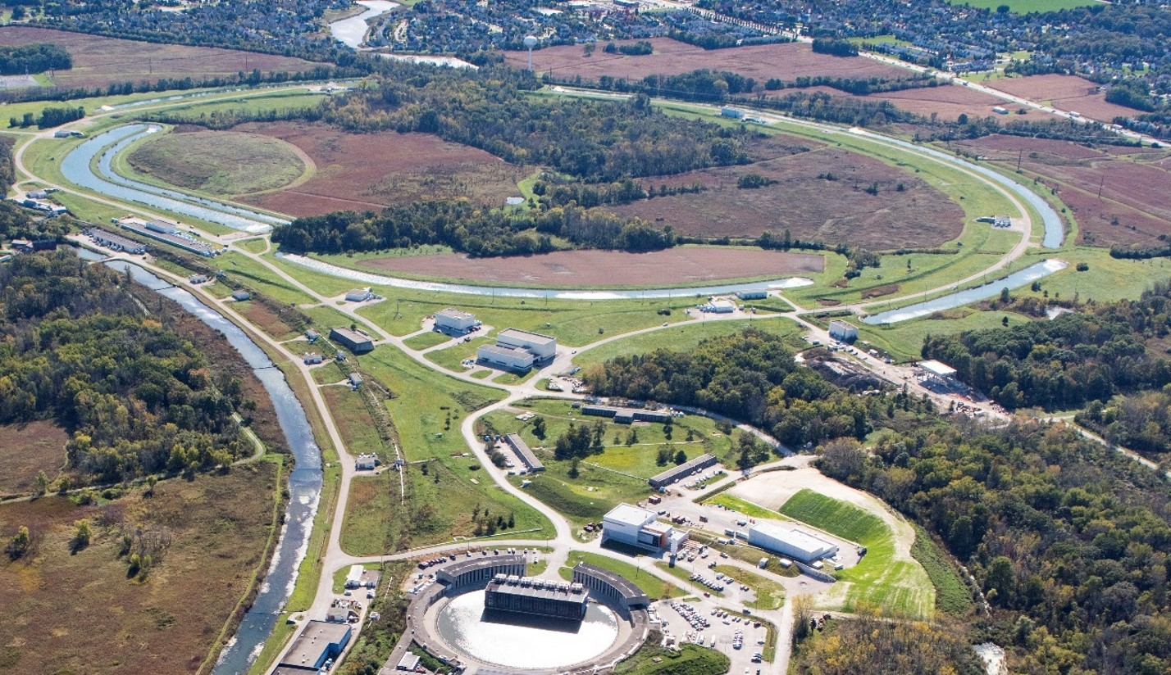
Muon Campus Overview - Layout
Recycler
P1, P2, M1
M2
(not in use)
AP0
Target Station
M3
Abort
Delivery Ring
AP50
AP30
AP10
M5
M4
Mu2e
(not in use)
MC-1
(g-2)
Notes:
Source of Protons is the Recycler fixed energy 8 GeV protons.
Muon Campus segment begins at the M1 beamline where it exits the Tevatron tunnel.
Muon Campus beamlines we will discuss are M1, M3, M2, Delivery Ring, abort line, M4 and M5 beamlines.

Slide 5
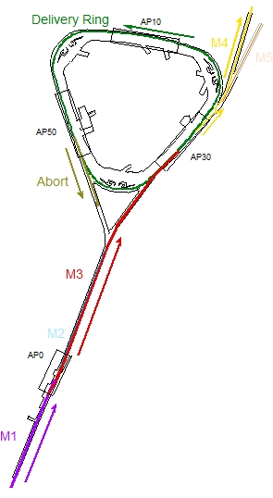
Muon Campus Overview - Modes of Operation
8 GeV beam sent from Recycler Ring in both modes of operation
  Beam in Recycler is rebunched to create shorter bunches (140 ns)
g-2 mode (no longer in operation)
  8 GeV protons to AP-0 Target Station, 3.1 GeV/c muons to MC-1
  Maximum 16 1E12 beam transfers every 1.4 seconds
Mu2e mode
  8 GeV protons bypass AP-0 and are transported to Delivery Ring
  Protons are resonantly extracted from DR and transported to MC-2
  Maximum 8 1E12 beam transfers every 1.4 seconds
g-2 operation
Mu2e operation
Notes:
g-2 mode directs protons onto AP0 target (used for Antiproton production) – secondary beam passes through M2, M3, DR (4 turns), Muons to M4, M5, g-2 storage ring. Protons go to DR abort.
Mu2e operations – Protons bypass Ap0 target, M3, DR, Resonant extraction, M4 to Mu2e. Left over protons to DR abort.

Slide 6
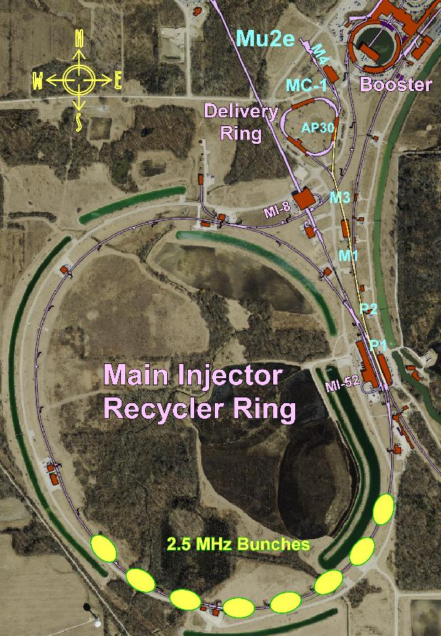
Muon Campus Overview - Recycler to Delivery Ring
Recycler energy is fixed at 8 GeV
Beam from Booster is re-bunched into 4 140 ns long bunches
  Two Booster injections to make 8 bunches
Beam is transferred to Delivery Ring every 48 ms (8 transfers every 1.4 s)
8 GeV beam passes through a series of beamlines to reach Delivery Ring
  P1 and P2 Lines in Tevatron Enclosure
  M1 line begins at F-17, passes through “sewer pipe” into PT/PV Encl.
  This buried pipe is the dividing line between the SY SAD and the Muon Campus SAD. The buried pipe is part of Muon Campus
  M3 Line bypasses AP-0 Target Station and connects to Delivery Ring
Less radiation shielding over M3 Line downstream of AP-0 Target Station
AP-0
Notes:
Beam for both modes come from 2 Booster batches with 8 bunches re-formed in the RR. Bunches are then transferred one at a time (g-2 transfers are faster).
Less shielding exist beyond the AP0 target because it was originally not designed for primary beam beyond the target. New enclosures are better shielded.

Slide 7
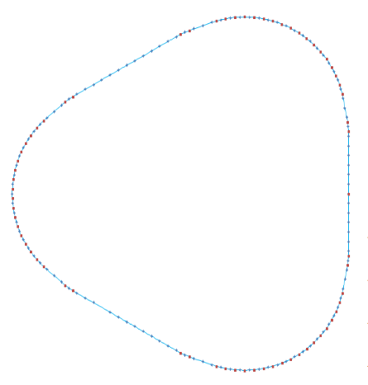
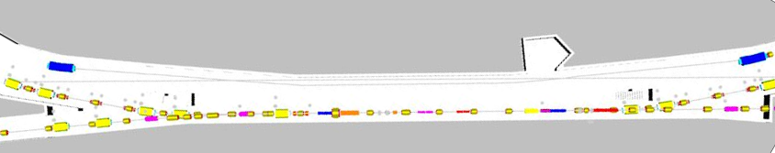
Muon Campus Overview – Delivery Ring and Abort
M4 – Resonantly extracted
protons to MC-2
Delivery Ring has 505 m circumference
  66 dipoles and 132 quadrupoles
  Three straight sections for injection, extraction or diagnostics
  Three arcs connect the straight sections
30 Straight Section has both injection and extraction
50 Straight Section has extraction to Abort Line
  Abort Line ends at steel absorber after about 50 m
  Old AP-2 Line
M3 – protons from RR
30 Straight Section
Abort Line
10 Straight Section
50 Straight Section
Injection
Extraction
30 Straight Section
M4 Line
M3 Line
Notes:
A look at the Delivery Ring to become familiar. Three straight sections under the service buildings, and arcs in between under earth berms. Both injection and extraction take place in the 30 straight section. The abort is from the 50 straight section and utilizes the old Antiproton injection line in the opposite direction.

Slide 8
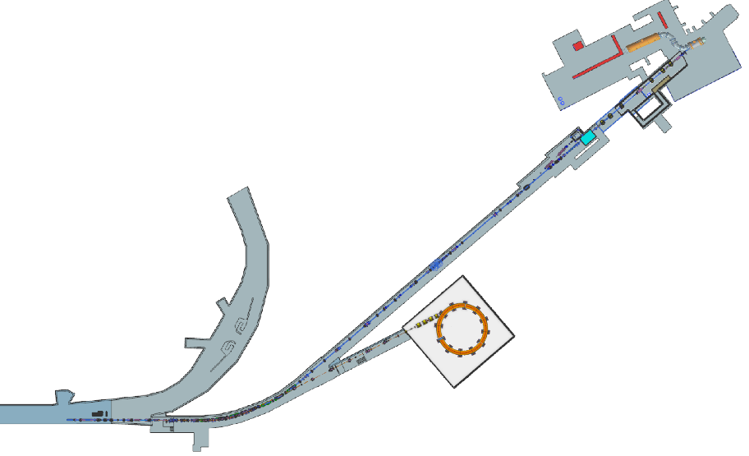
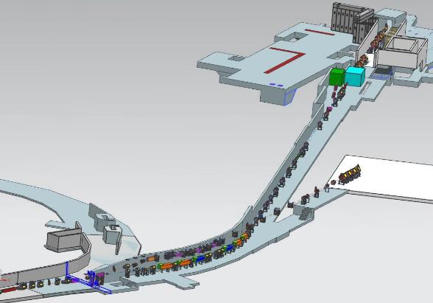
Muon Campus Overview - External Beamlines
M4 Line transports 8 GeV protons from Delivery Ring to Mu2e Experiment
  Resonantly extracted beam enters M4 Line in downstream 30 Straight Section
  245 m long, but has Diagnostic Absorber at 192 m for beam commissioning
  First 30 m of M4 Line also used to connect to M5 Line during g-2 operation
Mu2e Solenoids
In MC-2 Building
M4 Line
M4 Line
Delivery Ring
g-2 Storage Ring
In MC-1 Building
M5 Line
M5 Line
Shared section of M4
Notes:
Extraction for both experiments utilize the first part of the M4 line. There is a switch magnet early in the line where the Mu2e and g-2 beamlines separate.

Slide 9
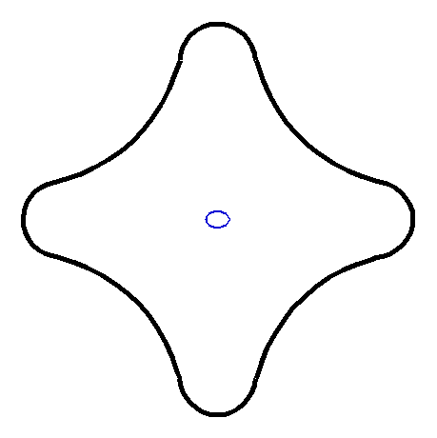
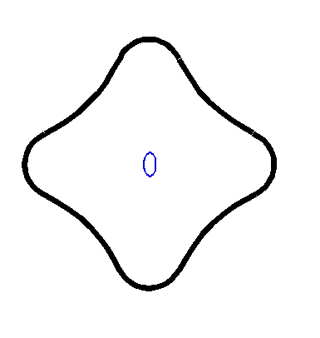
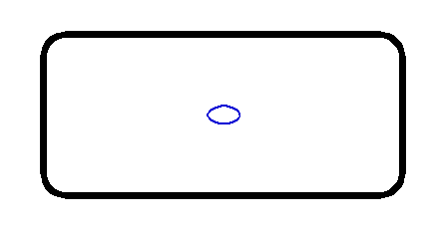
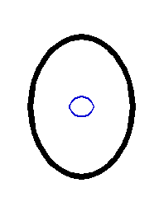
Muon Campus Overview - Apertures
Magnets used in Muon Campus designed with large apertures
  Secondary beams like antiprotons and muons have large transverse size
  Mu2e beam will be much smaller transversely, but with much higher intensity
  Delivery Ring has large Type 1 quadrupole vacuum chambers
  Beamlines have combination of Types 1 & 2 (Accumulator) vacuum chambers
  Specialty devices like those used for injection and extraction are smaller
Dipole
Delivery Ring
Injection Kicker
Quadrupole (Type 2)
beamlines
Quadrupole (Type 1)
Delivery Ring & beamlines
Notes:
Here is a look at the Mu2e beam footprint in our typical magnets. Using a machine built for a weak secondary beam leaves us with minimal shielding, we at least start with large apertures in general. Important point is that we are only operating with minimal beam power during this early commissioning phase.

Slide 10
Outline
Muon Campus Overview
Hazard Inventory
Non-Accelerator Specific Hazards
Accelerator Specific Hazards
Maximum Credible Incident (MCI) Discussion
Summary of Credited Controls
Summary of Defense in Depth Controls

Slide 11
Hazard Inventory for Muon Campus
Accelerator specific hazards are purple
Hazards not discussed today are evaluated via the common Risk Matrix tables
  Covered in SAD Section I, Chapter 4
Hazards evaluated via risk assessment methodology per DOE-HDBK-1163-2020
  Likelihood (L):
    Anticipated (A), Unlikely (U), Extremely Unlikely (EU), Beyond Extremely Unlikely (BEU)
  Consequence (C):
    High (H), Moderate (M), Low (L), Negligible (N)
  Risk (R):
    I , II, III, IV (descending order of concern)
Notes:
Hazards are evaluated based on likelihood and severity of consequences. We implement preventative measures to decrease the likelihood, and mitigative measures to reduce the consequences until the risks are at an acceptable level.

Slide 12
Outline
Muon Campus Overview
Hazard Inventory
Non-Accelerator Specific Hazards
Accelerator Specific Hazards
Maximum Credible Incident (MCI) Discussion
Summary of Credited Controls
Summary of Defense in Depth Controls

Slide 13
Non-Accelerator Specific Hazards - Radiological
Residual Activation
  Accelerator components can become activated from beam loss. Exposure to these activate components is possible.
  The residual dose rate found in the Muon Campus from initial entry surveys is historically less than 5 mrem/hr, exceptions include:
    <20 mrem/hr on either side of the AP0 target where the beam dimensions are large due to optics are set to maximize target yield
  Hazard applies to onsite facility workers and onsite co-located workers
Baseline Qualitative Risk (without controls) | Controls Preventive (P)/Mitigative (M) | Residual Qualitative Risk (with controls)
L: A C: H R: I | P – Employee Rad Worker training P – ALARA plan M – Shielding to reduce activation M – Proper dosimetry | L: EU C: L R: IV
Notes:
Residual radiation obviously a hazard. Here we see two preventative measures and two mitigative to reduce the risk to a minimal level.

Slide 14
Non-Accelerator Specific Hazards - Radiological
Ground Water
  Scattered beam has potential to activate ground water at low levels calculated in the Shielding Assessments.
  Hazard applies to onsite facility workers, onsite co-located workers and
Baseline Qualitative Risk (without controls) | Controls Preventive (P)/Mitigative (M) | Residual Qualitative Risk (with controls)
L: A C: N R: IV | M – Radiation monitors turn off the beam if beam loss in the area exceeds limits determined in the Shielding Assessments | L: A C: N R: IV
Notes:
Ground water only an issue in certain locations (minimal especially now the g-2 is not active).

Slide 15
Non-Accelerator Specific Hazards - Radiological
Surface water
  Potential exposure to activated surface water due to beam loss leakage from beam enclosures located near surface water impoundment.
  Hazard applies to onsite facility workers and onsite co-located workers
Baseline Qualitative Risk (without controls) | Controls Preventive (P)/Mitigative (M) | Residual Qualitative Risk (with controls)
L: A C: N R: IV | P – Beam Loss Monitors in enclosures prevent excessive beam loss. M – Shielding to reduce surface water activation | L: U C: N R: IV

Slide 16
Non-Accelerator Specific Hazards - Radiological
Radioactive water (RAW) systems
  RAW water system is used to cool the Lithium Lens, Pulsed Magnet and the beam absorber in the AP0 target hall during g-2 operation.
Baseline Qualitative Risk (without controls) | Controls Preventive (P)/Mitigative (M) | Residual Qualitative Risk (with controls)
L: A C: M R: II | P – Locked cage containing the water equipment is controlled by the RSO who only grants access once radiation rates have dropped to safe levels P – Radiation training required to access the water cage M – Radiation Technician coverage required for water cage access M – Dosimetry is required by relevant RWP | L: EU C: N R: IV
Notes:
Raw water system at AP0 target station which is currently inactive.

Slide 17
Non-Accelerator Specific Hazards - Radiological
Air Activation
  Particle beams interacting with the target and immediate air volume can radioactivate the air which could then migrate to accessible areas.
Baseline Qualitative Risk (without controls) | Controls Preventive (P)/Mitigative (M) | Residual Qualitative Risk (with controls)
L: A C: H R: I | P – Interlock system prevents access to beam enclosures while beam is enabled. P – Enclosure and service building key possession is linked to necessary radiological and controlled access training. P – Activated Air monitor is installed in the AP0 service building. M – Air flow controlled to route air through HEPA filter and into decay path that provides time for activated air to decay before being released. | L: BEU C: M R: IV
Notes:
The largest risk of activated air is also from the inactive AP0 target station.

Slide 18
Non-Accelerator Specific Hazards - Radiological
Soil Interactions
  Scattered beam has the potential to activate soil at low levels calculated in the shielding assessment.
Baseline Qualitative Risk (without controls) | Controls Preventive (P)/Mitigative (M) | Residual Qualitative Risk (with controls)
L: A C: N R: IV | M – Sensing equipment (radiation detectors) shot off beam if anticipated levels are exceeded. | L: A C: N R: IV
Notes:
Radiation sensing equipment is used to keep risk of soil interactions limited to the area of the inactive target station.

Slide 19
Non-Accelerator Specific Hazards - Radiological
Radioactive Waste
  Radioactive waste produced during beam operations will be managed within the established Radiological Protection Program (RPP) as prescribed in the Fermilab Radiological Control Manual (FRCM)
Baseline Qualitative Risk (without controls) | Controls Preventive (P)/Mitigative (M) | Residual Qualitative Risk (with controls)
L: A C: H R: I | P – Radiological worker training P - Any item in a beam enclosure during beam-on condition is removed and surveyed by radiological workers and classified appropriately. P – Any item identified for disposal is surveyed and process by Radiological Control organization personnel in accordance with FRCM chapter 4. M – Labeling required by material survey and release process | L: BEU C: M R: IV
Notes:
Many preventative measures to reduce radioactive waste hazards.

Slide 20
Non-Accelerator Specific Hazards - Radiological
Contamination
  Activated dust or debris could be ingested by a worker or removed from radiation area unintentionally
Baseline Qualitative Risk (without controls) | Controls Preventive (P)/Mitigative (M) | Residual Qualitative Risk (with controls)
L: A C: H R: I | P – Radiation areas of areas before work. P – Contamination wipes taken regularly in areas of likely contamination P – RWP specifies PPE P – Training - frisking on exit | L: BEU C: H R: III
Notes:
Again, contamination is a risk where we implement many preventative measures.

Slide 21
Outline
Muon Campus Overview
Hazard Inventory
Non-Accelerator Specific Hazards
Accelerator Specific Hazards
Maximum Credible Incident (MCI) Discussion
Summary of Credited Controls
Summary of Defense in Depth Controls

Slide 22
Accelerator Specific Hazards - Radiological
Prompt Ionizing Radiation – Beam Loss
  Ionizing radiation due to beam loss in the Muon Campus enclosures
  Analyzed maximum credible incident (MCI) to determine credited controls
  Hazard applies to onsite facility workers, onsite co-located workers and a maximally exposed offsite individual (MOI)
*Does not apply to MOI
Notes:
Prompt ionizing radiation is the only accelerator specific hazard to deal with in the Muon Campus. We will show the analysis of the Maximum Credible Incident (MCI) and how we mitigate this hazard under that (those) conditions.

Slide 23
Outline
Muon Campus Overview
Hazard Inventory
Non-Accelerator Specific Hazards
Accelerator Specific Hazards
Maximum Credible Incident (MCI) Discussion
Summary of Credited Controls
Summary of Defense in Depth Controls

Slide 24
Maximum Credible Incident (MCI) – Radiological
The MCI focuses on exposure to an onsite worker, an onsite coworker and the maximally exposed off-site individual (MOI)
Incident bounds all postulated accident scenarios for the Fermilab Muon Campus
Fermilab uses Credited Controls that flow down to the Accelerator Safety Envelope (ASE) to mitigate the consequences of an MCI to the following conditions:
  Less than 5 rem in one hour in any area accessible by facility workers or co-located workers
  Less than 500 mrem in one hour in all Laboratory areas to which the public is assumed to be excluded
  Less than 100 mrem in one hour at Fermilab’s site boundary and/or in any areas onsite in which the public is authorized (which includes Batavia Road, Prairie Path, parking lots open to the public, and general access areas including Wilson Hall, Ramsey Auditorium)
Notes:
We understand how an accident at the MCI can impact workers at Fermilab as well as the general public. We assume the MCI to result from the maximum beam intensity that can be delivered by the facility. We then implement credited controls to mitigate that MCI accident to be withing the exposure limits of the ASE . We note that there is no part of the Muon Campus where the public is invited.

Slide 25
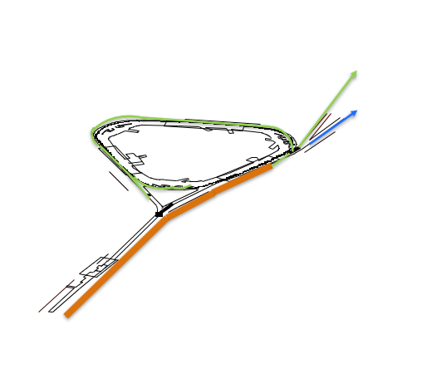
Regions separating MCI scenarios
Asynchronous MCI region
  Beginning from F17 location in Tevatron enclosure to the injection region of the Delivery Ring
Synchronous MCI region
  The Delivery Ring outside of the injection region plus the DR abort line and the M3 beamline to Mu2e
g-2 MCI region
  From V907 switch magnet in M4 line to the g-2 experimental hall
Notes:
We need to consider 3 different regions of the Muon Campus when we analyze the MCI. It is not possible to transport the same intensity everywhere in the Muon Campus and I will discuss why and the intensities that could be delivered in each region. We will identify the three regions as the Asynchronous region, the synchronous region, and the g-2 region. I will detail each in the next slides.

Slide 26
Maximum Credible Incident (MCI) – Radiological
The MCI for the Muon Campus between the buried pipe at F17 and the injection region of the Delivery Ring is 1.05 e14 protons/second at 8 GeV.
  This incident could result if the Booster was delivering its maximum beam intensity at 15 Hz to the Recycler. For the Muon Campus to receive this beam, at least one device in the Recycler would have to be malfunctioning in a way that steered beam on the first turn into the extraction channel of the Lambertson at approximately the same trajectory as beam meant for the Muon Campus.
  Assuming no shielding or other controls are present this incident would result in a dose to any individual higher than 1.2 e7 rem in an hour.
  In this scenario, beam that is not intended for the Muon Campus operation is delivered without participation of the normal transfer process. Since the pulse transfer devices are not triggered in this scenario, the beam would survive no further than the injection region under AP30 in the Delivery Ring. This scenario is identified as the asynchronous MCI.
  This scenario represents the maximum amount of beam that the upstream accelerators can physically transport.
Notes:
The Asynchronous MCI area is from the beginning of the MC at F17 to the injection region of the DR in AP30.
Maximum 15 Hz Booster beam with a mis-adjusted (malfunctioning) magnet(s) that just happen to steer the first turn in the Recycler onto the extraction trajectory at the extraction Lambertson. In this situation, all of the Booster beam would be steered toward the Muon Campus. The intensity in this scenario would be 1.05 e14 protons/hr. An accident at this intensity would result in a dose of 12 Mrem/hr without mitigations.

Slide 27
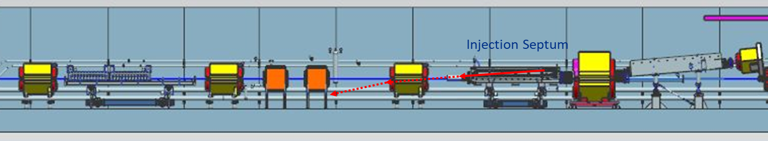
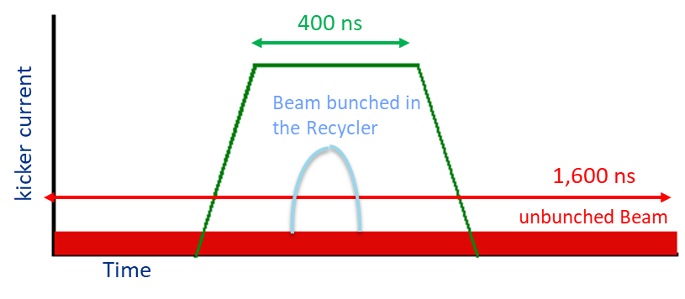
Asynchronous MCI beam trajectory and timing
If the beam does not arrive when the Injection Septum is pulsed (400 μsec), it continues downward through copper and steel into magnet body.
Bunches formed in Recycler are 140 nsec long and bunch trains from Booster are 1.6 μsec long. The kicker can only deflect the shorter bunches.
Timing required for injection
Notes:
This situation happens without being triggered by the beam transfer system from the RR, and would not involve the RF operations of the beam normally sent to the Muon Campus. The beam would arrive at a time where the injection septum and injection kicker were not activated. Beam would crash into the injection septum with a small among of surviving beam striking the steel of the next magnet.

Slide 28
Maximum Credible Incident (MCI) – Radiological
The MCI for the Muon Campus beyond the AP30 straight section is 1.54 e13 protons/second at 8 GeV.
Assuming no shielding or other controls are present this incident would result in a dose to any individual higher than 1.8 e6 rem in an hour.
The MCI beyond the AP30 straight section is determined by the maximum repetition rate the Recycler RF system and the beam transfer systems can operate.
  The Recycler can prepare two Booster batches at a time for transfer to the Muon Campus.
  Injection of the two Booster batches takes 100 msec.
  The RF system requires 90 msec to form the bunches to be transferred.
  The beam transfer system requires 336 msec to transfer the 8 bunches prepared in the Recycler
  The total time required for transferring the 8 bunches of 1 e12 protons is 526 msec. Since the Booster repetition rate is 15 Hz, the cycle can only repeat every 8 Booster cycles or every .53 seconds.
Since this incident requires the injection system to be synchronized with the incoming beam, we will identify this as the synchronous MCI.
This scenario represents the maximum amount of beam that can physically be transported beyond the DR injection devices.
Notes:
In order for the beam to transport past AP30, the normal transfer process must happen. We could conceive that the process was sped up to this maximum rate. This would result in beam intensity in the Delivery Ring and M4 line of 1.54 e13 protons/sec which could result in an accident exposure of 1.8 Mrem/hr without any mitigation.

Slide 29
Maximum Credible Incident (MCI) – Radiological
There is a third MCI scenario when considering the M5 beamline to the g-2 experiment. This scenario is not active at this time but could be re-activated with a modest amount of configuration.
The MCI in the M5 beamline and beyond would result from 3.1 GeV secondary particles at an intensity of 1.67 e13 particles/hr
  The M5 beamline is incapable of transporting 8 GeV particles. Since the Recycler is the only source of primary protons to the DR, the only reasonable energy to consider is the 3.1 GeV required by the g-2 experiment. Extensive simulations demonstrate that the maximum secondary beam intensity is 1.5e-4 times the number of Protons on Target. The MCI intensity in the M5 line is 1.67 e13 particles/hr at 3.1 GeV.
  The Recycler can prepare two Booster batches at a time for transfer to the Muon Campus.
  Injection of the two Booster batches takes 100 msec.
  The RF system requires 90 msec to form the bunches to be transferred.
  The beam transfer system requires 70 msec to transfer 8 bunches,
  The total time required for transferring the 8 bunches of 1 e12 protons is 260 msec. Since the Booster repetition rate is 15 Hz, the cycle can only repeat every 4 Booster cycles or every .267 seconds.
This scenario represents the maximum amount of beam that could be transported in the M5 beamline.
Notes:
The M5 beamline is incapable of transporting 8 GeV particles, so only a secondar beam could be transported. The only reasonable intensity to consider is 3.1 GeV which is the g-2 energy. The maximum rate of beam deliver in this mode is 1.67 e13 particles/hr which again results from the transfer process occurring as fast as possible.

Slide 30
Outline
Muon Campus Overview
Hazard Inventory
Non-Accelerator Specific Hazards
Accelerator Specific Hazards
Maximum Credible Incident (MCI) Discussion
Summary of Credited Controls
Shielding Assessment Discussion
Summary of Defense in Depth Controls

Slide 31
Credited Controls – Passive Engineering
Permanent Shielding
  Construction drawings and various topographical surveys of the berms have been used to determine the thickness of the permanent shielding in units of efd.
  20.3 efd of shielding is credited over the buried beam pipe between the Tevatron and Pre-Target enclosures.
  17.9 efd of shielding is credited where present in the asynchronous MCI areas
  15.1 efd of shielding is credited where present in the synchronous MCI areas
  4.0 efd of shielding is credited over the M5 beamline to the g-2 experiment hall
    Lesser amounts of shielding where credited active controls are implemented.
Notes:
Actual shielding determined from drawings made with input from metrology organization.
Shielding requirements in each area defined by geometry of beam line and MCI in the area.

Slide 32
Credited Controls – Passive Engineering
Movable Shielding
  A concrete block shield wall is constructed just upstream of the MC-1 experimental hall. This protects personnel in the hall from beam loss originating from the M4 beam line operation.
  A concrete block shield wall is constructed just upstream of the Mu2e Production Solenoid area. This protects personnel in the PS area from beam loss generated by operating with beam to the Diagnostic Absorber.
  There are seven magnet hatch openings in the Muon Campus that are filled with concrete shielding blocks for operation.
  The AP0 target hall is configured with many concrete shielding blocks and steel modules credited as shielding.
Notes:
Two shield walls and the target vault make up most of the visible moveable shielding. There are also filled magnet hatches and penetrations that are captured in the credited moveable shielding inventory.

Slide 33
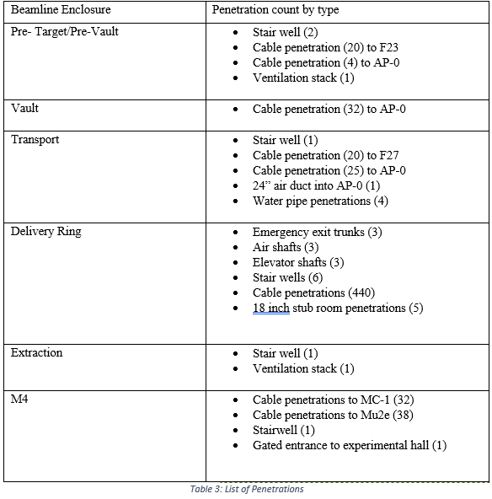
Credited Controls – Passive Engineering
Penetration Shielding
  The Muon Campus has many penetrations and labyrinths that are documented in the shielding assessments and in the SAD. The summary table from the SAD is shown here.
  There are also 23 survey risers throughout the Muon Campus that are filled with sand or Poly beads.
Notes:
List of the various types of penetrations in the Muon Campus

Slide 34
Credited Controls – Passive Engineering
Efficacy of passive shielding has been evaluated with the following three methods:
  The standard Tenth-Value Layer spreadsheet tool identifies areas where the minimum shielding in an area is sufficient shielding for the MCI in that area.
    The beamline between the Tevatron enclosure and the AP0 Target Vault are evaluated as sufficient by the TVL spreadsheet tool.
    The Extraction and M4 enclosures are evaluated as sufficient (including the inactive g-2 mode) by the TVL spreadsheet tool.
  Radiation measurements are used to evaluate areas that utilize active credited controls.
    These beam measurements are used to determine the credited control limit on the radiation monitors, and the amount of credited shielding that is necessary for those limits.
  The various shielding assessment utilize MARS simulations to evaluate the shielding in the AP0 target building, penetrations, the MC1 experimental hall, and the Mu2e Production Solenoid Room.
Notes:
TVL spreadsheet defines the shielding requirements shown 3 slides back. Radiation measurements used to calibrate trip settings of radiation monitors in areas where shielding alone is not sufficient. MARS simulations were used in the more unique areas of the MC like the AP0 target hall and the end of the beamlines at the entrances to the experimental areas.

Slide 35
Credited Controls – Active Engineering
Credited Control: Radiation Safety Interlock System (RSIS)
  Inhibits beam by controlled redundant critical devices
  Enforces the search and secure process
  Interlocked doors are present at all access points into the Muon Campus enclosures.
  Includes interlocked radiation detectors which protect individuals by disabling beam should prompt radiation from operations exceed specific dose rates
  The ES&H Radiation Physics Engineering Dept. (RPE) ensures that all requirements for hardware and system testing are completed semi-annually with a four-month grace period
  RPE also verifies the inventory of interlock keys and updates procedures for maintenance and testing of interlock systems
  All RSIS are designed, installed and configuration managed in conformance with the requirements of the Fermilab Radiological Control Manual (FRCM)
Notes:
ES&H Radiation Physics Engineering Dept designs, implements, and maintains the elements of the RSIS system.

Slide 36
Credited Controls – Active Engineering
Interlocked Radiation Detectors
  All interlocked detectors are calibrated on an annual basis
  For areas that do not have adequate permanent shielding these detectors are used to protect an individual outside of the shielding
  ES&H RPE Interlock group also installs, tests & maintains all interlocked detectors

Slide 37
Credited Controls – Active Engineering
Interlocked Radiation Detectors
  Muon Campus does not have enough shielding for the MCI in many areas, so interlocked radiation detectors are required
  The credited control limits for these interlocked radiation detectors are sufficient to protect against the MCI
    We operate at levels below the MCI intensity.
  Limit levels are set by the Radiation Physics Operations Department (RPO) to satisfy occupancy requirements per 10 CFR Part 835
Detector Details
  Chipmunks are placed every 13 feet within the AP10, AP30, AP50 service buildings over the DR beamline.
    Chipmunk limit settings are all 500 mrem/hr or lower.
  TLMs are located along the M3 line in the Transport and DR enclosures.
  TLMs are located throughout the DR arcs and along the abort line.
    TLM limit settings are all 100,000 nC/min or lower.
  Limit levels can be set lower than the values stated here and are determined by the Radiation Physics Operations Department (RPO) to satisfy occupancy requirements per 10 CFR Part 835.
Notes:
If detectors are required to satisfy the ASE, appropriate credited control limits are determined to satisfy the ASE limits. We operate at levels below the ASE and trips settings lower than the credited control level are set by the Radiation Physics Operations Department to satisfy requirements of the area postings. Credited Chipmunk and TLM locations and credited trip settings are noted here.

Slide 38
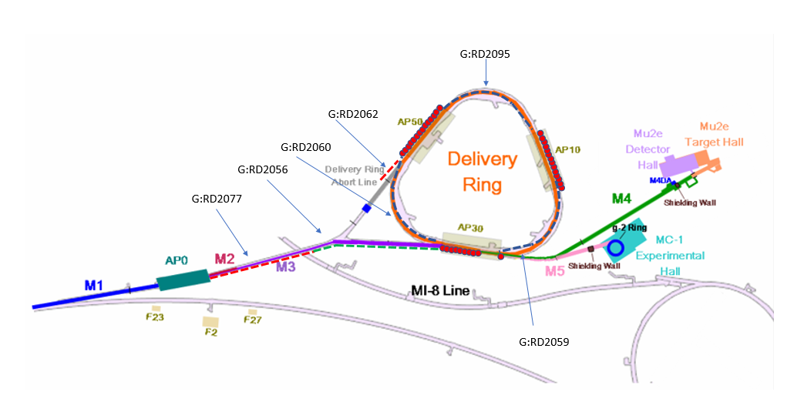

Credited radiation monitor locations
Chipmunks shown as red circles in service buildings
Notes:
Diagram shows the locations of the various credited radiation detectors

Slide 39
Credited Controls - Administrative
Credited Control: Operation Authorization Document
  Machine Beam Permit
  Machine Run Condition
  Beam will not be transported through the Muon Campus without approval of these documents
Credited Control: Staffing
  Ensures operations within bounding conditions specified in Operation Authorization Document
  The following staffing shall be in place during applicable beam operation:
    At least one member of the AD Operations Department who has achieved the rank of Operator II or higher shall be on duty and on site.
    At least one member of the AD Operations Department shall be present in the Main Control Room (MCR).
    These requirements can be satisfied by a single person.
Credited Control: Accelerator Operating Parameters
  The MCI intensity of 3.78 e17 protons/hr at 8 GeV shall not be exceeded anywhere in the Muon Campus.
  The intensity in the Delivery Ring outside of the 30 straight section, DR abort line and in the M4 beamline shall not exceed 5.54 e16 protons/hr at 8 GeV
  The intensity in the M5 beamline to g-2 shall not exceed 1.7 e13 particles/hr at an energy of 3.1 GeV
Notes:
Beam is not transported without signed beam permit and run conditions.
Staffing must be sufficient to operate beam in the Muon Campus
Credited controls must be in place to satisfy dose limits under the ASE intensities listed in the documentation.

Slide 40
Outline
Muon Campus Overview
Hazard Inventory
Non-Accelerator Specific Hazards
Accelerator Specific Hazards
Maximum Credible Incident (MCI) Discussion
Summary of Credited Controls
Summary of Defense in Depth Controls

Slide 41
Defense in Depth Controls
Permanent Shielding
  The buried pipe at F17 has 22.5 efd of shielding where 20.3 efd are required. 20.3 feet are credited shielding, and 2.2 feet are defense in depth.
  The Pre-Target enclosure has a minimum of 19 efd of shielding where 17.9 efd are required. 17.9 feet are credited shielding, and 1.1 feet are defense in depth.
  The Pre-Vault enclosure has a minimum of 20.5 efd of shielding where 17.5 efd are required. 17.9 feet are credited shielding, and 2.6 feet are defense in depth.
  The Transport enclosure has 14 feet of shielding. 11 efd of that shielding along with the TLMs in that area are credited. 3 efd of that shielding are defense in depth.
  The M3 beamline passes under Indian Rd in the Delivery Ring enclosure. Steel is buried between the road and the tunnel enclosure to enhance the shielding. There is a minimum of 13 efd of shielding between the steel, soil and structural material for the enclosure and road. 10 efd of shielding are credited along with the TLM, and 3 feet are defense in depth.
  The M3 line downstream of Indian Rd is in the DR enclosure and has a minimum of 13 efd of shielding. 10 feet of that shielding are credited, and 3 feet are defense in depth.
Notes:
List of the various areas stating where the shielding alone is sufficient, and where active controls are required. The credited shielding is listed along with the shielding amounts considered defense in depth. Where active controls are required, the credited control settings are listed. List also are the shielding amounts that are credited in conjunction with the active controls and the amount of shielding that is then Defense in Depth.

Slide 42
Defense in Depth Controls
Permanent Shielding
  There are 3 service buildings Delivery Ring that have 8 efd of shielding including gravel fill between the enclosure and building floor. The density of the gravel fill is 2 g/cc. 5 efd of shielding are credited in conjunction with chipmunks placed in the buildings, and 3 efd of shielding is defense in depth.
    In the downstream end of the AP30 straight section, supplemental steel shielding is stacked above 7 of the devices in the extraction area. The steel shielding stacks are 3 feet thick except over V901 where the steel is only 2.5 feet thick. The steel in that area is defense in depth.
  The arcs in the DR are covered with a berm that is 13 efd thick. 10 efd of the berm along with the TLMs in the arc are credited and 3 efd of dirt is defense in depth.
  The berm over the abort line in the DR enclosure is 13 efd thick. 10 efd of the berm along with the abort line TLM and the TLM in the 40 arc are credited and 3 efd of dirt are defense in depth.
  The Extraction and M4 enclosures both have a minimum of 16 efd of shielding where 15.1 efd are required. 15.1 feet are credited shielding, and 0.9 foot is defense in depth.
Notes:
Continuation of list from last slide.

Slide 43
Defense in Depth Controls
Machine Protection Controls
  The Muon Campus is protected by beam loss monitors, vacuum monitors, and power supply status monitors via the beam permit system.
Fencing and Posting
  Fencing is placed in the area of AP0 and posted consistent with its identification as a Radiation Area in accordance with the FRCM
  The AP0 service building is posted as a Radiation Area in accordance with the FRCM
  The AP10, AP30, and AP50 service buildings are posted as controlled areas in accordance with the FRCM
Training
  Personnel accessing the Muon Campus enclosures must have Radiological Worker Training, and Fermilab Controlled Access Training is required unless supervised access conditions have been established.
Notes:
Additional methods of reducing prompt ionizing radiation exposure are listed here.

Slide 44
Questions?

Slide 45
Outline
Muon Campus Overview
Hazard Inventory
Non-Accelerator Specific Hazards
Accelerator Specific Hazards
Maximum Credible Incident (MCI) Discussion
Summary of Credited Controls
Summary of Defense in Depth Controls
Backup Slide(s)

Slide 46
Methodology for implementing rad monitors
Determine MCI intensity for the area being analyzed.
Determine from TVL spreadsheets or MARS simulations if shielding is adequate for MCI intensity
If not, conduct beam loss studies with TLMs and Chipmunk monitors.
Determine the response of the radiation monitors per proton lost.
Calculate the response of the radiation monitors at the MCI loss rate to determine how long accident can persist before an ASE violation would occur.
Calculate the time for a rad monitor limit and total dose if rad monitor trip level is set lower (two orders of magnitude below ASE violation level as a starting point). This is done using the Chipmunk trip calculator and the TLM trip calculator.
State that the dose received in that time interval will be 10 times higher if there were 3 efd less shielding.
If that new dose is still within the ASE values, take that 3 efd of shielding as defense in depth, and credit the rest.

Slide 47
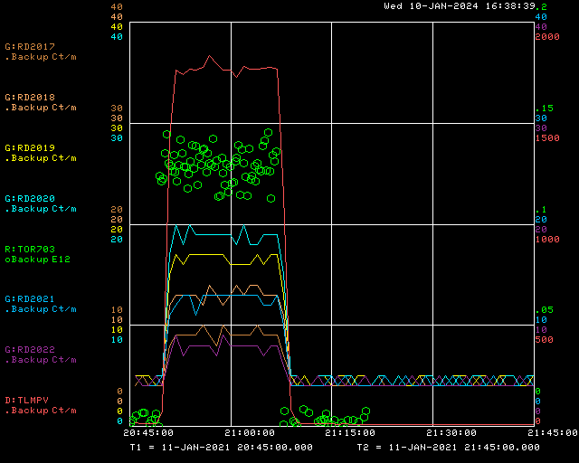
Example of beam data
TLM Data
Beam Toroid
Chipmunk readings
Background

Slide 48
Tabulated beam data

Slide 49
Full list of credited TLMs
Monitor name | Common name | Description
G:RD2077 | TLMXUP | Through Transport enclosure from target vault wall to Q723
G:RD2077 | TLMXDN | Through downstream Transport enclosure and DR enclosure from Q723 to Q743
G:RD2077 | TLMD20 | Through 20 arc in DR enclosure from Q207 to Q107
G:RD2077 | TLMD40 | Through 40 arc in DR enclosure from Q407 to Q307
G:RD2077 | TLMD60 | Through 60 arc in DR enclosure from Q607 to Q507
G:RD2077 | TLMABT | Along abort line from 10 feet downstream of VHA05 to absorber steel
Credited control limit setting required to be 100,000 nC/min or less

Slide 50
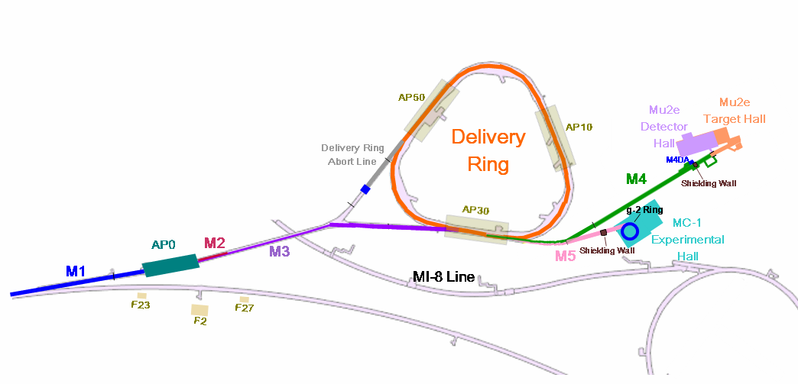
Muon Campus Enclosure map
Delivery Ring
Transport Mid
Pre-Target
M4
Pre-Vault
Tevatron
Extraction
Transport US/DS
Target Vault
g-2 experimental hall

Slide 51
Credited radiation monitor locations
Chipmunks shown as red circles in service buildings

Slide 52
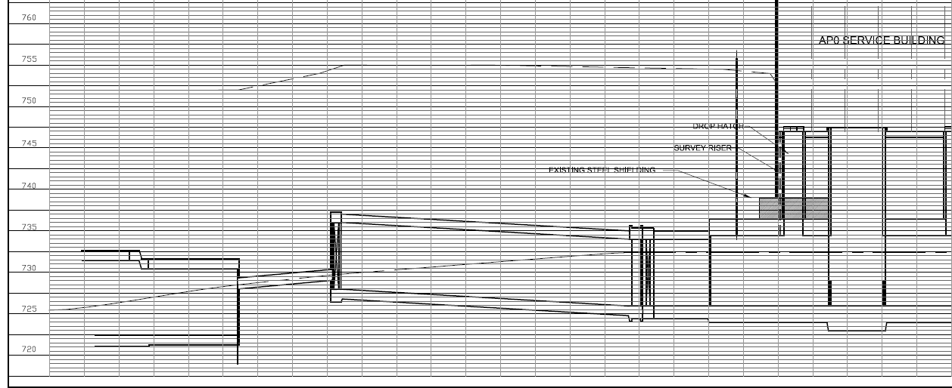
Maximum Credible Incident (MCI) – Radiological
P1, P2, M1
M2
(not in use)
AP0
Target Station
M3
Abort
Delivery Ring
AP50
AP30
AP10
M5
M4
Mu2e
(not in use)
MC-1
(g-2)
Vault
F17 buried pipe
Tevatron
Pre-Target
Pre-Vault

Slide 53
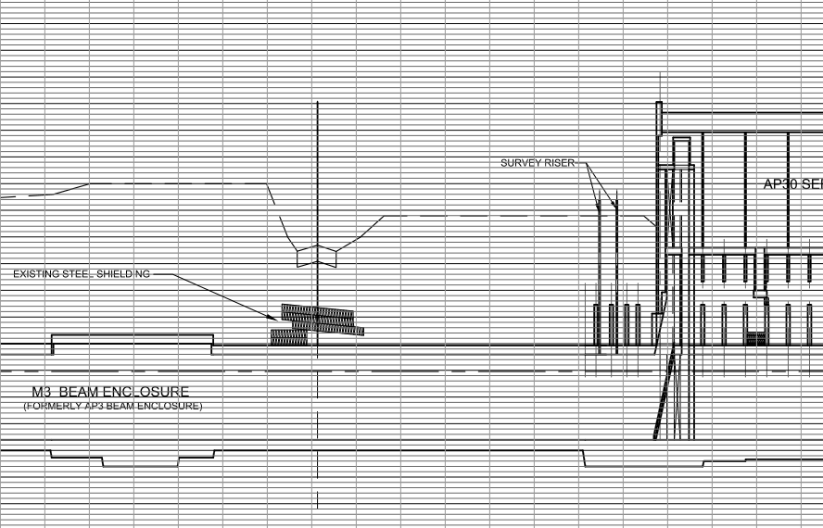
Maximum Credible Incident (MCI) – Radiological
P1, P2, M1
M2
(not in use)
AP0
Target Station
M3
Abort
Delivery Ring
AP50
AP30
AP10
M5
M4
Mu2e
(not in use)
MC-1
(g-2)

Slide 54
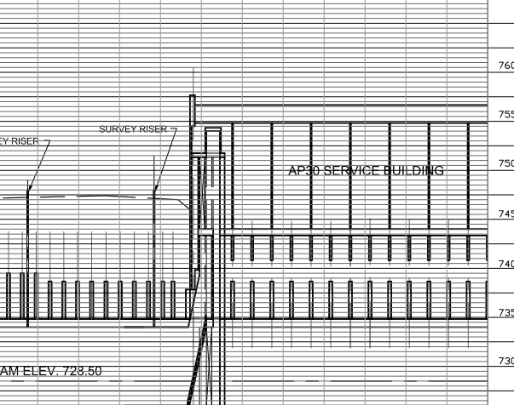
Maximum Credible Incident (MCI) – Radiological
P1, P2, M1
M2
(not in use)
AP0
Target Station
M3
Abort
Delivery Ring
AP50
AP30
AP10
M5
M4
Mu2e
(not in use)
MC-1
(g-2)

Slide 55
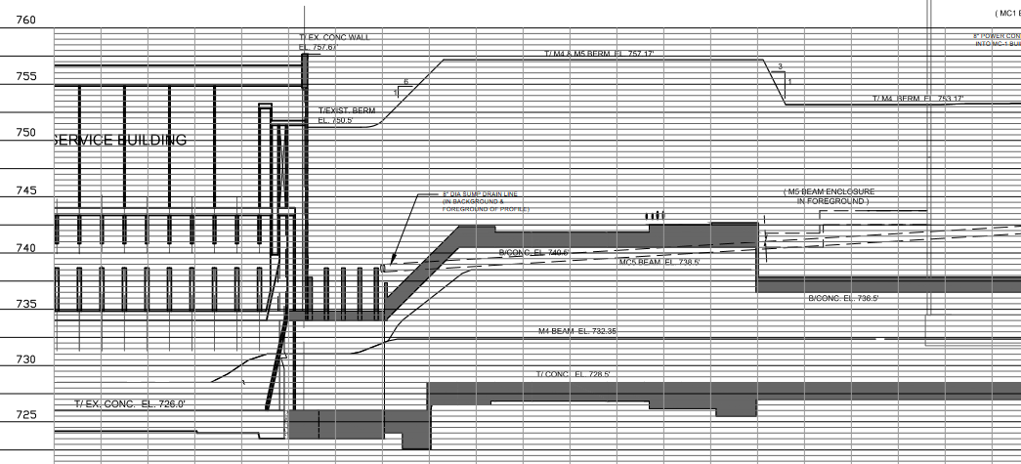
Maximum Credible Incident (MCI) – Radiological
P1, P2, M1
M2
(not in use)
AP0
Target Station
M3
Abort
Delivery Ring
AP50
AP30
AP10
M5
M4
Mu2e
(not in use)
MC-1
(g-2)

Slide 56
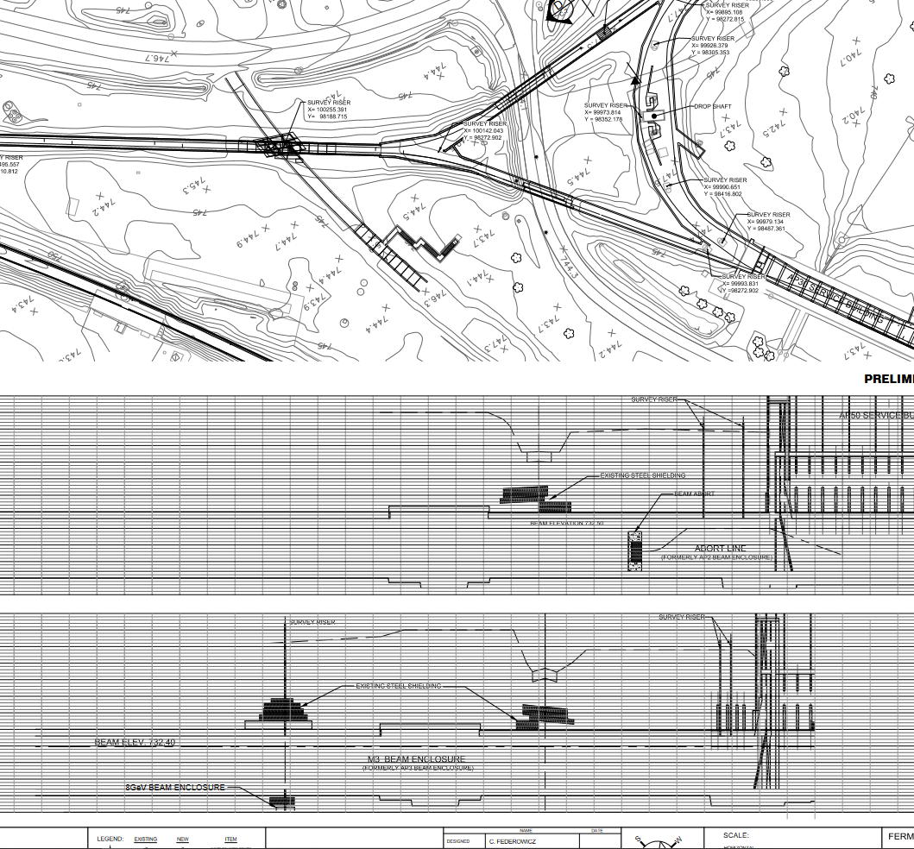
Drawing used for Indian Rd crossing

Slide 57
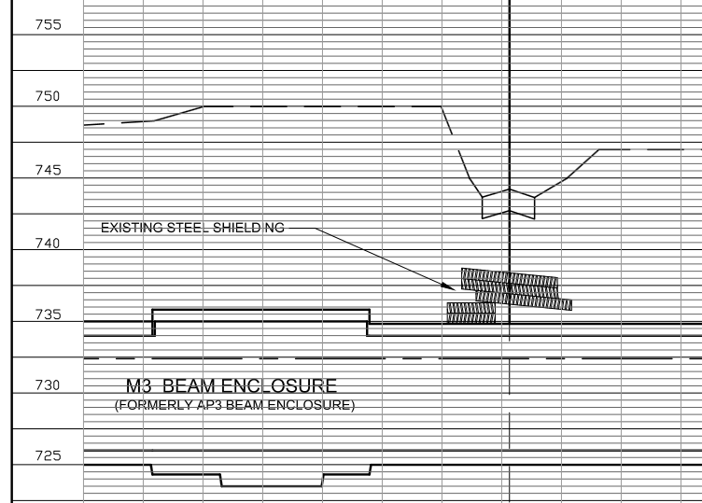
Drawing used for Indian Rd crossing

Slide 58

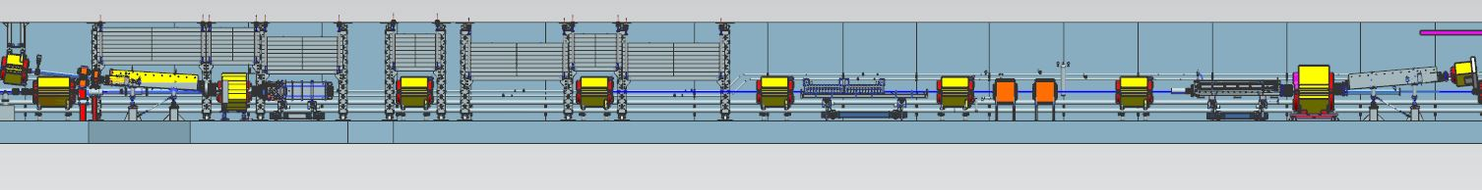
D30 Location of Chipmunks
RD2109
RD2108
RD2107
RD2106
RD2105
RD2104
RD2103
RD2102
RD2101
RD2100
RD2099
Service Building Floor
gravel shielding ~ 10’
Q206
ECMAG
Q205
ELAM
Q204
ESS2
Q203
ESS1
EKIK
Q202
IKIK
Q301
Q302
ISEP
Q303
Cmag
Q207
TLM30D
TLM30U
Q307
Not required – Not credited

Slide 59
Credited radiation monitor locations

Slide 60
Campus beamlines without annotations
Tevatron F17

