Slide 1
Safety Assessment Document Updates for DOE O 420.2D
SAD Section III Chapter 12 – Switchyard
Tom Kobilarcik presenting for Mike Olander
Switchyard Internal Readiness Review
23 January2024

Slide 2
Outline
Switchyard Overview
Hazard Inventory
Non-Accelerator Specific Hazards
Accelerator Specific Hazards
Maximum Credible Incident (MCI) Discussion
Summary of Credited Controls
Summary of Defense in Depth Controls

Slide 3
Outline
Switchyard Overview
Hazard Inventory
Non-Accelerator Specific Hazards
Accelerator Specific Hazards
Maximum Credible Incident (MCI) Discussion
Summary of Credited Controls
Summary of Defense in Depth Controls

Slide 4
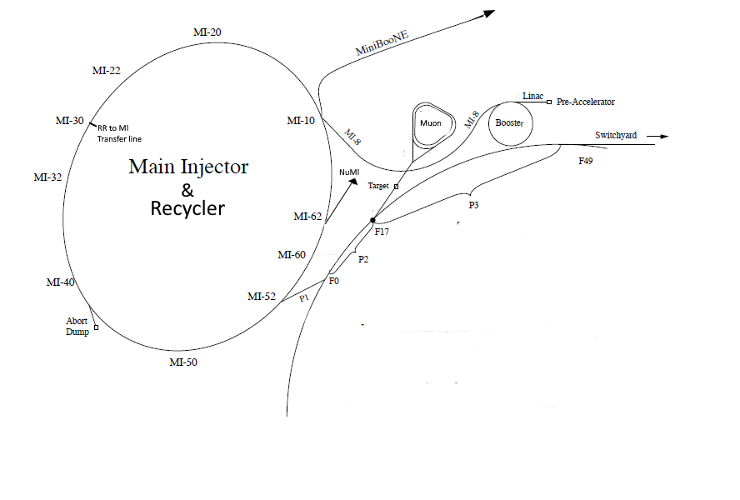
Switchyard Overview
One injection line, P1, from MI/RR
8 GeV from RR
120 GeV from MI
Three transfer lines
8 GeV beam to Muon
120 GeV beam to
Switchyard dump
Meson Area
Neutrino Area

Slide 5
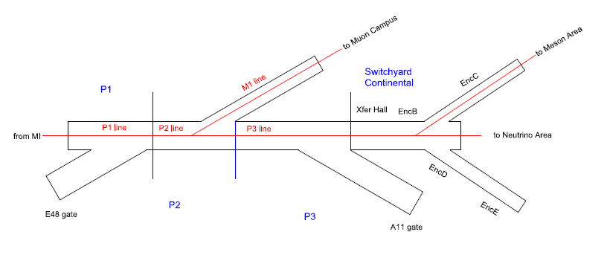
Switchyard Overview
8 GeV: RR -> P1 -> P2 -> M1
120 GeV: MI -> P1 -> P2 -> P3 -> Switchyard Continental -> (next slide)
The merger of RR and MI beam, into the P1 line, occurs in the Main Injector segment
The P1 and P2 lines can transport 8 GeV and 120 GeV beam, but not simultaneously

Slide 6
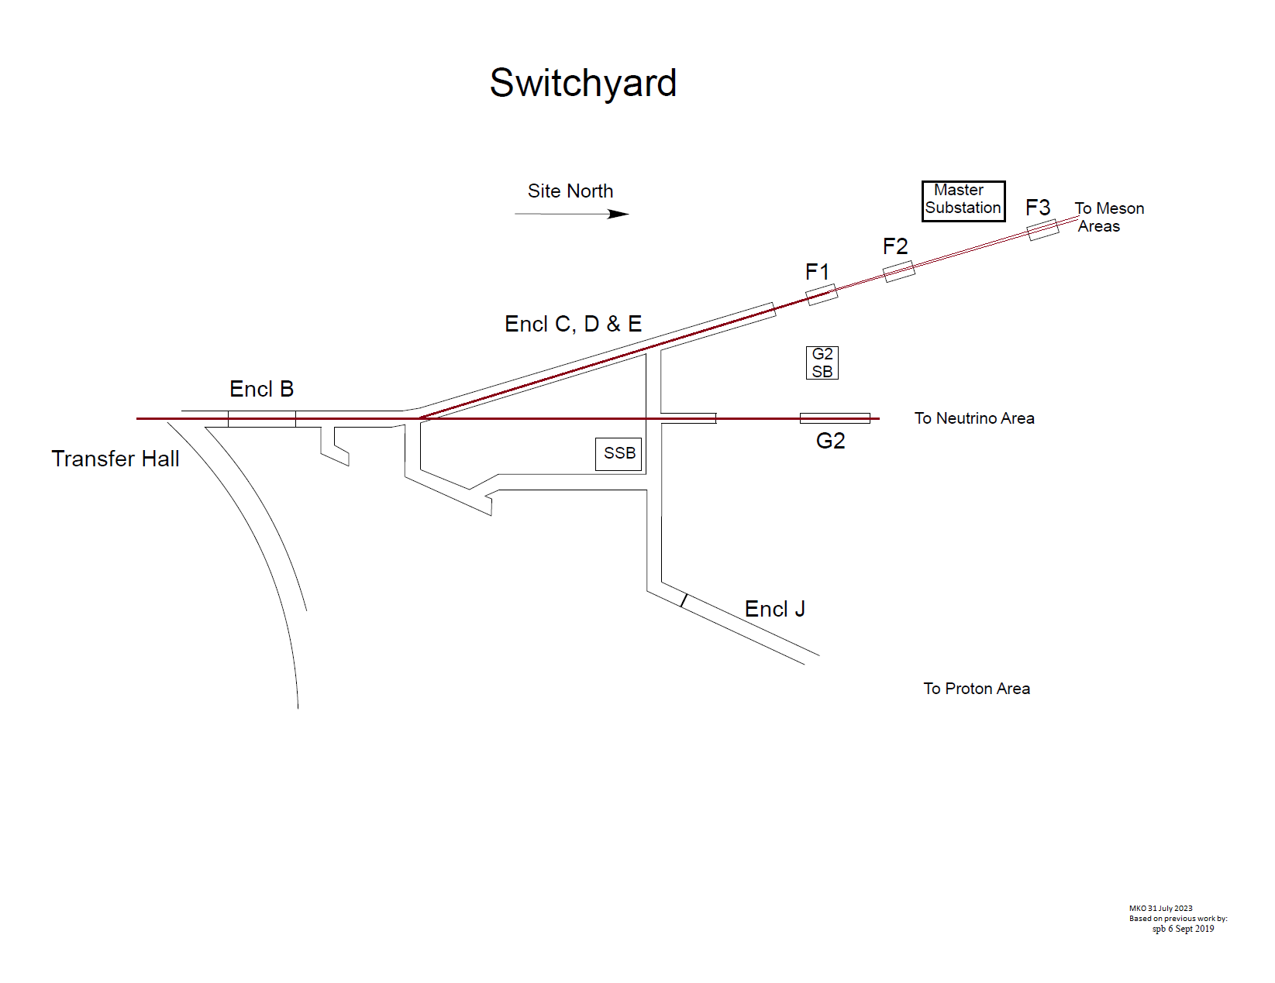
Switchyard Overview
8 GeV: RR -> P1 -> P2 -> M1
Switchyard Continental sends beam to the Meson Area or Neutrino Area
Switchyard Continental is no longer capable of sending beam to the Proton Area
Switchyard Continental cannot send beam to the Tevatron; the transport components in Transfer Hall have been removed

Slide 7
Outline
Switchyard Overview
Hazard Inventory
Non-Accelerator Specific Hazards
Accelerator Specific Hazards
Maximum Credible Incident (MCI) Discussion
Summary of Credited Controls
Summary of Defense in Depth Controls

Slide 8
Hazard Inventory for Switchyard
Radiological |  | Toxic Materials
☒ | Prompt Ionizing Radiation | ☒ | Lead
☒ | Residual Activation | ☐ | Beryllium
☒ | Groundwater Activation | ☐ | Fluorinert & Its Byproducts
☒ | Surface Water Activation | ☐ | Liquid Scintillator Oil
☒ | Radioactive Water (RAW) Systems | ☐ | Pseudocumene
☒ | Air Activation | ☐ | Ammonia
☐ | Closed Loop Air Cooling | ☐ | Nanoparticle Exposures
☒ | Soil Interactions | Flammables and Combustibles
☒ | Radioactive Waste | ☒ | Combustible Materials (e.g., cables, wood cribbing, etc.)
☒ | Contamination | ☒ | Flammable Materials (e.g., flammable gas, cleaning materials, etc.)
☒ | Beryllium-7 | Electrical Energy
☒ | Radioactive Sources | ☒ | Stored Energy Exposure
☐ | Nuclear Material | ☒ | High Voltage Exposure
☐ | Radiation Generating Devices (RGDs) | ☒ | Low Voltage, High Current Exposure
☐ | Non-Ionizing Radiation Hazards | Kinetic Energy
Thermal Energy |  | ☒ | Power Tools
☐ | Bakeouts | ☒ | Pumps and Motors
☒ | Hot Work | ☐ | Motion Tables
☐ | Cryogenics | ☐ | Mobile Shielding
Potential Energy |  | Magnetic Fields
☒ | Crane Operations | ☒ | Fringe Fields
☒ | Compressed Gasses | Other Hazards
☒ | Vacuum/Pressure Vessels/piping | ☒ | Confined Spaces
☒ | Vacuum Pumps | ☒ | Noise
☒ | Material Handling | ☐ | Silica
Access & Egress |  | ☒ | Ergonomics
☒ | Life Safety Egress | ☐ | Asbestos
Accelerator specific hazards are purple
Hazards not discussed today are evaluated via the common Risk Matrix tables
Covered in SAD Section I, Chapter 4
Hazards evaluated via risk assessment methodology per DOE-HDBK-1163-2020
Likelihood (L):
Anticipated (A), Unlikely (U), Extremely Unlikely (EU), Beyond Extremely Unlikely (BEU)
Consequence (C):
High (H), Moderate (M), Low (L), Negligible (N)
Risk (R):
I , II, III, IV (descending order of concern)

Slide 9
Outline
SwitchyardOverview
Hazard Inventory
Non-Accelerator Specific Hazards
Accelerator Specific Hazards
Maximum Credible Incident (MCI) Discussion
Summary of Credited Controls
Summary of Defense in Depth Controls

Slide 10
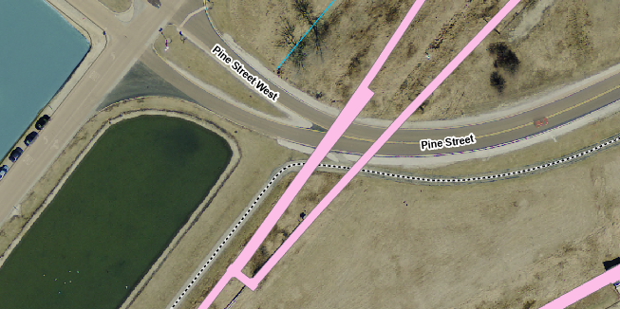
Non-Accelerator Specific Hazards
The public is not invited into most areas of Switchyard. An example of an exception is where Pine Street crosses a section of Switchyard Continental.

Slide 11
Non-Accelerator Specific Hazards - Radiological
Residual Activation
High intensity beam delivery can produce activated materials inside the Switchyard enclosures due to beam loss
Hazard applies to onsite facility workers and onsite co-located workers
Baseline Qualitative Risk (without controls) | Controls Preventive (P)/Mitigative (M) | Residual Qualitative Risk (with controls)
L: A C: H R: I | P – Radiological Work Permit P – Postings P – Training M – Run Conditions M – Local Component Shielding | L: BEU C: L R: IV

Slide 12
Non-Accelerator Specific Hazards - Radiological
Radioactive Water System
Applies to the Switchyard Dump
Passive water cooling
Hazard applies to onsite facility workers and onsite co-located workers
Baseline Qualitative Risk (without controls) | Controls Preventive (P)/Mitigative (M) | Residual Qualitative Risk (with controls)
L: A C: H R: I | P – Postings P – Radiological Work Permit P – Training M – Run Conditions | L: BEU C: M R: IV

Slide 13
Non-Accelerator Specific Hazards - Radiological
Air Activation
Air activation can occur at any area where high beam losses are present.
Hazard applies to onsite facility workers and onsite co-located workers
Baseline Qualitative Risk (without controls) | Controls Preventive (P)/Mitigative (M) | Residual Qualitative Risk (with controls)
L: A C: H R: I | M – Run Conditions M – Engineered Air Flow | L: A C: L R: III

Slide 14
Non-Accelerator Specific Hazards - Radiological
Soil Interactions
Radionuclides are produced which may contaminate ground water
Can occur in areas of high chronic losses when the beam passes through a berm pipe
Can occur around the Switchyard Dump
Hazard applies to onsite facility workers and onsite co-located workers
Baseline Qualitative Risk (without controls) | Controls Preventive (P)/Mitigative (M) | Residual Qualitative Risk (with controls)
L: A C: H R: I | P – Radiological Work Permit required for excavation M – Engineered Beam Dump M – Beamline Design M – Run Conditions | L: U C: N R: IV

Slide 15
Non-Accelerator Specific Hazards - Radiological
Radioactive Waste
Radioactive waste produced during Switchyard operations will be managed within the established Radiological Protection Program (RPP) as prescribed in the Fermilab Radiological Control Manual (FRCM)
Hazard applies to onsite facility workers and onsite co-located workers
Baseline Qualitative Risk (without controls) | Controls Preventive (P)/Mitigative (M) | Residual Qualitative Risk (with controls)
L: A C: H R: I | P – Locked Gates P – Key Control Program P – Postings M – Run Conditions M – Distance to Stored Material M – Material survey and release process | L:BEU C: N R: IV

Slide 16
Non-Accelerator Specific Hazards - Radiological
Contamination
Contamination is found in the Switchyard enclosures in areas where beam passes through an air gap, such as vacuum isolation at a septum.
Hazard applies to onsite facility workers and onsite co-located workers
Baseline Qualitative Risk (without controls) | Controls Preventive (P)/Mitigative (M) | Residual Qualitative Risk (with controls)
L: A C: H R: I | P – Radiation Survey P – Posting M – Radiological Work Permit M – Training | L: EU C: L R: IV

Slide 17
Outline
Switchyard Overview
Hazard Inventory
Non-Accelerator Specific Hazards
Accelerator Specific Hazards
Maximum Credible Incident (MCI) Discussion
Summary of Credited Controls
Summary of Defense in Depth Controls

Slide 18
Accelerator Specific Hazards - Radiological
Prompt Ionizing Radiation
Ionizing radiation due to beam loss in the Switchyard enclosure
Analyzed maximum credible incident (MCI) to determine credited controls
Hazard applies to onsite facility workers, onsite co-located workers
Credited Controls are needed

Slide 19
Outline
Switchyard Overview
Hazard Inventory
Non-Accelerator Specific Hazards
Accelerator Specific Hazards
Maximum Credible Incident (MCI) Discussion
Summary of Credited Controls
Summary of Defense in Depth Controls

Slide 20
Maximum Credible Incident (MCI) – Radiological
Two credible scenarios
8 GeV protons: 7E12 protons per cycle at 15 Hz cycle time
120 GeV protons: 4.2E13 protons per cycle at 55 second cycle time (1)
The P1&P2 lines transport both 8 GeV and 120 GeV protons (but not simultaneously).
Of the two credible scenarios, 8 GeV protons is more significant.
For the P1&P2 lines, the MCI is 3.8E17 protons per hour:
7E12 protons per batch
15 Hz cycle time
8 GeV protons
The P3 line transports 120 GeV protons
For the P3 line and downstream, the MCI is 2.8E15 protons per hour:
4.2E13 protons per cycle = 6 batches per cycle * 7E12 protons per batch
55 second cycle time
120 GeV protons
(1) The Fermilab Main Injector Design Report cites 3E13 protons per cycle as the maximum slow spill intensity.

Slide 21
Maximum Credible Incident (MCI) – Radiological
The MCI focuses on exposure to an onsite worker, an onsite coworker and the maximally exposed off-site individual (MOI)
Fermilab uses Credited Controls that flow down to the Accelerator Safety Envelope (ASE) to mitigate the consequences of an MCI to the following conditions:
Less than 5 rem in one hour in any area accessible by facility workers or co-located workers
Less than 500 mrem in one hour in all Laboratory areas to which the public is assumed to be excluded
Less than 100 mrem in one hour at Fermilab’s site boundary and/or in any areas onsite in which the public is authorized (which includes Batavia Road, Prairie Path, parking lots open to the public, and general access areas including Wilson Hall, Ramsey Auditorium)

Slide 22
Outline
Switchyard Overview
Hazard Inventory
Non-Accelerator Specific Hazards
Accelerator Specific Hazards
Maximum Credible Incident (MCI) Discussion
Summary of Credited Controls
Shielding Assessment Discussion
Summary of Defense in Depth Controls

Slide 23
Credited Controls – Passive
Permanent Shielding
The required shielding will vary depending on whether the beam strikes a magnet, long pipe, or buried pipe. Where the permanent shielding is less than the required shielding, active engineered controls will be used.
Movable Shielding
The Switchyard area has moveable shielding placed in the equipment drop hatches adjacent to the SSB, at the downstream end of the G2 enclosure, and at the upstream end of the F1-Manhole enclosure. The shielding is administratively controlled by ES&H, using a procedure that outlines the conditions required to access the equipment drop hatch. The shielding is locked with two padlocks, one padlock cored to the enclosure entry key and one cored to configuration control series, utilized exclusively by members of ESH. The assigned RSO or designee will document the application and removal of the configuration control in a database established for this purpose.

Slide 24
Credited Controls – Passive
Penetration Shielding
The Switchyard enclosures have utility penetrations throughout the service buildings and are accounted for in the Safety Assessment Document.
Radiation Area Fencing
The Radiation Area Fence surrounding the berm within the Master Substation is credited to prevent access to this area.

Slide 25
Credited Controls – Passive
Permanent Shielding – Example Table
Transverse Station (ft) or (cell) | Category | Credited Shielding (efd)
MI 8400 | 4C | 20.3
MI 8450 | 4C | 20.3
MI 8475 | 4C | 20.3
MI 8569 | 4A | 17.9
707 8650 | 4A | 17.9
708 8725 | 4A | 17.9
708 8740 | 4A | 17.9
E48-4 | 4A | 17.9
E48-7 | 4A | 17.9
E49-7 | 4A | 17.9
E49-9 | 4A | 17.9
F00-5 | 4A | 17.9
17270 | 4A | 17.9
17450 | 4A | 17.9
17657 | 4A | 17.9
17683 | 4A | 17.9
17707 | 4A | 17.9
17910 | 4A | 17.9
18100 | 4A | 17.9
Example of a permanent shielding table showing location, loss type (category), and credited shielding.

Slide 26
Credited Controls – Active Engineering
Credited Control: Radiation Safety Interlock System (RSIS)
Inhibits beam by controlled redundant critical devices
Enforces the search and secure process
Interlocked doors are present at all access points into the Switchyard enclosures
Includes interlocked radiation detectors which protect individuals by disabling beam should prompt radiation from operations cause exposure to exceed specific dose rates
Includes an interlocked repetition rate limiter which protect individuals by disabling beam if a magnet is energized longer than allowed in a fixed amount of time.
The ES&H Radiation Physics Engineering Dept. (RPE) ensures that all requirements for hardware and system testing are completed semi-annually with a four-month grace period
RPE also verifies the inventory of interlock keys and updates procedures for maintenance and testing of interlock systems
All RSIS are designed, installed and configuration managed in conformance with the requirements of the Fermilab Radiological Control Manual (FRCM)

Slide 27
Credited Controls – Active Engineering
Interlocked Radiation Detectors
Detector Type | Location | Credited Control Limit
Chipmunk | F15 Air Handler | 440 mrem/hour
Chipmunk | A-0 Ramp | 490 mrem/hour
Chipmunk | Transfer Gallery North Addition | 24.5 mrem/hour
Chipmunk | Transfer Gallery North Addition | 24.5 mrem/hour
TLM | Enclosure B | 14641 nC/min
TLM | Enclosure C | 74460 nC/min
Chipmunk | F2 Refrigerator Building | 4810 mrem/hour
Chipmunk | F3 Refrigerator Building | 4940 mrem/hour
Chipmunk | F4 Refrigerator Building | 4940 mrem/hour
Chipmunk | A-0 Kicker Building (South) | 4900 mrem/hour
Chipmunk | A-0 Kicker Building (Middle) | 4900 mrem/hour
Chipmunk | A-0 Kicker Buiding (North) | 4900 mrem/hour
Chipmunk | Enclosure B Cryo Penetration | 95 mrem/hour
Chipmunk | G2 Cryo Penetration (z=2333') | 495 mrem/hour
Chipmunk | G2 Cryo Penetration (z=2337') | 490 mrem/hour

Slide 28
Credited Controls - Administrative
Credited Control: Operation Authorization Document
Machine Beam Permit
Machine Run Condition
Beam will not be transported through Switchyard without approval of these documents
Credited Control: Staffing
Ensures operations within bounding conditions specified in Operation Authorization Document
The following staffing shall be in place during applicable beam operation:
At least one member of the AD Operations Department who has achieved the rank of Operator II or higher shall be on duty and on site.
At least one member of the AD Operations Department shall be present in the Main Control Room (MCR).
Note: these requirements could be satisfied by a single person
Credited Control: Accelerator Operating Parameters
For the P1 & P2 Beamlines, beam shall not exceed 3.78E17 protons per hour at 8 GeV beam energy
For the P3 Beamlines and all segments downstream, beam shall not exceed 2.75E15 protons per hour at 120 GeV

Slide 29
Outline
Switchyard Overview
Hazard Inventory
Non-Accelerator Specific Hazards
Accelerator Specific Hazards
Maximum Credible Incident (MCI) Discussion
Summary of Credited Controls
Summary of Defense in Depth Controls

Slide 30
Defense in Depth Controls
Passive Shielding
Not all shielding is credited
Machine Protection Controls
Beam Loss Monitors: Determine when beam is being lost at operationally unacceptable regions or rates
Beam Position Monitors and Segmented Wire Ionization Chambers: Determine the trajectories of the beam so that the Main Control Room may control losses
Beam Budget Monitor: Continually monitors the integrated beam delivered to the beam lines and the Switchyard Beam Absorber on an hourly basis
Fencing and Posting
Fences are used and posted to designate potential Radiation Areas during machine operations. Examples are the fences at the South Booster Road, and F1-Manhole enclosure equipment hatch F1MPA1.
Training
For example, Fermilab’s Radiation Worker training

Slide 31
Thank you for your attention

Slide 32
Outline
Switchyard Overview
Hazard Inventory
Non-Accelerator Specific Hazards
Accelerator Specific Hazards
Maximum Credible Incident (MCI) Discussion
Summary of Credited Controls
Summary of Defense in Depth Controls

