Slide 1
Safety Assessment Document Updates for DOE O 420.2D
SAD Section III Chapter 13 – Meson
Tom Kobilarcik presenting for Mike Olander
Switchyard Internal Readiness Review
23 January 2024

Slide 2
Outline
Meson Overview
Hazard Inventory
Non-Accelerator Specific Hazards
Accelerator Specific Hazards
Maximum Credible Incident (MCI) Discussion
Summary of Credited Controls
Summary of Defense in Depth Controls

Slide 3
Outline
Meson Overview
Hazard Inventory
Non-Accelerator Specific Hazards
Accelerator Specific Hazards
Maximum Credible Incident (MCI) Discussion
Summary of Credited Controls
Summary of Defense in Depth Controls

Slide 4
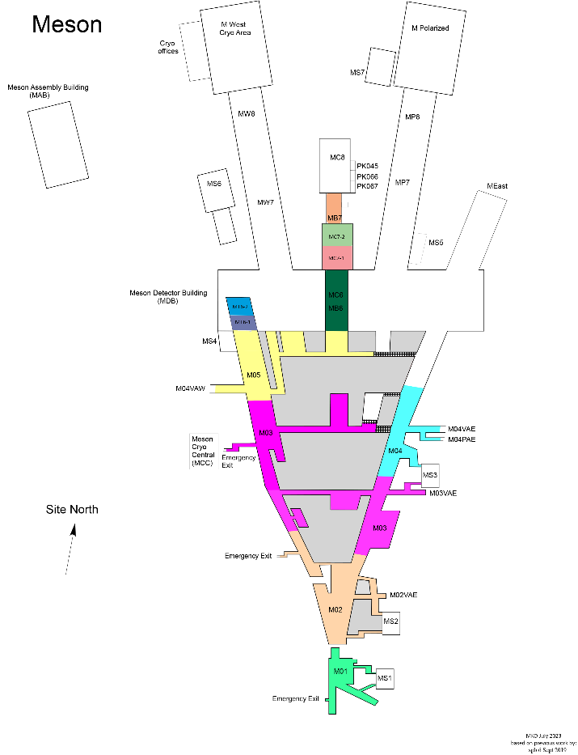
Switchyard Overview
One extraction line from Switchyard
120 GeV
Referred to as “Meson Primary” (MPrimary_)
Two transfer lines
Energy can vary
Meson Test (MTest)
Meson Center (MCenter)
MTest and MCenter can be independently dumped in the Meson Target Train (MTT), allowing independent access to the experimental halls

Slide 5
Switchyard Overview
MCenter
Beam is split in Switchyard, but follows a common beam pipe into M01
In M01, beam is directed to MTest, MCenter, or the Meson Target Train
M01 through MTT is MPrimary
There are primary targets along MTest, allowing for a variety of secondary energies.
There is a single primary target in MC6
There is no target in the Meson Target Train – the name is historic
MTest
Meson Target Train
MPrimary

Slide 6
Outline
Meson Overview
Hazard Inventory
Non-Accelerator Specific Hazards
Accelerator Specific Hazards
Maximum Credible Incident (MCI) Discussion
Summary of Credited Controls
Summary of Defense in Depth Controls

Slide 7
Hazard Inventory for Meson
Radiological |  | Toxic Materials
☒ | Prompt Ionizing Radiation | ☒ | Lead Shielding
☒ | Residual Activation | ☒ | Beryllium
☒ | Groundwater Activation | ☐ | Fluorinert & Its Byproducts
☒ | Surface Water Activation | ☐ | Liquid Scintillator Oil
☒ | Radioactive Water (RAW) Systems | ☐ | Pseudocumene
☒ | Air Activation | ☐ | Ammonia
☐ | Closed Loop Air Cooling | ☐ | Nanoparticle Exposures
☒ | Soil Interactions | Flammables and Combustibles
☒ | Radioactive Waste | ☒ | Combustible Materials (e.g., cables, wood cribbing, etc.)
☒ | Contamination | ☐ | Flammable Materials (e.g., flammable gas, cleaning materials, etc.)
☒ | Beryllium-7 | Electrical Energy
☒ | Radioactive Sources | ☒ | Stored Energy Exposure
☐ | Nuclear Material | ☒ | High Voltage Exposure
☐ | Radiation Generating Devices (RGDs) | ☒ | Low Voltage, High Current Exposure
☐ | Non-Ionizing Radiation Hazards | Kinetic Energy
Thermal Energy |  | ☒ | Power Tools
☐ | Magnet Bakeouts | ☒ | Pumps and Motors
☒ | Hot Work | ☒ | Motion Tables
☒ | Cryogenics | ☐ | Mobile Shielding
Potential Energy |  | Magnetic Fields
☒ | Crane Operations | ☒ | Fringe Fields
☒ | Compressed Gasses | Other Hazards
☒ | Vacuum/Pressure Vessels/Piping | ☒ | Confined Spaces
☒ | Vacuum Pumps | ☒ | Noise
☐ | Material Handling | ☐ | Silica
Access & Egress |  | ☒ | Ergonomics
☒ | Life Safety Egress | ☐ | Asbestos
Accelerator specific hazards are purple
Hazards not discussed today are evaluated via the common Risk Matrix tables
Covered in SAD Section I, Chapter 4
Hazards evaluated via risk assessment methodology per DOE-HDBK-1163-2020
Likelihood (L):
Anticipated (A), Unlikely (U), Extremely Unlikely (EU), Beyond Extremely Unlikely (BEU)
Consequence (C):
High (H), Moderate (M), Low (L), Negligible (N)
Risk (R):
I , II, III, IV (descending order of concern)

Slide 8
Outline
Meson Overview
Hazard Inventory
Non-Accelerator Specific Hazards
Accelerator Specific Hazards
Maximum Credible Incident (MCI) Discussion
Summary of Credited Controls
Summary of Defense in Depth Controls

Slide 9
Non-Accelerator Specific Hazards
The public is not invited into the Meson Area.

Slide 10
Non-Accelerator Specific Hazards - Radiological
Residual Activation
High intensity beam delivery can produce activated materials inside the Switchyard enclosures due to beam loss
Hazard applies to onsite facility workers and onsite co-located workers
Baseline Qualitative Risk (without controls) | Controls Preventive (P)/Mitigative (M) | Residual Qualitative Risk (with controls)
L: A C: H R: I | P – Radiological Work Permit P – Postings P – Training M – Run Conditions M – Local Component Shielding | L: BEU C: L R: IV

Slide 11
Non-Accelerator Specific Hazards - Radiological
Radioactive Water System
Applies to the Meson Target Train
Hazard applies to onsite facility workers and onsite co-located workers
Baseline Qualitative Risk (without controls) | Controls Preventive (P)/Mitigative (M) | Residual Qualitative Risk (with controls)
L: A C: H R: I | P – Postings P – Radiological Work Permit P – Training M – Run Conditions | L: BEU C: M R: IV

Slide 12
Non-Accelerator Specific Hazards - Radiological
Air Activation
Air activation can occur at any area where high beam losses are present.
Hazard applies to onsite facility workers and onsite co-located workers
Baseline Qualitative Risk (without controls) | Controls Preventive (P)/Mitigative (M) | Residual Qualitative Risk (with controls)
L: A C: N R: IV | P -- Measured air release documented in 2003 Shielding Assessment for the Switchyard 120 Project indicated 0 Ci per year under similar beam condition M – Engineered Air Flow M – Run Conditions | L: U C: N R: IV

Slide 13
Non-Accelerator Specific Hazards - Radiological
Soil Interactions
Radionuclides are produced which may contaminate ground water
Can occur in areas of high chronic losses when the beam passes through a berm pipe
Can occur around the Meson Target Train Dump
Hazard applies to onsite facility workers and onsite co-located workers
Baseline Qualitative Risk (without controls) | Controls Preventive (P)/Mitigative (M) | Residual Qualitative Risk (with controls)
L: A C: H R: I | P – Radiological Work Permit required for excavation M – Engineered Beam Dump M – Beamline Design M – Run Conditions | L: U C: N R: IV

Slide 14
Non-Accelerator Specific Hazards - Radiological
Radioactive Waste
Radioactive waste produced during Switchyard operations will be managed within the established Radiological Protection Program (RPP) as prescribed in the Fermilab Radiological Control Manual (FRCM)
Hazard applies to onsite facility workers and onsite co-located workers
Baseline Qualitative Risk (without controls) | Controls Preventive (P)/Mitigative (M) | Residual Qualitative Risk (with controls)
L: A C: H R: I | P – Locked Gates P – Key Control Program P – Postings M – Run Conditions M – Distance to Stored Material M – Material survey and release process | L:BEU C: N R: IV

Slide 15
Non-Accelerator Specific Hazards - Radiological
Contamination
Contamination is found in the Switchyard enclosures in areas where beam passes through an air gap, such as vacuum isolation at a septum.
Hazard applies to onsite facility workers and onsite co-located workers
Baseline Qualitative Risk (without controls) | Controls Preventive (P)/Mitigative (M) | Residual Qualitative Risk (with controls)
L: A C: H R: I | P – Radiation Survey P – Posting M – Radiological Work Permit M – Training | L: EU C: L R: IV

Slide 16
Outline
Meson Overview
Hazard Inventory
Non-Accelerator Specific Hazards
Accelerator Specific Hazards
Maximum Credible Incident (MCI) Discussion
Summary of Credited Controls
Summary of Defense in Depth Controls

Slide 17
Accelerator Specific Hazards
Radiological – Prompt Ionizing Radiation
Ionizing radiation due to beam loss in the Meson enclosures
Analyzed maximum credible incident (MCI) to determine credited controls
Hazard applies to onsite facility workers, onsite co-located workers
Credited Controls are needed
Cryogenics – Oxygen Deficiency Hazards (ODH)
Cryogens are not used operationally in Meson
Cryogenic transfer lines pass through the Meson enclosures
Meson enclosures M02, M03, M04, and M05 are classified as ODH-1 areas
Credited Controls are needed

Slide 18
Outline
Meson Overview
Hazard Inventory
Non-Accelerator Specific Hazards
Accelerator Specific Hazards
Maximum Credible Incident (MCI) Discussion
Summary of Credited Controls
Summary of Defense in Depth Controls

Slide 19
Maximum Credible Incident (MCI) – Radiological
120 GeV protons: 4.2E13 protons per cycle at 55 second cycle time, delivered from P3 line in Switchyard
The MTest and MCenter beamlines also transport secondary beam, that is, beam produced by the interaction of the 120 GeV protons with a target
The configuration of the secondary line is controlled by a “mode controller”, which is a credited control
Each secondary beamline is considered separately
Each secondary beam assumes 120 GeV protons, 4.2E13 protons per cycle, and 55 second cycle time
Each secondary beam is assumed to be in the mode which results in the greatest radiological impact

Slide 20
Maximum Credible Incident (MCI) – Radiological
For the Meson Area primary beam the MCI is 2.8E15 protons per hour:
The most we can get from Switchyard
55 second cycle time
120 GeV protons
For MTest secondary beam, results in:
2.8E10 particles per hour
55 second cycle time
30 GeV particles
For MCenter secondary beam, results in:
1.3E12 particles per hour
55 second cycle time
90 GeV particles

Slide 21
Maximum Credible Incident (MCI) – Radiological
The MCI focuses on exposure to an onsite worker, an onsite coworker and the maximally exposed off-site individual (MOI)
Fermilab uses Credited Controls that flow down to the Accelerator Safety Envelope (ASE) to mitigate the consequences of an MCI to the following conditions:
Less than 5 rem in one hour in any area accessible by facility workers or co-located workers
Less than 500 mrem in one hour in all Laboratory areas to which the public is assumed to be excluded
Less than 100 mrem in one hour at Fermilab’s site boundary and/or in any areas onsite in which the public is authorized (which includes Batavia Road, Prairie Path, parking lots open to the public, and general access areas including Wilson Hall, Ramsey Auditorium)

Slide 22
Outline
Meson Overview
Hazard Inventory
Non-Accelerator Specific Hazards
Accelerator Specific Hazards
Maximum Credible Incident (MCI) Discussion
Summary of Credited Controls
Shielding Assessment Discussion
Summary of Defense in Depth Controls

Slide 23
Credited Controls – Passive
Permanent Shielding
The required shielding will vary depending on whether the beam strikes a magnet, long pipe, or buried pipe. Where the permanent shielding is less than the required shielding, active engineered controls will be used.
Movable Shielding
The Meson Area has moveable shielding placed in the tunnel vehicle access entrances at M01, M02, M03, and M04, at the M04 and M05 crossovers, and along the sides and in between the MC7 and MC8 enclosures. The MC6 and MT6 enclosures are assembled from large concrete movable shielding blocks. These movable shield blocks are either posted to prohibit moving of these blocks without ESH approval or are additionally chained and locked with a Radiation Safety lock and an applicable padlock, where deemed necessary.
Penetration Shielding
The enclosures have utility penetrations throughout the service buildings and are accounted for in the Safety Assessment Document

Slide 24
Credited Controls – Passive
Permanent Shielding – Example Table
Z-Range (cell of ft) | Category | Credited Shielding (e.f.d)
3967-4003 | 4A | 13.9
4003-4062 | 4A | 13.9
4062-4160 | 4A | 13.9
4160-4300 | 4A | 13.9
4300-4340 | 4C | 16.3
4340-4605 | 4A | 13.9
4605-4710 | 4C | 16.3
4710-4716 | 4A | 13.9
4716-4841 | 4C | 16.3
4841-4889 | 4B | 11.4
4889-4989 | 4C | 16.3
4989-4995 | 4B | 11.4
4995-5043 | 4C | 16.3
5043-5164 | 9A | 5.5
5164-5590 | 4A | 3.0
5590-5618 | 4C | 3.0
Example of a permanent shielding table showing location, loss type (category), and credited shielding.

Slide 25
Credited Controls – Active Engineering
Credited Control: Radiation Safety Interlock System (RSIS)
Inhibits beam by controlled redundant critical devices
Enforces the search and secure process
Interlocked doors are present at all access points into the Switchyard enclosures
Includes interlocked radiation detectors which protect individuals by disabling beam should prompt radiation from operations cause exposure to exceed specific dose rates
Includes interlocked mode chassis which ensures the beam line is correctly configured to transport secondary particles
The ES&H Radiation Physics Engineering Dept. (RPE) ensures that all requirements for hardware and system testing are completed semi-annually with a four-month grace period
RPE also verifies the inventory of interlock keys and updates procedures for maintenance and testing of interlock systems
All RSIS are designed, installed and configuration managed in conformance with the requirements of the Fermilab Radiological Control Manual (FRCM)

Slide 26
Credited Controls – Active Engineering
Interlocked Radiation Detectors
Detector Type | Location | Credited Control Limit (mrem/hour)
Chipmunk | MDB MC6 US | 19.7
Chipmunk | MDB MC6 Mid | 28.2
Chipmunk | MDB MC6 DS | 28.2
Chipmunk | MC6 Catwalk | 4870
Chipmunk | One ft outside MC7 | 480
Chipmunk | On Lowest MC7 Roof | 440

Slide 27
Credited Controls – Active Engineering
ODH Safety System
During personnel access into Meson (M02, M03, M04, M05), the following components of the Oxygen Deficiency Hazard (ODH) Safety System shall be in place, with no known loss of safety function, during personnel access into applicable areas:
One (1) area/fixed oxygen monitor of four (4) available,
One (1) horn and one (1) strobe for each enclosure.

Slide 28
Credited Controls - Administrative
Credited Control: Operation Authorization Document
Meson Primary
Meson Primary Beam Permit
Meson Run Condition
Beam will not be transported through Meson Primary without approval of these documents
Meson Test
Meson Test Beam Permit
Meson Test Run Condition
Beam will not be transported through Meson Test without approval of these documents
Meson Center
Meson Center Beam Permit
Meson Center Run Condition
Beam will not be transported through Meson Center without approval of these documents

Slide 29
Credited Controls - Administrative
Credited Control: Staffing
Ensures operations within bounding conditions specified in Operation Authorization Document
The following staffing shall be in place during applicable beam operation:
At least one member of the AD Operations Department who has achieved the rank of Operator II or higher shall be on duty and on site.
At least one member of the AD Operations Department shall be present in the Main Control Room (MCR).
Note: these requirements could be satisfied by a single person
Credited Control: Accelerator Operating Parameters
Primary proton beam delivery shall not exceed 2.75E15 protons per hour at 120 GeV

Slide 30
Outline
Meson Overview
Hazard Inventory
Non-Accelerator Specific Hazards
Accelerator Specific Hazards
Maximum Credible Incident (MCI) Discussion
Summary of Credited Controls
Summary of Defense in Depth Controls

Slide 31
Defense in Depth Controls
Passive Shielding
Not all shielding is credited
Machine Protection Controls
Beam Loss Monitors: Determine when beam is being lost at operationally unacceptable regions or rates
Beam Position Monitors and Segmented Wire Ionization Chambers: Determine the trajectories of the beam so that the Main Control Room may control losses
Beam Budget Monitor: Continually monitors the integrated beam delivered to the beam lines and the Switchyard Beam Absorber on an hourly basis
Fencing and Posting
Fences are used and posted to designate potential Radiation Areas during machine operations. fences at the M01 enclosure including Gates M01PAE and M01PAW.
Training
For example, Fermilab’s Radiation Worker training

Slide 32
Thank you for your attention

Slide 33
Outline
Meson Overview
Hazard Inventory
Non-Accelerator Specific Hazards
Accelerator Specific Hazards
Maximum Credible Incident (MCI) Discussion
Summary of Credited Controls
Summary of Defense in Depth Controls

