Slide 1
Safety Assessment Document Updates for DOE O 420.2D
SAD Section IV Chapter 03 – Meson Switchyard 120 Experimental Areas
Evan Niner
Internal Readiness Review 1C
23 January 2024

Slide 2
Outline
Meson Switchyard 120 Experimental Area Overview
Hazard Inventory
Non-Accelerator Specific Hazards
Accelerator Specific Hazards
Maximum Credible Incident (MCI) Discussion
Summary of Credited Controls
Summary of Defense in Depth Controls

Slide 3
Outline
Meson Switchyard 120 Experimental Areas Overview
Hazard Inventory
Non-Accelerator Specific Hazards
Accelerator Specific Hazards
Maximum Credible Incident (MCI) Discussion
Summary of Credited Controls
Summary of Defense in Depth Controls

Slide 4
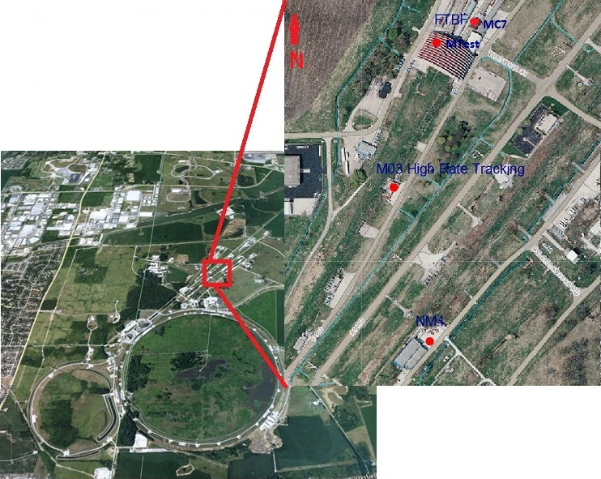
Meson Switchyard 120 Experimental Areas Overview
Beam from Meson Area segment (III-13)
Fermilab Test Beam Facility (FTBF)
  MT6 Section 1, MT6 Section 2 of MTest beamline
  MC7 Section 1, MC7 Section 2 of MCenter beamline
High rate tracking area located inside M03
Variety of short and medium term experiments rotating through the space

Slide 5
Meson Switchyard 120 Experimental Areas Overview
The Meson Switchyard 120 Experimental Areas are managed by the Particle Physics Directorate (PPD). The FTBF has a facility manager and dedicated scientific and technical support staff to schedule and coordinate experiment operations. Facility staff coordinate with the beamline physicist assigned from the External Beams Delivery Department in the Accelerator Directorate (AD) who maintains any AD owned systems, instrumentation, beamlines, and controls that are present in the experimental space.
Radiation safety has been carefully considered in the design of the Fermilab Meson Switchyard 120 Experimental Areas. All radiation hazards relating to beam operations safety are the responsibility of the Accelerator Directorate. The Accelerator Directorate, whose facilities includes all beamlines, their shielding, radiation, interlocks, beam surveys, monitors and impact of radiation on the environment, is addressed in SAD Section III Chapter 13 on the Meson Area.

Slide 6
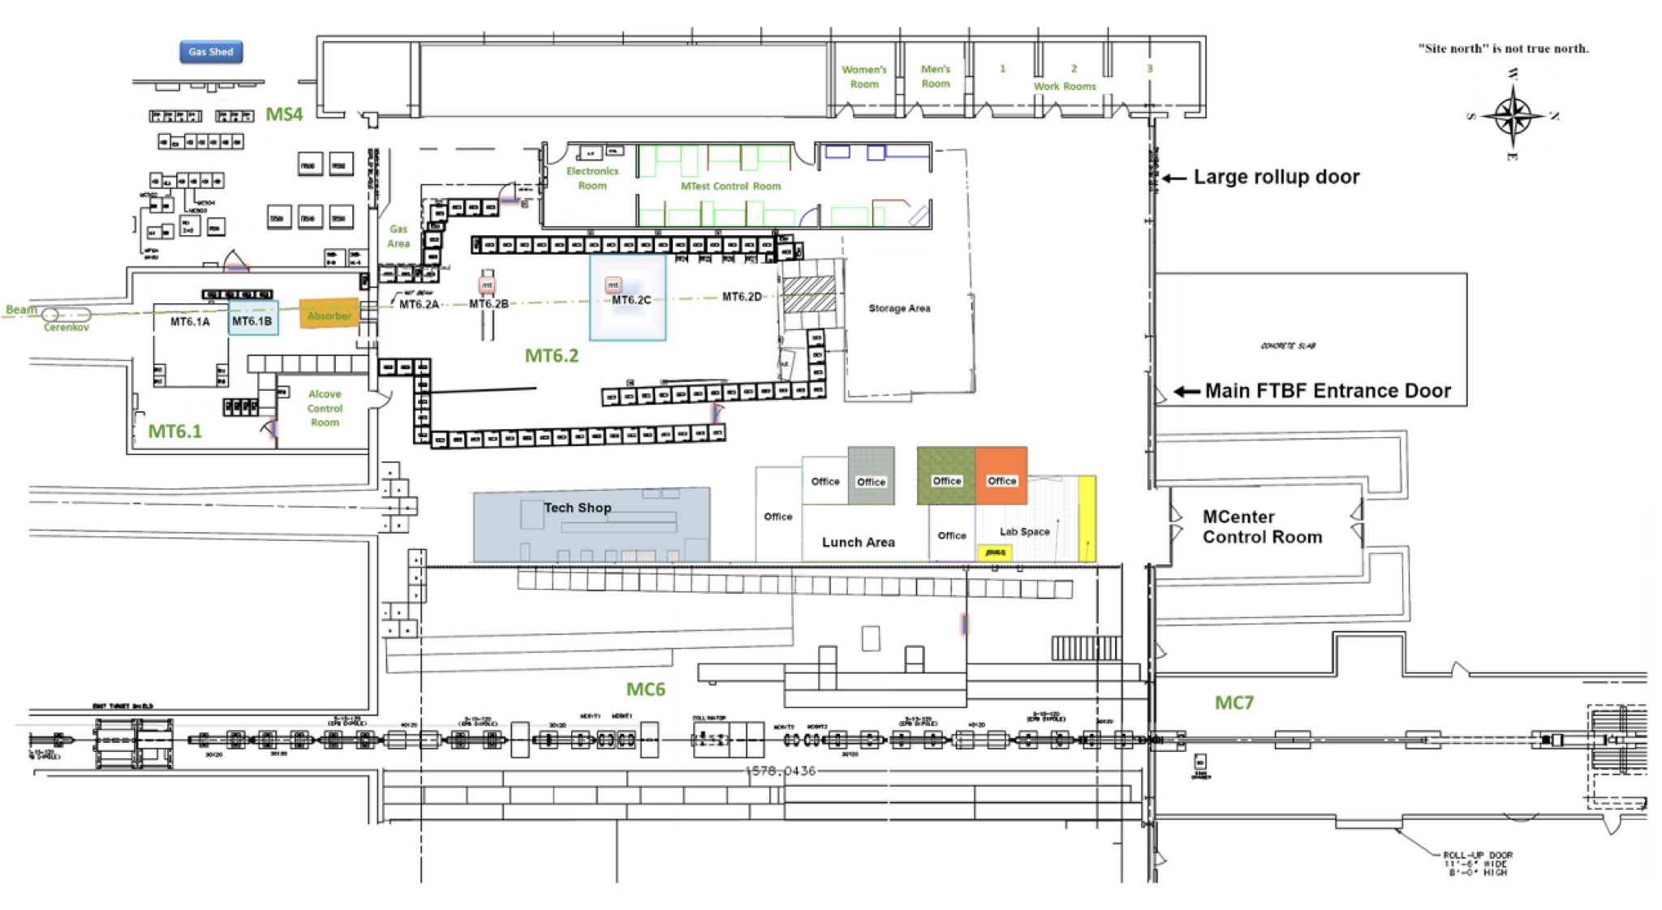
Meson Switchyard 120 Experimental Areas Overview
MTest: MT6 Section 1 and MT6 Section 2
  “Diffracted Proton Mode” 120 Gev Protons
  “High Energy Mode” 32 - 60 GeV secondary pion beam, as specified in shield assessment
  “Low Energy Pion Mode” 1 - 30 GeV secondary pion beam, as specified in shield assessment
  4.2 second spill once per 55 seconds with (O)10³ – (O)10⁶ particles per spill
  Experiments may be simultaneously staged in MT6 Section 1 and 2

Slide 7
Meson Switchyard 120 Experimental Areas Overview
MCenter: MC7 Section 1 and MC7 Section 2
  Secondary pion beam from 90 to 8 GeV, as specified in shield assessment
  4.2 second spill once per 55 seconds with (O)10¹⁰ or lower particles per spill
  Tertiary target available in MC7 Section 1 and MC7 Section 2 which may be placed in beam to produce lower energy particles in combination with analyzing magnet for momenta selection

Slide 8
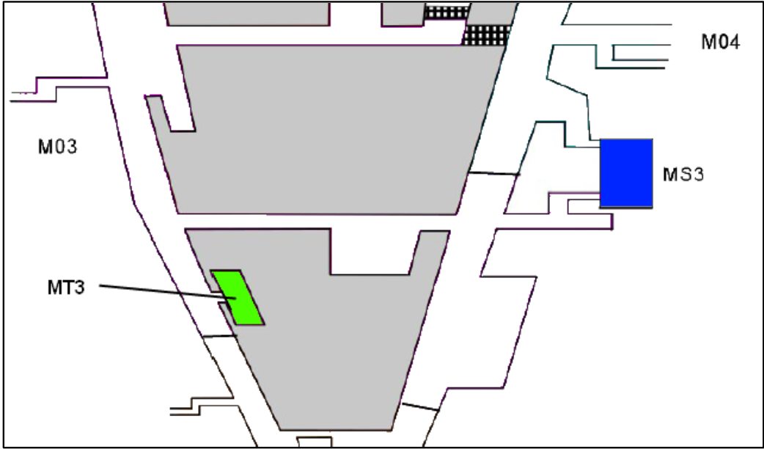
Meson Switchyard 120 Experimental Areas Overview
Location of M03 high rate tracking area in green
This is an air gap in the beam pipe with a motion table where an experiment may be placed
All credited controls and radiological hazards for this space are analyzed in III-13 for the Meson Area.

Slide 9
Meson Switchyard 120 Experimental Areas Overview
MT6 Section 1, MT6 Section 2, MC7 Section 1, and MC7 Section 2 enclosures have two access modes:
  Controlled
    Enclosures are secured for beam operations requiring keyed entry and radiological worker and controlled access training
  Open
    Interlocks may be dropped without radiological survey to put enclosure into an open state
    FTBF building surrounding enclosures is a posted controlled area with keycard entry
    Facility hazard awareness training and GERT required to enter building and enclosures in this state
    Radiological worker training required to remove impacted items from beam enclosures
    Radiological Control organization personnel required to survey impacted items for release from FTBF building
M03 high rate tracking area following RWPs and access procedures for Meson area.

Slide 10
Outline
Meson Switchyard 120 Experimental Areas Overview
Hazard Inventory
Non-Accelerator Specific Hazards
Accelerator Specific Hazards
Maximum Credible Incident (MCI) Discussion
Summary of Credited Controls
Summary of Defense in Depth Controls

Slide 11
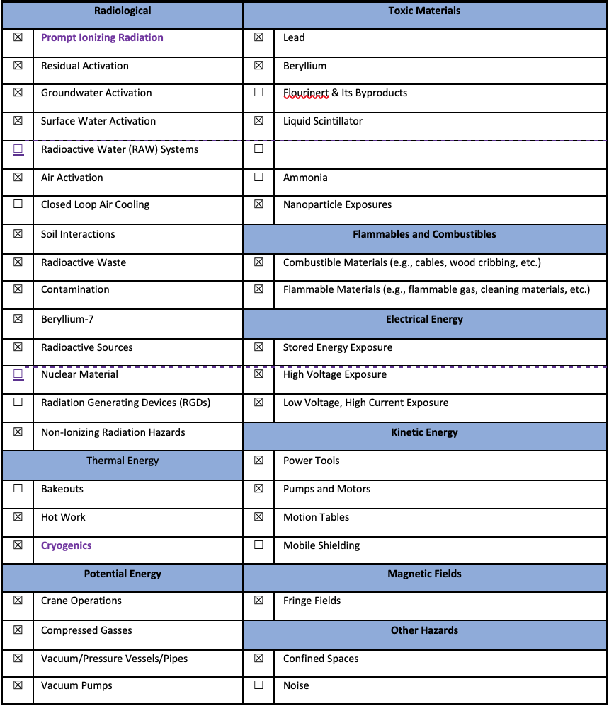
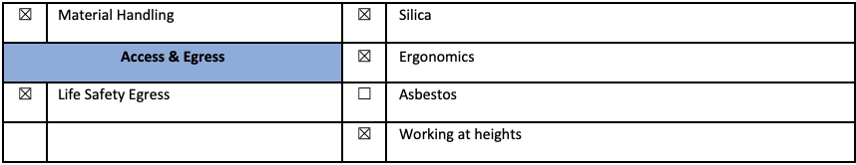
Hazard Inventory for Meson Switchyard 120 Experimental Areas
Accelerator specific hazards are purple
Hazards not discussed today are evaluated via the common Risk Matrix tables
  Covered in SAD Section I, Chapter 4
Hazards evaluated via risk assessment methodology per DOE-HDBK-1163-2020
  Likelihood (L):
    Anticipated (A), Unlikely (U), Extremely Unlikely (EU), Beyond Extremely Unlikely (BEU)
  Consequence (C):
    High (H), Moderate (M), Low (L), Negligible (N)
  Risk (R):
    I , II, III, IV (descending order of concern)

Slide 12
Hazard Inventory for Meson Switchyard 120 Experimental Areas
This segment contains a large variety of experiments which rotate through on 1-4 week timescales (MTest) or longer (MCenter)
While many experiments share similarities, the hazards do vary, not all hazards are present at one time
Each planned experiments submits a Technical Scope of Work (TSW)
  Describes the experiment and hazards months in advance of operations
  Screened by FTBF staff and SMEs
  Signed by division and directorate heads
  Ensures proposed experiment falls under the SAD/ASE.
Upon arrival each installed experiment goes through an Operational Readiness Clearance (ORC)
  Ensure safe operations and conformance with SAD/ASE before receiving beam
MCenter can see longer experiments (~1-3 year) which can require more significant changes to the beamline configuration or operations.
  These changes follow the USI process to modify shield assessments, SAD, and ASE as necessary.

Slide 13
Outline
Meson Switchyard 120 Experimental Areas Overview
Hazard Inventory
Non-Accelerator Specific Hazards
Accelerator Specific Hazards
Maximum Credible Incident (MCI) Discussion
Summary of Credited Controls
Summary of Defense in Depth Controls

Slide 14
Non-Accelerator Specific Hazards - Radiological
Residual Activation
  MTest and MCenter have never seen an experiment component activate to the class 1 level
    One piece of a lead calorimeter observed above background as class 0 since January 1, 2023.
  Hazard applies to onsite facility workers and onsite co-located workers
Baseline Qualitative Risk (without controls) | Controls Preventive (P)/Mitigative (M) | Residual Qualitative Risk (with controls)
L: A C: N R: IV | P – Training P – RWP as relevant M – Survey and classification of items leaving enclosure by radiological worker M– Survey of items by Radiological Control personnel following FRCM chapter 4 for unrestricted release M – Run Conditions | L: A C: N R: IV

Slide 15
Non-Accelerator Specific Hazards - Radiological
Radioactive Waste
  Radioactive waste produced during Main Injector operations will be managed within the established Radiological Protection Program (RPP) as prescribed in the Fermilab Radiological Control Manual (FRCM)
  Hazard applies to onsite facility workers and onsite co-located workers
Baseline Qualitative Risk (without controls) | Controls Preventive (P)/Mitigative (M) | Residual Qualitative Risk (with controls)
L: A C: N R: IV | P – Radiological worker training M – Any item in a beam enclosure during beam-on conditions is removed and surveyed by radiological workers and classified appropriately M – Any item identified for disposal is surveyed and processed by Radiological Control organization personnel in accordance with FRCM chapter 4 | L: U C: N R: IV

Slide 16
Non-Accelerator Specific Hazards - Radiological
Contamination
  Contamination has not been seen on experimental equipment from beam exposure in MT6 Section 1&2, MC7 Section 1&2
  Contaminated equipment could be brought to FTBF from another location (i.e. device irradiated in another beamline)
  M03 high rate tracking area could see Be7 contamination from beam in air gap
  Hazard applies to onsite facility workers and onsite co-located workers
Baseline Qualitative Risk (without controls) | Controls Preventive (P)/Mitigative (M) | Residual Qualitative Risk (with controls)
Item brought to FTBF L: A C: N R: IV Contamination at M03 L: A C: N R: IV | P – Radiological control prescreens items with contamination potential prior to acceptance. M – Radiological worker training M – RCT coverage and job specific RWP as determined by the RSO M – Contamination wipes to monitor space and equipment | L: U C: N R: IV L: A C: N R: IV

Slide 17
Non-Accelerator Specific Hazards - Radiological
Radioactive Sources
  Various low activity sealed sources (Sr-90, Co-60, CS-137, Fe-55, Ru-106, etc.) used by experiments
  Hazard applies to onsite facility workers and onsite co-located workers
Baseline Qualitative Risk (without controls) | Controls Preventive (P)/Mitigative (M) | Residual Qualitative Risk (with controls)
L: A C: N R: IV | P – All low activity sealed sources are kept in a lock box and registered through Radiological Control. P – Radiological and source training is required for source handling. | L: EU C: N R: IV

Slide 18
Non-Accelerator Specific Hazards – Kinetic Energy
Motion Tables
  A variety of motion tables available for use in experimental areas for equipment staging
  Hazard applies to onsite facility workers and onsite co-located workers
Baseline Qualitative Risk (without controls) | Controls Preventive (P)/Mitigative (M) | Residual Qualitative Risk (with controls)
L: A C: H R: I | P – Engineering notes/ORC procedure P – Safety stops P – Computer authorization for motion table controls P – Physical isolation of system (FTBF absorbers) M – Emergency stop as determined by SME M – Speed restrictions on motor | L: BEU C: L R: IV

Slide 19
Non-Accelerator Specific Hazards – Potential Energy
Compressed gases
  A wide variety of gases are brought by experiments through the TSW/ORC process
  Hazard applies to onsite facility workers and onsite co-located workers
Baseline Qualitative Risk (without controls) | Controls Preventive (P)/Mitigative (M) | Residual Qualitative Risk (with controls)
L: A C: H R: I | P – Engineering notes to evaluate ODH and piping P – TSW and/or ORC process P - Pressure Safety orientation training P - Compressed gas cylinder safety training P - All personnel have to be familiar with FESHM 5000 series and apply requirements. P - Gas cylinders are secured and capped when not in use. M - Personal Protective Equipment mitigates severity of injury | L: BEU C: M R: IV

Slide 20
Non-Accelerator Specific Hazards – Magnetic Fields
Fringe Fields
  Permanent and electromagnets
  Experiment may bring magnet through TSW/ORC process, analyzing magnets available in MC7
  Hazard applies to onsite facility workers and onsite co-located workers
Baseline Qualitative Risk (without controls) | Controls Preventive (P)/Mitigative (M) | Residual Qualitative Risk (with controls)
Exposure to fringe fields beyond allowable limits (worker with ferromagnetic or electronic medical device(s)) L: A C: H R: I Exposure to fringe fields beyond allowable limits (worker without ferromagnetic or electronic medical device(s)) L: A C: L R: III Exposure to flying metallic objects L: A C: M R: II | P- Industrial hygiene conducts field surveys to establish safe field boundaries for workers. P- Access control points and individual components of concern (e.g., experiment permanent magnet) have postings to notify workers of magnetic hazard. P – Facility specific hazard awareness training alerting to fringe fields P- Industrial hygiene conducts field surveys to establish safe field boundaries for workers. P- Access control points and individual components of concern (e.g., experiment permanent magnet) have postings to notify workers of magnetic hazard. P – Facility specific hazard awareness training alerting to fringe fields P- Brass tools are used to prevent flying metallic objects from occurring, thereby preventing worker injury as prescribed by relevant magnet SOP P-Work Control procedure/SOP (ferromagnetic object control) requires that all ferromagnetic objects are removed prior to entry into a fringe field area (30G administrative limit). P-Work Control procedure/SOP requires worker training while in areas possessing fringe fields (300 G administrative limit). | L: BEU C: H R: III L: BEU C: L R: IV L: BEU C: M R: IV

Slide 21
Outline
Meson Switchyard 120 Experimental Areas Overview
Hazard Inventory
Non-Accelerator Specific Hazards
Accelerator Specific Hazards
Maximum Credible Incident (MCI) Discussion
Summary of Credited Controls
Summary of Defense in Depth Controls

Slide 22
Accelerator Specific Hazards - Radiological
Prompt Ionizing Radiation – Beam Loss
  Ionizing radiation due to beam loss in the Meson Switchyard 120 Experimental Area spaces
  Analyzed maximum credible incident (MCI) to determine credited controls
  Hazard applies to onsite facility workers, onsite co-located workers
  Credited Controls are needed
Cryogenics – ODH
  MT6 Section 1, MT6 Section 2, MC7 Section 1, MC7 Section 2 are ODH 0 spaces
    Cryogenic liquids brought by an experiment evaluated through TSW and ORC process to ensure compliance with posting and oxygen level above 19.5%
    No credited controls required
  M03 high rate tracking area falls under ODH program for the Meson Area (III-13), no additional credited controls required for experiment operations

Slide 23
Outline
Meson Switchyard 120 Experimental Areas Overview
Hazard Inventory
Non-Accelerator Specific Hazards
Accelerator Specific Hazards
Maximum Credible Incident (MCI) Discussion
Summary of Credited Controls
Summary of Defense in Depth Controls

Slide 24
Maximum Credible Incident (MCI) – Radiological
Although the experiments are installed in the Meson beamline areas, the experiments themselves do not affect the Maximum Credible Incident (MCI) as presented in Section III Chapter 13 for the Meson Area beamlines. The MCI for the experimental area is covered by the MCI analysis for the beamlines which pass through the experimental enclosures. The Meson area experiments do not require any additional credited controls.
New experiments for the Meson Switchyard 120 Experimental Areas are proposed through a Technical Scope of Work (TSW). If an experiment introduces new hazards or requires changes to beamline configuration or operations, the USI screening process would evaluate any necessary changes to shielding assessments, the SAD chapter, or ASE for III-13 or IV-03.

Slide 25
Outline
Meson Switchyard 120 Experimental Areas Overview
Hazard Inventory
Non-Accelerator Specific Hazards
Accelerator Specific Hazards
Maximum Credible Incident (MCI) Discussion
Summary of Credited Controls
Summary of Defense in Depth Controls

Slide 26
Credited Controls – Radiological
All credited controls are presented in Section III Chapter 13 for the Meson Area beamlines including the experimental spaces. The experiments require no additional credited controls.

Slide 27
Outline
Main Injector Overview
Hazard Inventory
Non-Accelerator Specific Hazards
Accelerator Specific Hazards
Maximum Credible Incident (MCI) Discussion
Summary of Credited Controls
Summary of Defense in Depth Controls

Slide 28
Defense in Depth Controls
Training
  Radiological worker and controlled access training
  FTBF Hazard Awareness training for all work inside facility
Administrative
  TSW and ORC process to review and approve experiment operations

Slide 29
Summary
Meson Switchyard 120 Experimental Areas Overview
Hazard Inventory
Non-Accelerator Specific Hazards
Accelerator Specific Hazards
Maximum Credible Incident (MCI) Discussion
Summary of Credited Controls
Summary of Defense in Depth Controls

Slide 30
Thank you for your attention

Slide 31
Outline
Meson Switchyard 120 Experimental Areas Overview
Hazard Inventory
Non-Accelerator Specific Hazards
Accelerator Specific Hazards
Maximum Credible Incident (MCI) Discussion
Summary of Credited Controls
Summary of Defense in Depth Controls
Backup Slide(s)

