Slide 1
Safety Assessment Document Updates for DOE O 420.2D
SAD Section III Chapter 14 – Neutrino Area
Sue McGimpsey
Neutrino Area Internal Readiness Review
24 January 2024

Slide 2
Outline
Switchyard Fixed Target Overview
Neutrino Area Overview
Neutrino Muon Beam Line Overview
Hazard Inventory for Neutrino Area
Non-Accelerator Specific Hazards
Accelerator Specific Hazards
Maximum Credible Incident (MCI) Discussion
Summary of Credited Controls
Summary of Defense in Depth Controls

Slide 3
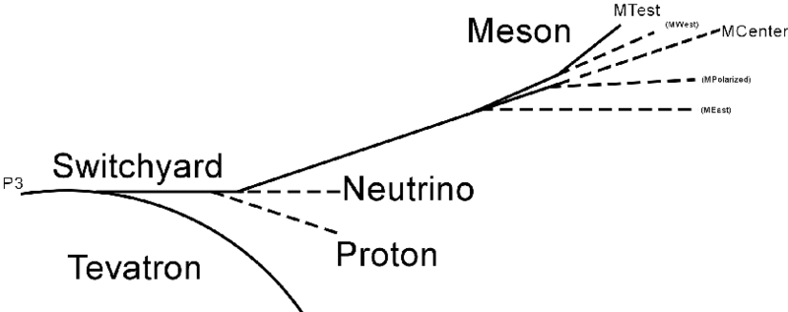
Switchyard Fixed Target Overview

Slide 4
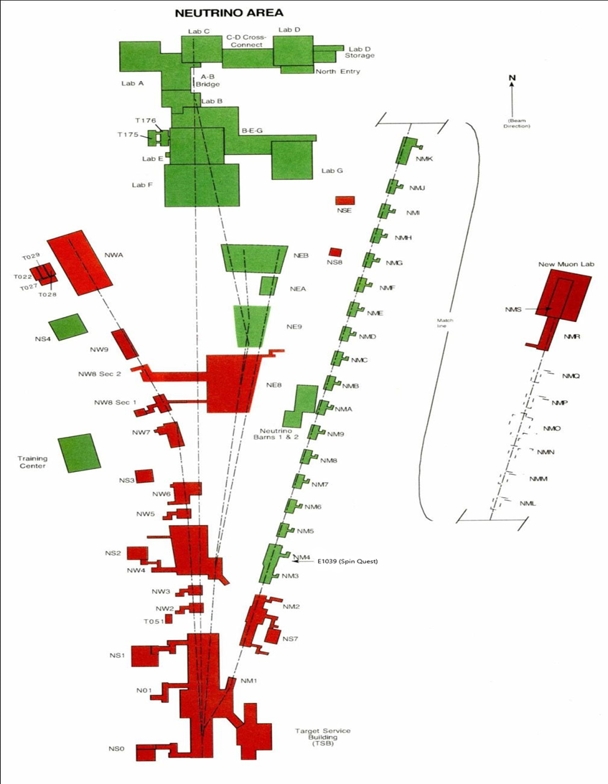
Neutrino Area Overview

Slide 5
Neutrino Muon Beam Line Overview
Switchyard receives 120 GeV beam from the Main Injector during a “slow spill” which is approximately 4.2 seconds in duration.
Beam split between Meson Area and SY absorber occurs at the electrostatic septa in Enclosure B
From Switchyard Enclosure C beam can be sent to the Meson Area and SY absorber.
When V100 is energized, beam is bent vertically down and away from the SY absorber and into the NM beam line.

Slide 6
Neutrino Muon Beam Line Overview
The NM physical beam line extends from Enclosure C (G1 Stub), through G2, N01/NM, NM2 and terminates in NM3
The Neutrino Muon beam travels through Enclosure C (G1 Stub), G2, N01/NM1, NM2, NM3 and NM4 (FMAG) enclosures
The “SpinQuest” experimental area resides in NM4
The boundaries for this SAD are N01 through NM4 (FMAG)

Slide 7
Hazard Inventory for Neutrino Area
Accelerator specific hazards are purple
Hazards not discussed today are evaluated via the common Risk Matrix tables
  Covered in SAD Section I, Chapter 4
Hazards evaluated via risk assessment methodology per DOE-HDBK-1163-2020
  Likelihood (L):
    Anticipated (A), Unlikely (U), Extremely Unlikely (EU), Beyond Extremely Unlikely (BEU)
  Consequence (C):
    High (H), Moderate (M), Low (L), Negligible (N)
  Risk (R):
    I , II, III, IV (descending order of concern)

Slide 8
Non-Accelerator Specific Hazards - Radiological
Residual Activation
  High intensity beam delivery can produce activated materials inside the Neutrino Muon beam enclosure due to beam loss
  The residual dose rate found in the NM from initial entry surveys is historically less than 10 mrem/hr
  Hazard applies to onsite facility workers and onsite co-located workers
Baseline Qualitative Risk (without controls) | Controls Preventive (P)/Mitigative (M) | Residual Qualitative Risk (with controls)
L: A C: H R: I | P – Radiological Work Permit P – Radiological Posting P – Use of an LSM; Beam Loss Monitoring P – Radiological Training M – Radiological Posting and Decay Time Requirements M – Radiological Shielding M – Run Conditions | L: BEU C: N R: IV

Slide 9
Non-Accelerator Specific Hazards - Radiological
Ground/Surface Water Activation
  High intensity beam delivery can interact with soil and leach into ground water
  Cooling water systems such as low conductivity water interact with activated beam line components
  The radioisotopes of concern for leaching are tritium and Na-22
  Hazard applies to onsite facility workers and onsite co-located workers
Baseline Qualitative Risk (without controls) | Controls Preventive (P)/Mitigative (M) | Residual Qualitative Risk (with controls)
L: A C: H R: I | P – Sump/Water Monitoring Systems P – Sump Pumps P – Beam Loss Monitoring M – Machine Protection System M – Run Conditions | L: BEU C: L R: IV

Slide 10
Non-Accelerator Specific Hazards - Radiological
Radioactive Water (RAW) system
  The primary beam absorber (FMAG) is cooled with water which becomes activated. As documented in the shielding assessment this system has been designated as a RAW system
  The system is self contained and part of the RSIS
  Hazard applies to onsite facility workers and onsite co-located workers
Baseline Qualitative Risk (without controls) | Controls Preventive (P)/Mitigative (M) | Residual Qualitative Risk (with controls)
L: A C: H R: I | P – Interlocked Gates P – Interlocked Key P – Key Control Program P – Radiological Postings P – Radiological Training M – Engineered Containment | L: BEU C: M R: IV

Slide 11
Non-Accelerator Specific Hazards - Radiological
Soil Interactions
  Radionuclides are produced which may contaminate ground water
  Can occur in areas of high chronic losses
  Hazard applies to onsite facility workers and onsite co-located workers
Baseline Qualitative Risk (without controls) | Controls Preventive (P)/Mitigative (M) | Residual Qualitative Risk (with controls)
L: A C: N R: IV | P – Beam Loss Monitoring M – Engineered Beam Dump M – Beamline Design M – Run Conditions | L: U C: N R: IV

Slide 12
Non-Accelerator Specific Hazards - Radiological
Radioactive Waste
  Radioactive waste produced during Neutrino Muon operations will be managed within the established Radiological Protection Program (RPP) as prescribed in the Fermilab Radiological Control Manual (FRCM)
  Hazard applies to onsite facility workers and onsite co-located workers
Baseline Qualitative Risk (without controls) | Controls Preventive (P)/Mitigative (M) | Residual Qualitative Risk (with controls)
L: A C: H R: I | P – Locked Gates P – Key Control Program P – Postings M – Run Conditions M – Distance to Stored Material | L:BEU C: L R: IV

Slide 13
Non-Accelerator Specific Hazards - Radiological
Air Activation
  Air activation can occur at any area in the accelerator where beam losses occur
  The radioisotopes of concern are C-11, O-15, N-13 and Ar-41
  Hazard applies to onsite facility workers and onsite co-located workers
Baseline Qualitative Risk (without controls) | Controls Preventive (P)/Mitigative (M) | Residual Qualitative Risk (with controls)
L: A C: H R: I | P – Air Monitoring P – RSIS P – Beam loss Monitoring M – Engineered Flow and Imposed Cool Off Times M – Run Conditions | L: BEU C: L R: IV

Slide 14
Non-Accelerator Specific Hazards - Radiological
Contamination
  Contamination can be found in the Neutrino Muon enclosures in areas where beam loss has occurred
  Hazard applies to onsite facility workers and onsite co-located workers
Baseline Qualitative Risk (without controls) | Controls Preventive (P)/Mitigative (M) | Residual Qualitative Risk (with controls)
L: A C: H R: I | P – Locked Gates P – Key Control Program P – Radiological Posting M – Radiological Work Permit M – Training M – Run Condition | L: BEU C: N R: IV

Slide 15
Non-Accelerator Specific Hazards - Radiological
Radioactive Sources
  Not encountered throughout the beam line
  Could be needed as part of an experimental set-up
  Hazard applies to onsite facility workers and onsite co-located workers
Baseline Qualitative Risk (without controls) | Controls Preventive (P)/Mitigative (M) | Residual Qualitative Risk (with controls)
L: A C: H R: I | P – Radiological Posting P – Radiological Training P – Kept in locked cabinet when not in use M- Kept is storge when not in the field M – Shielded containers | L: BEU C: L R: IV

Slide 16
Accelerator Specific Hazards - Radiological
Prompt Ionizing Radiation – Beam Loss
  Ionizing radiation due to beam loss in the Neutrino Muon enclosures
  Analyzed maximum credible incident (MCI) to determine credited controls
  Hazard applies to onsite facility workers, onsite co-located workers, and the maximally exposed off site individual (MOI)
CREDITED CONTROLS ARE NEEDED

Slide 17
Maximum Credible Incident (MCI) – Radiological
The MCI is defined as an event that is expected to occur over the lifetime of the beam line
The MCI focuses on exposure to an onsite worker, an onsite coworker and the maximally exposed off-site individual (MOI)
Incident bounds all postulated accident scenarios for the NM beam line
The Neutrino Area is located beyond the public access area and contains no areas where the public is invited
Fermilab uses Credited Controls that flow down to the Accelerator Safety Envelope (ASE) to mitigate the consequences of an MCI to the following conditions:
  Less than 5 rem in one hour in any area accessible by facility workers or co-located workers
  Less than 500 mrem in one hour in all Laboratory areas to which the public is assumed to be excluded
  Less than 100 mrem in one hour at Fermilab’s site boundary and/or in any areas onsite in which the public is authorized (which includes Batavia Road, Prairie Path, parking lots open to the public, and general access areas including Wilson Hall, Ramsey Auditorium)

Slide 18
Maximum Credible Incident (MCI) - Radiological
The MCI would be one where the full SY intensity is lost and continuously incident on a magnet or beam pipe
Highest radiation losses are generated by accidents at locations with reduced passive shielding
This NM MCI beam intensity is the same as the SY MCI beam intensity
This has been determined to be 2.8E15 protons/hr or 4.2E13 protons/pulse
120 GeV beam energy
55s cycle time

Slide 19
Summary of Credited Controls – Passive
Permanent shielding
  To protect against the MCI, the NM enclosures are constructed as a permanent concrete and earth covered shield
  This permanent shielding extends the entire length of the NM beam line
  Beam can be lost by beam hitting a magnet, beam hitting the beam pipe in the enclosure or beam hitting buried beam pipe
  13.9 effective feet of dirt (efd), 11.4 efd and 16.3 efd respectively, is required to limit the dose to less than 500 mrem in one hour for the MCI

Slide 20
Credited Controls – Passive
Permanent shielding
  Only one area on the NM3 berm lacks sufficient shielding
  All other areas have more than the required amount of shielding this shielding is a credited control
  In the area (NM3 berm at Z=4353 - 4368) without the amount of required shielding, the existing shielding (minus 0.5 ft) is a credited control along with active controls

Slide 21
Interlocked Detector – Credited Controls
Longitudinal Range | Location | Category | Curr. shielding | Req. Shielding
Z (ft) |  |  | efd | efd
4353-4357 | NM3 collimator | 4A | 17.5 | 13.9
4357-4360 | NM3 | 4B | 11.4 | 11.4
4360-4368 | Target Cave | 4A | 11.7 | 13.9
4368-4373 | Target Wall | 4A | 29.9 | 13.9
4373-4374 | Pre-FMAG | 4A | 31.4 | 13.9
4374-4378 | FMAG US | 4C | 31 | 16.3
4378-4381 | FMAG US | 4C | 28.8 | 16.3
4382-4388 | FMAG DS | 4C | 26 | 16.3
4388-4389 | FMAG DS | 4C | 22.4 | 16.3
4389-4390 | FMAG DS | 4C | 28.5 | 16.3
NM3 Berm Chipmunk Location – Credited Control. Transverse locations also protected

Slide 22
Interlocked Detector – Credited Controls
Transverse Location | Location | Category | Curr. Shielding | Req. Shielding | Interlocked detector
(ft) |  |  | efd | efd | Needed
4354-W | NM3 Collimator | 4A | 17.5 | 13.9 | Y – NM3 Berm
4354-E | NM3 Collimator | 8A | 17.5 | 4.7 | Y – NM3 Berm
4357-W | NM3 | 8B | 16.9 | 3.0 | Y – NM3 Berm
4357-E | NM3 | 8B | 16.9 | 3.0 | Y – NM3 Berm
4360-W | Target Cave | 9A | 4.0 | 3.0 | Y – NM3 Berm
4360-E(dn) | Target Cave | 4A | 19.8 | 13.9 | Y – NM3 Berm
4360-E(up) | Target Cave | 8A | 5.0 | 4.7 | Y – NM3 Berm
4361-W | Target Cave | 8A | 8.4 | 4.7 | Y – NM3 Berm
4361-E(dn) | Target Cave | 4A | 23.6 | 13.9 | Y – NM3 Berm
4361-E(up) | Target Cave | 8A | 11.4 | 4.7 | Y – NM3 Berm
4364-W | Cryo Line | 8A | 11.0 | 4.7 | Y – NM3 Berm
4364-E(dn) | Cryo Line | 4A | 23.6 | 13.9 | Y – NM3 Berm
4364-E(up) | Cryo Line | 8A | 11.4 | 4.7 | Y – NM3 Berm
4367-W | Target Cave | 8A | 6.7 | 4.7 | Y – NM3 Berm
4367-E(dn) | Target Cave | 4A | 32.6 | 13.9 | Y – NM3 Berm
4367-E(up) | Target Cave | 8A | 11.4 | 4.7 | Y – NM3 Berm
4368-W | Target Cave | 8A | 18.5 | 4.7 | Y – NM3 Berm
4368-E(dn) | Target Cave | 8A | 33.5 | 4.7 | Y – NM3 Berm
4368-E(up) | Target Cave | 8A | 20.3 | 4.7 | Y – NM3 Berm
4370-W | Target Wall | 8A | 22.9 | 4.7 | Y – NM3 Berm

Slide 23
Interlocked Detector – Credited Controls
Transverse Location | Location | Category | Curr. Shielding | Req. Shielding | Interlocked detector Needed?
4370-E(dn) | Target Wall | 4A | 32.8 | 13.9 | N
4370-E(up) | Target Wall | 4A | 20.5 | 13.9 | N
4373-W | Pre-FMAG | 8C | 25.9 | 7.0 | N
4373-E(dn) | Pre-FMAG | 4C | 29.4 | 16.3 | N
4373-E(up) | Pre-FMAG | 4C | 24.3 | 16.3 | N
4376-W | FMAG Face | 4C | 31.0 | 16.3 | N
4376-E(dn) | FMAG Face | 4C | 37.4 | 16.3 | N
4376-E(up) | FMAG Face | 4C | 31.0 | 16.3 | N
4378-W | FMAG | 4C | 28.8 | 16.3 | N
4378-E(dn) | FMAG | 4C | 39.9 | 16.3 | N
4378-E(up) | FMAG | 4C | 28.8 | 16.3 | N
4380-W | FMAG | 4C | 26.0 | 16.3 | N
4380-E(dn) | FMAG | 4C | 39.9 | 16.3 | N
4380-E(up) | FMAG | 4C | 26.0 | 16.3 | N
4382-W | FMAG | 4C | 26.0 | 16.3 | N
4382-E(dn) | FMAG | 4C | 33.9 | 16.3 | N
4382-E(up) | FMAG | 4C | 26.0 | 16.3 | N
4388-W | FMAG | 4C | 22.4 | 16.3 | N
4388-E(dn) | FMAG | 4C | 37.7 | 16.3 | N
4388-E(up) | FMAG | 4C | 22.4 | 16.3 | N
4389-W | FMAG | 4C | 26.1 | 16.3 | N
4389-E(dn) | FMAG | 4C | 37.0 | 16.3 | N
4389-E(up) | FMAG | 4C | 26.1 | 16.3 | N

Slide 24
Credited Control Device Parameters
Credited Control Device | Longitudinal and Transverse Protected Location | Location | Credited Control Trip Limit to protect against the MCI (mrem/hour)
Chipmunk | 4353 - 4368 | NM3 Berm | < 500

Slide 25
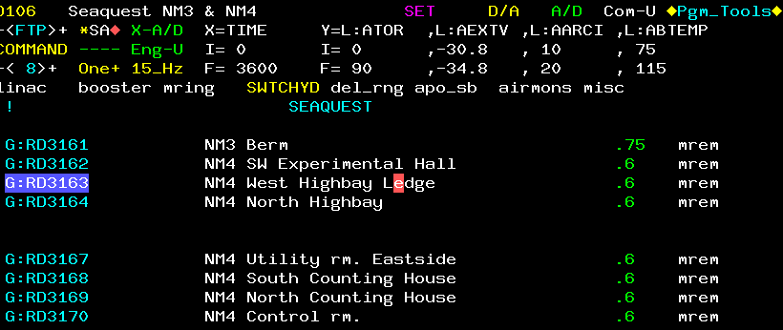
Credited Control – NM3 Interlocked Detector Only

Slide 26
Credited Controls – Radiological
Movable and penetration Shielding
  The “Target Station” which includes the area around the target cave and primary beam absorber is surrounded by steel and concrete
  All shielding is a credited control and is labeled accordingly
  The weight of the steel and concrete ranges from 10,000 lbs to 26,000 lbs and can only be moved with the NM4 crane
  The NM4 crane AC power disconnect switch is locked out and configuration controlled by the assigned RSO
  All moveable shielding is managed by the Radiation Physics Operations Dept. and utilizes a configuration management control system to ensure all required shielding is in place before transporting beam
  No penetrations were identified as exceeding the allowed dose limits.

Slide 27
Credited Controls – Active Engineering
Radiation Safety Interlock System (RSIS)
  Inhibits beam by controlled redundant critical devices
  Enforces the search and secure process
  Interlocked doors are present at all access points into the NM enclosures
  The ES&H Radiation Physics Engineering Dept. (RPE) ensures that all requirements for hardware and system testing are completed semi-annually with a four-month grace period
  RPE also verifies the inventory of interlock keys and updates procedures for maintenance and testing of interlock systems
  All RSIS are designed, installed and configuration managed in conformance with the requirements of the Fermilab Radiological Control Manual (FRCM)

Slide 28
Credited Controls – Active Engineering
Interlocked Radiation Detectors
  All interlocked detectors are part of standard RSIS used throughout Fermilab and are calibrated on an annual basis
  For areas that do not have the required amount of permanent shielding these detectors can be used to provide the same level of protection to an individual outside of the shielding
  Only one location on the NM3 berm requires the use of an interlocked radiation detector to protect against the MCI and is a credited control

Slide 29
Credited Controls - Administrative
Credited Control: Operation Authorization Document
  Machine Beam Permit
  Machine Run Condition
  Beam will not be transported through the Neutrino Muon beam line without approval of these documents
Credited Control: Staffing
  Ensures operations within bounding conditions specified in Operation Authorization Document
  The following staffing shall be in place during applicable beam operation:
    At least one member of the AD Operations Department who has achieved the rank of Operator II or higher shall be on duty and on site.
    At least one member of the AD Operations Department shall be present in the Main Control Room (MCR).
    Note: these requirements could be satisfied by a single person
Credited Control: Accelerator Operating Parameters
  The MCI intensity of 2.8E15 protons/hr shall not be exceeded

Slide 30
Defense in Depth Controls
Fermilab employs additional Defense in Depth (DD) controls to further reduce the possibility of an individual receiving a radiation exposure during an MCI
  Fencing and Posting
    The NM shielding assessment concluded that the NM berm is to be fenced off and posted as a Radiation Area
  Training
    Personnel accessing the NM berm and enclosure must have Radiological Worker Training and Fermilab Controlled Access Training
Additional interlocked detectors in NM4 for compliance with 10CFR835 and ALARA program

Slide 31
Thank you for your attention

