Slide 1
Project Activities for MSD
Mayling Wong-Squires
AD Operations Friday 9am Meeting
12 January 2024

Slide 2
LBNF LCW System Update Dave Hixson, Scott Oplt, Will Derylo
Preparing for CD-2 review
Going over LCW and bus Basis of Estimates (BOEs)
Going over LCW Project Design Report
Design engineering and drafting continue in all areas
Primary Water System and Bus: Flow Model​ and CAD model (mostly complete)
LBNF-05 Power Supply Room​, Pump Room, and the Primary Beam Line (PBE): CAD models in progress
LBNF-05 and PBE LCW and Bus: Flow Schematics in progress

Slide 3
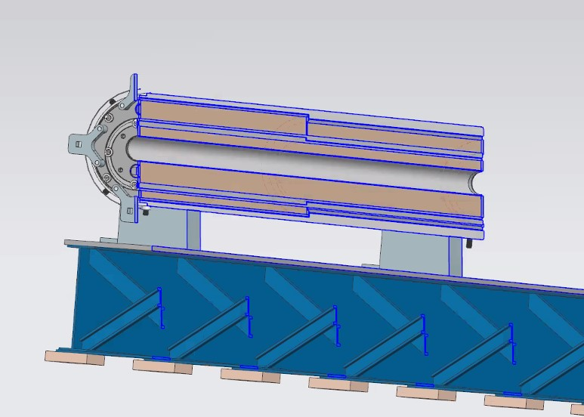
LBNF Primary Window Cartridge Update Christine Ader, Greg Bulat, CAD Group
Current
All the drawings have been TC approved and are with our fabrication specialist.
He believes the bid process will be 3-4 weeks because of the complexity of the job.
The engineering note for the assembly has been reviewed and should be approved soon.
The installation plan and the analysis of the beam vacuum window is also being working on.
Next Steps
Testing of the rotation of the cartridge will occur at A0 with the help of the External Beamlines techs. The area of work there will have to be determined.

Slide 4
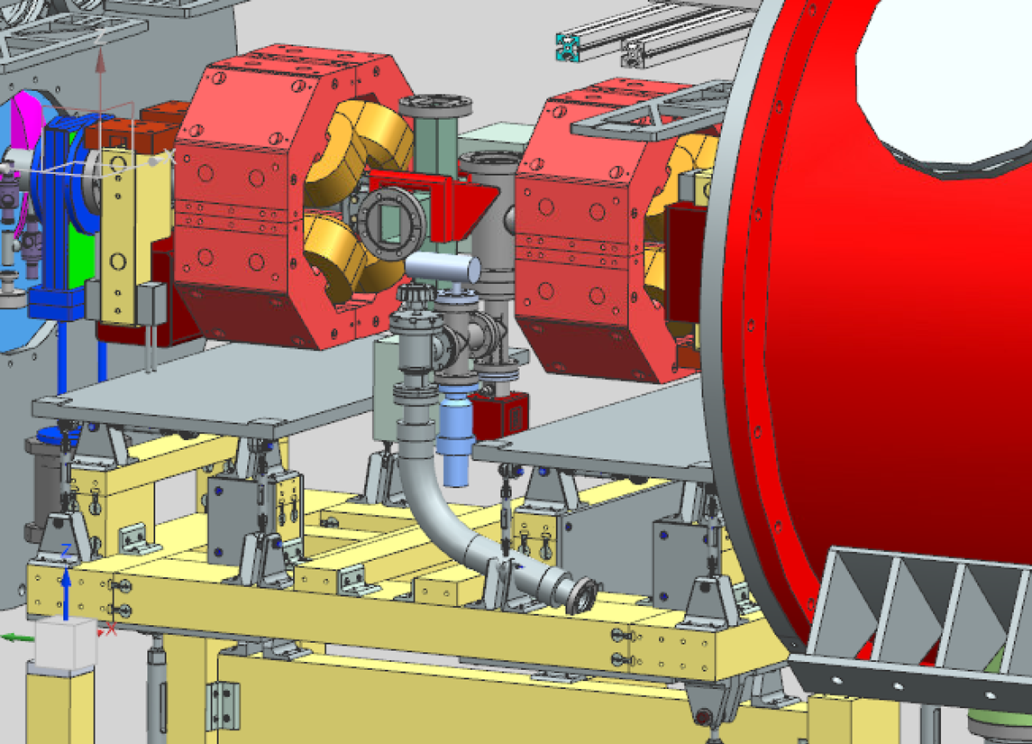
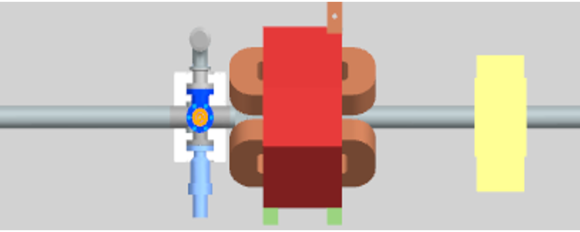
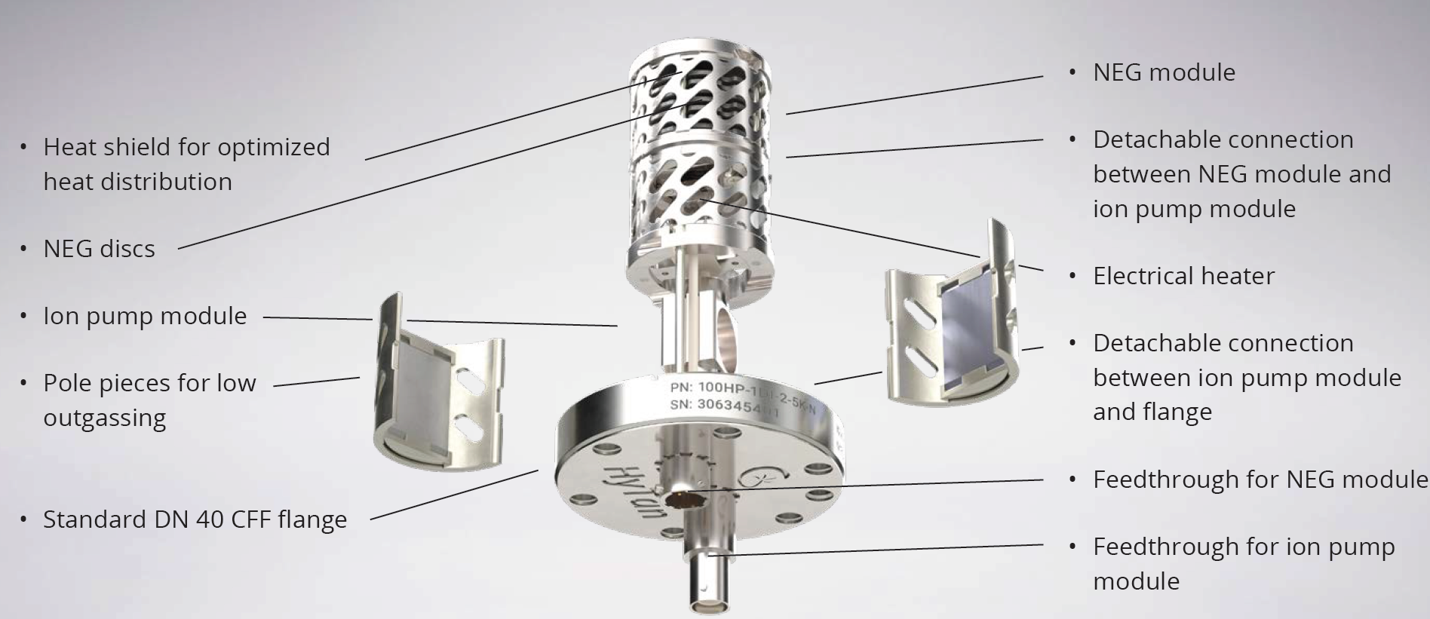
PIP-II Vacuum Systems Updates Raul Campos (L3/CAM), Lucy Nobrega* (Deputy L3), Alex Chen, Rich Andrews, Eric Pirtle, Dirk Hurd
Completed
Design Change Request for combination NEG/IP to replace ion pumps in Superconducting Linac (SCL) – awaiting approvals and possible new SAES mini pump competitor, Gamma (new Hy-Tan line released autumn 2023)
Working on
Procuring Warm Front End vacuum equipment
Finalizing design for Beam Transfer Line and Beam Absorber line
Detail BTL/BAL Vacuum CAD model and magnets interspaces configurations with input from stakeholders: MagPS, BI, BTL/BAL Installation
Vacuum chamber design for dipole magnets (quantity 40) in coordination with MagPS
Final design of interfaces with Beam Instrumentation devices, Booster vacuum, Beam Absorber Line
Validation of equipment selection with vacuum pressure and structural simulations
Addressing review recommendations
Updating documentation
Coming up
Integrated Vacuum Systems FDR – February 2024
Director’s Review – February 2024
Department resources needed
Engineering (review vacuum analysis document)
Fabrication Procurement (BTL dipole & septum chambers)
Design/Drafting (BTL design & integration)
Typical SCL warm unit with combination pump
Typical BTL beamtube section with Vacuum pump and gauges
Gamma Hy-Tan combination NEG/ion pump

