Slide 1
Main Injector Shutdown Status
M. Murphy/ D. Morris
09:00 Scheduling Meeting
January 12th, 2024

Slide 2
Tunnel Work
RF group repaired MI RF10 PA leak
Finishing dressing cables for dual PA upgrade
New transformer for the MI Test Cave anode has arrived
MSD/water techs & RCT accessed the Absorber and addressed a
low head pressure alarm on the RAW system.
MSD removed waste from the MVA with assistance from ESH
Working to get the Recycler 620 sextupole cable pull completed next week
External Beams is working with APS-TD to get repairs made to E:Q110
LCW leak identified on ceramic-Cu interface on LAM61-B
APS-TD will fix both in place.
MI 8 GeV BV825 jumper cable needs repairing; will be addressed next week.
Instrumentation accessed MI-10 to check on signal cable connections.
2
MI Department Meeting | D. Morris
1/12/24

Slide 3
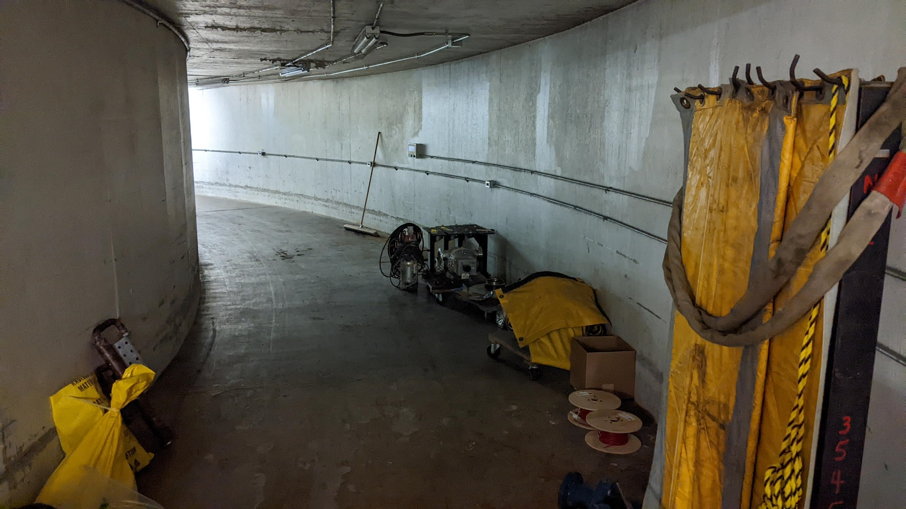
Tunnel Work
3
MI Department Meeting | D. Morris
1/12/24

Slide 4
Other Stuff
PESD requests one week of running a 1.067 second MI ramp to verify their
fixes and diagnostics are working and to locate any other issues out there.
Attempts to start the ramp on Thursday evening were unsuccessful; MI30U PS bypass loop issues holding off ramp.
RF needs to condition the two MI cavities with reworked water paths and
commission MI RF4 with the dual PA upgrade.
8-GeV & MI SAD/ASE IRR was completed with successful results. We are awaiting IRR committee’s final report.
4
MI Department Meeting | D. Morris
1/12/24

