Slide 1
Muon Campus Operation Report
Jerry Annala
Friday 09:00 Operation Meeting
January 12, 2024

Slide 2
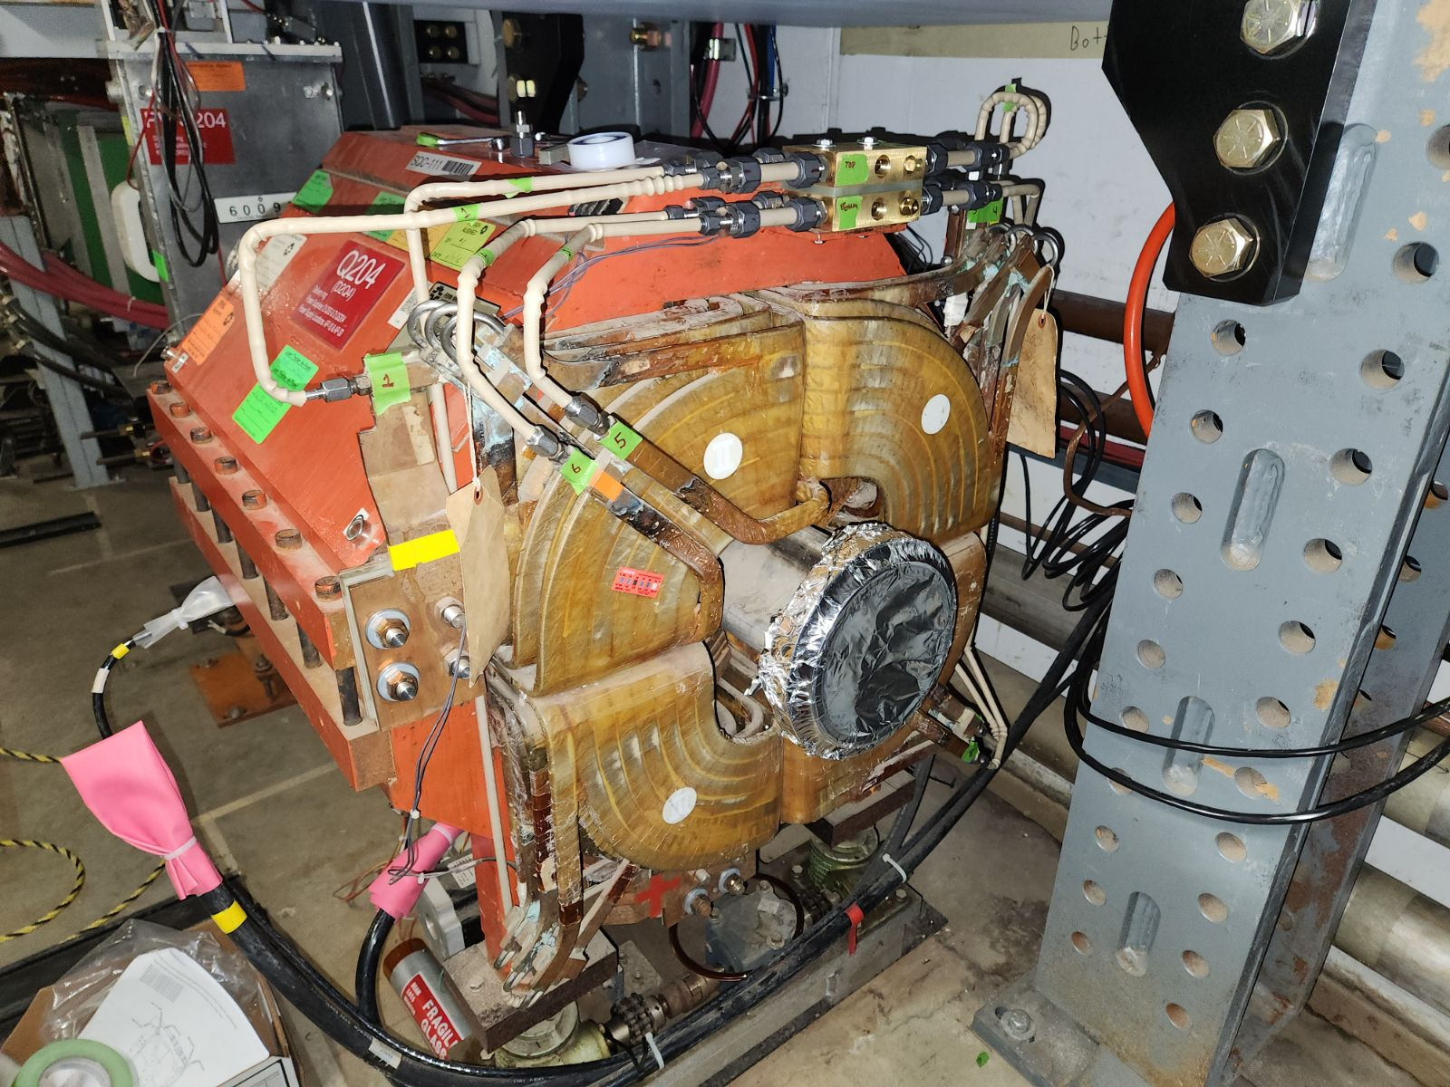
Quad water manifold upgrade (rad hard)
3 out of 4 small quads have manifolds replaced
4th magnet is special and requires a different modification

Slide 3
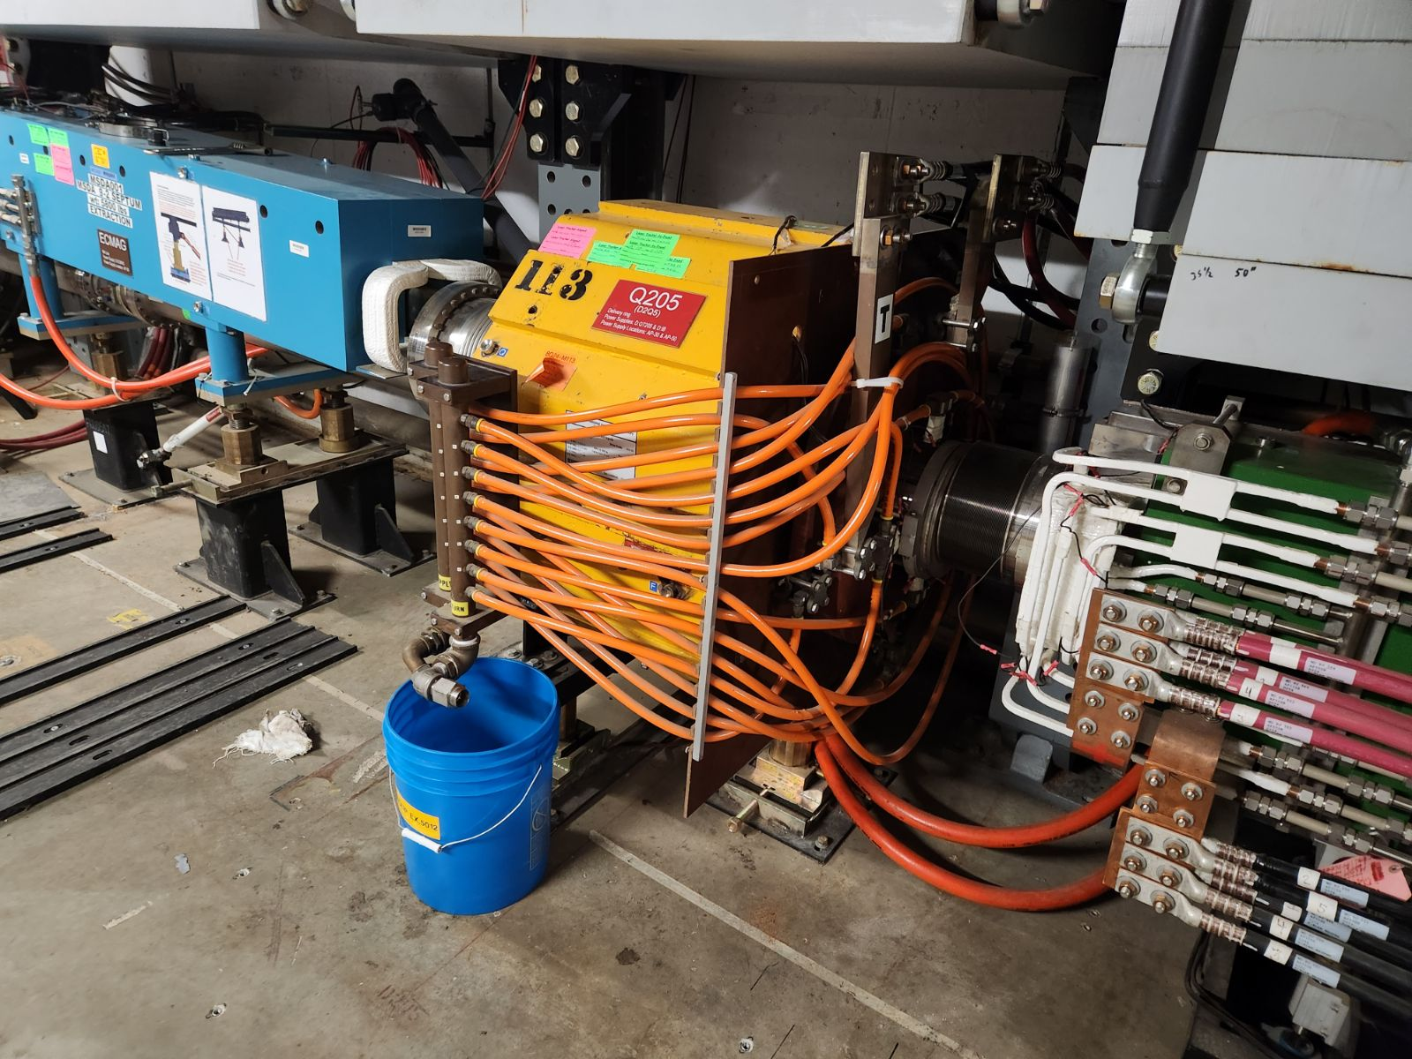
Q205 will be replaced
Q205 modification is more extensive so we will replace the magnet (modified at TD)

Slide 4
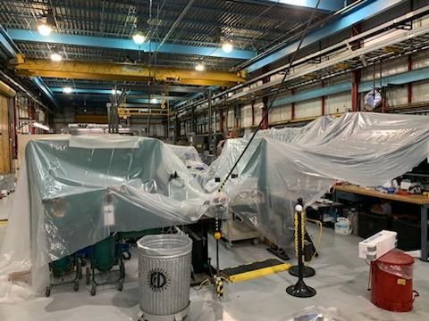
NWA status
Building is functional and repair can take place while work goes on in the building

Slide 5
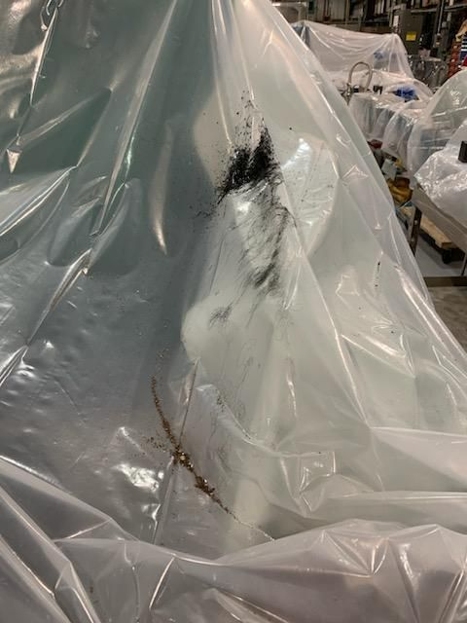
NWA Status
Clean up to building will be extensive.
Preparing clean room will take some time.
Not wise to open septum in the building.
Septa now at A0.
Plan to open up septum next week.

Slide 6
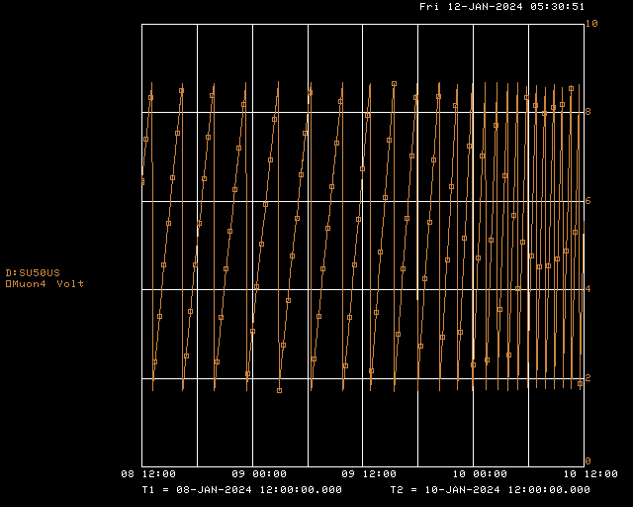
AP50 Sump Activity
AP50 sump activity increase and ceiling leak returned.
This time it was coincident with precipitation.

Slide 7
Future work
Next week
Open ESS1 and begin repair
Complete AP30 quad water manifold modifications
Following week
IRR3 – Muon Campus SAD/ASE review
Remaining to be scheduled
Q205 replacement
One critical beam tube component still needs modification in the machine shop.
Waiting for this modification before opening the hatch

