Slide 1
Findings in MQXFA05 VT analysis
V. Marinozzi
06-23-2022

Slide 2
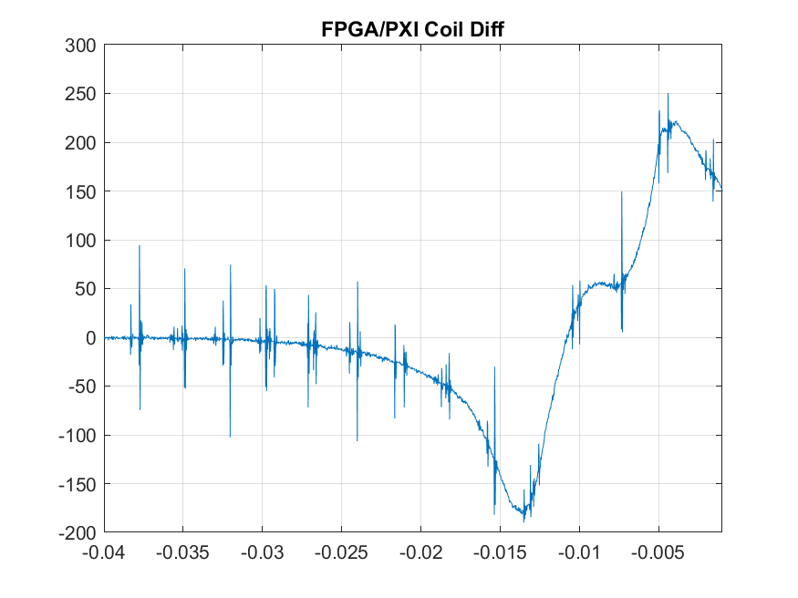
Signal found in magnet resistive voltage

Slide 3
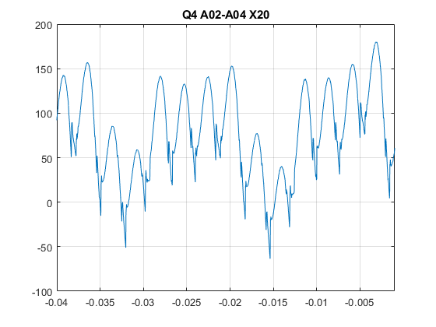
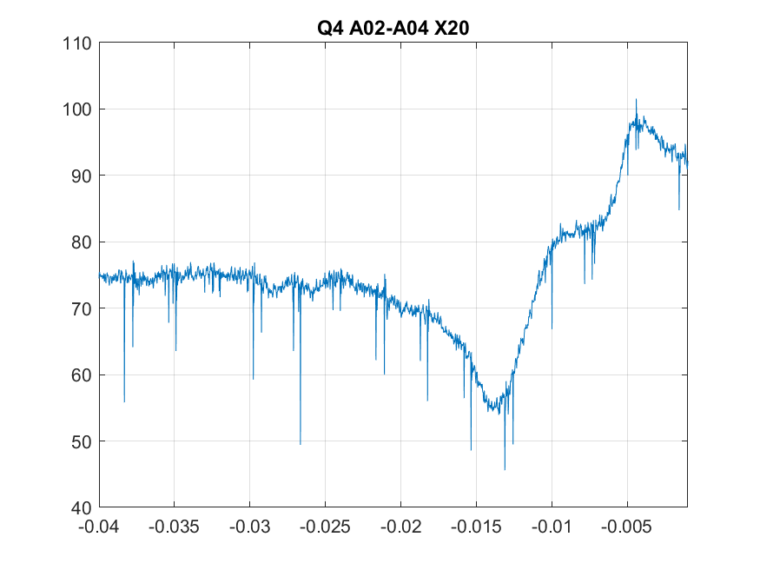
Same signal in VT (after noise removal)
First 50 ms based noise removal shows the same signal in almost all VT of all coils
Does not appear in shortest VT sections, probably under noise level

Slide 4
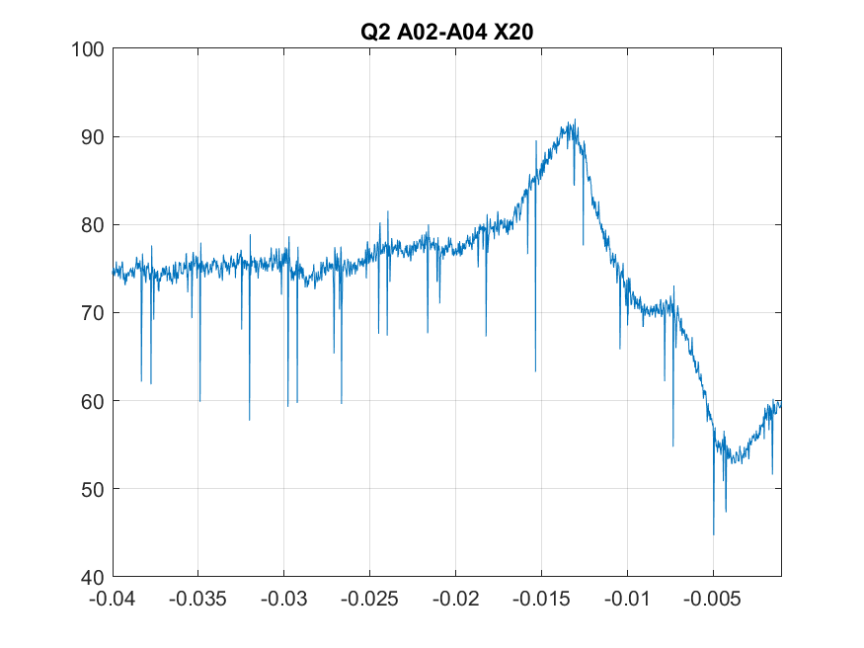
Signal characterization
Signal has been characterized tap per tap according to two parameters:
First peak polarity
First peak relative intensity
Peak value / length percentage of VT section (estimated with sequential resistance)
If the signal is generated by an uniform field change, it is expected to have the same relative intensity in all VT (proportional to length)
+

Slide 5
Voltage Taps

Slide 6
Overall results
 | Half magnet |  | Q1 taps |  |  |  |  | Q4 taps |  |  |  |  | Q2 taps |  |  |  |  |  |  | Q3 taps |  |  |  |  |  |  |  | Half magnet |  | Coil Diff |  | Single Coils
Channel | WC(+)-1/2(+) X1 | 1/2(-)-WC(-) X1 | Q1 B02-B03 X20 | Q1 B03-B04 X20 | Q1 B04-B05 X20 | Q1 A08-A04 X20 | Q1 A04-A02 X20 | Q4 A02-A04 X20 | Q4 A05-A06 X20 | Q4 B07-B06 X20 | Q4 B04-B03 X20 | Q4 B03-B02 X20 | Q2 A02-A04 X20 | Q2 A05-A06 X20 | Q2 A07-A08 X20 | Q2 B07-B06 X20 | Q2 B05-B04 X20 | Q2 B04-B03 X20 | Q2 B03-B02 X20 | Q3 B02-B03 X20 | Q3 B03-B04 X20 | Q3 B04-B05 X20 | Q3 B06-B07 X20 | Q3 A08-A07 X20 | Q3 A07-A05 X20 | Q3 A04-A03 X20 | Q3 A03-A02 X20 | 1/2 MAG Q1+Q4 X5 | 1/2 MAG Q2+Q3 X5 | FPGA/PXI Coil Diff | COIL DIFF | COIL Q1 X10 | COIL Q4 X10 | COIL Q2 X10 | COIL Q3 X10
First peak polarity | -1 | 1 | -1 | -1 | -1 | -1 | -1 | -1 | -1 | -1 | -1 | -1 | 1 | -1 | 1 | -1 | 1 | 1 | 1 | 1 | 1 | -1 | 1 | -1 | 1 | 1 | 1 | -1 | 1 | -1 | -1 | -1 | -1 | 1 | 1
Amplitude | 95 | 90 | 15 | 9 | 0.6 | 0.5 | 20 | 20 | 0.4 | 0.4 | 9 | 15 | 15 | 1.1 | 1.7 | 1.3 | 1.9 | 9 | 16 | 16 | 11 | 1.2 | 1.7 | 1.3 | 1.7 | 3.5 | 14 | 80 | 90 | 180 | 180 | 47 | 42 | 43 | 49
Relative intensity | 190 | 180 | 195 | 153 | 244 | 102 | 189 | 192 | -195 | 163 | 154 | 198 | 143 | 537 | 830 | 635 | 928 | 153 | 211 | 210 | 187 | 523 | 741 | 599 | 704 | 144 | 174

Slide 7
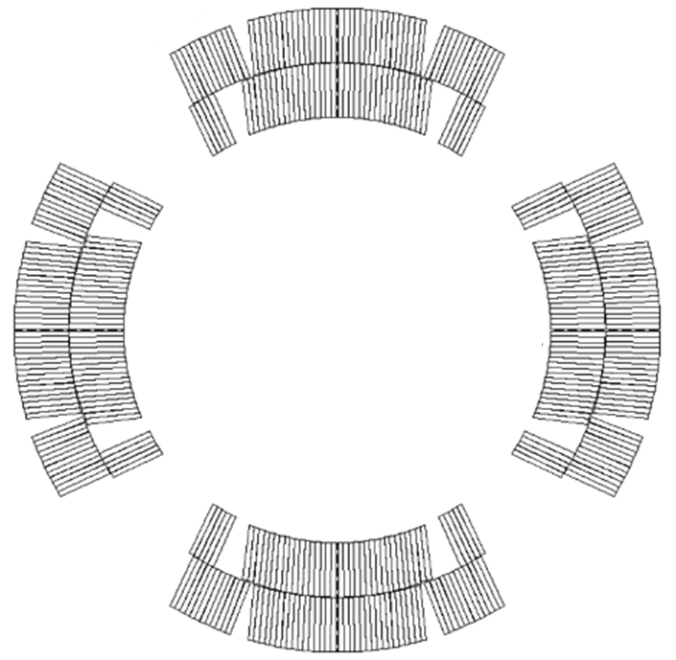
Polarity results
Q2
-
-
Q1
First finding: polarities of pole segments are negative to the right of Q2 and Q3 poles, positive to the left
Multiturn signals of Q2 and Q3 have lower peaks
All Q1 and Q4 VT sections are negative
Overall polarity is negative in Q1 and Q4, positive in Q2 and Q3
+
-
-
-
+
-
+
-
-
-
+
-
-
-
Q3
Q4

Slide 8
Relative intensity results
635
244
928
537
N/A
N/A
Relative intensity is not uniform
Signal is stronger in some taps
We can use pole turns as ‘antennas’ to see where the signal is stronger
Multiturn could be not reliable in Q2 – Q3
Signal appear to be stronger around the Q2 pole
830
N/A
704
N/A
741
N/A
599
195
523
163

Slide 9
Possible explanation?
Can the movement of the Q2 magnetic shim justify this behavior?

