Slide 1



Summary of spikes/QD trips in MQXFA07b and previous magnets
Anis Ben Yahia
8-January-2024

Slide 2
Summary
First recorded in MQXFA05 endurance test (first ramp to nominal after a cooldown at 20 A/s). Triggered the QD (no quench antenna data during the endurance test).
MQXFA11 first quench (at 20 A/s) and with spike detector during following ramps.
MQXFA07b in the ramps at 30 A/s

Slide 3
MQXFA07b

Slide 4
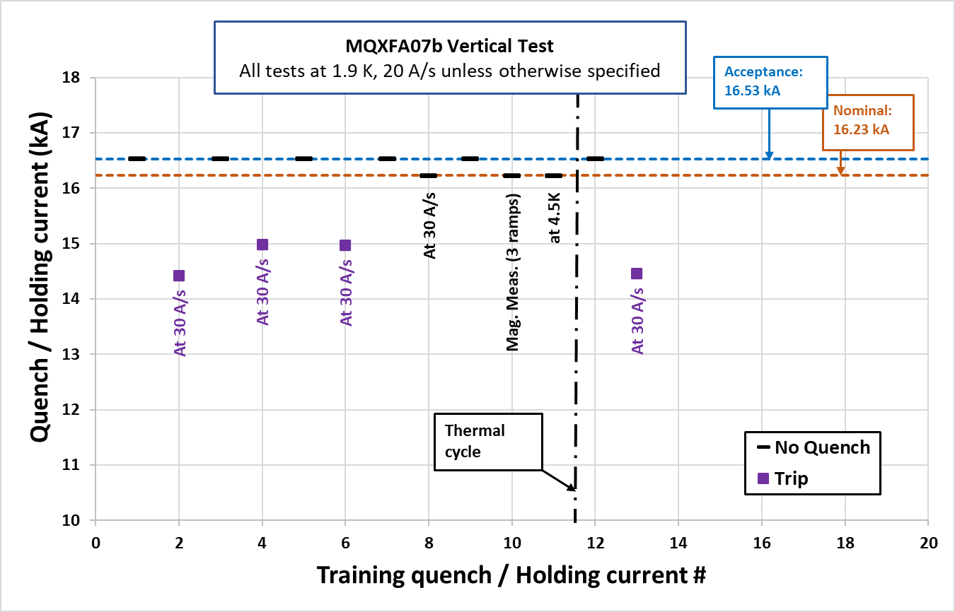
MQXFA07b

Slide 5
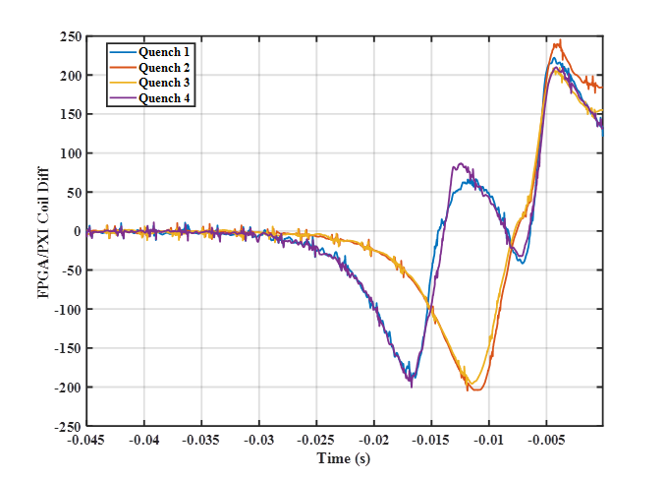
MQXFA07b - Half Diff

Slide 6
MQXFA07b - Coil signals

Slide 7
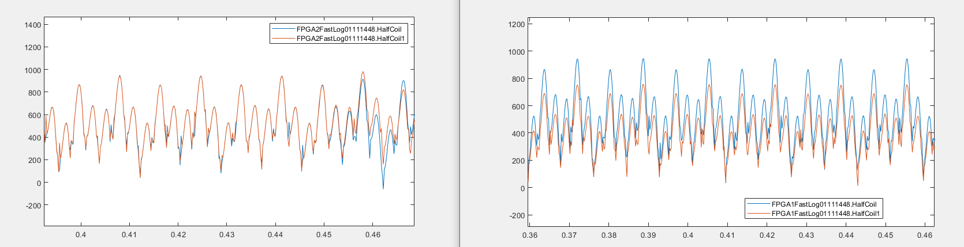
MQXFA07b – Quench 4 – imbalance in QD1

Slide 8
MQXFA05 Endurance Test

Slide 9
MQXFA05
QD trips

Slide 10
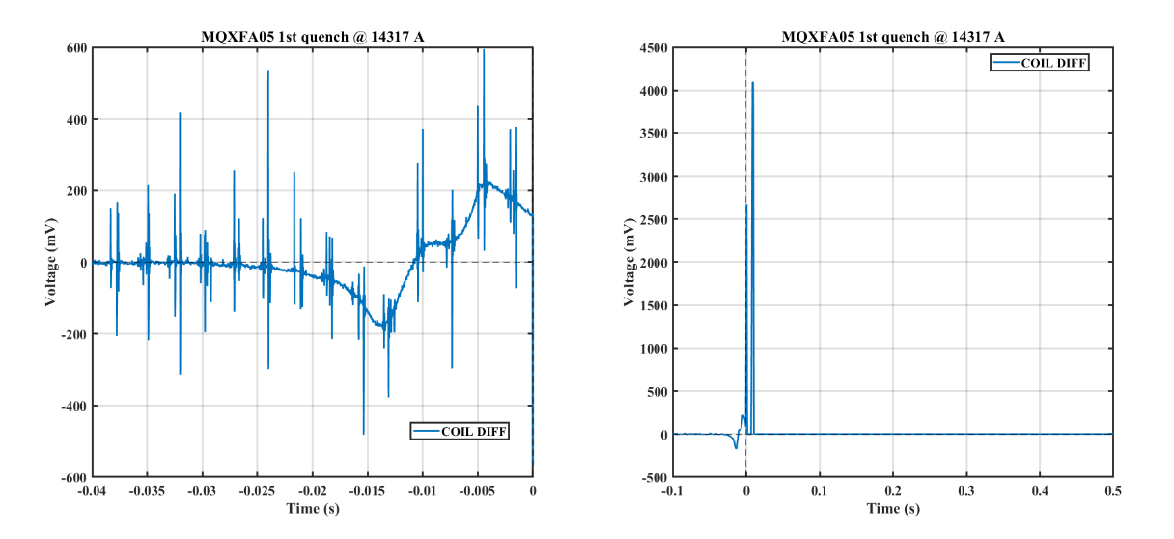
MQXFA05

Slide 11
MQXFA05

Slide 12
MQXFA05

Slide 13
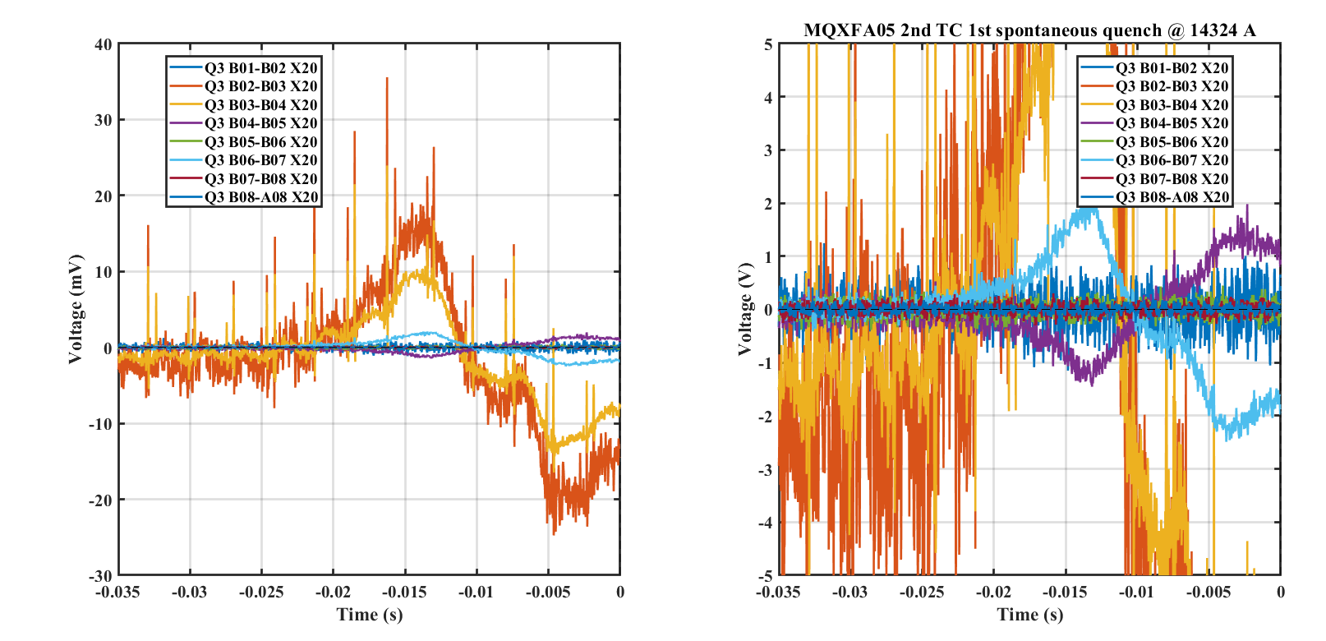
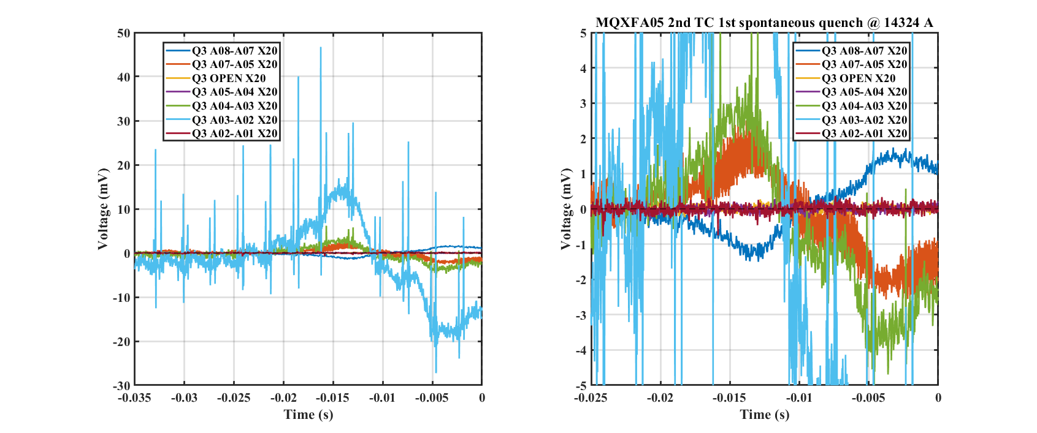
MQXFA05

Slide 14
MQXFA11

Slide 15
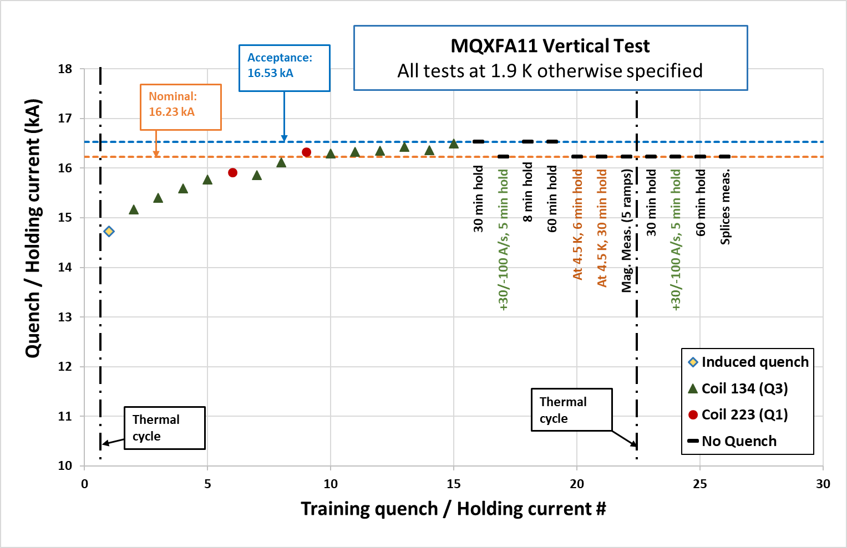
MQXFA11

Slide 16
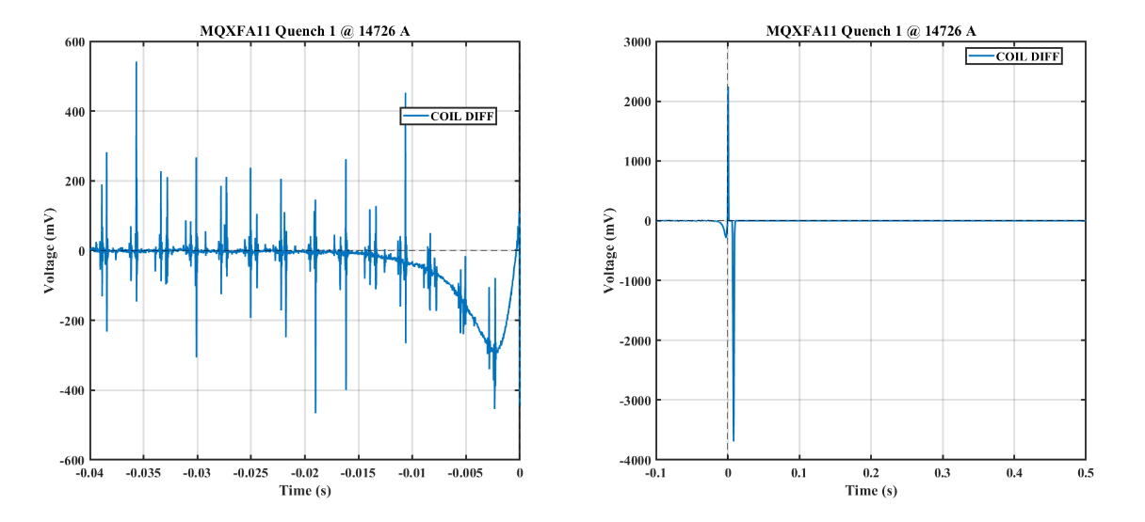
MQXFA11 first quench

Slide 17
MQXFA11 transients during ramps

Slide 18
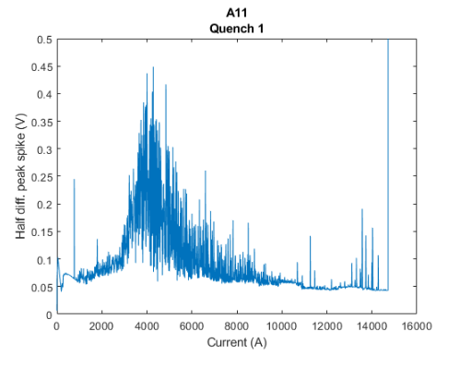
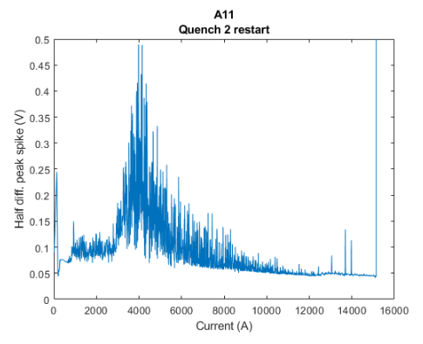
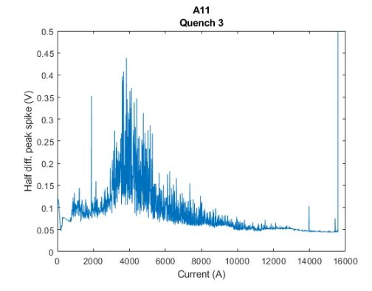
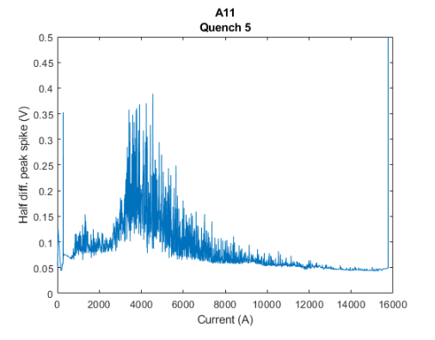

Slide 19
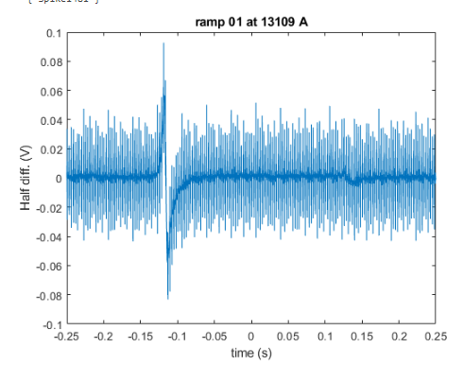
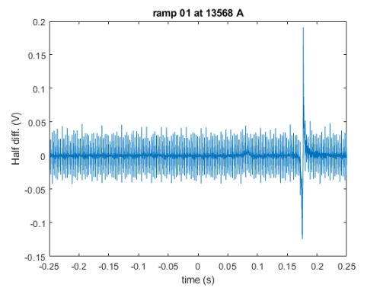
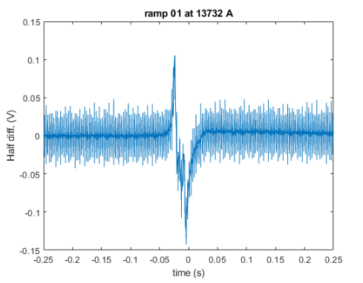

Slide 20
