Slide 1
Quench #1

Slide 2
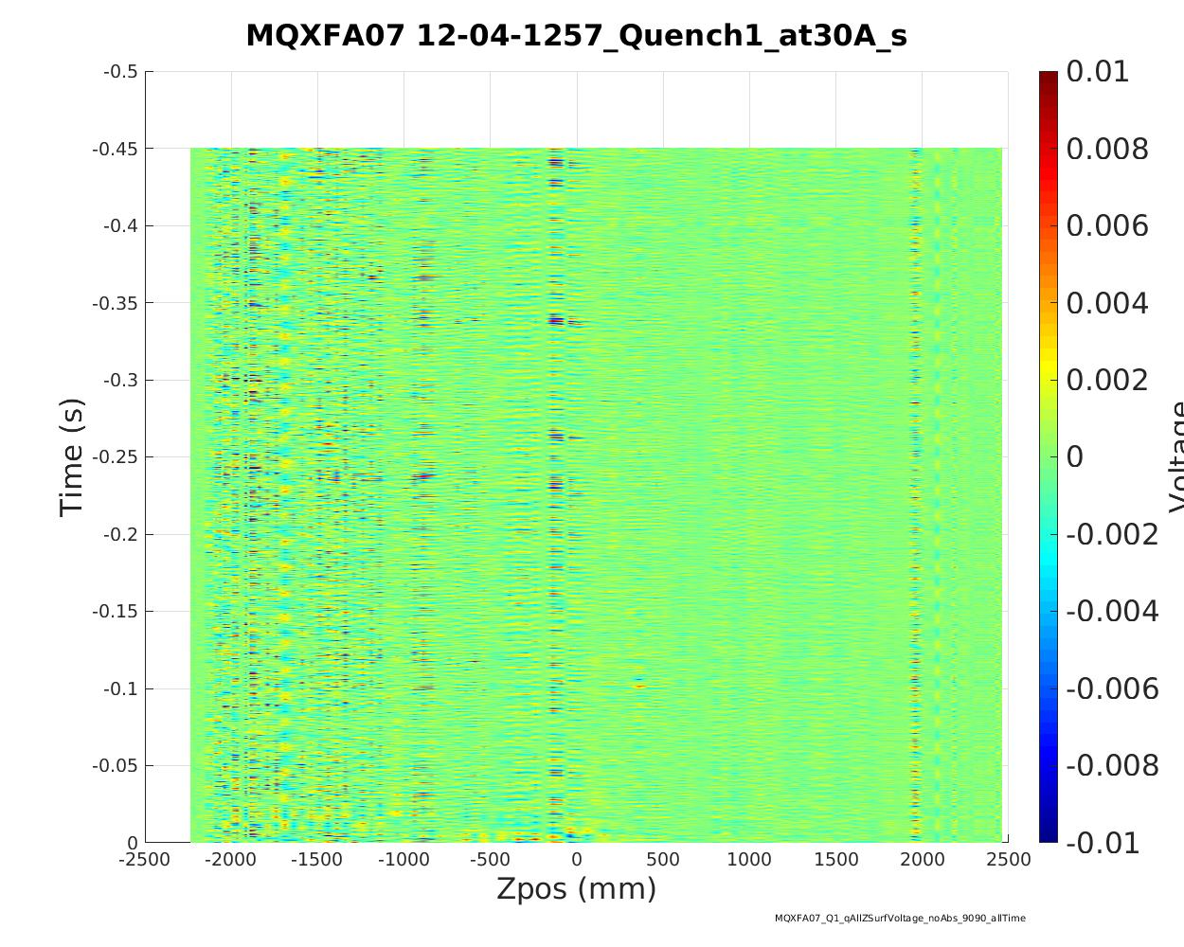

Slide 3
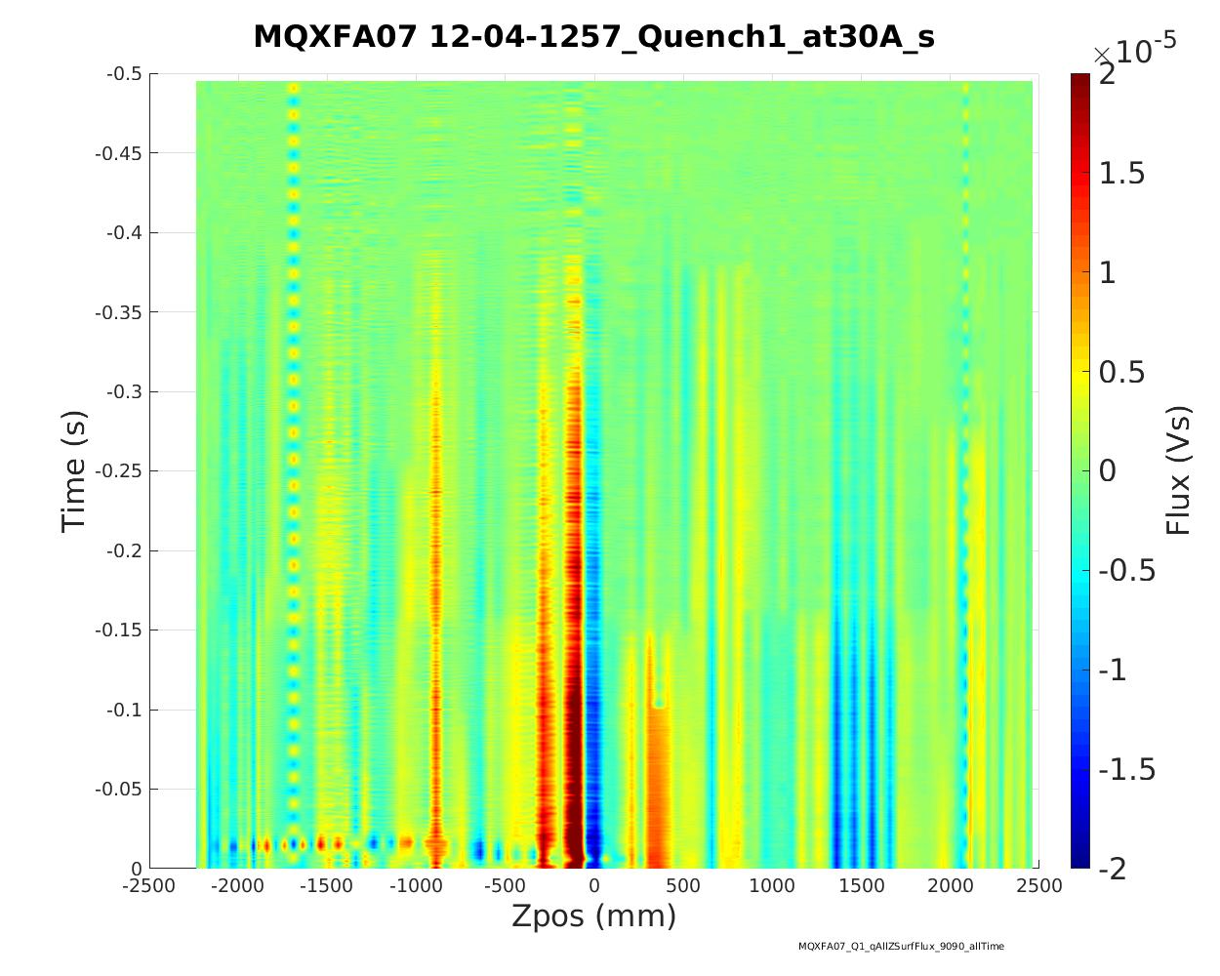

Slide 4
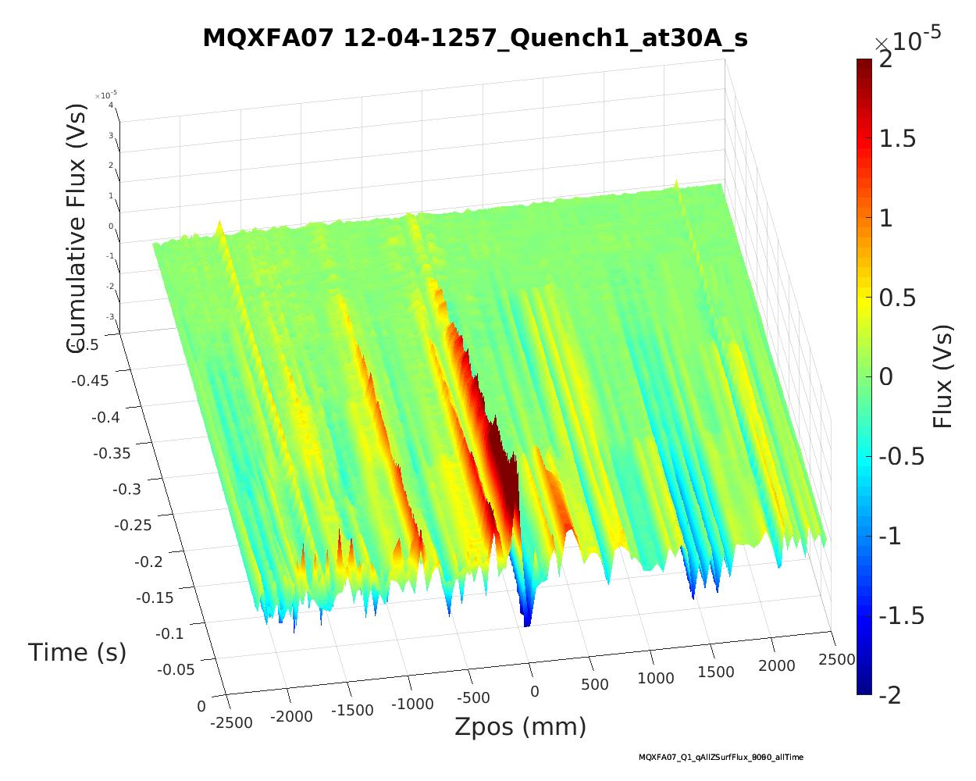

Slide 5
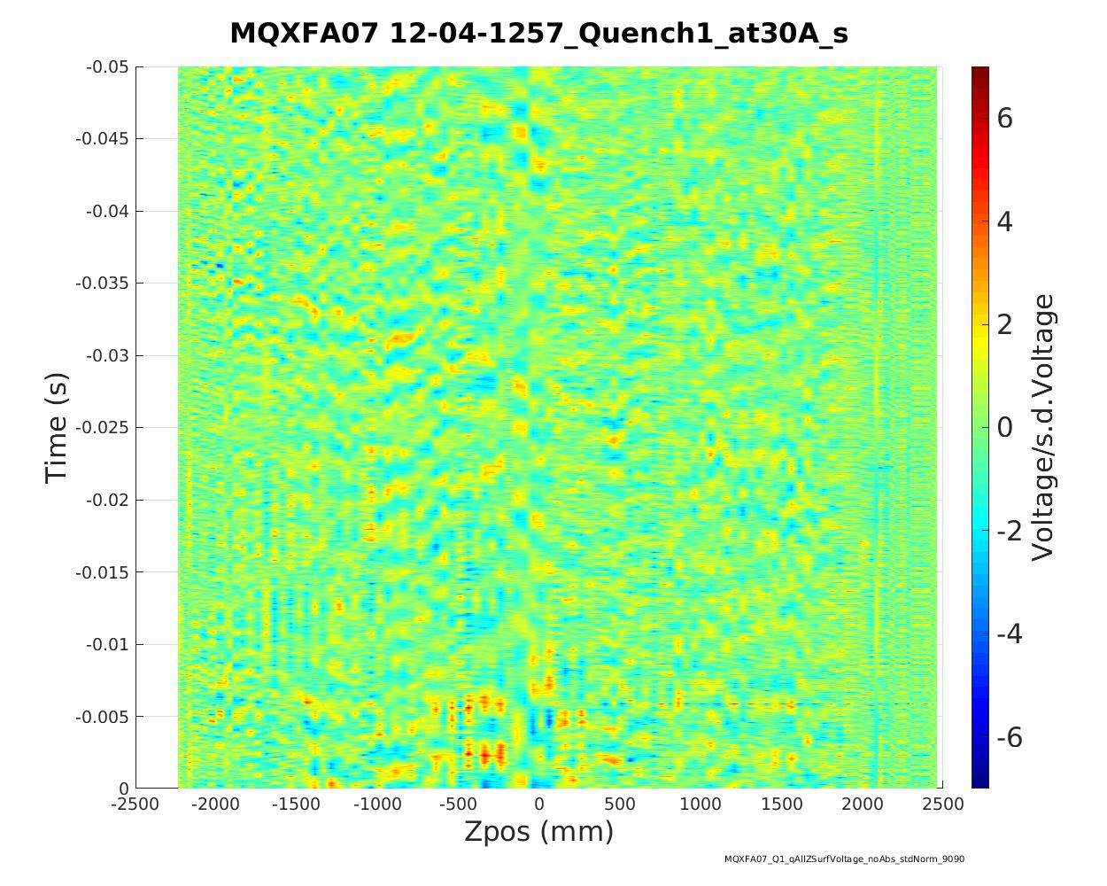
Activity is in every other channel – implying the same azimuthal orientation since every other channel shifts from normal to skew 6p sensitivity

Slide 6
Propagation? Speed ~200m/s
This activity looks simultaneous

Slide 7
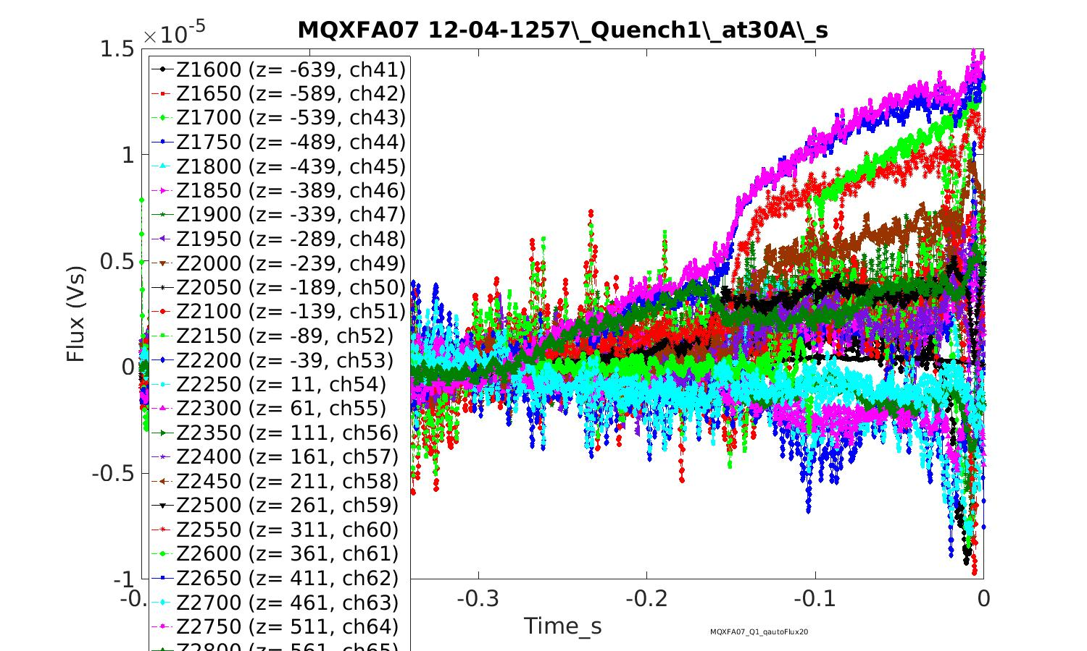
Flux shows some interesting changes long before quench with correlated transitions on signals active near quench

Slide 8
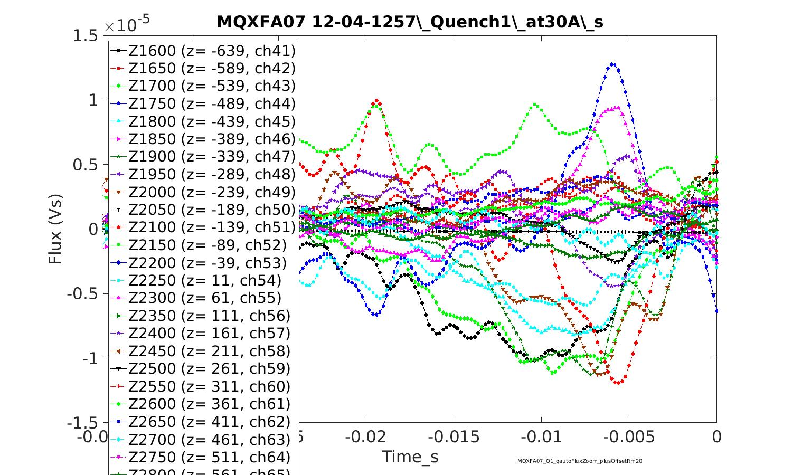
Flux change is relatively slow
- few ms

Slide 9
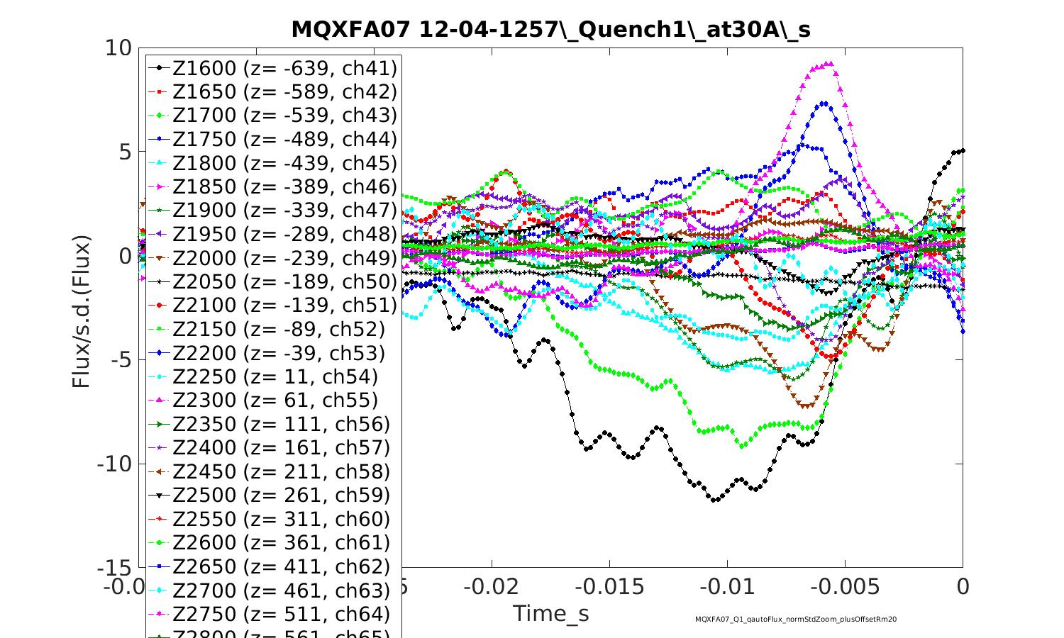

Slide 10
Quench #2

Slide 11
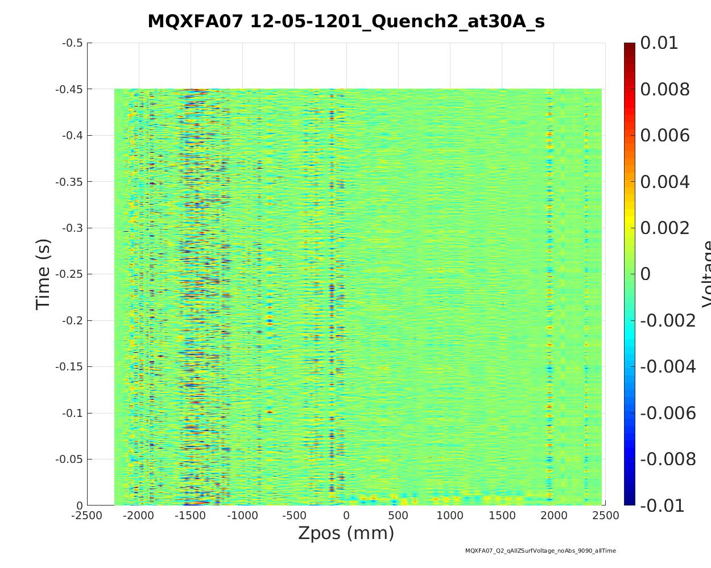

Slide 12
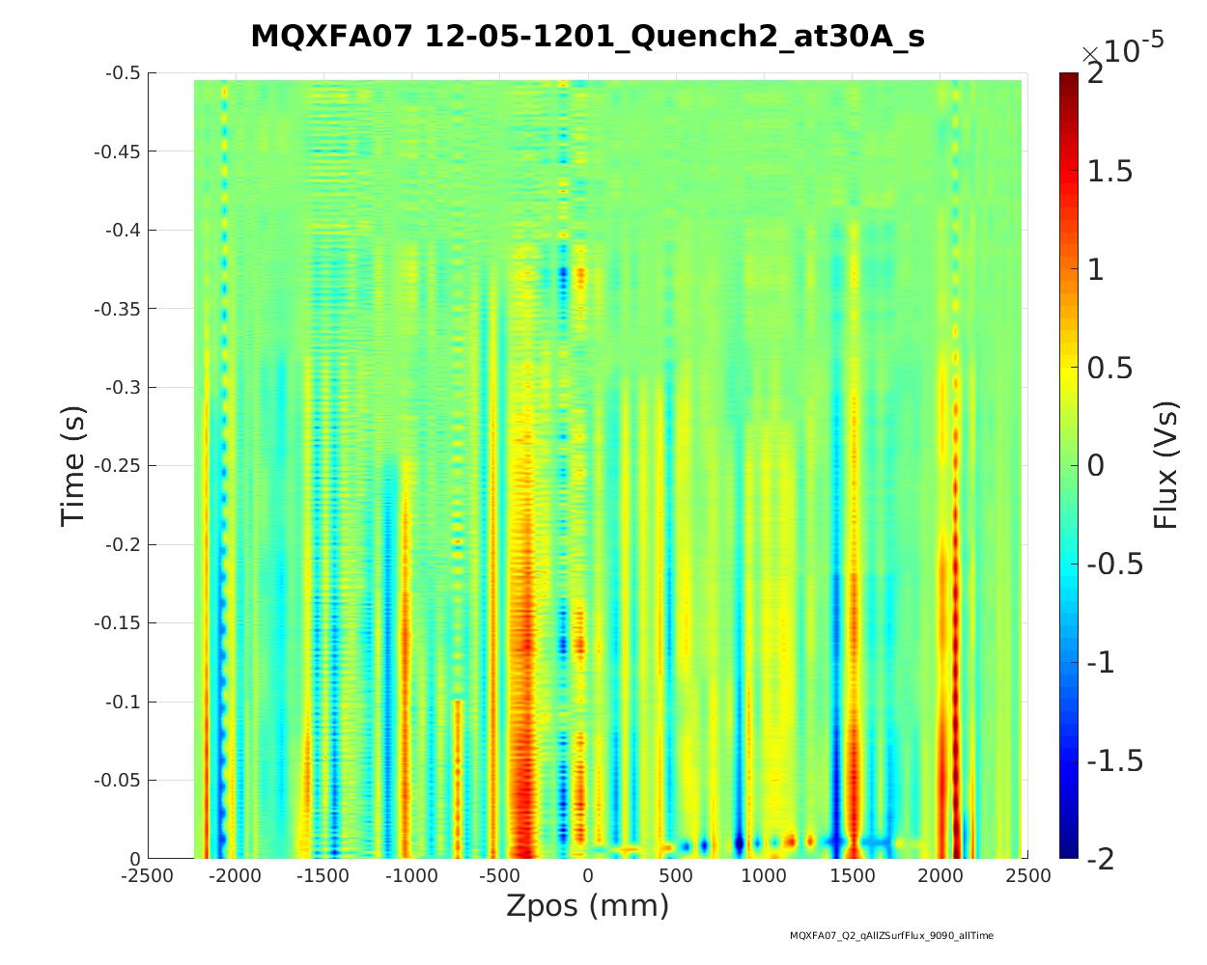

Slide 13
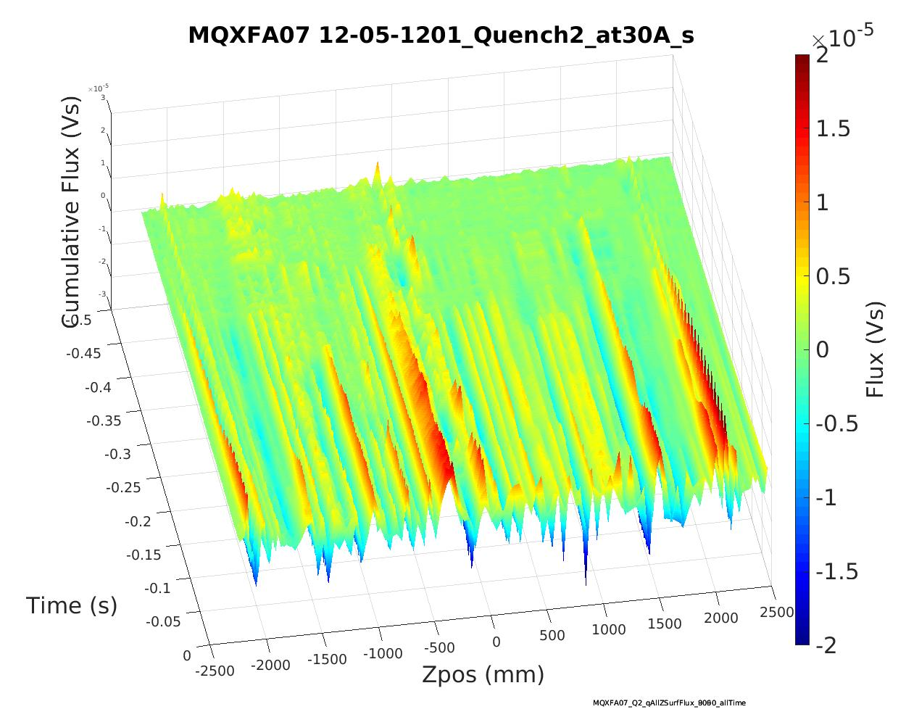

Slide 14
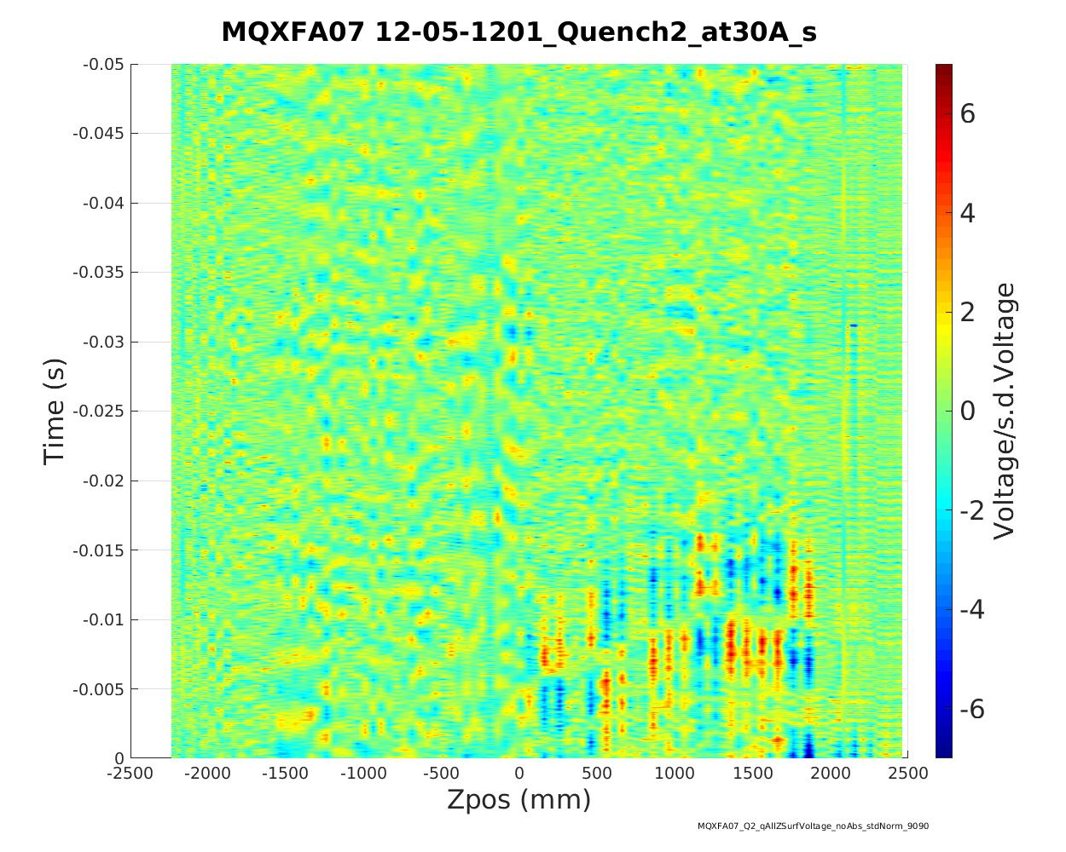
Activity mostly in LE half of magnet

Slide 15
Perhaps propagation?
Speed is ~200m/s
~400m/s?

Slide 16
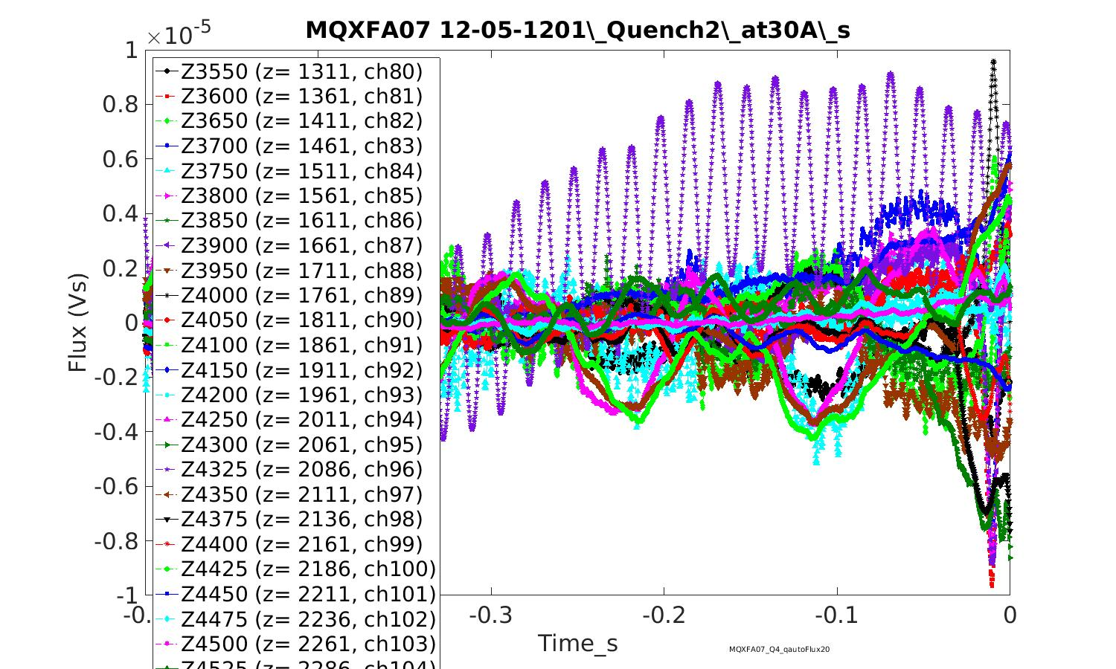
60Hz noise that I didn’t catch…

Slide 17
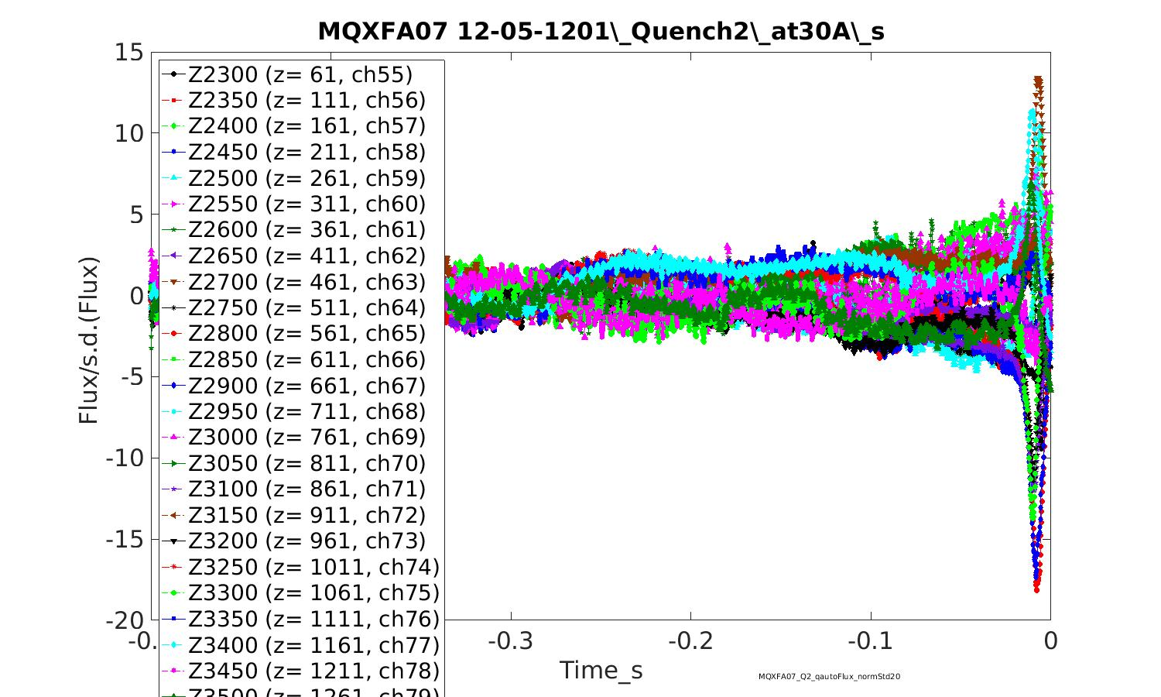

Slide 18
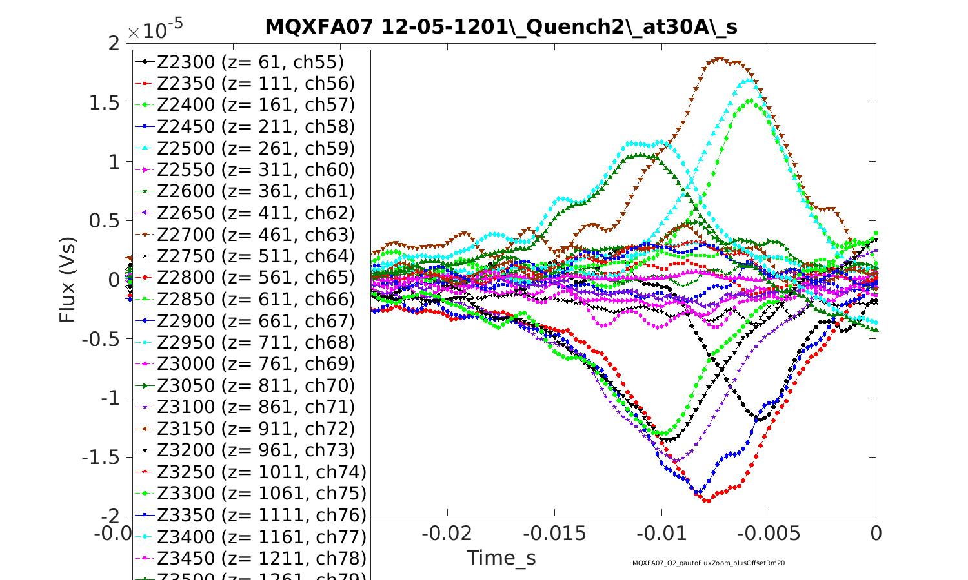
Again flux change is relatively slow
- few ms

Slide 19
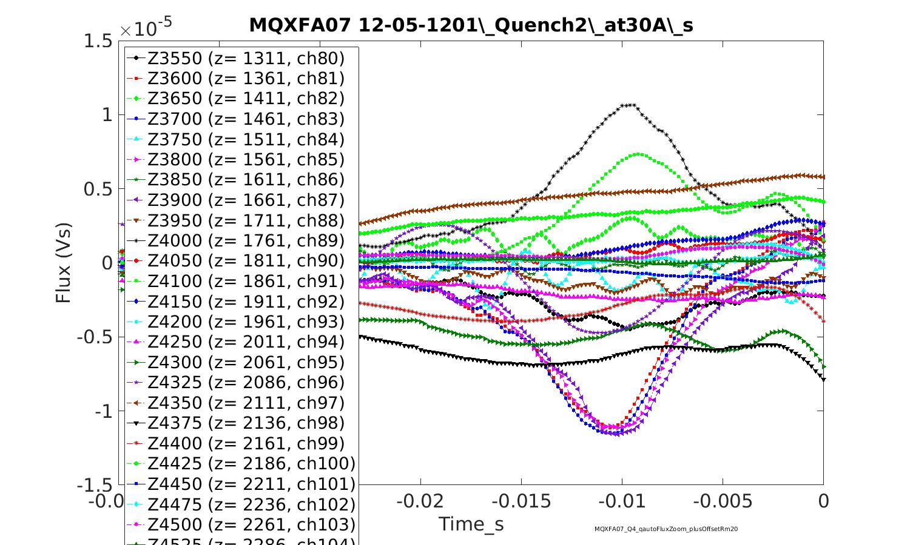

Slide 20
Quench #3

Slide 21
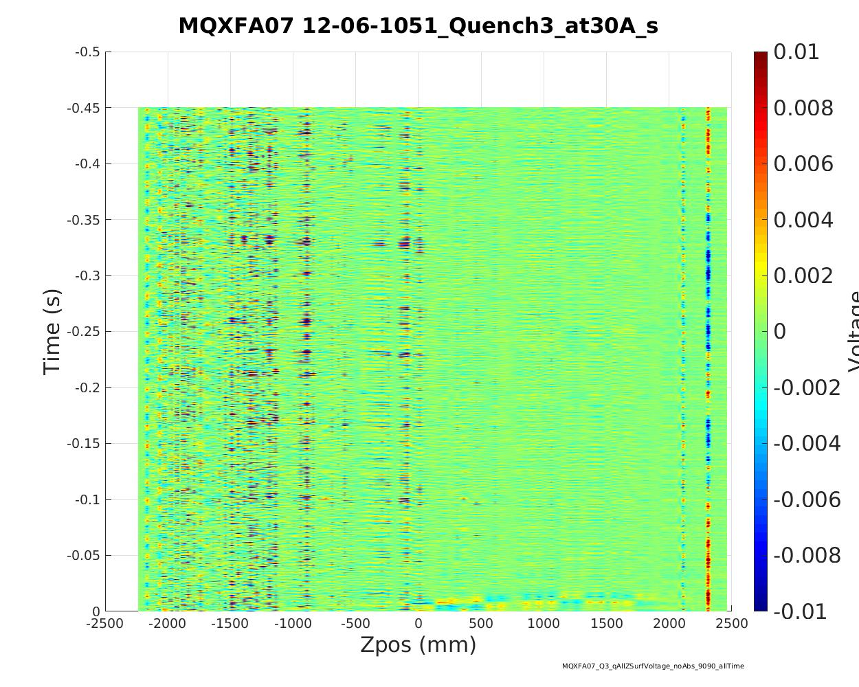

Slide 22
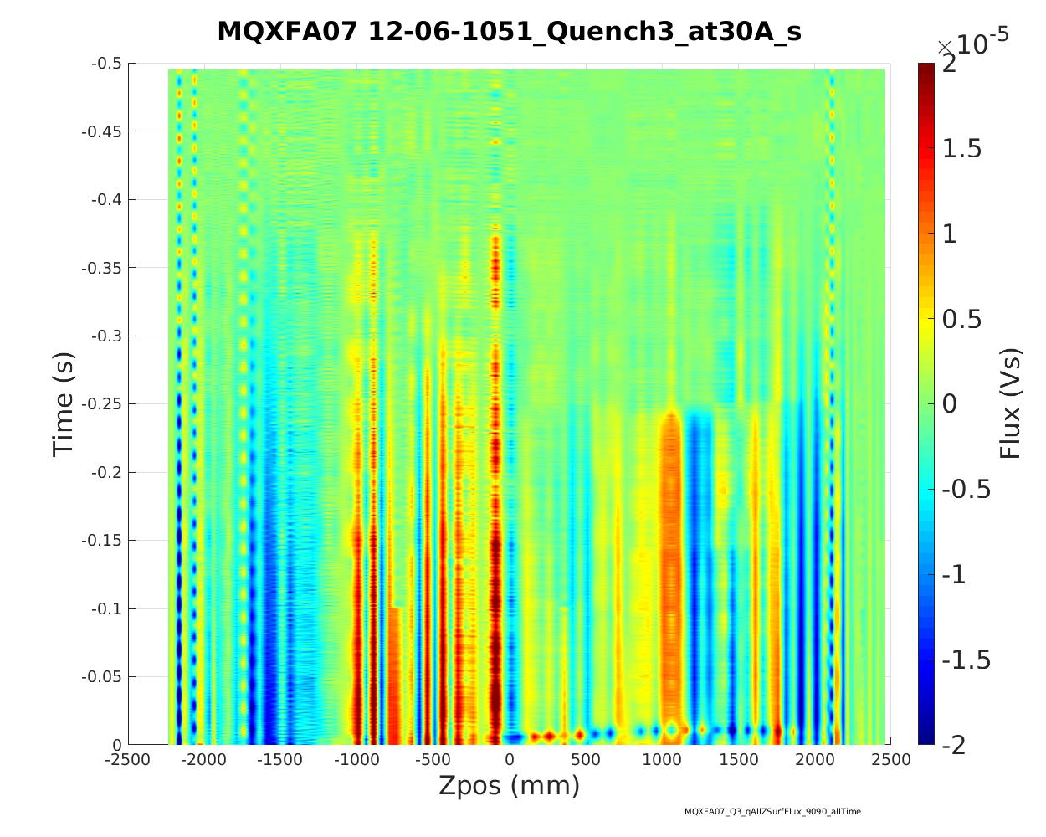

Slide 23
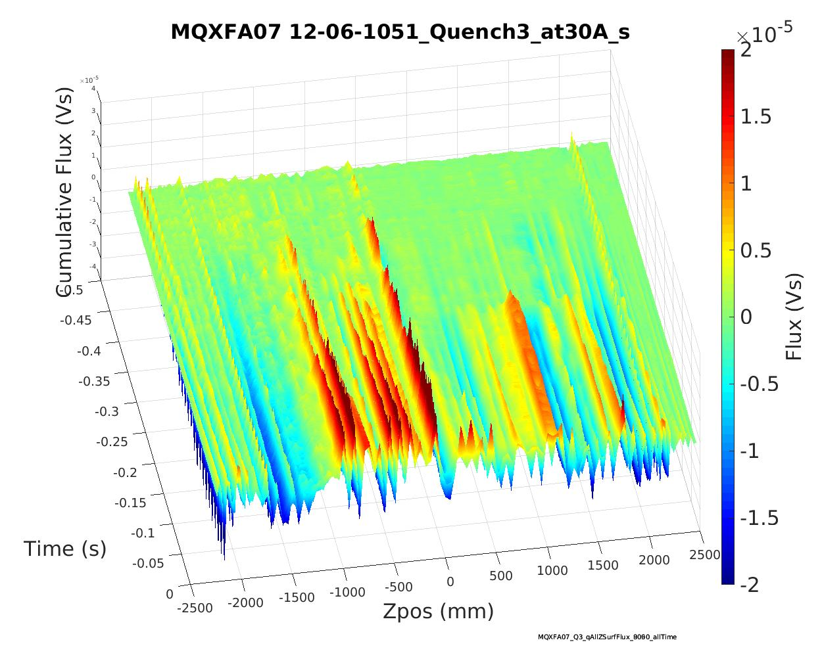

Slide 24
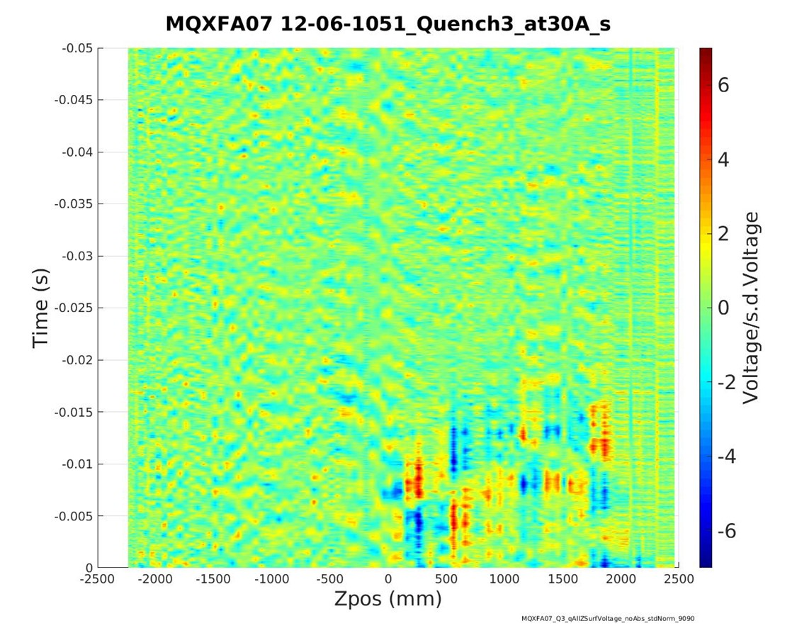
Activity mostly in LE half of magnet

Slide 25
Perhaps propagation?
Speed is ~200m/s
~400m/s?

Slide 26
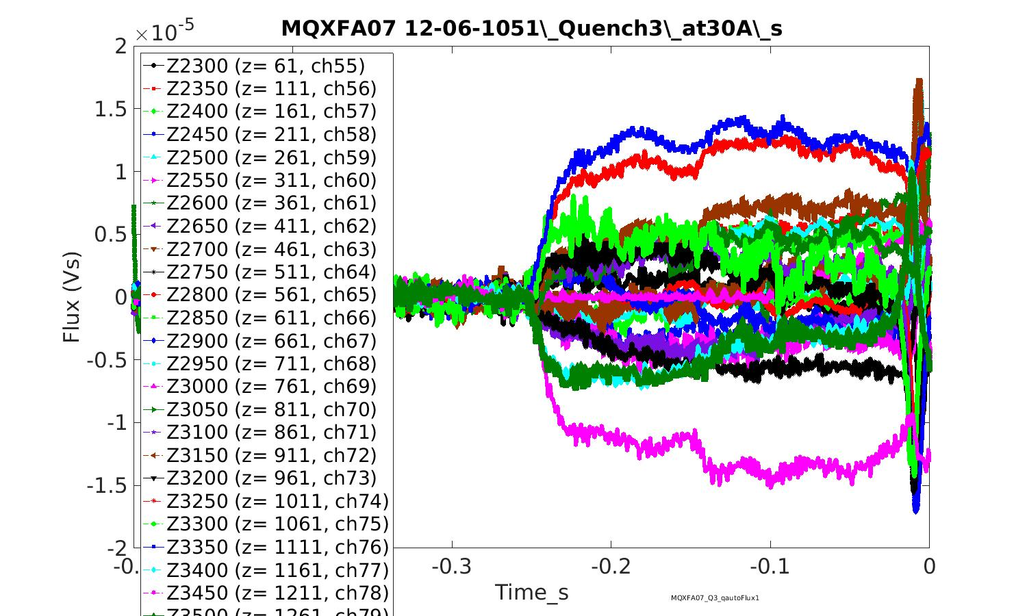

Slide 27
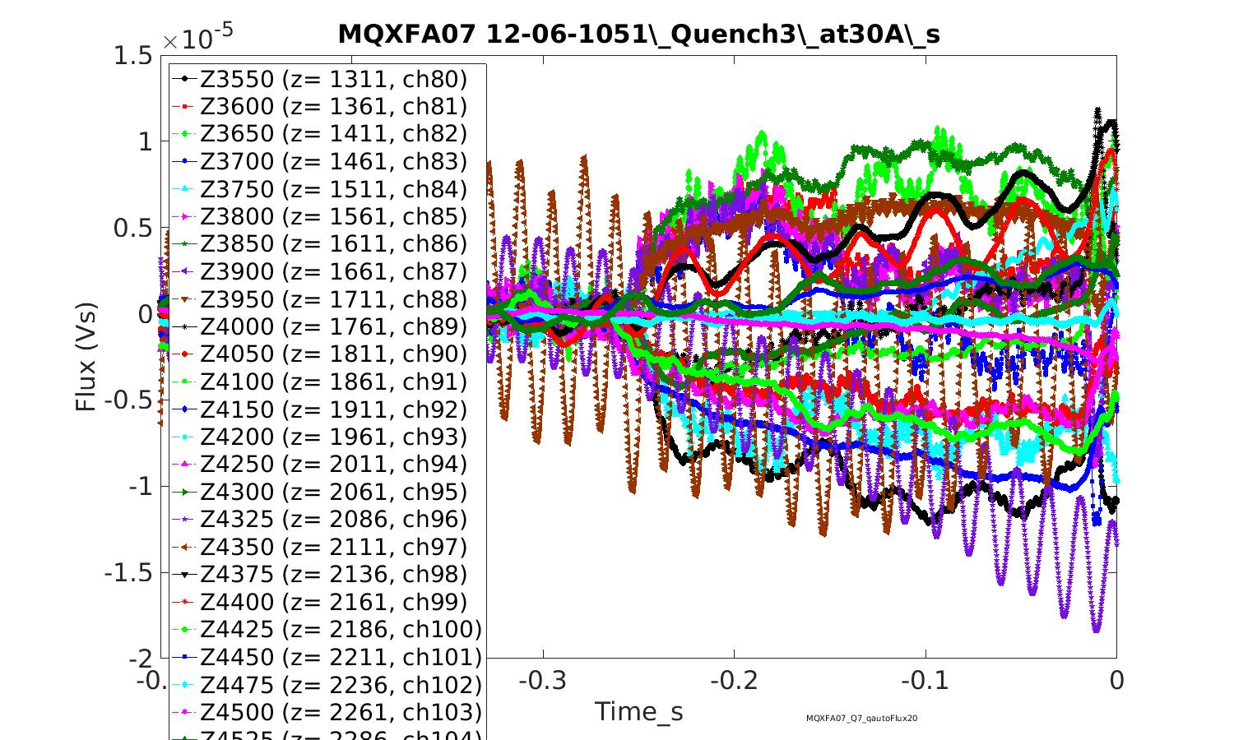

Slide 28
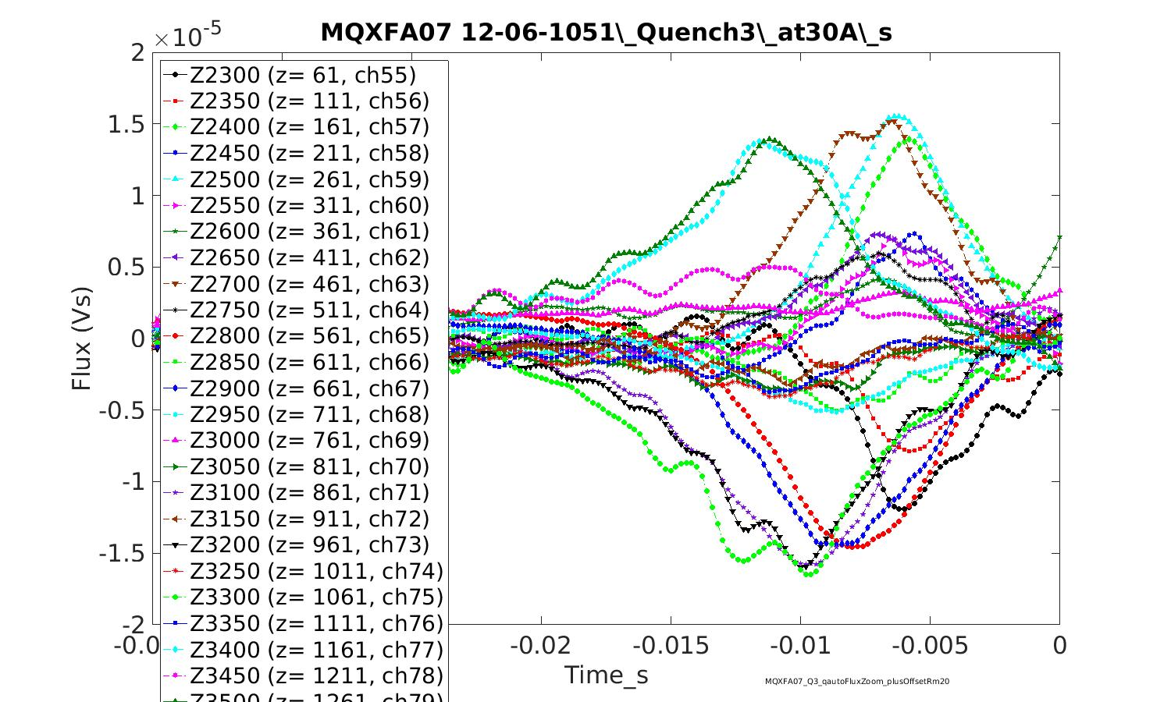

Slide 29
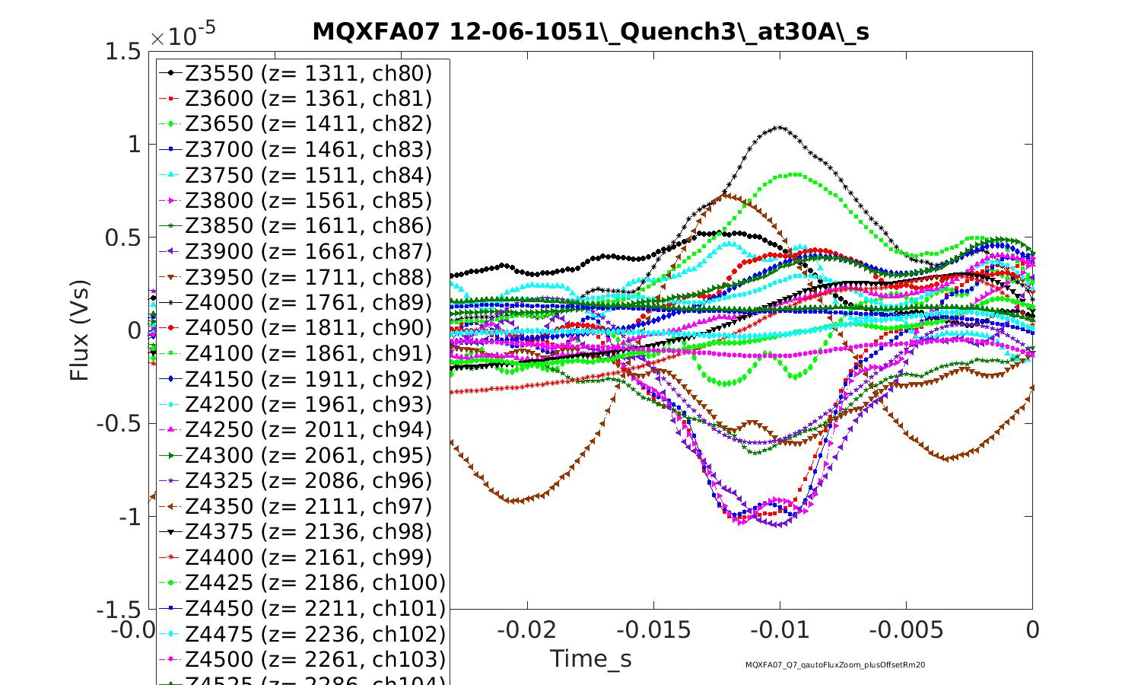

Slide 30
Quench #4

Slide 31
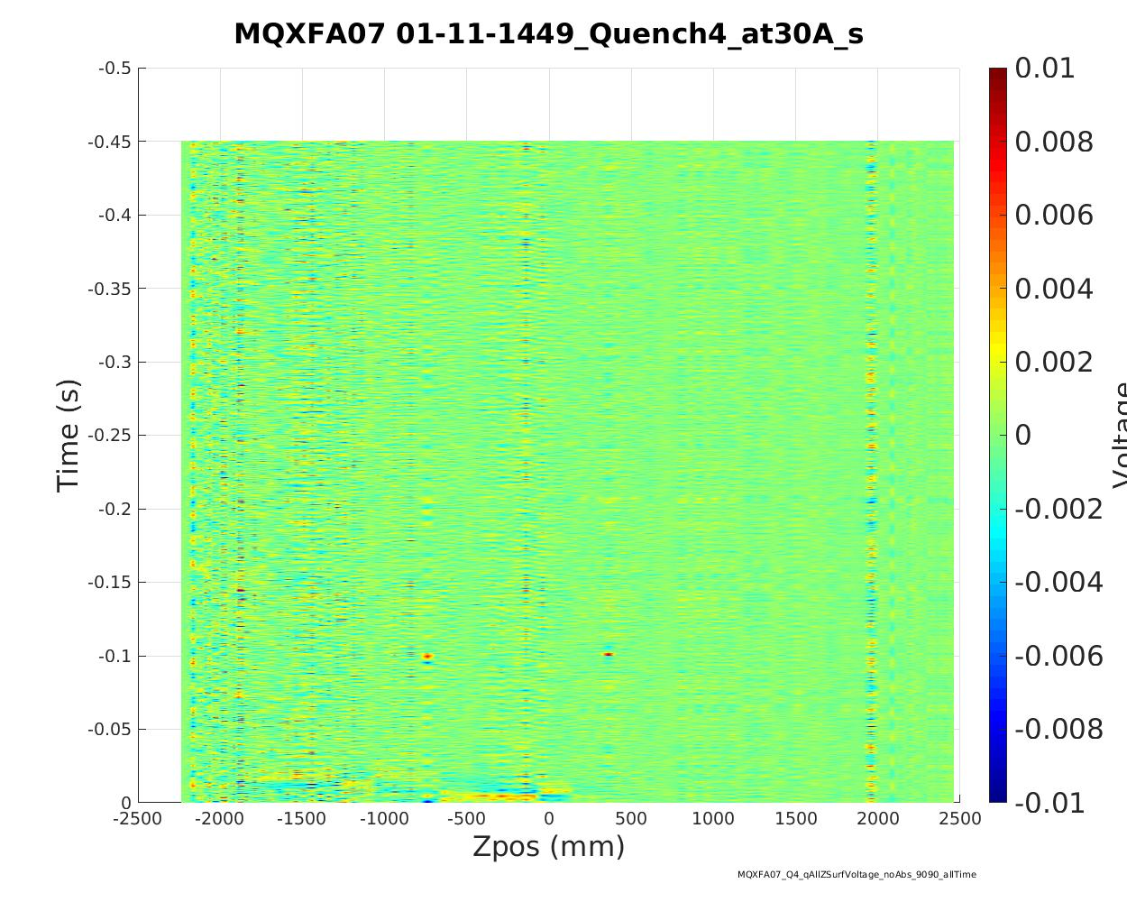

Slide 32
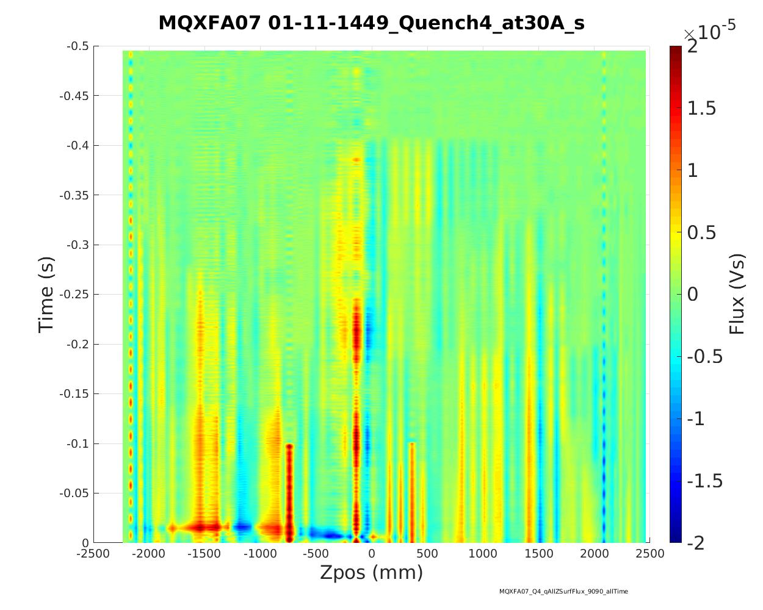

Slide 33
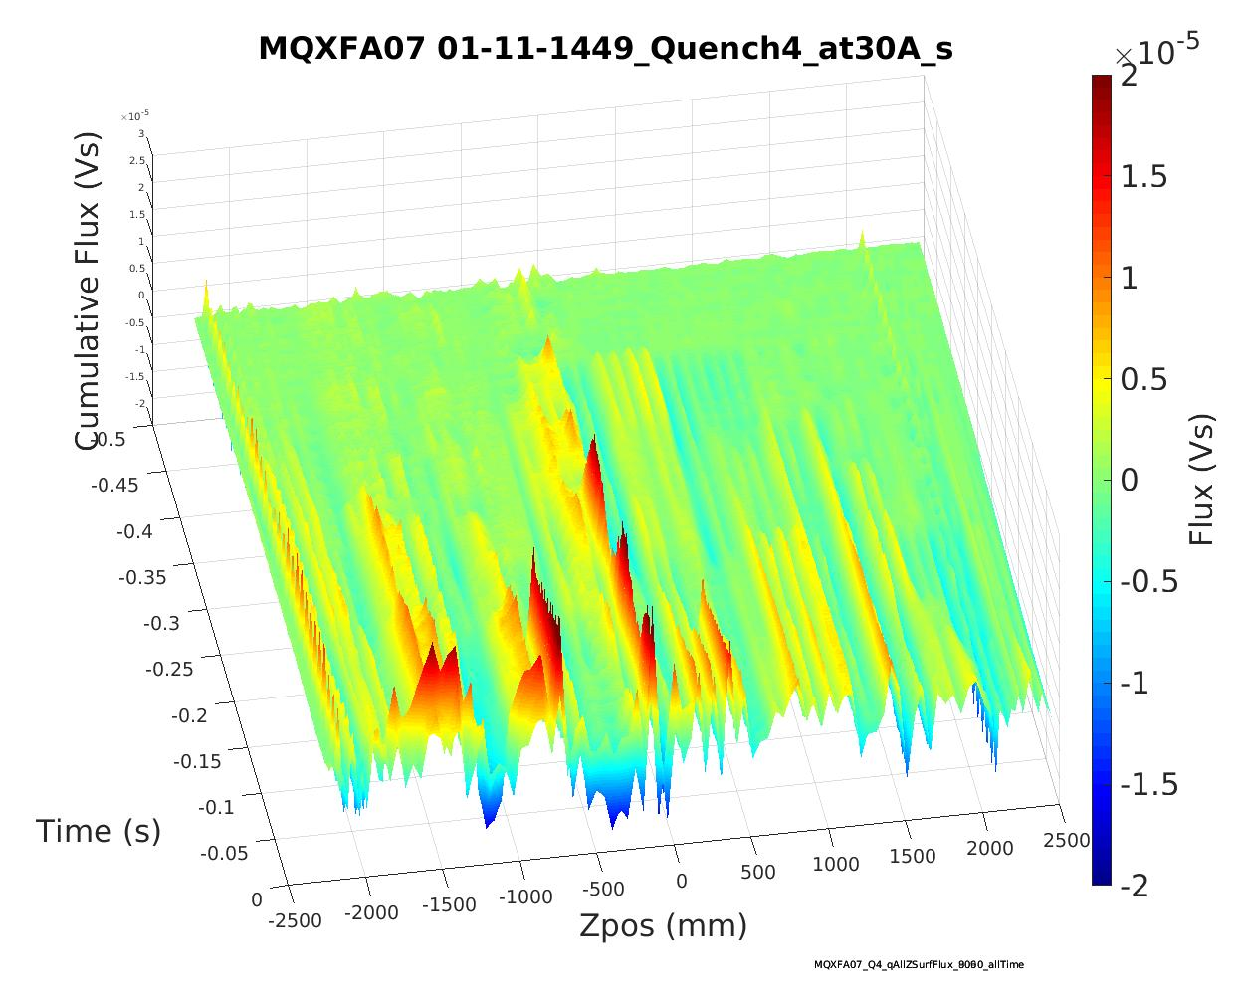

Slide 34
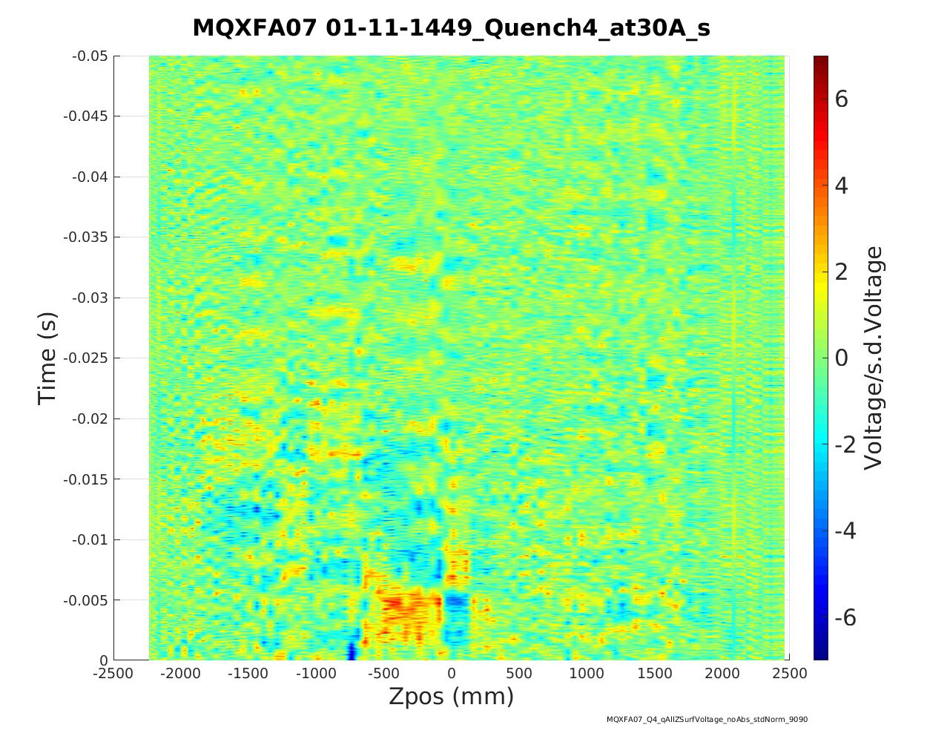

Slide 35
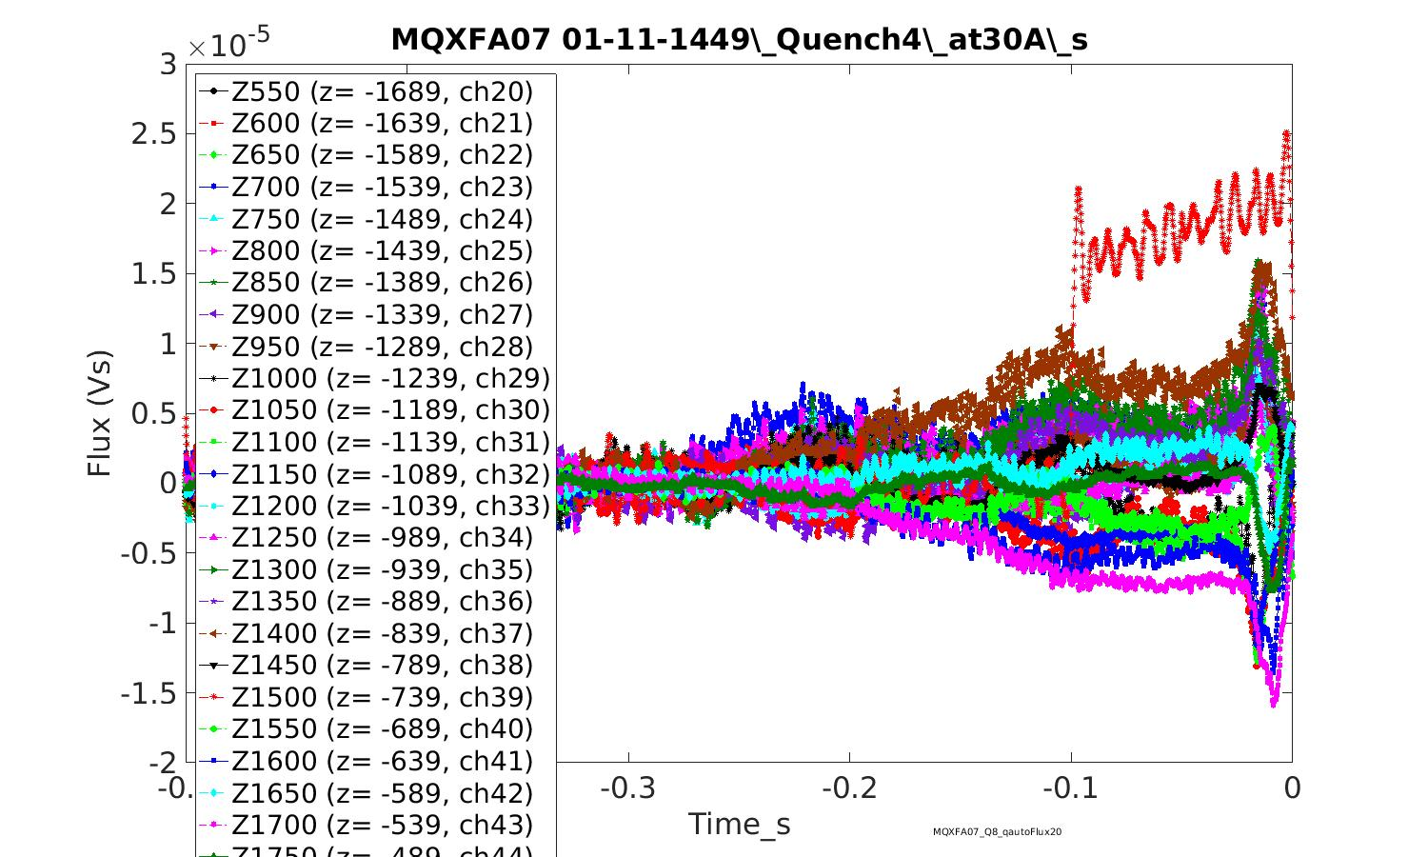

Slide 36
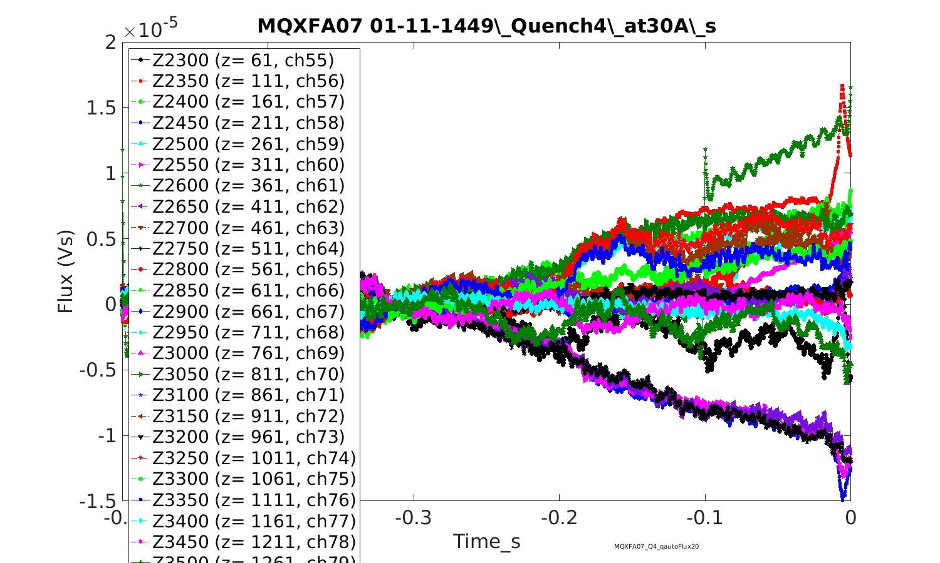

Slide 37
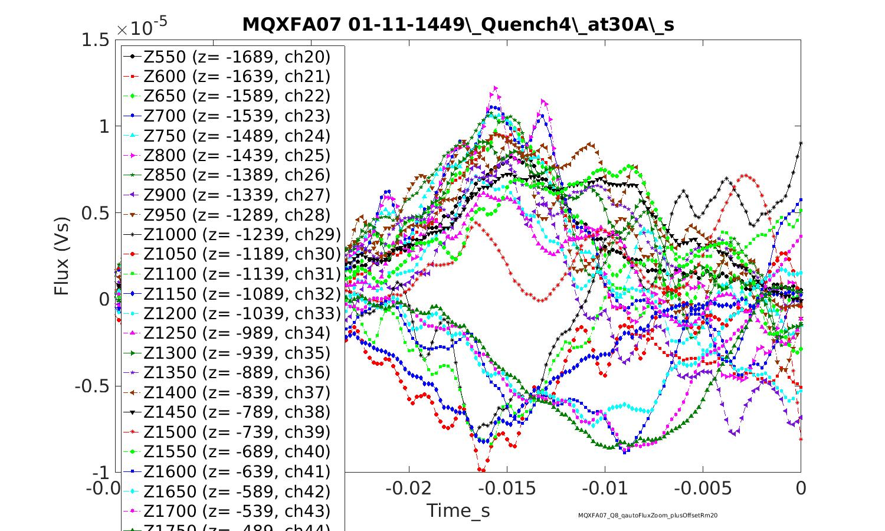

Slide 38
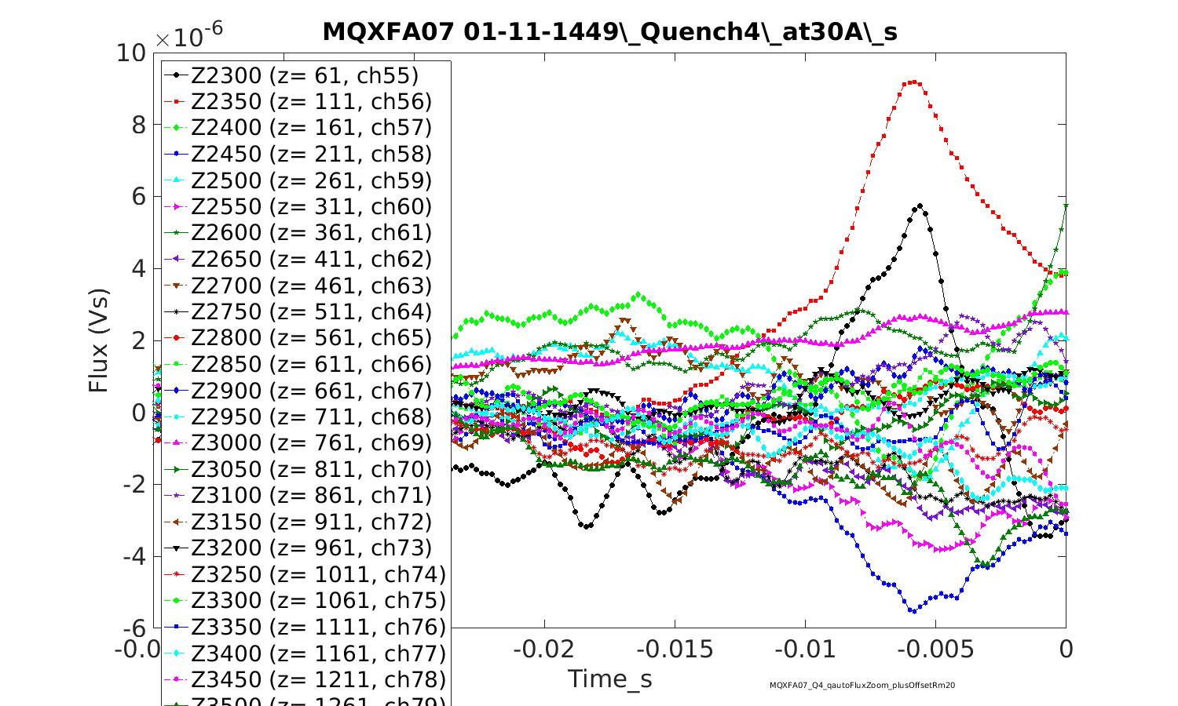

Slide 39
Theta Antennas

Slide 40
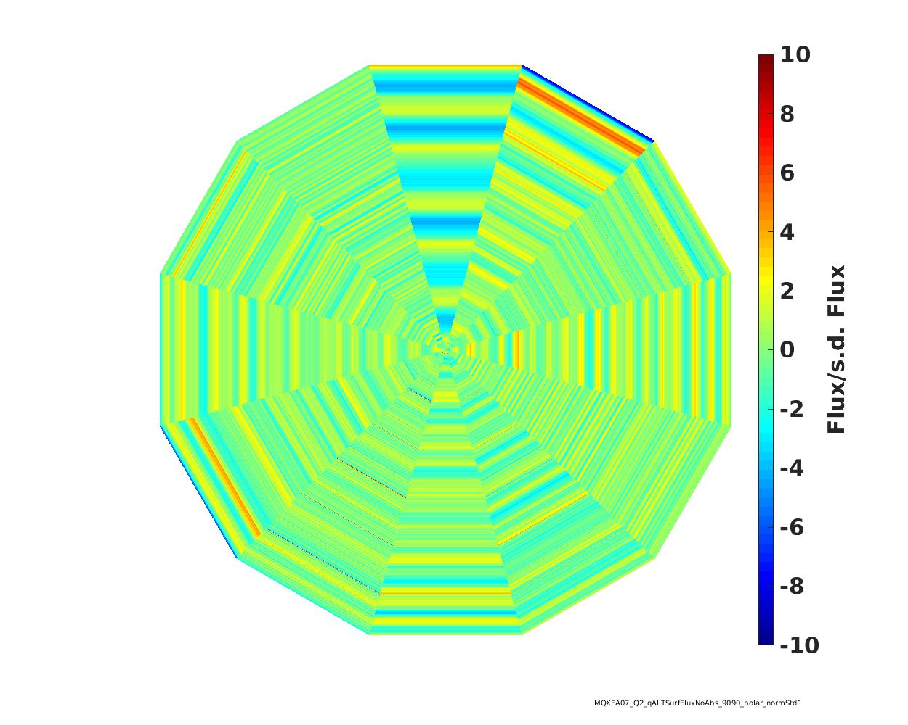
T0°
Quench#2
Q2
Q1
T90°
-0.05
-0.025
t=0
Q3
Q4
T180°

Slide 41
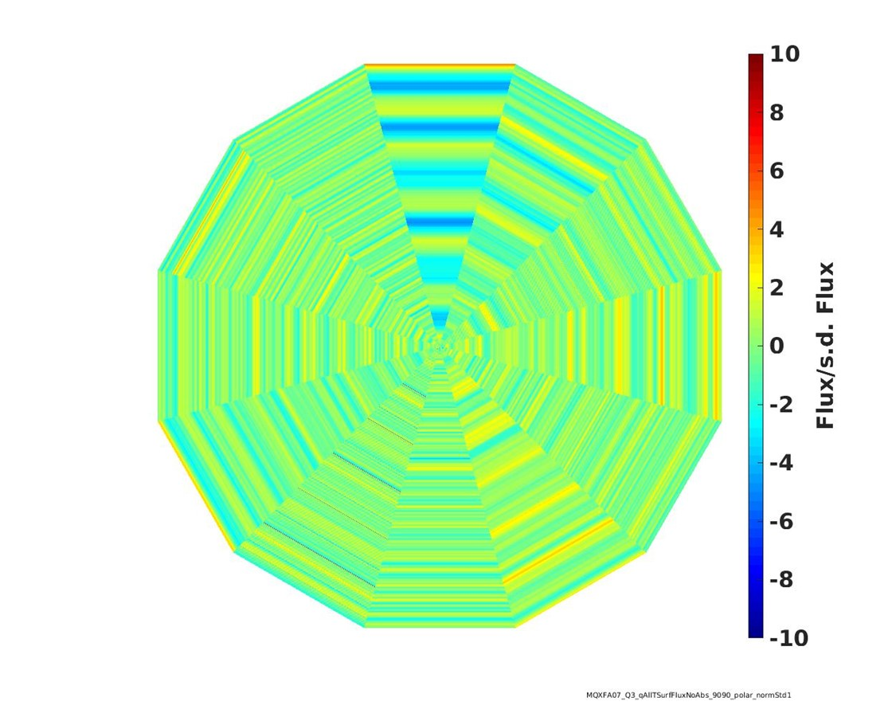
T0°
Quench#3
Q2
Q1
T90°
-0.05
-0.025
t=0
Q3
Q4
T180°

Slide 42
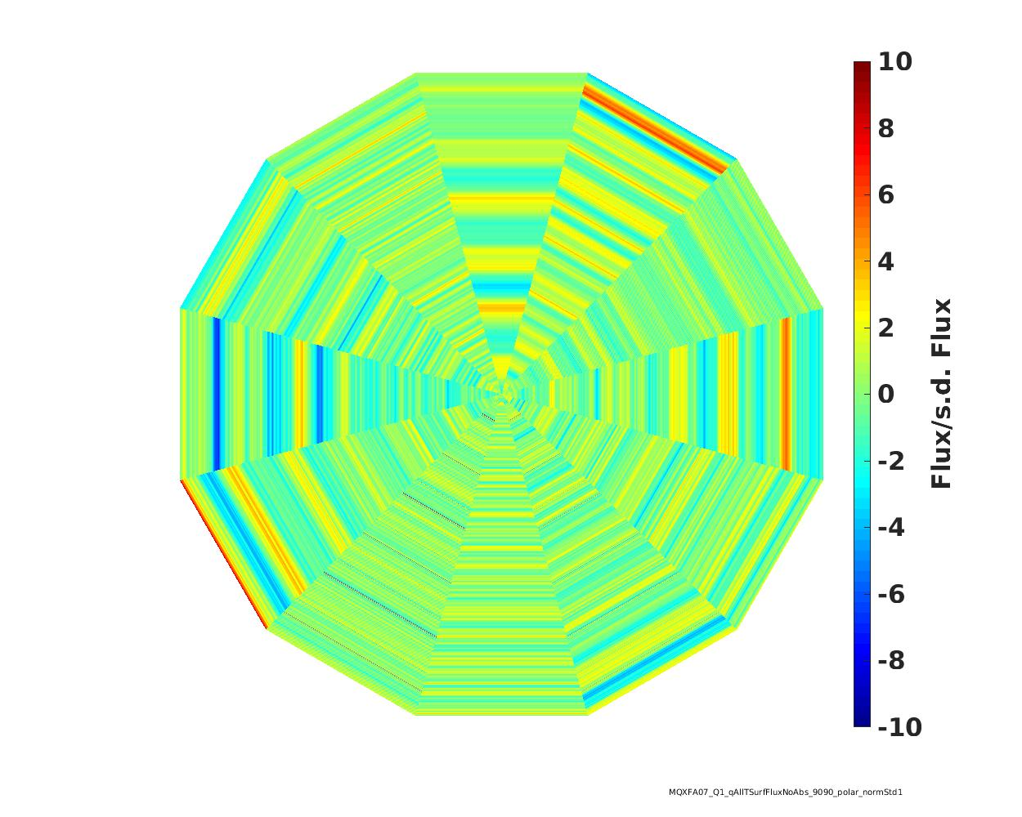
T0°
Quench#1
Q2
Q1
T90°
-0.05
-0.025
t=0
Q3
Q4
T180°

Slide 43
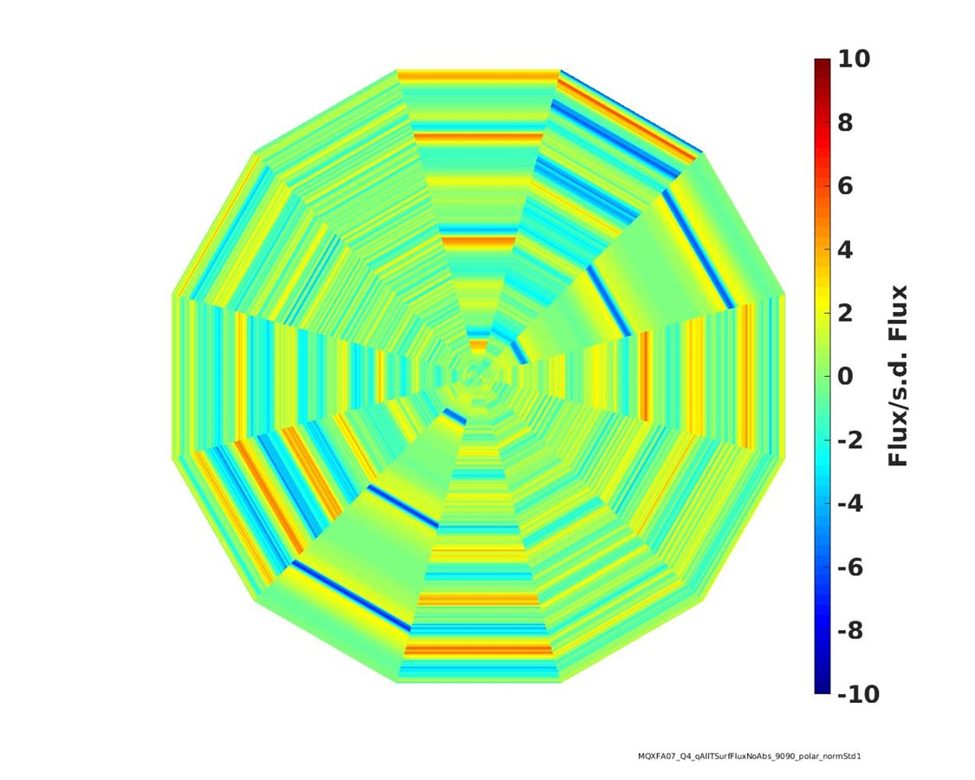
T0°
Quench#4
Q2
Q1
T90°
-0.05
-0.025
t=0
Q3
Q4
T180°

