Slide 1
News
K. Burkett
PPD Department Heads
1/17/24

Slide 2


Slide 3
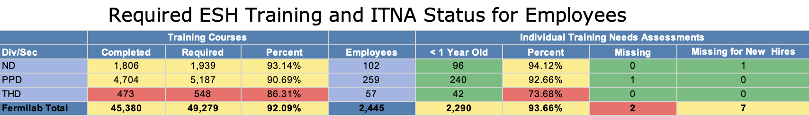
Training
Current status of required ESH training
This is for required ESH training, so we really need to do better
Please work with leaders in your teams to encourage people to catch up on their training
We can help you find out who is missing what course. Let us know if you need help
If a required course is not being offered, let us know and we can push on this.
In addition, there were several people who did not complete Harassment and Discrimination Prevention training in 2023. Our completion of this training is reported to the state of Illinois, so be sure that everyone in your group completes this training in 2024.

Slide 4
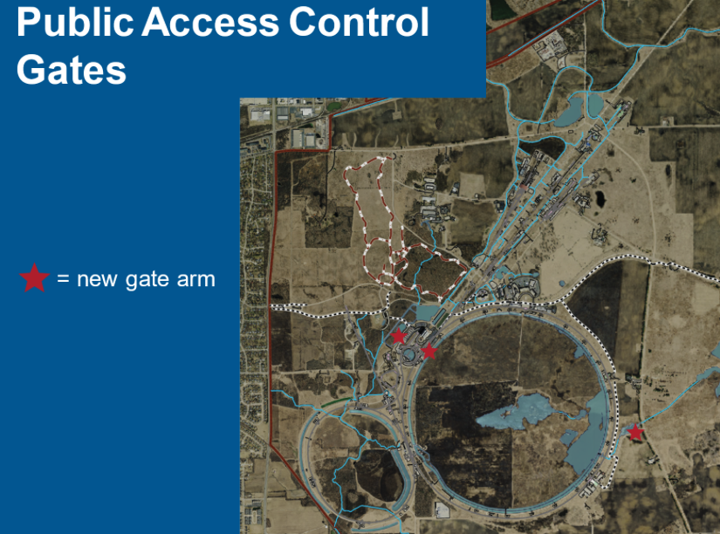
Site Access Update
Access Control Gates will be activated starting Monday, 1/22
  Will prevent inadvertent public access to much of accelerator complex
  All active badge holders have access (staff, users, affiliates, contractors) 24/7
Starting 1/23 we will be welcoming the public to visit Wilson Hall
Public will have unescorted access to Ground Floor (e.g. Credit Union), Ramsey Auditorium, Atrium, Café, 1-West, and Second Floor Art Gallery
  Will only need to show REAL-ID at gate
Wilson Hall front doors will be open during normal working hours
Small celebration being planned for 1/23
  Bring family/friend to lunch
  Remarks from Rep. Foster and other officials

Slide 5


Slide 6
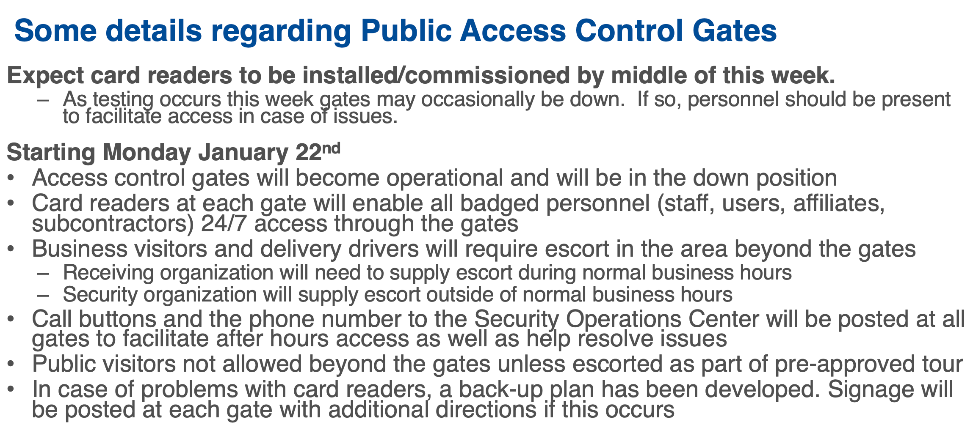
Site Access Update (2)
This is under discussion to find alternate solutions

Slide 7
Budgets (1)
We still have not received final guidance for FY24 because Congress has not yet passed a final budget, but we continue to plan based on the guidance received in October
Research and operations budgets are tight as expected. Still looking for opportunities to move some research effort to projects.
  Situation was presented to HEP by lab senior leadership in December and they are looking at how they can help us
HEP budget briefing March 21-22
  Normally this would be focused on plans for FY25-26 and we will still do that
  But this will also be an opportunity to discuss the situation in FY24
  We will be reaching out to B&R/Thrust owners for more information after we receive guidance on the briefing from Alan Stone

Slide 8
Budgets (2)
We have received some questions about the Program Support budget
While the PPDirectorate program support budget is up, our overall budget from indirects is down by about 10% ($1.4M) from FY23
  Some scope that was previously covered on G&A was moved to PS, without a compensating increase in budget, which has squeezed the PS budget
PS allocations were initially based on the input received from department heads in the FY24 planning process.
  Because of the overall PS budget reduction, some items had to be moved out of budget
  If you have specific questions about your PS allocation, please let us and finance know and we can setup a discussion

Slide 9
Promotions
We recently received the first half of our promotions budget for FY24, so it’s time to consider employees in your groups who should be considered for promotion this fiscal year.
If you have candidates you would like to bring forward, please send them to me and Brenna with specifics so that we can compile a list
For scientific promotions I have already been in contact with some of you. We received the list from FCSA of people due for extension/promotion this year
  Need to start preparing list of letter writers for those going up for promotion
  Are there others that should be considered this year?

Slide 10
Creating one Finance team and one Admin team for the directorate
As we continue toward a unified organization for the Particle Physics Directorate, we are merging our admins into one team and our finance people into one team
Being in one team, the admins will best be able to support each other, share best practices, and coordinate to support all our activities
Finance will be able to share best practices across the organization and provide backup for each other on some critical activities
No changes in admin assignments

Slide 11
Upcoming DOE reviews/briefings
Two DOE reviews currently planned for later this year
Theoretical Physics Research Review of National Laboratory programs – 4/22-26
Detector and Computing Operations review – tentatively week of 7/8 or 7/15
We will need finance support to prepare requested tables
Even for those not participating directly in the review, we may need your help reading documents or reviewing presentations
HEP budget briefing March 21-22
We will need help from B&R/Thrust owners on plans for FY25-26
More info when we receive instructions from Alan Stone

Slide 12
Lab Agenda
Lab agenda was introduced by Lia last year to track progress on key activities throughout the year
Science leads were asked to provide activities and milestones
320 of 444 milestones achieved in FY23
Need to prepare milestones for FY24
Marc/Doug have already started to assemble project milestones
I will be contacting you about science milestones for FY24

Slide 13
Lab Agenda – reminder from FY23

Slide 14
QA Assessment
Lab is doing an assessment of how we flow QA procedures/requirements throughout our organizations
Each organization is asked to respond to a series of questions. For example:
  What tools are used to plan and schedule work? Are there any organizational requirements documented to provide guidance on how to plan/schedule/perform work? Ex. Standard Operating Procedures
  Has the organization established training/mentoring programs?
  Are there any checks performed to catch quality issues before they occur?
  Is measuring and test equipment appropriately calibrated and maintained?
We have good answers to these questions.
Our response is due back to the QA team on 1/31. We will be assigning someone to collect this information from you.
  Please respond promptly
  Short answers are OK. No need to provide paragraphs of description.

