Slide 1
MQXFA17 Overtemp excursion on NbTi splice
D. Cheng, for the AUP team
January 16, 2024

Slide 2
Background
During the magnet splice operations two experienced technicians were assigned to make the second layer splice (“3/4” joint between Q1 and Q4)
When the operation was completed both technicians moved on to other tasks
Assumed that the other would turn off the variac that was controlling the heater
Approximately ~10 min. passed before building occupants started smelling burning G11
The variac was then powered off, but the G11 around the splice block was blackened by that time
No alarms or thermal protection were built into the splice tooling, since it was always supposed to be monitored for solder flow at ~200C, etc. when powered on
G11 discoloration was sanded/stoned for clean up, splice was packaged up as normal to stay stable while conditions were examined

Slide 3
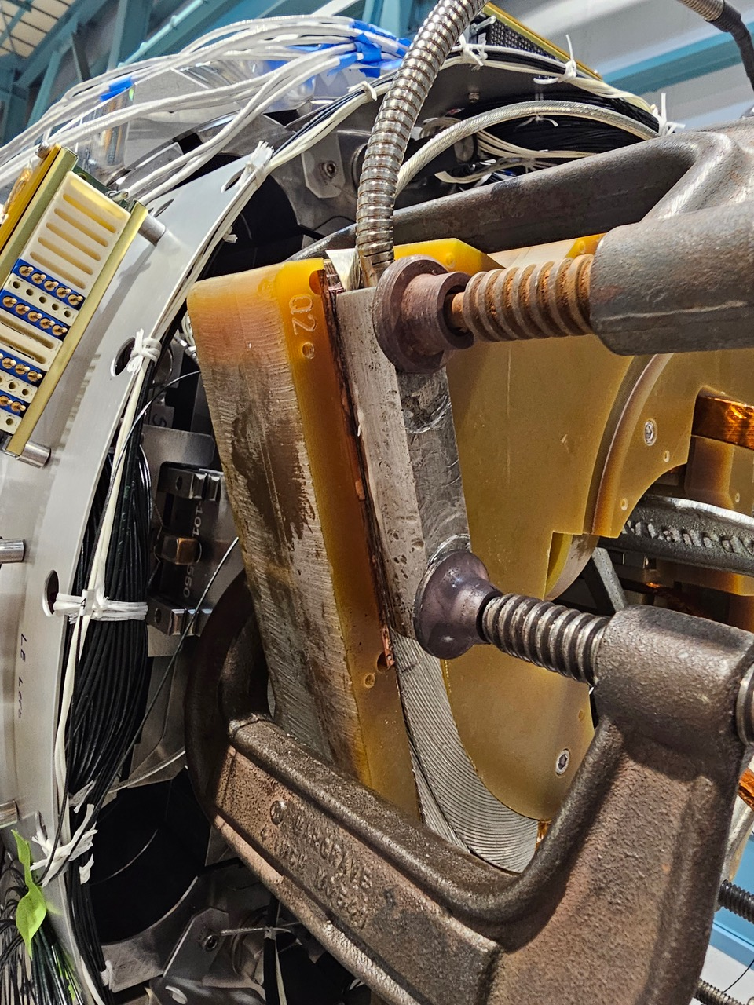
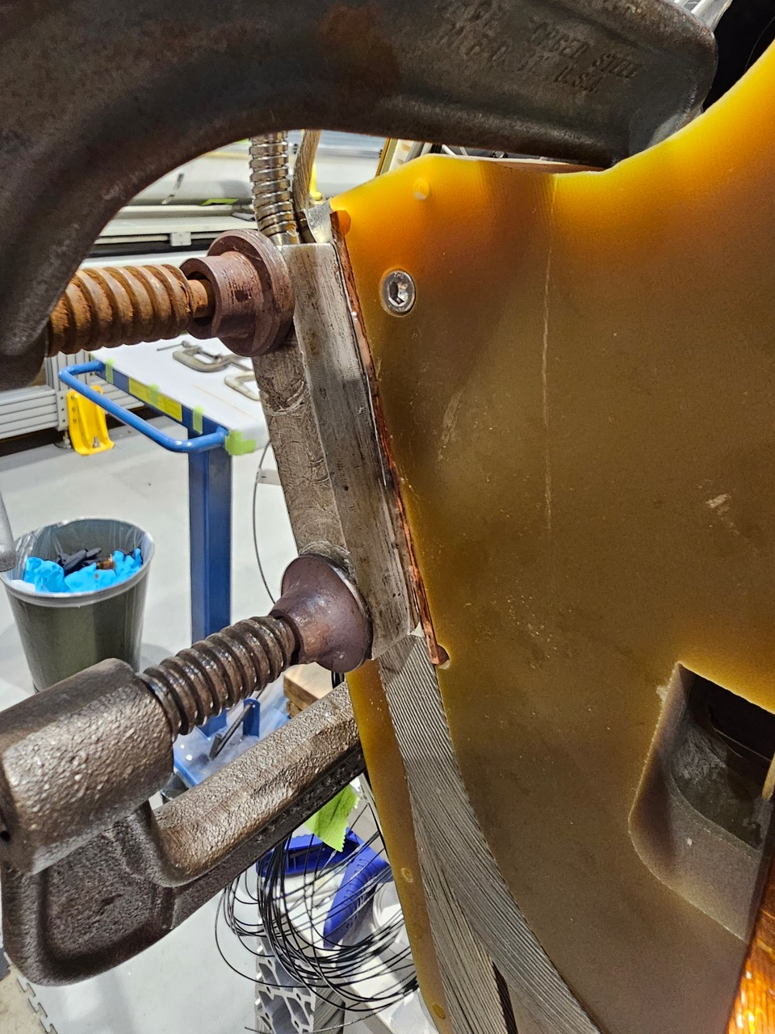
Background (2)
Splice joint setup

Slide 4
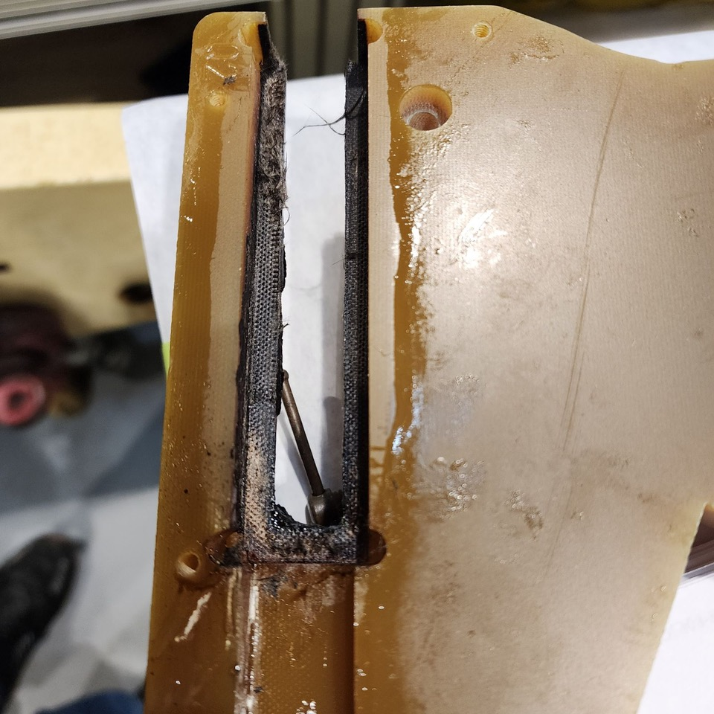
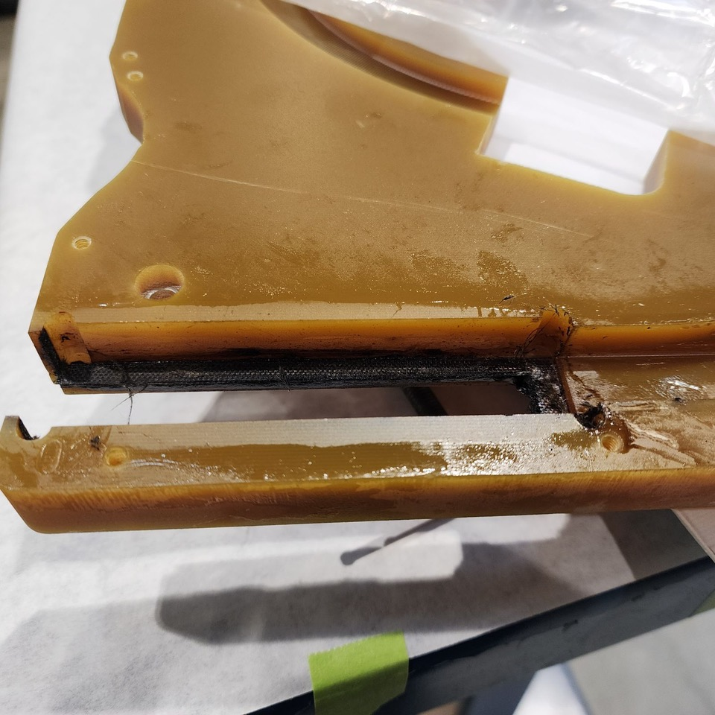
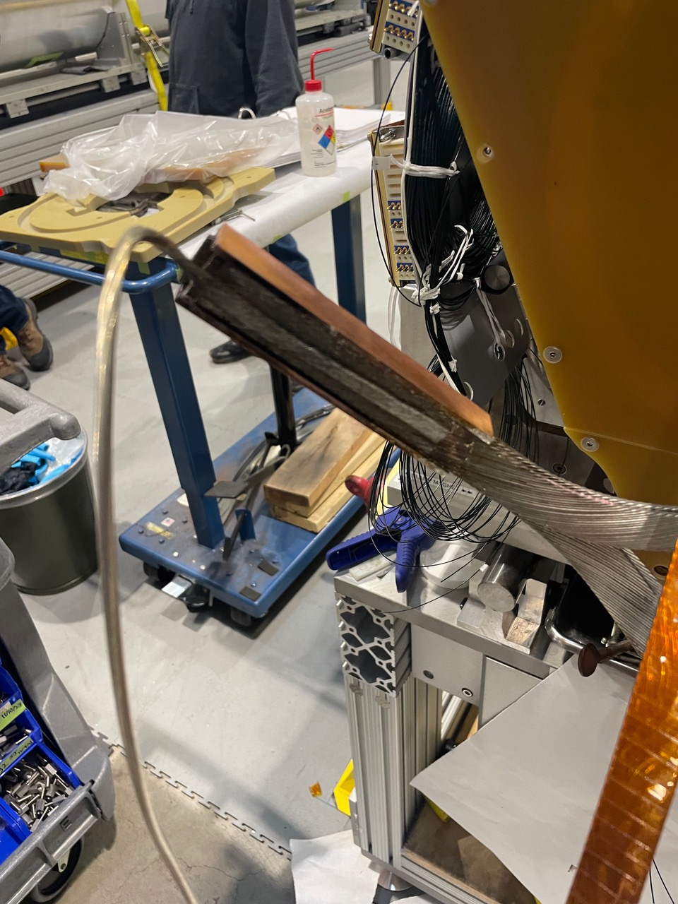
Background (3)

Slide 5
Preliminary Examination
Because no temperature monitoring was present the actual excursion was unknown
Flux burns off ~380 C, so temperature must have exceeded this value
Some sample G11 ”burn tests” were performed
One G11 pole key (bulk)
solder melts @ 190C approx 1 min 30 sec
Flux is gone @ 3 min 45 sec 380C
Discoloration @approx 380C-410C
Burnt G11 smell @ 410-415C
Visibly G11 burnt @ 480C
520c @6 min 30 sec
One thinner piece (~1/8” plate)
solder melts @ 190 1min 30sec
Flux is gone @ 3 min 45 sec 380C
~400 C visibly discoloring @ 4 min, and delaminating
Same clean up method Acetone and a wire brush after cool down
Preliminary conclusion from these tests is the the joint may be reached anywhere from 400C - 500C

Slide 6
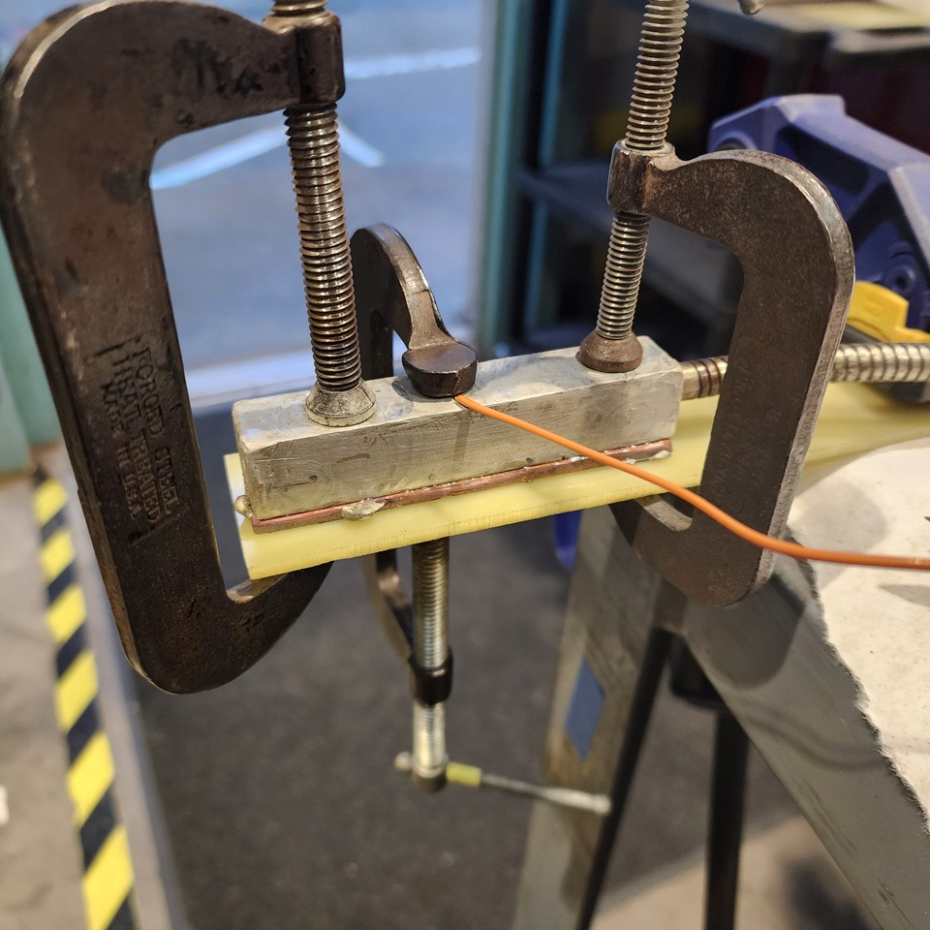
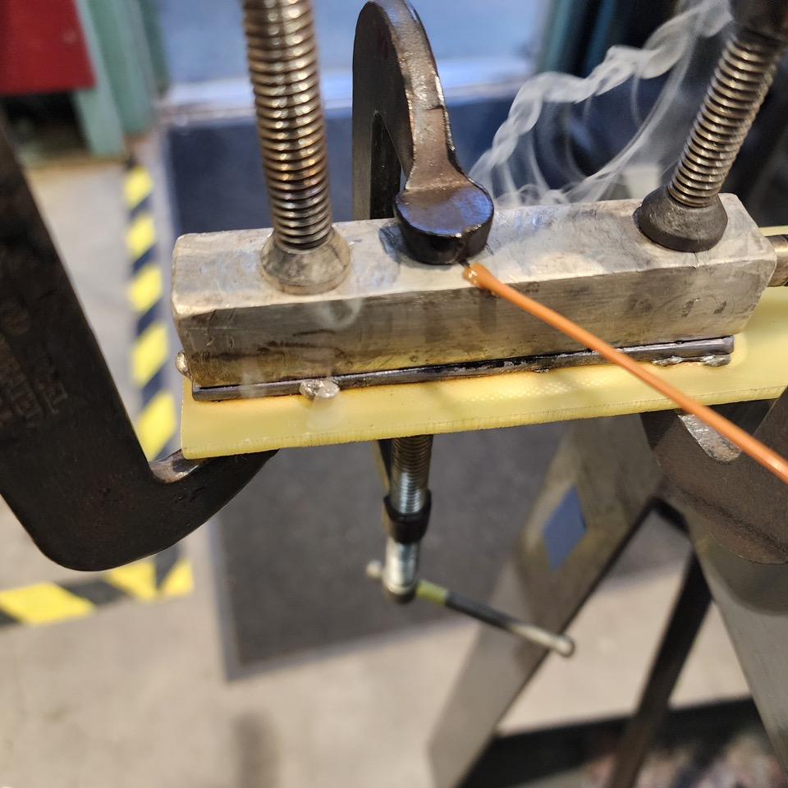
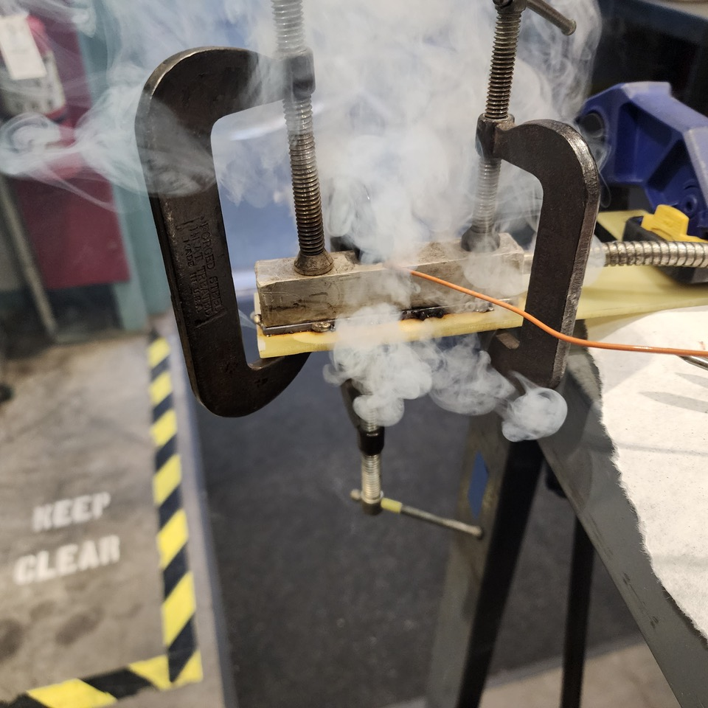
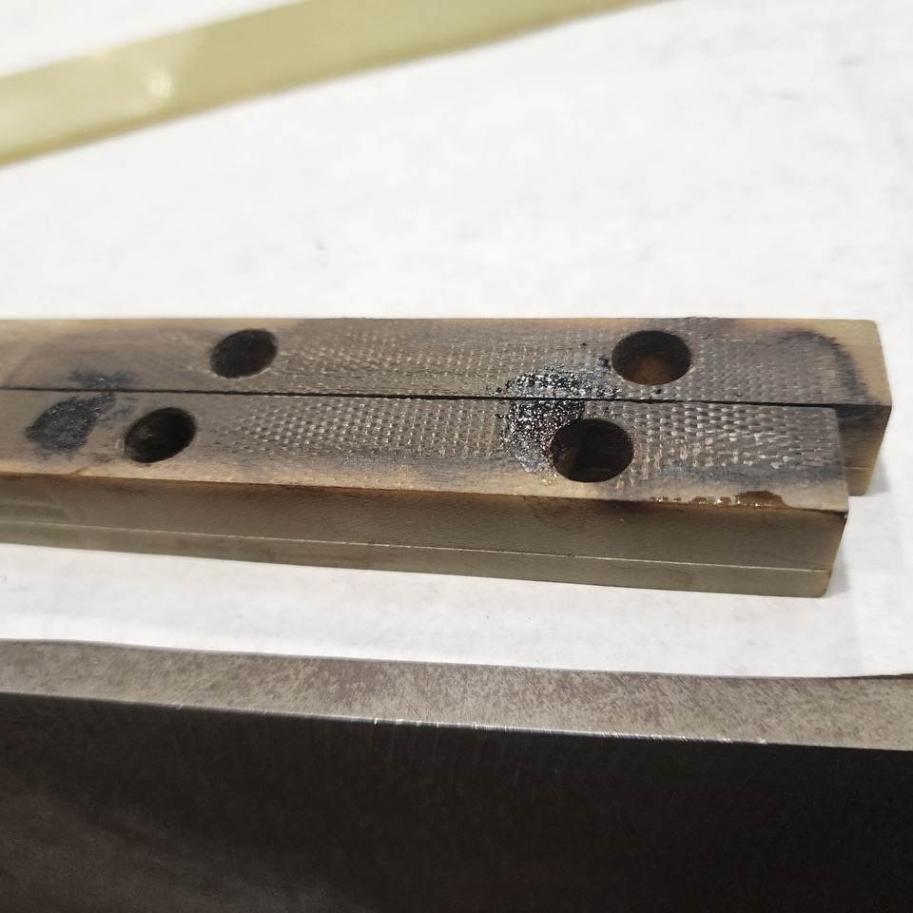
Preliminary Examination

Slide 7
Additional Examination Possible?
Can the CLIQ lead be used to determine temperature excursion in the joint?
Micrograph possible to compare with non-heated CLIQ lead?
This might be a NDE way to determine temperature excursion

Slide 8
Update
Splice joint was measured; currently showing 60 µohm resistance across the joint

