Slide 1


MQXFA12b
Magnets 302.2.02 and 03 –
• Strand Procurement & Testing
• Cable Fabrication & Testing
Lance Cooley – NHMFL/ASC (302.2.02 L3)
Vito Lombardo – FNAL (302.2.02 CAM)
Ian Pong – LBNL (302.2.03 L3 & CAM)
Mike Naus – LBNL (302.2.03 L3 Deputy & CAM Deputy)
Elizabeth Lee – LBNL
Jonathan Lee – LBNL Intern Student (now Grad Student at NHMFL)

Slide 2
Cable & Coil Overview
Coil # | Cable #
150 | P43OL1186
158 | P43OL1257
159 | P43OL1192
Spare. Already approved. Not reviewed here.
All cables are 2nd generation QXF cables produced under AUP

Slide 3
Cable QC Summary
All cables passed the required quality control testing per US-HiLumi-Doc 74
There were No Critical DRs

Slide 4
Cable 1192 (Coil 159)
DR Detail: 5 DRs

Slide 5
QXFA-159/ P43OL1192: RRR Reaction Temperatures
DR #12896 (1 of 5)
Issue: Inaccurate temperatures during first 33 h of 210°C plateau
Cause: Thermocouples plugged into wrong data logger ports
(i.e., calibrations were inaccurate)
Acceptance Justification
  Last ~15 h recorded correctly: Temperatures & range were good

Slide 6
QXFA-159/ P43OL1192: Ic Measurement
DR #12931 (2 of 5)
Issue: 1 of 3 primary I_{c} strands was unable to be measured
Cause: Unknown. Believed to be sample mounting issue.
Acceptance Justification
  Back-up sample successfully measured and acceptable, thus meeting the requirement

Slide 7
QXFA-159/ P43OL1192: Accelerometer Data
DR #12946 (3 of 5)
Issue: 1 of 2 shipment accelerometers had no data
Cause: Battery failure
Acceptance Justification
  Data from working accelerometer was passing
  Preventative Action: Batteries replaced on all accelerometers

Slide 8
QXFA-159/ P43OL1192: Insulation Thickness
DR #13170 & 13348 (4&5 of 5)
Issue: No insulation thickness verification measurement at LBNL
Cause:
Cable instability at braiding vendor 2x when starting at cable’s tail end
  Repaired at LBNL after 1st failure
  Cable sent to FNAL after 2nd failure for respooling in opposite direction to spool from cable’s point end
Instability caused by vendor crossing-over cable during work pauses to temporarily hold cable (No photos. Issue fixed: Clamp implemented.)
To maximize amount of stable conductor for coil winding, insulation verification sample not taken
Acceptance Justification
  Good insulation thickness correlation between LBNL verification and vendor’s data for previous cables
  Original unstable section will be part of ‘cable drops’ after coiling
  Cable successfully braided in presence of L3 (Ian Pong)

Slide 9
Cable 1257 (Coil 158)
DR Detail: 2 DRs

Slide 10
QXFA-158/ P43OL1257: RRR Reaction Temperatures
DR #12324 (1 of 2)
Issue 1: Sample reaction TCs outside of calibration window
Issue 2: Range of TC values along the sample length during HT plateaus varied by more than 2 °C.
210C Plateau: Range = 4.2 °C
400C Plateau: Range = 6.0 °C
665C Plateau: Range = 7.0 °C
Cause 1: Unable to calibrate TCs in RRR furnace, as built (fixed)
Cause 2: TC drift coupled with the inability to calibrate.
Acceptance Justification
  Quartz-encapsulated witness wire RRR was within normal range
  Average temperatures within the ±5°C spec
  210C Plateau, Average = 211.9 °C
  400C Plateau, Average = 400.8 °C
  665C Plateau, Average = 667.5 °C

Slide 11
QXFA-158/ P43OL1257: Cable Residual Twist
DR #12366 (2 of 2)
Issue: Cable residual twist 5° above upper spec (155° vs 150°)
Cause: Unknown. Process variation.
Acceptance Justification
  FNAL had previously stated this is not a hard limit
    Cable at 170° previously allowed without issue (Cable #1161)

Slide 12
END
[Back-Up Slides Below]

Slide 13
Strand Summary
All strands ordered per the “HiLumi” specification under the AUP program, per the following POs:
  FNAL PO 646116 SA1 Shipment E
  FNAL PO 655175 Shipment A
  FNAL PO 667037 Shipment D
Conductor Description:
  Ø0.85 mm, 108/127 stack, Ti-doped, Reduced-Sn core

Slide 14
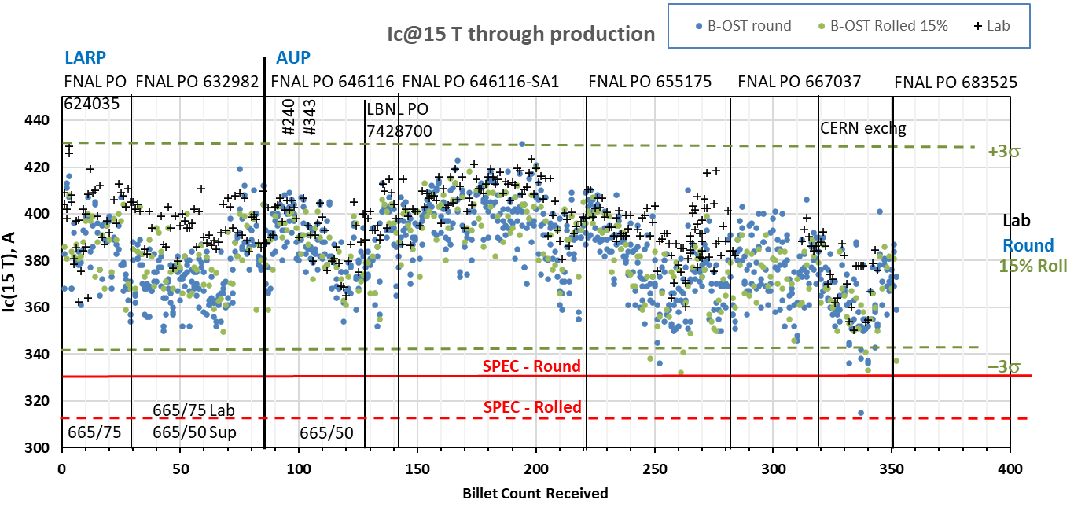
Strand Production Data – I_{c, 15T}
Yellow boxes indicate strand data for this cables
Both 665°C/75h
S: 665°C/50h
V: 665°/75h
Both 665°C/50h

Slide 15
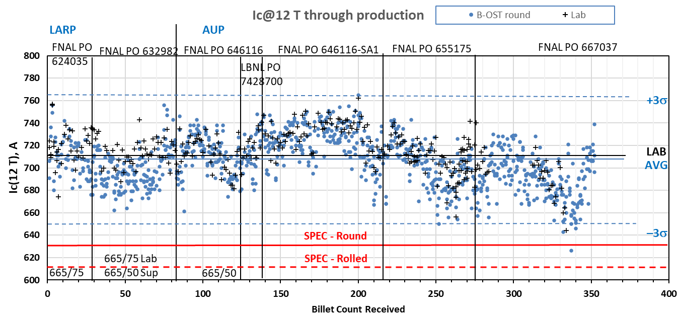
Strand Production Data – I_{c, 12T}
Yellow boxes indicate strand data for this cables
Both 665°C/50h
Both 665°C/75h
S: 665°C/50h
V: 665°/75h

Slide 16
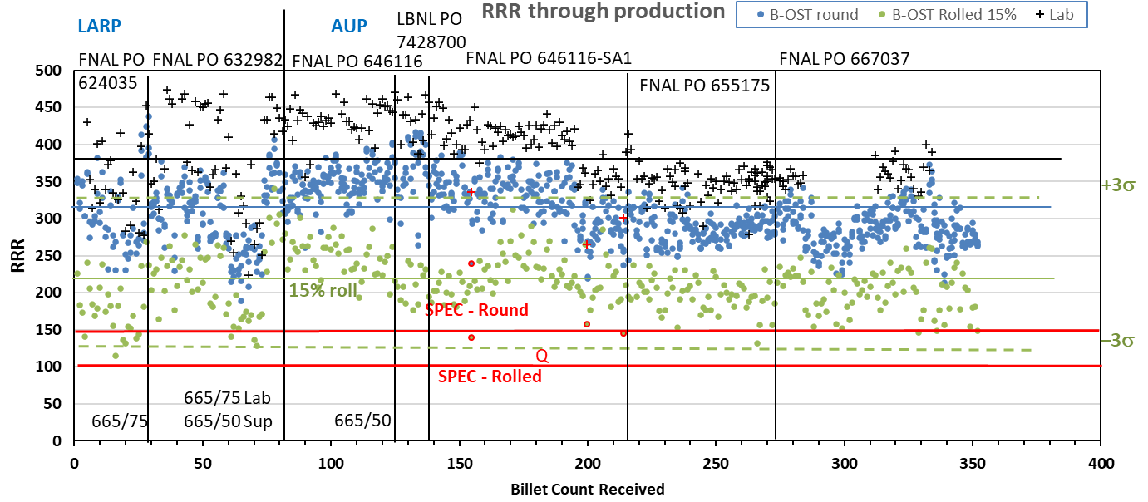
Strand Production Data - RRR
Data for 15% rolled strand predicts the RRR at cable sharp bend
Lab: IEC method, Supplier: 20K method
Inter-lab comparisons have validated approaches (see QP)
Yellow boxes indicate strand data for this cables

Slide 17
QXFA-159 / P43OL1192

Slide 18
P43OL1192 – Cable Date, Lengths
Cable Manufacture Date
  14 Apr 2022 (Production run)
Cable Length:
  466 m (LBNL, fabricated, including LBNL samples)

Slide 19
P43OL1192 – Strand and SS Core ID
Spool:
  PO08S00677A02U x 12 ULs
  PO08S00683A01U x 8 ULs
  PO08S00683A02U x 8 ULs
  PO08S00686A01U x 12 ULs
Core:
  120L43A7400804
    Heat: 850858. Lot: 17-521
    Material: 316L
    Chemical Properties CoT/CoC #187781-1: 0.16 wt% Co
    Core width: 12.0 mm
From 3 billets

Slide 20
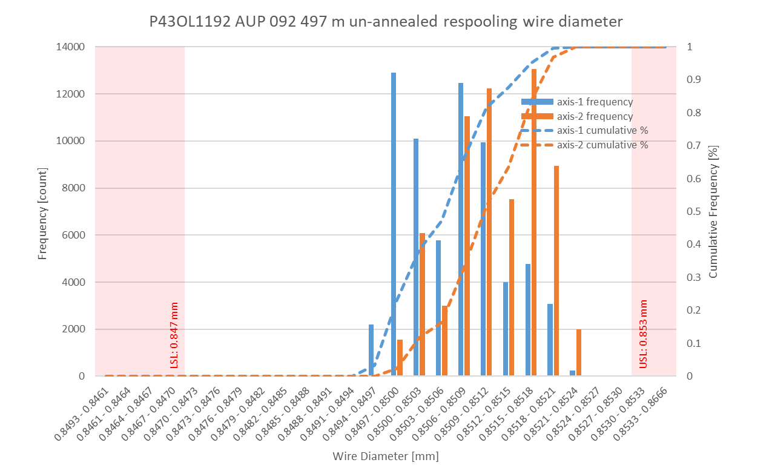
P43OL1192 Respooling Wire Diameter
Below LSL: 0.000%
Above USL: 0.014%

Slide 21
P43OL1192 – Cable QC Data Summary
CME:
Residual Twist: 150°
10-stack:
  Qualification: 1.533 mm
  Production tail end: 1.532 mm
 | Pressure (MPa) | Angle (°) | Width (mm) | Thickness (mm)
Maximum | 16.9 | 0.398 | 18.160 | 1.529
Average | 16.8 | 0.374 | 18.136 | 1.521
Minimum | 16.8 | 0.357 | 18.129 | 1.518
Sigma | 0.01 | 0.007 | 0.004 | 0.002

Slide 22
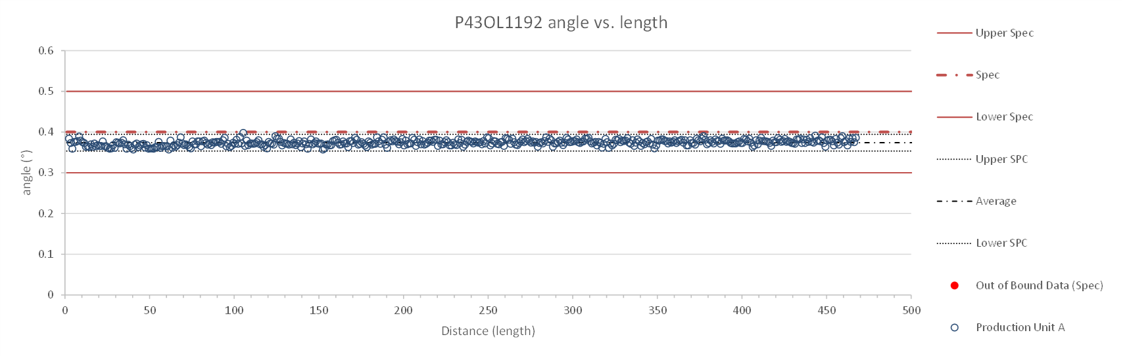
Rollers: P-93 (2021-08-09) & P-94 (2021-08-09)

Slide 23
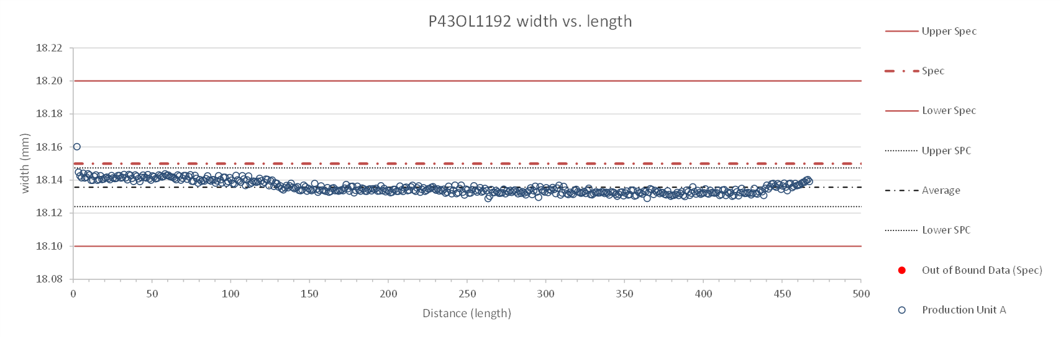
Rollers: P-93 (2021-08-09) & P-94 (2021-08-09)

Slide 24
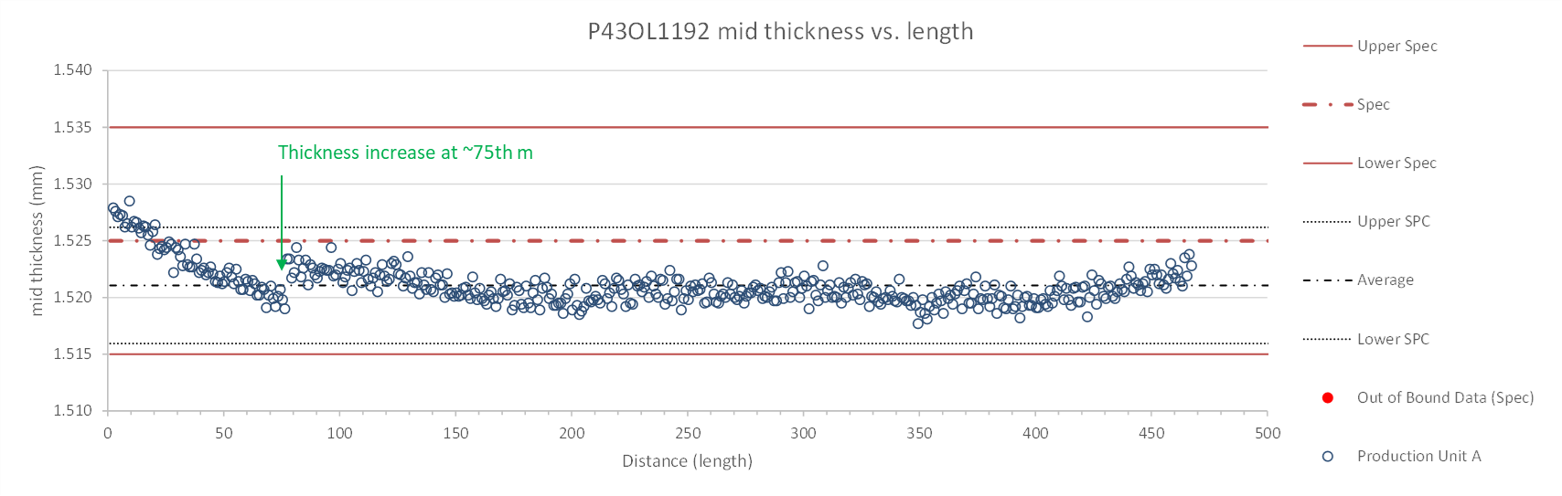
Rollers: P-93 (2021-08-09) & P-94 (2021-08-09)

Slide 25
P43OL1192 – Braiding
Fiberglass Lot: #RCV00011562
P/I: 18.9
Spool tension: 10 lbs. @ payoff. 20 lbs. @ takeup (12 lbs min)
Bobbin payoff tension: 0.125 lbs. ≤ T ≤ 0.250 lbs.
Insulation Thickness (at 5 MPa)
Site | Cycle #1 (mm) | Cycle #2 (mm) | Cycle #3 (mm) | Average (mm)
NEWT | 0.150 | 0.148 | 0.147 | 0.148
LBNL Verification* | N/A | N/A | N/A | N/A
*See DRs 13170 & 13348

Slide 26
P43OL1192 – Wire Parameters
Properties | Inspected Average
Wire Diameter | 0.8509 ± 0.001 mm (LBNL)¹
Cu ratio ª | 54.31% (BOST)
Strand twist pitch ª | 19.5mm (BOST)
RRR (RW) ª | 301 (BOST)
RRR (15% rolled) ª | 220 (BOST)
I_{C} (4.2 K, 15 T) ª | 370 A (BOST)
I_{C} (4.2 K, 14 T) ª | 461 A (BOST)
I_{C} (4.2 K, 13 T) ª | 567 A (BOST)
I_{C} (4.2 K, 12 T) ª | 685 A (BOST)
ª First billet averaged, then weighted average according
to the spool distribution in the cable
¹ As-received. LBNL respooling data. Mean ± 1 sigma

Slide 27
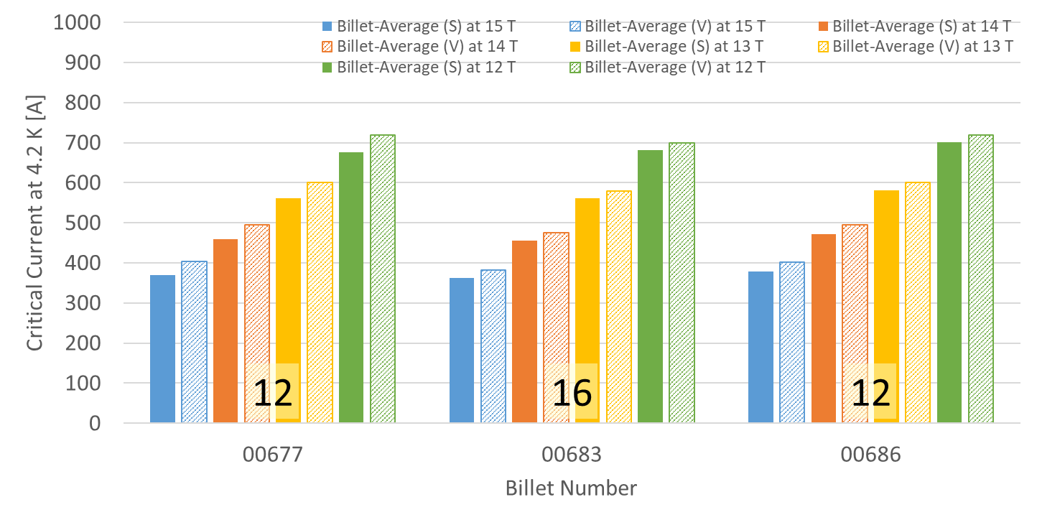
P43OL1192 – Wire Parameters
Supplier (S) and Verification (V) I_{C} Data
Number of spools from that billet used in the cable

Slide 28
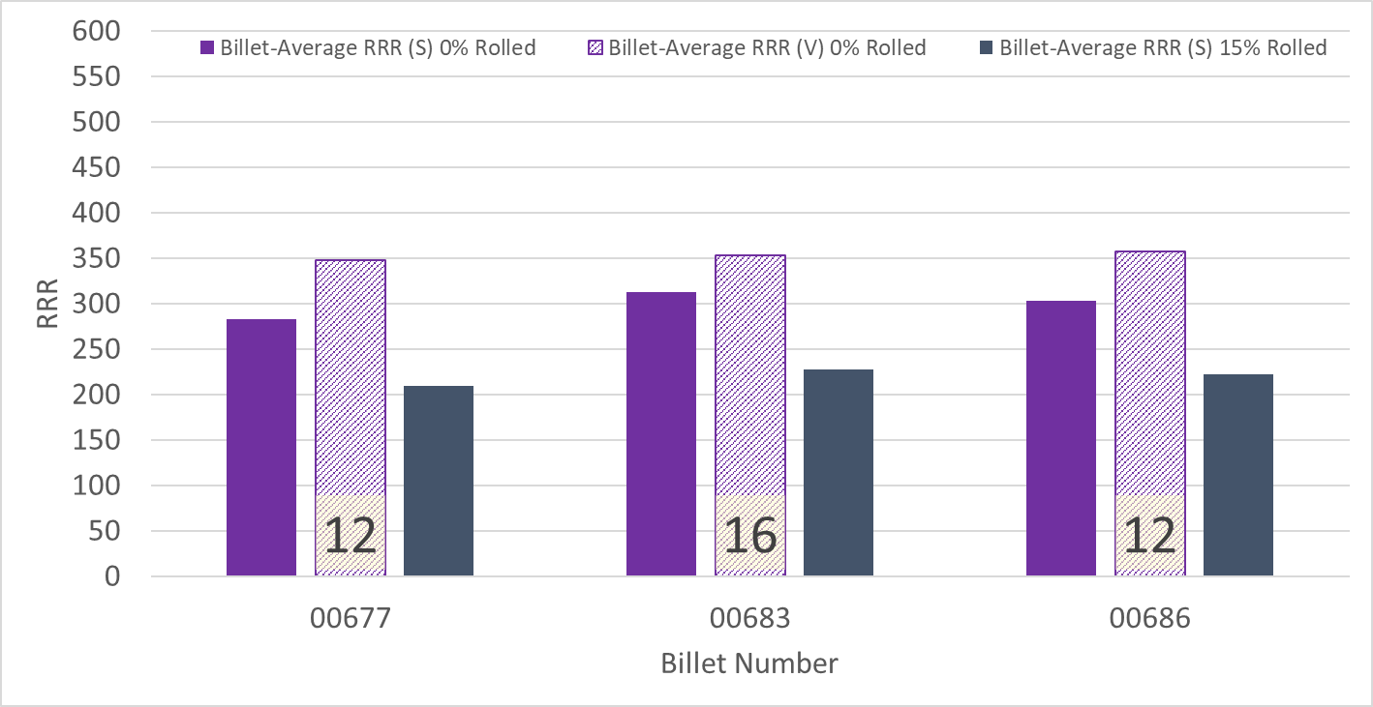
P43OL1192 – Wire Parameters
Supplier (S) and Verification (V) RRR Data
Number of spools from that billet used in the cable

Slide 29
P43OL11192 – Extracted Strand RRR
Cable ID | No. of Units from Billet (spool) | Heat Treat/ Sample ID | Major Edge RRR | Minor Edge RRR | Straight 1 RRR | Straight 2 RRR
PO08S00677A02U P43OL1192AE03E | 12 (12) | LRLK220523ALC1 | 307 | 272 | 326 | 345
PO08S00677A02U P43OL1192AE05E | 12 (12) | LRLK220523ALC1 | 299 | 276 | 331 | 347
PO08S00683A01U P43OL1192AE19E | 16 (8) | LRLK220523ALC1 | 285 | 260 | 328 | 321
PO08S00686A01U P43OL1192AE43E | 12 (12) | LRLK220523ALC1 | 286 | 251 | 325 | 333
PO08S00686A01U P43OL1192AE45E | 12 (12) | LRLK220523ALC1 | 294 | 279 | 342 | 346

Slide 30
P43OL1192 – I_{c}, Cable Qual Samples
Wire/ Cable Strand | I_{c}(A) at Field (T)
 | 12 T | 13 T | 14 T | 15 T
PO08S00686A01U P43OL1192AE43E | 614 | 513 | 422 | 347
PO08S00683A01U P43OL1192AE19E | 653 | 540 | 439 | 352
PO08S00677A02U P43OL1192AE03E | 662 | 543 | 444 | 357

Slide 31
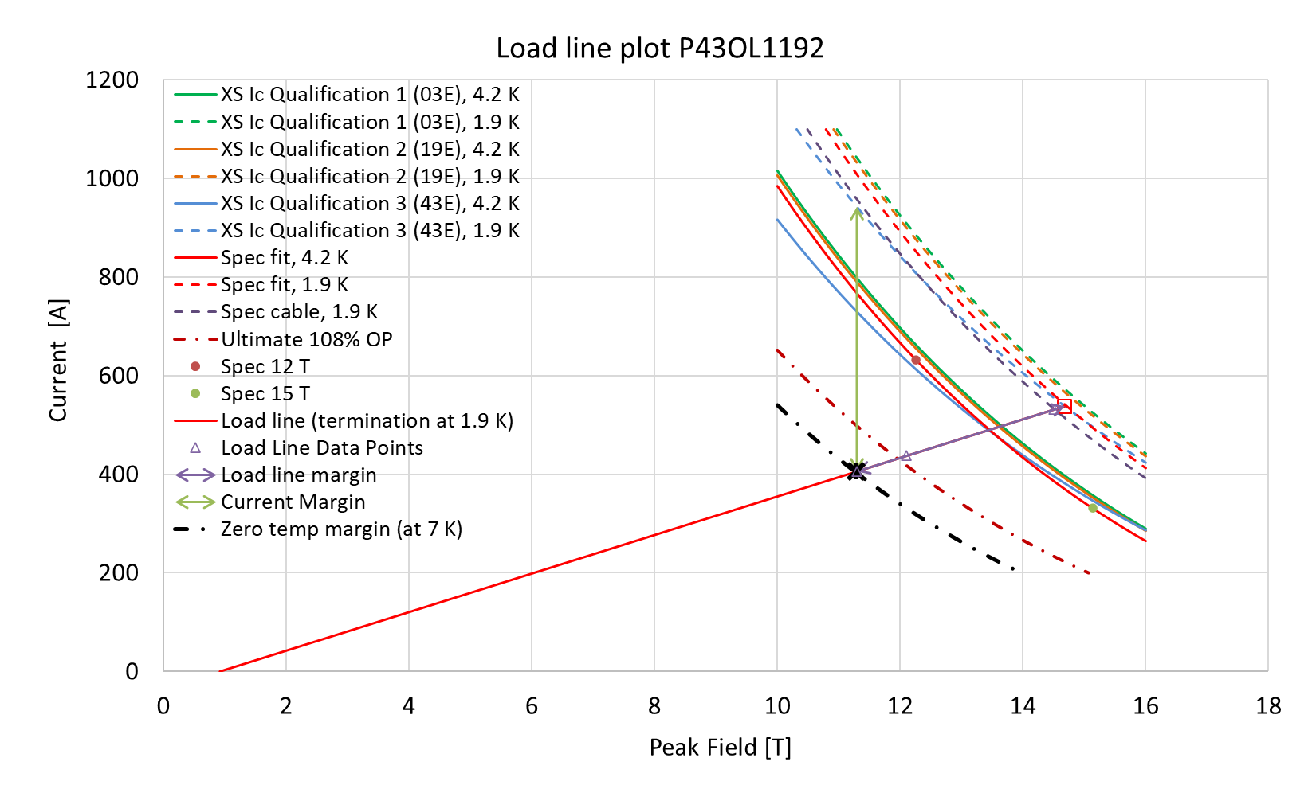
P43OL1192 – SSL Plot, Cable Qual Samples

Slide 32
P43OL1192 – SSL Margins, Qual Samples
Strand from which Margin is Calculated: | Strand # 43E @ 1.9 K
Margins | Margin | Operating Point (X)
Load Line Margin (Purple Arrow) | 24.6% | 75.4%
Current Margin (Green Arrow) | 56.9% | 43.1%
Temperature Margin (K) | 5.1 | 7.0
Limits | Strand | Strand x 40
Selected Strand’s Current (A) at Margin-Calculation Field | 942 | 37697
Selected Strand’s Current (A) at 100% SSL | 538 | 21524
Selected Strand’s Field (T) at 100% SSL | 14.7

Slide 33
QXFA-158 / P43OL1257

Slide 34
P43OL1257 – Cable Date, Lengths
Cable Manufacture Date
  16 Feb 2021 (Production run)
Cable Length:
  469 m (LBNL, fabricated, including LBNL samples)

Slide 35
P43OL1257 – Strand and SS Core ID
Spool:
  PO08S00078A04U x 1 ULs
  PO08S00517A02U x 14 ULs
  PO08S00519A01U x 3 ULs
  PO08S00519A02U x 7 ULs
  PO08S00519A03U x 4 ULs
  PO08S00520A03U x 11 Uls
  PO08S00535A02U x 1 ULs
Core:
  120L08A7400804
    Heat: 850858. Lot: 17-521
    Material: 316L
    Chemical Properties CoT/CoC #187781-1: 0.16 wt% Co
    Core width: 12.0 mm
From 5 billets

Slide 36
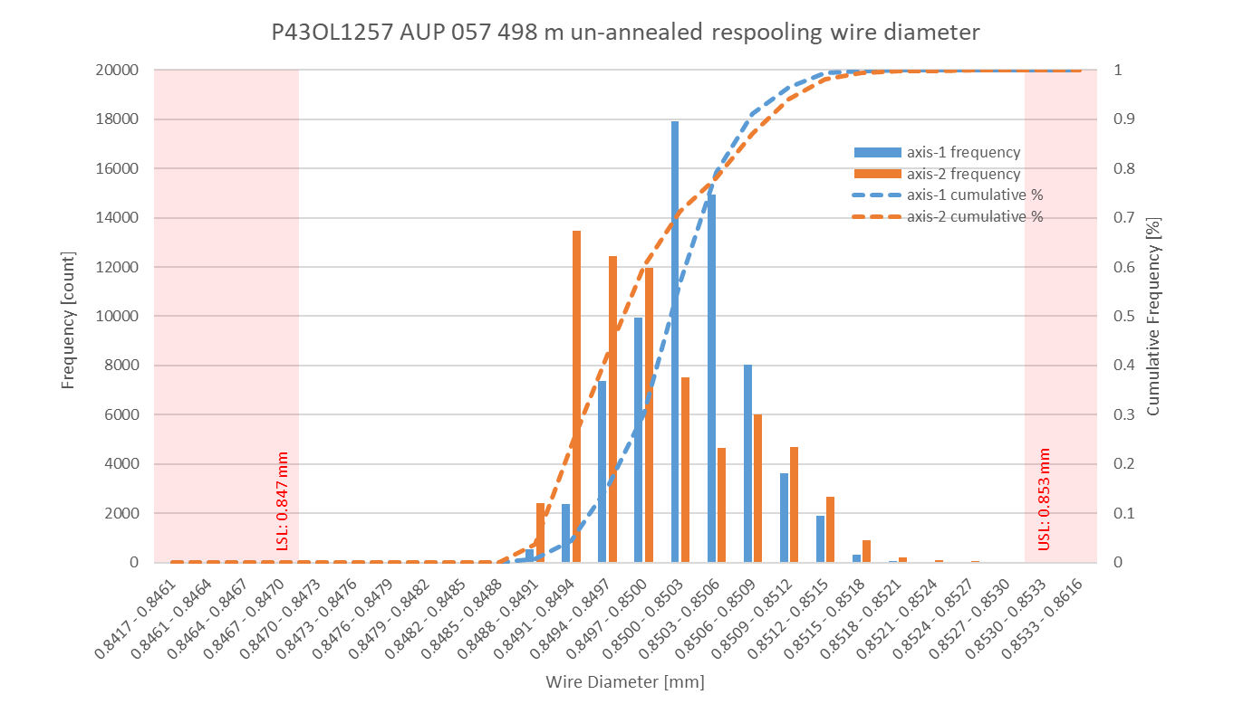
P43OL1257 Respooling Wire Diameter
Below LSL: 0.005%
Above USL: 0.008%

Slide 37
P43OL1257 – Cable QC Data Summary
CME:
Residual Twist: 155°
10-stack:
  Qualification: 1.538 mm
  Production tail end: 1.528 mm
 | Pressure (MPa) | Angle (°) | Width (mm) | Thickness (mm)
Maximum | 17.2 | 0.444 | 18.160 | 1.531
Average | 17.1 | 0.429 | 18.139 | 1.521
Minimum | 16.7 | 0.412 | 18.133 | 1.518
Sigma | 0.03 | 0.006 | 0.003 | 0.002

Slide 38
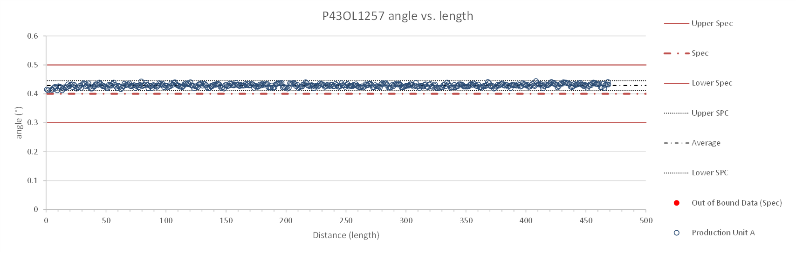
Rollers: P-93 (2020 09 02) & P-94 (2020 09 02)

Slide 39
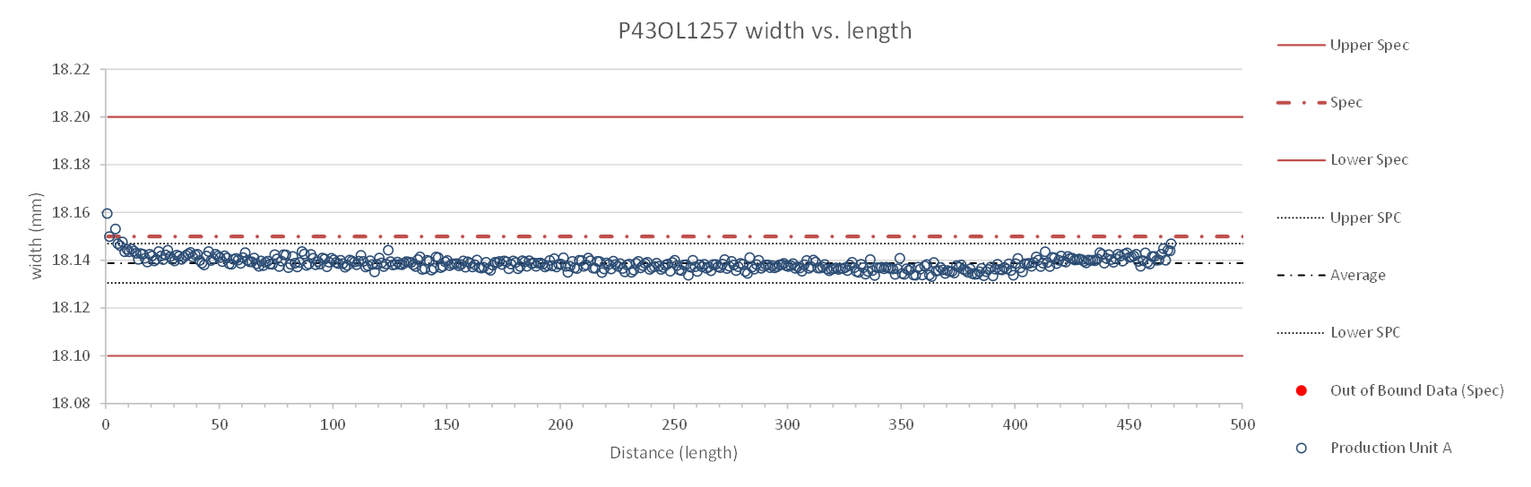
Rollers: P-93 (2020 09 02) & P-94 (2020 09 02)

Slide 40
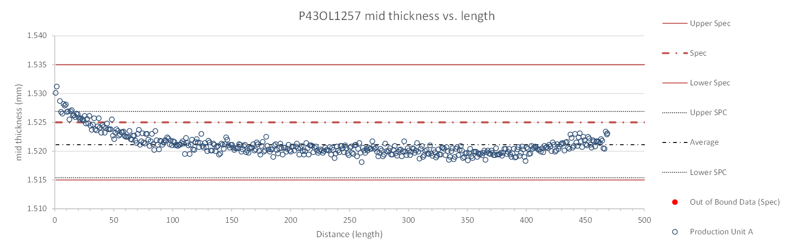
Rollers: P-93 (2020 09 02) & P-94 (2020 09 02)

Slide 41
P43OL1257 – Braiding
Fiberglass Lot: #111154
P/I: 18.0
Spool tension: 10 lbs. @ payoff. 20 lbs. @ takeup (12 lbs min)
Bobbin payoff tension: 0.125 lbs. ≤ T ≤ 0.250 lbs.
Insulation Thickness (at 5 MPa)
Site | Cycle #1 (mm) | Cycle #2 (mm) | Cycle #3 (mm) | Average (mm)
NEWT | 0.142 | 0.140 | 0.139 | 0.140
LBNL Verification | 0.143 | 0.140 | 0.139 | 0.141

Slide 42
P43OL1257 – Wire Parameters
Properties | Inspected Average
Wire Diameter | 0.8501 ± 0.001 mm (LBNL)¹
Cu ratio ª | 53.82% (BOST)
Strand twist pitch ª | 19.0mm (BOST)
RRR (RW) ª | 324 (BOST)
RRR (15% rolled) ª | 241 (BOST)
I_{C} (4.2 K, 15 T) ª | 408 A (BOST)
I_{C} (4.2 K, 14 T) ª | 505 A (BOST)
I_{C} (4.2 K, 13 T) ª | 615 A (BOST)
I_{C} (4.2 K, 12 T) ª | 739 A (BOST)
ª First billet averaged, then weighted average according
to the spool distribution in the cable
¹ As-received. LBNL respooling data. Mean ± 1 sigma

Slide 43
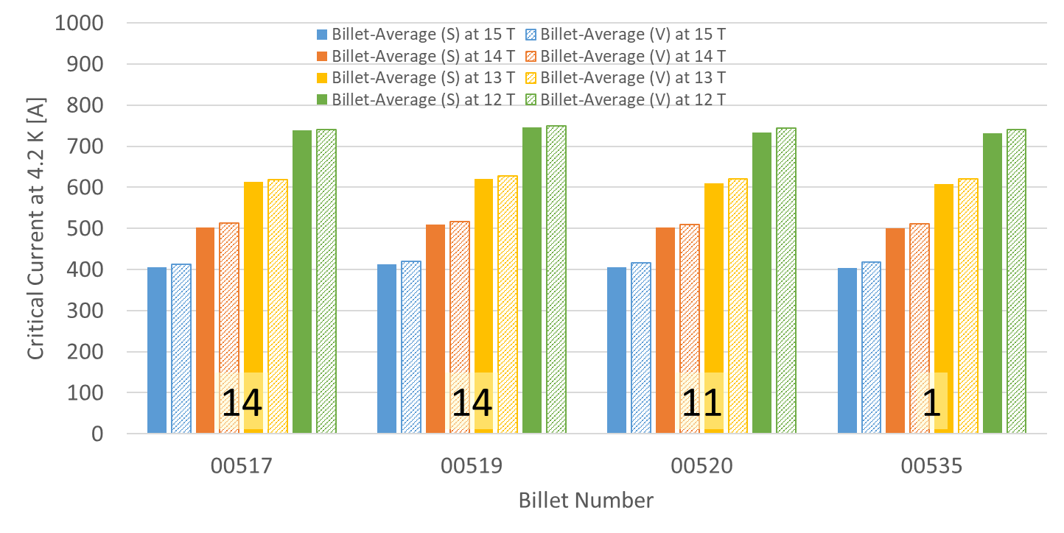
P43OL1257 – Wire Parameters
Supplier (S) and Verification (V) I_{C} Data
Number of spools from that billet used in the cable

Slide 44
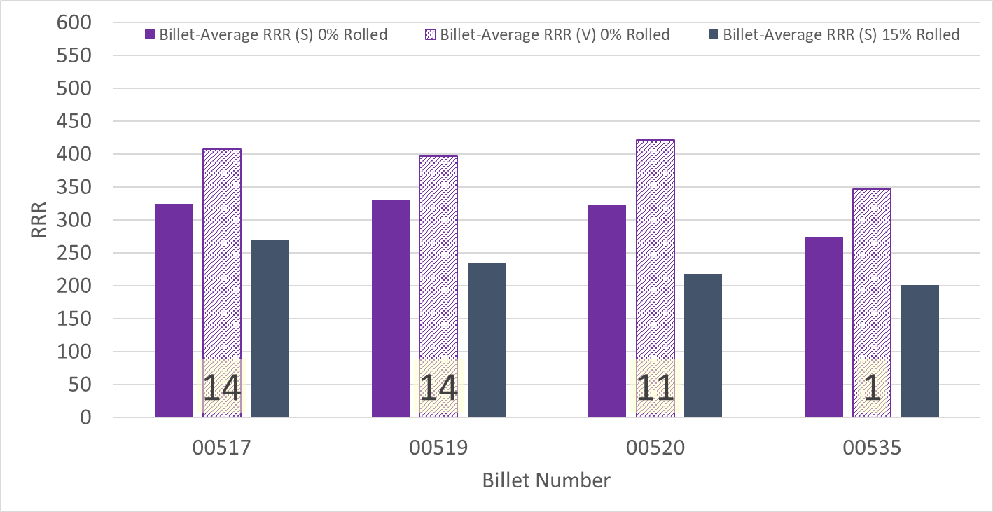
P43OL1257 – Wire Parameters
Supplier (S) and Verification (V) RRR Data
Number of spools from that billet used in the cable

Slide 45
P43OL1257 – Extracted Strand RRR
Cable ID | No. of Units from Billet (spool) | Heat Treat/ Sample ID | Major Edge RRR | Minor Edge RRR | Straight 1 RRR | Straight 2 RRR
PO08S00517A02U P43OL1257AE06E | 14 (14) | LRLK210219ALC1 | 357 | 245 | 363 | 341
PO08S00517A02U P43OL1257AE07E | 14 (14) | LRLK210219ALC1 | 322 | 266 | 381 | 372
PO08S00519A02U P43OL1257AE29E | 14 (7) | LRLK210219ALC1 | 353 | 233 | 365 | 358
PO08S00519A03U P43OL1257AE39E | 14 (4) | LRLK210219ALC1 | 289 | 225 | 326 | 314
PO08S00520A03U P43OL1257AE45E | 11 (11) | LRLK210219ALC1 | 371 | 248 | 360 | 349

Slide 46
P43OL1257 – I_{c}, Cable Qual Samples
Wire/ Cable Strand | I_{c}(A) at Field (T)
 | 12 T | 13 T | 14 T | 15 T
PO08S00517A02U P43OL1257AE06E | 710 | 589 | 484 | 389
PO08S00520A03U P43OL1257AE45E | 712 | 592 | 484 | 391
PO08S00519A02U P43OL1257AE29E | 726 | 606 | 498 | 402

Slide 47
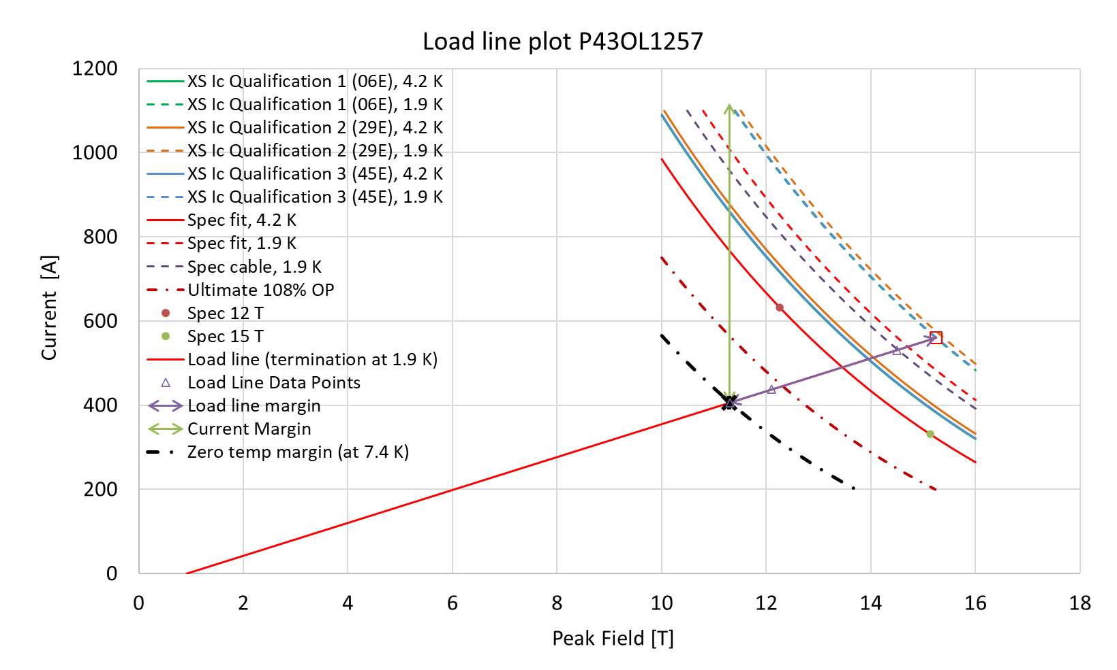
P43OL1257 – SSL Plot, Cable Qual Samples

Slide 48
P43OL1257 – SSL Margins, Qual Samples
Strand from which Margin is Calculated: | Strand # 06E @ 1.9 K
Margins | Margin | Operating Point (X)
Load Line Margin (Purple Arrow) | 27.6% | 72.5%
Current Margin (Green Arrow) | 63.7% | 36.3%
Temperature Margin (K) | 5.5 | 7.4
Limits | Strand | Strand x 40
Selected Strand’s Current (A) at Margin-Calculation Field | 1118 | 44707
Selected Strand’s Current (A) at 100% SSL | 560 | 22401
Selected Strand’s Field (T) at 100% SSL | 15.2

