Slide 1
Coil ordering in MQXFA12b based on conductor properties
Maria Baldini, Vittorio Marinozzi

Slide 2
MQXFA12 cables: RRR estimations
Maximum coil to ground voltage at quench with ordering: 353 V (EDMS 1963398, Us-HiLumi Docdb 879)
COIL | CABLE
158 | P43OL1257
159 | P43OL1192
224 | P43OL1148
225 | P43OL1149
150 | P43OL1186
Rolled and minor edge extracted samples used to estimate RRR of the coil
Each cable: 40 strands in parallels coming from several spools
Spools come from different billets.
There is one rolled sample value per billet.
If the Cu/NCu value of the spool used for the cable is not present, the Cu/NCu of a particular spool is estimated averaging data from spools belonging to the same billet.
A weighted mean (weight= # of strands) is used to estimate cable RRR rolled samples and Cu/NCu values.
Minor and Major edge extracted samples are collected only from the most represented billets. Values are averaged
Witness sample RRR are also collected on representative billets. Data are not measured anymore starting from cable 1134

Slide 3
MQXFA12b coils
COIL | RRR (rolled) | RRR (minor edge) | RRR (major edge)
158 | 241.02 | 243.4 | 338.4
159 | 220.1 | 267.6 | 294.2
224 | 205.62 | 222.8 | 339.8
225 | 216.3 | 217.4 | 333
150 | 188.42 | 259.8 | 272
COIL | Cu/NCu
158 | 1.148
159 | 1.188
224 | 1.162
225 | 1.163
150 | 1.181

Slide 4
MQXFA12b coil RRR

Slide 5
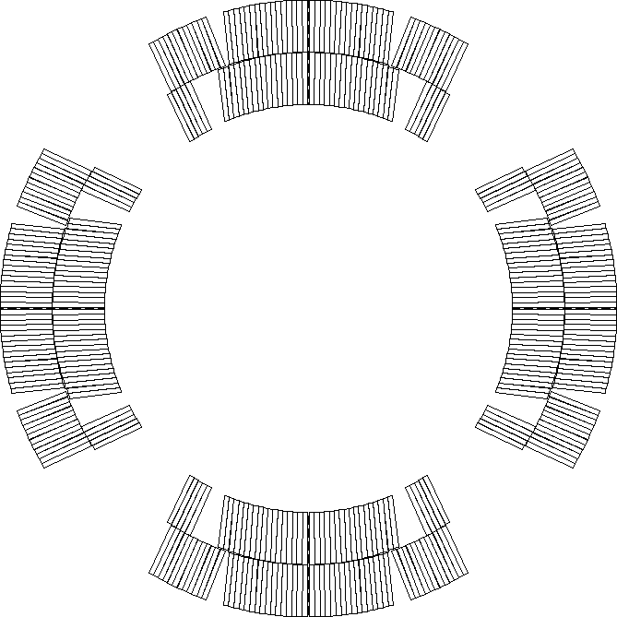
Peak voltages assumptions
Current: 16470
Old nominal, since electrical design criteria are based on old nominal current
Nominal protection (CLIQ 600 V - 40 mF, OL QH 300 V – 7.05 mF)
Coils are reported in mechanical ordering
Peak voltages have been computed using rolled and minor edge RRR values. All coil orderings resulting in peak voltage to ground less than 353 V with both assumptions and for all failure cases have been identified
Peak voltages computed using STEAM-LEDET app provided by CERN
All possible combinations of coils are considered (120)
For each combination, nominal scenario plus 3 failure scenarios are considered
P2
P1
P3
P4
Notes:
Need to be u

Slide 6
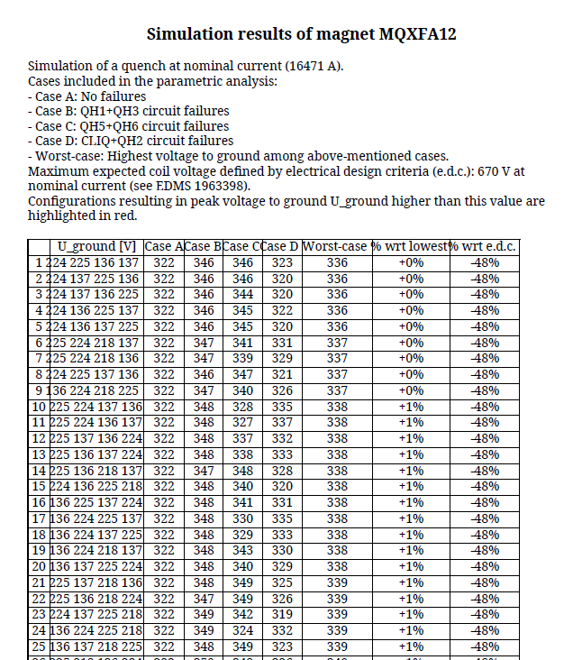
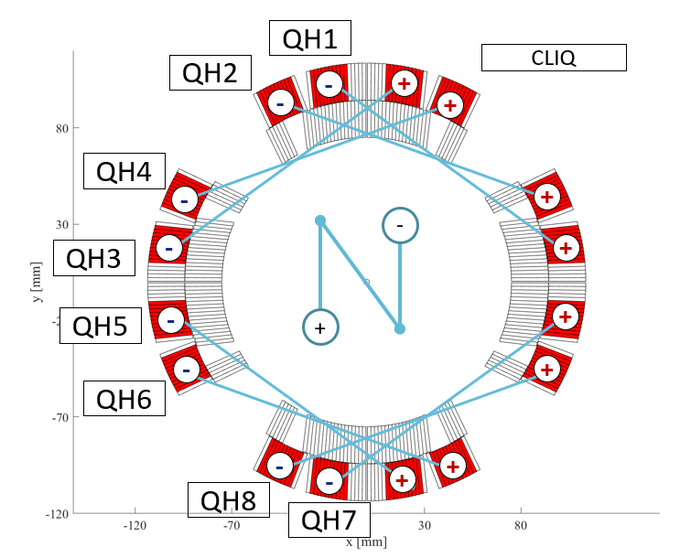
Peak voltages report
Old value, since design criteria are based on old nominal current

Slide 7
Acceptable coil orderings
There are 61 acceptable coil orderings with voltage < 353 V that are common for both rolled and minor edge RRR values (values reported for rolled RRR)
P1 | P2 | P3 | P4 | Volt
150 | 224 | 158 | 159 | 331
150 | 224 | 225 | 158 | 332
224 | 150 | 158 | 159 | 333
150 | 224 | 225 | 159 | 334
224 | 150 | 225 | 159 | 335
224 | 150 | 225 | 158 | 335
224 | 150 | 159 | 158 | 335
224 | 150 | 158 | 225 | 335
225 | 150 | 159 | 224 | 336
225 | 224 | 159 | 158 | 336
225 | 224 | 158 | 159 | 336
150 | 224 | 158 | 225 | 337
159 | 225 | 158 | 224 | 338
158 | 150 | 159 | 224 | 339
158 | 225 | 159 | 150 | 339
158 | 224 | 159 | 225 | 339
150 | 158 | 225 | 159 | 340
158 | 224 | 159 | 150 | 340
159 | 158 | 225 | 150 | 341
158 | 150 | 225 | 224 | 341
158 | 224 | 225 | 150 | 341
158 | 159 | 225 | 150 | 341
224 | 158 | 225 | 159 | 342
P1 | P2 | P3 | P4 | Volt
159 | 150 | 158 | 225 | 342
150 | 225 | 224 | 158 | 343
150 | 224 | 159 | 225 | 343
150 | 224 | 159 | 158 | 343
150 | 158 | 224 | 225 | 343
225 | 158 | 224 | 150 | 343
159 | 150 | 158 | 224 | 343
159 | 158 | 225 | 224 | 343
158 | 150 | 225 | 159 | 343
158 | 159 | 225 | 224 | 343
225 | 158 | 150 | 224 | 345
224 | 225 | 150 | 158 | 345
159 | 224 | 225 | 158 | 345
158 | 224 | 225 | 159 | 345
150 | 159 | 224 | 225 | 346
225 | 224 | 150 | 158 | 346
225 | 159 | 224 | 150 | 346
225 | 158 | 159 | 150 | 346
158 | 150 | 224 | 225 | 346
158 | 225 | 150 | 224 | 346
158 | 224 | 150 | 225 | 347
150 | 158 | 225 | 224 | 348
225 | 159 | 150 | 224 | 348
P1 | P2 | P3 | P4 | Volt
225 | 158 | 159 | 224 | 348
224 | 159 | 150 | 225 | 348
159 | 225 | 224 | 150 | 348
225 | 150 | 224 | 159 | 349
225 | 159 | 158 | 150 | 349
224 | 225 | 150 | 159 | 349
224 | 159 | 225 | 158 | 349
150 | 159 | 224 | 158 | 350
150 | 158 | 224 | 159 | 350
225 | 159 | 158 | 224 | 350
224 | 225 | 159 | 150 | 350
159 | 150 | 224 | 225 | 350
159 | 225 | 150 | 224 | 350
224 | 158 | 150 | 159 | 351
158 | 159 | 150 | 224 | 352
150 | 159 | 225 | 158 | 353

Slide 8
Measured vs estimated

Slide 9
Backup slides

