Slide 1
AD Controls Department Report
Adam Watts
18 January 2024

Slide 2
Java Engine Upgrade to Alma Linux 9
All 120 Java engine servers need to migrate from Scientific Linux 7 (end of life) to Alma Linux 9
Affects a wide range of central services
Some beam-critical (Autotune, Data Pool Manager)
Others less critical (specific dataloggers)
Planning for 4-5 per day. Beam-critical systems will be coordinated for opportunistic downtimes.
Specific data loggers may go down for an hour during each day; we’ll give everyone a warning at each 0900 meeting.
Schedule on next page indicates AM (0900-1200) or PM (1300-1700) window for each machine to be down for about an hour.
Schedule will certainly need to be adjusted as we progress: “Plans are nothing; planning is everything.”
Daily notification via the Elog and all-hands email.
Notes:
We are working on another robot that used to be part of the MARV family. It is now called HERMES, short for Helpful Robotic Messenger). It is the smallest robot that we have that can be used for confined spaces and high radiation areas. A co-op engineering student designed a 3D printed chassis. Curently, under Susanna Stevenson's and Adam Watt's guidance, a senior engineering design group at Northern Illinois University is buidling a payload for autonomous photographic mapping of enclosures.

Slide 3
Progress this week
Wednesday
Thursday
Friday (today)
AM | dse03 | DAE engine for java web startable applications like notify.
AM | dce03 | DAE
 |  | Data Logger: CDF OAC: MDBOPC
AM | dce44 | DAE
 |  | Data Logger: QRayH
PM | dse04 | DAE for AF applications, SCF Server
PM | dce04 | DAE
 |  | Data Logger: Lina2
AM | dse05 | DAE for AF applications, SCF Server OAC: BUNNY6
AM | dce05 | DAE
 |  | Data Logger: MLrn, Muon6
AM | due03 | DAE
 |  | Data Logger: EventH, PXIE OAC: EVENTH
PM | dse06 | DAE for AF applications, CDF, OAC: BUNNY5
PM | dce06 | DAE
 |  | Servlet:
 |  | D44 - servlets/JSPs for Data Logger Plotters.
 |  | epics_dl
 |  | Data Logger: TevJA OAC: CRYOPC
AM | dse01 | DAE engine for MCR's notify only
AM | dce08 | DAE
 |  | Data Logger: Backup OAC: BACKUP
PM | dce01 | DAE
 |  | Data Logger: ILCryo
PM | dse02 | DAE engine for notify
PM | dce02 | DAE
 |  | Data Logger: BigRay, BigSav
Notes:
We are working on another robot that used to be part of the MARV family. It is now called HERMES, short for Helpful Robotic Messenger). It is the smallest robot that we have that can be used for confined spaces and high radiation areas. A co-op engineering student designed a 3D printed chassis. Curently, under Susanna Stevenson's and Adam Watt's guidance, a senior engineering design group at Northern Illinois University is buidling a payload for autonomous photographic mapping of enclosures.

Slide 4
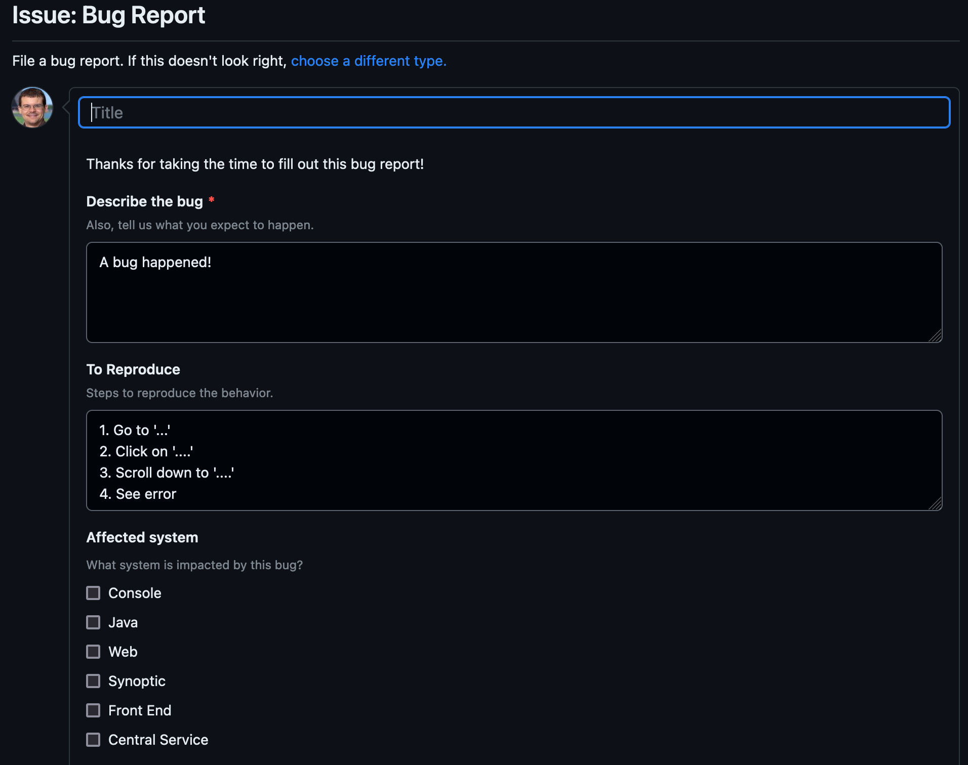
Issue reporting
On AD GitHub: https://github.com/fermi-ad/controls/issues/new?assignees=&labels=bug&projects=fermi-ad%2F13&template=bug_report.yaml
Or, https://github.com/fermi-ad/controls -> Issues -> Green “New Issue” button -> Bug report green “Get Started” button
Will add “Feature Request” option soon
Simple form for reporting operational issues with enough information for us to get started
Automatically tracks on the project board (previous slide)
Only requires (free) GitHub account to use
Not required, just convenient. You can always reach out to us to report issues directly.
Credit: Beau Harrison
Notes:
We are working on another robot that used to be part of the MARV family. It is now called HERMES, short for Helpful Robotic Messenger). It is the smallest robot that we have that can be used for confined spaces and high radiation areas. A co-op engineering student designed a 3D printed chassis. Curently, under Susanna Stevenson's and Adam Watt's guidance, a senior engineering design group at Northern Illinois University is buidling a payload for autonomous photographic mapping of enclosures.

