Slide 1
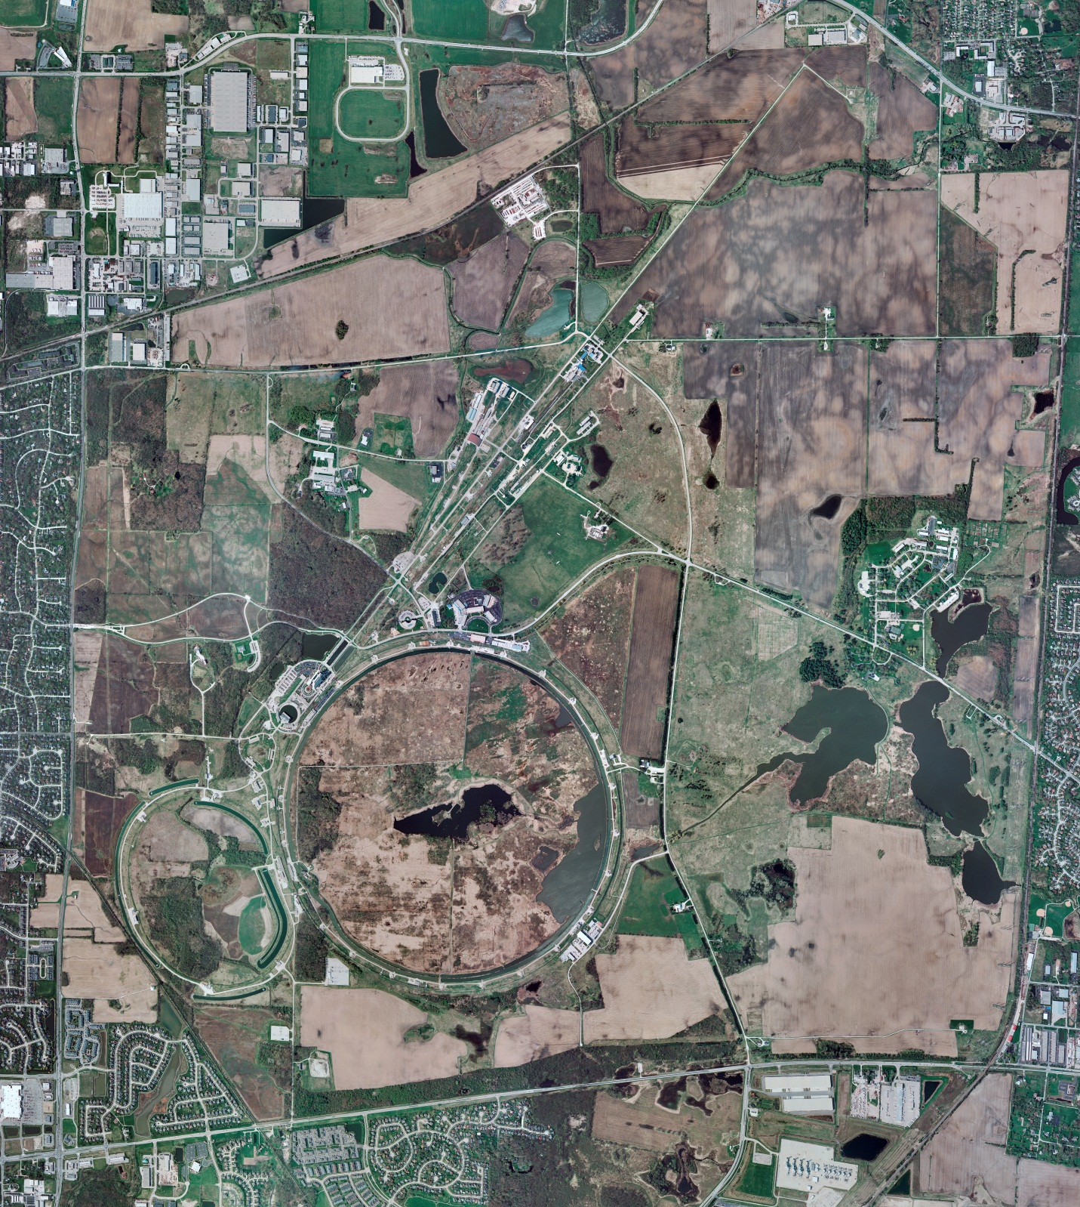
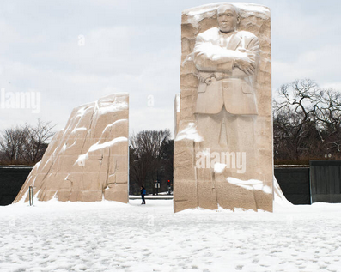
Helium Cryogenics
Status 1/19/2024 J.Makara
CMTF: SCP is shut down completely
CMTS: HECM28 at RT, LOTO’ed for its removal
PIP2IT: SSR1 pCM at RT, LOTO’ed for its removal
North CM stand empty
MCTF: cryo system restart in progress with 2 Comprs and Purifier operating
MDB/HTS: at RT
MDB/STC: .at RT but anticipate SSR2 cooldown soon
MDB Magnet: at RT
NML/FAST: Cryo system is shut down and isolated for extended shutdown period
CC1: at RT
CC2: at RT
CM: at RT
IB1: cryo system cold at 5 K and 2 K operations
Muon Campus: A0 comprs (3) online with MC-1 g-2 cryogenic system running fine at 5 K with g-2 magnet powering
Misc: ..

