Slide 1
Muon Campus Operation Report
Jerry Annala
Friday 09:00 Operation Meeting
January 12, 2024

Slide 2
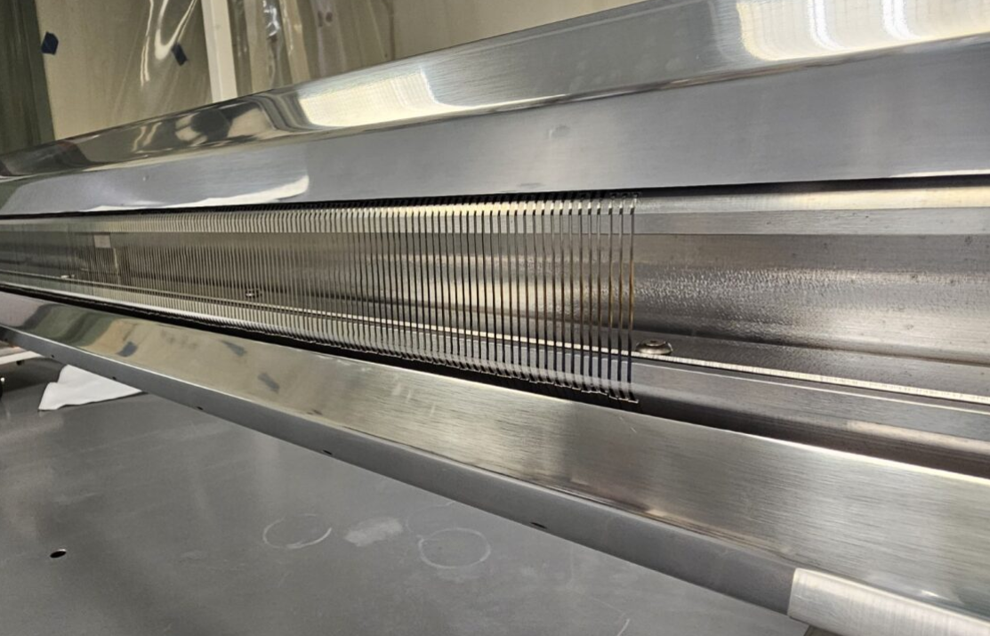
ESS1 status
ESS1 in A0 clean room under investigation.
Foil plane has been removed and inspected
All foils appear to be in be in place.

Slide 3
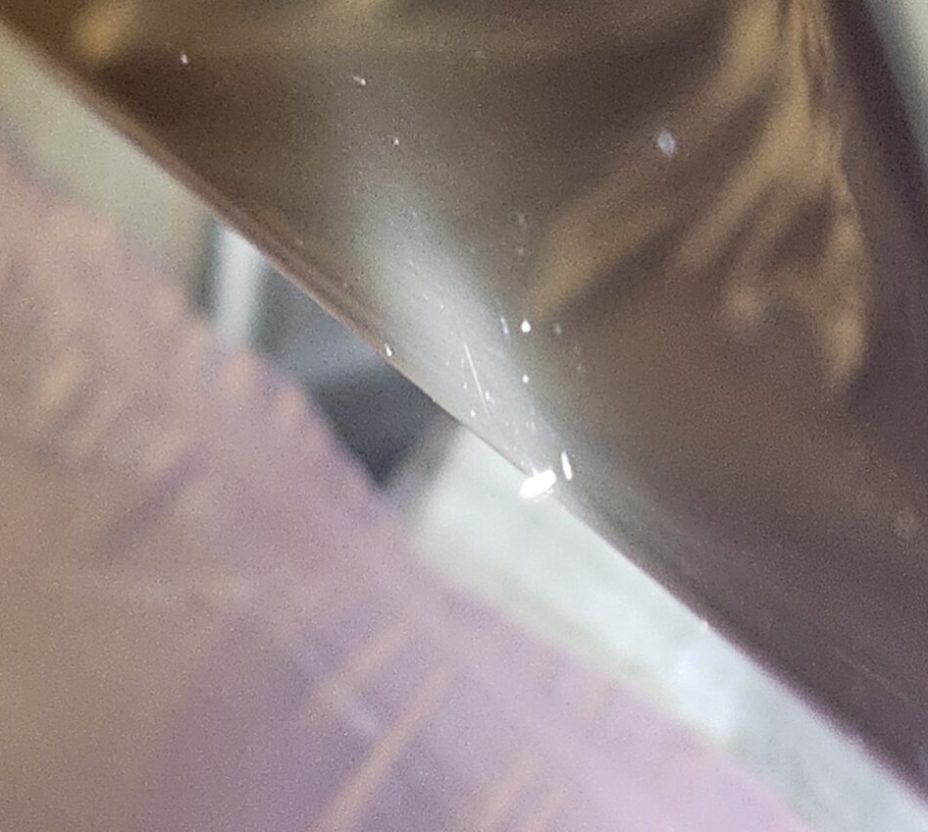
ESS1 status
Object reported to be seen on Cathode on original inspection before it was opened up.
This object fell off the cathode when it was being removed.
The object may have been retrieved.

Slide 4
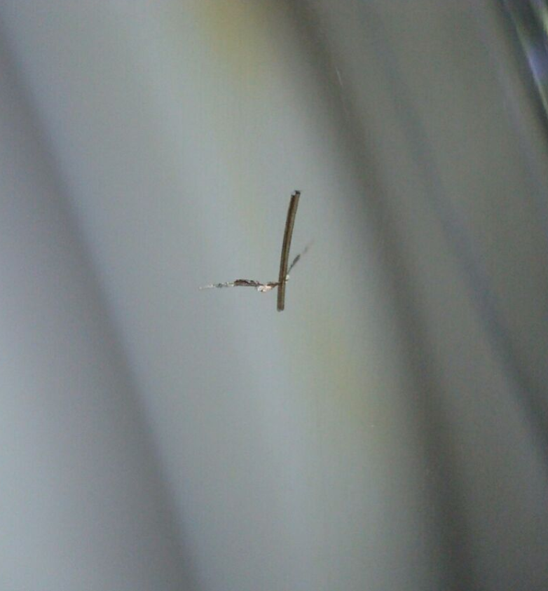
ESS1 status
Object against ceramic insulator.
Possible screw thread and silver plating?
Could have come off when standoff feedthrough flange is removed.

Slide 5
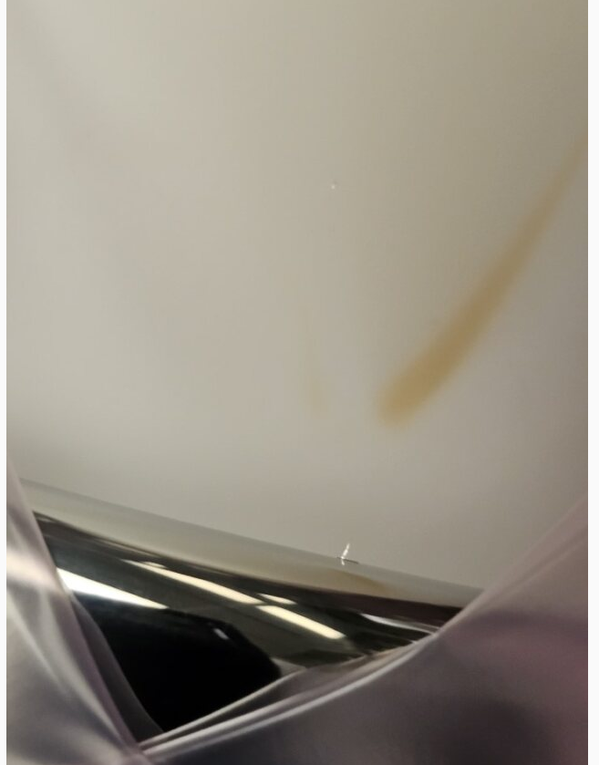
ESS1 status
Believed to be the main problem
Sharp metallic object (same as on previous slide) on corona shield (at High Voltage) with mark on HV feedthrough.
Identified X-rays were coming from this area.
More than just one similar object of worry.

Slide 6
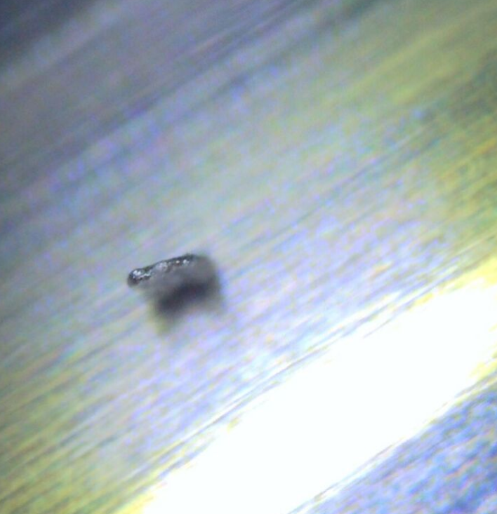
ESS1 status
object as seen magnified.

Slide 7
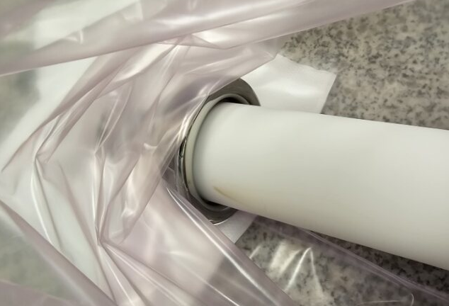
ESS1 status
Same feedthrough after removal.

Slide 8
ESS1 status
Much static electricity present when working with the septa.
Investigation and diagnosis continues.
Suspected problem object(s) have been collected
Cathode and wire plane appear to be OK by eye

Slide 9
Future work
Next week
IRR1C – Muon Campus SAD/ASE review
Remaining tunnel work to be scheduled
Finish rad hardening small quads once TD is able to get back to this work.
Q205 replacement
One critical beam tube component still needs modification in the machine shop.
Waiting for this modification before opening the hatch
Determine likely schedule for ESS1 for installation planning.
Replace North entrance door at AP0 – This is presently inoperable.

