Slide 1
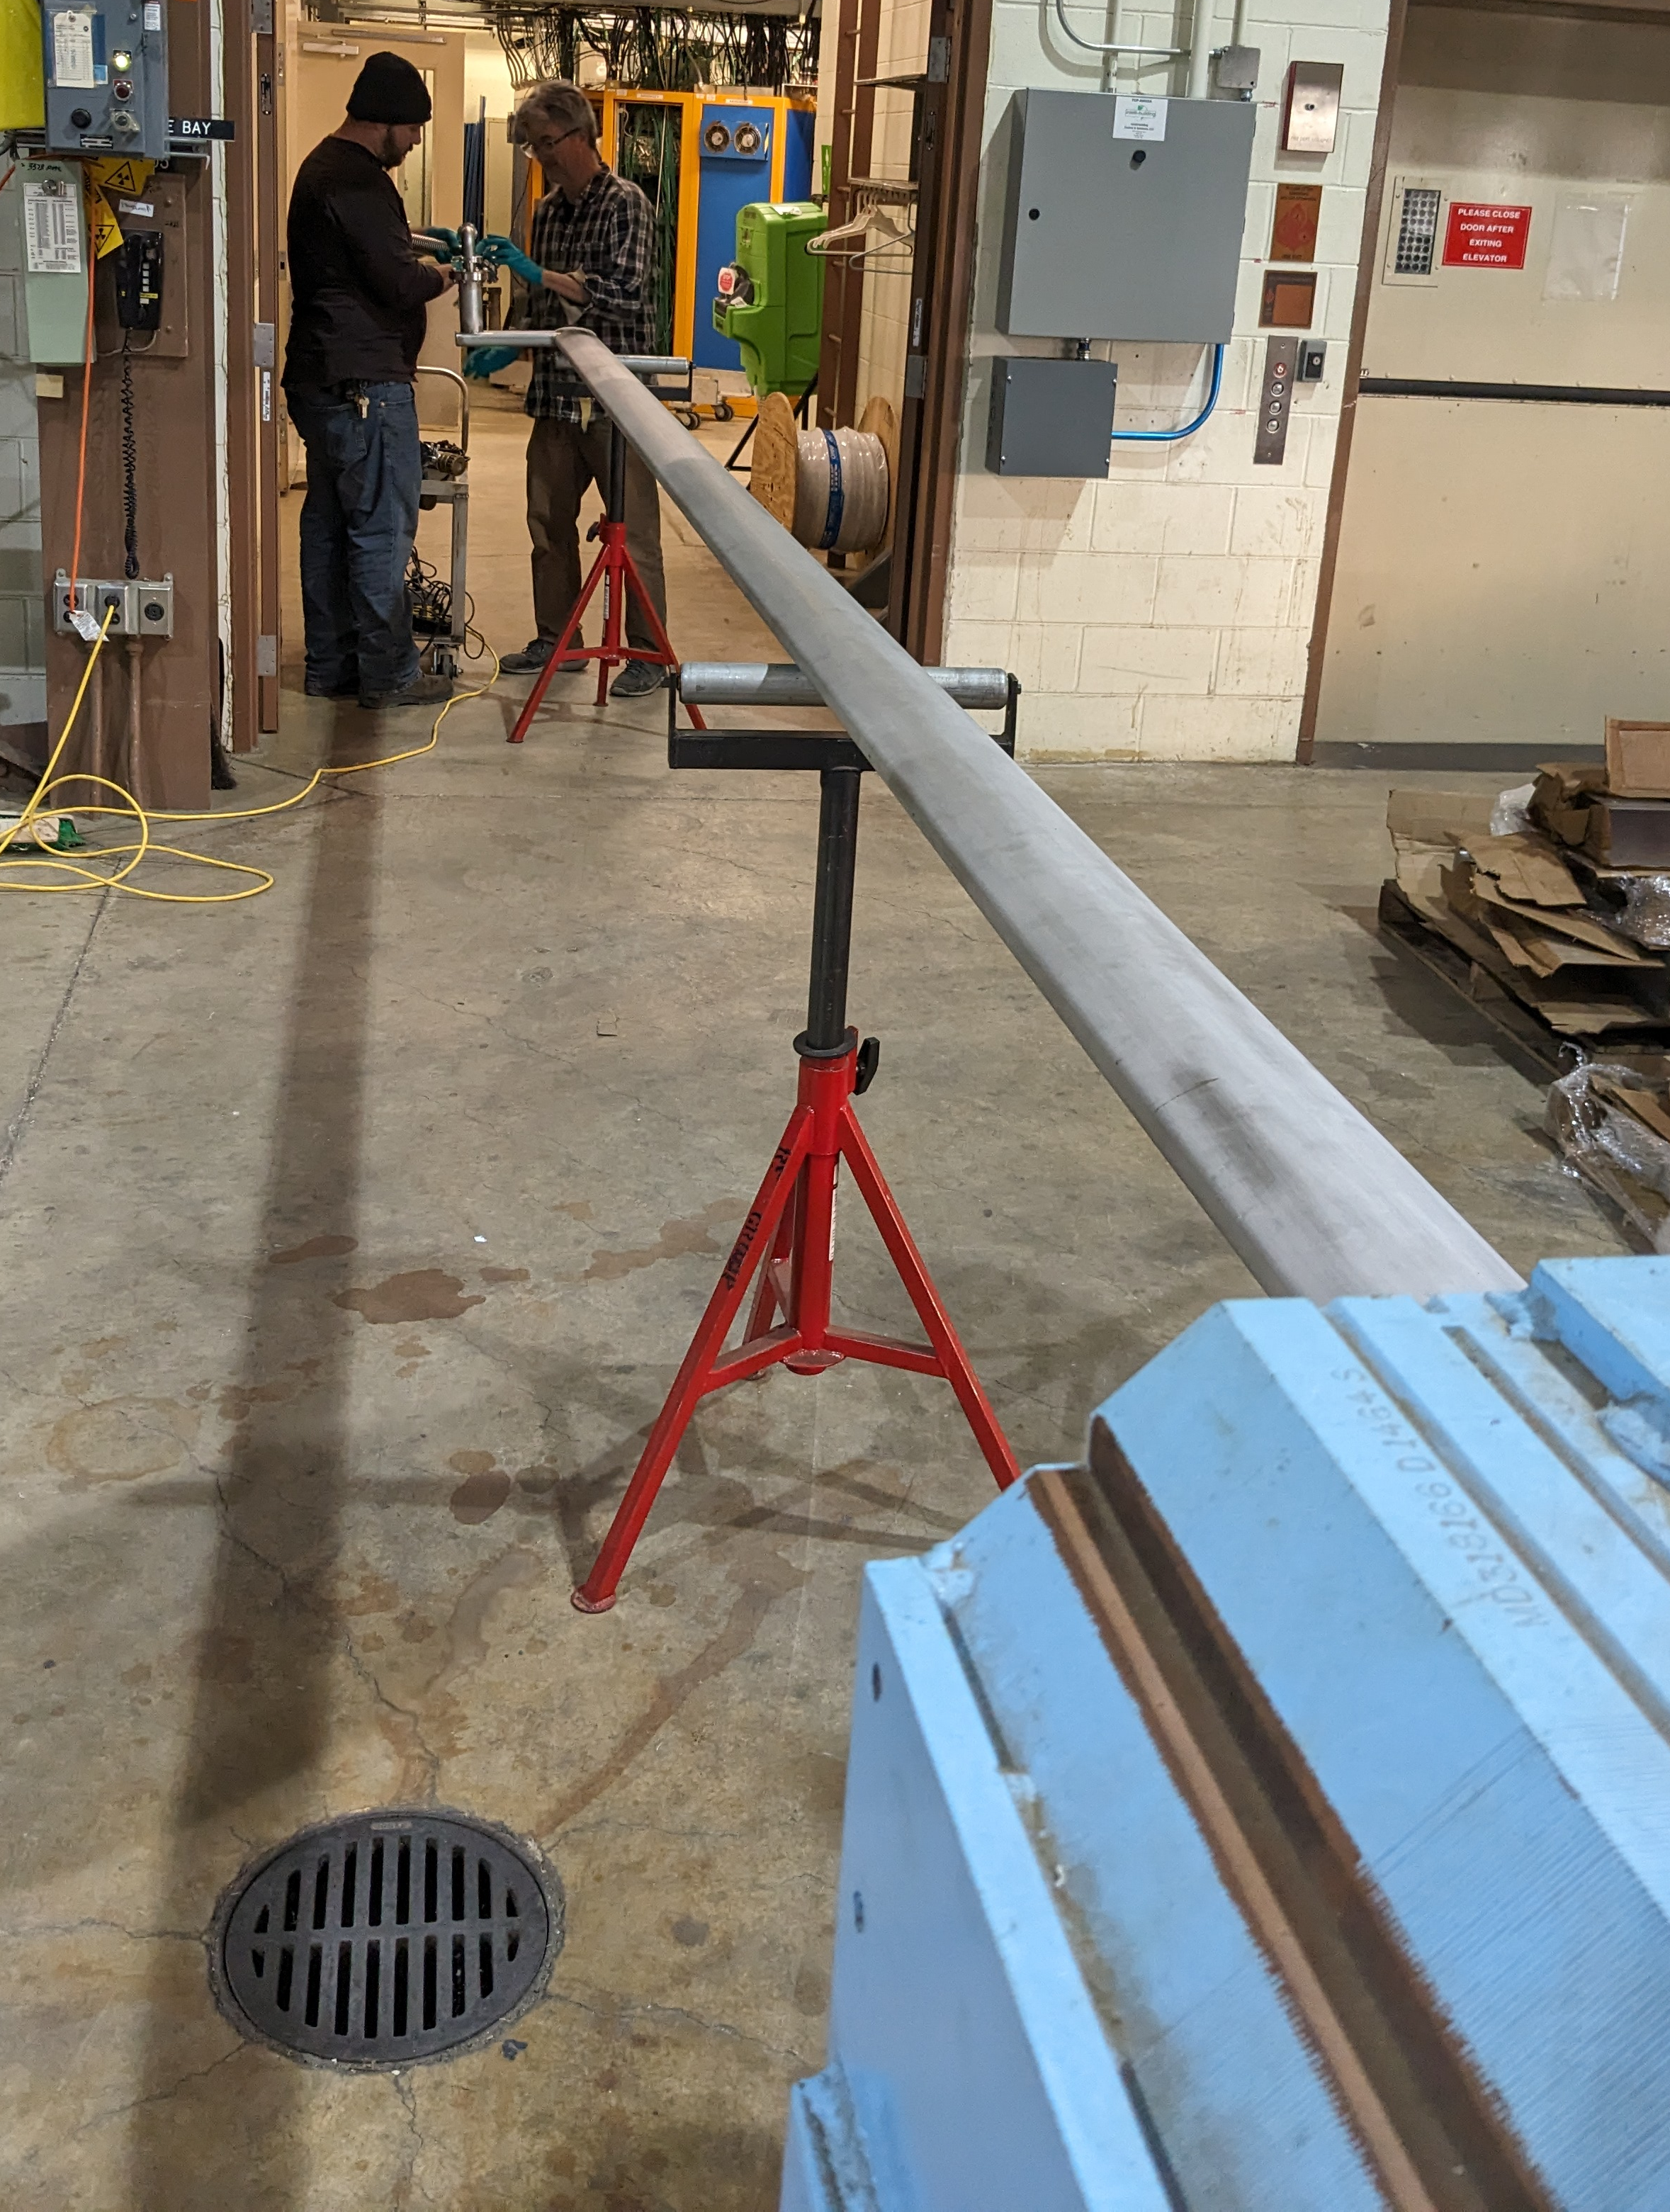
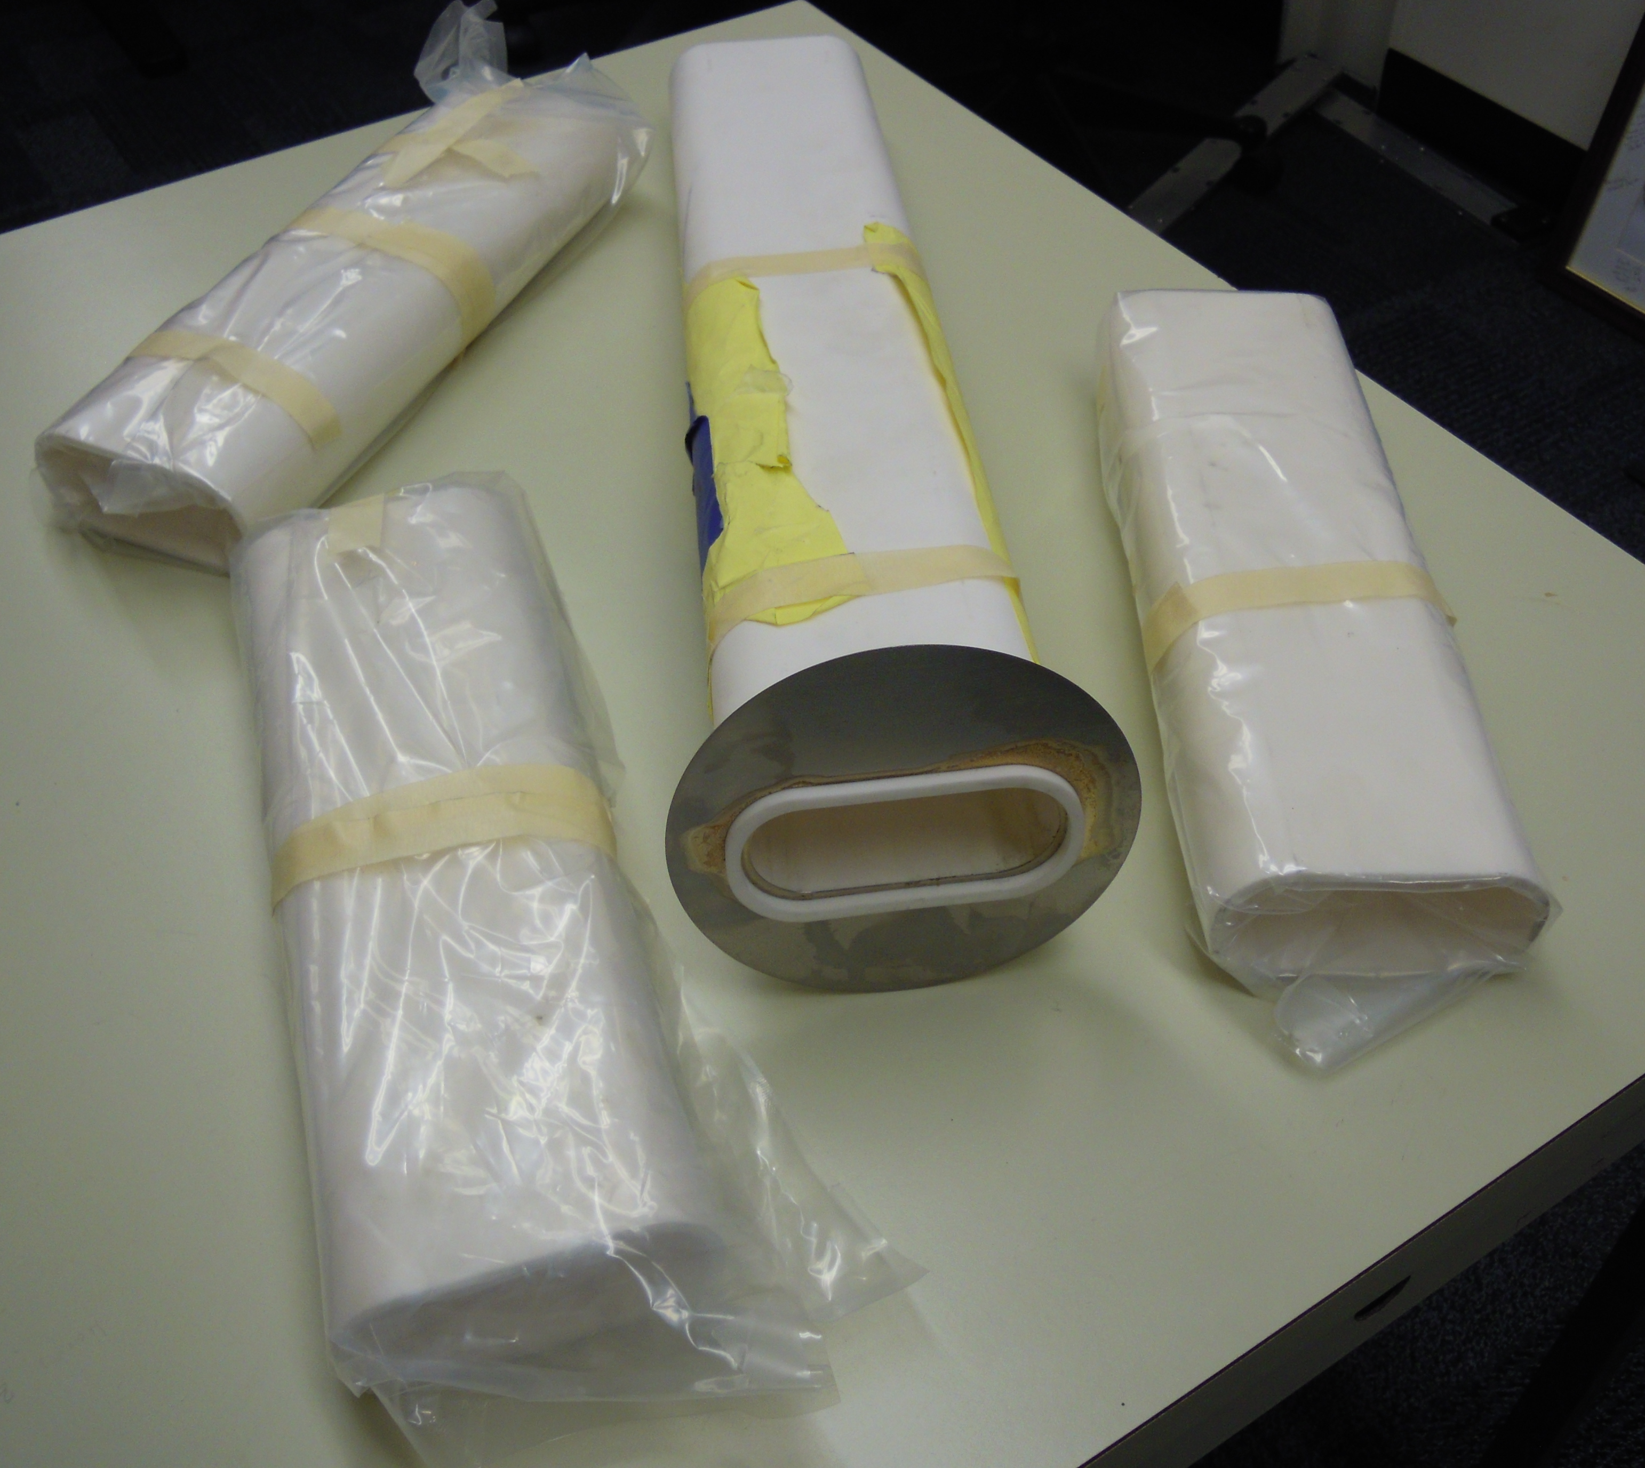
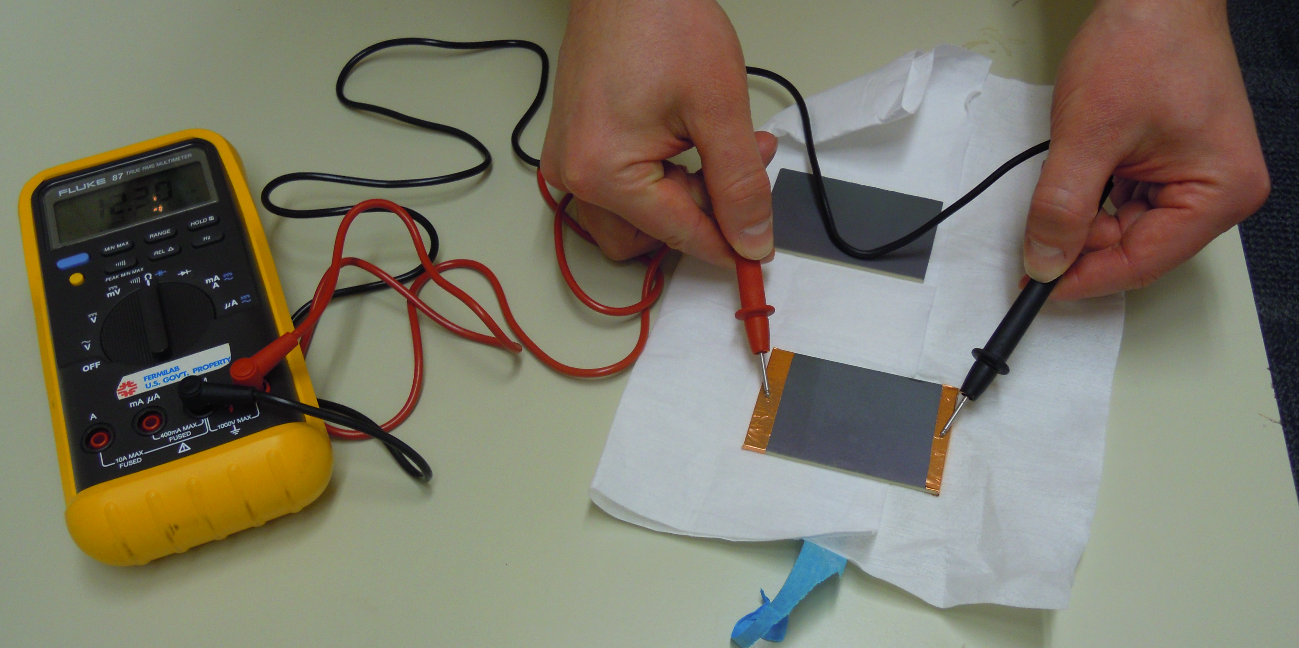
LBNF Primary Vacuum and Magnet Installation Kevin Duel (L4), Ty Funk, Rob Ridgway, Parth Gandhi, Monika Sadowski, Jason Morin, Scott Oplt, Eric Pirtle, Dirk Hurd, Freddie Roman, Matthew Volante, James Williams, Dan Vrbos
Primary Vacuum
Final Design Review held this past Wednesday (1/17)
Work continues on vacuum layout/installation drawings
Plan to release component drawings after receiving FDR report
Kicker ceramic beam tube alternate coating testing continues
Outgassing tests in queue at NWA
12” long tube samples on their way to vendor for coating
Dipole magnet beam tube installation demo performed in December
Magnet Installation
MI enclosure corrector stand engineering note review in progress
PBE quad stands and MI quad and dipole stands engineering notes reviewed and approved
PBE dipole stand and multiwire stand design/drafting and engineering note review in progress
Preparing for Final Design Review in mid-February 2024
12” samples for coating
Dipole beam tube installation demo
Kicker beam tube coating resistance measurement

