Slide 1
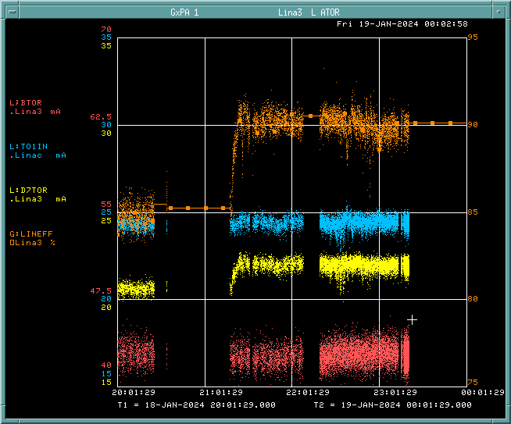
Linac Startup/Studies Update
Thank you to Operations for support with monitoring systems and tuning on the off-shifts!
Tuning all week in preparation for turning the machine over to studiers
Current status:
BTOR: ~45 mA
TO1IN: ~24.5 mA
D7TOR: ~22 mA
Efficiency: ~90%
Assuming smooth recovery after MTA/Linac berm work today, Linac studies can properly begin this afternoon

