Slide 1
TCAD Studies for CMOS, LGADS
The US has lagged behind Europe in developing infrastructure and expertise for TCAD simulation of silicon-based detector systems. There is some isolated work at Texas Tech, SLAC, BNL, Fermilab, UCSD, Oak Ridge, Syracuse and some others but no real effort at collaborative development.
We can take the opportunity presented by the upcoming RDC collaborations and various initiatives in LGAD and CMOS MAPS development to extend this work.
There are two major TCAD providers, Silvaco and Synopsys. I have been using Silvaco, which is less expensive and a bit less complex to use. However most of the HEP community uses Synopsys and Fermilab is now adding this capability. I have done a bit of work this weekend converting my Silvaco simulations to Synopsys.
It would be good to survey the availability of the TCAD options among collaborators at labs and universities and discuss possible unified approaches.
There have been a number of tutorials in Europe which can provide some basic references. Do we need to repeat something like that here? How would it be organized.

Slide 2
SIlvaco vs Sentaurus
Most of my work has been in Silvaco. Switching to Synopsys gives us common ground with the European groups and most foundries.
It would be very useful to repeat some of the central studies done in Silvaco in the Synopsys/Sentaurus framework. In particular much of the radiation damage parameterization has been done in sentaurus which is known to have different trap models than Silvaco. In addition Silvaco ionization integral calculations (effectively gain) has known flaws, in particular temperature dependence, and should be checked in Sentaurus. My impression is that Silvaco, as program-based rather than workbench-base is a bit more flexible than Sentaurus. For example my “generic_str.in” can build LGADs, diodes, pixelated, trenched devices depending on the input parameters. This would be very difficult in Sentaurus
It would be very useful to build “generic” infrastructure in Sentaurus to allow groups to build on existing models.

Slide 3
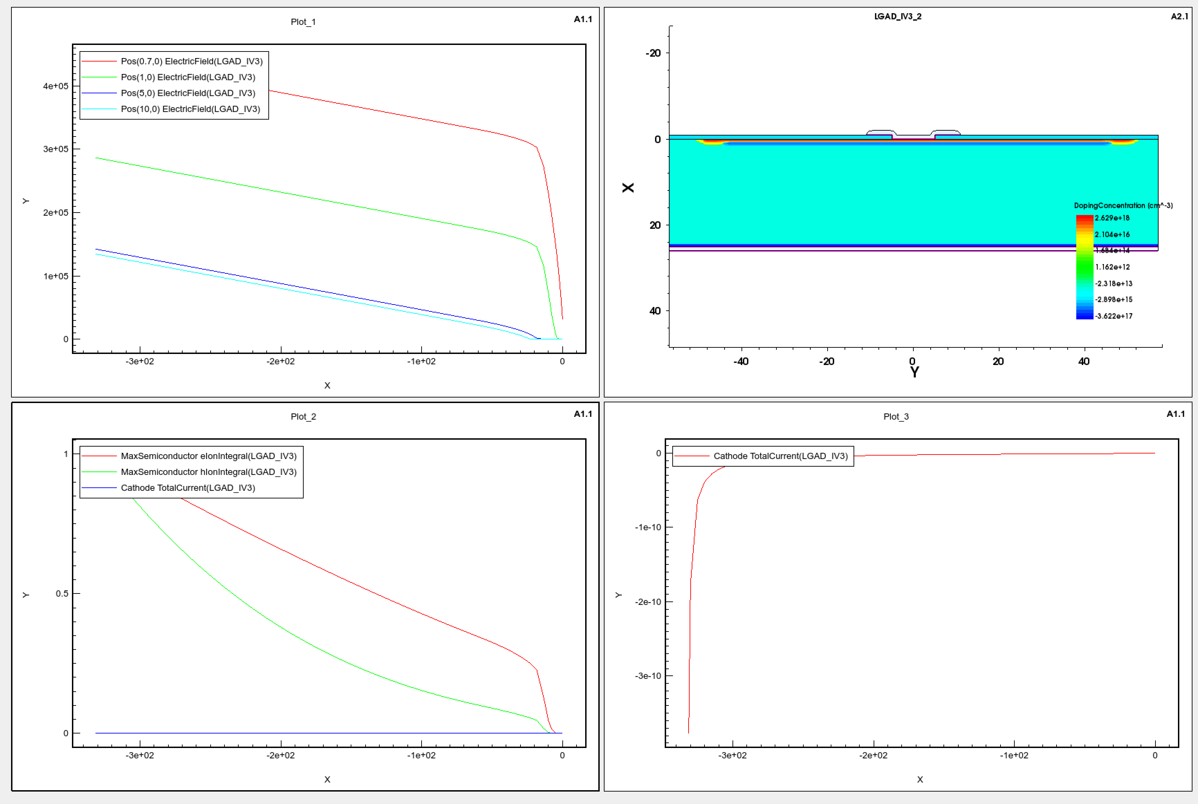
Example – LGAD in Sentaurus
E Field at various
depths
DC LGAD
Ionization
Integral
Current

Slide 4
Projects – CMOS Sensors
this is a collaboration started with Skywater but the funding is uncertain. U of C and Purdue are involved with others interested. This is a central thrust of the US instrumentation R&D program, but is well-behind Europe. The connection to Skywater provides a crucial wedge. The program depends on funding and manpower available.
Obtain the triple well doping parameters from Skywater and build a basic CMOS structure model
Model the simplest CMOS structure and access the limiting factors (inter-well capacitance, doping …)
Understand the fields at depletion and access issues of well breakdown at full depletion – what are the operating constraints
Understand how an additional high energy n-implant can moderate these issues.
Attempt optimization of the well structure within Skywater constraints
Begin to study alternative structures to lower node capacitance.
Can an LGAD structure be integrated?
Which test structures will provide useful information?
More

Slide 5
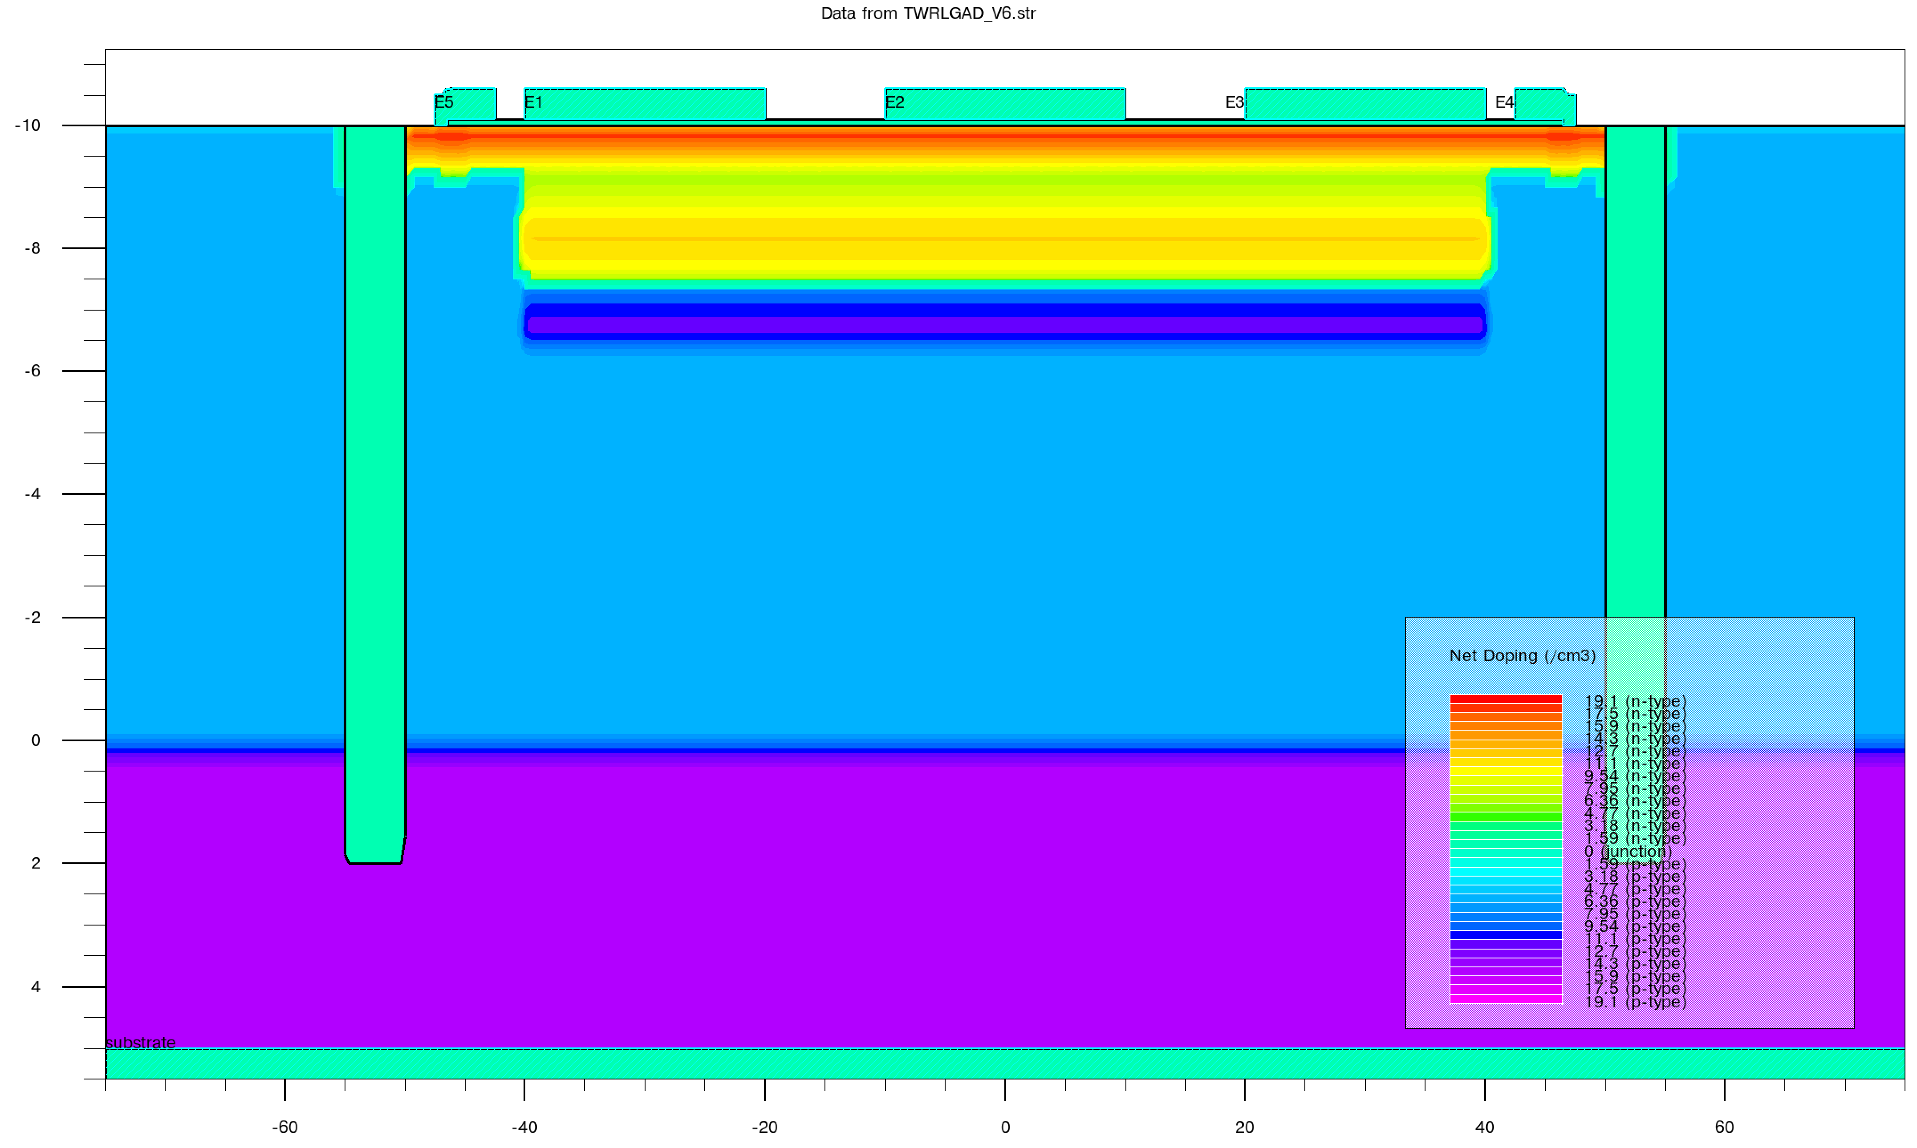
Projects – 3D LGAD
“Accelerate” 3D LGAD implementation in collaboration with FNAL/SLAC/Tower.
SLAC has provided a “baseline” Synopsys model based on earlier simulations. We should translate the existing Silvaco simulations to Synopsys and compare results. Crucial issues are the effects of the trench, trench lining, and possibility of deep implants to improve radiation hardness. We should verify the gain calculations with the Synopsys model. All of the device options (DC coupled, AC coupled, deep implant) should be modeled.
AC Deep junction LGAD
With trench temination

Slide 6
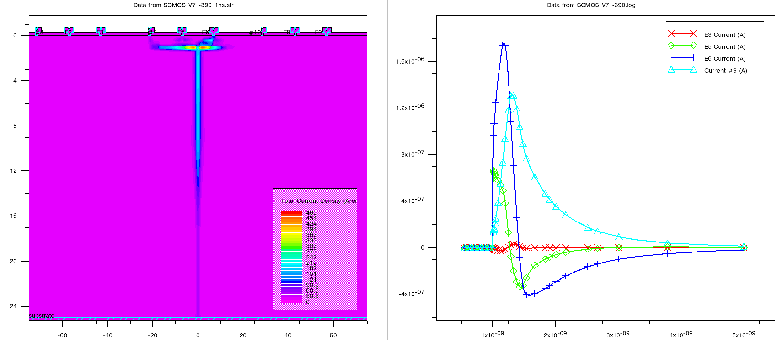
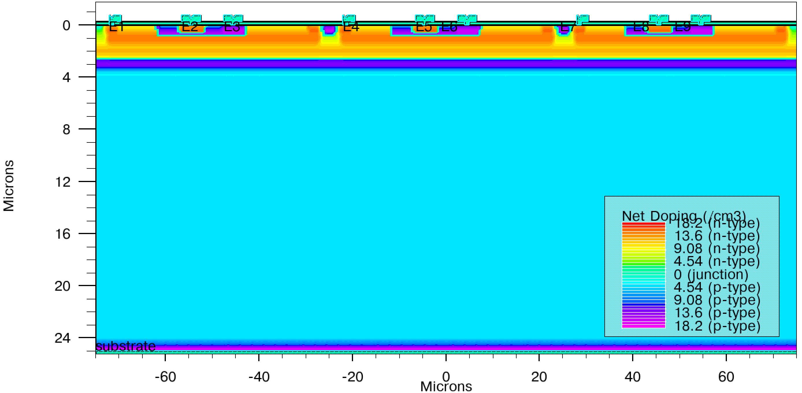
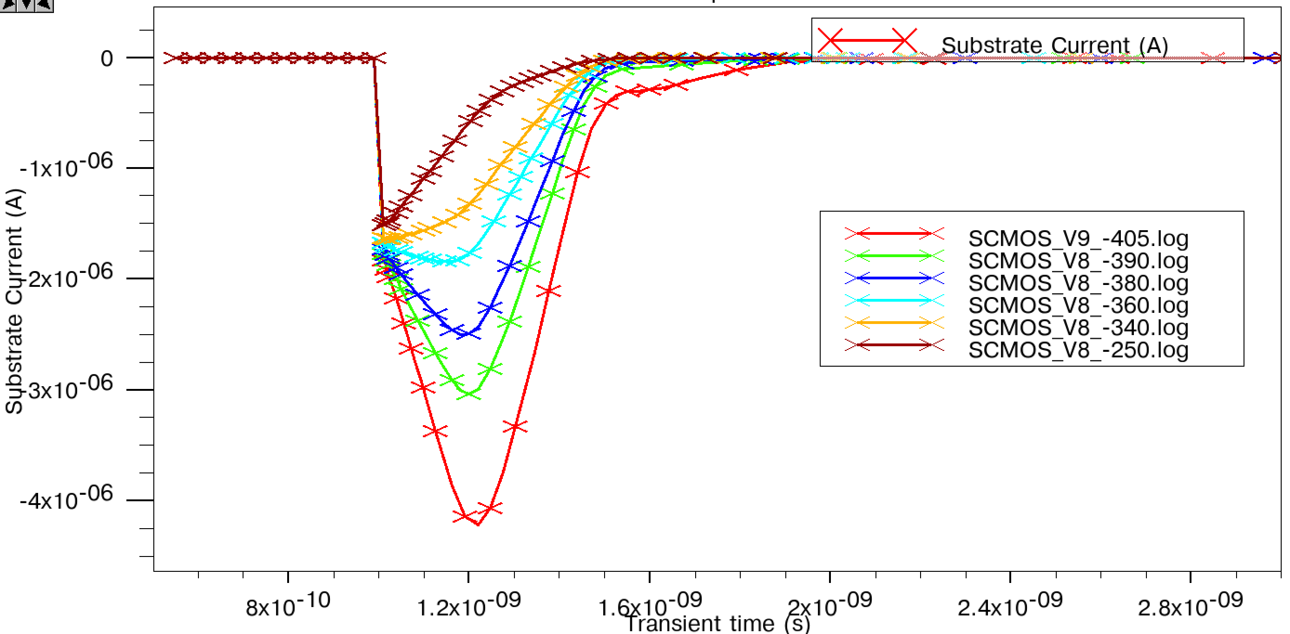
Other Studies
Silvaco AC LGAD
Detector Performance
Timing
Transient analysis, mixed mode
Radiation Damage
Comparison with test beam
Optimization of charge sharing
Optimal operation point and associated doping profiles
Breakdown and Single event effects
LGAD in CMOS
LGAD in CMOS
transient

Slide 7
Organization
At the moment there is a small core at Fermilab with interest from several universities. To organize the overall effort a subgroup within the RDC3 group would make sense – this would share knowledge and provide support.
This could be started now. Individual projects (as listed above) would have individual sets of collaborating institutions with various possible funding sources.
A basis for future discussion?

