Slide 1
at
26 Jan 2024
Davide Chiappara, Piero Giubilato, Caterina Pantouvakis, Michele Rignanese
S-curves – Fe55 measurement

Slide 2
Fe55 measurement
Goal: S-curve measurement using an X-ray monochromatic source instead of performing TP injections
Measurement with Fe⁵⁵ source scanning over different threshold values
Fe⁵⁵: kα₁ peak at 5.9 keV → $∼$ 1640 e⁻
Example of a Fe⁵⁵ measurement done on an array of 16x16 pixels in the central sector of the chip
With respect to a TP S-curve
the rate does not saturate
$∼2 min$ per point

Slide 3
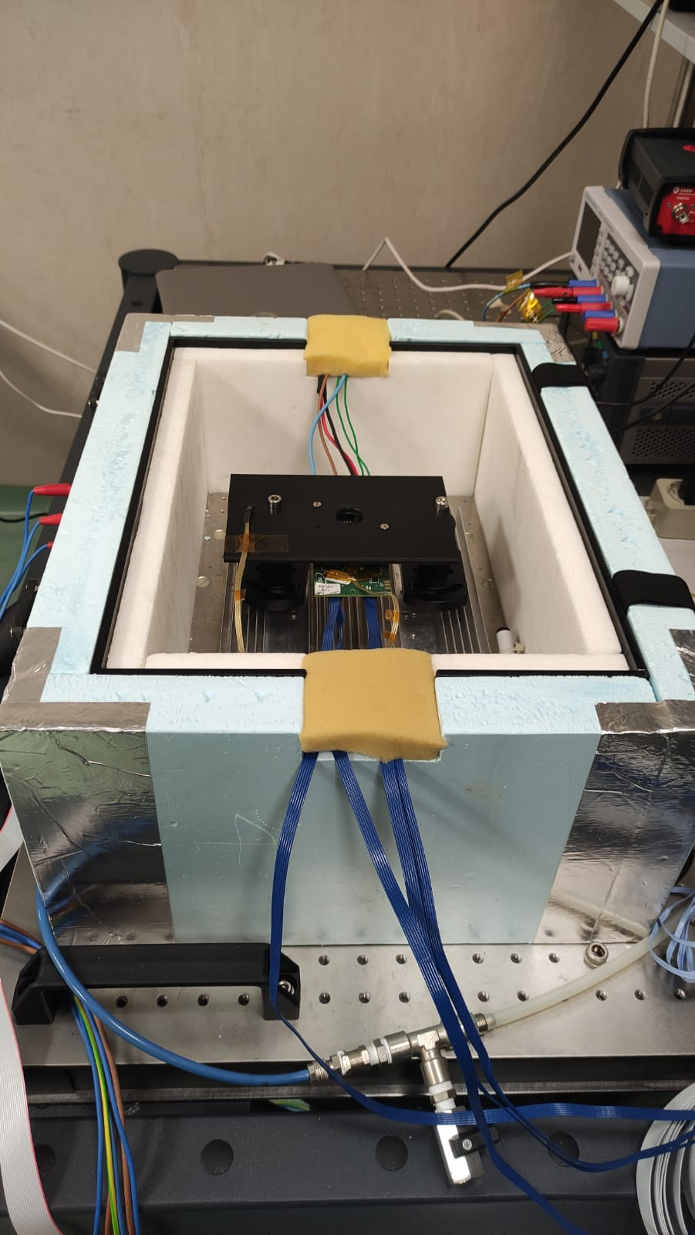
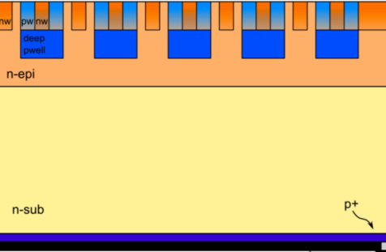
Fe55 measurement
Why does the rate keep increasing decreasing the threshold?
Hypothesis:
The electronic cloud generated by the X-ray interaction in Silicon widens by diffusion while drifting towards the electrodes and it can spread over more than one pixel (charge sharing).
Fluctuations of gain, noise, and baseline pixel to pixel are relevant when performing measurements over an array of pixels. Measurable thermal fluctuations.
To test:
To comply:
Comparison of measurements from frontside and backside of the chip + Monte Carlo simulations
Measurement on one single pixel in a temperature-controlled environment.
200 μm

Slide 4
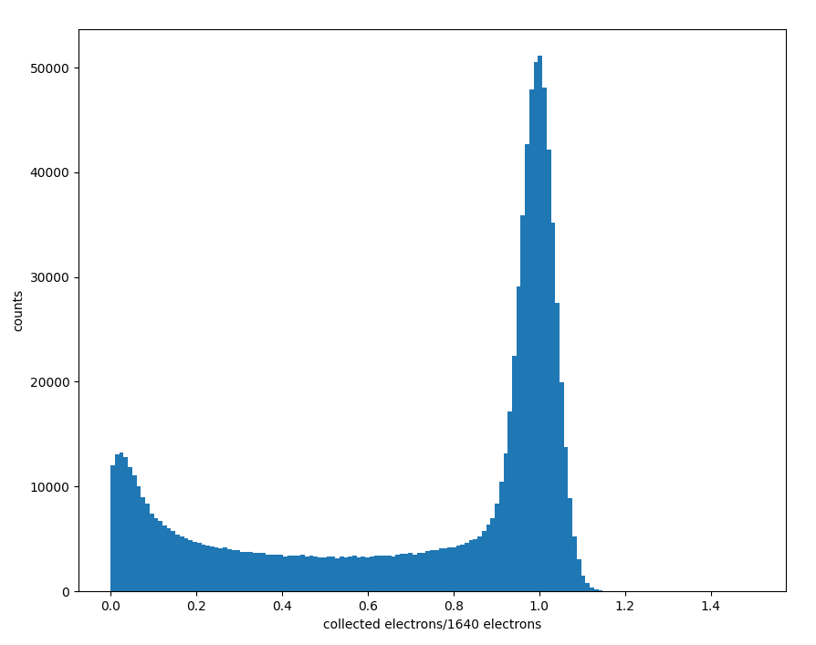
Single pixel simulation
Simple single pixel Monte Carlo simulation to study geometrical charge sharing effects
Simulation is performed using the following steps:
Set two different parameters:
Width of the electrons cloud ($σ$)
Front-end electronic noise
1
Generate hit coordinates (x, y) in range [-3$σ$, 1 + 3$σ$]
3$σ$
Full charge collection
Build a 2D gaussian with $μ$ = (x, y) and $σ$
Calculate numerical integral in pixel area
0
Noise
0
1
Fill analog histogram
Partial collection

Slide 5
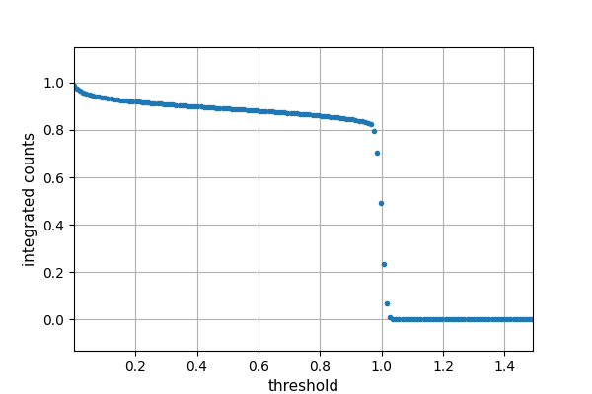
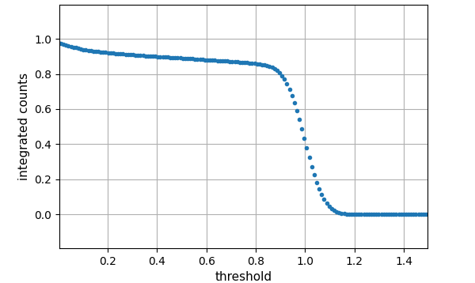
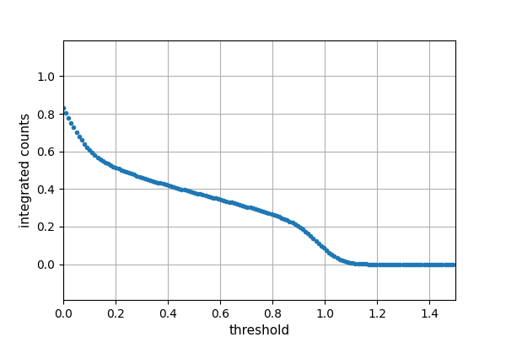
Fe55 simulations: rate vs threshold
$$N\left(t\right)=Ν_{0}\left(1+\frac{C_{S}}{σ}(t_{0}−t)\right)\left(1+erf\left(\frac{(t_{0}−t)}{σ}\right) \right)$$
t : threshold
$t_{0}$: threshold at which
the s-curve inflection
point is found
$C_{S}$ → Charge sharing contribution
$σ$→ Electronic noise
Small $σ$
Large $σ$
Small $C_{S}$
Large $C_{S}$

Slide 6
Fe55 frontside measurement vs simulation
Simulation parameters:
Cloud σ = 0.145
El. noise σ = 20 e⁻
Fit Parameter | Data | Simulation
t₀ | 0.98 | 0.98
C_{s} | 0.19 | 0.22
σ | 0.025 | 0.030

Slide 7
Fe55 frontside measurement vs simulation
Fixed electronic noise, charge sharing ±5%
Fixed charge sharing, electronic noise σ ±50%
The charge sharing contribution is dominant → Not sensitive on the electronic noise

Slide 8
Fe55 backside vs frontside
200 μm
Fit Parameter | Frontside | Backside
t₀ | 0.98 | 0.98
C_{s} | 0.19 | 0.54
σ | 0.025 | 0.048

Slide 9
Ongoing work
Improve statistics with ⁵⁵Fe source;
Measurements with more pixels;
More realistic simulation;
Larger simulation domain;
Measurements with monochromatic source at a different energy for calibration ?
Electronic cloud simulation with TCAD
Replication on SPICE of the analog front end loading correctly the libraries;
Quantification of some features of the analog pixels around the array (baseline, noise, gain, …);
Understanding of the amount of charge injected in the pixel.

