Slide 1
IOTA Proton Injector Update
Dean (Chip) Edstrom
01/26/2024

Slide 2
Points of Contact
There are lots of activities with more than one (valid & incompatible) opinions on how things should be done…
Overall Cable Pull – Chip Edstrom
  Questions on cable list/labels/types/destinations/problems
  Relying upon Jamie primarily as Electrician/contract liaison
Overall Beamline Component Installation – Sasha Romanov
  Questions on beamline stand/components
Overall Support Department Liaison – Jinhao Ruan
  Questions on support for Mechanical/Electrical/RF
Overall Commissioning – Chip Edstrom
  RGD Registration, ORC, etc…
  Source Commissioning / Characterization

Slide 3
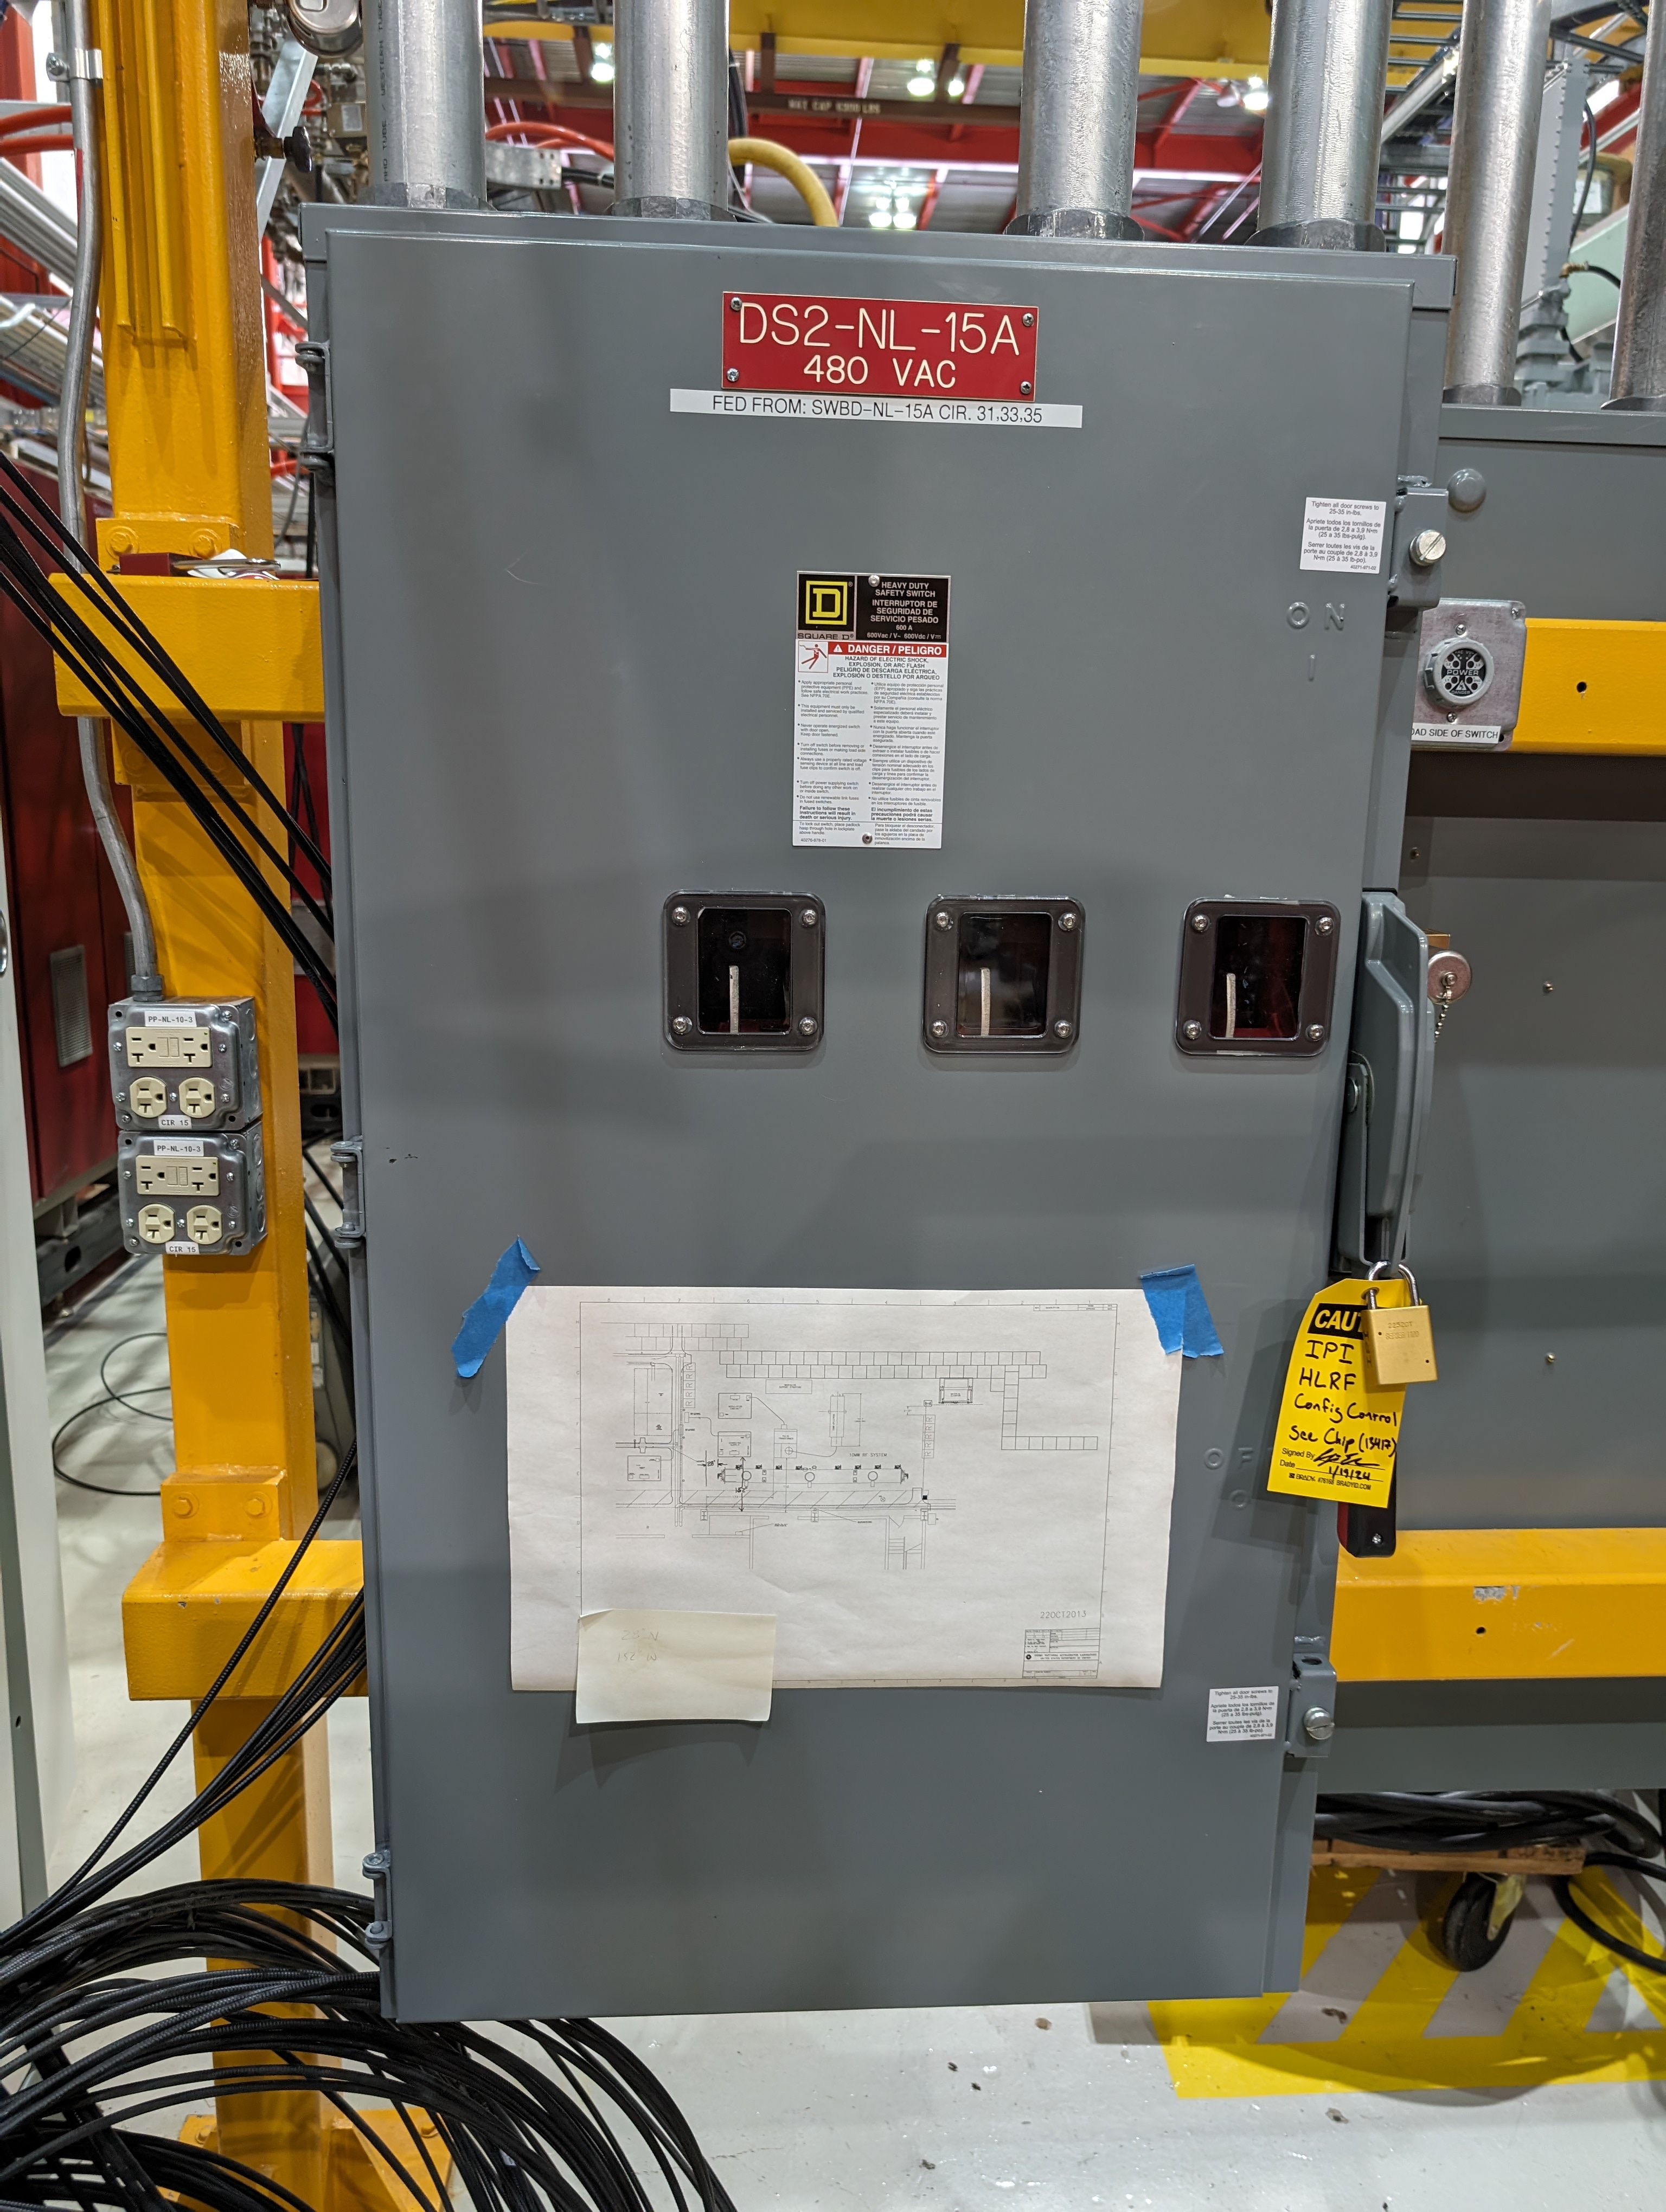
Electrical Status
Cable Pull Nearly Complete…
    T&M update: WebReq 55913
    RG58 & Safety pulls remain
    120 / 208 VAC beamline power
    A pile of cable remains in the gallery remains to be routed…
HLRF 600A Disconnect Replacement Complete!

Slide 4
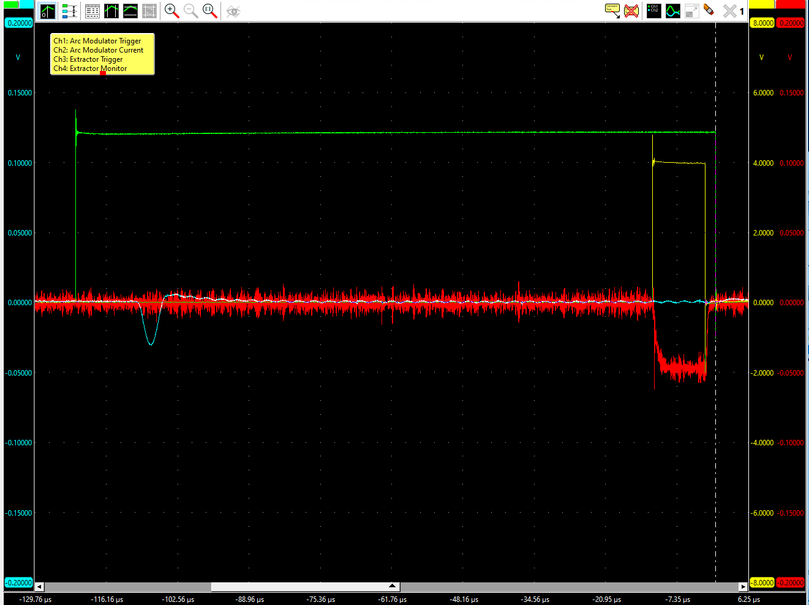
Commissioning Status
ORC Review for Full Source Operation
  Source Ready™ for Operation
    Filament supply may require
    adjustment (Steve Hays?)
    One Arc Modulator found bad
    and the trigger was inverted.
    VAT valve power restored.
  RGD Registration
    Still waiting on FSO approval
    iTrack item concerning the hydrogen bottle…
  ES&H Monitoring Plan
    RCT presence for initial turn-on / for any increase in max voltage
    Passive monitoring (badges in-place)

Slide 5
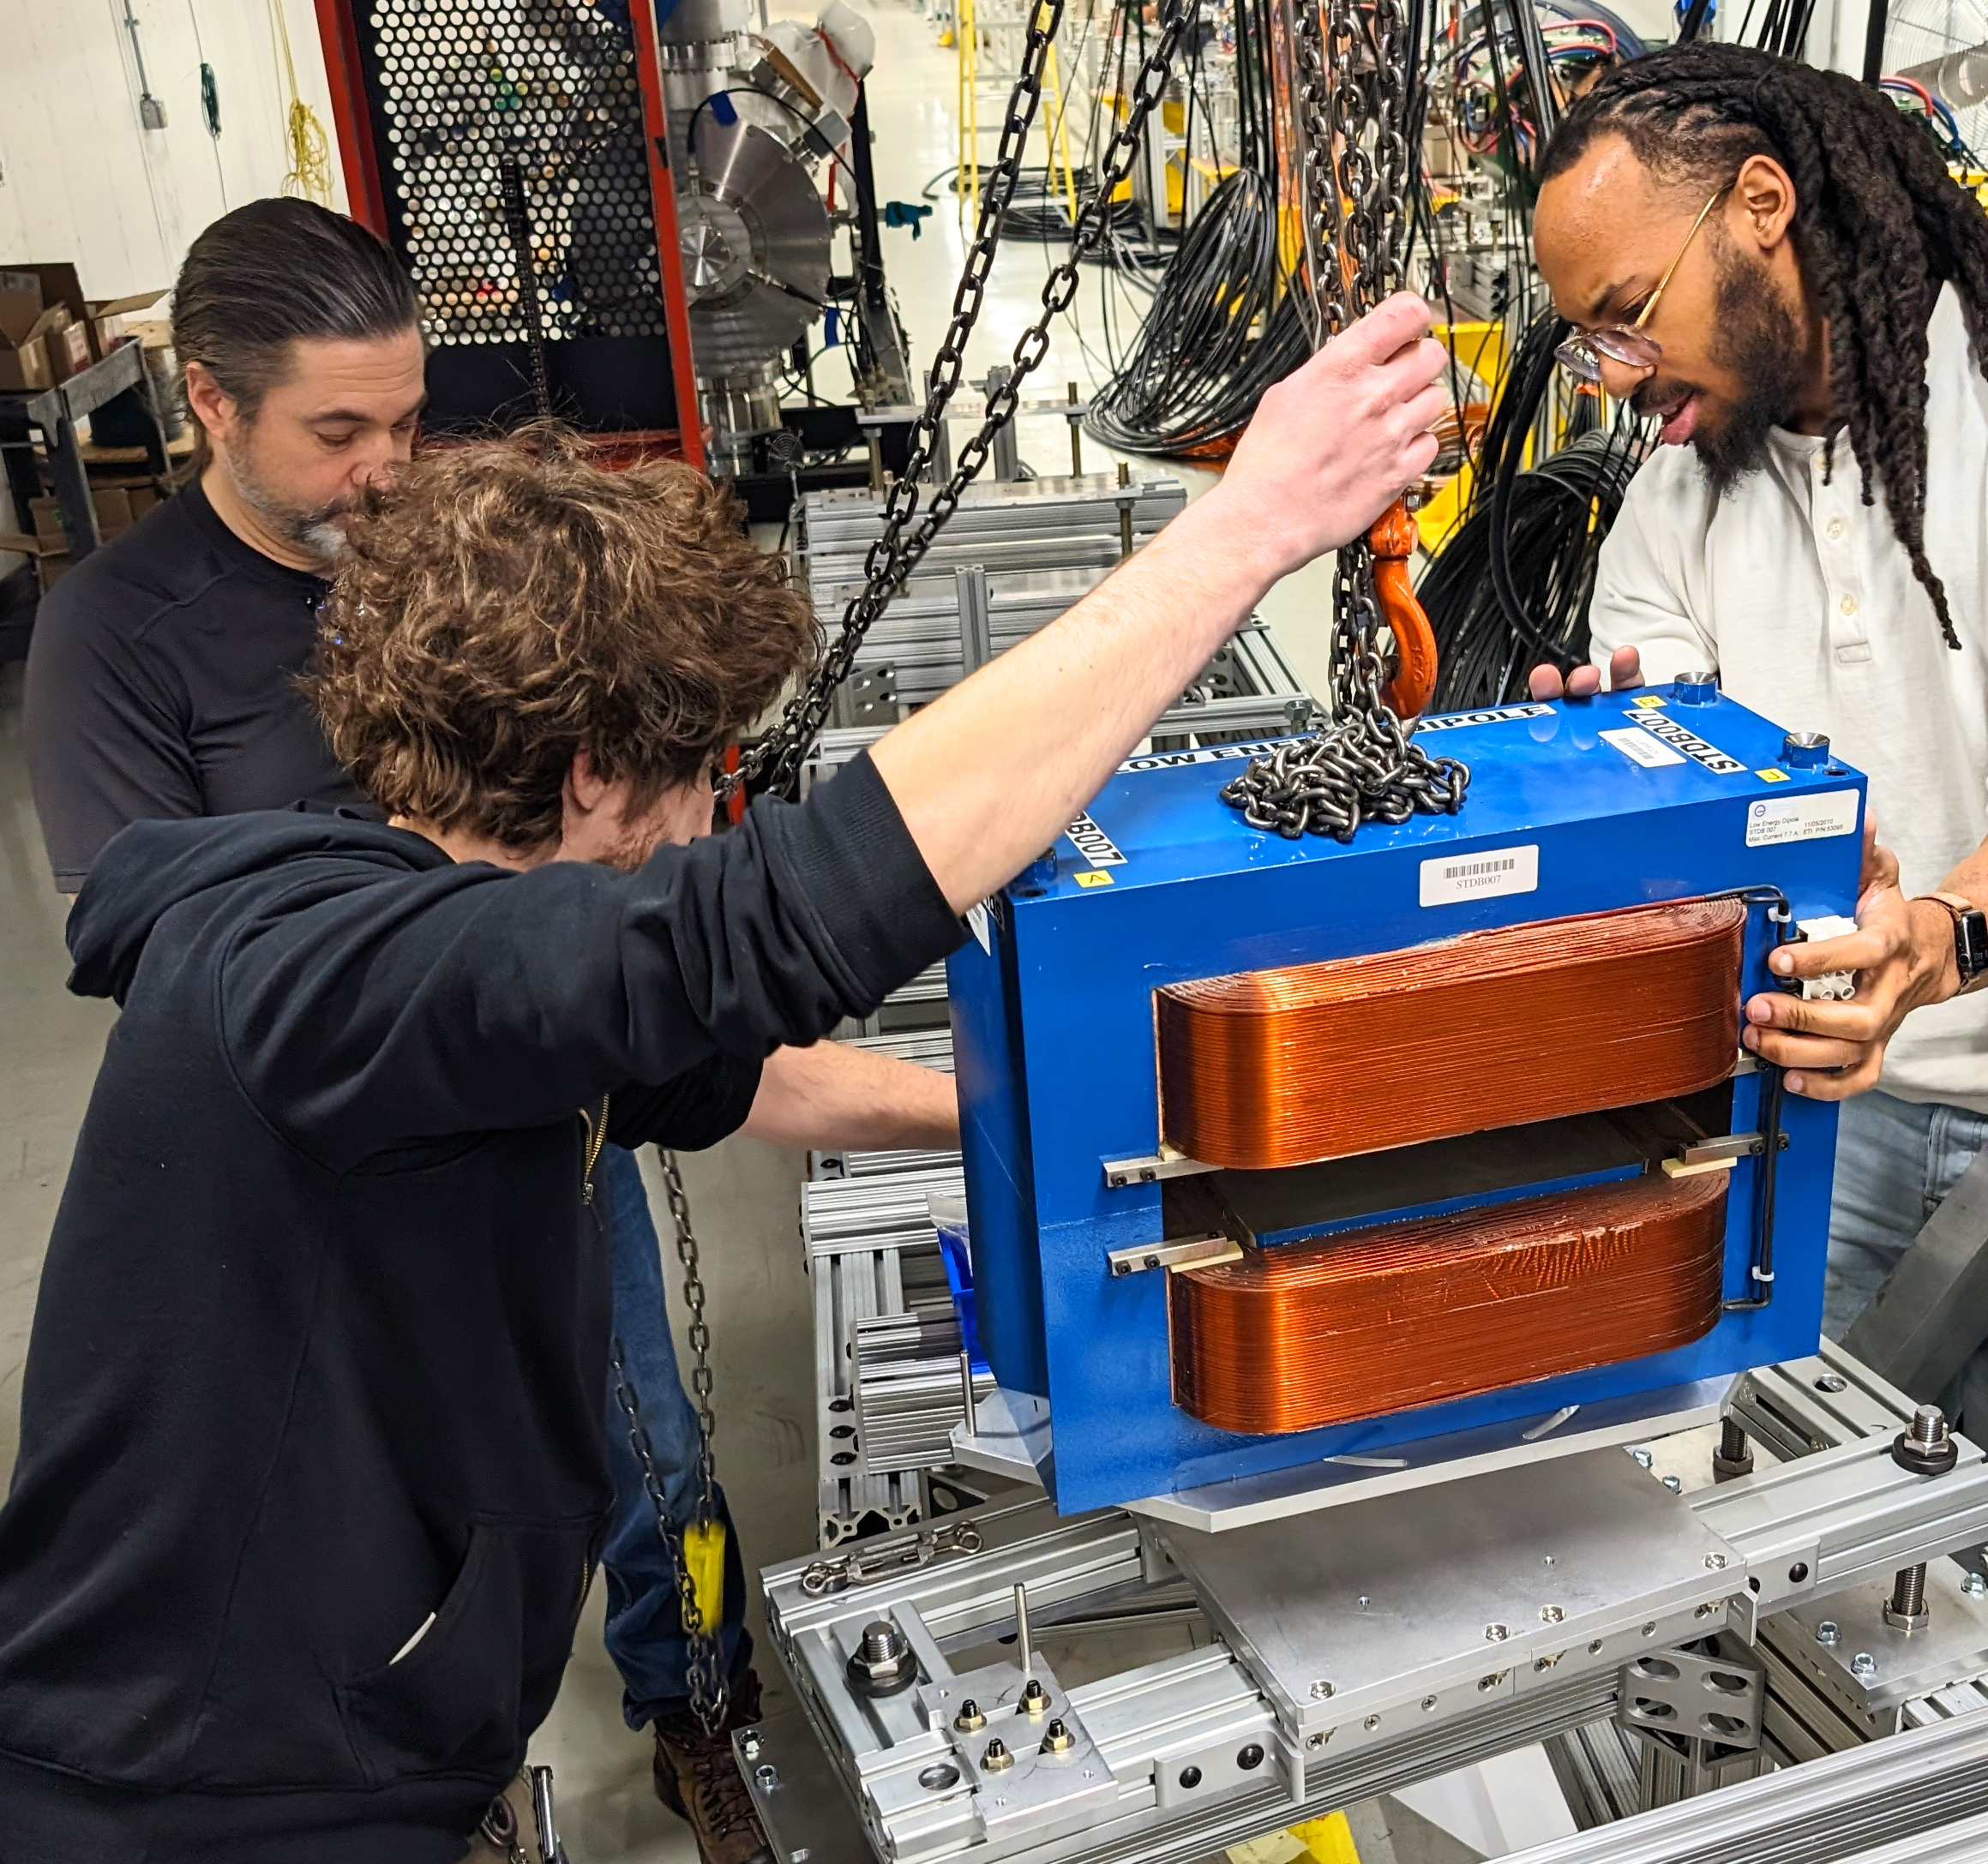
Beamline Installation – It’s Happening
First Magnets Installed
Dipole Bend Magnets
01 / 17 / 2024

Slide 6
Next Steps
Beamline Component Installation (Dave Franck / Sasha R)
  RFQ Placement (✔) / Anchoring (✔) / Alignment
  LEBT Stand Placement (✔) / Anchoring
  Quadrupole Installation (✔)
  MEBT Allison Scanner & Other beamline components
Cable Routing / Termination
  500MCM into a box to be mounted to the cable tray (Daniel)
  8-Pair Magnet / Turbo Breakouts (Chip)
  Heliax (Bogie / Brian Fellenz) in progress
    BPMs (will need to be phase-matched)
  6” RFQ Waveguide Installation (Trey / Ding / Rick) in progress

Slide 7
Support Departments
EE Support
  CDC Contactor Progress…
RF Support
  Ding Sun… Currently splitting time with PIP2
Mechanical Support
  Steve Wesseln… Currently working on PIP2
Instrumentation
  Bogie / Brian to assist with Heliax terminations, etc
  Brian Felenz assisting with racktops / signal manifolds / pigtails
  HLRF Fast Interlocks VME (Niral Patel / Steve Roccos)
Controls
  EPICS integration (Pierrick Hanlet)

