Slide 1
ACORN
Adam Watts
AD/Ops 0900 ACORN Update
26 January 2023

Slide 2
Console application analysis
ACORN 204.05 (Control System Applications) is analyzing all applications associated with the control system to determine operational criticality, complexity, and risk, for the purposes of prioritizing upgrade efforts.
Total active applications:
All Active Line Count (active)
PAs 1,076 429 3,518,167
Sas 211 96 266,883
Uls 96 60 3,408,663
Total 1,383 585 7,193,713
Source: Michael Guzman

Slide 3
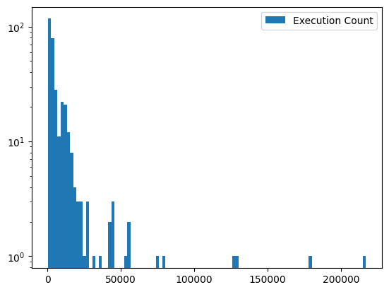
Application execution count
Top application Usage
Parameter Page
Digital Status and Control
Fast Time Plot
Multicast Alarms
Downtime Logger
Telephone Index
Alarm List/Control
Timeline Generator
Device Database
Booster Beam Turn Control
* Data from 10/2021-10/2023
application count
Source: Michael Guzman
# of application executions

Slide 4
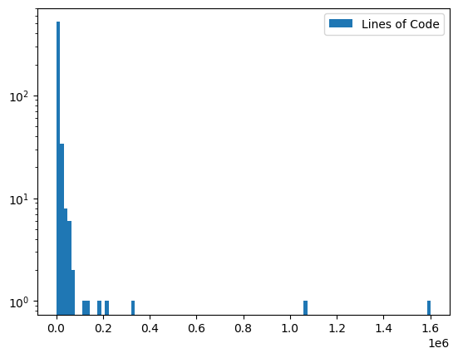
User library compexity
Top line count
ul_acl
ul_clib
ul_cbsaux
Booster-Transition Crossing
BPM/BLM Control and Display
BLM Information Viewer
Sequencer
Command files for Lex SA
Device Database
Beam line data analysis
Languages: C, C++, header files, FORTRAN, SQL
* Data from 10/2021-10/2023
application count
# of lines of code
Source: Michael Guzman

Slide 5
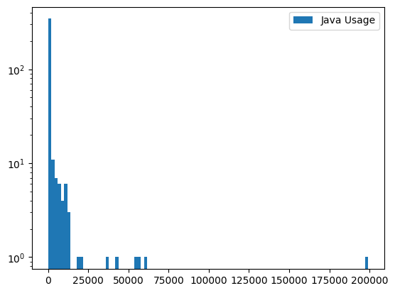
Java Applications
Top application Usage
Synoptic
Autotune
Node Poll
Boss-O-Gram
Boss-O-Schedule
Operations Scopes
Main Injector Beam Loss Monitoring
BoosterDDSCurves
Real Time Plotter Test
Muon Tor 704
application count
Source: Michael Guzman
# of application executions

Slide 6
Prioritization
Interviewed departments in July 2023
Understand each departments application usage
68 Console applications mentioned
Criticality categories
Core (12): Proposed to Operations Dept
Critical (54): Required for troubleshooting, commissioning, etc
Specialized (2): ‘nice to have’
Categorization from interviews aligns with data analysis based on # of executions, whether an application is mapped to a parameter page, etc.
Not enough money for every single application: this work helps ACORN prioritize with available budget.
Ongoing work: Java application, Synoptic display, and web application analyses.

