Slide 1
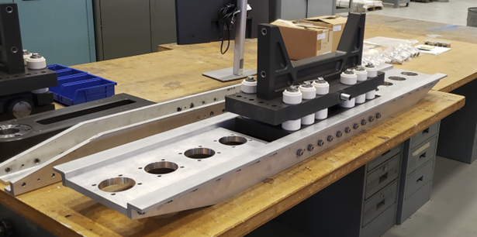
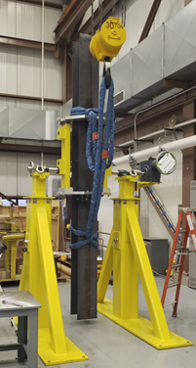
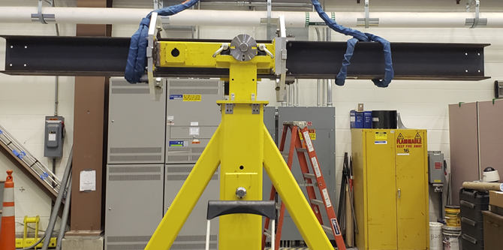
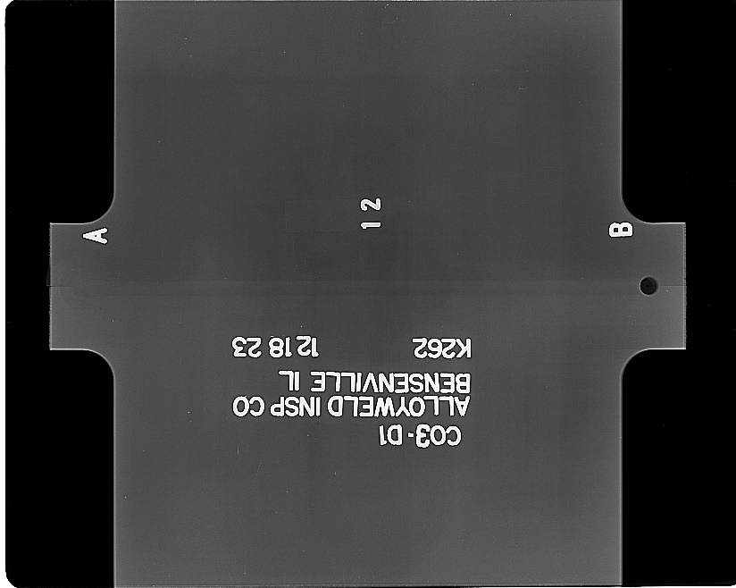
LBNF - Beamline – Target Complex
Horns
Continued work on drawings of inner and outer conductors of Horns B & C.
Friction Stir Welding vendor verification continues
SDSMT is to rework weld
Negotiating with PNNL to do samples
German vendor samples x-ray and found acceptable (QA./QC)
Started assembly of Prototype hangers
Flipping fixture tested safely and successfully

Slide 2
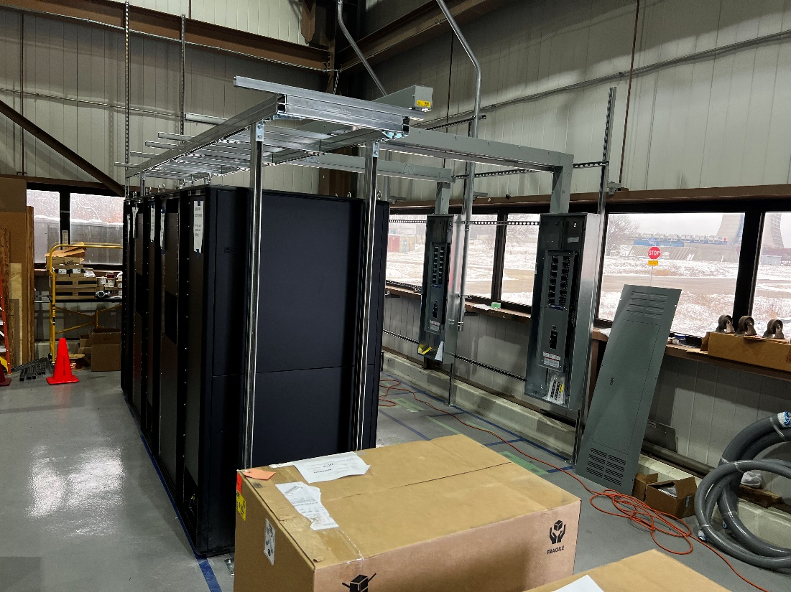
LBNF - Beamline – Target Complex
Horns Power Supply
Many procurements occurring for the full power supply for the Horns Test Stand at MI-8.
Components are arriving
Electrical work continues at MI-8 to support Test stand power supply and water-cooling system.
Water Systems
RAW system designs continue
Finished drawings of Horn Test Stand water- cooling system
Test Stand
Preparing to grout in place

Slide 3
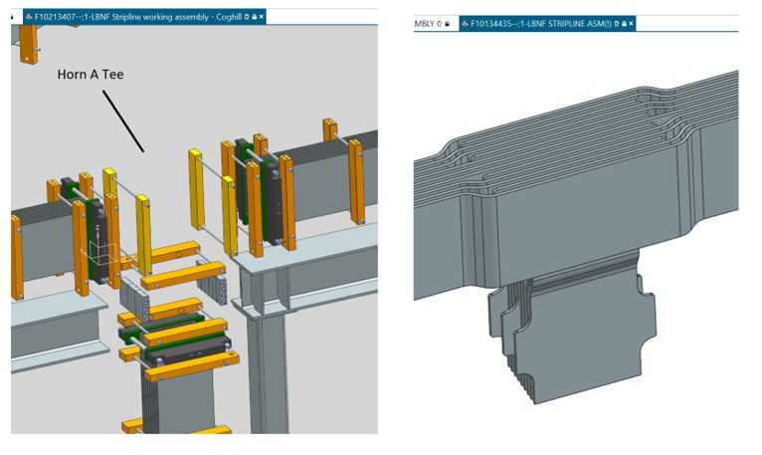
LBNF - Beamline – Target Complex
Stripline
FEA modeling of stripline
Modeling and drafting has begun on final design of stripline tee segments
Remote Handling
Check of designed lifting fixture being appropriate for possible change of COG for Horn A Module with Stripline Block and Target Utility Block

