Slide 1
Linac 9am Report
Daniel C. Jones

Slide 2
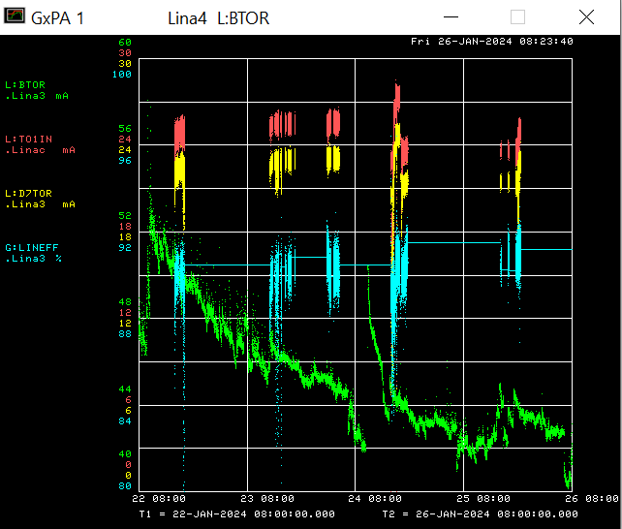
Linac/Preacc Operation Jan 22 – Jan 26 2023
Studies have been conducted on the off shift and plan to continue.
Thanks to Ops for all their assistance with the studies period, tuning in the off shift, and keeping the RF stations up.
The einzel lens switcher failed Thursday January 25th . The issue was traced down to a 15V power supply in the einzel lens switch controller. Thanks to Drew Felds & Kent Triplett for getting the system repaired.

Slide 3
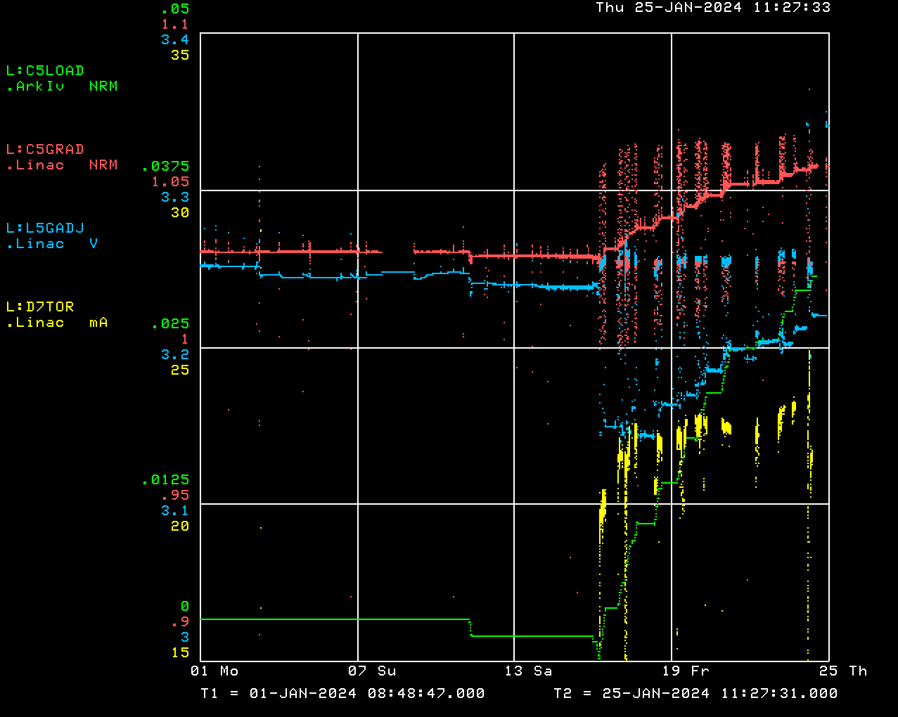
Linac/Preacc Operation Jan 22 – Jan 26 2023
Issues:
The gradient compensation loop at KRF5 is increasing every time we run beam. Until we resolve this we are not running beam through Linac.
The laser notcher is currently broken.

