Slide 1
Project Activities for MSD
Mayling Wong-Squires
AD Operations Friday 9am Meeting
26 January 2024

Slide 2
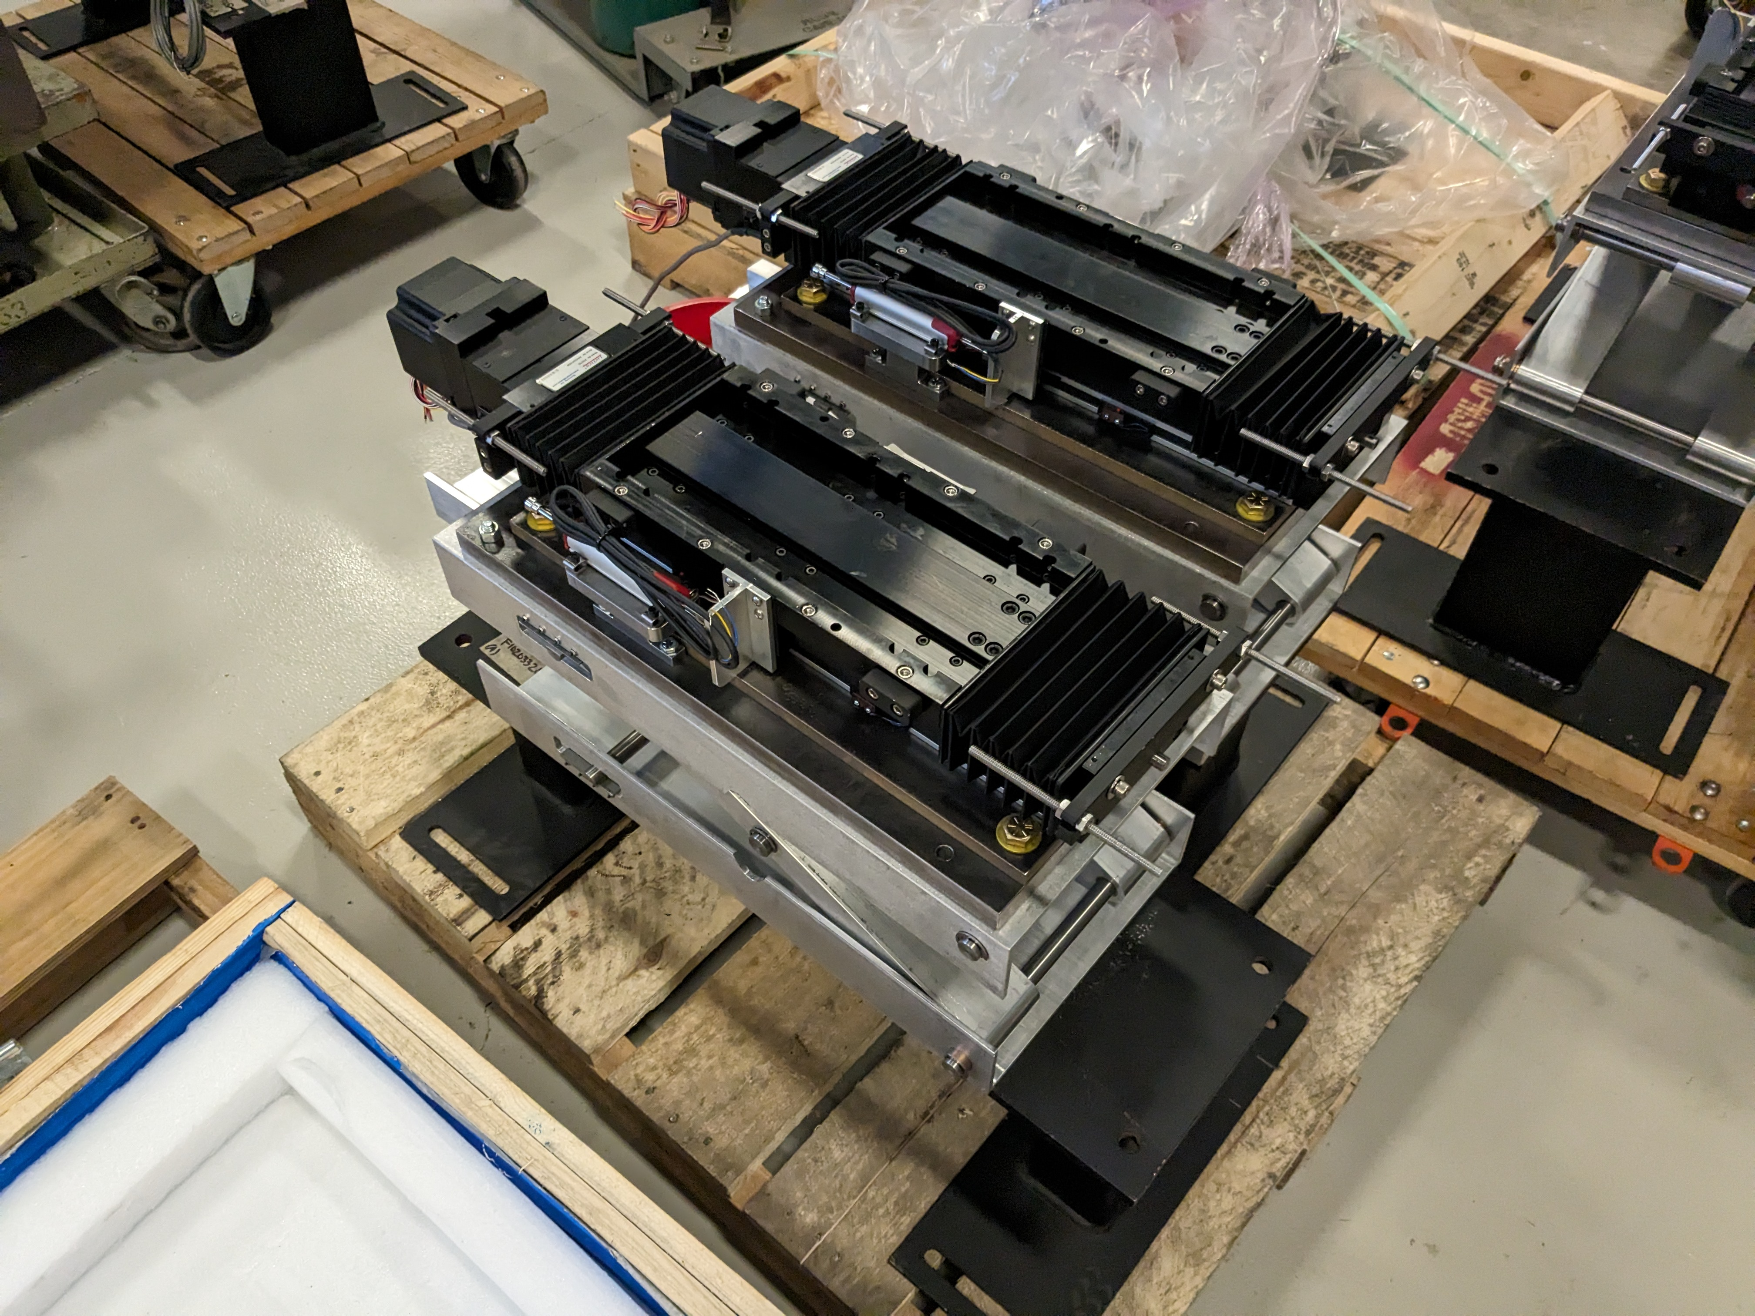
Mu2e Project Update Christine Ader, Jason Morin
Exit Collimator: The installation plan is finalized. Parts are ordered and will be assembled on site.
Electrostatic Septa Stands: 90% assembled. Wiring harnesses and connectors are being built and will be ready for testing soon.

Slide 3
PIP-II Instrumentation Update Dakota Krokosz, Bob Steinberg
Wirescanners
Transportation frame designs completed.
Started procurement for ceramic frames and MEBT wirescanner.
Will require a mechanical technician for assembly in ~June.
BPM’s
MEBT BPM Housings have arrived, buttons expected to be delivered beginning of February.
Ready to order the prototype of the 2” aperture BPM’s.
Laser Profile Monitor
Final Design Review in March 2024
Drafting of fabrication drawings in progress
Will require mechanical and vacuum technicians for assembly
Emittance Scanners
MEBT chamber stand has been procured, chamber order is being placed.
Transportation frame designs completed.
Procurement for LEBT AES has started.
Will require a mechanical technician for assembly in ~June.
Diagnostic Cart
Internal design review in March 2024.
Radiation simulations for 32 MeV and 177 MeV are complete.
Starting thermal simulation of the SNS Faraday Cup.
Writing a transportation plan for movement within the LINAC.
Work with RadiaBeam has started on the development of the Bunch Shape Monitor.

Slide 4
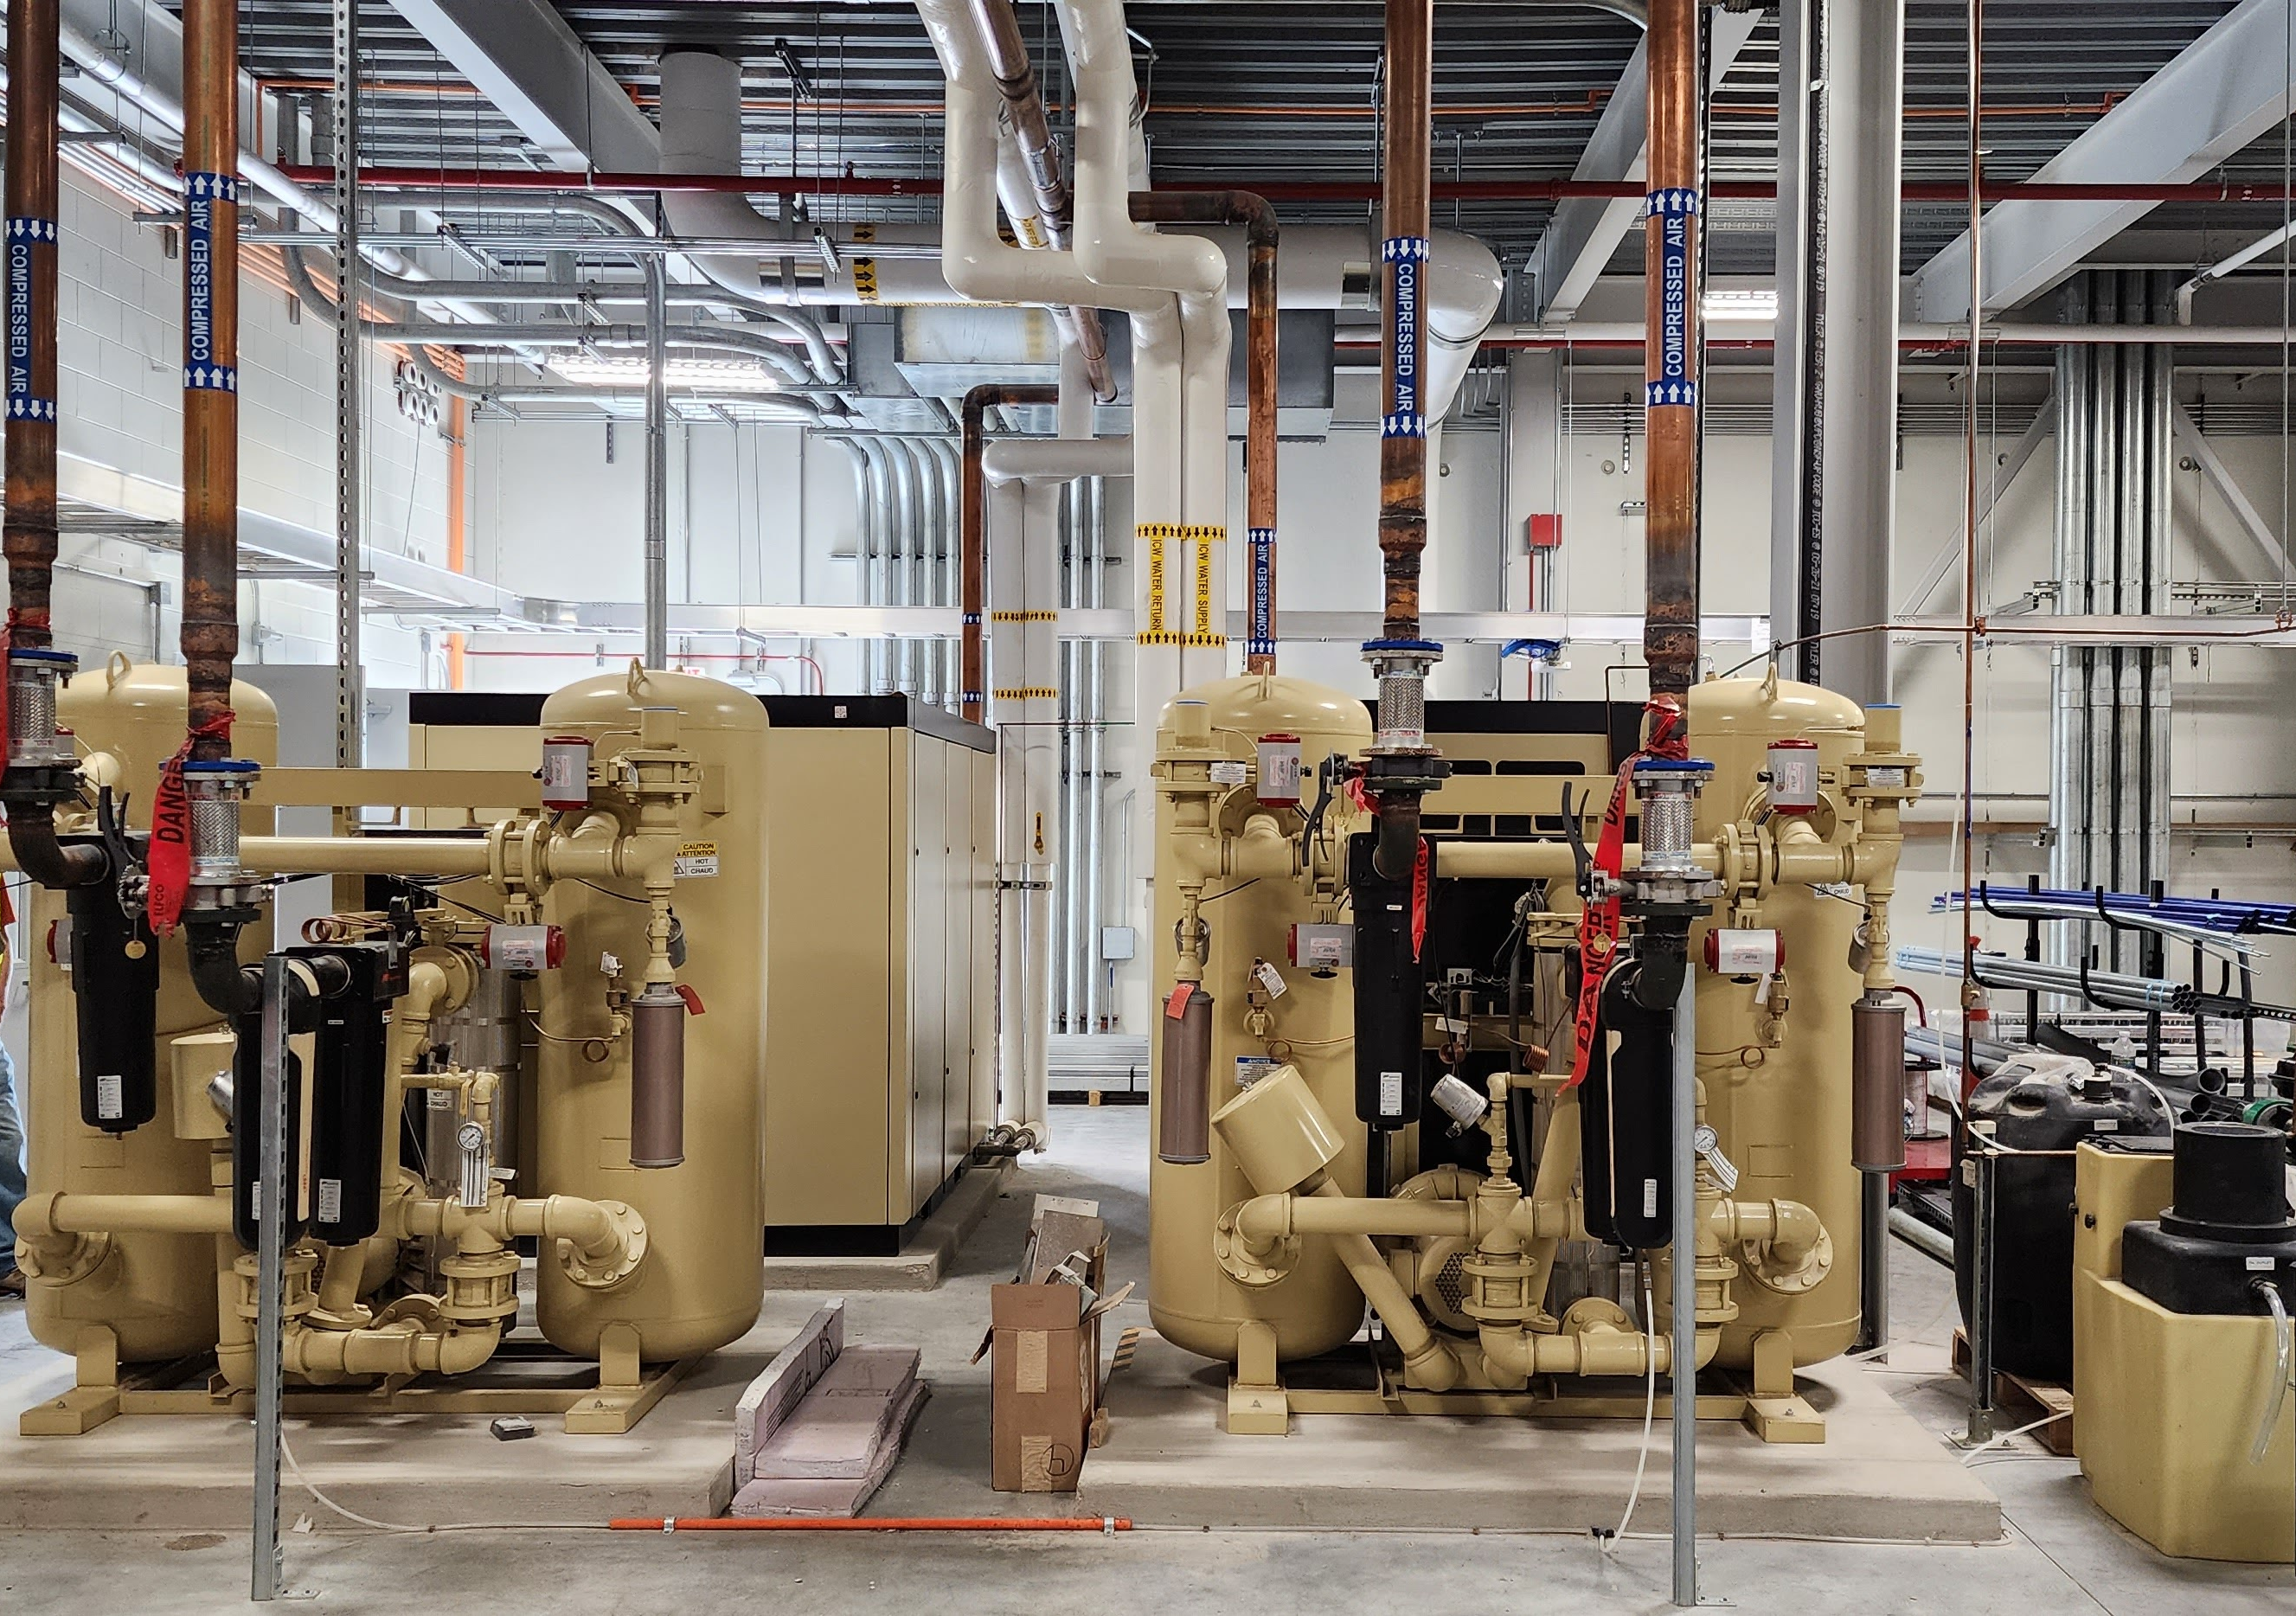
PIP-II LCW Status Maurice Ball, Michael Geelhoed, Yurick Czajkowski, Monika Sadowski, Jason Grischkat
Air Compressors/Dessicant Dryers installed and commissioned

Slide 5
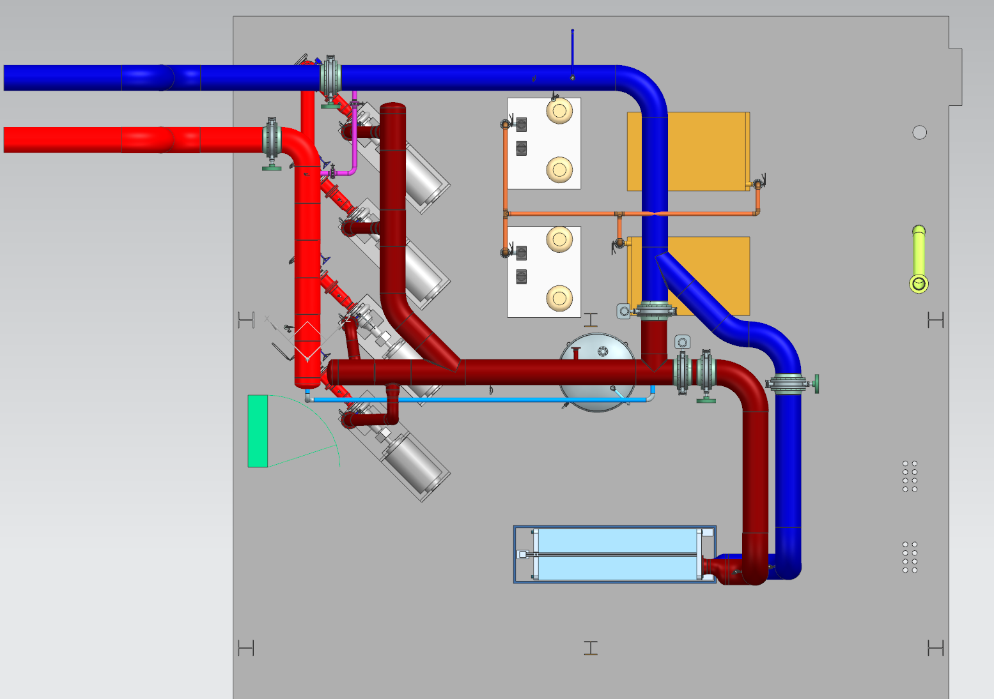
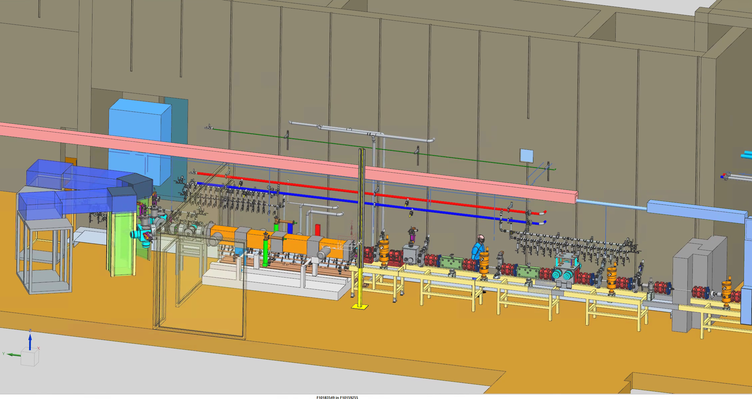
LCW Status (cont’d)
Procurement Package for Utility Plant Process Clean Water Piping System is out for Bid
Pre-bid walkthrough completed last week
Responding to questions
Bids due 7 February 2024
Final designs for Warm Front End Piping Manifolds completed
2D Drawings finalized and released in Teamcenter

