Slide 1
0900 AD Scheduling Meeting
Marty Murphy
26 January 2024

Slide 2
This Week
  Completed valve repair on BV825 in MI-8.
  Pulled and terminated new cables for MI sextupoles.
  BNB/Booster CDC testing was completed on Tuesday (this required no access to MI-10 or MI-8).
  Thanks to MSD & TD for repairing the dripper on LAM61-B
  Initial attempts to repair Q110 were not successful. Various repair methods are being explored in parallel up to and including magnet replacement. There is an “electrically” good spare in the tunnel now. Not sure of status of hydrostatic pressure testing.
  Various small tasks completed in the tunnel and service buildings.
  RF repairs in the tunnel are complete and Anode supply VCBs were switched ON at MI60.
  SAD/ASE writing is on-going.

Slide 3
Current Status
NuMI Q110 repairs continue today.
Plan to start RF pulsing today.
Repairs of leaking magnets continues in F-Sector.
Plan for Friday & Next Week
Continue tunnel work as required.
Energize MOS-89 at KRSS to check out MI beamline power supplies and complete MI CDC testing.
ISD wishes access pump Motor Control Centers at MI10, MI20 and MI40 to harvest MCC starter cards and inspect wire dimensions.
Complete SAD/ASE documents for submission.

Slide 4
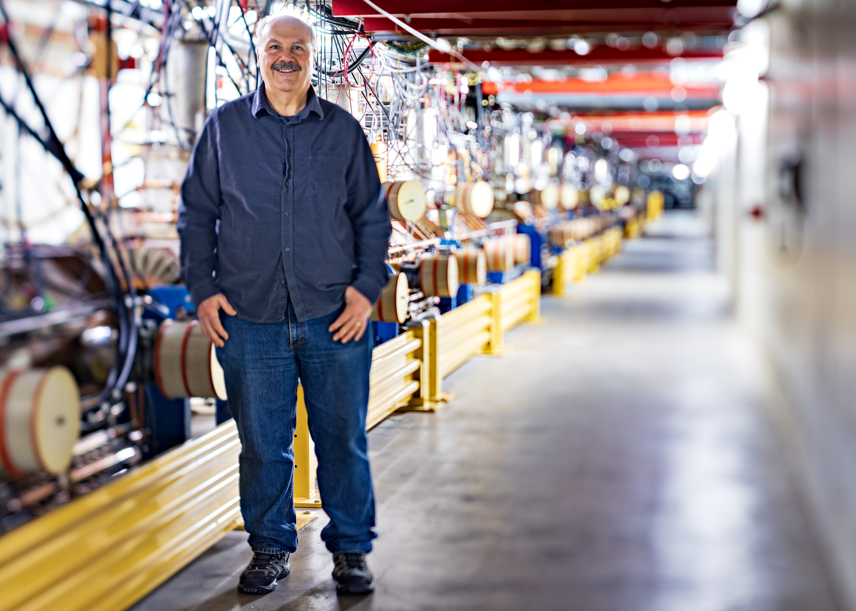
Many Thanks to Dave Capista for His Leadership, Work Ethic and Dedication to the AD over 39 Years.
Please join us tonight at the UC to wish him well.

